Slide 1
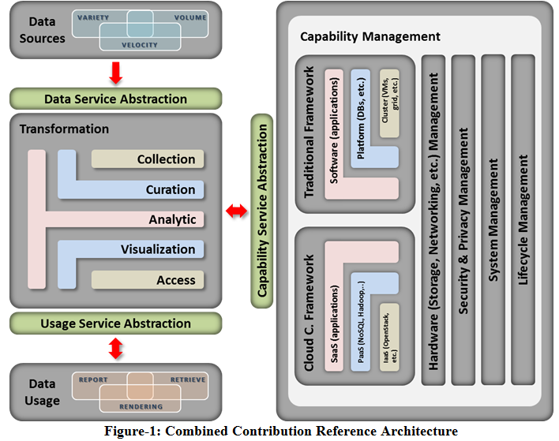
Objective of this deck: Align the RA with the Roadmap Categories
Architecture
Storage Architecture
Processing Architecture
Resource Managers Architecture
Infrastructure Architecture
Information Architecture
Standards Integration Architecture
Applications Architecture
Business Operations
Business Intelligence
Business Relationship Intelligence
Business Adoption
Business Gap Analysis
Processing Performance Improvements
Application Development Improvements
Complex Analytics Improvements
Interoperability Improvements
Possible Alternative Deployment Improvements
Interface Improvements

Slide 2

Use Case Requirement: Be able to support diversified data
sources with variety, volume, and velocity of data
RA Component:
Roadmap Capabilities to RA Component:
MATCH | FUZZY MATCH | NO MATCH
 | Architecture Storage Architecture Processing Architecture Resource Managers Architecture Infrastructure Architecture Information Architecture Standards Integration Architecture Applications Architecture | Business Operations Business Intelligence Business Relationship Intelligence Business Adoption Business Gap Analysis Processing Performance Improvements Application Development Improvements Complex Analytics Improvements Interoperability Improvements Possible Alternative Deployment Improvements Interface Improvements

Slide 3
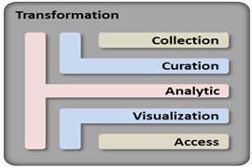
Use Case Requirement:
Be able to support various transformation functions such as collect, curate, analysis, visual, and access for a given
RA Component:
Roadmap Capabilities to RA Component:
MATCH | FUZZY MATCH | NO MATCH
Business Intelligence Business Relationship Intelligence Business Gap Analysis Complex Analytics Improvements |  | Architecture Storage Architecture Processing Architecture Resource Managers Architecture Infrastructure Architecture Information Architecture Standards Integration Architecture Applications Architecture | Business Operations Business Intelligence Business Relationship Intelligence Business Adoption Business Gap Analysis Processing Performance Improvements Application Development Improvements Interoperability Improvements Possible Alternative Deployment Improvements Interface Improvements

Slide 4
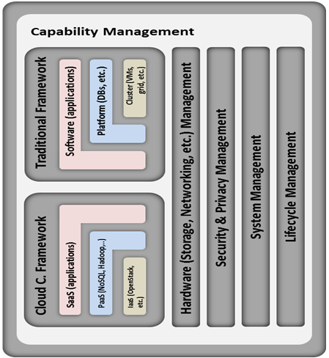
Use Case Requirement:
Be able to support mixed of legacy/traditional and cloud computing framework with the additional management of hardware, security and Privacy, systems, and lifecycle management.
RA Component:
Mapping Roadmap Capabilities to RA Component:
MATCH | FUZZY MATCH | NO MATCH
 | Architecture Storage Architecture Processing Architecture Resource Managers Architecture Infrastructure Architecture Information Architecture Standards Integration Architecture Applications Architecture |  | Business Intelligence Business Relationship Intelligence Business Gap Analysis Business Operations Business Intelligence Business Relationship Intelligence Business Adoption Business Gap Analysis Complex Analytics Improvements Processing Performance Improvements Application Development Improvements Interoperability Improvements Possible Alternative Deployment Improvements Interface Improvements

