Slide 1
NIST BIG DATA WG Reference Architecture Subgroup Intermediate Report
Co-chairs:
Orit Levin (Microsoft)
James Ketner (AT&T)
Don Krapohl (Augmented Intelligence)
July 24th, 2013

Slide 2
Reference Architecture Objectives
Addresses a broad range of stakeholders (e.g., data owners, industries, academia, policy makers)
Wide scope:
Encompasses the whole data life cycle or in the ecosystem
Can be applied to different use cases (including various verticals)
Represents different system architectures (e.g., an enterprise data warehouse, distributed cloud-based system using multiple service providers)
Focus
Potentially with initial focus on the Big Data analytics and tools
Assists in identifying security and privacy issues
Agnostic to any specific technologies

Slide 3
RA Diagram Independent Submissions
Different styles and perspectives, but easy to map between them
Data centric (Wo Chang)
Data Flow centric (Orit Levin, Bob Marcus)
Technology Layers / Stack diagram (Gary Mazzaferro)
The vocabulary used in these submissions and on the mailing list has been compiled and submitted as M-0057

Slide 4
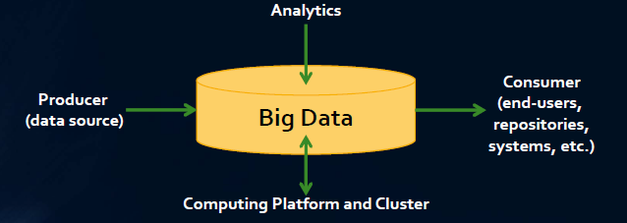
Abstract Reference Architecture by Wo Chang / NIST

Slide 5
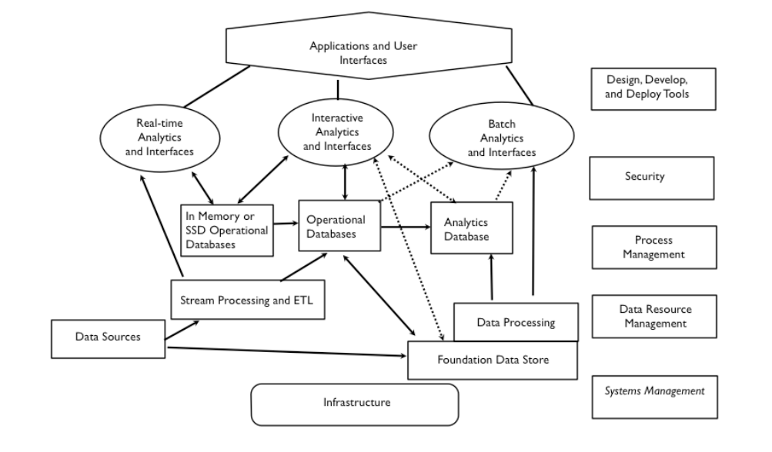
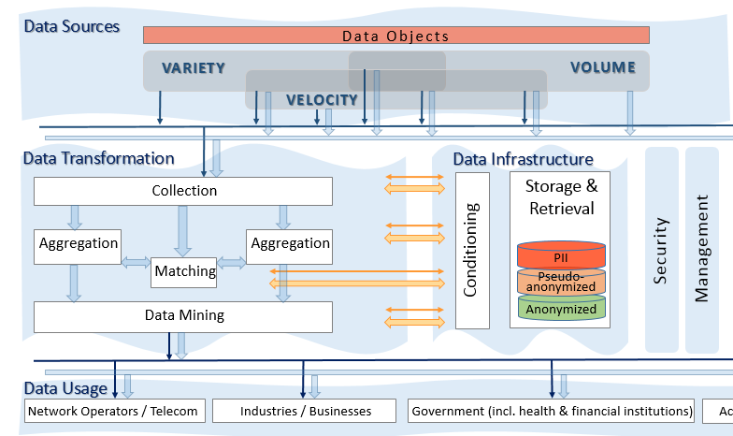
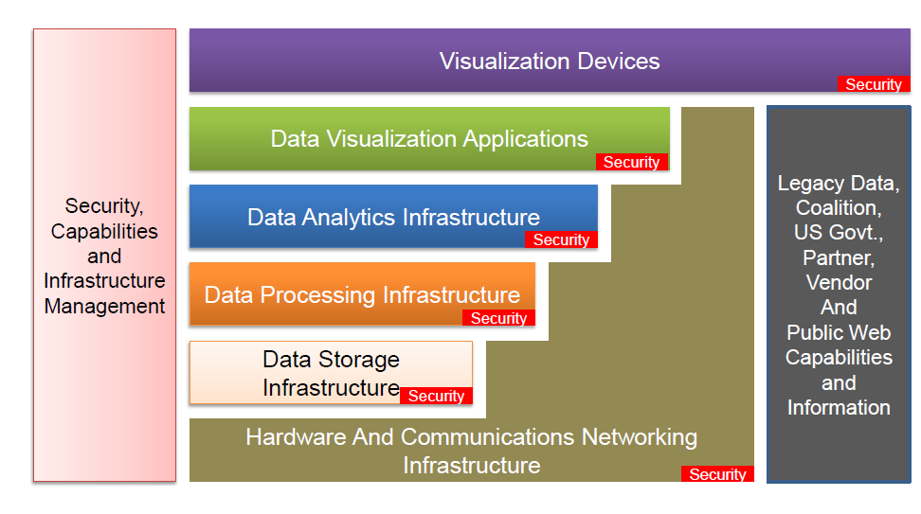
Independent RA Proposals: Big Data Sources, Usage, Transformation, and Infrastructure
Data Flow
Diagram by Bob Marcus
Data Flow Ecosystem Diagram by Orit Levin
Technology Stack / Layers
Diagram by G. Mazzaferro

Slide 6
Data Sources and Usage
Data Flow
Diagram by Bob Marcus
Data Flow Ecosystem Diagram by Orit Levin
Technology Stack / Layers
Diagram by G. Mazzaferro

Slide 7
Infrastructure: Storage, Security, and Management
Data Flow Ecosystem Diagram by Orit Levin
Technology Stack / Layers
Diagram by G. Mazzaferro
Data Flow
Diagram by Bob Marcus

Slide 8
Data Transformation: Processing, Analytics, and Visualization
Data Flow Ecosystem Diagram by Orit Levin
Technology Stack / Layers
Diagram by G. Mazzaferro
Data Flow
Diagram by Bob Marcus

Slide 9
Draft Agreement / Rough Consensus
Transformation includes
Processing functions
Analytic functions
Visualization functions
Data Infrastructure includes
Data stores
In-memory DBs
Analytic DBs
Sources
Transformation
Data Infrastructure
Security
Cloud Computing
Management
Network
Usage

Slide 10
Next Steps and AIs
Deliverable I: Write the White Paper draft showing one or more (e.g., Data Flow and Stack approaches) using the same or similar terminology
AI: Chairs will start the draft of the document incorporating the submissions to the Ref Arch subgroup
AI: Close cooperation between “Ref Arch” and “Def&Tax” sub-groups to produce the Output: taxonomy for the RA diagrams with definitions for major entities/blocks; Input: M-0057.
Deliverable II: A draft of a single RA requires more discussion and inputs based on the work of all sub-groups
AI: Chairs will start the draft of the document incorporating the findings of the Ref Arch subgroup
AI: Review the latest contributions to the Ref Arch and incorporate their findings (See email from Yuri Demchenko / University of Amsterdam)
AI: Close cooperation with the “Use Cases” and “Security” sub-groups to identify the areas of focus for “zooming” into their architecture

Slide 11
Backup Slides

Slide 12
Submitted RAs

Slide 13
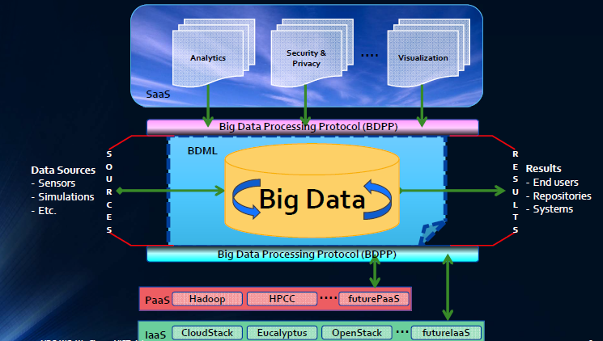
Data Centric by Wo Chang / NIST

Slide 14
Data Flow Diagram by Bob Marcus

Slide 15
Data Flow Ecosystem Diagram by Orit Levin
Individual Data Transfer
Big Data Transfer
Selected Data Storage and Retrieval
Data Sources
Big Data Storage and Retrieval
Data Objects
VARIETY
VOLUME
VELOCITY
Data Transformation
Data Infrastructure
Management
Security
Collection
Conditioning
Storage & Retrieval
Aggregation
Aggregation
PII
Matching
Pseudo- anonymized
Data Mining
Anonymized
Data Usage
Network Operators / Telecom
Industries / Businesses
Government (incl. health & financial institutions)
Academia
Notes:
Big Data Ecosystem RA

Slide 16
Technology Layers / Stack diagram by Gary Mazzaferro
NIST Big Data WG / Ref Arch Sub-group

Slide 17
Mapping to Technologies and Use Cases
Prepared by the authors of the original RAs

Slide 18
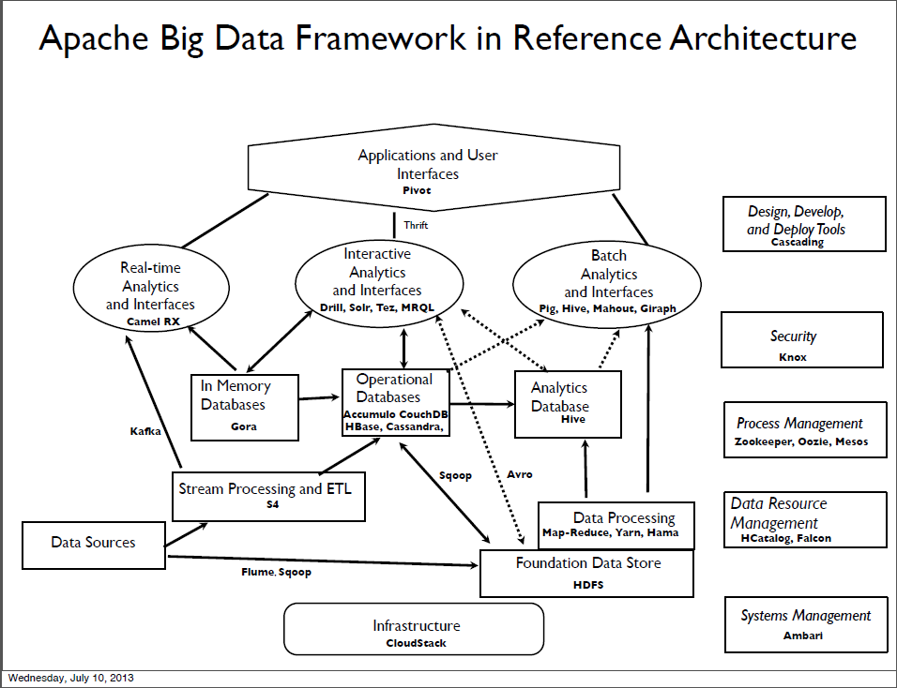

Slide 19
An Example of Cloud Computing Usage in Big Data Ecosystem
Individual Data Transfer
Big Data Transfer
Selected Data Storage and Retrieval
Data Sources
Big Data Storage and Retrieval
Data Objects
VARIETY
VOLUME
VELOCITY
Data Transformation
Data Infrastructure
Collection
Data Warehouse
Cloud Provider
/ Service Layer
Aggregation
IaaS
SaaS
PaaS
Matching
Data Mining
Data Usage
Network Operators / Telecom
Industries / Businesses
Government (incl. health & financial institutions)
Academia
Notes:
Big Data Ecosystem RA

Slide 20
Use Case: Advertising
Control
Individual Data Transfer
Online Sources
Offline Sources
Big Data Transfer
Data Subject / Person
1st Party
UI: Do Not Track (DNT)
2nd Party
Networks
End User devices incl. OS (mobile phones, etc.)
Other devices (Smart Grid, surveillance, scientific, etc.)
Internal Records
Public Records (commons, government, etc.)
3rd Party
PII
De-identified
DPI
Web Browsers
Aggregated
HTTP: DNT
DMP Container Tag
or Pixel request
Match Container Tag or Pixel request
Collection
Network Operators
Analytic Cookie
Applications (search, publishers, etc.)
Appl. with customers (communications, social network, etc.
Industries /
Businesses
Government, health, financial institutions, academia
Contextual Data Collection
Match Cookie
Data
Management
Platforms
(DMPs)
DMP Cookie
Online Data Aggregator
Match/Bridge Service
Offline Data Aggregator
Behavioral Data Creation
Data Mining
Person Attribution
Users
Advertising Industry Ecosystem
Publisher
AdNet
SSP
AdX
DSP
Agency
Advertiser
Notes:
Use Case: Advertising

Slide 21
Use Case: Enterprise Data Warehouse
Individual Data Transfer
Big Data Transfer
Selected Data Storage and Retrieval
Big Data Storage and Retrieval
Data Sources
Data Objects
MS Office Documents
Online Transaction Processing (OLTP) Systems
Files
Archives
Manual
Data Transformation
Data Infrastructure
Management
Security
Extraction, Transformation, and Loading
(ETL)
Central Data Warehouse
Online Analytical Processing (OLAP)
Operational Data Store
Managed Report Environment (MRE)
Data Mining /
Knowledge Discovery in Databases (KDD)
Staging Area
Data Usage
Subject Data Mart
Regional Data Mart
Department Data Mart
Application Data Mart
Functional Data Mart
Notes:
MPP Enterprise Warehouse

Slide 22
