Slide 1
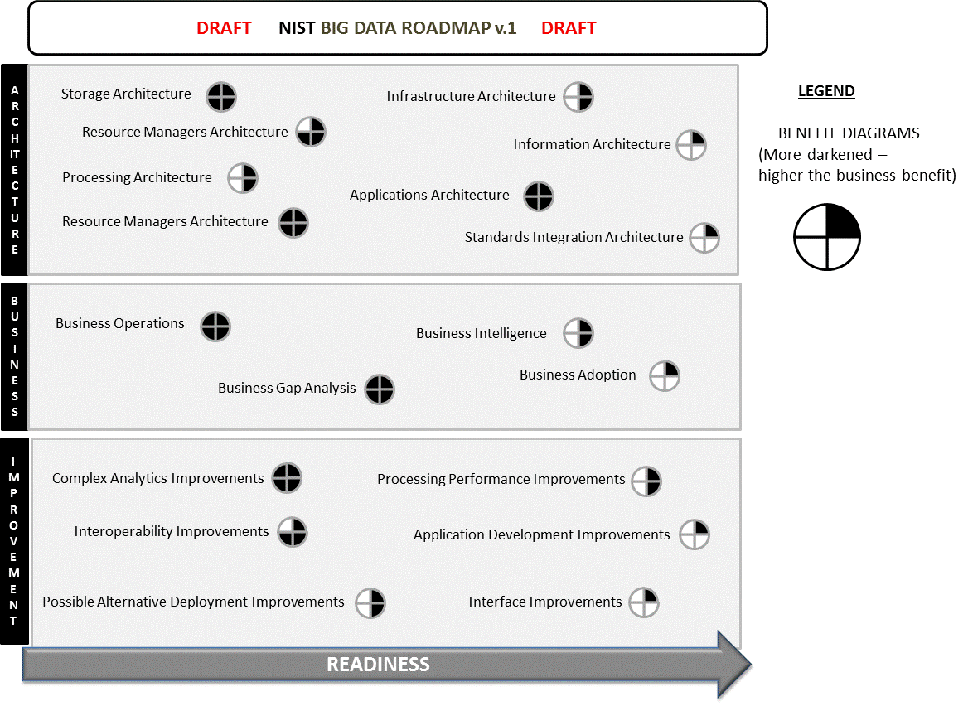

Slide 2
THIS GRAPHIC ON RIGHT
IS USED TO
COPY AND PASTE AS
A .GIF ON
PREVIOUS
SLIDE
DRAFT NIST BIG DATA ROADMAP v.1 DRAFT
ARCHITECTURE
LEGEND
BENEFIT DIAGRAMS
(More darkened –
higher the business benefit)
Storage Architecture
Infrastructure Architecture
Resource Managers Architecture
Information Architecture
Processing Architecture
Applications Architecture
Resource Managers Architecture
Standards Integration Architecture
BUSINESS
Business Operations
Business Intelligence
Business Adoption
Business Gap Analysis
IMPROVEMENT
Complex Analytics Improvements
Processing Performance Improvements
Interoperability Improvements
Application Development Improvements
Possible Alternative Deployment Improvements
Interface Improvements
READINESS

Slide 3
WORKING SLIDE
ARCHITECTURE
Business Operations
Business Intelligence
Business Adoption
Business Gap Analysis
Business Category
Storage Architecture
Infrastructure Architecture
Resource Managers Architecture
Architecture
Storage Architecture
Processing Architecture
Resource Managers Architecture
Infrastructure Architecture
Information Architecture
Standards Integration Architecture
Applications Architecture
Architecture Category Architecture
Information Architecture
Processing Architecture
Applications Architecture
Resource Managers Architecture
Standards Integration Architecture
BUSINESS
Business Operations
Business Intelligence
Business Adoption
Business Gap Analysis
IMPROVEMENT
Complex Analytics Improvements
Processing Performance Improvements
Processing Performance Improvements
Application Development Improvements
Complex Analytics Improvements
Interoperability Improvements
Possible Alternative Deployment Improvements
Interface Improvements
Improve Category
Interoperability Improvements
Application Development Improvements
Possible Alternative Deployment Improvements
Interface Improvements
READINESS

