Slide 1
NIST BIG DATA WG Reference Architecture Subgroup Agenda for the Subgroup Call
Co-chairs:
Orit Levin (Microsoft)
James Ketner (AT&T)
Don Krapohl (Augmented Intelligence)
September 26, 2013

Slide 2
Agenda
Deliverable #1 Survey M0151 / Coordinated by Wo
Deliverable #2 Ref Architecture M0226 / Coordinated by Orit
New M0226.v6 – 14 pages of text for review and feedback
Open Issues for review and resolution
IT (prev. Capabilities) Provider
Application (prev. Transformation) Provider

Slide 3
Latest RA M0226v5
INFORMATION VALUE CHAIN
System Orchestrator
Application Provider
Analytics
Data Provider
Curation
Visualization
Data Consumer
DATA
DATA
SW
Collection
Access
SW
DATA
SW
IT Provider
Big Data Processing Frameworks (analytic tools, etc.)
IT VALUE CHAIN
Horizontally Scalable
Vertically Scalable
Security & Privacy
Big Data Platforms (databases, etc.)
Management
Horizontally Scalable
Vertically Scalable
Infrastructures
Horizontally Scalable (VM clusters)
Vertically Scalable
Physical and Virtual Resources (Networking, Computing, etc.)

Slide 4
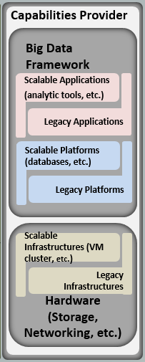
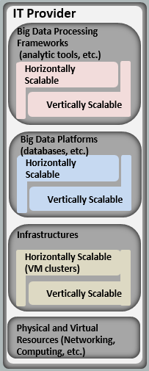
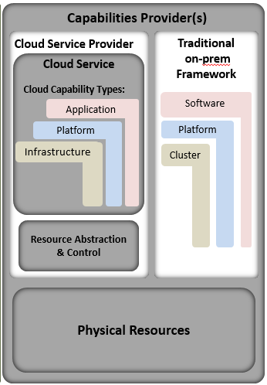
“IT Provider” Choices
M0226v4
M0226v5
M0251v1

Slide 5
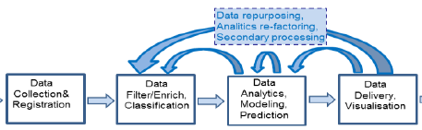
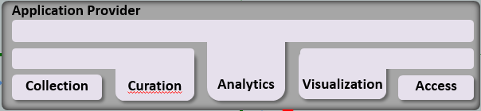
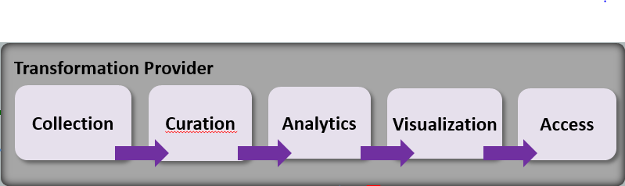
“Application Provider” Choices
University of Amsterdam / NIST RA White paper
M0226v5
M0243v1

