Slide 1
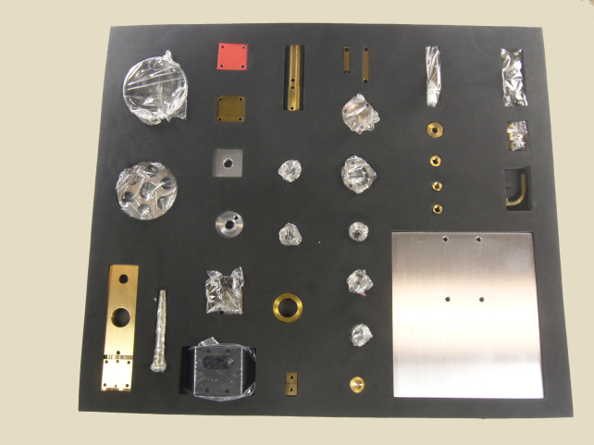
Functional Requirements of a Model for Kitting Plans
Stephen Balakirsky, Thomas Kramer, Zeid Kootbally,
Rajmohan Madhavan, Craig Schlenoff, Michael Shneier
National Institute of Standards and Technology
Industrial assembly of manufactured products often involves bringing parts together in a kit and then moving the kit to the assembly area
Kitting, the process of building kits, has not yet been automated in many industries. Consequently, the cost of building kits is higher than it could be.
This paper examines the knowledge required to operate an automated kitting workstation
  Non-executable information about a kitting workstation
    Information about a robot, parts, kit designs, grippers, etc.
  Executable plans for building kits
    The plans will be used by execution systems that control robots and other mechanical devices to build kits
  Functional requirements and what model constructs are needed to enable meeting those requirements
Sample kit, Image courtesy of LittleMachineShop.com
<ProcessPlan>
<About>
<PlanId>kitABCPlan</PlanId>
<PlanVersion>1.0</PlanVersion>
...
<TargetSKU>kitABC</TargetSKU>
</About>
<PlanRequirements>
<PlanRequirement>
<Name>boxOfEmptyTrays</Name>
<Type>LargeContainer</Type>
<SkuRef>Box1</SkuRef>
<ContentsType>
<SkuRef>KitTrayX</SkuRef>
</ContentsType>
</PlanRequirement>
...
Segment of process plan

