Slide 1
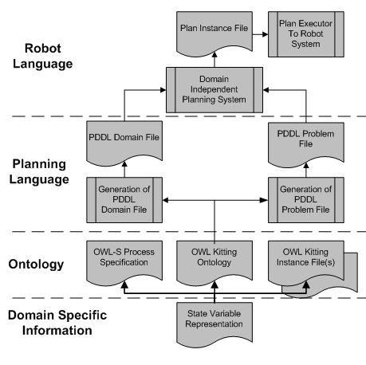
An Industrial Robotic Knowledge Representation for Kit Building Applications
Stephen Balakirsky¹, Zeid Kootbally², Craig Schlenoff¹, Thomas Kramer³, and Satyandra Gupta⁴
¹Intelligent Systems Division, NIST, USA
²Dept. of Mechanical Engineering, University of Maryland, USA
³Dept. of Mechanical Engineering, Catholic University of America, USA
⁴Maryland Robotics Center, University of Maryland, USA
Discuss the knowledge requirements for constructing an assembly kit for manufacturing
Present the flow of this knowledge from a representation in an ontology to a plan that may be executed on a real system
Demonstrate a simulated implementation involving USARSim and ROS
Discuss the application of this knowledge to the IEEE-RAS working group entitled Ontologies for Robotics and Automation
Kitting Data Flow Abstraction

