Slide 1
Next Generation Robotics and Automation Program
Elena Messina and Michael Shneier
Intelligent Systems Division
National Institute of Standards and Technology

Slide 2
Next Generation Robotics and Automation Program
Program Managers: Elena Messina
Michael Shneier
FY2011 Allocation: $3.65M
FY2012 Request: $3.8M
Develop and deploy advances in measurement science to safely increase the versatility, autonomy, and rapid re-tasking of intelligent robots and automation technologies for smart manufacturing and cyber-physical systems applications
Smart Manufacturing, Construction, and Cyber-Physical Systems
FY 2012 EL STRS
Program Review

Slide 3
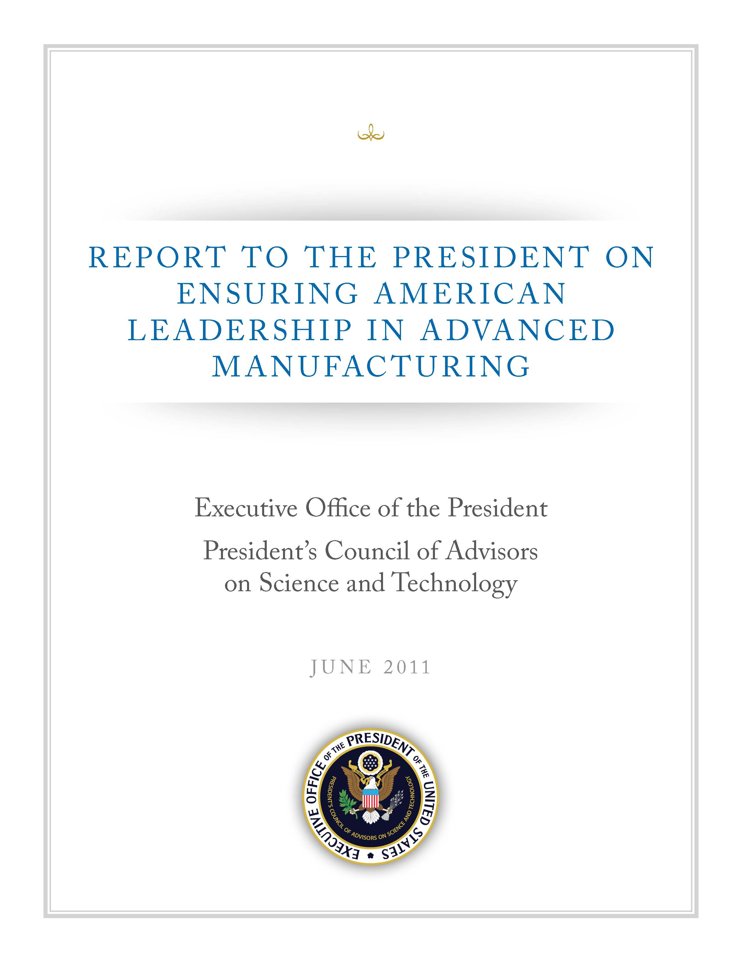
Robots are a key ingredient in maintaining US manufacturing leadership
EXAMPLES OF IMPORTANT TECHNOLOGY AREAS FOR ADVANCED MANUFACTURING (from the PCAST Report 6/2011)
Advanced robotics. Next-generation robots could be mobile and autonomous in their environment, with the ability to interact with their environment and achieve outcomes without programming of all procedures.
They also have the potential to be safely operable around humans or in dangerous environments. Intelligent automation could build robots’ capabilities to increase autonomy and flexibility to enable manufacturers to respond to needs and desires of customers very efficiently. Major advances could provide broad-based innovation benefiting multiple industries, such as that provided by computer-aided design and computer-aided manufacturing, total quality management, and just-in-time manufacturing. The private sector currently under-invests in robotics technology as the full benefits are dispersed across many firms and industries. Public-private investments to advance robotics technology could help US manufacturers compete by allowing quick, nimble improvements in product quality, productivity, time to market, and cost.
Smart Manufacturing, Construction, and Cyber-Physical Systems
FY 2012 EL STRS
Program Review

Slide 4
Why is it hard to solve, how is it solved today and by whom?
The problem is difficult because of the multi-disciplinary nature of robots and the diversity of application requirements
The problem is solved anew for each application:
Robot and sensor manufacturers develop automation products.
Users buy the products but typically lack the skill to install them in their factories and make them productive.
Integrators custom build robotic work cells and frequently continue to manage them over their entire lifetimes.
Smart Manufacturing, Construction, and Cyber-Physical Systems
FY 2012 EL STRS
Program Review

Slide 5
What is the new technical idea, why can we succeed now, and why NIST?
The key idea is to use standard test methods and associated performance metrics to isolate and measure robot performance against specific application requirements, accelerating the flow of innovations to address industry’s needs
i.e., robots that are easily re-tasked, can perform a much wider set of manufacturing tasks in dynamic unstructured environments , and can do so both independently of humans and in close collaboration with them
A new approach to robotics is emerging, made possible by greatly increased computer power, cheap, highly capable sensors, and the desire of industry to enable robots and people to work safely together to achieve joint tasks
NIST’s expertise in convening stakeholders and defining performance metrics, reference measurements and test methods is needed to establish comparisons between approaches and systems for sensory perception, dexterous manipulation, autonomous mobility, planning and modeling, and human-robot interaction
Smart Manufacturing, Construction, and Cyber-Physical Systems
FY 2012 EL STRS
Program Review

Slide 6
What is the impact if successful, and who cares?
U.S. industries will compete through greater responsiveness, productivity, and higher quality
Small and medium-sized businesses – which are the backbone of the U. S. Manufacturing economy – will adopt robotics and reap their benefits
The domestic robotics industry will be renewed
Robotics will enable a much improved quality of life through service robots, elder care, defense, transportation, and many other fields
Smart Manufacturing, Construction, and Cyber-Physical Systems
FY 2012 EL STRS
Program Review

Slide 7
What have been the results of this program?
This is a new program. Previous program results include:
NIST work led to changes in the B56.5 safety standard
This has had significant impact in industry, resulting in the growth of a market for such sensors
Drafted a technical specification (TS 15066) for ISO 10218 robot safety standards that allow humans and robots in same space
Participated in drafting ISO 10218, ISO 13488, RIA/ANSI R15.06
Adoption by industry of the ASTM E57 data transfer standard
First draft of a ASTM E57 standard for static pose measurement systems
Smart Manufacturing, Construction, and Cyber-Physical Systems
FY 2012 EL STRS
Program Review

Slide 8
What have been the results of this program?
Held competitions at premiere robotics conference to test performance metrics for manufacturing robotics
The virtual manufacturing automation competition
perception challenge competition (OSTP asked NIST to participate)
MOAST and USARSim software widely used by industry and academia and by the Army’s MAST Collaborative Technology Alliance to accelerate development and experimentation
Patent disclosures for micro-scale manipulation submitted and one patent licensed by industry
Establishing CRADAS in the micro- and nano-manipulation area
The 10th workshop on performance evaluation for intelligent systems (PerMIS) was held in Fall 2010
11 journal papers, 32 refereed conference papers, 12 NIST reports, and 2 book chapters were published

Slide 9
What is the Standards Strategy?
Participate actively in existing standards committees
Help to set up new standards working groups where a need is evident
Two kinds of standards: safety-related and measurement-related
The program will participate in ISO and US robot safety standards
ISO 10218 parts one and two and ISO 13482
Leadership in Technical Specification 15066 on human-robot collaboration
US robot safety standard RIA/ANSI R15.06
Industrial vehicle safety, ANSI/ITSDF B56.5
The program will participate in measurement-related standards
Leadership roles in ASTM E57 standards development for 3D measurement systems and for non-contact pose measurement systems
The program will develop conformance tests and validation methods to evaluate products claiming compliance with the standards
Smart Manufacturing, Construction, and Cyber-Physical Systems
FY 2012 EL STRS
Program Review

Slide 10
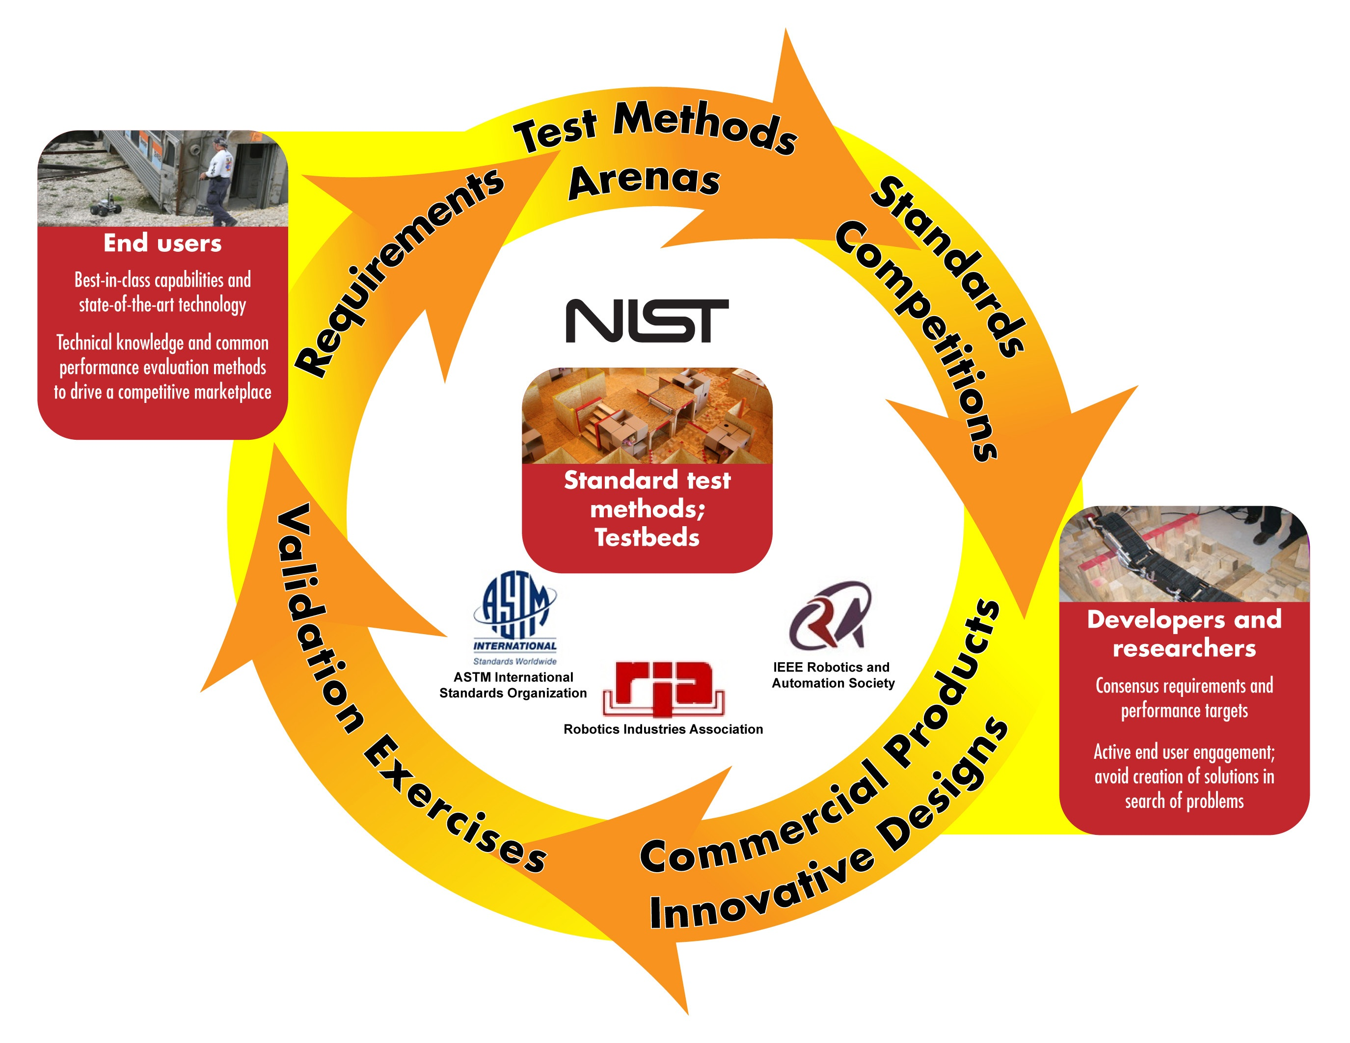
What is the Standards Strategy?
Follow, where possible, the proven philosophy driving the Response Robots/Homeland Security robot performance standards and evaluation family of projects

Slide 11
What changes are proposed for FY2012?
Measurement Science for Intelligent Manufacturing Robotics and Automation
Measurement Safety | Szabo | 523K¹
Perception | Hong | 775K
Mobility and Manipulation (split into two projects in NGRA) | Bostelman | 775K
Nanomanufacturing | Dagalakis | 535K
Nanorobotics (moving to Smart Manufacturing Processes and Equipment program) | Gorman | 315K
Performance Simulation | Balakirsky | 712K
Total |  | 3.65M
Next Generation Robotics and Automation
Safety | Szabo | 742K
Shop Floor Perception | Hong, Cheok | 849K
Dexterous Manipulation | Falco | 476K
Micro- and Nano-Manipulation | Dagalakis | 457K
Mobile Autonomous Vehicles | Bostelman | 573K
Intelligent Planning and Modeling | Balakirsky | 731K
Total |  | 3.8M
¹ Amounts in this table are adjusted to include Division overhead and SERI funds
Smart Manufacturing, Construction, and Cyber-Physical Systems
FY 2012 EL STRS
Program Review

Slide 12
What program outcomes are expected?
Safety
A Technical Specification on human-robot collaboration for the ISO 10218 Robot Safety Standard
Performance evaluation procedures for human detection that will enable verification of sensing systems and comparison between products
Measures to ensure force limits are not exceeded when humans work in contact with robots
Perception
A draft standard for static position and orientation measurement systems will address industry needs for locating parts without fixturing
Documented industry needs for calibration and sensor technology maturity measures developed through a workshop process
Dexterous Manipulation
Document describing the need for dexterous, force-based manipulation in unstructured environments
Smart Manufacturing, Construction, and Cyber-Physical Systems
FY 2012 EL STRS
Program Review

Slide 13
What program outcomes are expected?
Micro and Nano Manipulation
Measurement methods for micro- and nano-scale devices, including a system that can image the surfaces of micro/nano scale objects manipulated free of any substrate
The mathematical framework for the gripping and assembly of complex micro scale devices to allow 3D devices to be built
Mobility (and Safety)
Measurements to support changes in the B56.x industrial vehicle safety standards, particularly related to high-lift vehicles and visibility in manned vehicles
Development of a first draft for balloting of the ISO 13482 non-industrial robots safety standard
Planning and Modeling
Standard representations for world knowledge and plan knowledge to enable rapid retasking
Formation of a standards committee to address planning and modeling requirements for logistics (palletizing and truck loading)
Smart Manufacturing, Construction, and Cyber-Physical Systems
FY 2012 EL STRS
Program Review

Slide 14
How is the program being managed?
Safety: Robot test bed activities will adhere to the risk assessment and safety guidelines as specified in the test bed safety manual
A hazard review will be conducted before work is started on a project and, as necessary, when changes are made that might affect workplace safety
Teamwork: Most staff will work on multiple projects. The projects have specific ties where one project depends on another for data, capabilities, or expertise. Most projects will share a common test bed and will work to derive common scenarios to work towards.
OA opportunities: While all of the projects have ties to industry, standards organizations, and industry associations, most of these are not likely sources of funding. Some funding may come from DoD, NASA, and other government agencies.
Smart Manufacturing, Construction, and Cyber-Physical Systems
FY 2012 EL STRS
Program Review

Slide 15
How is the program being managed?
Knowledge transfer: Knowledge will be transferred through
standards activities, open source software and tools, competitions, conferences (including PerMIS), interaction with industry and academia, presentations, and publications
NIST will also participate in ongoing roadmap activities and continue to interact with OSTP (including NSTC) and the congressional robotics caucus as necessary and appropriate
Risks:
Intelligent systems have historically proved harder to develop than anticipated
Staff need substantial training to come up to speed on state of the art
Lack of a mature industry might force internal development of some technologies in order to make progress
Quality and schedule will be maintained, and budgets managed by careful oversight and regular program and project meetings
Smart Manufacturing, Construction, and Cyber-Physical Systems
FY 2012 EL STRS
Program Review

Slide 16
Project Ties Chart
Rapid Re-tasking
Human-robot collaboration
Next Generation Robotics
Unstructured Environments
Factory on a Chip
Small and Medium Manufacturers
Perception
Manipulation
Mobility
Autonomy
Dexterous Manipulation
Micro- and Nano-Manipulation
Shop-Floor Perception
Mobile Autonomous Vehicles
Planning and Modeling
Safety
Smart Manufacturing, Construction, and Cyber-Physical Systems
FY 2012 EL STRS
Program Review

Slide 17
NGRA Ranking Averages
Project title | Proposal and Planning Quality | Outputs and Outcomes | Contributions to Impacts | Contributions to Standards Strategy
Safety | 3,2,2,1,3,1=12/6=2 | 2,3,2,2,1,3=13/6=2 | 3,3,3,1,3,3=16/6=3 | 3,3,3,3,2,3=17/6=3
Shop-floor perception | 1,2,3,3,1,1=11/6=2 | 1,3,3,3,2,2=14/6=2 | 2,3,2,2,3,1=13/6=2 | 3,3,2,3,3,3=17/6=3
Dexterous manipulation | 3,2,3,3,3,2=16/6=3 | 2,3,2,1,2,3=13/6=2 | 3,3,3,2,2,2=15/6=3 | 2,3,1,1,2,3=12/6=2
Micro-nano manipulation | 1,2,1,1,2,3=10/6=2 | 2,3,3,1,3,2=14/6=2 | 1,3,1,1,1,1=8/6=1 | 1,3,1,1,1,1=8/6=1
Mobile Autonomous Vehicles | 2,2,2,1,2=9/5=2 | 3,3,2,3,1=12/5=2 | 3,1,3,2,2=11/5=2 | 3,2,2,3,2=12/5=2
Intelligent Planning and Modeling | 2,2,2,3,2,3=14/6=2 | 2,3,1,3,2,2=13/6=2 | 1,3,1,3,1,1=10/6=2 | 1,3,1,2,1,1=9/6=2

