Slide 1
Goal: Smart Manufacturing and Cyber-Physical Systems
Intelligent Planning and Modeling
Principal Investigator: Stephen Balakirsky FY 2010 allocation:
Co-investigators: Tom Kramer FY 2011 request:
Craig Schlenoff
Zeid Kootbally
Objective: This project will develop the necessary measurement science for planning and modeling by robots so that they are able to be more quickly re-tasked and are more flexible and adaptive in manufacturing applications. Areas of focus include ways to evaluate the effectiveness and efficiency of the representation of plan and world model data, and the evaluation of system performance through standardized test methodologies. The project will culminate in three years with standards for the automated logistics industry.

Slide 2
What is the problem, why is it hard to solve, how is it solved today and by whom?
Significant lack of detail in world representation of today’s state-of-the-art planning systems
No accepted technique for representing:
World model information ─ Plan/order information
No accepted technique for comparing:
Planning systems ─ Utility of representations
Begin by focusing on known community; mixed-pallet creation

Slide 3
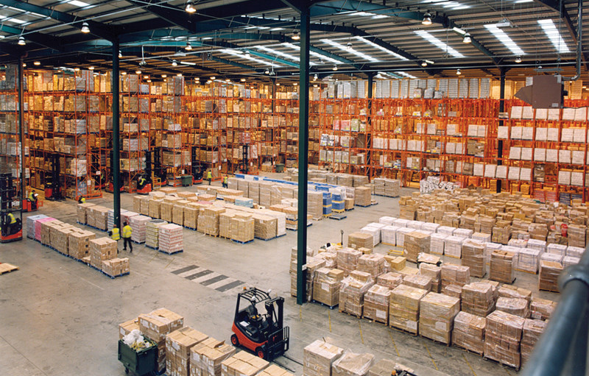
What is Palletizing?
Moving from 15,000 different SKUs in storage to pallets containing ~ 100-200 SKUs

Slide 4
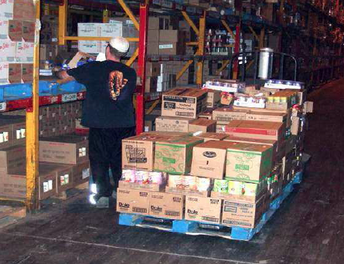
Typical US DC Data
230,000 SKUs / day
~2,500 pallets / day
15,000 different SKUs in storage
Most distribution today by manual operators
Typical performance
2 pallets / hour or 160 SKUs / hour
Walks 2.5 KM per 2 pallets
17 m between each SKU and 22 sec per SKU
Some robotic cells exist
Plan based only on density

Slide 5
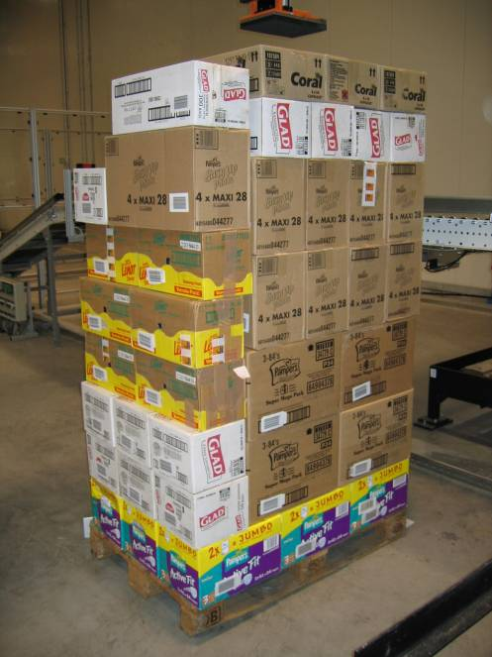
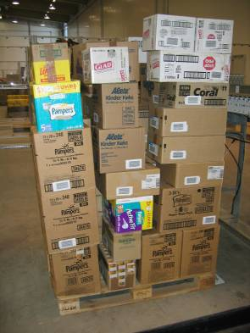
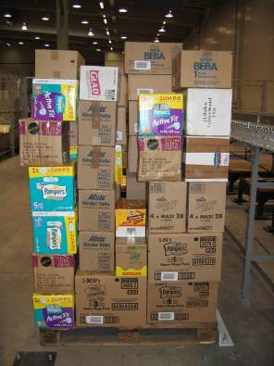
Palletizing?
YES
NO
NO

Slide 6
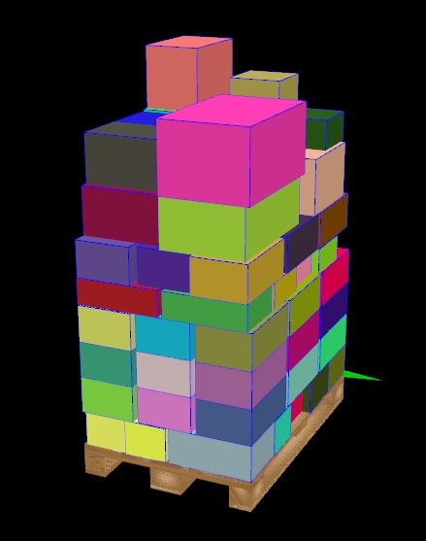
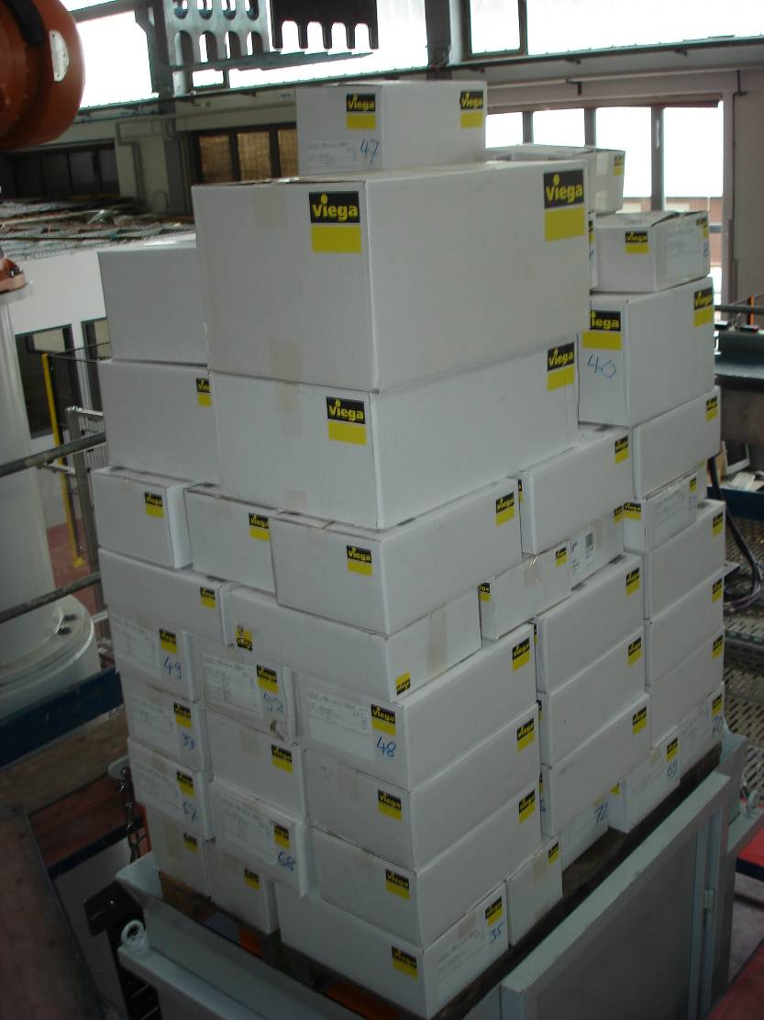
Post-construction Evaluation - Success

Slide 7
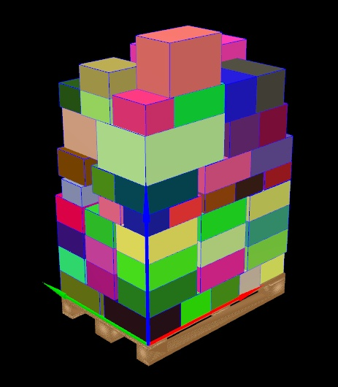
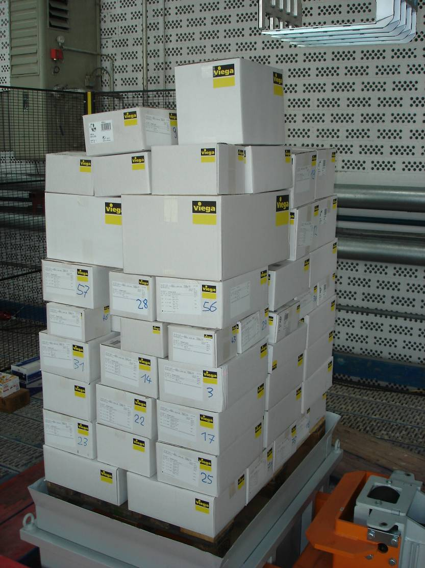
Post-construction Evaluation - Failure

Slide 8
Motivation: US Data
100,000 containers imported per day
Distributed through Distribution Centers (DCs)
Food distribution is ~ 80M SKUs per week
A pallet is ~ 100-200 SKUs (packages)
800,000 pallets/week or 160,000 pallets / day

Slide 9
What is the new technical idea, why can we succeed now and why NIST?
Sophisticated behaviors require detailed knowledge and a consistent representations
Allows for flexible optimization
Manipulation of the world
Take advantage of high-fidelity NIST-led simulation to create content rich worlds
Novel data representations will be developed for maintaining and sharing this content
Repeatable scenarios will allow for the comparison of planning frameworks
NIST experience in performance measurement techniques and artifacts

Slide 10
Why Can We Succeed Now? Potential Economic Impact
Beverages 30% manufacturing / 70% logistics
Food: 40% manufacturing / 60% logistics
Turn over $100B in food
$60B for logistics
A 1% saving is $600m/yr
Solutions have a very large potential for adoption by industry (major impact)

Slide 11
What is the research plan?
Five interrelated tasks:
Task 1: Develop standard representations for world knowledge, plan knowledge, and performance evaluation
Task 2: Develop techniques to compare planning algorithms that utilize the representations developed in task 1
Task 3: Simulation system enhancement and maintenance
Task 4: Simulation validation
Task 5: Real/Virtual Operation

Slide 12
What are the major outputs and outcomes (accomplished or anticipated) of this project?
Task 1 Standard Representations
Prior years: Preliminary XML schema for plan and order files has been developed along with visualization tools and scoring metrics
Q1: Formal draft representation for mixed-palletizing semantic world model
Q2: Tools to query and utilize the information stored in the world model
Q3: Formal draft representation for knowledge needed for truck loading
Q4: Modified tool set that allows planning systems to easily query and use the information stored in the combined world model
Year 2: Generalization of the world model to allow inclusion of previously unrecognized knowledge needs
Year 3: Formation of a formal standards committee and negotiations on the first draft of a new standard

Slide 13
What are the major outputs and outcomes (accomplished or anticipated) of this project?
Task 2 Planning Algorithm Comparison
Q1: Comparison of existing techniques
Q2: Planning system based on leading edge techniques will be developed for creating mixed palletizing static plans
Q3: The planning system will be augmented to use the tools developed in task 1
Q4: A planning system capable of dynamic planning (changing the plan based on the world model) will be developed
Year 2: A combined MOAST/PRIDE planning system will be developed and used as an example for the benefit of a complex standardized world model.
Year 3: The planning system will be introduced to the standards committee as a performance evaluation tool for the emerging representation standard.

Slide 14
What are the major outputs and outcomes (accomplished or anticipated) of this project?
Task 3 Simulation Enhancements
Prior years:
2010 Bronze medal award for developing open source software
2009 Government Open Source Conference Agency Award for Engaging Citizens
USARSim UT3 framework has achieved large external use (impact)
Q1: Implementation strategy for developing the ability to include high-level semantic knowledge
Q2: Semantic knowledge representation developed and embedded in an example environment
Q3: Integrated system with virtual sensing of high-level semantic knowledge
Q4: Simulation system/ planner interface for pallet stacking operations
Year 2: Range of features in the world model will be expanded
Year 3: System will be introduced to the standards committee as a performance evaluation tool for the emerging representation standard

Slide 15
What are the major outputs and outcomes (accomplished or anticipated) of this project?
Task 4: Simulation Validation
Q1: Evaluation of current validation techniques.
Q2: The most promising technique found will be augmented to fit our simulation framework
Q3: A validation study will be performed on a single sensor/vehicle
Q4: The tested sensor/vehicle will be modified to conform with the real sensor/vehicle’s characteristics
Year 2: Additional validations will be undertaken
Year 3: Additional validations will be undertaken

Slide 16
What are the major outputs and outcomes (accomplished or anticipated) of this project?
Task 5 Real/Virtual Operation
Prior Years:
Developed virtual safety system with real arm and avatar
Developed slave interface between real and virtual arms
Q1: Implement interface specification to allow our real Fanuc arm and the virtual Fanuc arm to accept identical commands
Q2: Movement of the real and virtual arms will be fully synchronized, including the use of the vacuum effector
Q3: The MOAST-based pallet stacking planning system will be integrated into the real/virtual setup so that virtual packages are stacked by the real arm
Q4: Both real and virtual arms will demonstrate similar movements when interfaced to the same pallet stacking planning system developed in task 2
Year 2: Human/robot safety will be investigated for pallet stacking
Year 3: The real/virtual system will be introduced to the standards committee as a performance evaluation tool for the emerging representation standard

Slide 17
How is project being managed?
Project team:
Paid project team to include NIST personnel, universities under grants
Leveraged project team to include universities participating in NIST sponsored competitions and corporations participating on standards committees
Knowledge transfer through competitions
Equipment loans from organizations participating in standard?
Risks
Lack of personnel
Delays that are inherent in standards process

Slide 18
Project Staffing
Five interrelated tasks:
Task 1: Standard representations for world, plan, and performance knowledge
Task 2: Techniques to compare planning algorithms
Task 3: Simulation system enhancement and maintenance
Task 4: Simulation validation
Task 5: Real/Virtual Operation
Staff
Stephen Balakirsky (80-100%) – Project man., supervises all tasks, leads Tasks 3, 4, 5
Tom Kramer (50%) – Lead Task 1
Zeid Kootbally (50%) – Lead Task 2
Craig Schlenoff (25%) – Task 1
Students (2) – Task 4 and general support
?? (100%) – Support task 3, 4, 5
Grants: Georgia Tech (60K) – Task 1 – 4 validation

