Slide 1
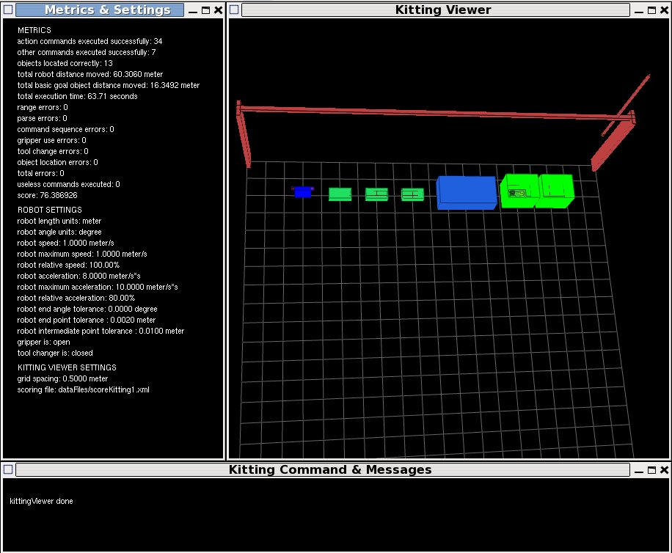
Performance Evaluation of Knowledge-based Kitting via Simulation
T. Kramer¹, Z. Kootbally², S. Balakirsky³, C. Schlenoff⁴, A. Pietromartire⁴,
and S. K. Gupta⁵
1 Department of Mechanical Engineering, Catholic University of America, Washington, DC, USA
2 Department of Mechanical Engineering, University of Maryland, College Park, MD, USA
3 Georgia Tech Research Institute, Atlanta, GA
4 National Institute of Standards and Technology, Gaithersburg, MD, USA
5 Maryland Robotics Center, University of Maryland,
^{College Park, MD, USA}
-Development of metrics for industrial kit building developed based on a knowledge model.
-Development of a configurable method of computing a net score from the metrics.
-Development of a Kitting Viewer that simulates the execution of a plan in the form of a robot command file intended to take a kitting workstation from an initial state to a goal state.
-Computation of the metrics and a final score for the plan by the Kitting Viewer.

