Slide 1

Understanding NIST HL7 v2 Test Tools
Focus on ONC Health IT Certification
Robert Snelick
National Institute of Standards and Technology (NIST)
March 26, 2024
Contact: robert.snelick@nist.gov

Slide 2
General Tool Capabilities and Navigation
Home – See Google Groups Link
Context-free Testing
Context-based Testing
Profile Viewer
Vocabulary Viewer
Documentation
Documentation
Resources
Tool Download
Release Notes
Known Issues
Notes:
Limited: by the (availability/testability/in-scope for this) of functional requirements; time/resources

Slide 3
Helpful Documents
ONC Test Procedure
NIST Normative Testing Process Document
HL7 v2 Standard
HL7 v2 Addendum (to the Standard)
Clarification (or tool implementation decision) Document
Quick Guide
Extended Tutorial
Understanding ONC Certification Document
Notes:
Limited: by the (availability/testability/in-scope for this) of functional requirements; time/resources

Slide 4
ONC Health IT Certification
HL7 V2.x Testing Tools

Slide 5
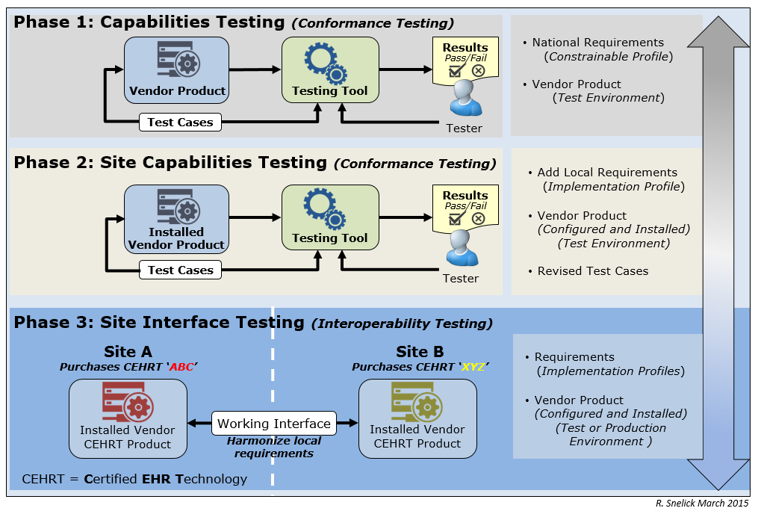
Testing Tiers

Slide 6
HL7 Content Testing: Test Tool Operation Modes
Testing the Sender (Message Creation)
Context-free Testing
Provides a simple and convenient method for testing message structure and most vocabulary
The context-free operational mode validates any message created by the EHR
It is disassociated from a test script, test case, or specific content (test data)
Good for site-testing
Context-based Testing (Use for Certification Testing)
Test Cases provided
Context (specific Test Scenario, etc.) is known to validation tool
Expands the scope of testing
Used in product certification testing
Testing the Receiver (Incorporation)
Incorporation of message and associated functional requirements
Employs inspection testing (Juror Document)

Slide 7
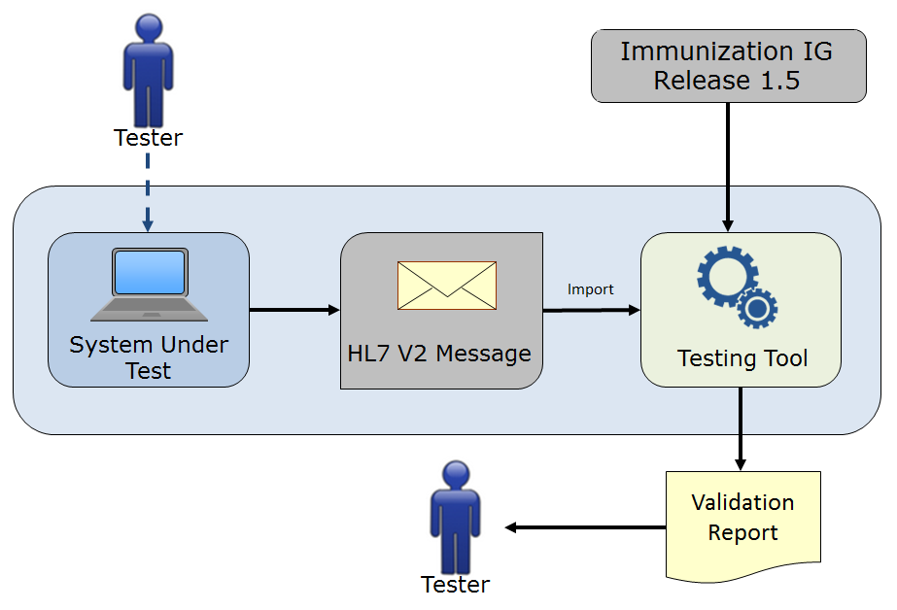
Context-free Testing: HL7 Content
No Test Cases provided
Context (Test Scenario, etc.) is unknown to validation tool
May be used to test any message created by an EHR
Provides a simple and convenient method for testing message structure and most vocabulary
Typically is not used for certifying EHR technologies for the ONC certification criteria, but may be used for certification testing in specific instances (the Tester must perform visual inspection to validate content of message)

Slide 8
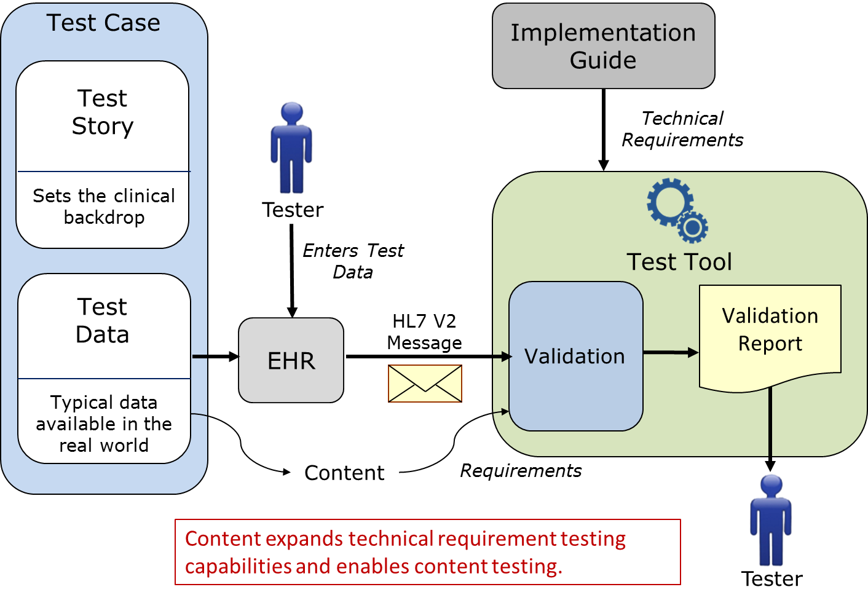
Context-based Testing (Sending Application)
Used for ONC Certification
Note: EHR-S is the SUT in this Example

Slide 9
Context-based Testing
The context-based operational mode validates messages associated with a given test script that includes data for a specific test scenario
The EHR creates a message that corresponds to the test data provided in the test script – Supports different use cases (Administered, Refusal, etc.)
Testing will include the technical requirements and content-specific requirements specified in the test case
Context (specific Test Scenario, etc.) is known to validation tool
Provides a method for testing/assessing a message for all conformance requirements of an Implementation Guide
Is used for certifying EHR technologies for the ONC certification criteria
Significantly expands the scope of testing
Usage: Required, but may be empty (RE), Conditionals (C)
Cardinality: Ranges
Length: Ranges
Vocabulary
Helps Interpretation and Use of the Standards

Slide 10
Test Case Overview
Example use cases and messages
Provides realistic scenarios
Demonstrates desired interpretation and implementation of the standard—”brings it all together”
Implementers like to copy what they see—”we provide the example we want them to copy!”
Test Plan
Scenario/Test Cases
Test Story
Test Data
Test Objectives
Pre-condition/Post Conditions
Evaluation Criteria and Notes to Testers
Poses questions to common real world scenarios and provides answers
Dynamic “living” test cases on test site

Slide 11
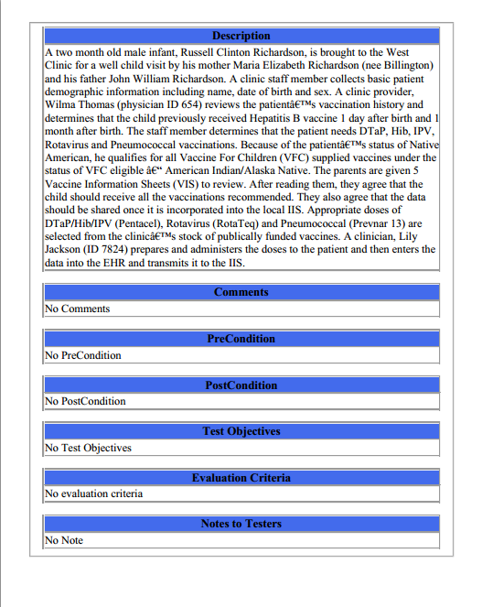
Test Cases: Test Story
Each Test Case includes a narrative Test Story that describes a real-world situation and provides context for each Test Step
Example Test Data document: Test Case: IZ-AD-1_Admin_Child – 1.IZ-AD-1.1_Send_V04_Z22

Slide 12
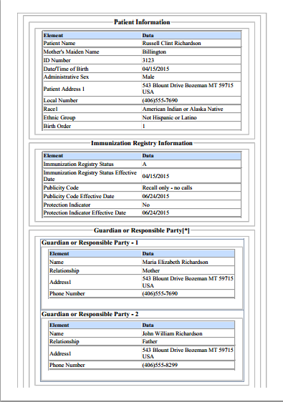
Test Cases: Test Data Specification
Each Test Case includes a Test Data Specification for each Test Step for which test data are expected to be entered into the HIT Module
Lists data associated with the Test Story
Consists of typical information found in the clinical setting
Along with the Test Story, provides sufficient information to be entered into the HIT Module for the Test Step
A test message is generated using these data and the HIT Module functions
Example Test Data document: Test Case: IZ-AD-1_Admin_Child – 1.IZ-AD-1.1_Send_V04_Z22
12
Notes:
12

Slide 13
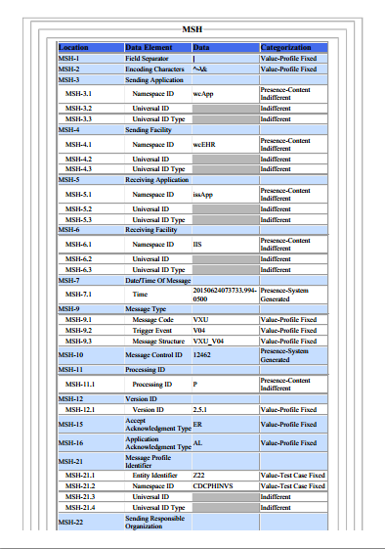
Test Cases: Message Content
Each Test Case includes a Message Content Data Sheet that shows a conformant message instance for each Test Step
The Category of the test data is listed in the Categorization column for each Data Element Location
Example Test Data document: Test Case: IZ-AD-1_Admin_Child – 1.IZ-AD-1.1_Send_V04_Z22
13
Notes:
13

Slide 14
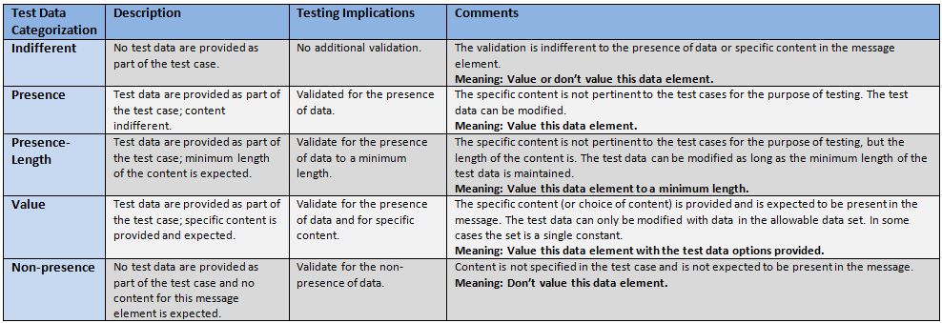
Test Data Categorization and Validation
The Message Content Data Sheet shows the Categorization of the test data that are provided for each Location
Each Test Data Category
Defines the criteria that are used by the test tool to assess the test data that populate each element in a message
Tells the Tester if the test data in a specific field can be changed, the source of the test data, and to what level of precision the validation tool will assess the data
Important point—some data can be modified, e.g., “Presence”

Slide 15
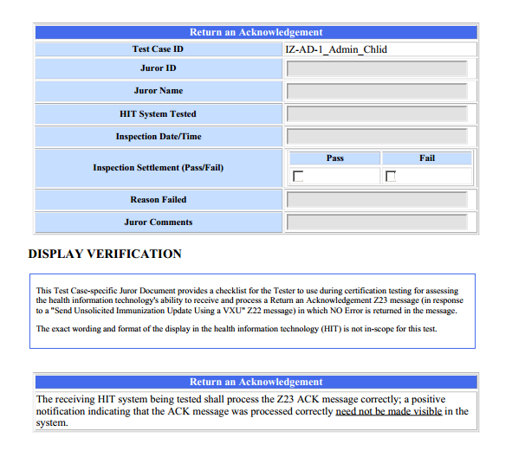
Test Cases: Juror Document
Each Test Case includes a Juror Document for the Receive or Response Test Step
Example Test Data document: Test Case: IZ-AD-1_Admin_Child – 2.IZ-AD-1.2_Receive_ACK_Z23
15
Notes:
15

Slide 16
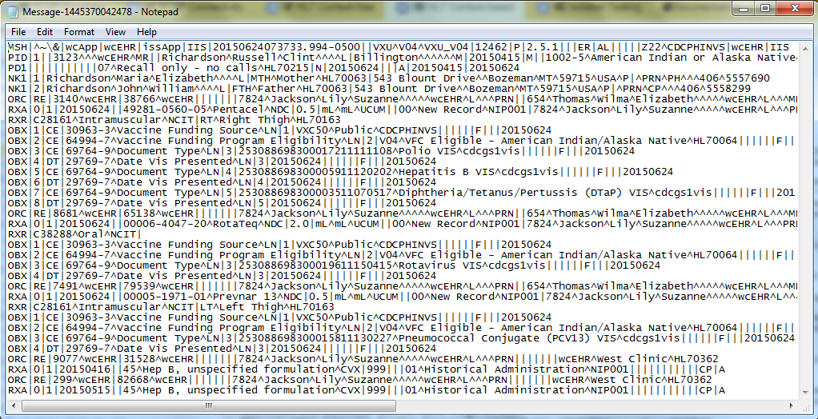
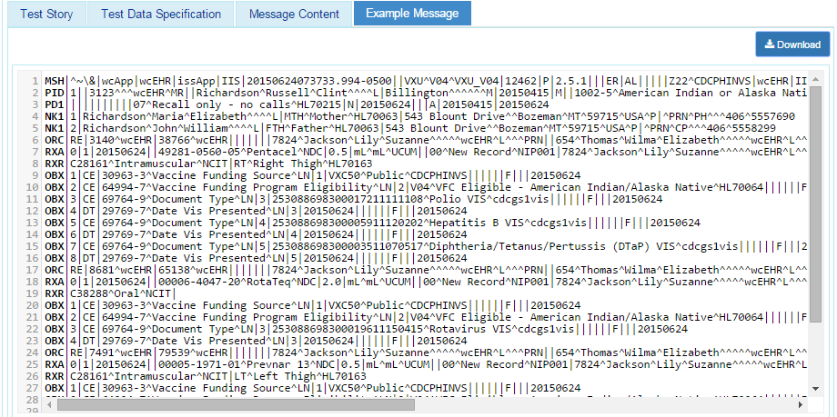
Test Cases: Example Messages
Each Test Case includes an Example Message instance for each Test Step
These example messages demonstrate use and interpretation of the standards
Example Test Data document: Test Case: IZ-AD-1_Admin_Child – 1.IZ-AD-1.1_Send_V04_Z22
16
Notes:
16

Slide 17
Test Case Design
Designed to test as much as possible with a minimum set of test cases—Yes, they’re all needed…the point of testing…
Goal is to try and test entire set of requirements
Provide a realistic set of test cases and scenarios
SMEs provided content and determined most important aspects to test
Each test case is designed to test something unique, and often aspects tested are mutually exclusive or require a multistep workflow
E.g., A record must exist before updating or deleting
Separate messages are needed
Testing aspects are combined when reasonable to do so
Always a trade-off between a few complicated test cases and a greater number of more isolated (~ Unit) test cases
We tried for a happy middle ground

Slide 18
Pre-loading Test Data
Can data be pre-loaded by the vendor prior to testing?
This is an ATL or ONC decision, not a NIST decision
It is certainly viable and makes sense for efficiency in testing
Certain measures should be taken to ensure no gaming of the tests—if they choose to do so, it is on the ATL (and out-of-scope for NIST test tools)

Slide 19
Understanding the Validation Results

Slide 20
Classification of Validation Detections
Classification | Description
Errors | Indicates non-conformance to a requirement. Errors do constitute a failed validation An EHR Product will fail certification if any of the validation reports indicate an Error (unless the Error can be proved to be a false negative—NIST can be consulted to remediate)
Warnings | Provides information about potential missing support for a requirement or recommendation. Warnings do not constitute a failed validation
Alerts | Provides information about how the validation verifies or does not verify requirements. For example, the specification may provide a value set binding to an element but the value set is empty. Therefore, the user is alerted to the fact that no meaningful validation can be performed. Alerts do not constitute a failed validation
Affirmatives | Provides an indication of a positive outcome to a validation assertion Affirmatives display only as user preference, not by default

Slide 21
Detection Categories
Structure Validation | Content Validation
R-Usage | Constraint Failure add content failure
X-Usage | Content (Based on Test Cases)
W-Usage | Predicate Failure – Usage determined by a Conditional
RE-Usage | Constraint Spec Error
Cardinality | Predicate Spec Err
Null-cardinality | Value Set Validation
Length | EVS
Format | PVS
Extra | Code Not Found
UnescapedSeparator | VS Not Found
Unexpected | Empty VS
InvalidContent | VS Error
 | VS No Validation
 | Coded Element
BLUE = Not relevant for ONC Certification

Slide 22
Detection Categories: Structure Validation
Category | Description
R-Usage | Issued when “Required” element is missing.
X-Usage | Issued when a “Not Supported” element is present.
W-Usage | Issued when a HL7 withdrawn element is present.
RE-Usage | Issued when a "Required or Empty" element is missing.
Cardinality | Issued when either the minimal or the maximal cardinality is violated.
Null-cardinality | Issued when a null element has more than one occurrence.
Length | Issued when the specified data element length is violated.
Format | Issued when the data element format is violated. Format is derived from the data type.
Extra | Issued when a complex element has extra children.
UnescapedSeparator | Issued when a primitive element contains un-escaped separators.
Unexpected | Issued for an unexpected segment at a specific position in the message.
InvalidContent | Issued for every line in the message instance which doesn't represent a valid segment definition.

Slide 23
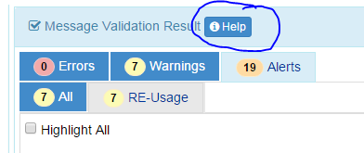
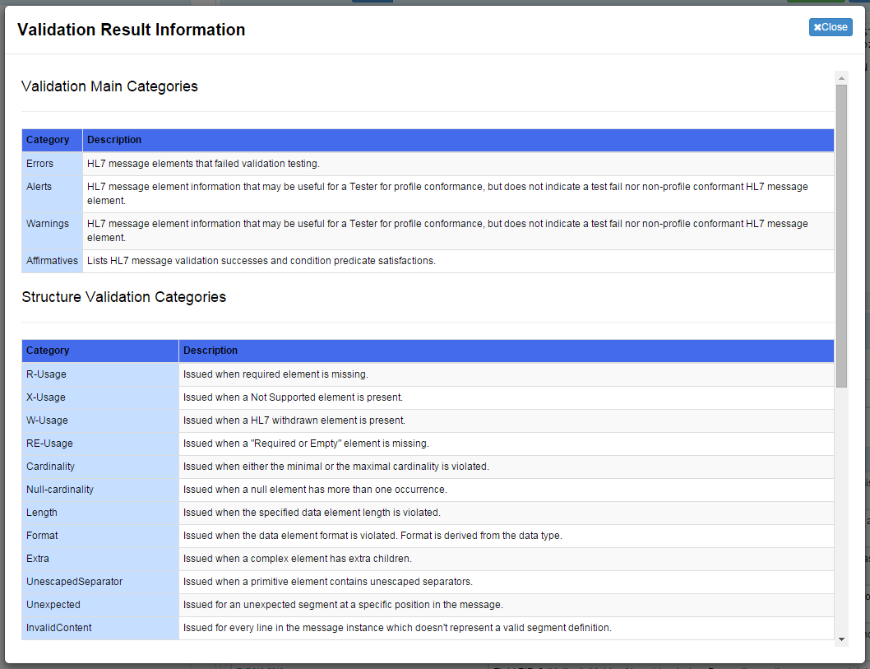
Validation Detections: Help

Slide 24
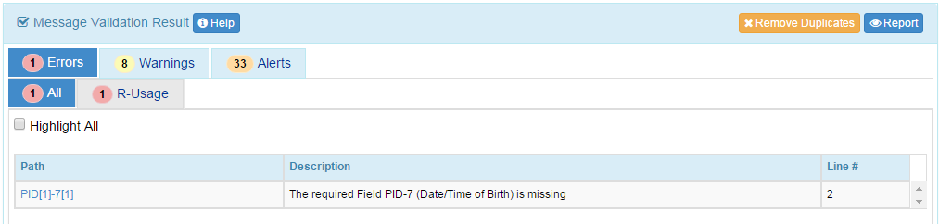
R-Usage Error
R-Usage Error
Reason | Issued when “Required” element is missing.
Example Report | The required Field PID-7 (Date/Time of Birth) is missing
Comments | The usage for the message element is “R-Required” therefore a data value is expected. In it’s absence an Error is reported. Default Classification: Error
Example Message
MSH|^~\&|NISTEHRAPP|NISTEHRFAC|NISTIISAPP|NISTIISFAC|20150625121047.839-0500||VXU^V04^VXU_V04|NIST-IZ-AD-7.1_Send_V04_Z22|P|2.5.1|||ER|AL|||||Z22^CDCPHINVS|NISTEHRFAC^^^^^NIST-AA-IZ-1^XX^^^100-6482|NISTIISFAC^^^^^NIST-AA-IZ-1^XX^^^100-3322
PID|1||7120^^^NIST-MPI-1^MR||Barrett^Helen^^^^^L|||F||2106-3^White^CDCREC|763 Main St^^Bozeman^MT^59715^USA^P||^PRN^PH^^^406^5554064~^NET^^Helen.Barrett@isp.com|||||||||2186-5^Not Hispanic or Latino^CDCREC||N|1|||||N
PD1|||||||||||06^Recall only - any method^HL70215|Y|20150625|||A|19500317|20150625
ORC|RE|7646^NIST-AA-IZ-2|53100^NIST-AA-IZ-2|||||||7824^Jackson^Lily^Suzanne^^^^^NIST-PI-1^L^^^PRN|||||||NISTEHRFAC^NISTEHRFacility^HL70362|
RXA|0|1|20150317||121^zoster^CVX|999|||01^Historical Administration^NIP001|||||||||||CP|A

Slide 25
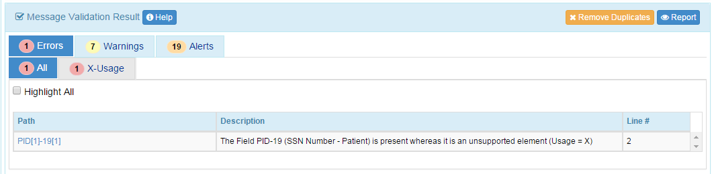
X-Usage Error
X-Usage Error
Reason | Issued when “Not-supported” element is present.
Example Report | The Field PID-19 (SSN Number - Patient) is present whereas it is an unsupported element (Usage = X)
Comments | The usage for the message element is “X-Not-supported” therefore a data value is not expected. If it is present an Error is reported. Default Classification: Error
Example Message
MSH|^~\&|NISTEHRAPP|NISTEHRFAC|NISTIISAPP|NISTIISFAC|20150625121047.839-0500||VXU^V04^VXU_V04|NIST-IZ-AD-7.1_Send_V04_Z22|P|2.5.1|||ER|AL|||||Z22^CDCPHINVS|NISTEHRFAC^^^^^NIST-AA-IZ-1^XX^^^100-6482|NISTIISFAC^^^^^NIST-AA-IZ-1^XX^^^100-3322
PID|1||7120^^^NIST-MPI-1^MR||Barrett^Helen^^^^^L||19500317|F||2106-3^White^CDCREC|763 Main St^^Bozeman^MT^59715^USA^P||^PRN^PH^^^406^5554064~^NET^^Helen.Barrett@isp.com||||||VALUE|||2186-5^Not Hispanic or Latino^CDCREC||N|1|||||N
PD1|||||||||||06^Recall only - any method^HL70215|Y|20150625|||A|19500317|20150625
ORC|RE|7646^NIST-AA-IZ-2|53100^NIST-AA-IZ-2|||||||7824^Jackson^Lily^Suzanne^^^^^NIST-PI-1^L^^^PRN|||||||NISTEHRFAC^NISTEHRFacility^HL70362|
RXA|0|1|20150317||121^zoster^CVX|999|||01^Historical Administration^NIP001|||||||||||CP|A

Slide 26
W-Usage Error
W-Usage Error
Reason | Issued when a HL7 withdrawn element is present.
Example Report | The Field PID-19 (SSN Number - Patient) is present whereas it is an unsupported element (Usage = X)
Comments | The usage for the message element is “X-Not-supported” therefore a data value is not expected. If it is present an Error is reported. Default Classification: Error
Example Message
MSH|^~\&|NISTEHRAPP|NISTEHRFAC|NISTIISAPP|NISTIISFAC|20150625121047.839-0500||VXU^V04^VXU_V04|NIST-IZ-AD-7.1_Send_V04_Z22|P|2.5.1|||ER|AL|||||Z22^CDCPHINVS|NISTEHRFAC^^^^^NIST-AA-IZ-1^XX^^^100-6482|NISTIISFAC^^^^^NIST-AA-IZ-1^XX^^^100-3322
PID|1||7120^^^NIST-MPI-1^MR||Barrett^Helen^^^^^L||19500317|F||2106-3^White^CDCREC|763 Main St^^Bozeman^MT^59715^USA^P||^PRN^PH^^^406^5554064~^NET^^Helen.Barrett@isp.com||||||VALUE|||2186-5^Not Hispanic or Latino^CDCREC||N|1|||||N
PD1|||||||||||06^Recall only - any method^HL70215|Y|20150625|||A|19500317|20150625
ORC|RE|7646^NIST-AA-IZ-2|53100^NIST-AA-IZ-2|||||||7824^Jackson^Lily^Suzanne^^^^^NIST-PI-1^L^^^PRN|||||||NISTEHRFAC^NISTEHRFacility^HL70362|
RXA|0|1|20150317||121^zoster^CVX|999|||01^Historical Administration^NIP001|||||||||||CP|A

Slide 27
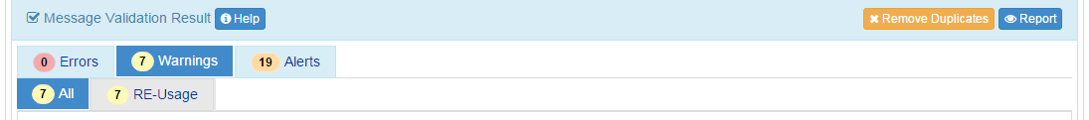
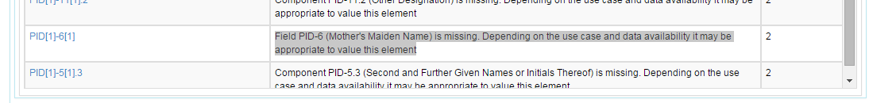
RE-Usage Detection
RE-Usage Detection
Reason | Issued when “Required, but maybe Empty” element is missing.
Example Report | Field PID-6 (Mother's Maiden Name) is missing. Depending on the use case and data availability it may be appropriate to value this element
Comments | The usage for the message element is “RE-Required, but maybe Empty” therefore a data value is expected in certain circumstances. In it’s absence a detection (Warning by Default) is reported. Default Classification: Warning
Example Message
MSH|^~\&|NISTEHRAPP|NISTEHRFAC|NISTIISAPP|NISTIISFAC|20150625121047.839-0500||VXU^V04^VXU_V04|NIST-IZ-AD-7.1_Send_V04_Z22|P|2.5.1|||ER|AL|||||Z22^CDCPHINVS|NISTEHRFAC^^^^^NIST-AA-IZ-1^XX^^^100-6482|NISTIISFAC^^^^^NIST-AA-IZ-1^XX^^^100-3322
PID|1||7120^^^NIST-MPI-1^MR||Barrett^Helen^^^^^L||19500317|F||2106-3^White^CDCREC|763 Main St^^Bozeman^MT^59715^USA^P||^PRN^PH^^^406^5554064~^NET^^Helen.Barrett@isp.com|||||||||2186-5^Not Hispanic or Latino^CDCREC||N|1|||||N
PD1|||||||||||06^Recall only - any method^HL70215|Y|20150625|||A|19500317|20150625
ORC|RE|7646^NIST-AA-IZ-2|53100^NIST-AA-IZ-2|||||||7824^Jackson^Lily^Suzanne^^^^^NIST-PI-1^L^^^PRN|||||||NISTEHRFAC^NISTEHRFacility^HL70362|
RXA|0|1|20150317||121^zoster^CVX|999|||01^Historical Administration^NIP001|||||||||||CP|A

Slide 28
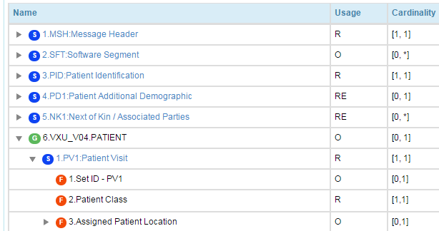
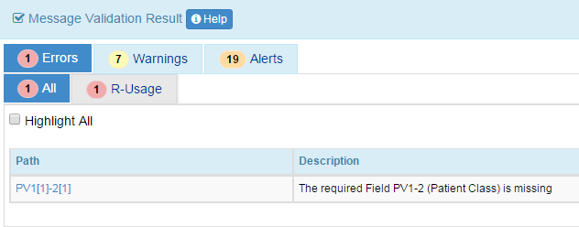
Optional Usage
Primitive Elements with Optional Usage generates no detections
Complex Elements with Optional Usage follows the base standard rules (if the element is present in the message instance). That is, if an implementer decides to support Optional Usage Elements, then they need to follow the base standard requirements for that Element.
Example, if the PV1 segment is included, then PV1-2 SHALL be valued since it is Required.
PV1|XXX||||| (will generate and error). This is a Certification Error.

Slide 29
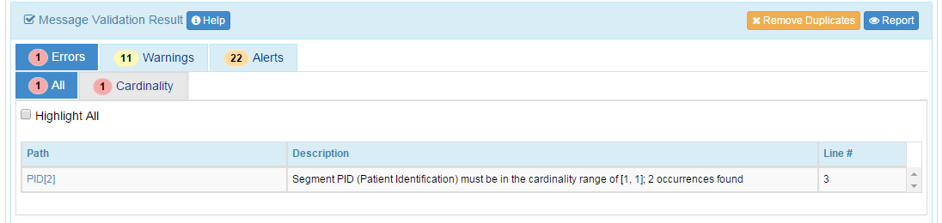
Cardinality: Segment Level
Cardinality: Segment Level
Reason | Issued when the number of occurrences of an element is not in the specified cardinality range.
Example Report | Segment PID (Patient Identification) must be in the cardinality range of [1, 1]; 2 occurrences found.
Comments | The cardinality of the PID segment is specified as [1,1]. The message instance is expected to have one and only one occurrence. Default Classification: Error
Example Message
MSH|^~\&|NISTEHRAPP|NISTEHRFAC|NISTIISAPP|NISTIISFAC|20150625121047.839-0500||VXU^V04^VXU_V04|NIST-IZ-AD-7.1_Send_V04_Z22|P|2.5.1|||ER|AL|||||Z22^CDCPHINVS|NISTEHRFAC^^^^^NIST-AA-IZ-1^XX^^^100-6482|NISTIISFAC^^^^^NIST-AA-IZ-1^XX^^^100-3322
PID|1||7120^^^NIST-MPI-1^MR||Barrett^Helen^^^^^L||19500317|F||2106-3^White^CDCREC|763 Main St^^Bozeman^MT^59715^USA^P||^PRN^PH^^^406^5554064~^NET^^Helen.Barrett@isp.com|||||||||2186-5^Not Hispanic or Latino^CDCREC||N|1|||||N
PID|1||7120^^^NIST-MPI-1^MR||Barrett^Helen^^^^^L||19500317|F||2106-3^White^CDCREC|763 Main St^^Bozeman^MT^59715^USA^P||^PRN^PH^^^406^5554064~^NET^^Helen.Barrett@isp.com|||||||||2186-5^Not Hispanic or Latino^CDCREC||N|1|||||N
PD1|||||||||||06^Recall only - any method^HL70215|Y|20150625|||A|19500317|20150625
ORC|RE|7646^NIST-AA-IZ-2|53100^NIST-AA-IZ-2|||||||7824^Jackson^Lily^Suzanne^^^^^NIST-PI-1^L^^^PRN|||||||NISTEHRFAC^NISTEHRFacility^HL70362|
RXA|0|1|20150317||121^zoster^CVX|999|||01^Historical Administration^NIP001|||||||||||CP|A

Slide 30
Cardinality Errors
Note in some cases a Cardinality is not reported when in theory it should be; a Usage error is reported.
By the design the validation checks usage first; if a usage error is detected, no cardinality checks are performed.
For example, the Cardinality of an element is [1,1] with a usage of R. The message instance does not contain a value for the element; a R-usage error is detected. In this case, the validation does not perform a Cardinality. This is why you won’t get multiple errors for this example.

Slide 31
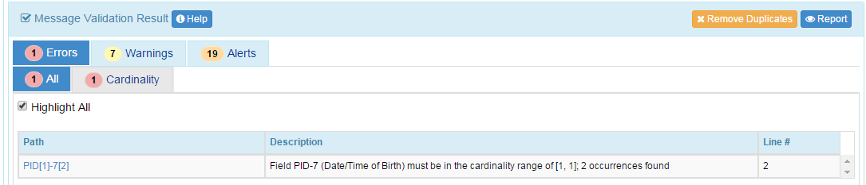
Cardinality: Field Level
Cardinality: Field Level
Reason | Issued when the number of occurrences of an element is not in the specified cardinality range.
Example Report | Segment PID (Patient Identification) must be in the cardinality range of [1, 1]; 2 occurrences found.
Comments | The cardinality of the PID segment is specified as [1,1]. The message instance is expected to have one and only one occurrence. Default Classification: Error
Example Message
MSH|^~\&|NISTEHRAPP|NISTEHRFAC|NISTIISAPP|NISTIISFAC|20150625121047.839-0500||VXU^V04^VXU_V04|NIST-IZ-AD-7.1_Send_V04_Z22|P|2.5.1|||ER|AL|||||Z22^CDCPHINVS|NISTEHRFAC^^^^^NIST-AA-IZ-1^XX^^^100-6482|NISTIISFAC^^^^^NIST-AA-IZ-1^XX^^^100-3322
PID|1||7120^^^NIST-MPI-1^MR||Barrett^Helen^^^^^L||19500317~19520320|F||2106-3^White^CDCREC|763 Main St^^Bozeman^MT^59715^USA^P||^PRN^PH^^^406^5554064~^NET^^Helen.Barrett@isp.com|||||||||2186-5^Not Hispanic or Latino^CDCREC||N|1|||||N
PD1|||||||||||06^Recall only - any method^HL70215|Y|20150625|||A|19500317|20150625
ORC|RE|7646^NIST-AA-IZ-2|53100^NIST-AA-IZ-2|||||||7824^Jackson^Lily^Suzanne^^^^^NIST-PI-1^L^^^PRN|||||||NISTEHRFAC^NISTEHRFacility^HL70362|
RXA|0|1|20150317||121^zoster^CVX|999|||01^Historical Administration^NIP001|||||||||||CP|A

Slide 32
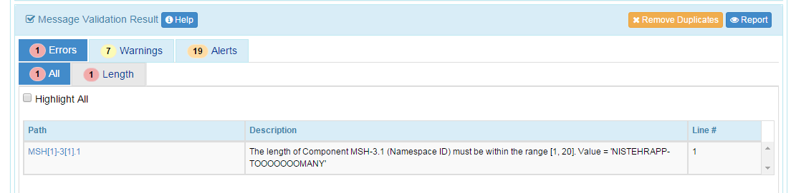
Length Error (Maximum)
Length Error - Maximum
Reason | Issued when the length of a primitive element is not in the specified length range.
Example Report | The length of Component MSH-3.1 (Namespace ID) must be within the range [1, 20]. Value = 'NISTEHRAPP-TOOOOOOOMANY'
Comments | The length of the element is specified as [1,20]; the data value is longer than 20 characters. Default Classification: Error
Example Message
MSH|^~\&|NISTEHRAPP-TOOOOOOOMANY|NISTEHRFAC|NISTIISAPP|NISTIISFAC|20150625121047.839-0500||VXU^V04^VXU_V04|NIST-IZ-AD-7.1_Send_V04_Z22|P|2.5.1|||ER|AL|||||Z22^CDCPHINVS|NISTEHRFAC^^^^^NIST-AA-IZ-1^XX^^^100-6482|NISTIISFAC^^^^^NIST-AA-IZ-1^XX^^^100-3322
PID|1||7120^^^NIST-MPI-1^MR||Barrett^Helen^^^^^L||19500317|F||2106-3^White^CDCREC|763 Main St^^Bozeman^MT^59715^USA^P||^PRN^PH^^^406^5554064~^NET^^Helen.Barrett@isp.com|||||||||2186-5^Not Hispanic or Latino^CDCREC||N|1|||||N
PD1|||||||||||06^Recall only - any method^HL70215|Y|20150625|||A|19500317|20150625
ORC|RE|7646^NIST-AA-IZ-2|53100^NIST-AA-IZ-2|||||||7824^Jackson^Lily^Suzanne^^^^^NIST-PI-1^L^^^PRN|||||||NISTEHRFAC^NISTEHRFacility^HL70362|
RXA|0|1|20150317||121^zoster^CVX|999|||01^Historical Administration^NIP001|||||||||||CP|A

Slide 33
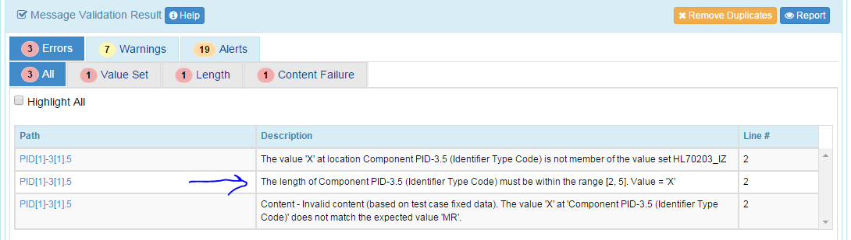
Length Error (Minimum)
Length Error - Minimum
Reason | Issued when the length of a primitive element is not in the specified length range.
Example Report | The length of Component PID-3.5 (Identifier Type Code) must be within the range [2, 5]. Value = 'X'
Comments | The length of the element is specified as [2,5]; the data value has only 1 character. Default Classification: Error
Example Message
MSH|^~\&|NISTEHRAPP|NISTEHRFAC|NISTIISAPP|NISTIISFAC|20150625121047.839-0500||VXU^V04^VXU_V04|NIST-IZ-AD-7.1_Send_V04_Z22|P|2.5.1|||ER|AL|||||Z22^CDCPHINVS|NISTEHRFAC^^^^^NIST-AA-IZ-1^XX^^^100-6482|NISTIISFAC^^^^^NIST-AA-IZ-1^XX^^^100-3322
PID|1||7120^^^NIST-MPI-1^X||Barrett^Helen^^^^^L||19500317|F||2106-3^White^CDCREC|763 Main St^^Bozeman^MT^59715^USA^P||^PRN^PH^^^406^5554064~^NET^^Helen.Barrett@isp.com|||||||||2186-5^Not Hispanic or Latino^CDCREC||N|1|||||N
PD1|||||||||||06^Recall only - any method^HL70215|Y|20150625|||A|19500317|20150625
ORC|RE|7646^NIST-AA-IZ-2|53100^NIST-AA-IZ-2|||||||7824^Jackson^Lily^Suzanne^^^^^NIST-PI-1^L^^^PRN|||||||NISTEHRFAC^NISTEHRFacility^HL70362|
RXA|0|1|20150317||121^zoster^CVX|999|||01^Historical Administration^NIP001|||||||||||CP|A

Slide 34
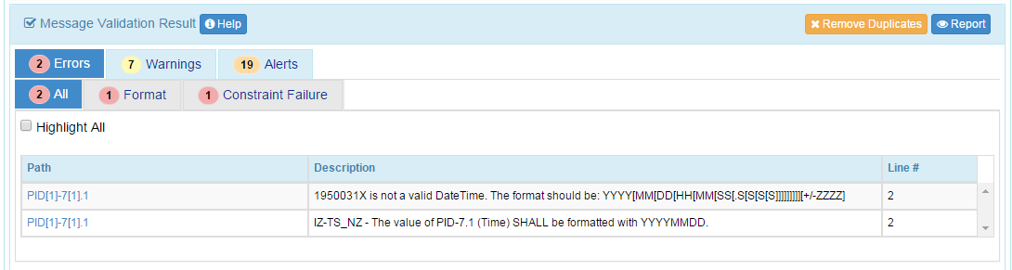
Format Error
Format Error
Reason | Issued when the content of an element doesn't conform to the format specified (e.g., date format).
Example Report | IZ-TS_NZ - The value of PID-7.1 (Time) SHALL be formatted with YYYYMMDD.
Comments | The format of the data value does not match the format indicated in the standard or by an explicit conformance statement. Default Classification: Error
Example Message
MSH|^~\&|NISTEHRAPP|NISTEHRFAC|NISTIISAPP|NISTIISFAC|20150625121047.839-0500||VXU^V04^VXU_V04|NIST-IZ-AD-7.1_Send_V04_Z22|P|2.5.1|||ER|AL|||||Z22^CDCPHINVS|NISTEHRFAC^^^^^NIST-AA-IZ-1^XX^^^100-6482|NISTIISFAC^^^^^NIST-AA-IZ-1^XX^^^100-3322
PID|1||7120^^^NIST-MPI-1^MR||Barrett^Helen^^^^^L||1950031X|F||2106-3^White^CDCREC|763 Main St^^Bozeman^MT^59715^USA^P||^PRN^PH^^^406^5554064~^NET^^Helen.Barrett@isp.com|||||||||2186-5^Not Hispanic or Latino^CDCREC||N|1|||||N
PD1|||||||||||06^Recall only - any method^HL70215|Y|20150625|||A|19500317|20150625
ORC|RE|7646^NIST-AA-IZ-2|53100^NIST-AA-IZ-2|||||||7824^Jackson^Lily^Suzanne^^^^^NIST-PI-1^L^^^PRN|||||||NISTEHRFAC^NISTEHRFacility^HL70362|
RXA|0|1|20150317||121^zoster^CVX|999|||01^Historical Administration^NIP001|||||||||||CP|A

Slide 35
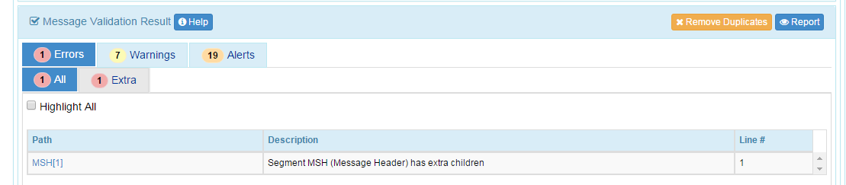
Extra Content: Segment
Extra Content: Segment
Reason | Issued when a complex element has extra children.
Example Report | Segment MSH (Message Header) has extra children.
Comments | The Segment has unexpected (Extra) content. In this case an extra field that is not part of the standard (profile). Default Classification: Error
Example Message
MSH|^~\&|NISTEHRAPP|NISTEHRFAC|NISTIISAPP|NISTIISFAC|20150625121047.839-0500||VXU^V04^VXU_V04|NIST-IZ-AD-7.1_Send_V04_Z22|P|2.5.1|||ER|AL|||||Z22^CDCPHINVS|NISTEHRFAC^^^^^NIST-AA-IZ-1^XX^^^100-6482|NISTIISFAC^^^^^NIST-AA-IZ-1^XX^^^100-3322||||MSH-26
PID|1||7120^^^NIST-MPI-1^MR||Barrett^Helen^^^^^L||19500317|F||2106-3^White^CDCREC|763 Main St^^Bozeman^MT^59715^USA^P||^PRN^PH^^^406^5554064~^NET^^Helen.Barrett@isp.com|||||||||2186-5^Not Hispanic or Latino^CDCREC||N|1|||||N
PD1|||||||||||06^Recall only - any method^HL70215|Y|20150625|||A|19500317|20150625
ORC|RE|7646^NIST-AA-IZ-2|53100^NIST-AA-IZ-2|||||||7824^Jackson^Lily^Suzanne^^^^^NIST-PI-1^L^^^PRN|||||||NISTEHRFAC^NISTEHRFacility^HL70362|
RXA|0|1|20150317||121^zoster^CVX|999|||01^Historical Administration^NIP001|||||||||||CP|A

Slide 36
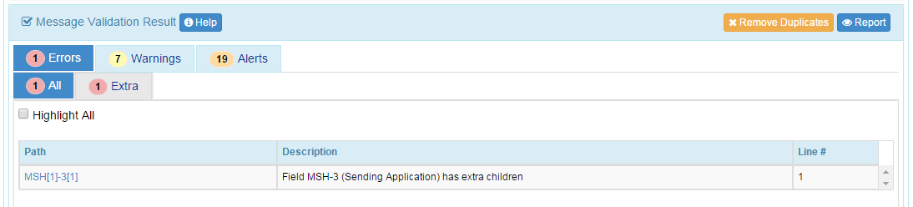
Extra Content: Field
Extra Content: Field
Reason | Issued when a complex element has extra children.
Example Report | Field MSH-3 (Sending Application) has extra children.
Comments | The field has unexpected (Extra) content. In this case an extra component that is not part of the standard (profile). Default Classification: Error
Example Message
MSH|^~\&|NISTEHRAPP^^^MSH-3.4|NISTEHRFAC|NISTIISAPP|NISTIISFAC|20150625121047.839-0500||VXU^V04^VXU_V04|NIST-IZ-AD-7.1_Send_V04_Z22|P|2.5.1|||ER|AL|||||Z22^CDCPHINVS|NISTEHRFAC^^^^^NIST-AA-IZ-1^XX^^^100-6482|NISTIISFAC^^^^^NIST-AA-IZ-1^XX^^^100-3322
PID|1||7120^^^NIST-MPI-1^MR||Barrett^Helen^^^^^L||19500317|F||2106-3^White^CDCREC|763 Main St^^Bozeman^MT^59715^USA^P||^PRN^PH^^^406^5554064~^NET^^Helen.Barrett@isp.com|||||||||2186-5^Not Hispanic or Latino^CDCREC||N|1|||||N
PD1|||||||||||06^Recall only - any method^HL70215|Y|20150625|||A|19500317|20150625
ORC|RE|7646^NIST-AA-IZ-2|53100^NIST-AA-IZ-2|||||||7824^Jackson^Lily^Suzanne^^^^^NIST-PI-1^L^^^PRN|||||||NISTEHRFAC^NISTEHRFacility^HL70362|
RXA|0|1|20150317||121^zoster^CVX|999|||01^Historical Administration^NIP001|||||||||||CP|A

Slide 37
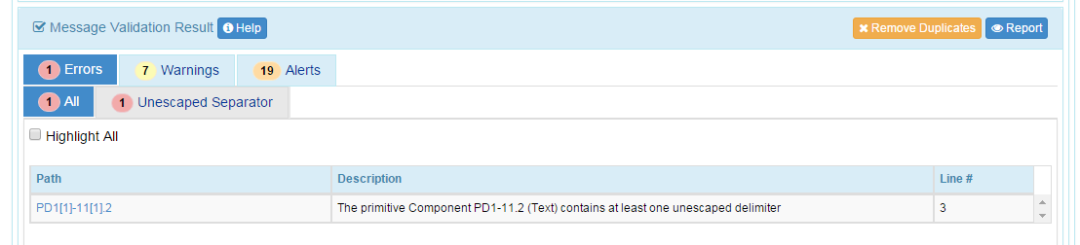
Un-escaped Character
Un-escaped Character
Reason | Issued when a primitive element contains un-escaped separators.
Example Report | The primitive Component PD1-11.2 (Text) contains at least one un-escaped delimiter.
Comments | The primitive data value contains and un-escaped delimiter. To fix, escape the delimiter with the escape delimiter (i.e., \T\). Default Classification: Error
Example Message
MSH|^~\&|NISTEHRAPP|NISTEHRFAC|NISTIISAPP|NISTIISFAC|20150625121047.839-0500||VXU^V04^VXU_V04|NIST-IZ-AD-7.1_Send_V04_Z22|P|2.5.1|||ER|AL|||||Z22^CDCPHINVS|NISTEHRFAC^^^^^NIST-AA-IZ-1^XX^^^100-6482|NISTIISFAC^^^^^NIST-AA-IZ-1^XX^^^100-3322
PID|1||7120^^^NIST-MPI-1^MR||Barrett^Helen^^^^^L||19500317|F||2106-3^White^CDCREC|763 Main St^^Bozeman^MT^59715^USA^P||^PRN^PH^^^406^5554064~^NET^^Helen.Barrett@isp.com|||||||||2186-5^Not Hispanic or Latino^CDCREC||N|1|||||N
PD1|||||||||||06^Recall only & any method^HL70215|Y|20150625|||A|19500317|20150625
ORC|RE|7646^NIST-AA-IZ-2|53100^NIST-AA-IZ-2|||||||7824^Jackson^Lily^Suzanne^^^^^NIST-PI-1^L^^^PRN|||||||NISTEHRFAC^NISTEHRFacility^HL70362|
RXA|0|1|20150317||121^zoster^CVX|999|||01^Historical Administration^NIP001|||||||||||CP|A

Slide 38
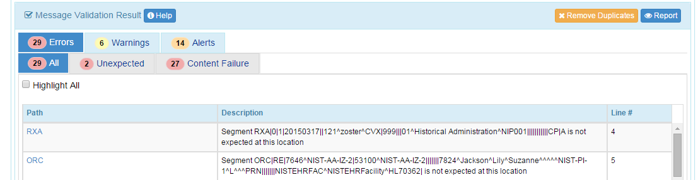
Unexpected Content: Segment
Unexpected Content: Segment
Reason | This detection is issued when an unexpected segment is found.
Example Report | Segment RXA|0|1|20150317||121^zoster^CVX|999||| 01^Historical Administration^NIP001|||||||||||CP|A is not expected at this location.
Comments | The Segment is unexpected according to the published standard (Profile). RXA should come after the ORC. This is a conformance error. Many errors may be indicated. Default Classification: Error
Example Message
MSH|^~\&|NISTEHRAPP|NISTEHRFAC|NISTIISAPP|NISTIISFAC|20150625121047.839-0500||VXU^V04^VXU_V04|NIST-IZ-AD-7.1_Send_V04_Z22|P|2.5.1|||ER|AL|||||Z22^CDCPHINVS|NISTEHRFAC^^^^^NIST-AA-IZ-1^XX^^^100-6482|NISTIISFAC^^^^^NIST-AA-IZ-1^XX^^^100-3322
PID|1||7120^^^NIST-MPI-1^MR||Barrett^Helen^^^^^L||19500317|F||2106-3^White^CDCREC|763 Main St^^Bozeman^MT^59715^USA^P||^PRN^PH^^^406^5554064~^NET^^Helen.Barrett@isp.com|||||||||2186-5^Not Hispanic or Latino^CDCREC||N|1|||||N
PD1|||||||||||06^Recall only - any method^HL70215|Y|20150625|||A|19500317|20150625
RXA|0|1|20150317||121^zoster^CVX|999|||01^Historical Administration^NIP001|||||||||||CP|A
ORC|RE|7646^NIST-AA-IZ-2|53100^NIST-AA-IZ-2|||||||7824^Jackson^Lily^Suzanne^^^^^NIST-PI-1^L^^^PRN|||||||NISTEHRFAC^NISTEHRFacility^HL70362|

Slide 39
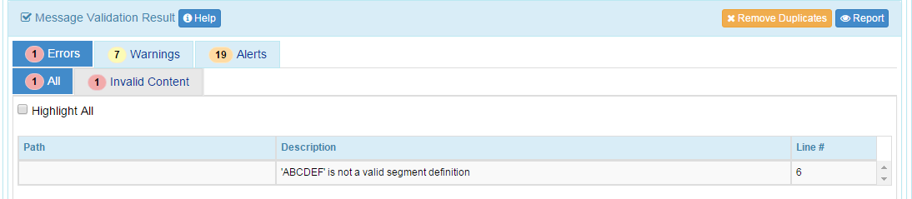
Invalid Content: Segment
Invalid Content: Segment
Reason | Issued when an invalid content is found in the message.
Example Report | 'ABCDEF' is not a valid segment definition
Comments | Segment definitions are constrained to 3 characters. This message contains a segment that is 6 characters long. Many errors may be indicated. Default Classification: Error
Example Message
MSH|^~\&|NISTEHRAPP|NISTEHRFAC|NISTIISAPP|NISTIISFAC|20150625121047.839-0500||VXU^V04^VXU_V04|NIST-IZ-AD-7.1_Send_V04_Z22|P|2.5.1|||ER|AL|||||Z22^CDCPHINVS|NISTEHRFAC^^^^^NIST-AA-IZ-1^XX^^^100-6482|NISTIISFAC^^^^^NIST-AA-IZ-1^XX^^^100-3322
PID|1||7120^^^NIST-MPI-1^MR||Barrett^Helen^^^^^L||19500317|F||2106-3^White^CDCREC|763 Main St^^Bozeman^MT^59715^USA^P||^PRN^PH^^^406^5554064~^NET^^Helen.Barrett@isp.com|||||||||2186-5^Not Hispanic or Latino^CDCREC||N|1|||||N
PD1|||||||||||06^Recall only - any method^HL70215|Y|20150625|||A|19500317|20150625
ORC|RE|7646^NIST-AA-IZ-2|53100^NIST-AA-IZ-2|||||||7824^Jackson^Lily^Suzanne^^^^^NIST-PI-1^L^^^PRN|||||||NISTEHRFAC^NISTEHRFacility^HL70362|
RXA|0|1|20150317||121^zoster^CVX|999|||01^Historical Administration^NIP001|||||||||||CP|A
ABCDEF

Slide 40
Detection Categories: Content Validation
Category | Description
Constraint Failure | Issued for a failed constraint verification (associated with conformance statements).
Content Failure | Issued when content does not conform to test case specific data content constraints. See Test Data Categories for sub-categories and details.
Predicate Failure | Issued for a failed predicate constraint verification. In essence is a Usage (R, X, W, RE) constraint failure where usage is determined by a conditional.
Constraint Spec Error | Issued for an inconclusive constraint verification. This usually occurs when there is an erroneous constraint specification.
Predicate Spec Err | Issued for inconclusive predicate constraint verification. This usually occurs when the predicate constraint specification is erroneous.

Slide 41
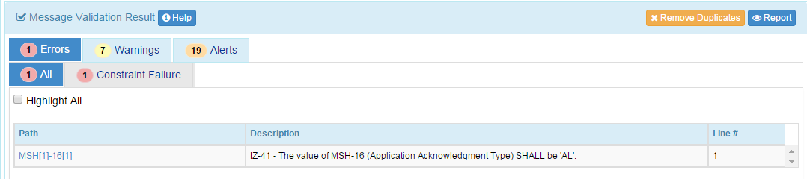
Constraint Failure
Constraint Failure
Reason | Issued when a defined constraint on the message content fails; usually expressed as conformance statements.
Example Report | IZ-41 - The value of MSH-16 (Application Acknowledgment Type) SHALL be 'AL'.
Comments | Constraints that can’t be expressed with the conformance constructs are expressed as explicit conformance statements. Each constraint defines its own description that serves as the error message when the assertion verified by the constraint fails. Default Classification: Error
Example Message
MSH|^~\&|NISTEHRAPP|NISTEHRFAC|NISTIISAPP|NISTIISFAC|20150625121047.839-0500||VXU^V04^VXU_V04|NIST-IZ-AD-7.1_Send_V04_Z22|P|2.5.1|||ER|XX|||||Z22^CDCPHINVS|NISTEHRFAC^^^^^NIST-AA-IZ-1^XX^^^100-6482|NISTIISFAC^^^^^NIST-AA-IZ-1^XX^^^100-3322
PID|1||7120^^^NIST-MPI-1^MR||Barrett^Helen^^^^^L||19500317|F||2106-3^White^CDCREC|763 Main St^^Bozeman^MT^59715^USA^P||^PRN^PH^^^406^5554064~^NET^^Helen.Barrett@isp.com|||||||||2186-5^Not Hispanic or Latino^CDCREC||N|1|||||N
PD1|||||||||||06^Recall only - any method^HL70215|Y|20150625|||A|19500317|20150625
ORC|RE|7646^NIST-AA-IZ-2|53100^NIST-AA-IZ-2|||||||7824^Jackson^Lily^Suzanne^^^^^NIST-PI-1^L^^^PRN|||||||NISTEHRFAC^NISTEHRFacility^HL70362|
RXA|0|1|20150317||121^zoster^CVX|999|||01^Historical Administration^NIP001|||||||||||CP|A

Slide 42
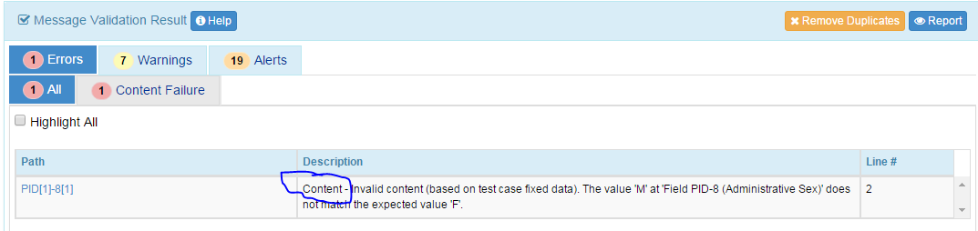
Data Content Failure
Data Content Failure
Reason | Issued when content does not conform to test case specific data content constraints.
Example Report | Content - Invalid content (based on test case fixed data). The value 'M' at 'Field PID-8 (Administrative Sex)' does not match the expected value 'F'.
Comments | See Test Data Categories for sub-categories and details. Default Classification: Error
Example Message
MSH|^~\&|NISTEHRAPP|NISTEHRFAC|NISTIISAPP|NISTIISFAC|20150625121047.839-0500||VXU^V04^VXU_V04|NIST-IZ-AD-7.1_Send_V04_Z22|P|2.5.1|||ER|AL|||||Z22^CDCPHINVS|NISTEHRFAC^^^^^NIST-AA-IZ-1^XX^^^100-6482|NISTIISFAC^^^^^NIST-AA-IZ-1^XX^^^100-3322
PID|1||7120^^^NIST-MPI-1^MR||Barrett^Helen^^^^^L||19500317|M||2106-3^White^CDCREC|763 Main St^^Bozeman^MT^59715^USA^P||^PRN^PH^^^406^5554064~^NET^^Helen.Barrett@isp.com|||||||||2186-5^Not Hispanic or Latino^CDCREC||N|1|||||N
PD1|||||||||||06^Recall only - any method^HL70215|Y|20150625|||A|19500317|20150625
ORC|RE|7646^NIST-AA-IZ-2|53100^NIST-AA-IZ-2|||||||7824^Jackson^Lily^Suzanne^^^^^NIST-PI-1^L^^^PRN|||||||NISTEHRFAC^NISTEHRFacility^HL70362|
RXA|0|1|20150317||121^zoster^CVX|999|||01^Historical Administration^NIP001|||||||||||CP|A

Slide 43
Predicate Failure: Usage based on Conditional
Predicate Failure: Usage based on Conditional
Reason | Issued for a failed predicate constraint verification. That is, it is a Usage failure based on the outcome of a conditional.
Example Report | The required Field RXA-7 (Administered Units) is missing. The element is required based on the condition predicate evaluation: If the value of RXA-6 (Administered Amount) is not '999'.
Comments | The Usage constraint is determined at runtime. Therefore this is classified as a Predicate Failure although it is a Usage Failure. Default Classification: Error
Example Message | See next Slide.

Slide 44
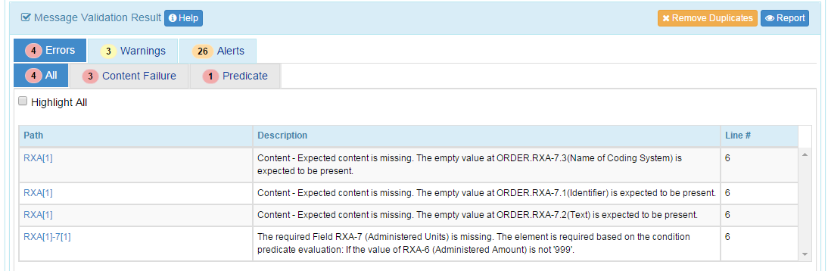
Predicate Failure: Example
MSH|^~\&|NISTEHRAPP^2.16.840.1.113883.3.72.5.40.1^ISO|NISTEHRFAC^2.16.840.1.113883.3.72.5.40.2^ISO|NISTIISAPP^2.16.840.1.113883.3.72.5.40.3^ISO|NISTIISFAC^2.16.840.1.113883.3.72.5.40.4^ISO|20150625103328.757-0500||VXU^V04^VXU_V04|NIST-IZ-AD-8.1_Send_V04_Z22|P|2.5.1|||ER|AL|||||Z22^CDCPHINVS|NISTEHRFAC^^^^^NIST-AA-IZ-1&2.16.840.1.113883.3.72.5.40.9&ISO^XX^^^100-6482|NISTIISFAC^^^^^NIST-AA-IZ-1&2.16.840.1.113883.3.72.5.40.9&ISO^XX^^^100-3322
PID|1||77100^^^NIST-MPI-1&2.16.840.1.113883.3.72.5.40.5&ISO^MR||Broadway^Ashley^Jennifer^^^^L|Layton^^^^^^M|20150516|F||2054-5^African American^CDCREC|901 North 12th St^^Bozeman^MT^59715^USA^P||^PRN^PH^^^406^5552262|||||||||2186-5^Not Hispanic or Latino^CDCREC||N|1|||||N
PD1|||||||||||03^Reminder/recall - no calls^HL70215|N|20150625|||A|20150516|20150625
NK1|1|Broadway^Ellen^^^^^L|MTH^Mother^HL70063|901 North 12th St^^Bozeman^MT^59715^USA^P|^PRN^PH^^^406^5552262
ORC|RE|3881^NIST-AA-IZ-2^2.16.840.1.113883.3.72.5.40.10^ISO|13926^NIST-AA-IZ-2^2.16.840.1.113883.3.72.5.40.10^ISO|||||||7824^Jackson^Lily^Suzanne^^^^^NIST-PI-1&2.16.840.1.113883.3.72.5.40.7&ISO^L^^^PRN||654^Thomas^Wilma^Elizabeth^^^^^NIST-PI-1&2.16.840.1.113883.3.72.5.40.7&ISO^L^^^MD|||||NISTEHRFAC^NISTEHRFacility^HL70362
RXA|0|1|20150625||58160-0820-01^ENGERIX-B^NDC|0.5|||00^New Record^NIP001|7824^Jackson^Lily^Suzanne^^^^^NIST-PI-1&2.16.840.1.113883.3.72.5.40.7&ISO^L^^^PRN|^^^NIST-Clinic-1&2.16.840.1.113883.3.72.5.40.12&ISO||||797397|20151203|SKB^GlaxoSmithKline^MVX|||CP|A
RXR|C28161^Intramuscular^NCIT|LT^Left Thigh^HL70163
OBX|1|CE|30963-3^Vaccine Funding Source^LN|1|PHC70^Private^CDCPHINVS||||||F|||20150625
OBX|2|CE|64994-7^Vaccine Funding Program Eligibility^LN|2|V01^Not VFC Eligible^HL70064||||||F|||20150625|||VXC40^per immunization^CDCPHINVS
OBX|3|CE|69764-9^Document Type^LN|3|253088698300005911120202^Hepatitis B VIS^cdcgs1vis||||||F|||20150625
OBX|4|DT|29769-7^Date Vis Presented^LN|3|20150625||||||F|||20150625

Slide 45
Detection Categories: Value Set Validation
Category | Description
EVS | Issued when the code is in the value set but the usage is "E" (Excluded).
PVS | Issued when the code is in the value set but the usage is "P" (Permitted).
Code Not Found | Issued when the code cannot be found in the value set.
VS Not Found | Issued when the value set cannot be found in the value set library.
Empty VS | Issued when the value set is empty.
VS Error | Issued when there are multiple occurrences of the same code within a value set (with the same code system). This is a specification Error.
VS No Validation | Issued when an excluded value set is encountered, i.e., the entire value set has been excluded from validation for one reason or another.
Coded Element | Issued when coded element validation fails.

Slide 46
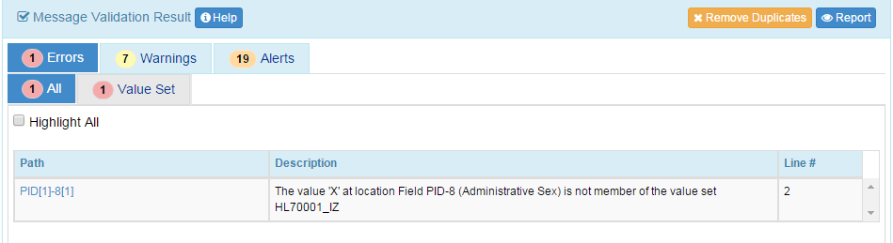
Value Set Error—Code not Found
Value Set Error-Code not Found
Reason | Issued when the code for an element is not a member of the value set it is bound to.
Example Report | The value 'X' at location Field PID-8 (Administrative Sex) is not member of the value set HL70001_IZ.
Comments | X is not a member of the specified value set. The list of accepted values can be found in the HL70001_IZ value set. Default Classification: Error
Example Message
MSH|^~\&|NISTEHRAPP|NISTEHRFAC|NISTIISAPP|NISTIISFAC|20150625121047.839-0500||VXU^V04^VXU_V04|NIST-IZ-AD-7.1_Send_V04_Z22|P|2.5.1|||ER|AL|||||Z22^CDCPHINVS|NISTEHRFAC^^^^^NIST-AA-IZ-1^XX^^^100-6482|NISTIISFAC^^^^^NIST-AA-IZ-1^XX^^^100-3322
PID|1||7120^^^NIST-MPI-1^MR||Barrett^Helen^^^^^L||19500317|X||2106-3^White^CDCREC|763 Main St^^Bozeman^MT^59715^USA^P||^PRN^PH^^^406^5554064~^NET^^Helen.Barrett@isp.com|||||||||2186-5^Not Hispanic or Latino^CDCREC||N|1|||||N
PD1|||||||||||06^Recall only - any method^HL70215|Y|20150625|||A|19500317|20150625
ORC|RE|7646^NIST-AA-IZ-2|53100^NIST-AA-IZ-2|||||||7824^Jackson^Lily^Suzanne^^^^^NIST-PI-1^L^^^PRN|||||||NISTEHRFAC^NISTEHRFacility^HL70362|
RXA|0|1|20150317||121^zoster^CVX|999|||01^Historical Administration^NIP001|||||||||||CP|A

Slide 47
Value Set Not Found
Value Set Not Found
Reason | Issued when the value set cannot be found in the value set library.
Example Report
Comments | Doesn’t apply to any test here. All value sets are provided.
Example Message

Slide 48
Value Set is Empty
Value Set is Empty
Reason | Issued when the value set is empty.
Example Report
Comments | Doesn’t apply to any test here. All value sets that are found have values.
Example Message

Slide 49
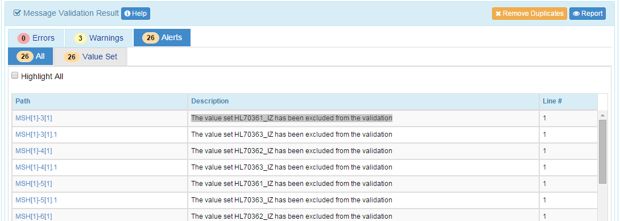
Value Set is Excluded
Value Set is Excluded
Reason | Issued when an excluded value set is encountered, i.e., the entire value set has been excluded from validation for one reason or another.
Example Report | The value set HL70361_IZ has been excluded from the validation
Comments | Accounts for Value Sets that are bounded in the standard but are to be determined at the local (installation) level. Default Classification: Alert
Example Message

Slide 50
Validation Results: Things to Note

Slide 51
Test Data Validation – Sequencing of Segments
The NIST context-based testing performs specific content validation depending on the Category/Qualifier combination assigned to the Data Elements in the message.
In some cases, in order to perform this type of validation the NIST Tool expects the segments/segment groups in the message to be sequenced in a certain order. The complexity of automatically evaluating specific content necessitates this approach.
If the Message Validation Result generated by the NIST Tool indicates content-related errors, the ATL may change the order of the segments/segment groups in the test message to match the Test Case once the message has been loaded into the Message Content window of the Test Tool.
These kinds of content-related errors do not imply a failure of the vendor product nor a requirement to create the message with the segments/segment groups in a certain order (beyond the base message structure).

Slide 52
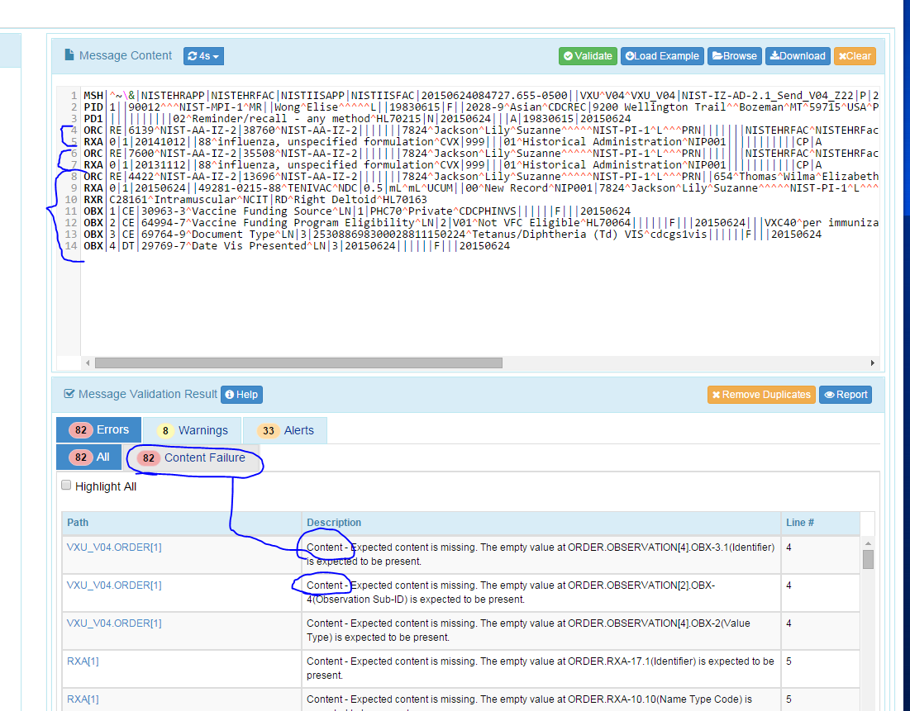
Example: Sequencing of Segments
Immunization: Test Case: IZ-AD-2.1_Send_V04_Z22
Move the first ORDER group to the end of the message
Content Errors are reported (false negatives)
Remediate
Copy message into Context-free—confirm no technical errors
Rearrange Segments to match expected Segment order manually
If errors still exist then these are true negative errors and must be addressed by the vendor

Slide 53
Test Message with Segment Groups Order Altered
Original Example Message
MSH|^~\&|NISTEHRAPP|NISTEHRFAC|NISTIISAPP|NISTIISFAC|20150624084727.655-0500||VXU^V04^VXU_V04|NIST-IZ-AD-2.1_Send_V04_Z22|P|2.5.1|||ER|AL|||||Z22^CDCPHINVS|NISTEHRFAC|NISTIISFAC
PID|1||90012^^^NIST-MPI-1^MR||Wong^Elise^^^^^L||19830615|F||2028-9^Asian^CDCREC|9200 Wellington Trail^^Bozeman^MT^59715^USA^P||^PRN^PH^^^406^5557896~^NET^Internet^Elise.Wong@isp.com|||||||||2186-5^Not Hispanic or Latino^CDCREC||N|1|||||N
PD1|||||||||||02^Reminder/recall - any method^HL70215|N|20150624|||A|19830615|20150624
ORC|RE|4422^NIST-AA-IZ-2|13696^NIST-AA-IZ-2|||||||7824^Jackson^Lily^Suzanne^^^^^NIST-PI-1^L^^^PRN||654^Thomas^Wilma^Elizabeth^^^^^NIST-PI-1^L^^^MD|||||NISTEHRFAC^NISTEHRFacility^HL70362|
RXA|0|1|20150624||49281-0215-88^TENIVAC^NDC|0.5|mL^mL^UCUM||00^New Record^NIP001|7824^Jackson^Lily^Suzanne^^^^^NIST-PI-1^L^^^PRN|^^^NIST-Clinic-1||||315841|20151216|PMC^Sanofi Pasteur^MVX|||CP|A
RXR|C28161^Intramuscular^NCIT|RD^Right Deltoid^HL70163
OBX|1|CE|30963-3^Vaccine Funding Source^LN|1|PHC70^Private^CDCPHINVS||||||F|||20150624
OBX|2|CE|64994-7^Vaccine Funding Program Eligibility^LN|2|V01^Not VFC Eligible^HL70064||||||F|||20150624|||VXC40^per immunization^CDCPHINVS
OBX|3|CE|69764-9^Document Type^LN|3|253088698300028811150224^Tetanus/Diphtheria (Td) VIS^cdcgs1vis||||||F|||20150624
OBX|4|DT|29769-7^Date Vis Presented^LN|3|20150624||||||F|||20150624
ORC|RE|6139^NIST-AA-IZ-2|38760^NIST-AA-IZ-2|||||||7824^Jackson^Lily^Suzanne^^^^^NIST-PI-1^L^^^PRN|||||||NISTEHRFAC^NISTEHRFacility^HL70362|
RXA|0|1|20141012||88^influenza, unspecified formulation^CVX|999|||01^Historical Administration^NIP001|||||||||||CP|A
ORC|RE|7600^NIST-AA-IZ-2|35508^NIST-AA-IZ-2|||||||7824^Jackson^Lily^Suzanne^^^^^NIST-PI-1^L^^^PRN|||||||NISTEHRFAC^NISTEHRFacility^HL70362|
RXA|0|1|20131112||88^influenza, unspecified formulation^CVX|999|||01^Historical Administration^NIP001|||||||||||CP|A
Modified Example Message
MSH|^~\&|NISTEHRAPP|NISTEHRFAC|NISTIISAPP|NISTIISFAC|20150624084727.655-0500||VXU^V04^VXU_V04|NIST-IZ-AD-2.1_Send_V04_Z22|P|2.5.1|||ER|AL|||||Z22^CDCPHINVS|NISTEHRFAC|NISTIISFAC
PID|1||90012^^^NIST-MPI-1^MR||Wong^Elise^^^^^L||19830615|F||2028-9^Asian^CDCREC|9200 Wellington Trail^^Bozeman^MT^59715^USA^P||^PRN^PH^^^406^5557896~^NET^Internet^Elise.Wong@isp.com|||||||||2186-5^Not Hispanic or Latino^CDCREC||N|1|||||N
PD1|||||||||||02^Reminder/recall - any method^HL70215|N|20150624|||A|19830615|20150624
ORC|RE|6139^NIST-AA-IZ-2|38760^NIST-AA-IZ-2|||||||7824^Jackson^Lily^Suzanne^^^^^NIST-PI-1^L^^^PRN|||||||NISTEHRFAC^NISTEHRFacility^HL70362|
RXA|0|1|20141012||88^influenza, unspecified formulation^CVX|999|||01^Historical Administration^NIP001|||||||||||CP|A
ORC|RE|7600^NIST-AA-IZ-2|35508^NIST-AA-IZ-2|||||||7824^Jackson^Lily^Suzanne^^^^^NIST-PI-1^L^^^PRN|||||||NISTEHRFAC^NISTEHRFacility^HL70362|
RXA|0|1|20131112||88^influenza, unspecified formulation^CVX|999|||01^Historical Administration^NIP001|||||||||||CP|A
ORC|RE|4422^NIST-AA-IZ-2|13696^NIST-AA-IZ-2|||||||7824^Jackson^Lily^Suzanne^^^^^NIST-PI-1^L^^^PRN||654^Thomas^Wilma^Elizabeth^^^^^NIST-PI-1^L^^^MD|||||NISTEHRFAC^NISTEHRFacility^HL70362|
RXA|0|1|20150624||49281-0215-88^TENIVAC^NDC|0.5|mL^mL^UCUM||00^New Record^NIP001|7824^Jackson^Lily^Suzanne^^^^^NIST-PI-1^L^^^PRN|^^^NIST-Clinic-1||||315841|20151216|PMC^Sanofi Pasteur^MVX|||CP|A
RXR|C28161^Intramuscular^NCIT|RD^Right Deltoid^HL70163
OBX|1|CE|30963-3^Vaccine Funding Source^LN|1|PHC70^Private^CDCPHINVS||||||F|||20150624
OBX|2|CE|64994-7^Vaccine Funding Program Eligibility^LN|2|V01^Not VFC Eligible^HL70064||||||F|||20150624|||VXC40^per immunization^CDCPHINVS
OBX|3|CE|69764-9^Document Type^LN|3|253088698300028811150224^Tetanus/Diphtheria (Td) VIS^cdcgs1vis||||||F|||20150624
OBX|4|DT|29769-7^Date Vis Presented^LN|3|20150624||||||F|||20150624

Slide 54
Test Data Validation – Sequencing of Fields
The NIST context-based testing performs specific content validation depending on the Category/Qualifier combination assigned to the Data Elements in the message.
In some cases, in order to perform this type of validation the NIST Tool expects the repeating fields in the message to be sequenced in a certain order. The complexity of automatically evaluating specific content necessitates this approach.
If the Message Validation Result generated by the NIST Tool indicates content-related errors, the ATL may change the order of the repeating fields in the test message to match the Test Case once the message has been loaded into the Message Content window of the Test Tool.
These kinds of content-related errors do not imply a failure of the vendor product nor a requirement to create the message with the repeating fields in a certain order (beyond the base message structure).

Slide 55
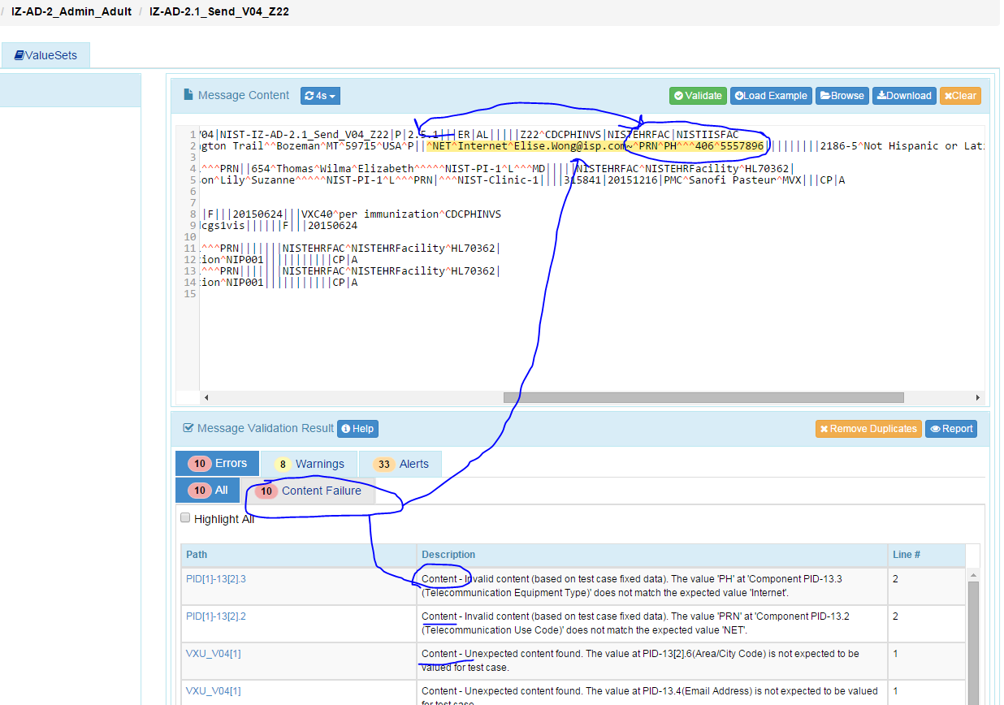
Example: Sequencing of Repeating Fields
Immunization: Test Case: IZ-AD-2.1_Send_V04_Z22
Change the order of the PID-13 (Phone Number)
^PRN^PH^^^406^5557896~^NET^Internet^Elise.Wong@isp.com
Content Errors are reported (false negatives)
Remediate
Copy message into Context-free—confirm no technical errors
Rearrange fields to match expected fields order manually
If errors still exist then these are true negative errors and must be addressed by the vendor

Slide 56
Test Message with Fields Order Altered
Original Example Message
MSH|^~\&|NISTEHRAPP|NISTEHRFAC|NISTIISAPP|NISTIISFAC|20150624084727.655-0500||VXU^V04^VXU_V04|NIST-IZ-AD-2.1_Send_V04_Z22|P|2.5.1|||ER|AL|||||Z22^CDCPHINVS|NISTEHRFAC|NISTIISFAC
PID|1||90012^^^NIST-MPI-1^MR||Wong^Elise^^^^^L||19830615|F||2028-9^Asian^CDCREC|9200 Wellington Trail^^Bozeman^MT^59715^USA^P||^PRN^PH^^^406^5557896~^NET^Internet^Elise.Wong@isp.com|||||||||2186-5^Not Hispanic or Latino^CDCREC||N|1|||||N
PD1|||||||||||02^Reminder/recall - any method^HL70215|N|20150624|||A|19830615|20150624
ORC|RE|4422^NIST-AA-IZ-2|13696^NIST-AA-IZ-2|||||||7824^Jackson^Lily^Suzanne^^^^^NIST-PI-1^L^^^PRN||654^Thomas^Wilma^Elizabeth^^^^^NIST-PI-1^L^^^MD|||||NISTEHRFAC^NISTEHRFacility^HL70362|
RXA|0|1|20150624||49281-0215-88^TENIVAC^NDC|0.5|mL^mL^UCUM||00^New Record^NIP001|7824^Jackson^Lily^Suzanne^^^^^NIST-PI-1^L^^^PRN|^^^NIST-Clinic-1||||315841|20151216|PMC^Sanofi Pasteur^MVX|||CP|A
RXR|C28161^Intramuscular^NCIT|RD^Right Deltoid^HL70163
OBX|1|CE|30963-3^Vaccine Funding Source^LN|1|PHC70^Private^CDCPHINVS||||||F|||20150624
OBX|2|CE|64994-7^Vaccine Funding Program Eligibility^LN|2|V01^Not VFC Eligible^HL70064||||||F|||20150624|||VXC40^per immunization^CDCPHINVS
OBX|3|CE|69764-9^Document Type^LN|3|253088698300028811150224^Tetanus/Diphtheria (Td) VIS^cdcgs1vis||||||F|||20150624
OBX|4|DT|29769-7^Date Vis Presented^LN|3|20150624||||||F|||20150624
ORC|RE|6139^NIST-AA-IZ-2|38760^NIST-AA-IZ-2|||||||7824^Jackson^Lily^Suzanne^^^^^NIST-PI-1^L^^^PRN|||||||NISTEHRFAC^NISTEHRFacility^HL70362|
RXA|0|1|20141012||88^influenza, unspecified formulation^CVX|999|||01^Historical Administration^NIP001|||||||||||CP|A
ORC|RE|7600^NIST-AA-IZ-2|35508^NIST-AA-IZ-2|||||||7824^Jackson^Lily^Suzanne^^^^^NIST-PI-1^L^^^PRN|||||||NISTEHRFAC^NISTEHRFacility^HL70362|
RXA|0|1|20131112||88^influenza, unspecified formulation^CVX|999|||01^Historical Administration^NIP001|||||||||||CP|A
Modified Example Message
MSH|^~\&|NISTEHRAPP|NISTEHRFAC|NISTIISAPP|NISTIISFAC|20150624084727.655-0500||VXU^V04^VXU_V04|NIST-IZ-AD-2.1_Send_V04_Z22|P|2.5.1|||ER|AL|||||Z22^CDCPHINVS|NISTEHRFAC|NISTIISFAC
PID|1||90012^^^NIST-MPI-1^MR||Wong^Elise^^^^^L||19830615|F||2028-9^Asian^CDCREC|9200 Wellington Trail^^Bozeman^MT^59715^USA^P||^NET^Internet^Elise.Wong@isp.com~^PRN^PH^^^406^5557896|||||||||2186-5^Not Hispanic or Latino^CDCREC||N|1|||||N
PD1|||||||||||02^Reminder/recall - any method^HL70215|N|20150624|||A|19830615|20150624
ORC|RE|4422^NIST-AA-IZ-2|13696^NIST-AA-IZ-2|||||||7824^Jackson^Lily^Suzanne^^^^^NIST-PI-1^L^^^PRN||654^Thomas^Wilma^Elizabeth^^^^^NIST-PI-1^L^^^MD|||||NISTEHRFAC^NISTEHRFacility^HL70362|
RXA|0|1|20150624||49281-0215-88^TENIVAC^NDC|0.5|mL^mL^UCUM||00^New Record^NIP001|7824^Jackson^Lily^Suzanne^^^^^NIST-PI-1^L^^^PRN|^^^NIST-Clinic-1||||315841|20151216|PMC^Sanofi Pasteur^MVX|||CP|A
RXR|C28161^Intramuscular^NCIT|RD^Right Deltoid^HL70163
OBX|1|CE|30963-3^Vaccine Funding Source^LN|1|PHC70^Private^CDCPHINVS||||||F|||20150624
OBX|2|CE|64994-7^Vaccine Funding Program Eligibility^LN|2|V01^Not VFC Eligible^HL70064||||||F|||20150624|||VXC40^per immunization^CDCPHINVS
OBX|3|CE|69764-9^Document Type^LN|3|253088698300028811150224^Tetanus/Diphtheria (Td) VIS^cdcgs1vis||||||F|||20150624
OBX|4|DT|29769-7^Date Vis Presented^LN|3|20150624||||||F|||20150624
ORC|RE|6139^NIST-AA-IZ-2|38760^NIST-AA-IZ-2|||||||7824^Jackson^Lily^Suzanne^^^^^NIST-PI-1^L^^^PRN|||||||NISTEHRFAC^NISTEHRFacility^HL70362|
RXA|0|1|20141012||88^influenza, unspecified formulation^CVX|999|||01^Historical Administration^NIP001|||||||||||CP|A
ORC|RE|7600^NIST-AA-IZ-2|35508^NIST-AA-IZ-2|||||||7824^Jackson^Lily^Suzanne^^^^^NIST-PI-1^L^^^PRN|||||||NISTEHRFAC^NISTEHRFacility^HL70362|
RXA|0|1|20131112||88^influenza, unspecified formulation^CVX|999|||01^Historical Administration^NIP001|||||||||||CP|A

Slide 57
Content Testing—Test Data Categories

Slide 58
Test Data Categorization and Validation
The Message Content Data Sheet shows the Categorization of the test data that are provided for each Location
Each Test Data Category
Defines the criteria that are used by the test tool to assess the test data that populate each element in a message
Tells the Tester if the test data in a specific field can be changed, the source of the test data, and to what level of precision the validation tool will assess the data
Important point—some data can be modified, e.g., “Presence”

Slide 59
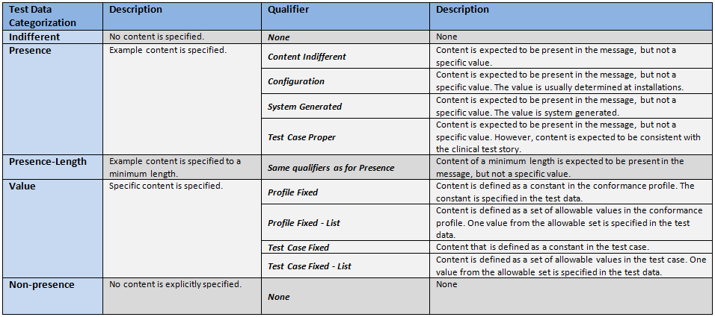
Test Data Categorization and Validation (cont’d)
Qualifiers enable refinement of the Test Data Category, providing additional information to the Tester about the source of the data and the expectations of the data element
The Qualifier does not impact the validation of the data element

Slide 60
Test Category Assessment Table (Examples)
Element | Usage | Test Data | Test Category | Conformity Assessment | Data in Message | Validation Result
PID-5.3 (Middle Name)* | RE | Donna | Presence-Content-Indifferent | Required | <Empty> | Fail
PID-5.3 (Middle Name) | RE | Donna | Presence-Content-Indifferent | Required | Donna | Pass
PID-5.3 (Middle Name) | RE | Donna | Presence-Content-Indifferent | Required | Sue | Pass
PID-5.3 (Middle Name) | RE | Donna | Presence-Length-Content-Indifferent | Required Min Length = 5 | Victoria | Pass
PID-5.3 (Middle Name) | RE | Donna | Presence-Length-Content-Indifferent | Required Min Length = 5 | Sue | Fail
PID-5.3 (Middle Name) | RE | Donna | Value-Test Case Fixed | Required Value = Donna | Donna | Pass
PID-5.3 (Middle Name) | RE | Donna | Value-Test Case Fixed | Required Value = Donna | Sue | Fail
MSH-9.2 (Trigger Event) | R | V04 | Value-Profile Fixed | Required Value = V04 | V04 | Pass
* Actual description is “Second and Further Given Names or Initials Thereof”

Slide 61
Coded Element Examples
Example Message Segment:
RXA|0|1|20150624||49281-0560-05^Pentacel^NDC|0.5|mL^mL^UCUM||00^New Record^NIP001|7824^Jackson^Lily^Suzanne^^^^^wcEHR^L^^^PRN|^^^wcEHR||||526434|20150722|SKB^GlaxoSmithKline^MVX|||CP|A
Element | Test Data | Test Category | Conformity Assessment
RXA.5.1 | 49281-0560-05 | Value-Test Case Fixed | Content must be present and exactly “49281-0560-05”
RXA.5.2 | Pentacel | Presence-Test Case Proper | Content must be present and indicate a value equivalent to Pentacel
RXA.5.3 | NDC | Value-Test Case Fixed | Content must be present and exactly “NDC”
Example Message Segment:
RXR|C28161^Intramuscular^NCIT|RT^Right Thigh^HL70163
Element | Test Data | Test Category | Conformity Assessment
RXR-1.1 | C28161 | Presence-Content Indifferent | Content is expected to be present in the message, but not a specific value
RXR-1.2 | Intramuscular | Presence-Test Case Proper | Content must be present and indicate a value equivalent to the code in RXR-1.1
RXR-1.3 | NCIT | Value-Profile Fixed | Content is defined as a constant in the profile. The constant is specified in the test data; value must be present and exactly “NCIT”

