Slide 1

ONC 2015 Health IT Certification
NIST Syndromic Surveillance Test Suite
Robert Snelick
National Institute of Standards and Technology (NIST)
Sheryl Taylor
National Institute of Standards and Technology (NIST)
January 21st, 2016
Contact: robert.snelick@nist.gov

Slide 2
Objectives
Training on the new NIST Syndromic Surveillance Test Suite to support ONC 2015 Health IT Certification
Test Criterion
Test Cases
Documentation
Notes:
Limited: by the (availability/testability/in-scope for this) of functional requirements; time/resources

Slide 3
http://hl7v2-ss-r2-testing.nist.gov
Syndromic Surveillance Validation Tool Overview
Purpose: The tool validates Syndromic Surveillance (SS) messages created by Health IT Modules, and Context-based Testing is intended for ONC 2015 Edition certification.
Tool Key Capabilities
Context-free Testing | (No Test Scenario - Test any Syndromic Surveillance message created by EHR) Context is unknown to validation tool Provides a simple and convenient method for testing message structure and most vocabulary
Context-based Testing | (Test Scenarios - Test Syndromic Surveillance message associated with a specific test scenario) Context is known to validation tool All conformance requirements of the SS Implementation Guide can be assessed Used for certifying ONC 2015 Edition Health IT Modules
Profile Viewer | Provides a browsable version of the conformance profile which encapsulates the requirements. Can be used to assist in the interpretation of errors.
Value Set Browser | Provides a browsable view of the vocabulary requirements. Can be used to assist in the interpretation of value set errors.
Documentation | Provides access to documents that will assist in using the tool (including test procedure, test cases, profile descriptions, vocabulary descriptions and validation tool download).
No registration or log-in credentials are needed. Simply click on the link below and send/paste/load message into tool to obtain a Validation report.
NOTE: The Test Tool (.war file) can also be downloaded and installed locally.
NOTE: Web Application is compatible with Firefox, Chrome, and Safari.
Register to Google Group at: https://groups.google.com/d/forum/hl7v2-syndromic-testing to ask questions and provide feedback.

Slide 4
ONC 2015 Syndromic Surveillance
No mention of Ambulatory VS Inpatient
Certification Criteria
§170.315(f)(2) Transmission to public health agencies—syndromic surveillance. Create syndrome-based public health surveillance information for electronic transmission in accordance with the standard (and applicable implementation specifications) specified in § 170.205(d)(4).
Referenced Standards
§170.205 Content exchange and implementation specifications for exchanging electronic health information
(d) Electronic submission to public health agencies for surveillance or reporting
(4) Standard. HL7 2.5.1 Implementation specifications. PHIN Messaging Guide for Syndromic Surveillance: Emergency Department, Urgent, Ambulatory Care, and Inpatient Settings, Release 2.0, April 21, 2015, and Erratum to the CDC PHIN 2.0 Implementation Guide, August 20, 2015

Slide 5
Messaging Standard – Supported Message Types
HL7 2.5.1 PHIN Guide Release 2.0
HL7 2.5.1 PHIN Guide Erratum for Release 2.0
Three care settings supported
Urgent Care
Emergency Care
Inpatient Care
Four ADT Message Types supported
ADT^A04 – Registration
ADT^A08 – Update
ADT^A03 – Discharge
ADT^A01 – Admit

Slide 6
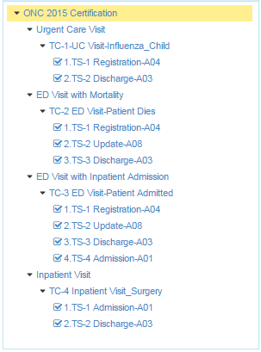
Test Plans and Associated Test Cases and Test Steps
ONC 2015 Certification Test Plan
Designed for ONC 2015 Edition certification testing
Consists of four Test Scenarios
One Test Case per Scenario (for now)
Provide 2 – 4 Test Steps containing the test data
Include the four ADT Message Types defined in the PHIN Guide Release 2.0

Slide 7
Test Cases and Associated Test Steps
Each Test Case includes a Test Story, Test Data Specification, Message Content Data Sheet, and Example Message for each of its Test Steps
For certification testing of Health IT Modules, the Tester shall select and use each of the Test Steps in the Test Cases
Test Cases | Test Steps
 | ADT^A04 Message | ADT^A03 Message | ADT^A08 Message | ADT^A01 Message
SS-UC-1_UC_Visit_Influenza_Child | SS-UC-1.1_Registration_A04 | SS-UC-1.2_Discharge_A03
SS-ED-2_ED_Visit_Patient_Dies | SS-ED-2.1_Registration_A04 | SS-ED-2.3_Discharge_A03 | SS-ED-2.2_Update_A08
SS-ED-3_ED_ Visit_Patient_Admitted | SS-ED-3.1_Registration_A04 | SS-ED-3.3_Discharge_A03 | SS-ED-3.2_Update_A08 | SS-ED-3.4_Admission_A01
SS-IP-4_Inpatient_Visit_Surgery |  | SS-IP-4.2_Discharge_A03 |  | SS-IP-4.1_Admission_A01

Slide 8
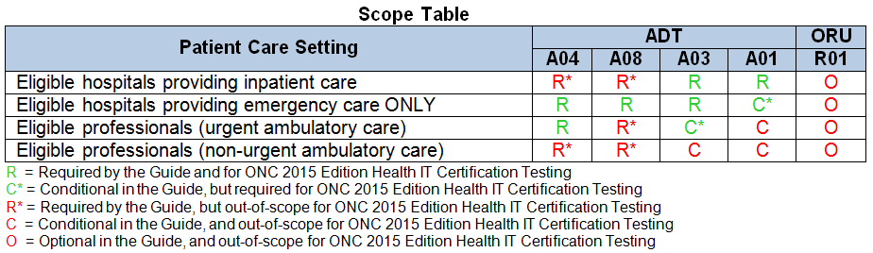
ADT Message Types Required by Care Setting
The ONC 2015 Edition Final Rule scope
Inpatient care, emergency care, and urgent care settings in the PHIN Messaging Guide
The PHIN Messaging Guide scope
Required (R) and Conditional (C) ADT Message Types for each patient care setting
ONC certification testing scope (shown in Scope Table below)
Patient care settings and Message Types: in-scope and out-of-scope

Slide 9
Syndromic Test Scenario Matrix
New
Description | UC Visit | ED Visit - Mortality | ED Visit - Admit | Inpatient Visit
ADT A04 – Registration | √ | √ | √
ADT A03 – Discharge | √ | √ | √ | √
ADT A08 – Update |  | √ | √
ADT A01 – Admit |  |  | √ | √
Facility ID is from the treating facility | Different Treating & Sending ID | √ | √ | √
Visit Date/Time, Unique Visit ID, and Unique Patient ID are consistent among messages for a single visit | √ | √ | √ | √
Patient Age is sent in: | months | years | years | years
Free-text Chief Complaint only | √ | √ | √ | √
A coded Admit/Encounter Reason is sent | Free-text | √ | √ | √
ICD-9-CM Diagnosis codes sent | √
ICD-10-CM Diagnosis codes sent |  | √ |  | √
SNOMED CT Diagnosis codes sent |  |  | √
Discharge Disposition of death is sent |  | √
Patient Address City, State, Country are sent | √ | √ | √ | √
New
New
New
New
New
New
New
New

Slide 10
Syndromic Test Scenario Matrix (cont’d)
New
Description | UC Visit | ED Visit - Mortality | ED Visit - Admit | Inpatient Visit
Coded Patient Class is sent | √ | √ | √ | √
Hospital Unit / Patient Location |  |  |  | √
Height | √ | √ | √ | √
Weight | √ | √ | √ | √
Smoking Status | √ | √ | √ | √
New
New
New
New
New

Slide 11
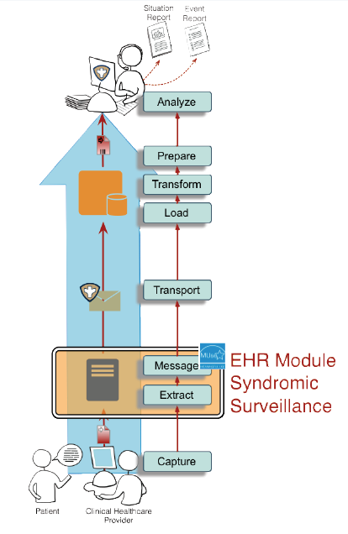
Syndromic Surveillance Certification Criteria and Testing 2015
For certification, message creation function must conform to standards
Capability Testing
2015 Certification: (NIST Test Tool Target)
Healthcare IT Modules
HL7 2.5.1 format
PHIN Guide for Syndromic Surveillance – Release 2.0
PHIN Erratum to Release 2.0
PHIN Testing Clarification Document
Normative Test Process
Scenario-based
Urgent Care Visit
ED Visit – Patient Mortality
ED Visit – Patient Admitted
Inpatient Visit – Surgery
Message focused (A01, A03, A04, A08)
Healthcare IT Module Syndromic Surveillance

Slide 12
Syndromic Surveillance to Public Health Testing Process
PHIN Messaging Guide Release 2.0 and Erratum
Syndromic Surveillance Record Source
HIT Module (System under Test)
Message Imported
NIST Validation Tool (acting as PHA System)
ADT* Message
ADT* Message
ADT* Elements
ONC Certification Testing Scope
Direct Data Entry
ADT* Message Elements
*A01, A03, A04, and A08 Message Types
The HIT Module is the system being tested. The HIT Module is required to create messages that conform to the referenced standards (see previous slides).
Test data can be entered into HIT Module directly via the Module’s user interface, or can be loaded via an incoming message or using some other automated method.
The HIT Module is expected to process the test data to create a message. This message is captured and uploaded into the testing tool for validation.
Test data are available through the Test Tool via the Test Steps in the Test Scenarios. Each Test Step includes a Test Story that provides the context, a Test Data Specification that lists the test data, and a Message Content Data Sheet that shows a conformant message (in a table format).

Slide 13
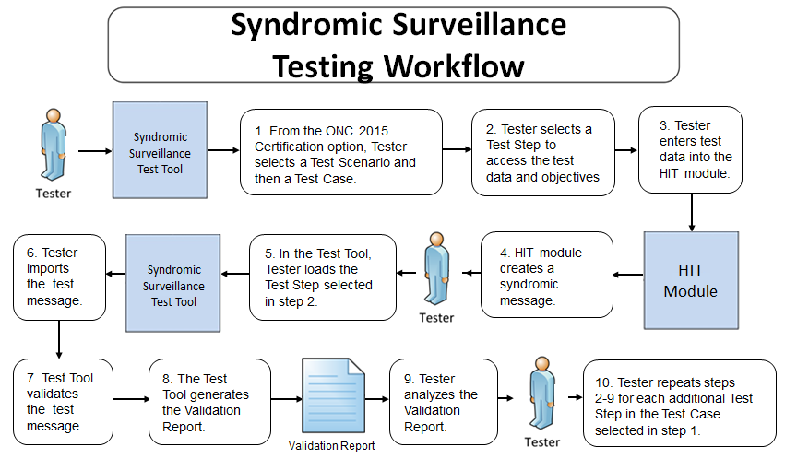
Testing Workflow Diagram
This diagram shows
How the major steps of the Context-based test are sequenced
When the Test Tool is to be used

Slide 14
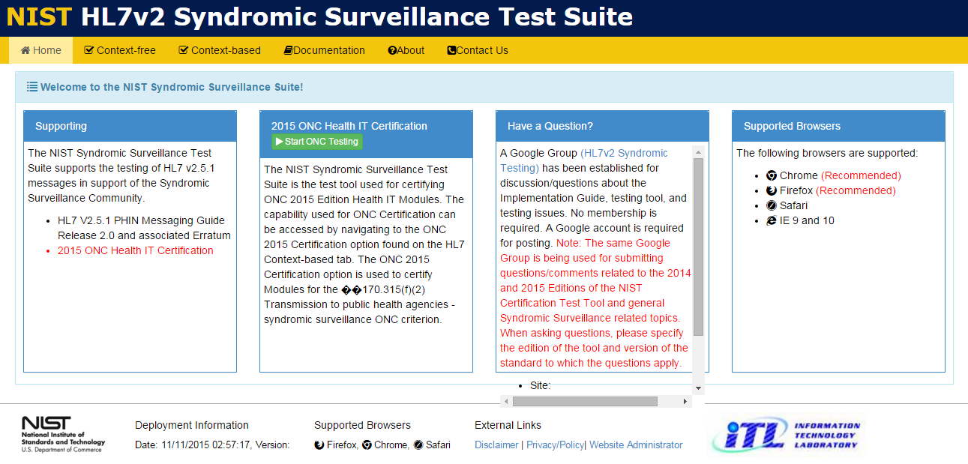
Tool Access and Navigation
Objectives | Informative Reference
Establish access to the NIST Syndromic Surveillance Test tool (web application). Locate the Navigation Bar. Locate the SS Home page. Locate the Test Suite. | The NIST SS Test Tool is accessible through the following URL: http://hl7v2-ss-r2-testing.nist.gov. This displays the NIST Syndromic Surveillance Test Suite’s Welcome Screen, which is indicated by the ‘Home’ tab. The ‘Documentation’ tab contains relevant downloadable User, Documentation, Resources/Artifacts, and Notations.
2
Open Syndromic Surveillance Validation tool using link: http://hl7v2-ss-r2-testing.nist.gov.
2
The tool’s Navigation Bar is located along the top. The options are ‘Home’, ‘Context free’, ‘Context-based’, ‘Documentation’, ‘About’ and ‘Contact Us’..
The Welcome Screen is located under the ‘Home’ tab.
The Welcome Screen provides information about Supporting the Syndromic Surveillance community, information about 2015 ONC Health IT Certification, questions on the tool and supported browsers.,

Slide 15
Scenarios Overview

Slide 16
Syndromic Surveillance Scenarios
Test the Healthcare IT Module’s capability to create syndromic surveillance messages based on PHIN Guide / Associated Erratum and specific Test Data
Differ slightly from each other to show real-world and logical clinical situations while collectively covering the specified requirements in the ONC criterion and PHIN Guide documents

Slide 17
Urgent Care Visit Scenario Overview
Urgent Care Visit Test Case – Influenza_Child
Patient is seen in Urgent Care Center and is discharged/dispositioned to home.
Test Case consists of 2 test steps: (1) Create ADT-A04 Registration Message (2) Create ADT-A03 Discharge Message
Provides an example of a clinical encounter that could take place in either an urgent care or emergency clinical setting and an example where the facility sending the syndromic surveillance message is different from the facility where the patient received care. Encounter Reason is captured as free-text. Multiple diagnoses are captured using ICD-9-CM.
Create ADT-A04 Message | An infant is seen at an urgent care center for fever, cough, and earache. Diagnostic tests show that he has influenza and stenosis of the external ear canal.
(2) Create ADT-A03 Message | He is discharged to home with treatment instructions and a prescription. Syndromic surveillance data about the visit are transmitted to the local health department.

Slide 18
Emergency Care Visit - Mortality Scenario Overview
ED Care Visit Test Case – Patient Dies
Patient is seen in ED and dies.
Test Case consists of 3 test steps: (1) Create ADT-A04 Registration Message (2) Create ADT-A08 Update Message (2) Create ADT-A03 Discharge Message
Provides an example of an ED visit where the patient's demographic information is unavailable at registration, admit/encounter reason, working diagnosis, and final diagnosis are captured as coded values using ICD-10 CM, and the patient dies.
Create ADT-A04 Message | The patient is unconscious and their demographic information is unavailable at registration; admit/encounter reason is captured as a coded value, two working diagnoses are captured.
Create ADT-A08 Message | Scan of the head reveals a skull fracture and intracranial bleeding. The patient's driver's license is found and the demographic data are updated.
(3) Create ADT-A03 Message | A final diagnosis is captured, and the patient dies.

Slide 19
Emergency Care Visit - Admission Scenario Overview
ED Care Visit Test Case – Patient Admitted
Patient is seen in ED and admitted to hospital.
Test Case consists of 4 test steps: Create ADT-A04 Registration Message Create ADT-A08 Update Message (3) Create ADT-A03 Discharge Message (4) Create ADT-A01 Admission Message
Provides an example of an ED care visit for a patient with diagnosis coded in SNOMED CT and who is admitted to hospital.
Create ADT-A04 Message | The patient's chief complaint is captured as free-text, working diagnosis is captured with SNOMED CT codes.
Create ADT-A08 Message | Lab results indicate severe metabolic acidosis and carbon monoxide poisoning. Hyperbaric oxygen therapy (HBOT), overnight observation, and a full neurological assessment are ordered. Patient's record is updated with a working diagnosis coded with SNOMED CT.
(3) Create ADT-A03 Message | The patient is ordered to be discharged from the ED for admission to inpatient care.
(4) Create ADT-A01 Message | The patient is prepared for admission to the hospital, and the Admit/Encounter Reason is captured with a SNOMED CT code.

Slide 20
Inpatient Visit - Scenario Overview
Inpatient Visit Test Case – Inpatient Visit-Surgery
Patient is admitted and discharged from hospital.
Test Case consists of 2 test steps: (1) Create ADT-A01 Admission Message (2) Create ADT-A03 Discharge Message
Provides an example of an inpatient surgical visit for which the Admit Reason, working diagnosis, and final diagnosis are captured as coded values using ICD-10-CM. Syndromic surveillance data are sent to a state public health agency once following admission and once following discharge in accordance with recommended ISDS guidelines.
Create ADT-A01 Message | A 51-year old male arrives at the hospital for a pre-scheduled surgical removal of a coronary artery obstruction and insertion of stents. The patient has a history of chest pain; the reason for visit is atherosclerotic heart disease of native coronary artery with unstable angina pectoris. The patient has the procedure and afterward is transported to a cardiac unit for overnight observation.
(2) Create ADT-A03 Message | The patient is seen the next day and reports he is not having chest pain, though he is diagnosed with cardiac arrhythmia. He is cleared for discharge to home.

Slide 21
Documentation

Slide 22
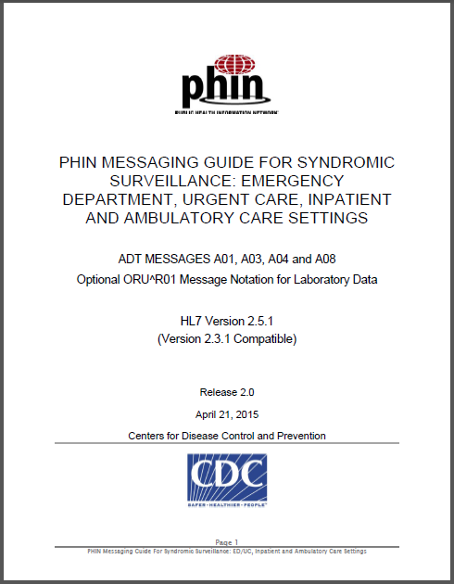
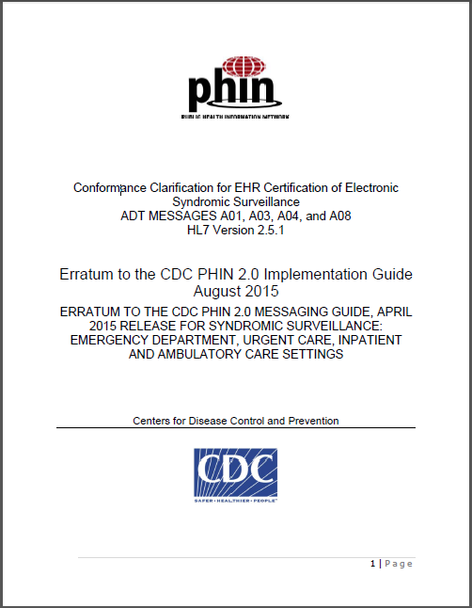
Referenced Content Exchange Standards Documents
PHIN Messaging Guide for Syndromic Surveillance: Emergency Department, Urgent, Ambulatory Care, and Inpatient Settings, Release 2.0, April 21, 2015
Erratum to the CDC PHIN 2.0 Implementation Guide August 2015
http://www.cdc.gov/nssp/documents/guides/syndrsurvmessagguide2_messagingguide_phn.pdf
http://www.cdc.gov/nssp/documents/guides/erratum-to-the-cdc-phin-2.0-implementation-guide-august-2015.pdf
CDC site with links to SS Messaging Guides http://www.cdc.gov/nssp/mmg/index.html

Slide 23
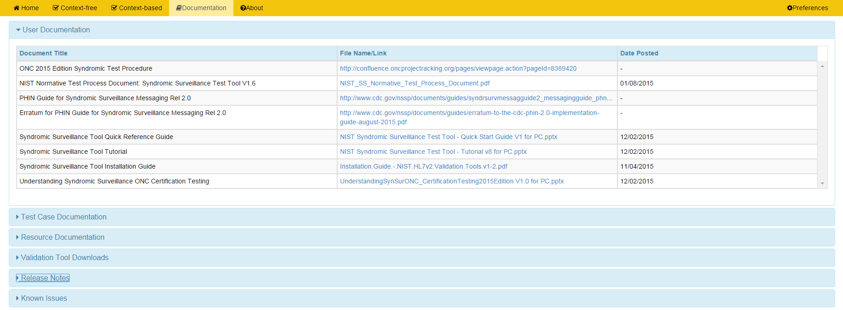
Documentation

Slide 24


