Slide 1
2015 ONC Certification Testing Approach Overview: Using the HL7 V2 Syndromic Surveillance Test Tool for Testing a Health IT Module
§170.315(f)(2) Transmission to public health agencies – syndromic surveillance
Testing Process Supplement
Robert Snelick, NIST (rsnelick@nist.gov)
July 19, 2016

Slide 2
Purpose
Provide an additional resource to explain the process of certification testing of a Health IT Module related to HL7 v2 Syndromic Surveillance Messaging
Describe the National Institute of Standards and Technology (NIST) approach for assessing and validating the test messages created by Health IT Modules
Provide an overview of the testing requirements

Slide 3
Table of Contents
List of Resources
ONC Syndromic Surveillance Criterion
Referenced Standards
Test Tool Overview
Scope of NIST Syndromic Surveillance Testing
Testing Process and Testing Workflow Diagrams
Explanation of Test Cases and Test Steps
Example Test Case Documents
Explanation of Test Data Categorization/Validation
Test Tool Overview and Example Test Tool Screen
Additional Resources

Slide 4
Resources
ONC Test Procedure (https://www.healthit.gov/policy-researchers-implementers/2015-edition-test-method )
Test Tool Web Site (http://hl7v2-ss-r2-testing.nist.gov/ )
Validation Tools
User Documentation
PHIN Messaging Guide for Syndromic Surveillance, Release 2.0 (http://www.cdc.gov/nssp/documents/guides/syndrsurvmessagguide2_messagingguide_phn.pdf )
Erratum to PHIN Messaging Guide for Syndromic Surveillance
(http://www.cdc.gov/nssp/documents/guides/erratum-to-the-cdc-phin-2.0-implementation-guide-august-2015.pdf )
On Test Tool Documentation Tab
NIST Syndromic Surveillance Testing Process
Syndromic Surveillance Tool Quick Reference Guide
Syndromic Surveillance Tool Tutorial
Release Notes for each version of Test Tool
Known Issues
Syndromic Surveillance Test Tool Google Group for submitting questions to the Test Tool developers
Same url is used for Editions 2014 and 2015 Syndromic Test Tools
(https://groups.google.com/d/forum/hl7v2-syndromic-testing)

Slide 5
ONC Final Rule Criterion – Syndromic Surveillance
§170.315(f)(2) Transmission to public health agencies – syndromic surveillance
Evaluates the capability for a Health IT Module to electronically create syndromic surveillance information for electronic transmission to public health agencies using the PHIN Messaging Guide and associated Erratum
Note: The ONC criterion does not specify use of a transport standard; therefore, testing for this criterion does not require Health IT Modules to be certified to any transport standard

Slide 6
Referenced Standards – Syndromic Surveillance
§170.205 Content exchange and implementation specifications for exchanging electronic health information
(d) Electronic submission to public health agencies for surveillance or reporting
(4) Standard. HL7 2.5.1 Implementation specifications. PHIN Messaging Guide for Syndromic Surveillance: Emergency Department, Urgent, Ambulatory Care, and Inpatient Settings, Release 2.0, April 21, 2015, and Erratum to the CDC PHIN 2.0 Implementation Guide, August 20, 2015

Slide 7
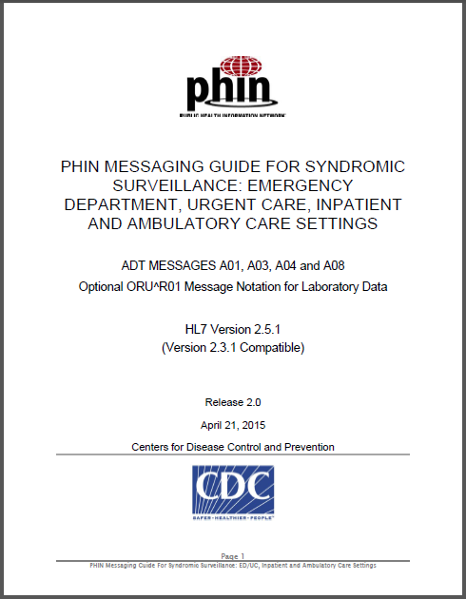
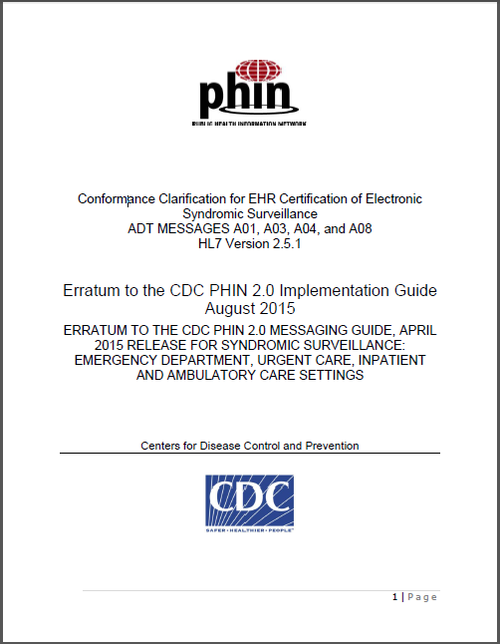
Referenced Content Exchange Standards Documents
PHIN Messaging Guide for Syndromic Surveillance: Emergency Department, Urgent, Ambulatory Care, and Inpatient Settings, Release 2.0, April 21, 2015
Erratum to the CDC PHIN 2.0 Implementation Guide August 2015
http://www.cdc.gov/nssp/documents/guides/syndrsurvmessagguide2_messagingguide_phn.pdf
http://www.cdc.gov/nssp/documents/guides/erratum-to-the-cdc-phin-2.0-implementation-guide-august-2015.pdf
CDC site with links to SS Messaging Guides http://www.cdc.gov/nssp/mmg/index.html

Slide 8
http://hl7v2-ss-r2-testing.nist.gov/
Syndromic Surveillance Validation Tool Overview
Purpose: The tool validates Syndromic Surveillance (SS) messages created by Health IT Modules, and Context-based Testing is intended for ONC 2015 Edition certification.
Tool Key Capabilities
Context-free Testing | (No Test Scenario - Test any Syndromic Surveillance message created by EHR) Context is unknown to validation tool Provides a simple and convenient method for testing message structure and most vocabulary
Context-based Testing | (Test Scenarios - Test Syndromic Surveillance message associated with a specific test scenario) Context is known to validation tool All conformance requirements of the SS Implementation Guide can be assessed Used for certifying ONC 2015 Edition Health IT Modules
Profile Viewer | Provides a browsable version of the conformance profile which encapsulates the requirements. Can be used to assist in the interpretation of errors.
Value Set Browser | Provides a browsable view of the vocabulary requirements. Can be used to assist in the interpretation of value set errors.
Documentation | Provides access to documents that will assist in using the tool (including test procedure, test cases, profile descriptions, vocabulary descriptions and validation tool download).
No registration or log-in credentials are needed. Simply click on the link below and send/paste/load message into tool to obtain a Validation report.
NOTE: The Test Tool (.war file) can also be downloaded and installed locally.
NOTE: Web Application is compatible with Firefox, Chrome, and Safari.
Register to Google Group at: https://groups.google.com/d/forum/hl7v2-syndromic-testing to ask questions and provide feedback.

Slide 9
Scope of ONC Final Rule Criteria and Testing
Per the ONC Edition 2015 Final Rule, capabilities of each Health IT Module are tested rather than specific installed instances of a Health IT Module
The ONC certification criterion specifies testing the capability of a Health IT Module to electronically create syndromic surveillance messages for electronic transmission
Transmission of the messages is not being tested
Receiving systems, such as public health registries, are not being certified; however, the receiving system should be capable of processing the data specified in the ONC criterion
Testing focus and scope are narrow
Testing encompasses only the specific use case indicated in the Final Rule
Testing does not attempt to address the entire spectrum of use cases found in practice or specified in implementation guides
Health IT Module certification testing is driven by the test data
The NIST test tool assesses the capability of a Health IT Module to use specific data to create syndromic surveillance messages for transmission to public health agencies
The Test Scenarios provided do not cover the full range of use cases specified in the PHIN Messaging Guide; through consultation with CDC syndromic surveillance experts, a set of scenarios were selected to be used for testing
The testing will not demonstrate complete conformance to the implementation guide as it is not practical for ONC certification testing to be exhaustive
The Centers for Disease Control and Prevention (CDC), in collaboration with NIST, developed the test scenarios and test data for the syndromic surveillance testing process

Slide 10
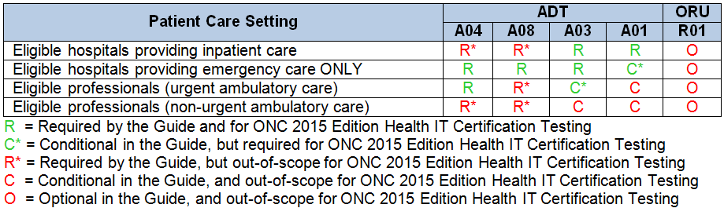
ADT Message Types Required by Care Setting
The ONC 2015 Edition Final Rule specifies that only the requirements for inpatient care, emergency care, and urgent care settings in the PHIN Messaging Guide are in-scope for ONC certification testing of Health IT Modules
The PHIN Messaging Guide specifies Required (R) and Conditional (C) ADT Message Types for each patient care setting
The table below shows which patient care settings and Message Types are in-scope and out-of-scope for the ONC certification testing

Slide 11
Out-of-Scope for ONC Final Rule Criteria and Testing
The focus of the testing is not on the workflow that may be used for transmitting syndromic surveillance messages in the production setting, but is on the ability of the HIT Module to create conformant versions of these messages
Batch requirements are not included in the testing
If an HIT Module creates syndromic surveillance messages in batch, the Tester must import each message individually into the NIST Test Tool for validation
The NIST Test Tool may support batch processing in the future
Ambulatory HIT Module-specific testing is not included in the testing; ONC did not adopt certification requirements for the ambulatory setting due to lack of mature standards and the lack of widespread acceptance of ambulatory syndromic surveillance data across public health jurisdictions

Slide 12
Out-of-Scope for ONC Final Rule Criteria and Testing (cont’d)
The NIST Test Tool does not support validation of optional message types
The PHIN Syndromic Surveillance Messaging Guide specifies that HL7 Unsolicited Observation (ORU^R01) Messages that may be sent for submission of laboratory results relevant to syndromic surveillance are O (Optional)
ORU^R01 Messages are out-of-scope for the testing
Though HIT Modules should be able to receive acknowledgement (ACK) messages transmitted by public health agency (PHA) systems, testing of the Modules for this capability has been deemed by NIST to be out-of-scope for the 2015 Edition certification testing

Slide 13
Derived Conformance Statements / Requirements
The NIST HL7 v2 Syndromic Surveillance Test Tool performs certain conformance testing that is not directly related to any conformance statement in the PHIN Messaging Guide
These “derived statements” are based on requirements from the HL7 v2.5.1 Base Standard, as well as statements that NIST has determined should be included in the validation (e.g., evaluating the format of a code for conformance to the Code System’s format, or testing for conformance to a specific Time Stamp format)

Slide 14
Syndromic Surveillance to Public Health Testing Process
PHIN Messaging Guide Release 2.0 and Erratum
Syndromic Surveillance Record Source
HIT Module (System under Test)
Message Imported
NIST Validation Tool (acting as PHA System)
ADT* Message
ADT* Message
ADT* Elements
ONC Certification Testing Scope
Direct Data Entry
ADT* Message Elements
*A01, A03, A04, and A08 Message Types
The HIT Module is the system being tested. The HIT Module is required to create messages that conform to the referenced standards (see previous slides).
Test data can be entered into HIT Module directly via the Module’s user interface, or can be loaded via an incoming message or using some other automated method.
The HIT Module is expected to process the test data to create a message. This message is captured and uploaded into the testing tool for validation.
Test data are available through the Test Tool via the Test Steps in the Test Scenarios. Each Test Step includes a Test Story that provides the context, a Test Data Specification that lists the test data, and a Message Content Data Sheet that shows a conformant message (in a table format).

Slide 15
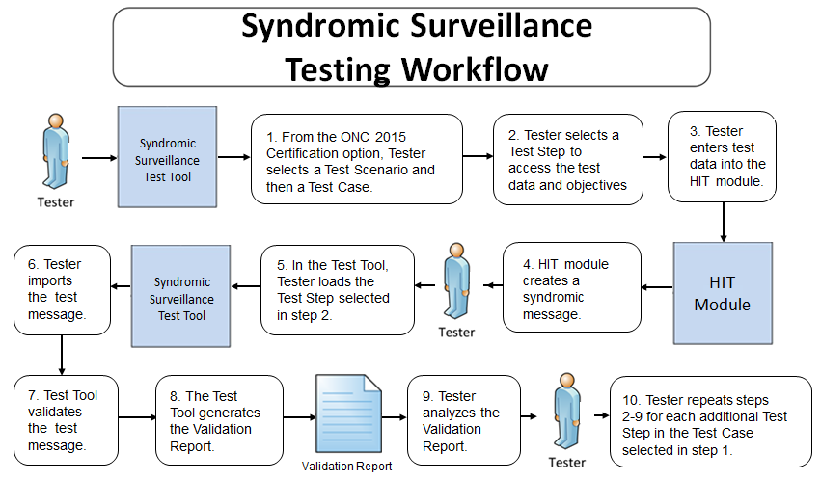
Testing Workflow Diagram
This diagram shows
How the major steps of the Context-based test are sequenced
When the Test Tool is to be used

Slide 16
Test Scenarios and Test Cases/Steps
Test data are available in the Syndromic Surveillance Test Tool via the Test Scenarios provided in the ONC 2015 Certification test plan
The test data are used for testing Health IT Modules that are designed for deployment in inpatient care, emergency care, and urgent care settings
The Tool provides four Test Scenarios
The Test Scenarios are composed of one Test Case with two to four Test Steps
Each Test Step includes a Test Story, Test Data Specification, Message Content Data Sheet, and Test Message
The PHIN Messaging Guide, Release 2.0, defines four ADT Message Types that are relevant for certification testing of Health IT Modules:
ADT^A01 Admit / Visit Notification
ADT^A03 Discharge / End Visit
ADT^A04 Register a Patient
ADT^A08 Update Patient Information (snapshot mode)*
*A08 update messages are sent at the time the new or changed information becomes available, whether before or after discharge. The information they contain is cumulative (i.e., snapshot mode), presenting all previously sent information that remains correct and adding the new or changed information.

Slide 17
Test Cases and Associated Test Steps
For certification testing, the health IT developer identifies which of the health care setting(s) (Emergency Department, Inpatient, Urgent Care) are applicable to their Health IT Module
The Module creates syndromic surveillance messages using the test data for each of the Test Steps for the identified health care setting(s)
In order to be conformant to the PHIN Messaging Guide and associated Erratum, HIT developers must demonstrate for certification testing that their Module supports ICD-9CM, ICD-10CM, and SNOMED CT value sets for PV2-3 (Admit/Encounter Reason) and DG1-3 (Diagnosis Code)
Codes for only one of the three value sets are provided in the test data for each Test Step associated with each health care setting
(see next slide for details)
Verbiage in the Notes for Testers section of the Test Story tab for each Test Step provides detailed instructions to the Tester regarding how to ensure testing includes demonstration of support for ICD-9CM, ICD-10CM, and SNOMED CT value sets for PV2-3 and DG1-3 when an HIT developer indicates their Module does not support all of the health care settings

Slide 18
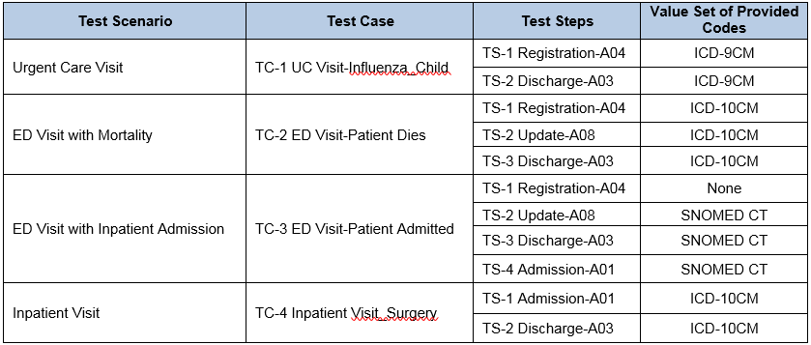
Test Cases and Associated Test Steps (cont’d)
The four Test Scenarios, their associated Test Cases/Steps, and the codes that are provided in the test data are shown in the table below

Slide 19
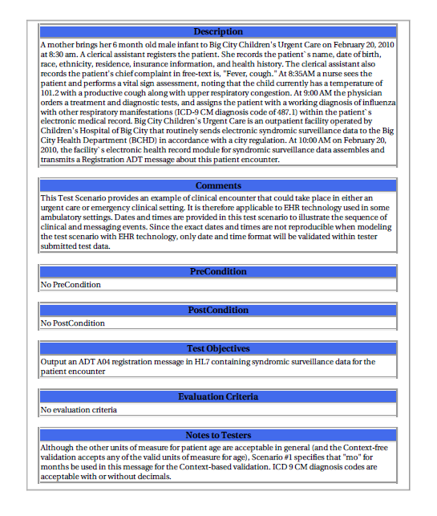
Test Data Documents for the Test Cases
Each Test Case includes a narrative Test Story that describes a real world situation and provides context for each Test Step
Example Test Data document: Test Case
UC Visit-Influenza_Child – TS-1 Registration-A04 Step 1

Slide 20
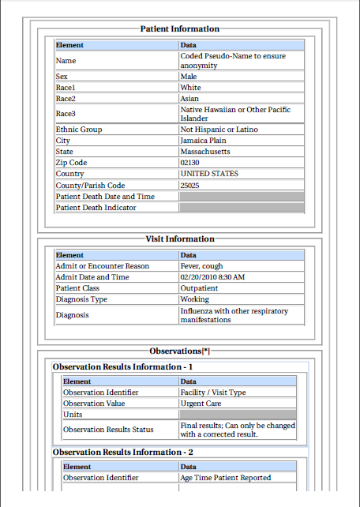
Test Data Documents for the Test Cases (cont’d)
Each Test Case includes a Test Data Specification for each Test Step
Lists data associated with the Test Story
Consists of typical information found in the clinical setting
Along with the Test Story, provides sufficient information to be entered into the HIT Module for the Test Step
A test message is generated using these data and the HIT Module functions
Example Test Data document: Test Case
UC Visit-Influenza_Child – TS-1 Registration-A04 Step 1
20
Notes:
20

Slide 21
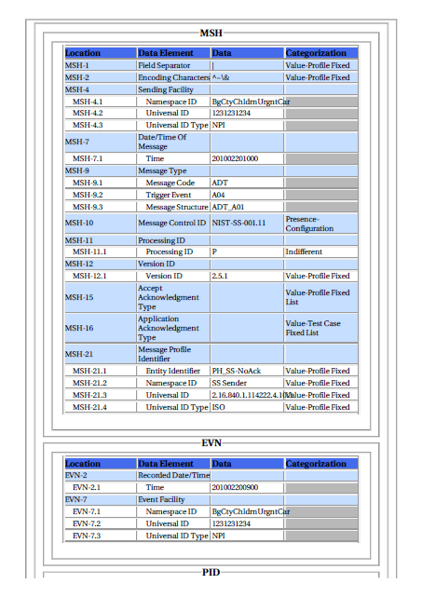
Test Data Documents for the Test Cases (cont’d)
Each Test Case includes a Message Content Data Sheet that shows a conformant message instance for each Test Step
The Category of the test data is listed in the Categorization column for each Data Element Location
Example Test Data document: Test Case
UC Visit-Influenza_Child – TS-1 Registration-A04 Step 1
21
Notes:
21

Slide 22
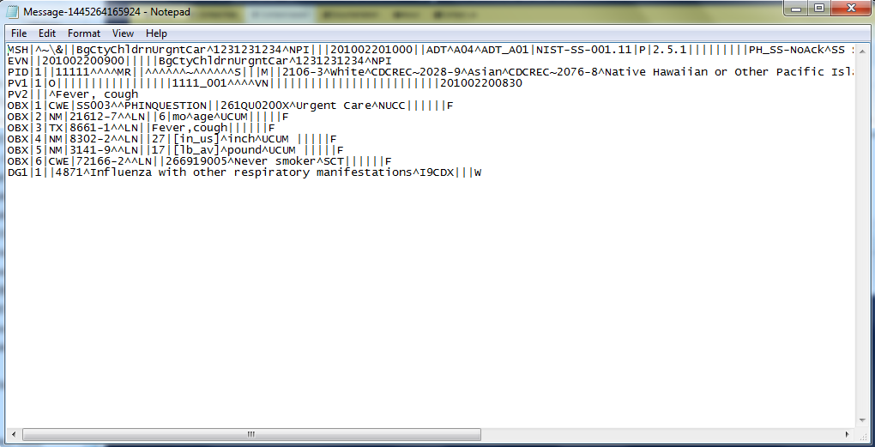
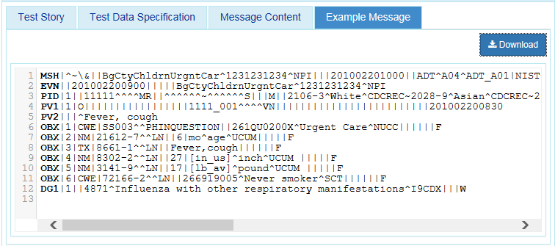
Test Data Documents for the Test Cases (cont’d)
Each Test Case includes an Example Message instance for each Test Step
These example messages demonstrate use and interpretation of the standards
Example Test Data document: Test Case
UC Visit-Influenza_Child – TS-1 Registration-A04 Step 1
22
Notes:
22

Slide 23
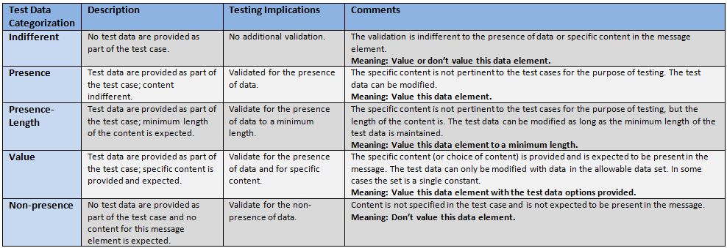
Test Data Categorization and Validation
The Message Content Data Sheet shows the Categorization of the test data that are provided for each Location
Each Test Data Category
Defines the criteria that are used by the test tool to assess the test data that populate each field in a message
Tells the Tester if the test data in a specific field can be changed, the source of the test data, and to what level of precision the validation tool will assess the data

Slide 24
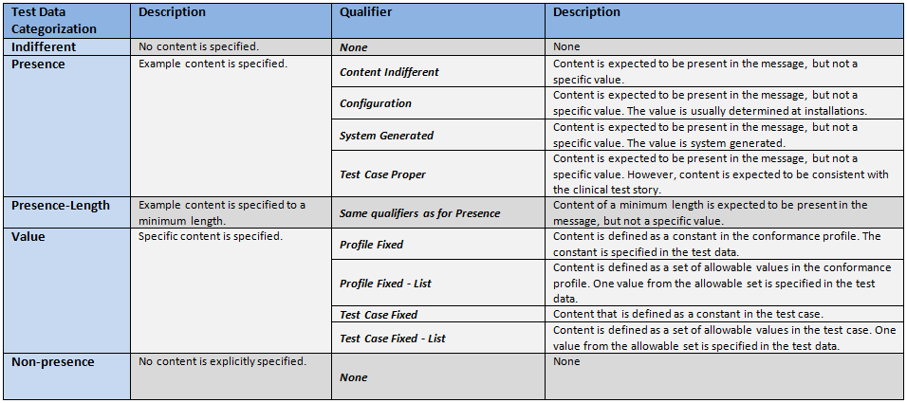
Test Data Categorization and Validation (cont’d)
Qualifiers enable refinement of the Test Data Category, providing additional information to the Tester about the source of the data and the expectations of the data element
The Qualifier does not impact the validation of the data element

Slide 25
Test Category Assessment Table (Examples)
Element | Usage | Test Data | Test Category | Conformity Assessment | Data in Message | Validation Result
PID-5.3 (Middle Name)* | RE | Donna | Presence-Content-Indifferent | Required | <Empty> | Fail
PID-5.3 (Middle Name) | RE | Donna | Presence-Content-Indifferent | Required | Donna | Pass
PID-5.3 (Middle Name) | RE | Donna | Presence-Content-Indifferent | Required | Sue | Pass
PID-5.3 (Middle Name) | RE | Donna | Presence-Length-Content-Indifferent | Required Min Length = 5 | Victoria | Pass
PID-5.3 (Middle Name) | RE | Donna | Presence-Length-Content-Indifferent | Required Min Length = 5 | Sue | Fail
PID-5.3 (Middle Name) | RE | Donna | Value-Test Case Fixed | Required Value = Donna | Donna | Pass
PID-5.3 (Middle Name) | RE | Donna | Value-Test Case Fixed | Required Value = Donna | Sue | Fail
MSH-9.2 (Trigger Event) | R | V04 | Value-Profile Fixed | Required Value = V04 | V04 | Pass
* Actual description is “Second and Further Given Names or Initials Thereof”

Slide 26
Test Data Validation Examples
Example Message Segment:
OBX|2|NM|21612-7^^LN||6|mo^age^UCUM|||||F
Location | Data | Categorization | Assessment
OBX-3.1 | 21612-7 | Value-Test Case Fixed | Content is defined as a constant in the test case, and it must be present and exactly “21612-7”
OBX-3.2 |  | Indifferent-None | No content is specified, content is not expected, but content may be present in the message
OBX-3.3 | LN | Value-Profile Fixed | Content is defined as a constant in the conformance profile, and is specified in the test data; content must be present and exactly “LN”
OBX-5 | 6 | Value-Test Case Fixed | Content is defined as a constant in the test case, and it must be present and exactly “6”
OBX-6.1 | mo | Value-Test Case Fixed | Content is defined as a constant in the test case, and it must be present and exactly “mo”
OBX-6.2 | age | Presence-Test Case Proper | Content is expected to be present in the message, but not a specific value; content is expected to be consistent with the clinical test story
OBX-6.3 | UCUM | Value-Profile Fixed | Content is defined as a constant in the conformance profile, and is specified in the test data; content must be present and exactly “UCUM”

Slide 27
Test Data Validation Examples (cont’d)
Example Message Segment:
DG1|1||4871^Influenza with other respiratory manifestations^I9CDX|||W
Location | Data | Categorization | Assessment
DG1-3.1 | 4871 | Value-Test Case Fixed-List | Content is defined as a set of allowable values in the test case; one value from the allowable set is specified in the test data, and this value or one of the other allowable values must be present in the message (Ex: “487.0”, “4870”, “487.1”, “4871”, “487.8”, or “4878”
OBX-3.2 | Influenza with other respiratory manifestations | Presence-Test Case Proper | Content is expected to be present in the message, but not a specific value; content is expected to be consistent with the clinical test story
OBX-3.3 | I9CDX | Value-Profile Fixed-List | Content is defined as a set of allowable values in the conformance profile; one value from the allowed set is specified in the test data, and this exact value must be present and exactly “I9CDX”

Slide 28
Test Data Validation – Sequencing of Segments
The NIST context-based testing performs specific content validation depending on the Category/Qualifier combination assigned to the Data Elements in the message.
In some cases, in order to perform this type of validation the NIST Tool expects the segments/segment groups in the message to be sequenced in a certain order. The complexity of automatically evaluating specific content necessitates this approach.
If the Message Validation Result generated by the NIST Tool indicates content-related errors, the ATL may change the order of the segments/segment groups in the test message to match the Test Case once the message has been loaded into the Message Content window of the Test Tool.
These kinds of content-related errors do not imply a failure of the vendor product nor a requirement to create the message with the segments/segment groups in a certain order (beyond the base message structure).

Slide 29
http://hl7v2-ss-r2-testing.nist.gov/
Syndromic Surveillance Validation Tool Overview
Purpose: The tool validates Syndromic Surveillance (SS) messages created by Health IT Modules and Context-based Testing is intended for ONC 2015 Edition certification.
Tool Key Capabilities
Context-free Testing | (No Test Scenario - Test any Syndromic Surveillance message created by EHR) Context is unknown to validation tool Provides a simple and convenient method for testing message structure and most vocabulary
Context-based Testing | (Test Scenarios - Test Syndromic Surveillance message associated with a specific test scenario) Context is known to validation tool All conformance requirements of the SS Implementation Guide can be assessed Used for certifying ONC 2015 Edition Health IT Modules
Profile Viewer | Provides a browsable version of the conformance profile which encapsulates the requirements. Can be used to assist in the interpretation of errors.
Value Set Browser | Provides a browsable view of the vocabulary requirements. Can be used to assist in the interpretation of value set errors.
Documentation | Provides access to documents that will assist in using the tool (including test procedure, test cases, profile descriptions, vocabulary descriptions and validation tool download).
No registration or log-in credentials are needed. Simply click on the link below and send/paste/load message into tool to obtain a Validation report.
NOTE: The Test Tool (.war file) can also be downloaded and installed locally.
NOTE: Web Application is compatible with Firefox, Chrome, and Safari.
Register to Google Group at: https://groups.google.com/d/forum/hl7v2-syndromic-testing to ask questions and provide feedback.

Slide 30
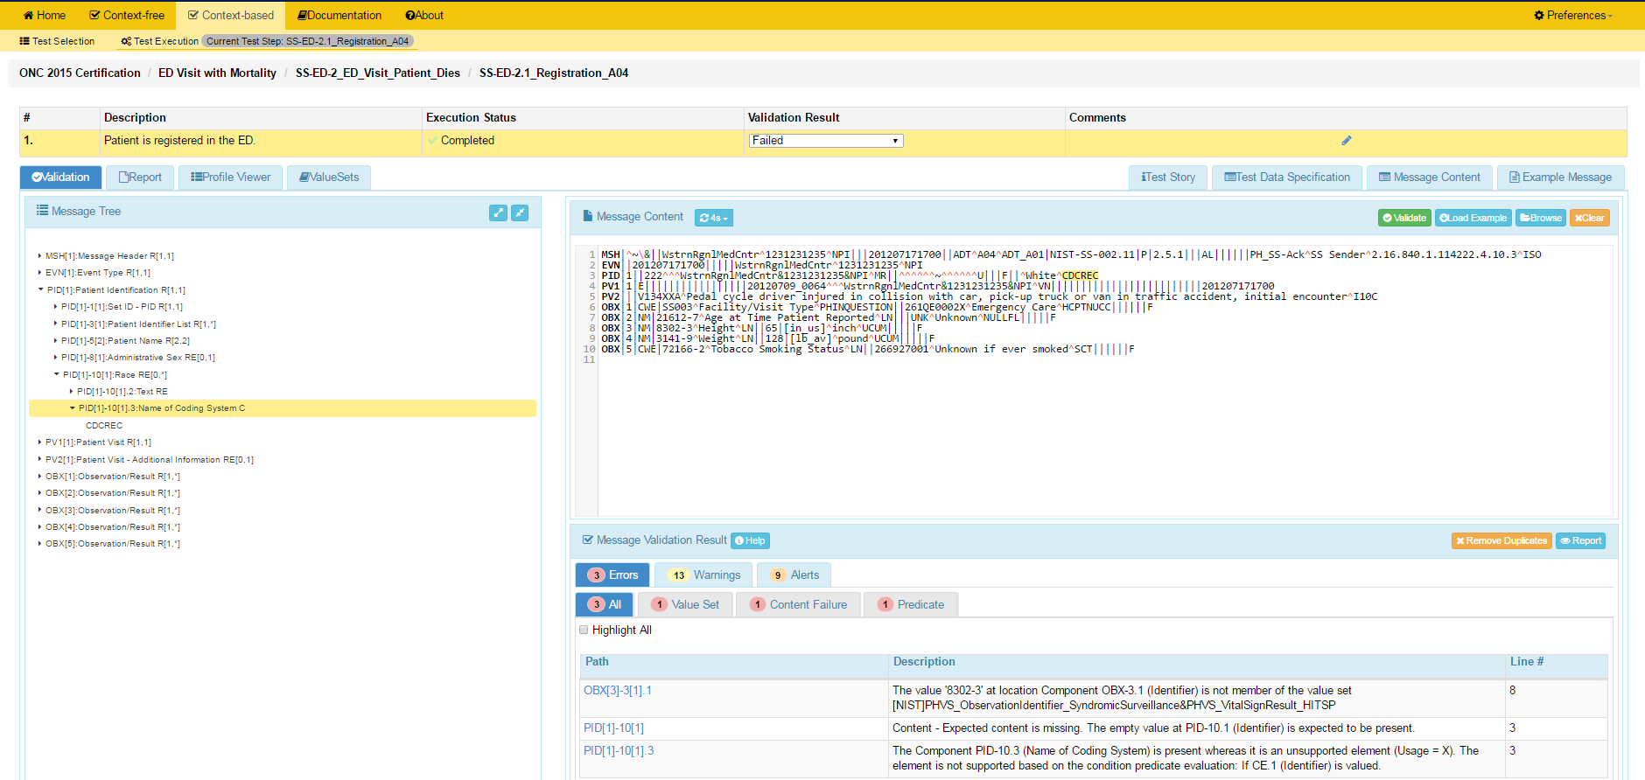
Example Syndromic Surveillance Test Suite Screen
See Syndromic Surveillance Tool Tutorial on Documentation Tab for full guide
1
Context-based Validation
2
Validation Result displays.
3
Test message displays.
4
If message fails validation, errors will display in Message Validation Result section of page.
5
Click on Path link to highlight within the Message Tree
the data element causing the error

Slide 31
Resources
ONC Test Procedure (https://www.healthit.gov/policy-researchers-implementers/2015-edition-test-method )
Test Suite Web Site (http://hl7v2-ss-r2-testing.nist.gov/) provides
Test Tool (API, Web Application, and Desktop)
Test Cases / Test Stories / Message Content Details / Test Data / User Documentation
Example messages
Testing Artifacts
Message Profiles
Value Sets
Contact
Rob Snelick (rsnelick@nist.gov)

