Slide 1

Syndromic Surveillance (SS)
Validation Tool
Quick Start Guide
Robert Snelick
National Institute of Standards and Technology
April 4, 2024
Contact: rsnelick@nist.gov

Slide 2
http://hl7v2-ss-r2-testing.nist.gov/
Syndromic Surveillance Validation Tool Overview
Purpose: The tool validates Syndromic Surveillance (SS) messages created by Health IT Modules, and Context-based Testing is intended for ONC certification.
Tool Key Capabilities
Context-free Testing | (No Test Scenario - Test any Syndromic Surveillance message created by EHR) Context is unknown to validation tool Provides a simple and convenient method for testing message structure and most vocabulary
Context-based Testing | (Test Scenarios - Test Syndromic Surveillance message associated with a specific test scenario) Context is known to validation tool All conformance requirements of the SS Implementation Guide can be assessed Used for certifying ONC Health IT Modules
Profile Viewer | Provides a browsable version of the conformance profile which encapsulates the requirements. Can be used to assist in the interpretation of errors.
Value Set Browser | Provides a browsable view of the vocabulary requirements. Can be used to assist in the interpretation of value set errors.
Documentation | Provides access to documents that will assist in using the tool (including test procedure, test cases, profile descriptions, vocabulary descriptions and validation tool download).
No registration or log-in credentials are needed. Simply click on the link below and send/paste/load message into tool to obtain a Validation report.
NOTE: The Test Tool (.war file) can also be downloaded and installed locally.
NOTE: Web Application is compatible with Firefox, Chrome, Safar, and Edge.
Register to Google Group at: https://groups.google.com/d/forum/hl7v2-syndromic-testing to ask questions and provide feedback.

Slide 3
Syndromic Surveillance Context-free
Test Scenario Walk Through Tool Demonstration

Slide 4
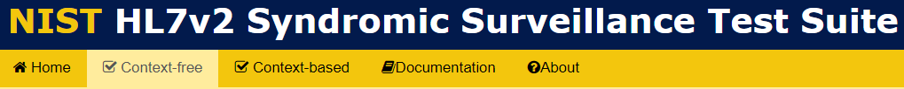
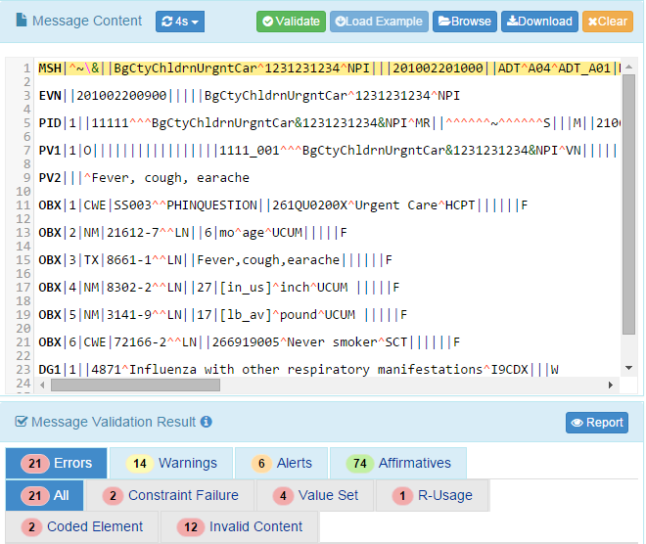
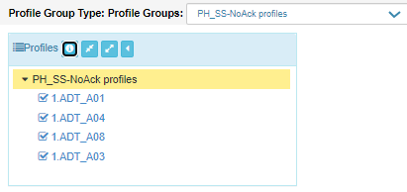
Syndromic Surveillance Context-free Testing
Profile Viewer page
This page allows tester to view data element information including usage, cardinality, data type, length, table, condition predicate and conformance statements.
Context-free Validation page
This page validates any Syndromic Surveillance message created by the HIT Module. Testing will include the technical requirements and content-specific requirements specified in the selected conformance profile.
1
Open Syndromic Surveillance Test Suite using link http://hl7v2-ss-r2-testing.nist.gov/ , and click on Context-free Validation tab.
3
Copy/Paste, or Browse to find and upload, your HL7 test message. Validation Results are displayed in the Message Validation Result window.
2
Select Profile Group and then select the Profile.
4
Errors, Warnings and Alerts, etc., will be displayed. Click the Report tab to display the Message Validation Report

Slide 5
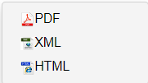
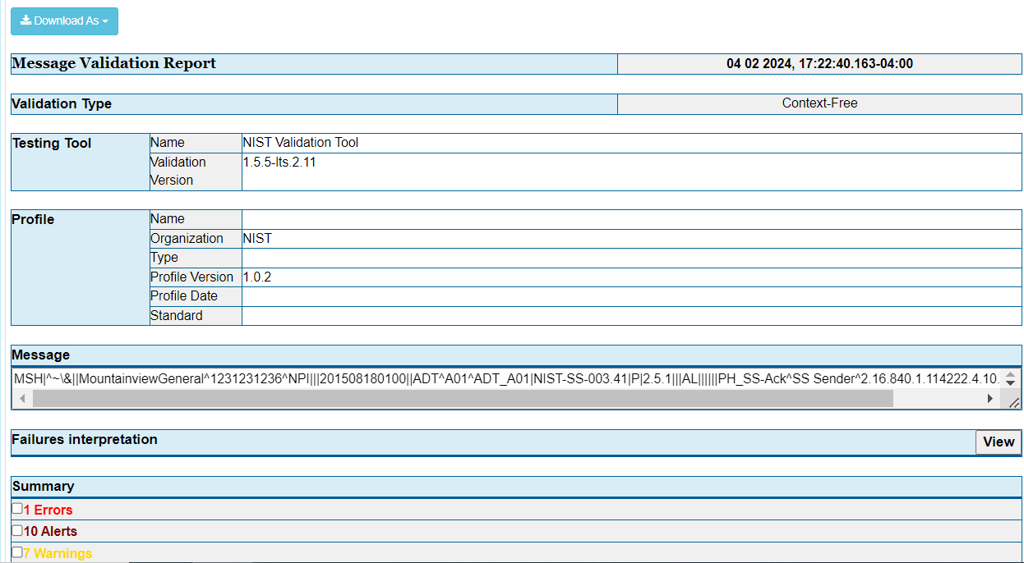
Syndromic Surveillance Message Validation Report
Info
The Message Validation Report presents the complete results of HL7 message validation testing.
Metadata such as Validation Type, tool used, and profile used to validate are included in the report.
A detailed summary of Errors, Alerts, Warnings, and Information elements are also presented in the report.
The Report may be downloaded as:
PDF
XML
HTML
Notes:
Fix all images; Sheryl commented too small to read

Slide 6
Syndromic Surveillance Context-based
Test Scenario Walk Through Tool Demonstration

Slide 7
Using Context-based Testing Capabilities
Context-based testing can be accomplished in two ways:
Single Message Method Test Step Level (step-by-step) testing consists of separate validation of each message in a Test Case. After accessing the desired Context-based Test Plan and opening a Test Case, the Tester selects and loads each of the Test Steps in their given sequence and validates the corresponding messages individually.
Multiple Message Method Test Case Level testing provides the capability of loading a complete Test Case (all Test Steps) at once. After accessing the desired Context-based Test Plan and selecting and loading a Test Case, the Tester sees all of the Test Steps listed in order on the Test Execution screen and validates the corresponding messages by clicking on the “Next” button to advance from Test Step to Test Step.
See NIST-Syndromic-Surveillance-(SS)-Test-Tool---Tutorial for instructions on how to use Test Case Level Testing.

Slide 8
Context-based Test Step Level Testing Demonstration

Slide 9
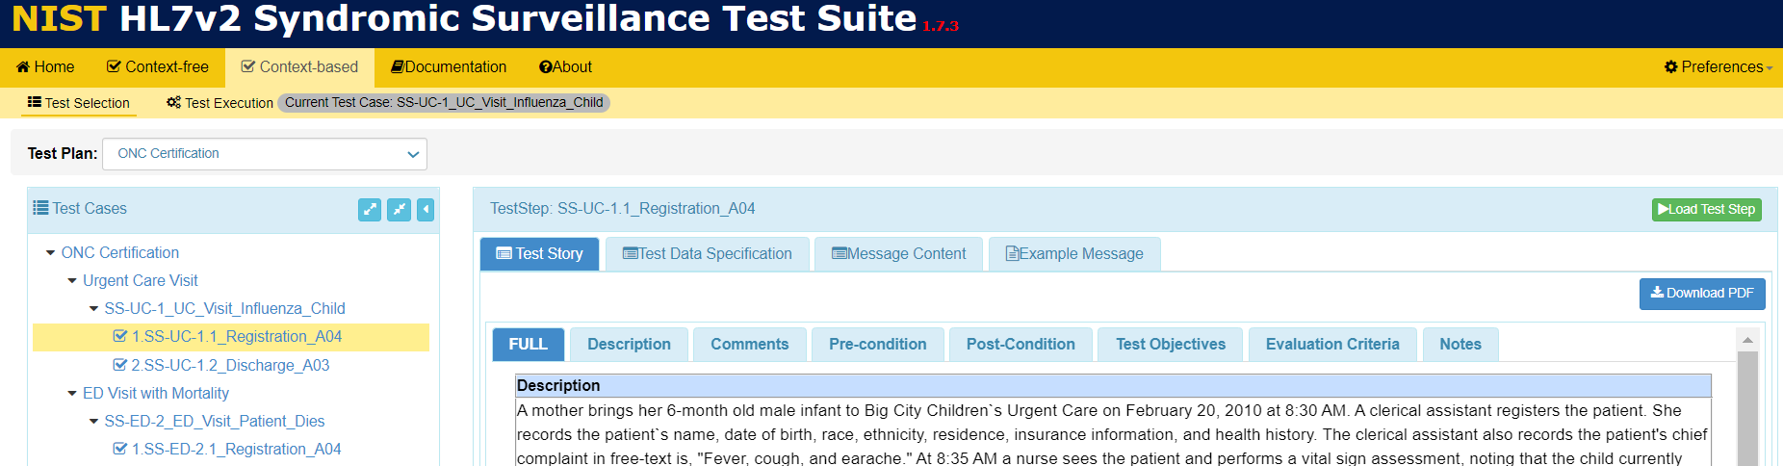
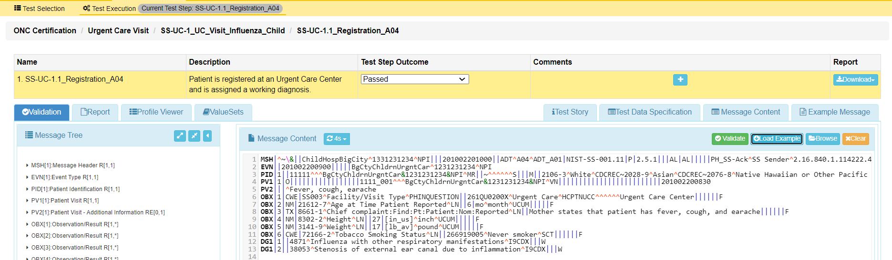
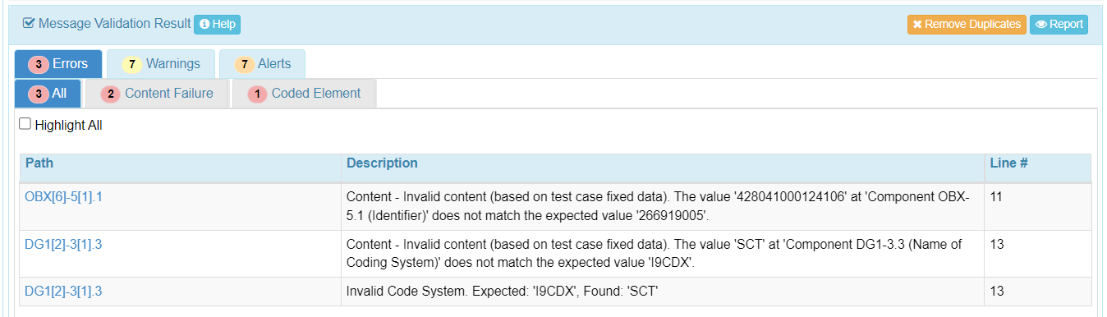
Syndromic Test Step Level Context-based Testing
1
Open Syndromic Surveillance Validation tool using link: http://hl7v2-ss-r2-testing.nist.gov/
and click on Context-based Validation tab.
2
4
Click on Load Test Step button to load Test Step.
Click on arrows to expand the Test Cases navigation window. Select a Test Step.
3
Review Test Story.
5
Copy/paste or click on Browse button to upload test message into Message Content window to initiate the validation process.
6
Validation results display in the Message Validation Result window. Errors display if the message failed.
7
Click on the Report button to display the Message Validation Report

Slide 10
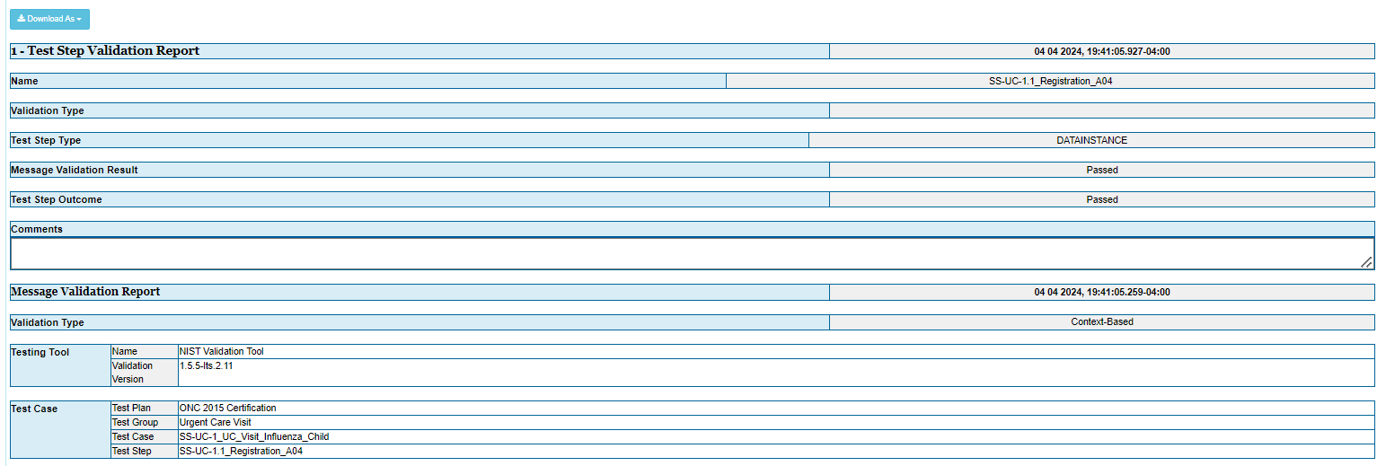
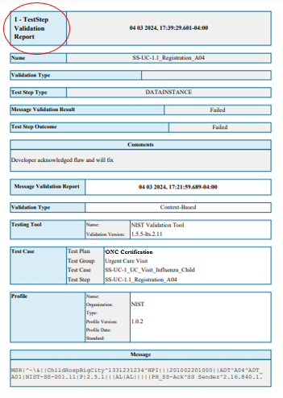
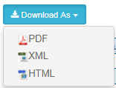
Context-based Test Step Level Testing – Validation Report (1)
8
View Message Validation Result generated automatically by the Tool.
9
Click on Download As to select one of the Report format options from the dropdown menu.
Info
Total number of notifications (e.g., Errors, Warnings, and Alerts) and detailed information for each notification also display on this Report.
Notes:
When errors are inserted into that test message in the Message Content window (or when the test message is replaced by a message that contains errors) and the test tool finds the errors when that message is re-validated
“Failed” displays automatically in the Test Step Outcome column on the Execution Screen
“Failed” displays in both the Message Validation Result and Test Step Outcome fields the in the metadata of the Validation Report.

Slide 11
Utilities

Slide 12
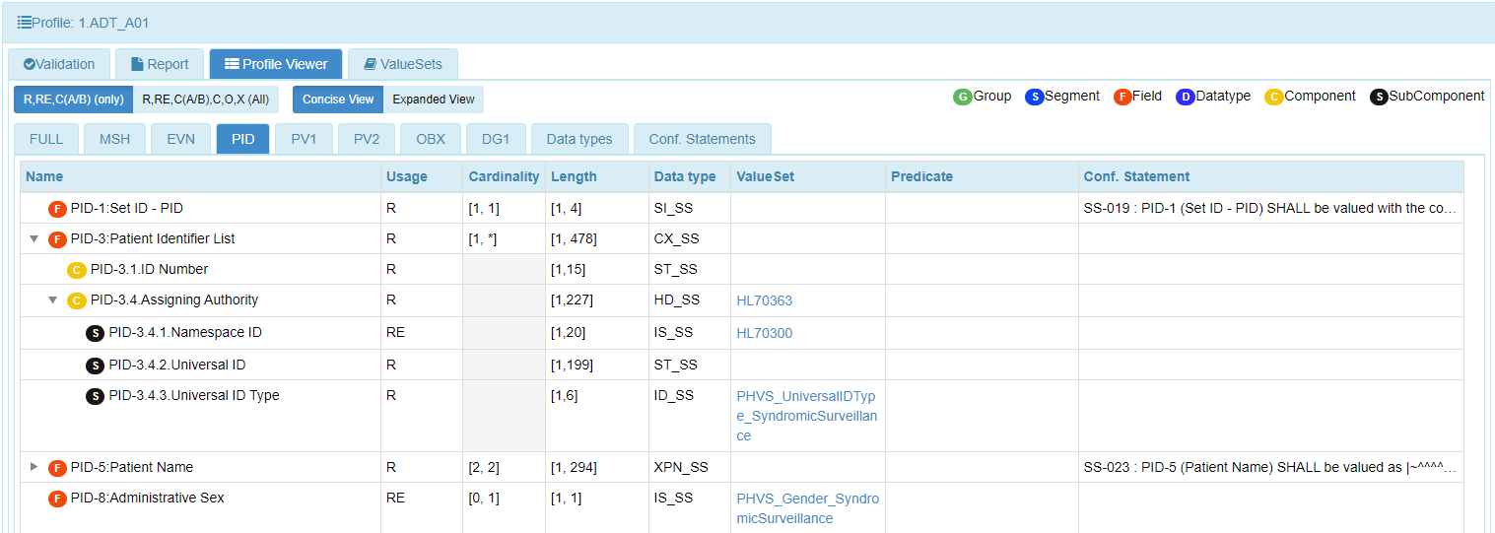
View Conformance Profile Data Elements
10
Select the Profile Viewer tab.
Info
This display presents an interactive interface that allows the Tester to look up the component of the message that generated an error and view the related conformance data (such as Usage, format, Value Set, etc.) to correct the message.
Data are organized based on message Group, Segment, Field, Datatype, Component, and Subcomponent.
Data elements may be filtered according to Usage by selecting either:
R, RE, C(A/B (only) – Required, Required but may be empty, and Conditional; or
or R, RE, C(A/B), O, X (All) – Required, Required but may be empty, Conditional, Optional, and Not supported.
Each segment can be displayed by selecting the corresponding tab.
Usage, Cardinality, Length, Data Type, Value Set, Predicate, and Conformance Statement for each field are also displayed.
Notes:
Fix all images; Sheryl commented too small to read

Slide 13
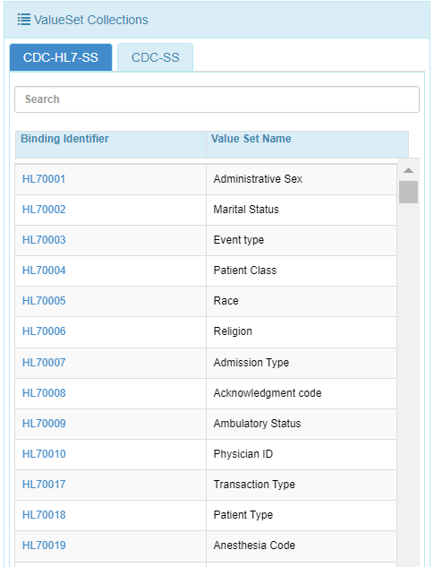
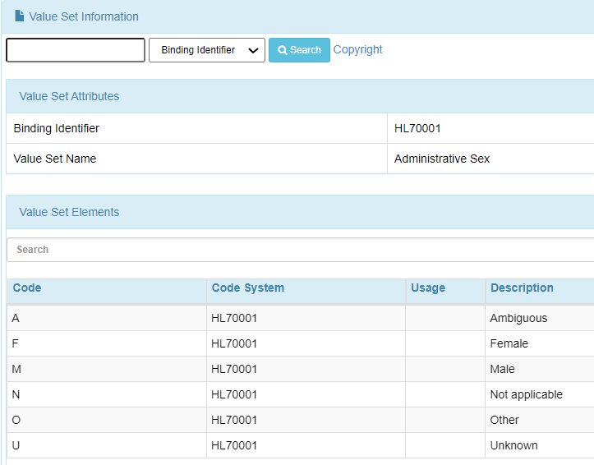
View Conformance Profile Vocabulary
11
Select the Value Sets tab.
Info
This display presents an interactive interface that allows the Tester to look up the table value that generated an error and view valid values to correct the message.
Info
The search feature includes the capability to search based on Binding Identifier, Value Set Name, Value Set Code, and Description.
Notes:
Fix all images; Sheryl commented too small to read

