Slide 1

Syndromic Surveillance (SS)
Validation Test Suite
Tutorial and Guide
Robert Snelick
National Institute of Standards and Technology
April 4, 2024
Contact: rsnelick@nist.gov

Slide 2
Contents
NIST Syndromic Surveillance Test Suite Overview
Syndromic Surveillance Message Testing Process Diagram
Test Suite Access and Navigation
Context-free Test Scenario Walk Through Tool Demonstration
Context-based Test Scenario Walk Through Tool Demonstrations
Test Step Level
Test Case Level

Slide 3
http://hl7v2-ss-r2-testing.nist.gov/
Syndromic Surveillance Test Suite Overview
Purpose: The tool validates Syndromic Surveillance (SS) messages created by Health IT Modules, and Context-based Testing is intended for ONC certification.
Tool Key Capabilities
Context-free Testing | (No Test Scenario - Test any Syndromic Surveillance message created by EHR) Context is unknown to validation tool Provides a simple and convenient method for testing message structure and most vocabulary
Context-based Testing | (Test Scenarios - Test Syndromic Surveillance message associated with a specific test scenario) Context is known to validation tool All conformance requirements of the SS Implementation Guide can be assessed Used for certifying ONC Health IT Modules
Profile Viewer | Provides a browsable version of the conformance profile which encapsulates the requirements. Can be used to assist in the interpretation of errors.
Value Set Browser | Provides a browsable view of the vocabulary requirements. Can be used to assist in the interpretation of value set errors.
Documentation | Provides access to documents that will assist in using the tool (including test procedure, test cases, profile descriptions, vocabulary descriptions and validation tool download).
No registration or log-in credentials are needed. Simply click on the link below and send/paste/load message into tool to obtain a Validation report.
NOTE: The Test Tool (.war file) can also be downloaded and installed locally.
NOTE: Web Application is compatible with Firefox, Chrome, Safari, and Edge
Register to Google Group at: https://groups.google.com/d/forum/hl7v2-syndromic-testing to ask questions and provide feedback.

Slide 4
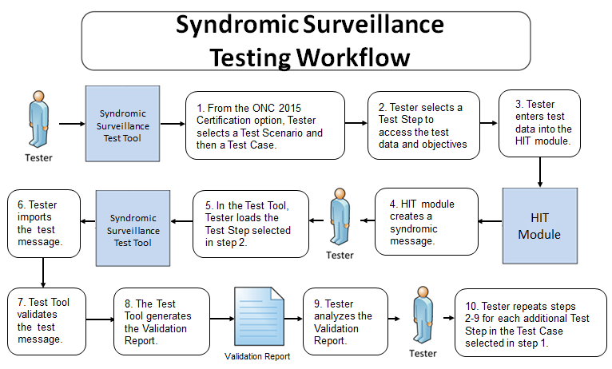
Syndromic Surveillance Message Testing Process

Slide 5
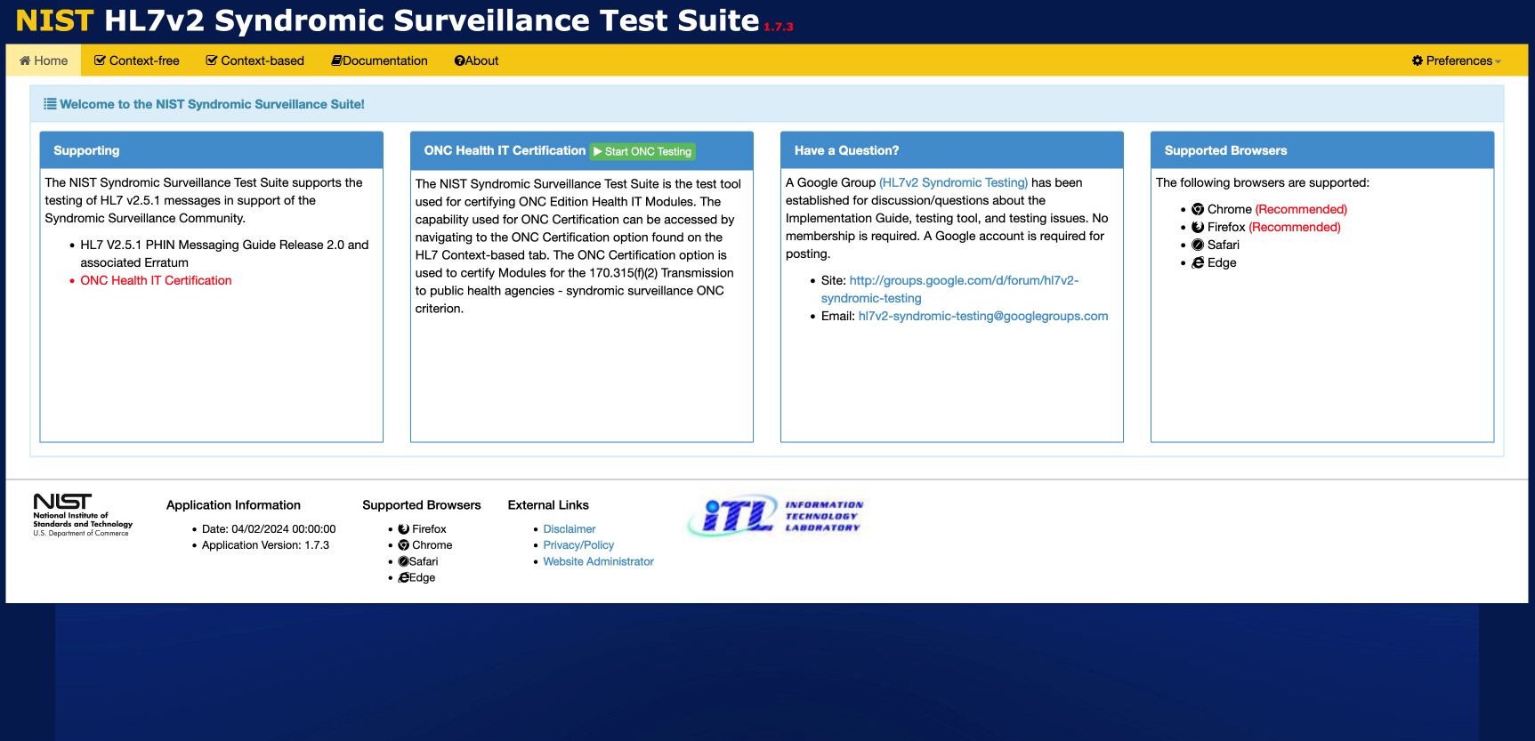
Syndromic Surveillance Test Suite Access and Navigation
1
Open the Syndromic Surveillance Test Suite using link: http://hl7v2-ss-r2-testing.nist.gov/
Info
The Menu Bar is located along the top. The options are
Home
Context free
Context-based
Documentation
About
Preferences.
The Welcome Screen is located on the Home tab and provides information about
The testing support for the Syndromic Surveillance community
The use for ONC Health IT Certification
How to submit questions about the tool
The browsers that are supported by the tool

Slide 6
Syndromic Surveillance Context-free
Test Scenario Walk Through Tool Demonstration

Slide 7
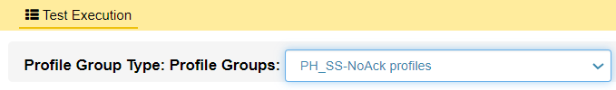
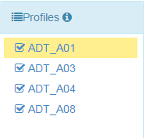

Syndromic Context-free Conformance Profile Selection
1
Select HL7 Context-free from the Menu Bar.
2
Select a Profile Group from the dropdown menu.
Then Select a Profile to test an HL7 message.
3
Copy and paste the HL7 Message that is to be tested into the Message Content window; or select the Browse tab and upload the desired message.
Notes:
Images associated with 2, 3, and 4 too small to read

Slide 8
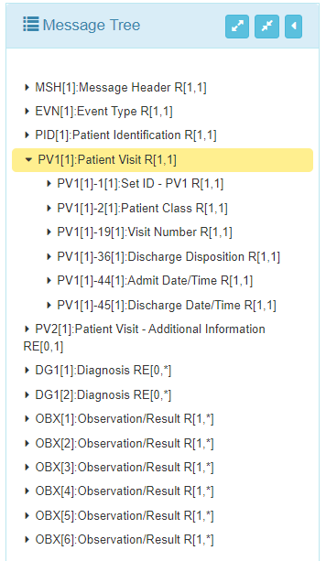
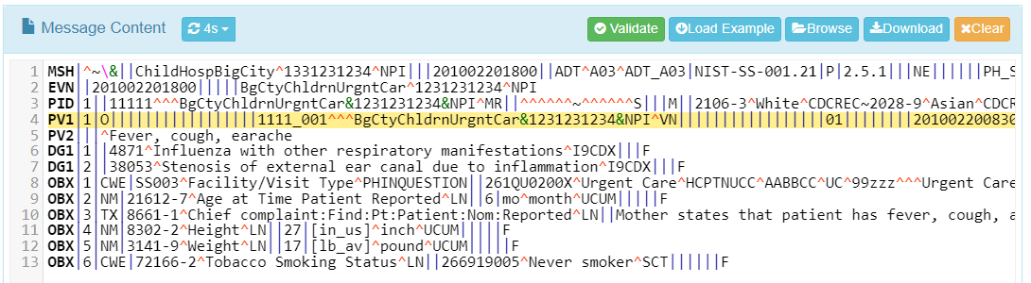
Load HL7 Message
5
When an HL7 message is loaded into the Message Content window, the Message Tree is automatically populated with the relevant HL7 message instance segments.
Click on the expand icon to open all of the segments. Click on an individual arrow to open a single segment.
Select an individual item to highlights it in yellow in the Message Tree and in the Message in the Message Content window.
4
With a Conformance Profile selected, load the HL7 message into the Message Content window:
Click the Browse button to load an existing HL7 message from the Tester’s local machine; OR
Click the Load Example button to populate the window with the sample HL7 message.
The test tool automatically begins the validation process; the Tester also may click on the Validate button to initiate the validation process.
Selecting Download allows the Tester to save the HL7 message in a .TXT file on their local machine.
Selecting Clear removes the HL7 message from the Message Content window.
Notes:
Images with 5, 6, and 7 too small to read

Slide 9
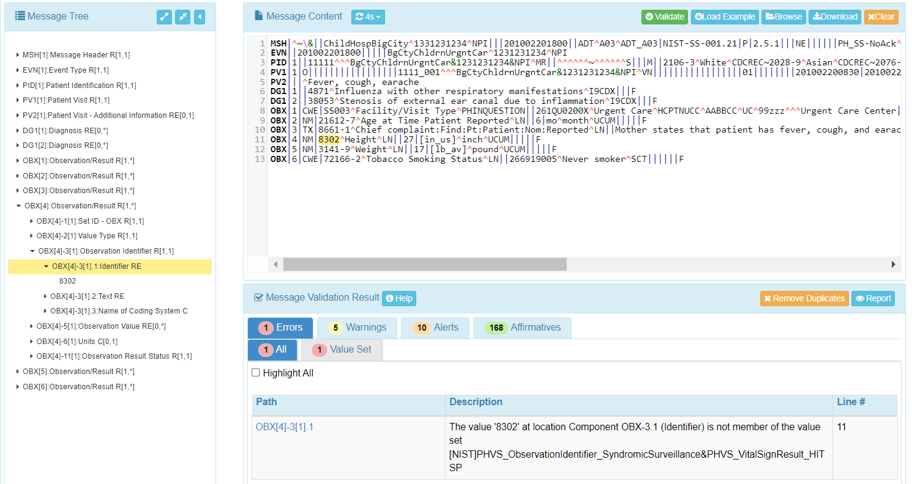
Syndromic Surveillance Context-free Validation
Info
The HL7 message validation results are displayed with the Message Validation Result window. Various testing notifications are generated for the Tester.
The types of notifications are:
Errors – HL7 message elements that failed validation testing.
Warnings and Alerts – HL7 message element information that may be useful for a Tester for profile conformance but does not indicate a test fail nor a non-profile-conformant HL7 message element.
Affirmatives – Lists HL7 message validation successes and satisfaction of condition predicates. (This notification is optional and can be activated by the Tester via the Preferences dropdown menu on the Home page.)
The exact HL7 message Line # location and the Description of the notification are displayed.
Clicking on the Path causes yellow highlighting of the location in the message that is triggering the notification.
Clicking the Report button presents the Tester with a Message Validation Report that captures the results of HL7 Context-free validation for the message being tested.
Notes:
Fix all images; Sheryl commented too small to read

Slide 10
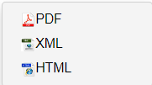
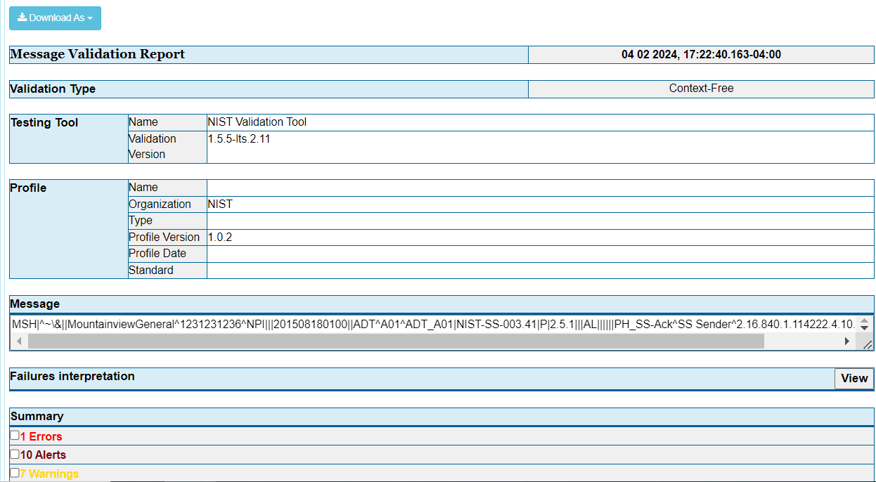
Syndromic Surveillance Message Validation Report
6
Click on the Report button or select the Report tab.
Info
The Message Validation Report presents the complete results of HL7 message validation testing.
Metadata such as Validation Type, tool used, and profile used to validate are included in the report.
A detailed summary of Errors, Alerts, Warnings, and Information elements are also presented in the report.
The Report may be downloaded as:
PDF
XML
HTML
Notes:
Fix all images; Sheryl commented too small to read

Slide 11
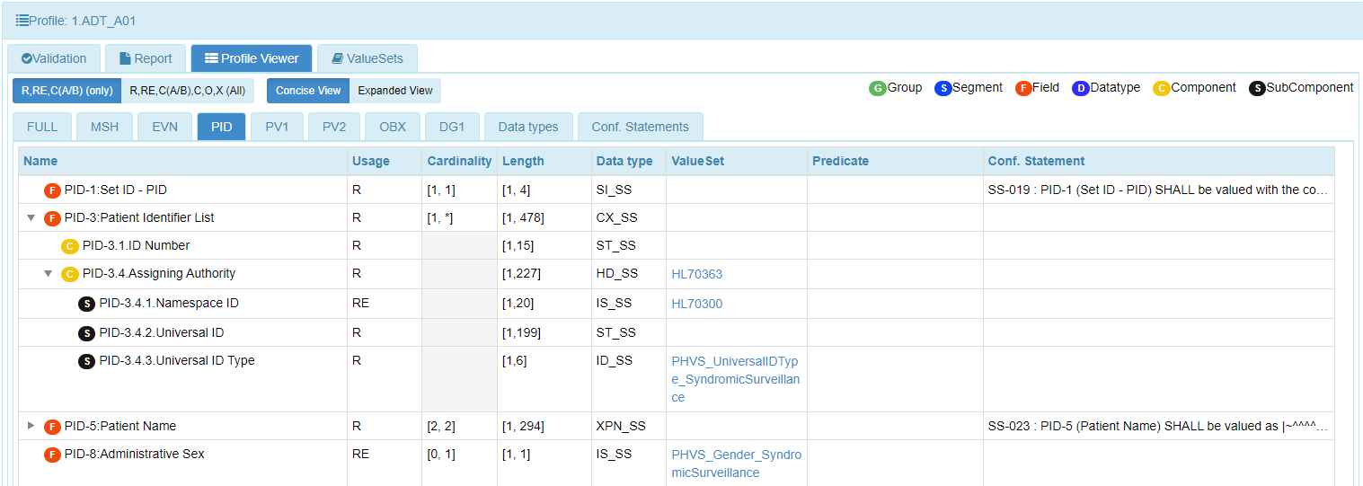
View Conformance Profile Data Elements
7
Select the Profile Viewer tab.
Info
This display presents an interactive interface that allows the Tester to look up the component of the message that generated an error and view the related conformance data (such as Usage, format, Value Set, etc.) to correct the message.
Data are organized based on message Group, Segment, Field, Datatype, Component, and Subcomponent.
Data elements may be filtered according to Usage by selecting either:
R, RE, C(A/B (only) – Required, Required but may be empty, and Conditional; or
or R, RE, C(A/B), O, X (All) – Required, Required but may be empty, Conditional, Optional, and Not supported.
Each segment can be displayed by selecting the corresponding tab.
Usage, Cardinality, Length, Data Type, Value Set, Predicate, and Conformance Statement for each field are also displayed.
Notes:
Fix all images; Sheryl commented too small to read

Slide 12
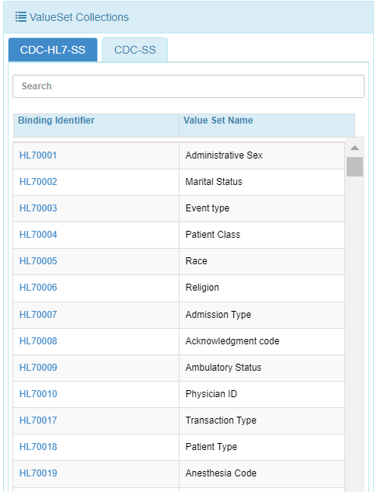
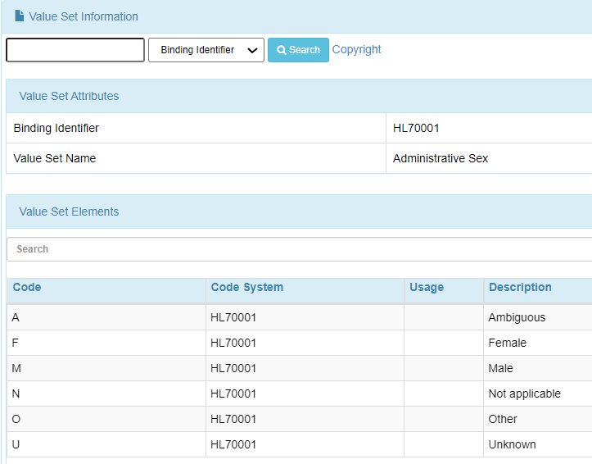
View Conformance Profile Vocabulary
8
Select the Value Sets tab.
Info
This display presents an interactive interface that allows the Tester to look up the table value that generated an error and view valid values to correct the message.
Info
The search feature includes the capability to search based on Binding Identifier, Value Set Name, Value Set Code, and Description.
Notes:
Fix all images; Sheryl commented too small to read

Slide 13
Syndromic Surveillance Test Suite
Context-based Testing Tool
Demonstration

Slide 14
Using Context-based Testing Capabilities
Context-based testing can be accomplished in two ways:
Single Message Method Test Step Level (step-by-step) testing consists of separate validation of each message in a Test Case. After accessing the desired Context-based Test Plan and opening a Test Case, the Tester selects and loads each of the Test Steps in their given sequence and validates the corresponding messages individually.
Multiple Message Method Test Case Level testing provides the capability of loading a complete Test Case (all Test Steps) at once. After accessing the desired Context-based Test Plan and selecting and loading a Test Case, the Tester sees all of the Test Steps listed in order on the Test Execution screen and validates the corresponding messages by clicking on the “Next” button to advance from Test Step to Test Step.
A demonstration for each method is provided in the next several slides.

Slide 15
Context-based Test Step Level Testing Demonstration

Slide 16
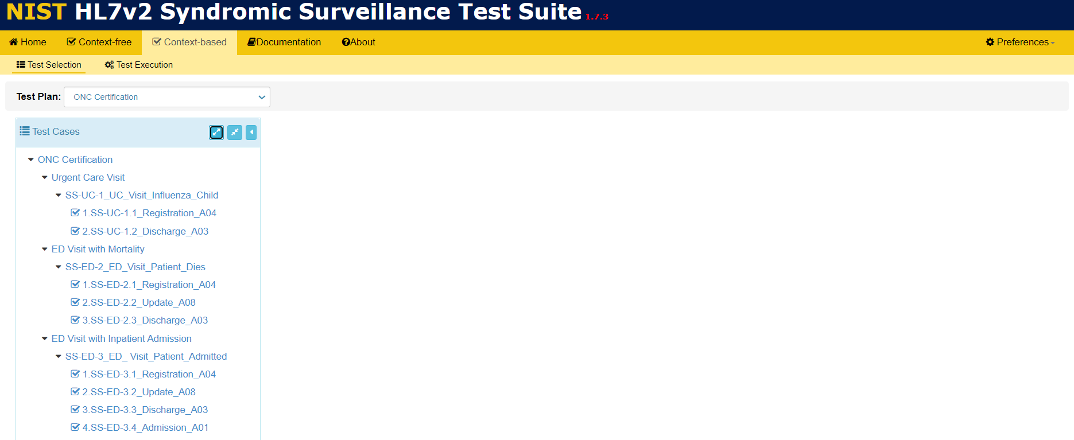
Context-based Test Step Level Testing (1)
Objectives | Informative Reference
Locate the Context-based option on the Menu Bar. Locate Cases and Test Steps in the Test Cases navigation bar. Access Test Step-specific information via the corresponding tabs. Load a Test Step and execute the validation process. | The Context-based option provides HL7 v2 syndromic surveillance message testing capabilities using specific test scenarios and the message validation engine.
1
Select Context-based from the Menu Bar.
2
Click the Expand All arrow icon on the Test Selection function screen to open and display the Test Cases and Test Steps.

Slide 17
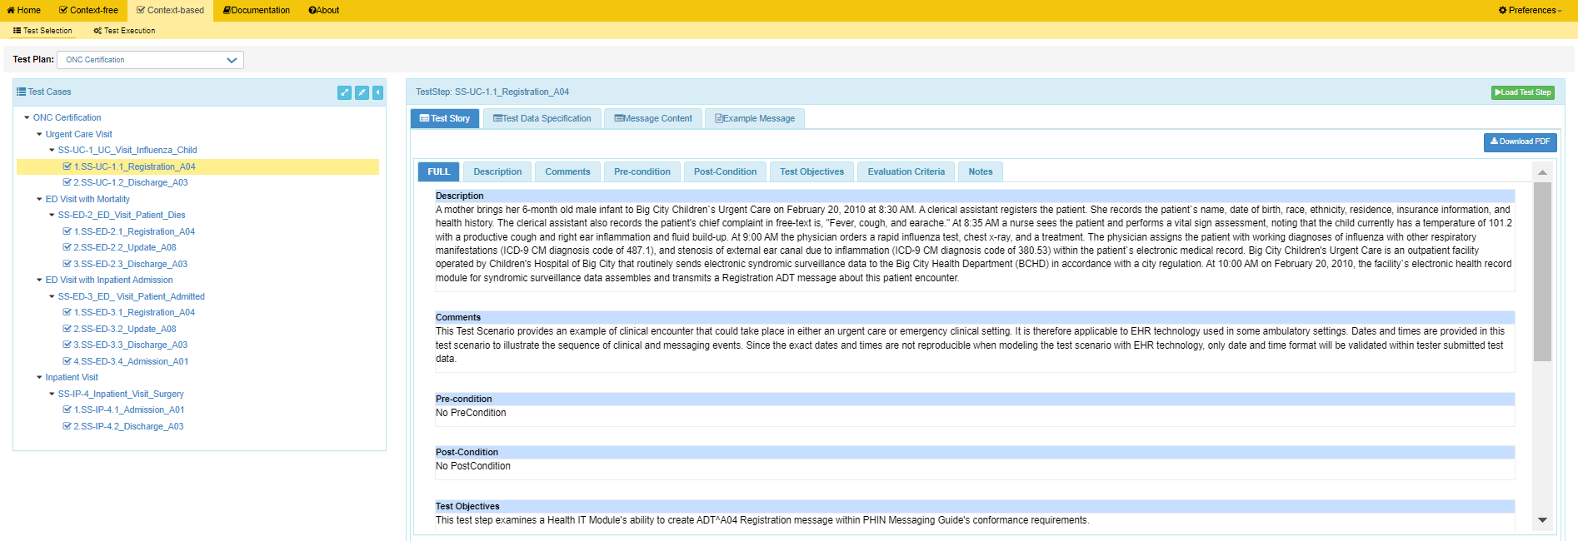
Context-based Test Step Level Testing (2)
5
info
The Load Test Step button can be clicked to begin the validation process once a Test Step has been selected and before viewing of any of the available tabs.
3
Click on Download PDF button to obtain the Test Story document.
Select a Test Step.
6
Select the tab for each section to view just the specified information, e.g., Text Objectives.
4
info
7
Scroll down to review the additional information in the sections provided on the Full Test Story tab.
View the Test Story displayed in the TestStep window for the selected Test Step. The Full tab is selected automatically for display of all sections of the Test Story.
The Test Story tab provides a narrative Description about the context (use case scenario) of the Test Step, as well as sections with Comments, Precondition, Post condition, Test Objectives, Evaluation Criteria, and Notes information.

Slide 18
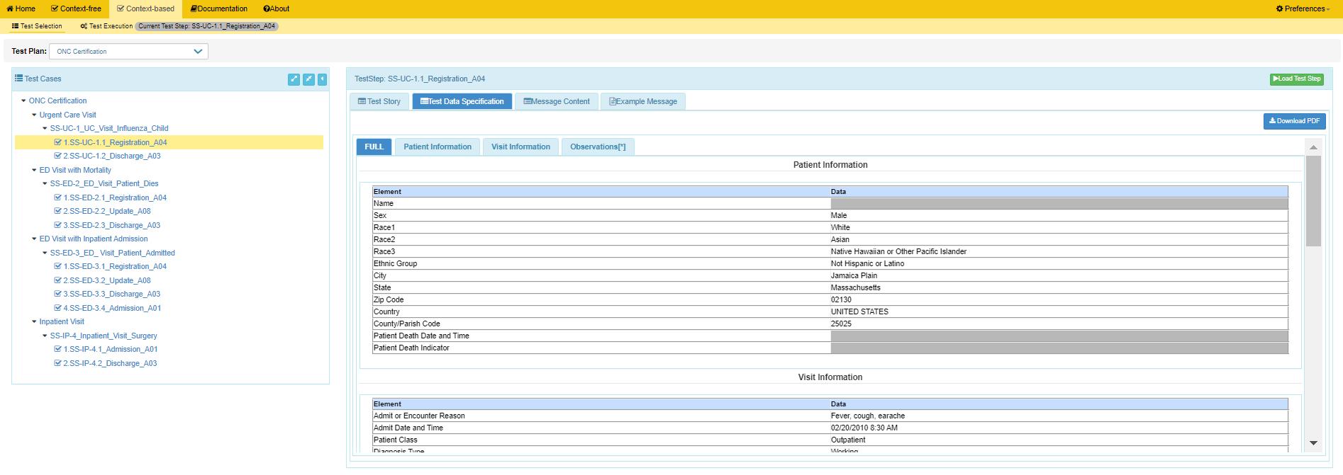
Context-based Test Step Level Testing – Test Data Specification
8
Click on the Test Data Specification tab to view the real-world information that would typically be available for a given situation in the specified clinical setting.
11
Click on Download PDF button to obtain the Test Data Specification document.
10
Scroll down to review the additional information in the sections provided on the Full Test Data Specification tab.
Info
The Full tab is selected by default.
9
Select the tab for each section to view just the specified information, e.g., Visit Information.

Slide 19
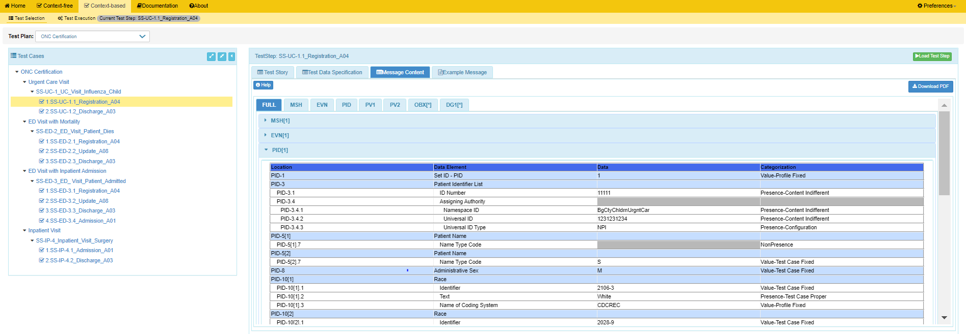
Context-based Test Step Level Testing – Message Content
12
15
Click on the Example Message tab to view the example HL7 syndromic message provided for the Test Step.
16
Click on the Message Content tab to view a conformant message instance for the Test Step.
Click on Load Test Step to begin the validation process.
13
Select the tab for each segment to view just the specified message segment , e.g., PID.
OR
open a segment on the Message Content tab to view detailed message content.
Info
Location indicates the location of a data element within the HL7 message.
Info
Name of each Data Element is displayed.
Info
Value (Data) for each data element is displayed. (e.g. Identifier Code for Race).
14
Click on Download PDF button to obtain the Message Content document.
Info
Categorization indicates if the Value must match the test data provided (“fixed”) or can be changed. It also indicates the source of the Value as well as how the Tool will validate the Value in the message.

Slide 20
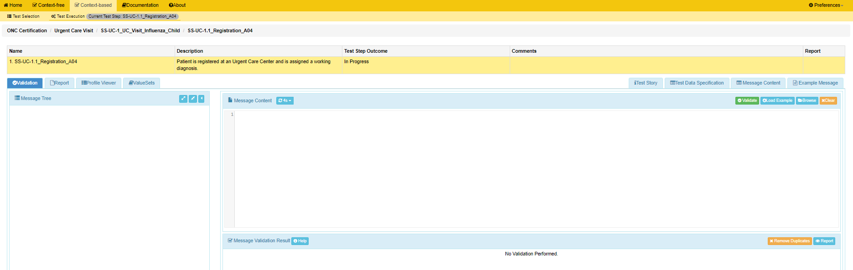
Context-based Test Step Level Testing – Message Validation (1)
Info
17
Clicking on the Load Test Step button causes the Test Execution screen to display.
Click on the Test Story or Test Data Specification or Message Content or Example Message tabs if you want to view that information on the Test Execution screen…then click on the Validation tab to return to the Validation function.
Info
The name of the Test Step appears at the top of the Test Execution screen; and Test Step information is displayed in the fields below.
Info
The Validation tab is selected by default.
ONC Test Plan /
18
Copy/paste, or click on Browse button to find test message, to upload test message into Message Content window.

Slide 21
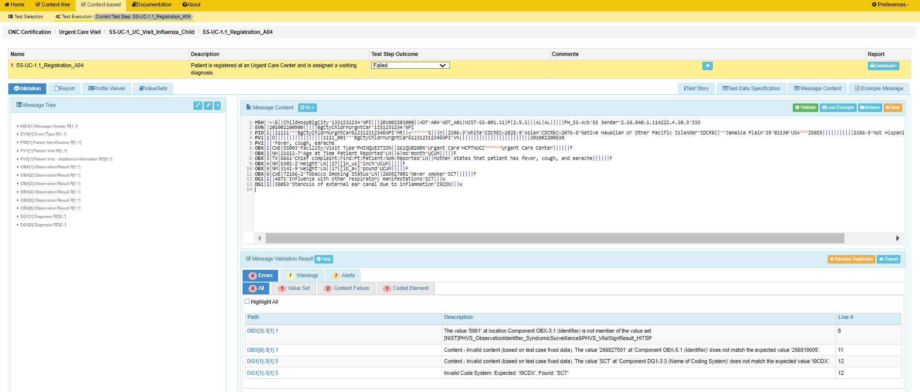
Context-based Test Step Level Testing – Message Validation (2)
19
After test message displays, click the Validate button to initiate validation by the Tool.
Info
Download button displays in Report column for quick download/view/print capability.
Info
Validation result produced by the Test Tool for this Test Step displays automatically in the Test Step Outcome field.
20
View the results displayed in the Message Validation Result window.
Info
Total number of notifications (e.g., Errors, Warnings, and Alerts) display.

Slide 22
Context-based Test Step Level Testing – Message Validation (3)
Passed
Passed – Notable Exception
Failed
Failed – Not Supported
Incomplete
Inconclusive
21
Open the Test Step Outcome dropdown menu and select an option if you want to enter a test step outcome that is different from the automatic validation result.
Passed
Passed – Notable Exception
Failed
Failed – Not Supported
Incomplete
Inconclusive

Slide 23
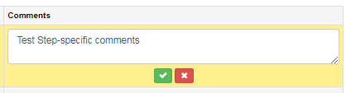

Context-based Test Step Level Testing – Message Validation (4)
Info
22
Option selected from the Test Step Outcome dropdown menu displays in the Test Step Outcome field.
Click on the icon to add Test Step-specific Comments to the Validation Report.
23
Click on the icons to accept/delete the Test Step-specific Comments.
24
Click on the icons to append more Comments to/delete all of the Comments that were accepted.

Slide 24
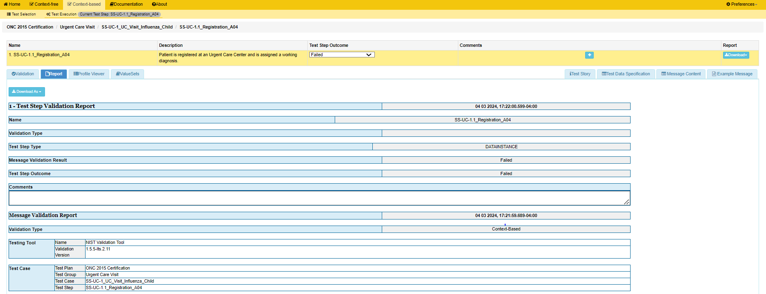

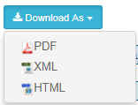
Context-based Test Step Level Testing – Validation Report (1)
25
Click on Report tab to view the validation report.
ONC Certification /
29
Click on Download As to select one of the Report format options from the dropdown menu.
26
View Message Validation Result generated automatically by the Tool.
Info
28
View the Test Step-specific Comments entered by the Tester.
27
Total number of notifications (e.g., Errors, Warnings, and Alerts) and detailed information for each notification also display on this Report.
View the different Test Step Outcome if one was selected from the dropdown menu by the Tester.
Notes:
When errors are inserted into that test message in the Message Content window (or when the test message is replaced by a message that contains errors) and the test tool finds the errors when that message is re-validated
“Failed” displays automatically in the Test Step Outcome column on the Execution Screen
“Failed” displays in both the Message Validation Result and Test Step Outcome fields the in the metadata of the Validation Report.

Slide 25
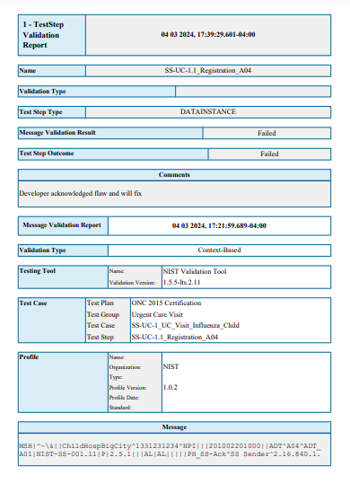
Context-based Test Step Level Testing – Validation Report (2)
ONC Certification /
ONC Certification
Notes:
When errors are inserted into that test message in the Message Content window (or when the test message is replaced by a message that contains errors) and the test tool finds the errors when that message is re-validated
“Failed” displays automatically in the Test Step Outcome column on the Execution Screen
“Failed” displays in both the Message Validation Result and Test Step Outcome fields the in the metadata of the Validation Report.

Slide 26
Context-Based Test Case Level Testing
Demonstration

Slide 27
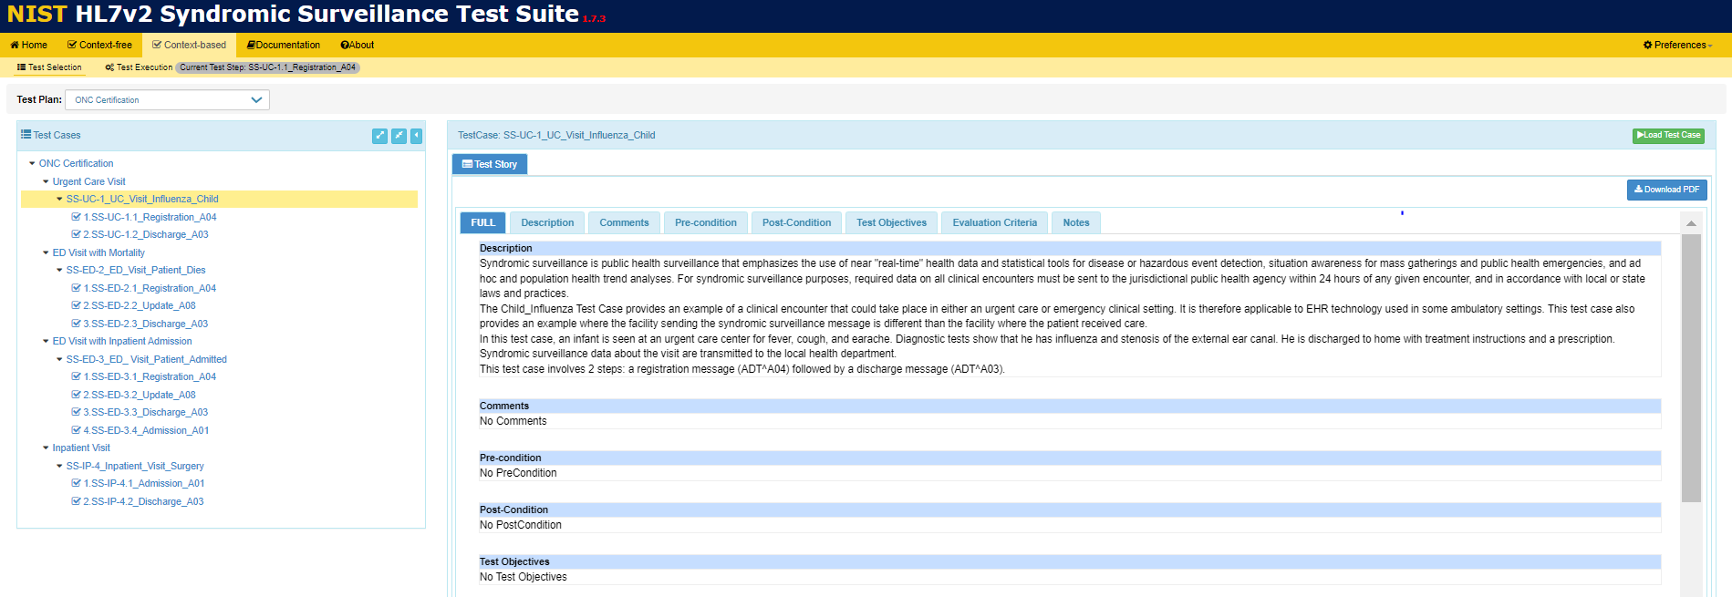
Context-based Test Case Level Testing (1)
Objectives | Informative Reference
Locate the Context-based option on the Menu Bar. Locate Test Cases in the Test Cases navigation bar. Access Test Case-specific information via the corresponding tabs. Load a Test Case and execute the validation process | The Context-based option provides HL7 v2 syndromic message testing capabilities using specific test scenarios and the message validation engine.
1
Select Context-based from the Menu Bar.
2
Arrow-down in the Test Cases navigation bar on the Test Selection function screen to open and display the Test Cases for the desired Group. Select a Test Case.
6
5
Select Load Test Case.
ONC Test Plan
Click on Download PDF button to obtain the Test Story document.
4
Select the tab for each section to view just the Test Case-specific information, e.g., Notes.
3
View the Test Story displayed in the TestCase window for the selected Test Case. The Full tab is selected automatically for display of all sections of the Test Story.

Slide 28
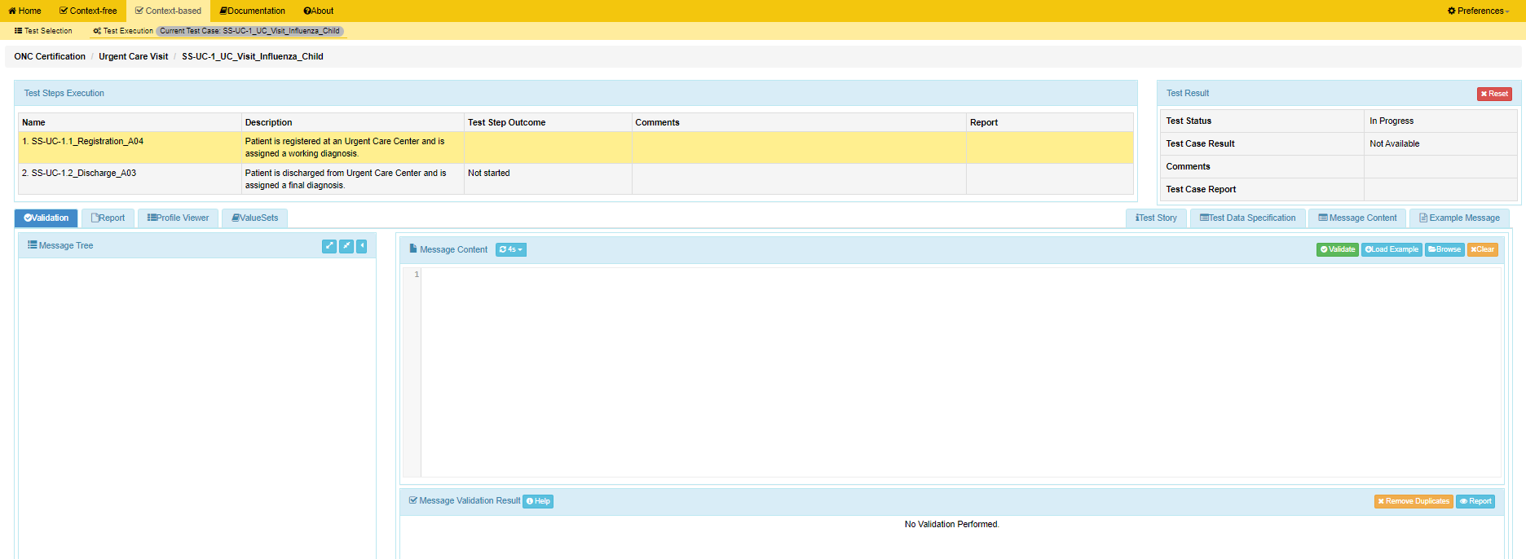
Context-based Test Case Level Testing (2)
info
The name of the Test Case appears at the top of the Test Execution screen.
info
The names of the Test Steps appear here.
info
The first Test Step in the Test Case is selected automatically.
7
Click on these tabs to view Test Step-specific information from the Test Execution screen (see detailed explanations for these features in the Context-based Test Step Level Testing Demonstration section of this Tutorial) …then click on the Validation tab to return to the Validation function.
8
Copy/paste, or click on Browse button to find test message, to upload test message into Message Content window.

Slide 29
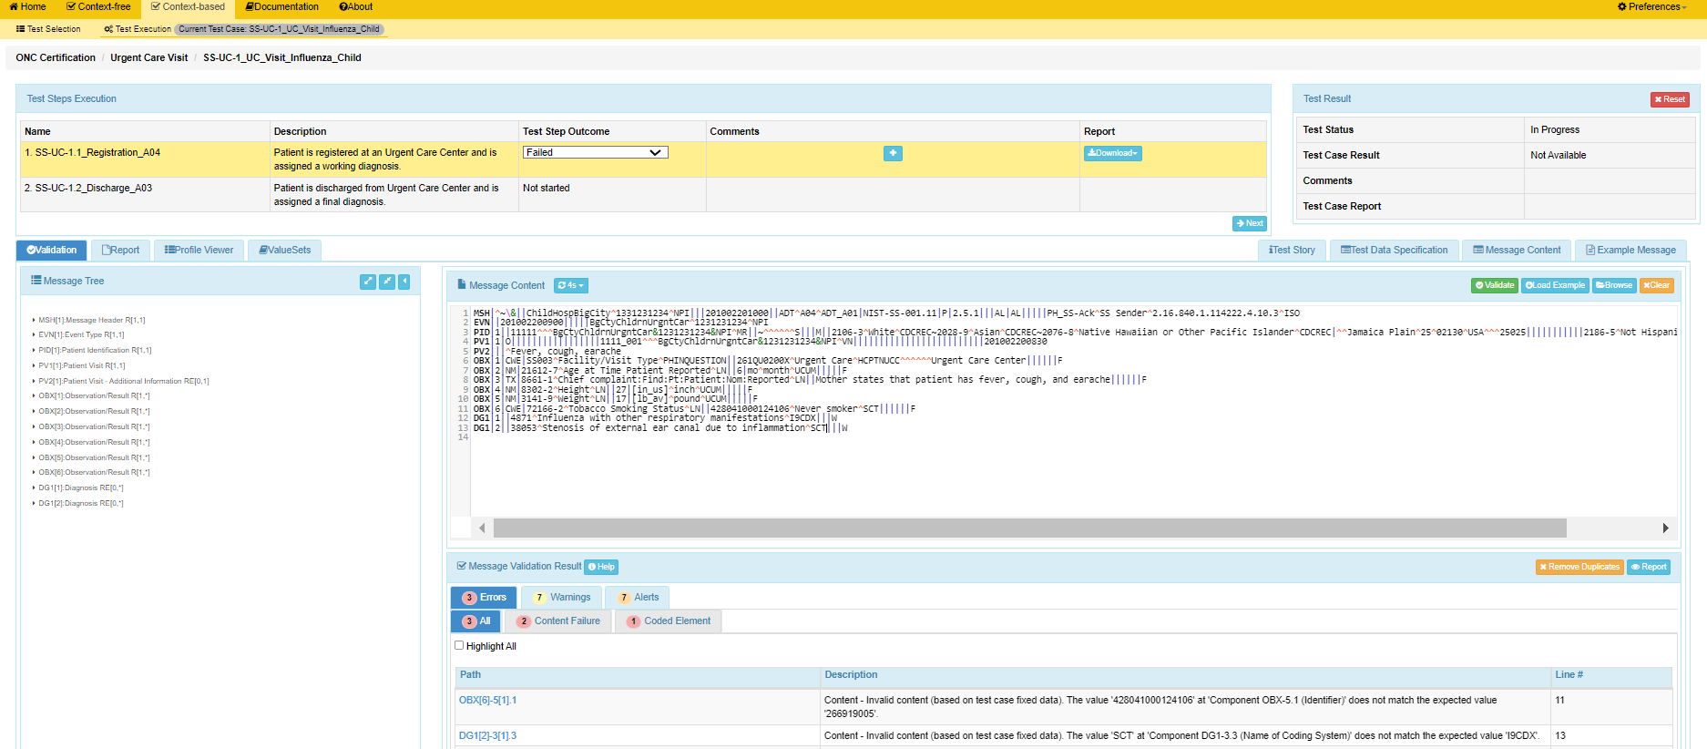
Context-based Test Case Level Testing (3)
9
After test message displays, click the Validate button to initiate validation by the Tool.
10
info
Download button in Report column is used for quick download/view/print.
Validation result produced by the Test Tool for this Test Step displays automatically in the Test Step Outcome field. Use the Test Step Outcome dropdown menu to enter a test step outcome that is different from the automatic validation result if necessary.
12
Add Test Step-specific Comments via the icon.
14
Click Next button to display the next Test Step.
11
View detailed validation results in the Message Validation Results window.
13
Click on the Report tab or the Report button to view and generate the Validation Result Report for this Test Step.

Slide 30
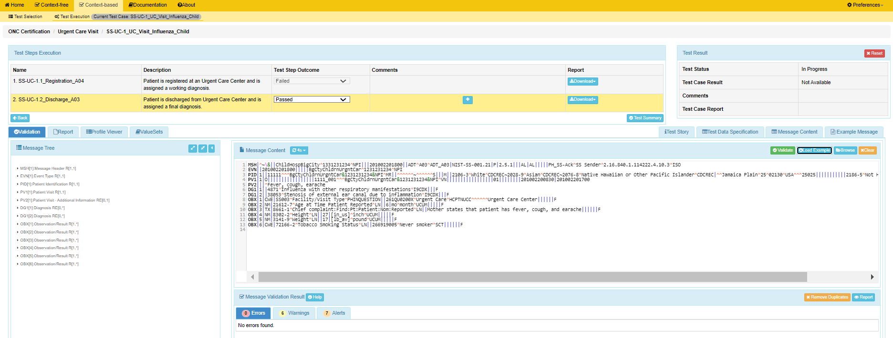
Context-based Test Case Level Testing (4)
15
info
Copy/paste, or click on Browse button to find test message, to upload test message into Message Content window and initiate validation.
Test Status displays “In Progress” and Test Case Result displays “Not Available” until Test Summary button is clicked.
info
Download button in Report column is used for quick download/view/print.
16
View the Test Step Outcome; select a different Test Step Outcome from the Test Step Outcome dropdown menu if desired.
17
View validation results in the Message Validation Results window.
19
Click on the Test Summary button to complete the testing for this Test Case.
18
Click on the Report tab or the Report button to view and generate the Validation Result Report for this Test Step.

Slide 31
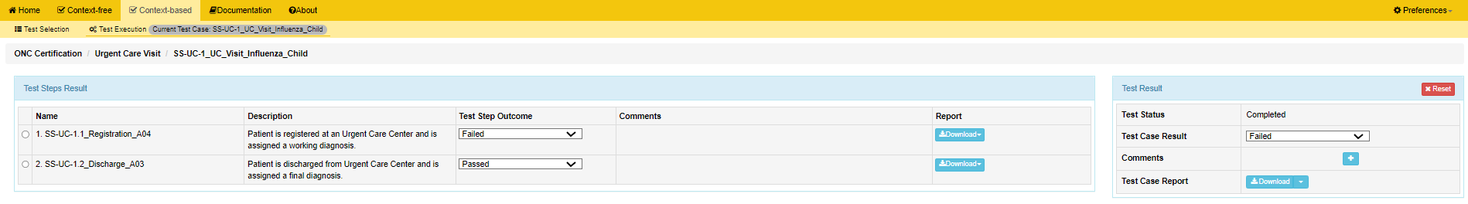

Context-based Test Case Level Testing (5)
20
info
Keep the Test Case Result that is displayed or override this result by selecting a different Test Case Result from the dropdown menu.
When Test Summary is selected, Test Status displays “Completed” and Test Case Result displays the lowest result value applied to one of the Test Steps.
21
Click on the icon to add Test Case-specific testing Comments to the Test Summary as necessary.
22
Click on the Download button to select/view/print one of the Report format options from the dropdown menu.

Slide 32
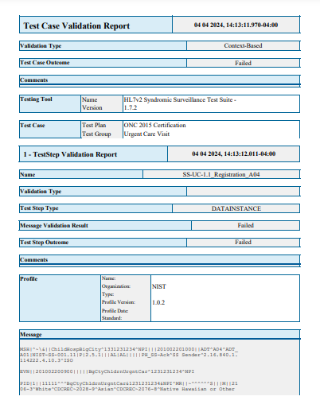
Context-based Test Case Level Testing (6)
info
info
The Test Summary report includes Test Case Level information as well as Test Step Level information for each Test Step executed.
The Result listed for the Test Case Validation Report section in the Test Summary is derived from the lowest Result associated with any of the Test Steps included in the Test Case unless the Tester overrides the Test Case Result here.
ONC Certification
info
The Message Validation Result and Test Step Outcome are listed for the Test Step Validation Report section in the Test Summary

