Slide 1

HL7 V2 Vocabulary Specification
Value Set Classification Proposal
Draft 11 – Concise Proposal and Specification
Conformance and Guidance for Implementation and Testing (CGIT)
Robert Snelick
National Institute of Standards and Technology
Last Update: June 7th, 2015
Original Proposal: September 2013
Contact: robert.snelick@nist.gov

Slide 2
Background and Overview
This version includes:
a summary of the value set proposal
a guide for IG authors (creating value set spreadsheet specifications)
specification for tool developers and implementers
For reasoning and background information see the original (complete) proposal (Draft 10).
Scope
HL7 V2
This is not the way V2 is, this is a proposal for what we believe it should be
This concepts “should” apply universally across the HL7 product lines (although they most certainly will use different terminology)
Pilot of method is for US LAB IGs (eDOS, LOI, LRI, and ELR)
Planned for Immunization Release 1.6 (2015/2016)
Implementation
NIST to implement for 2015 Edition MU Certification

Slide 3
Considerations for Value Set Specification and Implementation
Value Set Binding
Value Set Binding Strength
Value Set Binding Location
Value Set Definition
Value
Value Usage
Extensibility
Stability
Content Definition
Other metadata (related to identification but do not affect requirements)
Value Set Composition
Profile Type
Relationship to Data Type Definitions
The above factors lead to many conformance implications

Slide 4
Value Set Spreadsheet Package
A set of spreadsheets that defines all the value set(s) for an extended use case domain (a set of related implementation guides containing multiple conformance profiles)
A spreadsheet is created for each domain concept (e.g., administrative sex, name type code, lab results, etc.)
A spreadsheet contains a value set for each use of a concept domain (i.e., each time a message element that binds to the concept domain) for every conformance profile in the implementation guide
A spreadsheet consists of multiple tabs containing
the root value set meta data (Meta Data Tab)
Set of value set definitions (Value Tab)
A value set definition is represented in the spreadsheet by a column that describes the attributes of the value set
The column also includes the conformance profile in which the value set is used and the specific message element that it is bound to
E.g., LRI PID-8

Slide 5
Big Picture
Extended Use Case Domain – Collection of implementation guides harmonized to address an extended use case (eDOS, LOI, LRI, EHR-S Lab FR, ELR).
1
Value Set Package - Package of Spreadsheets for a use case domain (US LAB in this case). One spreadsheet file is created for a concept domain (e.g., Administrative Sex).
1
1
*
1
Implementation Guide – Collection of message profiles for a targeted use case.
1 Spreadsheet in the Package
*
Value Set Collection – The set of value sets for a concept domain (organized in a single Spreadsheet file). Contains the value set “global” meta data and a collection of value set definitions.
1
*
Message Profile – A message profile equates to an interaction (e.g., send lab result [LRI GU-RU] or send an acknowledgement [LRI GU]).
1
1 Column in the Spreadsheet
*
1
Value Set – A value set is defined for every use in the use case domain (i.e., for every message profile in which a message element is bound to a coded concept domain).
1
*
Value Set Library - Set of value sets that pertain to a given message profile. For example, all the value sets that are referenced (i.e., there is a value set binding to a message element) in the LRI GU-RU message profile.
1
Every column for a given message profile in the Value Set Package

Slide 6
US LAB Extended Use Case Domain
eDOS Implementation Guide
LOI Implementation Guide
M04
Profile
M08
Profile
M10
Profile
OML
Profile
ACK
Profile
…
…
LRI Implementation Guide
ELR Implementation Guide
ORU
Profile
ACK
Profile
ORU
Profile
ACK
Profile
…
…
Value Set Package – Package of Spreadsheets for an extended use case domain (US LAB in this case). Each spreadsheet is created for a concept domain (e.g., Administrative Sex).
HL70001_US_LAB
HL70005_US_LAB
HL70078_US_LAB
HL70203_US_LAB
LONIC_US_LAB

Slide 7
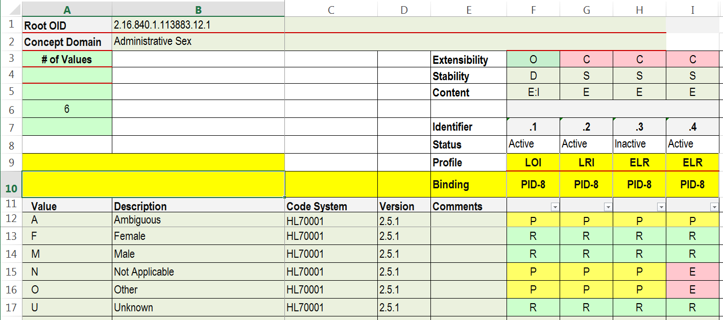
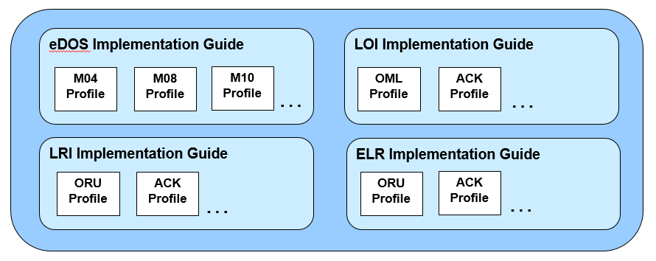
Value Set Package
Value Set Package – Package of Spreadsheets for an extended use case domain (US LAB in this case). Each spreadsheet is created for a concept domain (e.g., Administrative Sex).
HL70001_US_LAB
HL70005_US_LAB
HL70078_US_LAB
HL70203_US_LAB
LONIC_US_LAB
Value Sets – A value set is defined for every use in the extended use case domain (i.e., for every message profile in which a message element is bound to a coded concept domain).
PID-8
PID-8
PID-8

Slide 8
A Column defines a Value Set for a Specific Context
Value Set Spreadsheet Package for US LAB Implementation Guides
HL70001_US_LAB
HL70005_US_LAB
HL70078_US_LAB
HL70203_US_LAB
LONIC_US_LAB
Value Set
Collection =
1 Spreadsheet
Value Set =
1 Column
This context can be at different levels, e.g., data type, field, profile

Slide 9
Value Set Library
Value Set Library – Set of value sets that pertain to a given message profile. For example, all the value sets for the LRI ORU GU RU message profile.
HL70001_US_LAB
HL70005_US_LAB
HL70078_US_LAB
HL70203_US_LAB
LONIC_US_LAB
LRI
LRI
LRI
LRI
LRI
LRI
LRI
Value Sets – A value set is defined for every use in the extended use case domain (i.e., for every message profile in which an message element is bound to a coded concept domain).
LRI ORU GU RU Value Set Library
LRI
PID-8
LRI

Slide 10
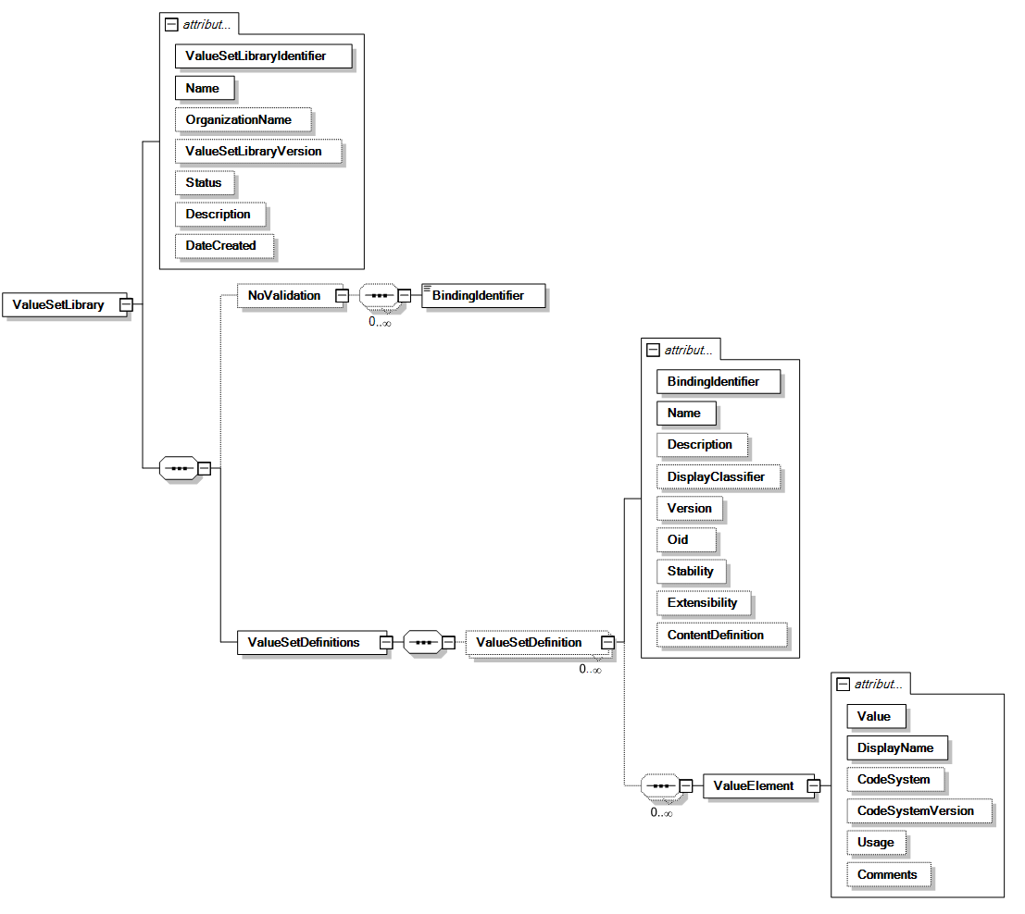
Value Set Library Model (NIST Internal)

Slide 11
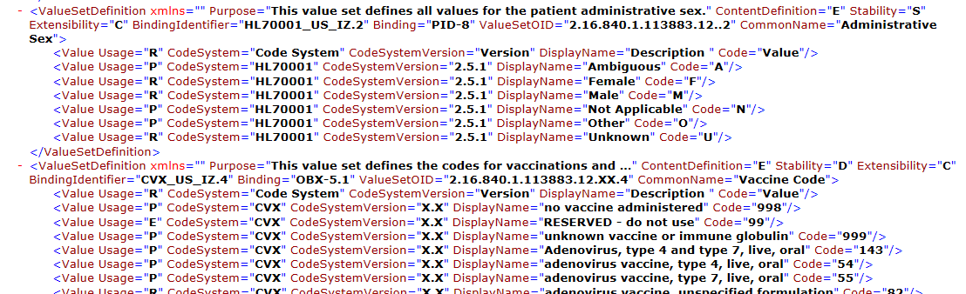
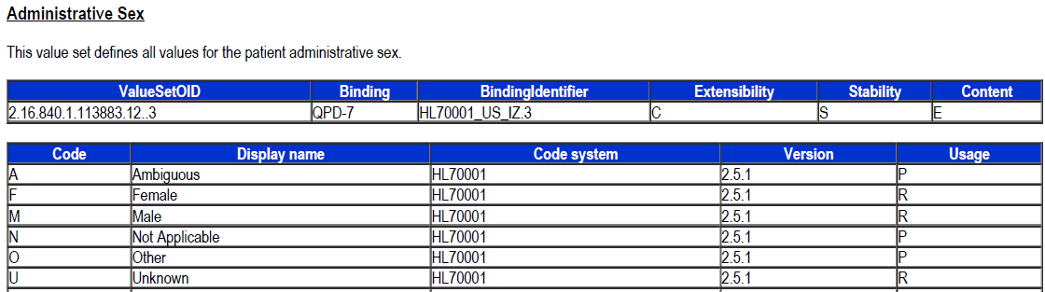
Automatic Generation of Value Set Library

Slide 12
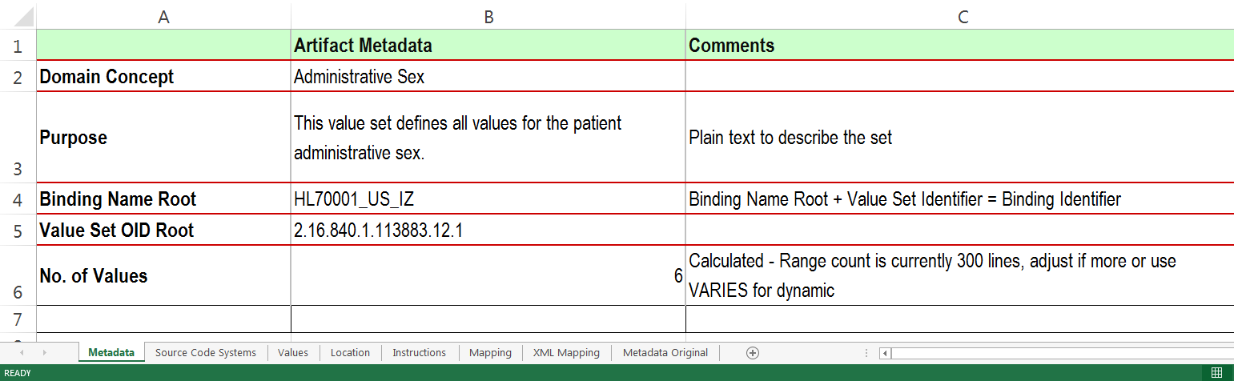
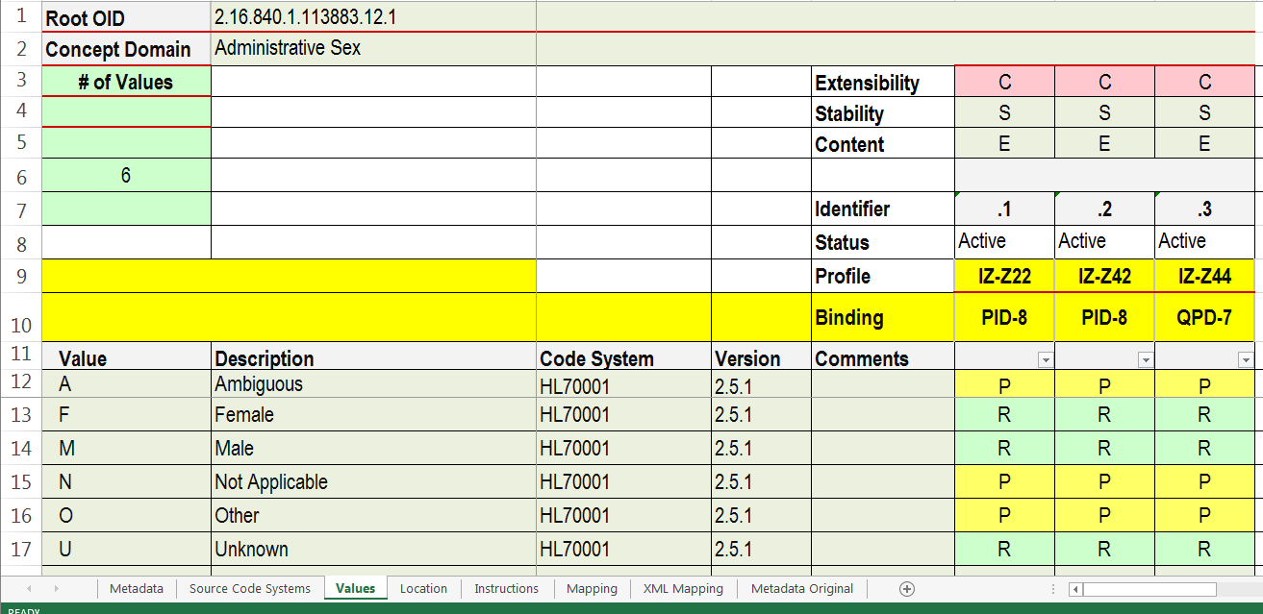
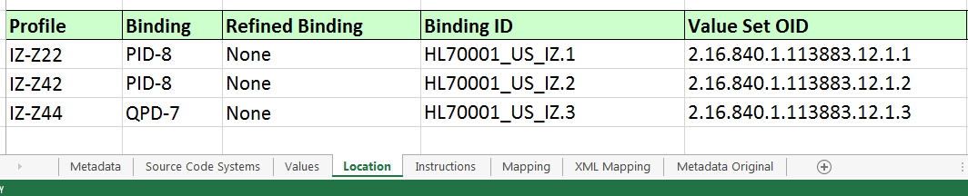
Anatomy of a Value Set Collection

Slide 13
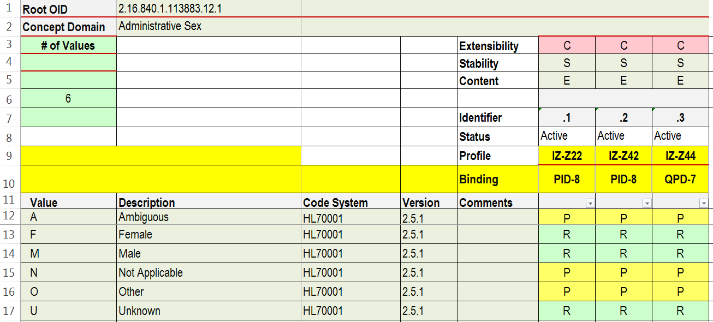
Anatomy of a Value Set Collection: Value Set Definitions
Static or Dynamic
Open or Closed
Extensional or Intensional or both
Individual qualifier that when added to the binding root name or value set root OID provides a unique value set identifier (mnemonic and OID)
Active or inactive
Indicates the profile or profile component in which the value set is applicable to. This can be identified as a profile, profile component, or a combination of both.
In combination with the profile, binding indicates the message element in which the value set applies. This may be a the field or data type level.

Slide 14
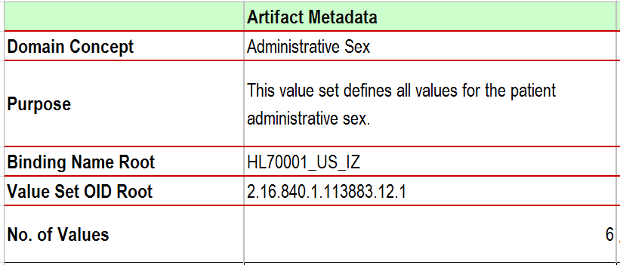
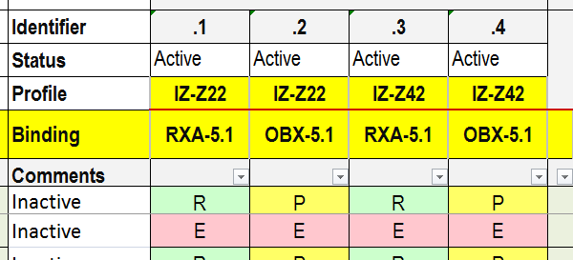
Value Set Naming Convention (Mnemonic Name)
Convention | Root Code System | Domain | Qualifier | Mnemonic Identifier
Example 1 | HL70001 | US_LAB | .1 | HL70001_US_LAB.1
Example 2 | HL70001 | US_IZ | .1 | HL70001_US_IZ.1
Example 3 | CVX | US_IZ | .1 | CVX_US_IZ.1
Example 4 | CVX | US_IZ | .2 | CVX_US_IZ.2
Notes: Use root code system (e.g., HL70001)first so reader quickly identify the concept domain; this convention is consistent with the data type flavor names (e.g., CWE_R).
HL70001_US_IZ + .1 = HL70001_US_IZ.1

Slide 15
Value Set identification Convention (OID)
Convention | Root Code System | Root Code System OID | Qualifier | Value Set OID
Example 1 | HL70001 | 2.16.840.1.113883.12.101 | .1 | 2.16.840.1.113883.12.101.1
Example 2 | HL70001 | 2.16.840.1.113883.12.1 | .1 | 2.16.840.1.113883.12.1.1
Example 3 | CVX | 2.16.840.1.113883.12.292 | .1 | 2.16.840.1.113883.12.292.1
Example 4 | CVX | 2.16.840.1.113883.12.292 | .2 | 2.16.840.1.113883.12.292.2
2.16.840.1.113883.12.1
+
.1
=
2.16.840.1.113883.12.1.1

Slide 16
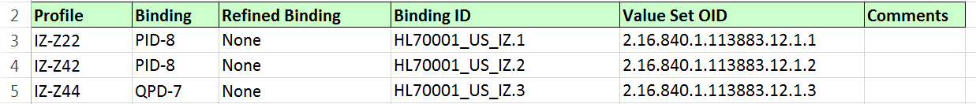
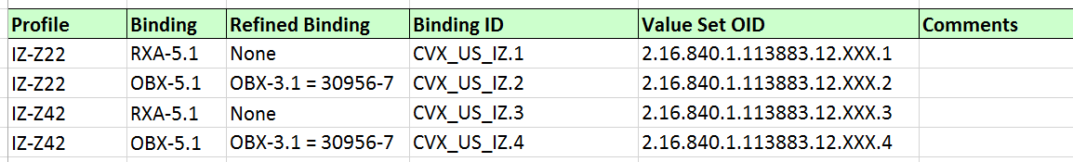
Binding Location

Slide 17
Collection of Spreadsheets to Define Value Sets
Value Set Spreadsheet Package for US LAB Implementation Guides
HL70001_US_LAB
HL70005_US_LAB
HL70078_US_LAB
HL70203_US_LAB
LONIC_US_LAB

Slide 18
Value Sets are Bound to a Specific Message Element
Value Set Spreadsheet Package for US LAB Implementation Guides
Patient Identification Segment (PID)
Seq | Element Name | DT | Usage | Cardinality | Value Set | Conformance Binding | Comments
 | …
8 | Administrative Sex | IS | R | [1..1] | HL70001_LRI | Mandatory
9 | Patient Alias |  | X
10 | Race | CE | RE | [0..*] | HL70005 | Recommended
 | … |  | O
17 | Religion | CWE | O |  | HL70006 | Mandatory

Slide 19
Statement of Proposal
Specify the binding of a value set to a message element
Specify the conformance strength of the binding
Specify the value set definition
Define value (code) usage codes and their use
Handle coding exceptions with the definition of the data type
1.
2.
3.
4.
5.
1.
1.
2.
Patient Identification Segment (PID)
Seq | Element Name | DT | Usage | Cardinality | Value Set | Binding Strength | Comments
 | …
8 | Administrative Sex | IS | R | [1..1] | LRI_HL70001 | Mandatory
9 | Patient Alias |  | X
10 | Race | CE | RE | [0..*] | HL70005 | Recommended
 | … |  | O
17 | Religion | CWE | O |  | HL70001 | Mandatory
4.
Usage | Name
R | Required
P | Permitted (applicable to constrainable profiles only)
E | Excluded
Attribute | Value | Attribute | Value
ID: | HL70001_LRI | Base ID: | HL70001
Name: | LRI Administrative Sex | Base Name: | Administrative Sex
Version: | 1.0 | Code System: | HL7 2.5.1
Value Set Type: | Internal | Content Definition: | Extensional
Extensibility: | Closed | Stability: | Static
5.
Code Required? Specification
Code Required |  | Code Not Required
Element | Usage | Element | Usage
CWE.1 | R | CWE.1 | RE
CWE.2 | RE | CWE.2 | C(R/RE)
CWE.3 | R | CWE.3 | R
… | … | … | …
CWE.9 | RE | CWE.9 | RE
3.
HL70001_LRI (Constrained): HL7 Table 0001 Administrative Sex
Value | Description | Usage | Code System | Comments
F | Female | R | V2.5 HL70001
M | Male | R | V2.5 HL70001
U | Unknown | R | V2.5 HL70001

Slide 20
Key Observations of the Proposal
Proposal provides methodology to specify:
The conformance binding of a value set definition to a message element (i.e., the conformance requirements of the binding)
The value set definition
The V2 table definition and binding mechanisms are superseded by this methodology
That is, the value set binding and definition define conformance requirements
The data type no longer influences conformance requirements
A value set definition includes:
A set of informational attributes defining the properties including the name, identifier, version, etc.
A clear explanation of associated conformance requirements
The Usage of the codes
The extensibility of the value set
The stability of the value set
Classification of value set definitions
Based on the extensibility and stability properties
Aids IG authors when defining the expectation for this IG and derived IGs
Initial focus is on the HL7 Tables (i.e., HL7nnnn)

Slide 21
1) Binding a Value Set to a Message Element
Patient Identification Segment (PID)
Seq | Element Name | DT | Usage | Cardinality | Value Set | Comments
 | …
8 | Administrative Sex | IS | R | [1..1] | HL70001_US_LAB.1
9 | Patient Alias |  | X
10 | Race | CE | RE | [0..*] | HL70005_US_LAB.1
 | … |  | O
17 | Religion | CWE | O |  | HL70001
Nothing new
Indicates that the HL70001_US_LAB.1 value set is to be used for message element PID.8 (Administrative Sex)
Naming convention for HL7 Tables [binding_name_root.identifier]
HL70001_US_LAB.1 is the symbolic name of the value set
This provides the link to the value set
The value set will have an OID assigned to it
The identifier is the extension given in the SS column
HL70001_US_LAB.1 = Binding Identifier
Details of the requirements are specified elsewhere

Slide 22
2) Binding Strength
Patient Identification Segment (PID)
Seq | Element Name | DT | Usage | Cardinality | Value Set | Binding Strength | Comments
 | …
8 | Administrative Sex | IS | R | [1..1] | HL70001_US_LRI.1 | Required | Hard Requirement
9 | Patient Alias |  | X
10 | Race | CE | RE | [0..*] | HL70005_US_LAB.1 | Suggested | Best Practice
 | … |  | O
16 | Marital Status | CE | O |  | HL70002 | Unspecified | To be determined if used
17 | Religion | CWE | O |  | HL70006_US_LAB.4 | Required | Provisional
Specifies the “conformance strength” of the binding (Called “Binding Strength”)
Options for Binding Strength in Constrainable Profiles:
Required (R) - The system SHALL support the value set
Suggested (S) - The system SHOULD support the value set
Unspecified (U) – Not determined at this stage of specification
For implementation profiles all value sets that are bound to a message element SHALL BE specified as Required. Suggested and Unspecified can only be specified in constrainable profiles and have no conformance implications (i.e., there are no requirements associated with these bindings).
The base level Data Type “Binding Strength” implications are no longer relevant since their definitions are not rich enough in V2 to support the array of bindings necessary
For example, the “IS” data type association to element does not specify any requirements with regard to the use of the value set; the DT only declares structural requirements

Slide 23
Short-Hand Notation: Binding and Binding Strength
Patient Identification Segment (PID)
Seq | Element Name | DT | Usage | Cardinality | Value Set | Binding Strength | Comments
 | …
8 | Administrative Sex | IS | R | [1..1] | HL70001_US_LRI.1 | Required | Hard Requirement
9 | Patient Alias |  | X
10 | Race | CE | RE | [0..*] | HL70005_US_LAB.1 | Suggested | Best Practice
 | … |  | O
16 | Marital Status | CE | O |  | HL70002 | Unspecified | To be determined if used
17 | Religion | CWE | O |  | HL70006_US_LAB.4 | Required | Provisional
Replace with this notation:
Patient Identification Segment (PID)
Seq | Element Name | DT | Usage | Cardinality | Value Set | Comments
 | …
8 | Administrative Sex | IS | R | [1..1] | R:HL70001_US_LRI.1 | Hard Requirement
9 | Patient Alias |  | X
10 | Race | CE | RE | [0..*] | S:HL70005_US_LAB.1 | Best Practice
 | … |  | O
16 | Marital Status | CE | O |  | U:HL70002 | To be determined if used
17 | Religion | CWE | O |  | R:HL70006_US_LAB.4 | Provisional

Slide 24
3) Value Set Definition
Value Definition is composed of:
Meta-Data
Set of Codes
Some attributes are required to be specified and some are optional
Value Set Meta Data (at minimum, other metadata cab be included—TDB)
Attribute | Value | Attribute | Value
Binding Identifier | HL70001_US_LAB.1 | Extensibility | Closed
Value Set OID | 2.16.840.1.113883.12.1 | Stability | Static
Domain Concept | Administrative Sex | Content Definition | Extensional
Purpose | Use is for Administrative Gender
Set of Codes
HL70001_LAB (Constrained): HL7 Table 0001 Administrative Sex
Value | Description | Usage | Code System | Code System Version | Comments
F | Female | R | HL70001 | 2.5.1
M | Male | R | HL70001 | 2.5.1
U | Unknown | R | HL70001 | 2.5.1

Slide 25
3A) Value Set Definition – Meta Data
Attribute | Definition
Symbolic ID: | Provides an unique ID for the value set. The Symbolic ID is used in the message element definition to link the value set to the message element.
Value Set OID | OID assigned to the value set. Provides the unique ID to access the value set in terminology servers.
Name: | More human readable name of the Value Set; Recommended to tie to origin and use (e.g., LAB Administrative Sex derived from the HL7 Standard name Administrative Sex)
Value Set Version: | Defines the version of the value set – this allows for a constant Symbolic ID and OID
Value Set Locality: | Indicates where the value set is defined. The two possibilities are Internal and External. Internal is an HL7 SDO defined value set and is often given explicitly in the implementation guide. External is defined by an external SDO and often is not given explicitly in the implementation guide.
Extensibility: | Indicates whether a value set can be extended in a derived profile. Extensibility has two states, Open and Closed. For Open Extensibility, the value set may be extended in a derived profile. For Closed Extensibility, the value set may not be changed in a derived profile.
Base ID: | The Symbolic name from the origin source (for HL7 V2 tables, this is the HL7 Table Identifier, e.g., HL70001).
Code Set OID | OID assigned to the Code System.
Base Name: | Name from the origin source of the code system/table (e.g., Administrative Sex)
Source/Code System: | Identifier of the source/code system or code systems the values were drawn from
Content Definition: | Indicates how the codes in the value set are presented either extensional (i.e., enumerated) or intensional (i.e., algorithmically).
Stability: | Indicates whether the value set can be updated outside the scope of the implementation guide. Static indicates that values are fixed. Dynamic indicates that definitions are fixed, but the values in the set may vary as new versions of the code system upon which they are based are released. Dynamic value sets are controlled external stewards.
Purpose: | Provides a description and use of the value set.
Candidate list of attributes and definitions - will need refinement and likely based on the S&I Framework/HL7 Value Set project (in progress)

Slide 26
Value Set Classification
There are 2 attributes that have conformance implications and are the basis for establishing a value set classification
IG authors reviews the requirements for the value set and select from a classification
The attributes include Extensibility and Stability
Extensibility
Open- The value set may be extended in a derived profile. This would apply where local sites (or realms) need latitude to extend the value set to meet their requirements. This would also apply in cases which a standard code does not exist to represent all concepts. [Local codes allowed]
Closed- The value set is fixed in derived profiles (All possible codes are given, i.e., as R or P). [A closed set prohibits local (or realm) extensions.]
Stability
Static- The member list (values) is fixed forever. If there is to be a new member definition then it becomes a new value set with new identifier.
Dynamic- The member list (values) may change as new versions of the code system upon which they are based are released. Existing value/concept pairs always remain fixed (i.e., if A = Apple, A will always mean Apple).

Slide 27
3B) Set of Codes Specification
Value and Description are required
Usage and Code System are optional
If usage is not explicitly specified, rules are defined that govern their interpretation
All codes listed are R-Required
Codes not listed: in closed value set are E-Excluded and in an open value set are P-Permitted
If the code system is not explicitly specified, then the code system is that which is defined in the value set meta data
When multiple code systems are used to define a value set, the code system must be explicitly stated
There are multiple ways to express in an IG (2 examples below)
HL70001_LAB: LAB Administrative Sex
Value | Description | Usage | Code System | Comments
A | Ambiguous | E | V2.5 HL70001
F | Female | R | V2.5 HL70001
M | Male | R | V2.5 HL70001
N | Not Applicable | E | V2.5 HL70001
O | Other | R | V2.5 HL70001
U | Unknown | P | V2.5 HL70001
HL70001_LAB: LAB Administrative Sex
Value | Description | Comments
A | Ambiguous
F | Female
M | Male
N | Not Applicable
O | Other
U | Unknown

Slide 28
Profile Hierarchy and Value Set Usage Allowable Constraints
Profile Hierarchy
Example
Allowable Constraints
Standard
(Open Framework)
HL7 V2 Base
Permitted (P)
Constrainable
Profile A
(Add Constraints)
National
S&I Framework
R
P
E
Constrainable
Profile B
(Add Constraints)
Vendor
e.g., generic implementation
Derived Profiles
R
P
E
Implementation Profile
(No Optionality)
Vendor
(as implemented)
R
E

Slide 29
4) Define Value (Code) Usage (Constrainable Profile)
This is for conformance testing; need to have table indicating requirements for sender/receiver.
Need to indicate that R for the receiver is just a capability. Not that it is a must requirement that the sender every provide. This is different then R for message elements.
Usage | Name | Conformance
R | Required | The system SHALL support the code.
 |  | Conformance Assessment
 |  | If the concept being expressed is represented by the code, then that code SHALL be sent.
P | Permitted (applicable to constrainable profiles only) | Designates that the code in a derived profile may be agreed upon to be R-Required, P-Permitted, or E-Excluded
 |  | Conformance Assessment
 |  | If the code is present in the message an error SHALL NOT be raised. *
E | Excluded | The code SHALL NOT be supported.
 |  | Conformance Assessment
 |  | The system SHALL NOT support the code. If the code is present an error SHALL be raised.
Base Usage | Allowable Usage in Derived Profile
R | R
A | R, P**, E (**Not permitted in implementation profile)
E | E
* Our testing perspective here is at the constrainable profile level, however, we are testing an implementation that may have decided to support the permitted code (based on the requirements in a derived profile). Therefore, if we see the code we can’t make a definitive determination. The same principle applies to value sets that are open and don’t explicitly mark codes with permitted usage. For closed we rule out all not in the R, P, or E set.

Slide 30
Extensibility Implications for Unspecified Codes
Open
All codes not explicitly specified with a usage code default to P-Permitted
i.e., codes in a code system and not explicitly specified in the value set and all potential local codes
Closed
All codes not explicitly specified with a usage code default to E-Excluded
i.e., codes in a code system and not explicitly specified in the value set and all potential local codes
P usage is allowed in a closed value set; the value set is extendable in this sense (but in a fully closed-pre-defined manner)

Slide 31
5) Handling Coded with Exceptions & Code with No Exception
Coded with/without exceptions is an orthogonal concept to value set binding strength and specification (i.e., it is another dimension)
In the base HL7 standard this concept is captured in the data type declaration
CNE – coded with no exception (A code is always required)
CWE – coded with exception (If the concept wanting to be expressed doesn’t exist in the value set then text can be sent in lieu of)
It does not mean that a local code can be sent (upon agreement, the value set could be extended)
Issue: Current specifications often override the intent of the data type since authors want to further constrain the requirements (i.e., a CWE data type flavor requires CWE.1), thus making the implications of the CWE data type meaningless and confusing (i.e., it is now a CNE)
Issue: Data type definitions requirements are co-mingled with conformance/binding/code strength requirements (not a good idea)
Issue: There is no guidance for constraining a data type (i.e., can a CWE be constrained to a CNE; such guidance is not in the base standard or the conformance chapter)—not saying that it should be
The concept of CNE and CWE data type should disappear (or effectively disappear with the proposed specification presented here)
Simple and Complex Coded Element definitions are sufficient

Slide 32
Justification for Overriding CWE and CNE Standard Definitions
CNE and CWE are not “rich” enough to cover the potential constraints an IG Authors want to place on value sets
We may want a combination of points 1, 2, and 3 below.
In cases where the base standard is CWE but we want the data type to be CNE or something close to the CNE data type. No formal mechanism to make CWE → CNE.
From HL7 V2.5.1 (Section 2.5.3.6)
The data type for the field will be CWE if 1) other tables are allowed in the field or 2) the external table may be locally extended or 3) when the code may be replaced by local text.
The data type for the field will be CNE if 1) no other table is allowed in the field and 2) the external table may not be locally extended and 3) text may not replace the code. A CNE field must have an HL7 defined or external table associated with it. It must be specified in the standard.
The solution is to declared the constraints either in the value set definition or the data type definition
In essence there should really only be a single complex coded element DT
For point 1 above, this is covered by the value set definition
For point 2 above, this is covered by the value set definition (Extensibility)
For point 3 above, this is covered by the data type definition
The last point (for CNE) is covered by the “binding strength”

Slide 33
Proposed: Handling Coded-with-Exception (Ex. Version 2.5.1)
The data type definitions control whether text can replace a code
CWE.1 can be specified as R to always require a code, and CWE.1 can be set to RE to allow free text in place of the code
Setting CWE.1 to RE indicates that if the concept desired to be expressed is not available in the value set then free text can be sent; if a code does exist the code SHALL be sent
Table 5‑1. Coded with Exceptions − Code Required But May Be Empty (CWE_CRE)
SEQ | Component Name | DT | Usage | Value Set | Comments
1 | Identifier | ST | RE
2 | Text | ST | C(R/RE) |  | Condition Predicate: If CWE_CRE.1 (Identifier) is not valued It is strongly recommended that text be sent to accompany any identifier. When a coded value is not known, the text element (CWE_CRE.2) is used to carry the text, not the original text (CWE_CRE.9) element.
3 | Name of Coding System | ID | R | HL70396 | Indicates the code system for the identifier or the code system or value set for the text when an identifier is not found for the concept.
4 | Alternate Identifier | ST | O
5 | Alternate Text | ST | O
6 | Name of Alternate Coding System | ID | O | HL70396
7 | Coding System Version ID |  | O
8 | Alternate Coding System Version ID |  | O
9 | Original Text | ST | RE |  | Original Text is used to convey the text that was the basis for coding (CWE.1, CWE.4) or text (CWE.2, CWE.5)
All other elements optional (in 2.7 and beyond, note 2.6 and 2.7 are different than 2.5.1 and prior)

Slide 34
Process of Creating a Value Set
Value Set 1
Value | Description
M | …
F | …
O | …
HL7 2.5.1 0001
Value | Description
M | …
F | …
O | …
U | …
N | …
Value set is a “view” of the Code System or Code Systems
Next: Determine value set attributes (e.g., open/closed)
Value Set 2
Value | Description
M | …
F | …
O | …
N | …
Code System (Note, not all (or any?) HL7 tables are technically code systems but we will refer to them as if they are—irrelevant for this proposal since there is a project to make HL7 tables code systems and assigned as OID to them)
Once we specify the value set and bind it to an element with conformance, these become the binding requirements; the underlying characteristics of the original table (Code System), e.g., HL7 or User, and the implied “binding strength” are no longer relevant.
Only include values that are pertinent to the use of the element it is bound to (and supportive of the defined use case)

Slide 35
Process of Creating a Value Set – Using Code Usage
Value Set 1
Value | Usage | Description
M | R | …
F | R | …
O | R | …
U | E | …
N | E | …
HL7 2.5.1 0001
Value | Description
M | …
F | …
O | …
U | …
N | …
Value set is a “view” of the Code System or Code Systems
Value Set 2
Value | Usage | Description
M | R | …
F | R | …
O | R | …
U | E | …
N | R | …

Slide 36
Process of Creating a Value Set (using multiple code systems)
Value Set 1
Value | Description | Code System
X | … | CDC Gender
Y | … | CDC Gender
O | … | HL7 2.5.1 0001
HL7 2.5.1 0001
Value | Description
M | …
F | …
O | …
U | …
N | …
Value set is a “view” of the Code System or Code Systems
Value Set 2
Value | Description | Code System
X | … | CDC Gender
Y | … | CDC Gender
O | … | HL7 2.5.1 0001
N | … | HL7 2.5.1 0001
CDC Gender
Value | Description
X | …
Y | …
Z | …
Value Set 3
Value | Description | Code System
M | … | HL7 2.5.1 0001
F | … | HL7 2.5.1 0001
O | … | HL7 2.5.1 0001
Z | … | CDC Gender
Code Systems

Slide 37
Process of Creating a Value Set (using multiple code systems)
HL7 2.5.1 0001
Value | Description
M | …
F | …
O | …
U | …
N | …
Value Set 1
Value | Usage | Description | Code System
X | R | … | CDC Gender
Y | R | … | CDC Gender
Z | E | … | CDC Gender
M | E | … | HL7 2.5.1 0001
F | E | … | HL7 2.5.1 0001
O | R | … | HL7 2.5.1 0001
U | E | … | HL7 2.5.1 0001
N | E | … | HL7 2.5.1 0001
Value set is a “view” of the Code System or Code Systems
CDC Gender
Value | Description
X | …
Y | …
Z | …
Value Set 2
Value | Usage | Description | Code System
X | R | … | CDC Gender
Y | R | … | CDC Gender
Z | E | … | CDC Gender
M | E | … | HL7 2.5.1 0001
F | E | … | HL7 2.5.1 0001
O | R | … | HL7 2.5.1 0001
U | E | … | HL7 2.5.1 0001
N | R | … | HL7 2.5.1 0001
Value Set 3
Value | Usage | Description | Code System
X | E | … | CDC Gender
Y | E | … | CDC Gender
Z | R | … | CDC Gender
M | R | … | HL7 2.5.1 0001
F | R | … | HL7 2.5.1 0001
O | R | … | HL7 2.5.1 0001
U | E | … | HL7 2.5.1 0001
N | E | … | HL7 2.5.1 0001
Code Systems

Slide 38
Examples Value Set Specifications (Constrainable Profile)
V2.5.1 HL70000
Value
A
B
C
D
E
F
Important: The concept represented by the code must always be maintained in the value set definition (e.g., if B = Ball, it must always mean Ball, not Basketball).
Code System (Tables)
Extensibility
Open
Closed
Open
Closed
(Explicit)
(Explicit)
HL70000-A3
Value
A
C
F
HL70000-A5
Value
A
C
F
HL70000-A1
Value | Usage
A | R
B | P
C | R
D | E
E | E
F | R
Allowed to add local codes
HL70000-A2
Value | Usage
A | R
B | P
C | R
D | E
E | E
F | R
(Implicit)
(Implicit)
(Explicit)
(Explicit)
Value Set
HL70000-A4
Value | Usage
A | R
B | P
C | R
D | P
E | P
F | R
Allowed to add local codes
HL70000-A6
Value | Usage
A | R
B | E
C | R
D | E
E | E
F | R
D and E are excluded; B & local codes are allowed in a derived profile
B is allowed and D, E, & local codes are excluded
B, D, E, & local codes are allowed in a derived profile
B, D, E, & local codes are excluded
Interpretation
Stability
Pick Static/Dynamic
Pick Static/Dynamic
Pick Static/Dynamic
Pick Static/Dynamic

Slide 39
Implications of the Specification: Example 1
Attribute | Value | Attribute | Value
Symbolic ID: | HL70000-A1 | Base ID: | HL70000
Value Set OID | 2.16.840.1.113883.XX.X | Code System OID | 2.16.840.1.113883.XX.X
Name: | My Example | Base Name: | Example
Value Set Version: | 1.0 | Source/Code System: | V2.5.1 HL70000
Value Set Locality: | Internal | Content Definition: | Extensional
Extensibility: | Open | Stability: | Static
Purpose | This is a value set is for demonstration purposes.
Conformance Requirements | The system SHALL support the codes A, C, and F. The system SHALL NOT support codes D and E
Specification Options for a Derived Profile | In a Constrainable Profile the code B MAY BE further specified as R or E, or remain P In an Implementation Profile the code B SHALL BE further specified as R or E Additional codes are allowed to be added to the value set
Testing (If the Constrainable Profile is all I know about) | Support for codes A, C, and F can be tested Non-support for code D and E can be tested B cannot be tested because the usage requirement is unknown Additional codes cannot be tested because the requirement is unknown
Testing (if the Implementation Profile is provided) | All codes in the value set can be tested In this case B would have had to be specified as R or E and any local codes added would have code usage of R
HL70000-A1
Value | Usage
A | R
B | P
C | R
D | E
E | E
F | R
Allowed to add local codes
Binding= Required

Slide 40
Implications of the Specification: Example 2
Attribute | Value | Attribute | Value
Symbolic ID: | HL70000-A2 | Base ID: | HL70000
Value Set OID | 2.16.840.1.113883.XX.X | Code System OID | 2.16.840.1.113883.XX.X
Name: | My Example | Base Name: | Example
Value Set Version: | 1.0 | Source/Code System: | V2.5.1 HL70000
Value Set Locality: | Internal | Content Definition: | Extensional
Extensibility: | Closed | Stability: | Static
Purpose | This is a value set is for demonstration purposes.
Conformance Requirements | The system SHALL support the codes A, C, and F. The system SHALL NOT support codes D and E
Specification Options for a Derived Profile | In a Constrainable Profile the code B MAY BE further specified as R or E, or remain P In an Implementation Profile the code B SHALL BE further specified as R or E Additional codes are NOT allowed to be added to the value set
Testing (If the Constrainable Profile is all I know about) | Support for codes A, C, and F can be tested Non-support for code D and E can be tested B cannot be tested because the usage requirement is unknown Additional codes CAN BE tested (if present then it is an error)
Testing (if the Implementation Profile is provided) | All codes in the value set can be tested In this case B would have had to be specified as R or E
HL70000-A2
Value | Usage
A | R
B | P
C | R
D | E
E | E
F | R
Binding= Required

Slide 41
Implications of the Specification: Example 3
Attribute | Value | Attribute | Value
Symbolic ID: | HL70000-A3 | Base ID: | HL70000
Value Set OID | 2.16.840.1.113883.XX.X | Code System OID | 2.16.840.1.113883.XX.X
Name: | My Example | Base Name: | Example
Value Set Version: | 1.0 | Source/Code System: | V2.5.1 HL70000
Value Set Locality: | Internal | Content Definition: | Extensional
Extensibility: | Open | Stability: | Static
Purpose | This is a value set is for demonstration purposes.
Conformance Requirements | None
Specification Options for a Derived Profile | The IG authors are suggesting that the specified value set be used however there is no obligation to do so in the implementation Any set of codes could be specified
Testing (If the Constrainable Profile is all I know about) | Support for codes A, C, and F can be tested and a warning could be issued (Note that this is not however a failure; the system is still considered to be conformant) Non-support for code D and E can be tested and a warning could be issued (Note that this is not however a failure; the system is still considered to be conformant) B cannot be tested because the usage requirement is unknown Additional codes cannot be tested because the requirement is unknown
Testing (if the Implementation Profile is provided) | All codes in the value set can be tested In this case a value set would have been fully specified, either the recommended value set or another value set
HL70000-A3
Value | Usage
A | R
B | P
C | R
D | E
E | E
F | R
Allowed to add local codes
Binding= Suggested
or Undetermined

Slide 42
Implications of the Specification: Example 4
Attribute | Value | Attribute | Value
Symbolic ID: | LOINC_LRI | Base ID: | LOINC
Value Set OID | 2.16.840.1.113883.XX.X | Code System OID | 2.16.840.1.113883.XX.X
Name: | MyLONIC | Base Name: | Example
Value Set Version: | X.X | Source/Code System: | LONIC Y.X.X
Value Set Locality: | External | Content Definition: | Extensional
Extensibility: | Closed | Stability: | Dynamic
Purpose | This is a value set is for demonstration purposes.
Conformance Requirements | The system SHALL support the codes A, C, and F. The system SHALL NOT support codes D and E
Specification Options for a Derived Profile | In a Constrainable Profile the code B MAY BE further specified as R or E, or remain P In an Implementation Profile the code B SHALL BE further specified as R or E Additional codes are NOT allowed to be added to the value set
Testing (If the Constrainable Profile is all I know about) | Support for codes A, C, and F can be tested Non-support for code D and E can be tested B cannot be tested because the usage requirement is unknown Additional codes CAN BE tested (if present then it is an error)
Testing (if the Implementation Profile is provided) | All codes in the value set can be tested In this case B would have had to be specified as R or E
LONIC – Version X.X
Value | Code System
123-1 | LN
234-1 | LN
234-2 | LN
332-9 | LN
747-1 | LN
583-3 | LN
Binding= Required

Slide 43
Example: Untangling Value Set Usage – Typical Approach
This example illustrates the case where the same original HL7 Table is needed to be used for different message elements. In this case multiple value sets are created that draw upon the base HL7 Table (i.e., code system) → See Next Slide.
Message Header Segment (MSH)
Seq | Element Name | DT | Usage | Cardinality | Value Set | Comments
… | …
15 | Accept Acknowledgment Type | ID | R | [1..1] | HL70155
16 | Application Acknowledgment Type | ID | R | [1..1] | HL70155
… | …
HL70155 – Accept/Application Acknowledgment Conditions – Code System
Value | Description | Comment
AL | Always
ER | Error/reject conditions
NE | Never
SU | Successful completion only
Specification is what is in LOI and what is typically specified in implementation guides
Implications are that all codes for MSH.15 and MSH.16 are required to be supported and are valid; we determined this is not the case
Our current solution is to make explicit requirements (conformance statements) for their appropriate use
This is OK, especially for small value sets (are there alternatives?)

Slide 44
Example: Untangling Value Set Usage – Alternative Approach
Two value sets are created drawn from the same code system
Need to define value set meta data attributes (e.g., here the extensibility is closed)
Message Header Segment (MSH)
Seq | Element Name | DT | Usage | Cardinality | Value Set | Binding Strength | Comments
… | …
15 | Accept Acknowledgment Type | ID | R | [1..1] | LOI_HL70155_1 | Required
16 | Application Acknowledgment Type | ID | R | [1..1] | LOI_HL70155_2 | Required
… | …
LOI_HL70155_1 - Accept Acknowledgment Value Set
Value | Description | Usage | Comment
AL | Always | R
ER | Error/reject conditions | E
NE | Never | P | ”Describe circumstance where appropriate”
SU | Successful completion only | E
LOI_HL70155_2 – Application Acknowledgment Value Set
Value | Description | Usage | Comment
AL | Always | E
ER | Error/reject conditions | E
NE | Never | R
SU | Successful completion only | P

Slide 45
Example: Using Multiple Code Systems
Attribute | Value | Attribute | Value
ID: | 2.16.840.1.114222.4.11.3589 | Base ID:
Name: | Observation Identifier (SS) | Base Name: | Observation Identifier
Version: | 1.0 | Code System: | LN; PHINQUESTION
Value Set Type: | External | Content Definition: | Extensional
Extensibility: | Open | Stability: | Dynamic
Observation Identifier (Syndromic Surveillance)
Value | Description | Code System | Comments
11289-6 | Body temperature:Temp:Enctrfrst:Patient:Qn: | LN
11368-8 | Illness or injury onset date and time:TmStp:Pt:Patient:Qn: | LN
21612-7 | Age Time Patient Reported | LN
44833-2 | Diagnosis.preliminary:Imp:Pt:Patient:Nom: | LN
54094-8 | Triage note:Find:Pt:Emergency department:Doc: | LN
59408-5 | Oxygen saturation:MFr:Pt:BldA:Qn:Pulse oximetry | LN
8661-1 | Chief complaint:Find:Pt:Patient:Nom:Reported | LN
SS001 | Treating Facility Identifier | PHINQUESTION
SS002 | Treating Facility Location | PHINQUESTION
SS003 | Facility / Visit Type | PHINQUESTION

Slide 46
Conformance
Usage
Required: The System SHALL support all R-Required codes.
Excluded: The System SHALL NOT support E-Excluded codes.
Permitted: Determined to be R or E in a derived profile. However, in a constrainable profile testing will treat P as a MAY. If it is present an error can’t be issue, and test cases can’t require it.
Extensibility
Closed: All codes not explicitly listed default to E-Excluded usage
The system SHALL support the R codes
The system SHALL NOT support the E codes
The system MAY support the P codes
Open: All codes not explicitly listed default to P-Permitted usage

Slide 47
Value Set Consistency with Respect to the Profile Type
When building a value set that is unattached to a conformance profile, the value set will assume properties of being bound to a constrainable profile—there is no other alternative
Unless the creator explicitly states that the intent of the value set is for an implementation profile
An option in the tooling sets the consistency check function to constrainable or implementation
This is not to say that the value set now has to be bound in this manner; it only indicates how the value set is being checked for correctness
Therefore, by default consistency checks are performed with respect to a constrainable profile (option to change to implementable)
If the value set is ultimately bound to an implementation profile then additional consistency checks can be performed (when the binding is applied)
The next slide indicates the consistency checks that apply depending on the context

Slide 48
Consistency Checks
Setting = Constrainable
Tool will provide constraints but some maybe imported
Usage: Only R, P, and E
Extensibility: Closed/Open
Stability: Static/Dynamic
Content Definition: Extensional/Intensional
Locality: Internal/External
Free Edit Allowed
Setting = Implementable
Usage: Only R and E
Extensibility: Only Closed
Stability: Static/Dynamic
Content Definition: Extensional/Intensional
Locality: Internal/External
Only codes from code systems can be added (no free edit)

Slide 49
HL7 V2 Vocabulary Specification
NIST Implementation and Mappings

Slide 50
Definitions and Relationships of Profiles and Value Sets
Implementation Guide (Integration Profile)
A collection of conformance profiles (interactions, e.g., messages) grouped together to target a specific workflow
For example, the HL7 2.5.1 R1.5 Immunization Implementation Guide (which contains 8 conformance profiles). The workflow supports sending and acknowledging immunization reporting, querying for immunizations, and responding with immunization histories and forecasts.
Conformance Profile
Equates to 1 (and only 1) interaction (message)
This is the level in which we specify requirements at in the implementation guide (independently, or at least we should be although some guides are comingling requirements).
Value Set Library
The collection of value sets that pertain to a conformance profile.
Note: These definitions and relationships are conceptual views and not an indication how one might implement. For example, all value set for a given implementation guide could be maintain as a single entity or could reside in a “global” terminology server.

Slide 51
Working Slides
The following slides are work-in-progress slides.

Slide 52
Value Set Organization
Value Set Library
Contains a collection of value set definitions for a conformance profile
For every value set spreadsheet in the package extract the value set column for the given conformance profile.
Value Set Definition
Contains the list of value set elements and identification meta data.
Value Set Element
Code
Description
Code System
Code System Version
Usage
Required
Permitted
Excluded

Slide 53
Possible Combinations of Attributes for each Value Set
Item | Extensibility (Open/Closed) | Stability (Static/Dynamic) | Code Requirement (Code Only/ Text Allowed) | Binding Strength (Required/ Suggested/ Undetermined) | Implications
1 | Open | Static | Code Only | Required
2 | Open | Static | Code Only | Suggested
3 | Open | Static | Code Only | Undetermined
4 | Open | Static | Text Allowed | Required
5 | Open | Static | Text Allowed | Suggested
6 | Open | Static | Text Allowed | Undetermined
7 | Open | Dynamic | Code Only | Required
8 | Open | Dynamic | Code Only | Suggested
9 | Open | Dynamic | Code Only | Undetermined
10 | Open | Dynamic | Text Allowed | Required
11 | Open | Dynamic | Text Allowed | Suggested
12 | Open | Dynamic | Text Allowed | Undetermined
13 | Closed | Static | Code Only | Required
14 | Closed | Static | Code Only | Suggested
15 | Closed | Static | Code Only | Undetermined
16 | Closed | Static | Text Allowed | Required
17 | Closed | Static | Text Allowed | Suggested
18 | Closed | Static | Text Allowed | Undetermined
19 | Closed | Dynamic | Text Allowed | Required
20 | Closed | Dynamic | Text Allowed | Suggested
21 | Closed | Dynamic | Text Allowed | Undetermined
22 | Closed | Dynamic | Code Only | Required
23 | Closed | Dynamic | Code Only | Suggested
24 | Closed | Dynamic | Code Only | Undetermined

Slide 54
1) Code Required and 2) Code Not Required (Text Allowed) Specifications
1)
Table 5‑1. Coded with No Exceptions − Code Required (CWE_CR) OR CNE
S | Component Name | DT | Usage | VS | Comments
1 | Identifier | ST | R
2 | Text | ST | RE |  | It is strongly recommended that text be sent to accompany any identifier.
3 | Name of Coding System | ID | R | HL70396 | Indicates the code system for the identifier or the code system or value set for the text when an identifier is not found for the concept.
4 | Alternate Identifier | ST | O
5 | Alternate Text | ST | O
6 | Name of Alternate Coding System | ID | O | HL70396
7 | Coding System Version ID |  | O
8 | Alternate Coding System Version ID |  | O
9 | Original Text | ST | RE |  | Original Text is used to convey the text that was the basis for coding (CWE.1, CWE.4)
All other elements optional (in 2.7 and beyond, note 2.6 and 2.7 are different than 2.5.1 and prior)
Not sure why this shouldn’t be R
I think we need to say value set here because it could be from multiple code systems (but maybe only say that when we know it?)
2)
Table 5‑1. Coded with Exceptions − Code Required But May Be Empty (CWE_CRE)
S | Component Name | DT | Usage | VS | Comments
1 | Identifier | ST | RE
2 | Text | ST | C(R/RE) |  | Condition Predicate: If CWE_CRE.1 (Identifier) is not valued It is strongly recommended that text be sent to accompany any identifier. When a coded value is not known, the text element (CWE_CRE.2) is used to carry the text, not the original text (CWE_CRE.9) element.
3 | Name of Coding System | ID | R | HL70396 | Indicates the code system for the identifier or the code system or value set for the text when an identifier is not found for the concept.
4 | Alternate Identifier | ST | O
5 | Alternate Text | ST | O
6 | Name of Alternate Coding System | ID | O | HL70396
7 | Coding System Version ID |  | O
8 | Alternate Coding System Version ID |  | O
9 | Original Text | ST | RE |  | Original Text is used to convey the text that was the basis for coding (CWE.1, CWE.4) or text (CWE.2, CWE.5)
All other elements optional (in 2.7 and beyond, note 2.6 and 2.7 are different than 2.5.1 and prior)

Slide 55
Possible Combinations of Attributes for each Value Set
Item | Extensibility (Open/Closed) | Stability (Static/Dynamic) | Binding Strength (Required/ Suggested/ Undetermined) | Implications
1 | Open | Static | Required
2 | Open | Static | Suggested
3 | Open | Static | Undetermined
7 | Open | Dynamic | Required
8 | Open | Dynamic | Suggested
9 | Open | Dynamic | Undetermined
10 | Closed | Static | Required
11 | Closed | Static | Suggested
12 | Closed | Static | Undetermined
13 | Closed | Dynamic | Required
14 | Closed | Dynamic | Suggested
15 | Closed | Dynamic | Undetermined

Slide 56
Constrainable Profile/Required to be Supported
Item | Internal Allow Local Codes | Stability (Static/Dynamic) | Binding Strength (Required/ Suggested/ Undetermined) | Implications
Allow local codes; Fixed codes; Internal to Guide; Enumerated List | Open | Static | Required | Required to be supported; Allow local codes; Fixed codes; Internal to Guide; Enumerated List
2 | Open | Static | Suggested
3 | Open | Static | Undetermined
7 | Open | Dynamic | Required
8 | Open | Dynamic | Suggested
9 | Open | Dynamic | Undetermined
10 | Closed | Static | Required
11 | Closed | Static | Suggested
12 | Closed | Static | Undetermined
13 | Closed | Dynamic | Required
14 | Closed | Dynamic | Suggested
15 | Closed | Dynamic | Undetermined

Slide 57
Constrainable Profile/Required Binding
Classification | Extensibility | Stability | Implication
1-Open/Static | Open | Static | Local codes can be added to the value set. The stewards of the value set can not modify the value set.
2-Open/Dynamic | Open | Dynamic | Local codes can be added to the value set. The stewards of the value set may change the codes in the value set at their discretion. Implementers are expected to changed implementations accordingly and consult with trading partners.
3-Closed/Static | Closed | Static | The value set is fixed to the publish codes; no modifications can be made.
4-Closed/Dynamic | Closed | Dynamic | The stewards of the value set may change the codes in the value set at their discretion. Implementers are expected to changed implementations accordingly and consult with trading partners. Implementers can’t add local codes.

Slide 58
Constrainable Profile/Required Binding
Classification | Extensibility | Stability | Implication
1-Open/Static | Open | Static | Local codes can be added to the value set. The stewards of the value set can not modify the value set.
2-Open/Dynamic | Open | Dynamic | Local codes can be added to the value set. The stewards of the value set may change the codes in the value set at their discretion. Implementers are expected to changed implementations accordingly and consult with trading partners.
3-Closed/Static | Closed | Static | The value set is fixed to the publish codes; no modifications can be made.
4-Closed/Dynamic | Closed | Dynamic | The stewards of the value set may change the codes in the value set at their discretion. Implementers are expected to changed implementations accordingly and consult with trading partners. Implementers can’t add local codes.

Slide 59
Constrainable Profiles / Binding Strength: Required
Item | Extensibility (Open/Closed) | Stability (Static/Dynamic) | Implications
1 | Open | Static | dfsewewe
2 | Open | Dynamic
3 | Closed | Static
4 | Closed | Dynamic

Slide 60
Constrainable Profile/Binding Strength: Suggested
Item | Extensibility (Open/Closed) | Stability (Static/Dynamic) | Implications
1 | Open | Static
2 | Open | Dynamic
3 | Closed | Static
4 | Closed | Dynamic

Slide 61
Implementable Profiles / Binding Strength: Required
Item | Extensibility (Open/Closed) | Stability (Static/Dynamic) | Implications
1 | Closed | Static
2 | Closed | Dynamic

