Slide 1
CD-SAXS
Diffraction Derivations
Caitlyn Wolf, Matthew Wade

Slide 2
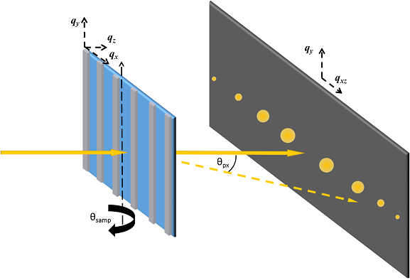













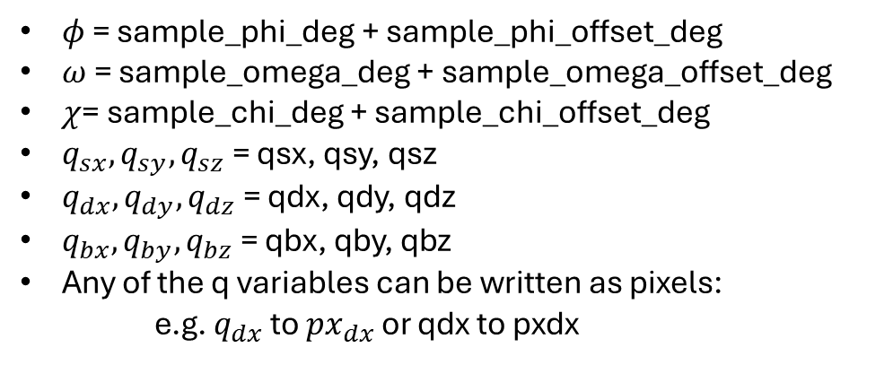









Coordinate system and variable names
detector_y_mm
– detector_y0_mm
$$q_{dy}$$
$$q_{bx}$$
$$q_{by}$$
$$q_{sz}$$
$$q_{sy}$$
$$q_{sx}$$
$$q_{sx}$$
$$q_{bz}$$
$$q_{sz}$$
$$q_{dy}$$
$$q_{bx}$$
$$q_{by}$$
$$q_{dz}$$
$$φ_{d}$$
$$q_{bz}$$
$$q_{dx}$$
$$χ$$
detector_phi_deg
– detector_phi0_deg
$$ω$$
$$φ$$
$$q_{dy}$$
$φ$ = sample_phi_deg + sample_phi_offset_deg
$ω$ = sample_omega_deg + sample_omega_offset_deg
$χ$= sample_chi_deg + sample_chi_offset_deg
$q_{sx}, q_{sy}, q_{sz}$ = qsx, qsy, qsz
$q_{dx}, q_{dy}, q_{dz}$ = qdx, qdy, qdz
$q_{bx}, q_{by}, q_{bz}$ = qbx, qby, qbz
Any of the q variables can be written as pixels:
e.g. $q_{dx}$ to ${px}_{dx}$ or qdx to pxdx
$$q_{dx}$$
$$q_{dz}$$
Subscript “s” refers to sample based coordinates
Subscript “b” refers to beam source based coordinates
Subscript “d” refers to detector based coordinates

Slide 3
Rotations
Active rotation = rotating an object in space, keep the coordinate system (also called alibi rotation)
  Rotation matrix R
Passive rotation = rotating the coordinate system (also called alias rotation)
  Passive transformation matrix Q = R⁻¹
Intrinsic rotation = each rotation is performed on the coordinate system after the previous rotation
  R = rotation 1 * rotation 2 * rotation 3
Extrinsic rotation = each rotation is performed from the original global coordinate system
  R = rotation 3 * rotation 2 * rotation 1

Slide 4
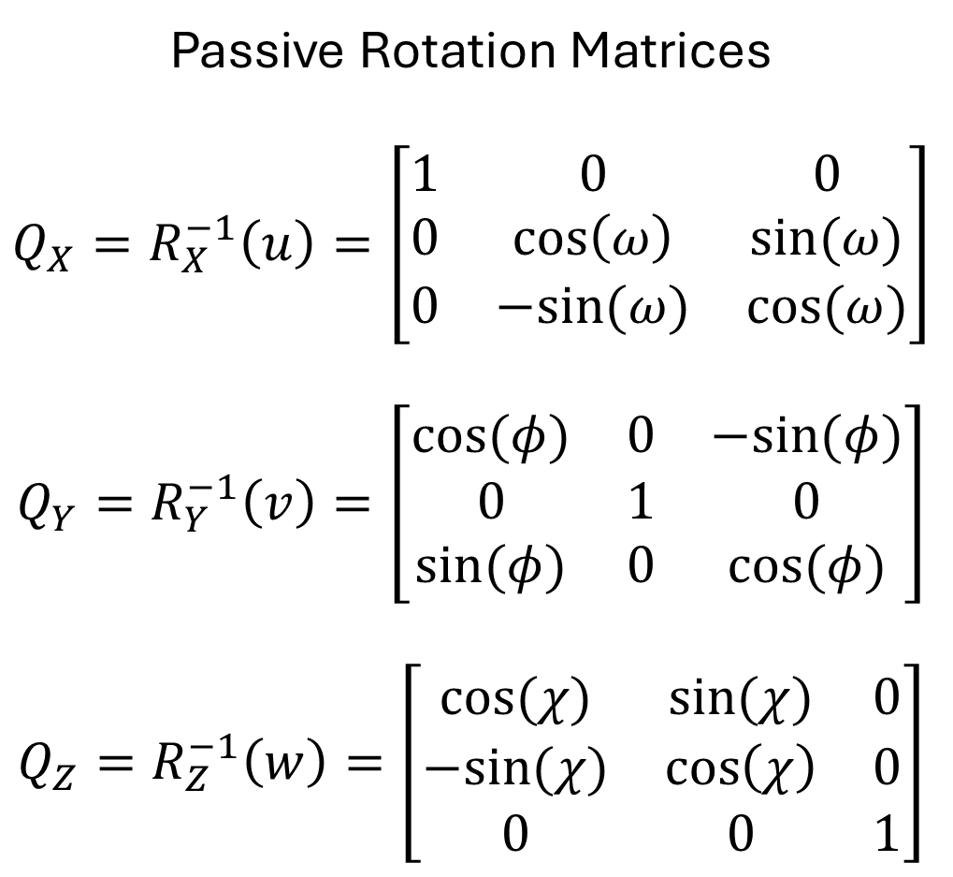
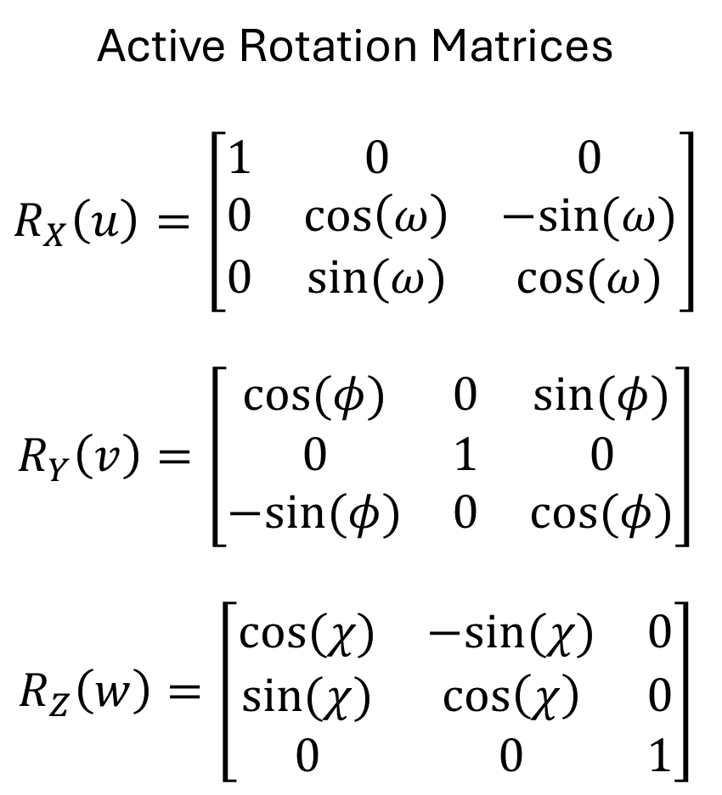
Active Rotation Matrices
$$R_{X}\left(u\right)=\left[\begin{matrix}1 & 0 & 0 \\ 0 & \cos\left(ω\right) & −sin⁡(ω) \\ 0 & sin⁡(ω) & cos⁡(ω)\end{matrix}\right]$$
$$R_{Y}\left(v\right)=\left[\begin{matrix}cos⁡(φ) & 0 & sin⁡(φ) \\ 0 & 1 & 0 \\ −sin⁡(φ) & 0 & cos⁡(φ)\end{matrix}\right]$$
$$R_{Z}\left(w\right)=\left[\begin{matrix}cos⁡(χ) & −sin⁡(χ) & 0 \\ sin⁡(χ) & \cos\left(χ\right) & 0 \\ 0 & 0 & 1\end{matrix}\right]$$
Passive Rotation Matrices
$$Q_{X}=R_{X}^{−1}\left(u\right)=\left[\begin{matrix}1 & 0 & 0 \\ 0 & \cos\left(ω\right) & sin⁡(ω) \\ 0 & −sin⁡(ω) & cos⁡(ω)\end{matrix}\right]$$
$$Q_{Y}=R_{Y}^{−1}\left(v\right)=\left[\begin{matrix}cos⁡(φ) & 0 & −sin⁡(φ) \\ 0 & 1 & 0 \\ sin⁡(φ) & 0 & cos⁡(φ)\end{matrix}\right]$$
$$Q_{Z}=R_{Z}^{−1}\left(w\right)=\left[\begin{matrix}cos⁡(χ) & sin⁡(χ) & 0 \\ −sin⁡(χ) & \cos\left(χ\right) & 0 \\ 0 & 0 & 1\end{matrix}\right]$$

Slide 5
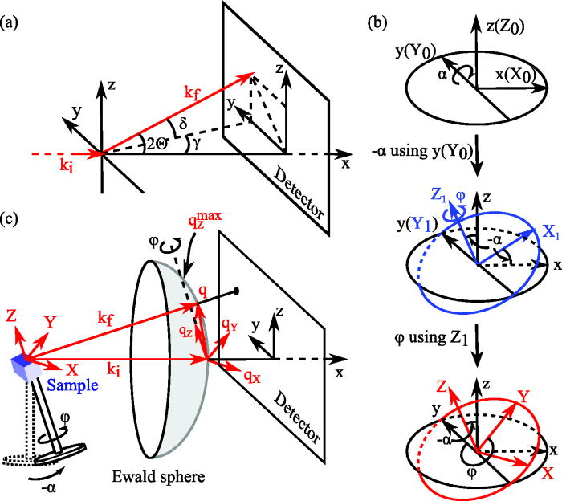
In our CD-SAXS measurement, we are converting the coordinate system for the scattering vector q from detector/beam space coordinates to the sample space coordinates.
We can do this by applying a passive intrinsic or extrinsic rotation.
Reference: https://pubs.aip.org/aip/apr/article/8/1/011305/238646/Recent-advances-in-small-angle-x-ray-scattering

Slide 6





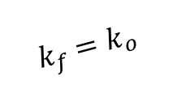





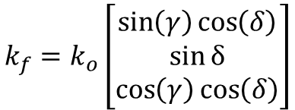
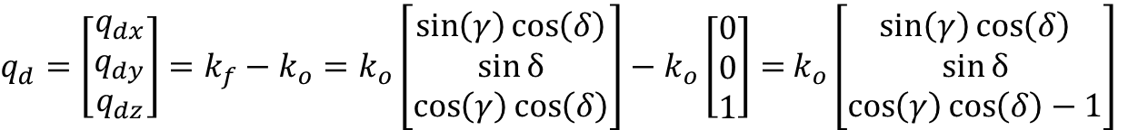








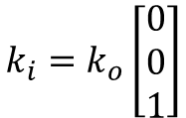




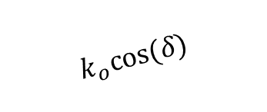
Calculate q in detector space
$k_{o}=\frac{2π}{λ}$, radius of Ewald sphere
$$y$$
$$y$$
$$k_{f}=k_{o}\left[\begin{matrix}\sin\left(γ\right)\cos\left(δ\right) \\ \sin{δ} \\ \cos\left(γ\right)\cos\left(δ\right)\end{matrix}\right]$$
$$x$$
$$x$$
$$k_{i}=k_{o}\left[\begin{matrix}0 \\ 0 \\ 1\end{matrix}\right]$$
$$θ$$
$$z$$
$$k_{f}=k_{o}$$
$$k_{f,y}=k_{o}sin⁡(δ)$$
$$δ$$
$$k_{o}cos⁡(δ)$$
$$k_{o}cos⁡(δ)$$
$$Y$$
$$X$$
$$y$$
$$k_{f,x}=k_{o}sin\left(γ\right)cos⁡(δ)$$
$$q_{X}$$
$$x$$
$$γ$$
$$q_{Y}$$
$$k_{f,z}=k_{o}cos\left(γ\right)cos(δ)$$
$$Z$$
$$z$$
$$q_{Z}$$
$q_{d}=\left[\begin{matrix}q_{dx} \\ q_{dy} \\ q_{dz}\end{matrix}\right]=k_{f}−k_{o}=k_{o}\left[\begin{matrix}\sin\left(γ\right)\cos\left(δ\right) \\ \sin{δ} \\ \cos\left(γ\right)\cos\left(δ\right)\end{matrix}\right]−k_{o}\left[\begin{matrix}0 \\ 0 \\ 1\end{matrix}\right]=$ $k_{o}\left[\begin{matrix}\sin\left(γ\right)\cos\left(δ\right) \\ \sin{δ} \\ \cos\left(γ\right)\cos\left(δ\right)−1\end{matrix}\right]$

Slide 7
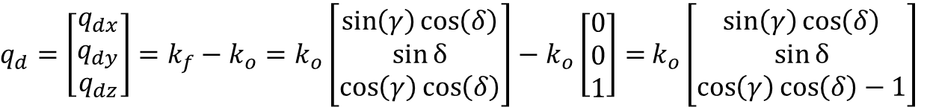

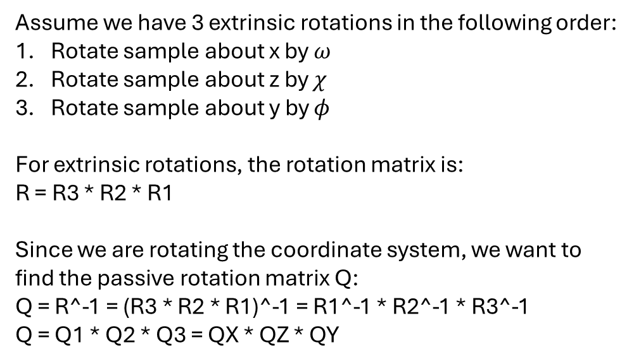
Rotate to sample-based coordinate system
$q_{d}=\left[\begin{matrix}q_{dx} \\ q_{dy} \\ q_{dz}\end{matrix}\right]=k_{f}−k_{o}=k_{o}\left[\begin{matrix}\sin\left(γ\right)\cos\left(δ\right) \\ \sin{δ} \\ \cos\left(γ\right)\cos\left(δ\right)\end{matrix}\right]−k_{o}\left[\begin{matrix}0 \\ 0 \\ 1\end{matrix}\right]=$ $k_{o}\left[\begin{matrix}\sin\left(γ\right)\cos\left(δ\right) \\ \sin{δ} \\ \cos\left(γ\right)\cos\left(δ\right)−1\end{matrix}\right]$
$$y$$
$$y$$
$$x$$
$$x$$
$$θ$$
Assume we have 3 extrinsic rotations in the following order:
Rotate sample about x by $ω$
Rotate sample about z by $χ$
Rotate sample about y by $φ$
For extrinsic rotations, the rotation matrix is:
R = R3 * R2 * R1
Since we are rotating the coordinate system, we want to find the passive rotation matrix Q:
Q = R^-1 = (R3 * R2 * R1)^-1 = R1^-1 * R2^-1 * R3^-1
Q = Q1 * Q2 * Q3 = QX * QZ * QY
$$z$$
$$Y$$
$$X$$
$$y$$
$$q_{X}$$
$$x$$
$$q_{Y}$$
$$Z$$
$$z$$
$$q_{Z}$$
$$q_{s}=Qq_{d}$$

Slide 8
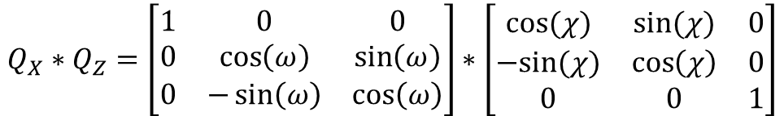
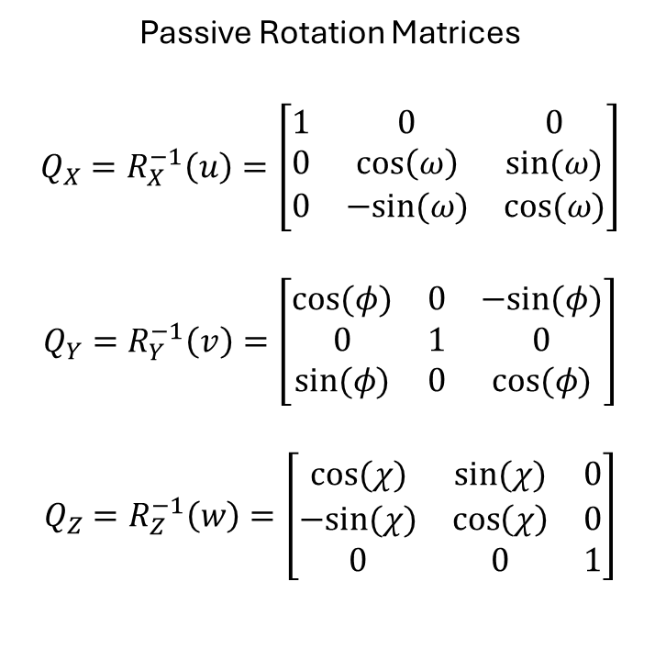
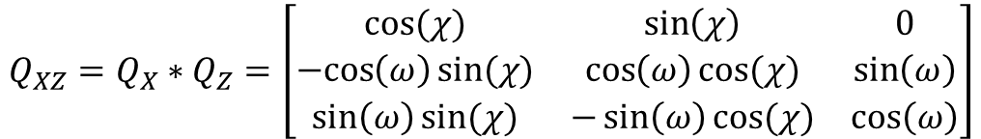
Passive Rotation Matrices
$$Q_{X}=R_{X}^{−1}\left(u\right)=\left[\begin{matrix}1 & 0 & 0 \\ 0 & \cos\left(ω\right) & sin⁡(ω) \\ 0 & −sin⁡(ω) & cos⁡(ω)\end{matrix}\right]$$
$$Q_{Y}=R_{Y}^{−1}\left(v\right)=\left[\begin{matrix}cos⁡(φ) & 0 & −sin⁡(φ) \\ 0 & 1 & 0 \\ sin⁡(φ) & 0 & cos⁡(φ)\end{matrix}\right]$$
$$Q_{Z}=R_{Z}^{−1}\left(w\right)=\left[\begin{matrix}cos⁡(χ) & sin⁡(χ) & 0 \\ −sin⁡(χ) & \cos\left(χ\right) & 0 \\ 0 & 0 & 1\end{matrix}\right]$$
Q = Q1 * Q2 * Q3 = QX * QZ * QY
$$Q_{X}∗Q_{Z}=\left[\begin{matrix}1 & 0 & 0 \\ 0 & \cos\left(ω\right) & \sin\left(ω\right) \\ 0 & −\sin\left(ω\right) & \cos\left(ω\right)\end{matrix}\right]∗\left[\begin{matrix}cos⁡(χ) & sin⁡(χ) & 0 \\ −sin⁡(χ) & \cos\left(χ\right) & 0 \\ 0 & 0 & 1\end{matrix}\right]$$
$$Q_{XZ}=Q_{X}∗Q_{Z}=\left[\begin{matrix}cos⁡(χ) & \sin\left(χ\right) & 0 \\ −cos\left(ω\right)sin(χ) & \cos\left(ω\right)cos⁡(χ) & \sin\left(ω\right) \\ \sin\left(ω\right)sin⁡(χ) & −\sin\left(ω\right)cos⁡(χ) & \cos\left(ω\right)\end{matrix}\right]$$
$Q_{XZY}=Q_{XZ}∗Q_{Y}=\left[\begin{matrix}\cos\left(χ\right) & \sin\left(χ\right) & 0 \\ −cos\left(ω\right)\sin\left(χ\right) & \cos\left(ω\right)\cos\left(χ\right) & \sin\left(ω\right) \\ \sin\left(ω\right)\sin\left(χ\right) & −\sin\left(ω\right)\cos\left(χ\right) & \cos\left(ω\right)\end{matrix}\right]∗$ $\left[\begin{matrix}cos⁡(φ) & 0 & −sin⁡(φ) \\ 0 & 1 & 0 \\ sin⁡(φ) & 0 & cos⁡(φ)\end{matrix}\right]$
$$Q_{XZY}=\left[\begin{matrix}\cos\left(χ\right)cos⁡(φ) & \sin\left(χ\right) & −\cos\left(χ\right)sin⁡(φ) \\ −cos\left(ω\right)\sin\left(χ\right)\cos\left(φ\right)+\sin\left(ω\right)sin⁡(φ) & \cos\left(ω\right)\cos\left(χ\right) & \cos\left(ω\right)\sin\left(χ\right)\sin\left(φ\right)+\sin\left(ω\right)cos⁡(φ) \\ −sin\left(ω\right)\sin\left(χ\right)\cos\left(φ\right)+\cos\left(ω\right)sin⁡(φ) & −\sin\left(ω\right)\cos\left(χ\right) & −\sin\left(ω\right)\sin\left(χ\right)\sin\left(φ\right)+\cos\left(ω\right)cos⁡(φ)\end{matrix}\right]$$

Slide 9
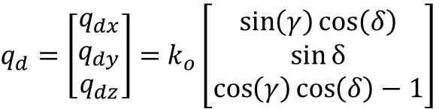
$$Q_{XZY}=\left[\begin{matrix}\cos\left(χ\right)cos⁡(φ) & \sin\left(χ\right) & −\cos\left(χ\right)sin⁡(φ) \\ −cos\left(ω\right)\sin\left(χ\right)\cos\left(φ\right)+\sin\left(ω\right)sin⁡(φ) & \cos\left(ω\right)\cos\left(χ\right) & \cos\left(ω\right)\sin\left(χ\right)\sin\left(φ\right)+\sin\left(ω\right)cos⁡(φ) \\ −sin\left(ω\right)\sin\left(χ\right)\cos\left(φ\right)+\cos\left(ω\right)sin⁡(φ) & −\sin\left(ω\right)\cos\left(χ\right) & −\sin\left(ω\right)\sin\left(χ\right)\sin\left(φ\right)+\cos\left(ω\right)cos⁡(φ)\end{matrix}\right]$$
$q_{d}=\left[\begin{matrix}q_{dx} \\ q_{dy} \\ q_{dz}\end{matrix}\right]=$ $k_{o}\left[\begin{matrix}\sin\left(γ\right)\cos\left(δ\right) \\ \sin{δ} \\ \cos\left(γ\right)\cos\left(δ\right)−1\end{matrix}\right]$
$$q_{s}=Qq_{d}$$
$$q_{s}=\left[\begin{matrix}q_{sx} \\ q_{sy} \\ q_{sz}\end{matrix}\right]=k_{o}\left[\begin{matrix}\cos\left(χ\right)cos⁡(φ) & \sin\left(χ\right) & −\cos\left(χ\right)sin⁡(φ) \\ −cos\left(ω\right)\sin\left(χ\right)\cos\left(φ\right)+\sin\left(ω\right)sin⁡(φ) & \cos\left(ω\right)\cos\left(χ\right) & \cos\left(ω\right)\sin\left(χ\right)\sin\left(φ\right)+\sin\left(ω\right)cos⁡(φ) \\ −sin\left(ω\right)\sin\left(χ\right)\cos\left(φ\right)+\cos\left(ω\right)sin⁡(φ) & −\sin\left(ω\right)\cos\left(χ\right) & −\sin\left(ω\right)\sin\left(χ\right)\sin\left(φ\right)+\cos\left(ω\right)cos⁡(φ)\end{matrix}\right]\left[\begin{matrix}\sin\left(γ\right)\cos\left(δ\right) \\ \sin{δ} \\ \cos\left(γ\right)\cos\left(δ\right)−1\end{matrix}\right]$$
We can expand this but in the code we can calculate all rotation matrices, delta, and gamma for every pixel in our detector image based on where the beam center is located using numpy (multidimensional calculations become reasonably inexpensive and only need to be calculated once after all relevant metadata has been provided).

Slide 10


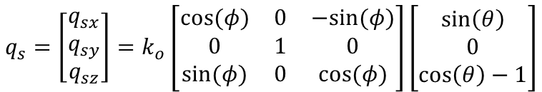
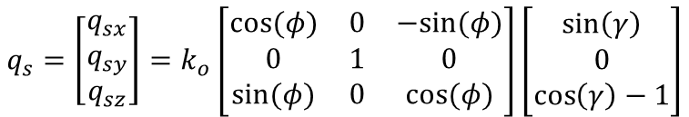
Simplify to our typical CD-SAXS case
Assume sample is only rotated $φ$ about y-axis
Assume that we only take data at $q_{dy}=0$ (so $δ=0$)
Red goes to 0, blue goes to 1
$$q_{s}=\left[\begin{matrix}q_{sx} \\ q_{sy} \\ q_{sz}\end{matrix}\right]=k_{o}\left[\begin{matrix}\cos\left(χ\right)cos⁡(φ) & \sin\left(χ\right) & −\cos\left(χ\right)sin⁡(φ) \\ −cos\left(ω\right)\sin\left(χ\right)\cos\left(φ\right)+\sin\left(ω\right)sin⁡(φ) & \cos\left(ω\right)\cos\left(χ\right) & \cos\left(ω\right)\sin\left(χ\right)\sin\left(φ\right)+\sin\left(ω\right)cos⁡(φ) \\ −sin\left(ω\right)\sin\left(χ\right)\cos\left(φ\right)+\cos\left(ω\right)sin⁡(φ) & −\sin\left(ω\right)\cos\left(χ\right) & −\sin\left(ω\right)\sin\left(χ\right)\sin\left(φ\right)+\cos\left(ω\right)cos⁡(φ)\end{matrix}\right]\left[\begin{matrix}\sin\left(γ\right)\cos\left(δ\right) \\ \sin{δ} \\ \cos\left(γ\right)\cos\left(δ\right)−1\end{matrix}\right]$$
$$q_{s}=\left[\begin{matrix}q_{sx} \\ q_{sy} \\ q_{sz}\end{matrix}\right]=k_{o}\left[\begin{matrix}cos⁡(φ) & 0 & −sin⁡(φ) \\ 0 & 1 & 0 \\ sin(φ) & 0 & cos⁡(φ)\end{matrix}\right]\left[\begin{matrix}\sin\left(γ\right) \\ 0 \\ \cos\left(γ\right)−1\end{matrix}\right]$$
Since $δ=0$, $γ=θ$
$$q_{s}=\left[\begin{matrix}q_{sx} \\ q_{sy} \\ q_{sz}\end{matrix}\right]=k_{o}\left[\begin{matrix}cos⁡(φ) & 0 & −sin⁡(φ) \\ 0 & 1 & 0 \\ sin(φ) & 0 & cos⁡(φ)\end{matrix}\right]\left[\begin{matrix}\sin\left(θ\right) \\ 0 \\ \cos\left(θ\right)−1\end{matrix}\right]$$

Slide 11







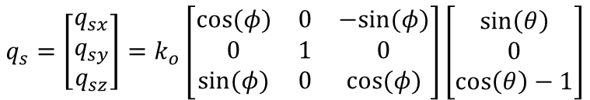


Solve for $q_{sx}$
$$q_{sx}=2k_{o}\sin\left(\frac{θ}{2}\right)\left[\cos\left(φ\right)\cos\left(\frac{θ}{2}\right)+\sin\left(φ\right)\sin\left(\frac{θ}{2}\right)\right]$$
$$q_{s}=\left[\begin{matrix}q_{sx} \\ q_{sy} \\ q_{sz}\end{matrix}\right]=k_{o}\left[\begin{matrix}cos⁡(φ) & 0 & −sin⁡(φ) \\ 0 & 1 & 0 \\ sin(φ) & 0 & cos⁡(φ)\end{matrix}\right]\left[\begin{matrix}\sin\left(θ\right) \\ 0 \\ \cos\left(θ\right)−1\end{matrix}\right]$$
Apply subtraction identity
$$\cos\left(α−β\right)=\cos\left(α\right)\cos\left(β\right)+\sin\left(α\right)sin⁡(β)$$
$$q_{sx}=2k_{o}\sin\left(\frac{θ}{2}\right)\left[\cos\left(φ−\frac{θ}{2}\right)\right]$$
$$q_{sx}=k_{o}\left[\cos\left(φ\right)sin\left(θ\right)−\sin\left(φ\right)\left(\cos\left(θ\right)−1\right)\right]$$
Apply double angle identity $\cos\left(2α\right)=1−2\sin^{2}{α}$
$$q_{sx}=2\left(\frac{2π}{λ}\right)\sin\left(\frac{θ}{2}\right)\left[\cos\left(φ−\frac{θ}{2}\right)\right]$$
$$q_{sx}=k_{o}\left[\cos\left(φ\right)sin\left(θ\right)−\sin\left(φ\right)\left(1−2\sin^{2}{\frac{θ}{2}}−1\right)\right]$$
$$q_{sx}=\left(\frac{4π}{λ}\right)\sin\left(\frac{θ}{2}\right)\left[\cos\left(φ−\frac{θ}{2}\right)\right]$$
$$q_{sx}=k_{o}\left[\cos\left(φ\right)sin\left(θ\right)+2\sin\left(φ\right)\sin^{2}{\frac{θ}{2}}\right]$$
$$q_{sx}=q\left[\cos\left(φ−\frac{θ}{2}\right)\right]$$
Apply double angle identity $\sin\left(2α\right)=2\sin\left(α\right)\cos\left(α\right)$
$$q_{sx}=k_{o}\left[\cos\left(φ\right)2sin\left(\frac{θ}{2}\right)\cos\left(\frac{θ}{2}\right)+2\sin\left(φ\right)\sin^{2}{\frac{θ}{2}}\right]$$

Slide 12










Solve for $q_{sz}$
$$q_{sz}=2k_{o}\sin\left(\frac{θ}{2}\right)\left[\sin\left(φ\right)\cos\left(\frac{θ}{2}\right)−\cos\left(φ\right)\sin\left(\frac{θ}{2}\right)\right]$$
$$q_{s}=\left[\begin{matrix}q_{sx} \\ q_{sy} \\ q_{sz}\end{matrix}\right]=k_{o}\left[\begin{matrix}cos⁡(φ) & 0 & −sin⁡(φ) \\ 0 & 1 & 0 \\ sin(φ) & 0 & cos⁡(φ)\end{matrix}\right]\left[\begin{matrix}\sin\left(θ\right) \\ 0 \\ \cos\left(θ\right)−1\end{matrix}\right]$$
Apply subtraction identity
$$sin⁡(α−β)=\sin\left(α\right)\cos\left(β\right)−\cos\left(α\right)sin⁡(β)$$
$$q_{sz}=k_{o}\left[\sin\left(φ\right)sin\left(θ\right)+\cos\left(φ\right)\left(\cos\left(θ\right)−1\right)\right]$$
$$q_{sz}=2k_{o}\sin\left(\frac{θ}{2}\right)\sin\left(φ−\frac{θ}{2}\right)$$
Apply double angle identity $\cos\left(2α\right)=1−2\sin^{2}{α}$
$$q_{sz}=2\left(\frac{2π}{λ}\right)\sin\left(\frac{θ}{2}\right)\sin\left(φ−\frac{θ}{2}\right)$$
$$q_{sz}=k_{o}\left[\sin\left(φ\right)sin\left(θ\right)+\cos\left(φ\right)\left(1−2\sin^{2}\left(\frac{θ}{2}\right)−1\right)\right]$$
$$q_{sz}=\left(\frac{4π}{λ}\right)\sin\left(\frac{θ}{2}\right)\sin\left(φ−\frac{θ}{2}\right)$$
$$q_{sz}=k_{o}\left[\sin\left(φ\right)sin\left(θ\right)−2\cos\left(φ\right)\sin^{2}\left(\frac{θ}{2}\right)\right]$$
$$q_{sz}=q\sin\left(φ−\frac{θ}{2}\right)$$
Apply double angle identity $\sin\left(2α\right)=2\sin\left(α\right)\cos\left(α\right)$
$$q_{sz}=k_{o}\left[\sin\left(φ\right)2sin\left(\frac{θ}{2}\right)\cos\left(\frac{θ}{2}\right)−2\cos\left(φ\right)\sin^{2}\left(\frac{θ}{2}\right)\right]$$
$$q_{sz}=2k_{o}\sin\left(\frac{θ}{2}\right)\left[\sin\left(φ\right)\cos\left(\frac{θ}{2}\right)−\cos\left(φ\right)\sin\left(\frac{θ}{2}\right)\right]$$

Slide 13
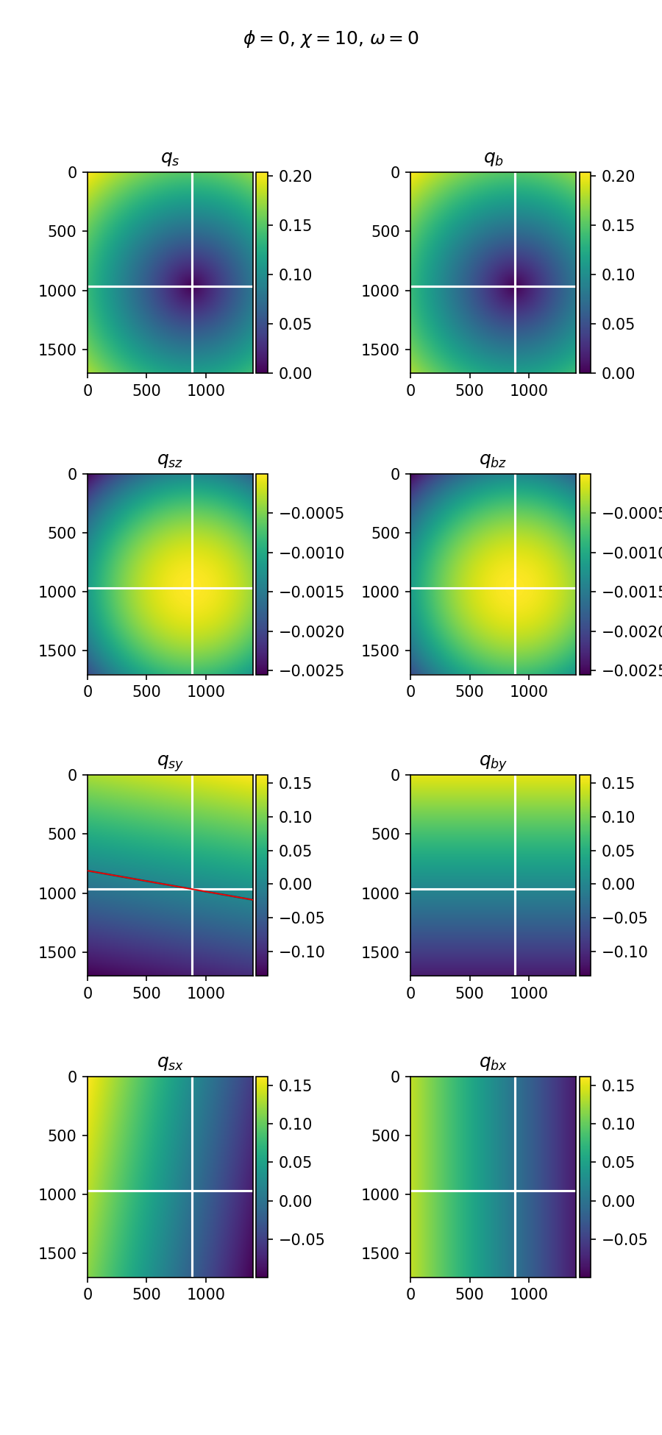
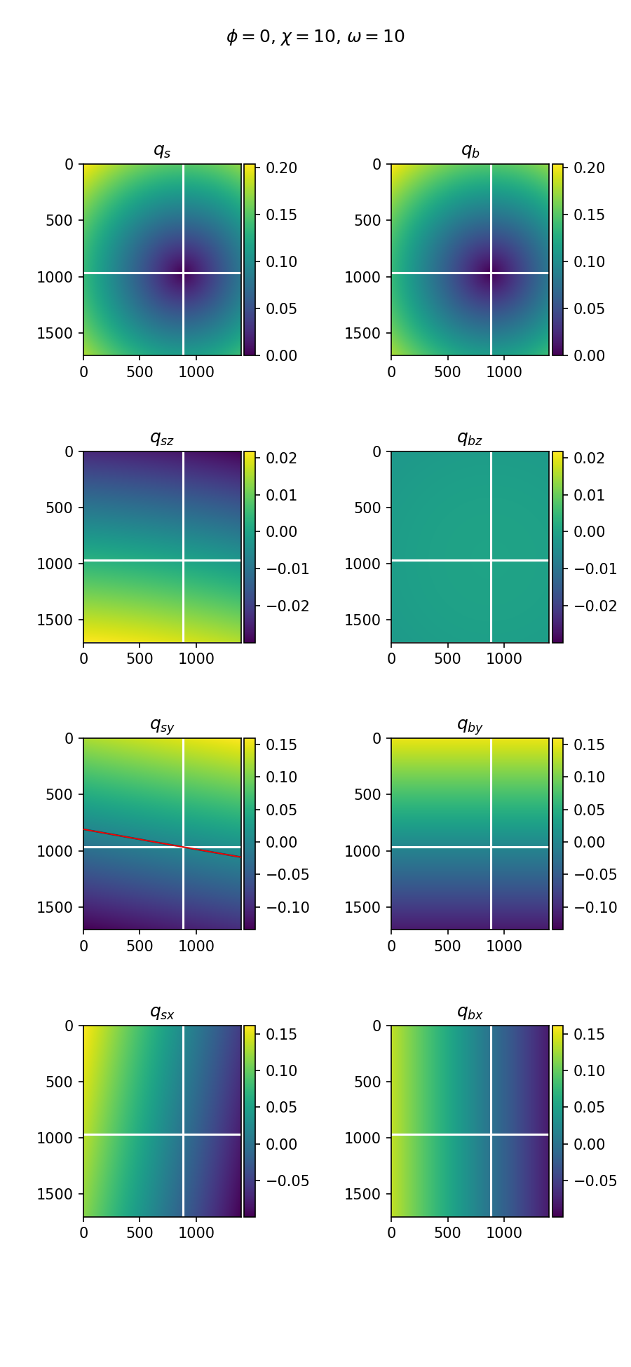

Slide 14
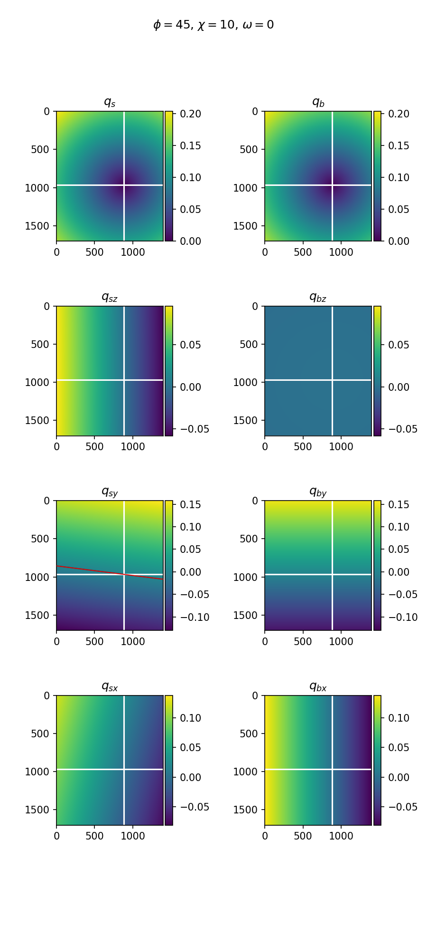
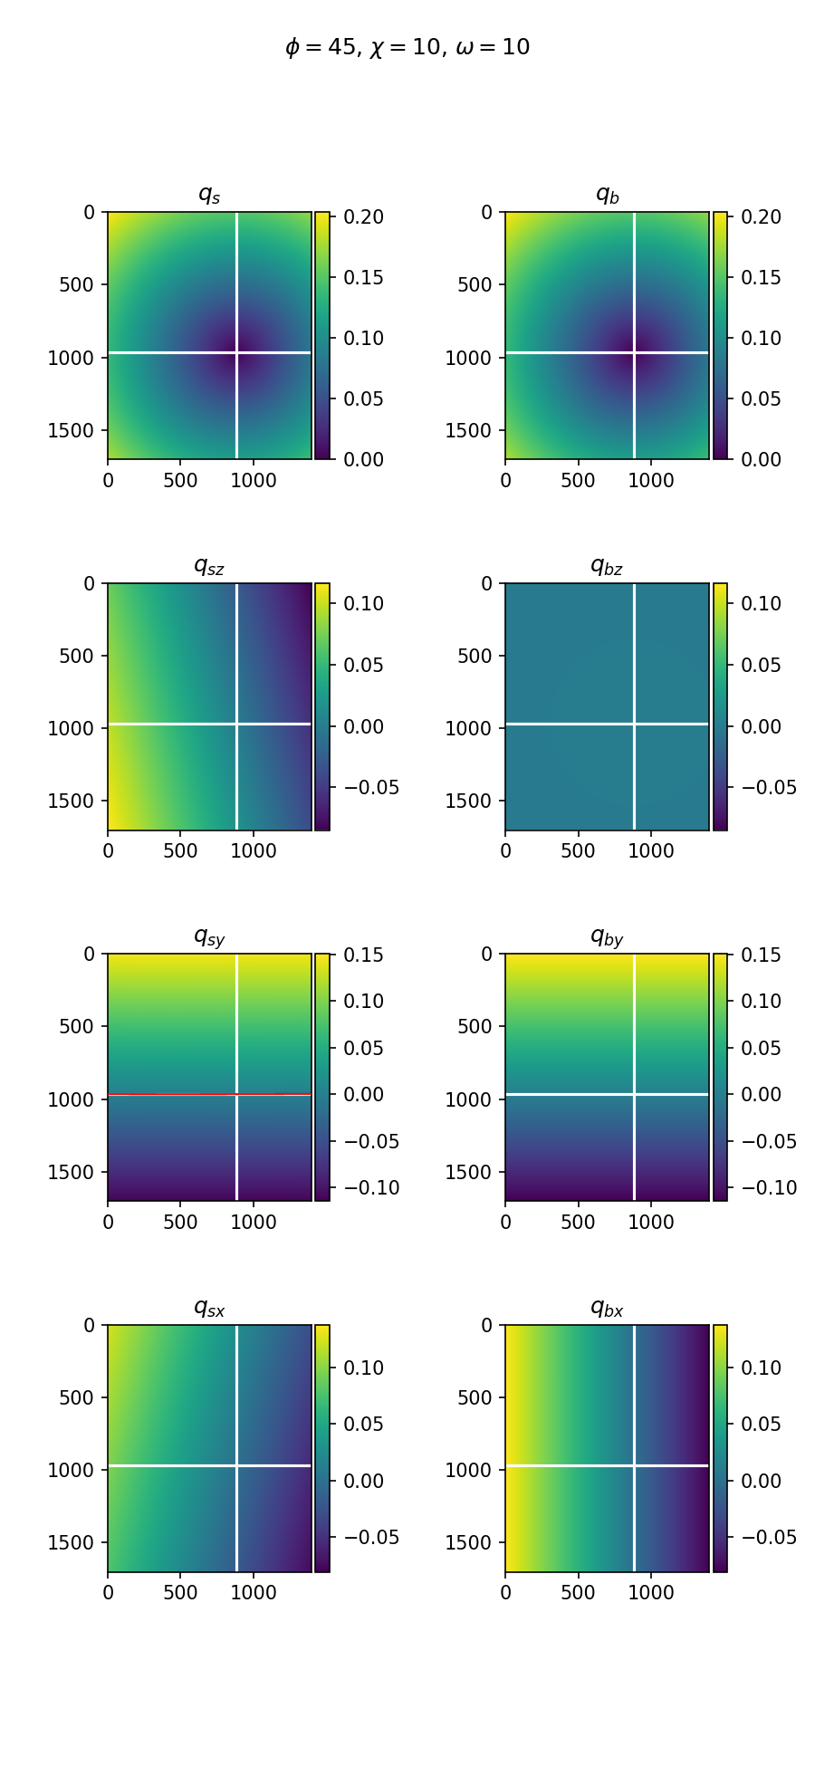

Slide 15
