Slide 1
Chroma I: A High Level View
  Bálint Joó (bjoo@jlab.org)
  Jefferson Lab, Newport News, VA
  given at
  HackLatt'06
  NeSC, Edinburgh
  March 29, 2006

Slide 2

Introduction
Chroma and its dependent software components
Getting it
Building it
Linking against it
What's in it?
Running it
Believing it (?)

Slide 3
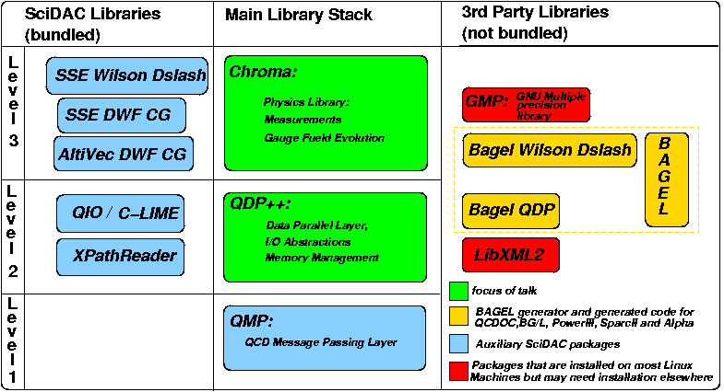
Chroma and Other Software Components
Optional feature or optional
performance optimisation

Slide 4



Getting the bits and pieces
QMP, QDP++ and Chroma (and bundled packages) and BAGEL QDP from anonymous CVS:
    Root :pserver:anonymous@cvs.jlab.org:/group/lattice/cvsroot
    Modules: bagel_qdp, qmp, qdp++, chroma
  USQCD Web page:
    http://www.usqcd.org/usqcd/software
BAGEL and Wilson Dslash from Peter's web page
    http://www.ph.ed.ac.uk/~paboyle/bagel/Bagel.html
GMP from: http://www.swox.com/gmp
LibXML2 from: http://www.xmlsoft.org

Slide 5
Building
Easiest Target: Anyone Can Build
  Scalar Workstation Build
  Assumption: libXML and GMP already installed with OS distribution
  Modules to build: qdp++, chroma
Most Difficult Targets:
  QCDOC, BG/L and IBM Pseries or new Machines
  Modules to build: gmp, bagel modules, libxml, qdp++, chroma. Possibly qmp too (except where it is native)
  Best done by developing a script

Slide 6
General Build Information
Uses GNU autoconf 2.59 and GNU automake 1.9.3
Typical configure; make ; make install type build
Atypical aspects:
  Work in “cross compilation” mode most of the time
    Autoconf cannot autodetect many features of target system (Custom OS, Queues etc etc)
    pervasive use of --enable-feature and --with-package switches
  Want most efficient compiler flags
    CXXFLAGS and CFLAGS on configure command line get complicated

Slide 7
Some Typical Flags: QDP++
QDP++
  --prefix=<install location>
  --enable-parallel-arch=(scalar|parscalar)
  --enable-precision=(single|double)
  --enable-sse, --enable-sse2 (SSE compatible only)
  --with-libxml2=<location of libxml2 installation>
  --with-qmp=<location of QMP installation>
  --with-bagel-qdp=<location of Bagel QDP installation>
  --enable-qcdoc (QCDOC Specific memory allocator)
  CXXFLAGS=”-O2 -finline-limit=50000” CFLAGS=”-O2”

Slide 8
Some Typical Flags: Chroma
Chroma
  --prefix=<install location>
  --with-qdp=<location of QDP++ installation>
  --enable-sse-wilson-dslash (SSE Only)
  --enable-sse-dwf-cg (SSE single prec only)
  --enable-altivec-dwf-cg (AltiVec Single prec only)
  --with-bagel-wilson-dslash=<location of BAGEL dslash>
  --with-gmp=<location of GMP library>
  CXXFLAGS=”” CFLAGS=”” (disables default -g flag)
    Other flags picked up from lower layers eg QDP++

Slide 9

Hints to help you get building
There is a work in progress installation guide
  http://www.ph.ed.ac.uk/~bj/HackLatt05/Installation/html/index.html
There are possibly out of date example configurations in
  qdp++/install_scripts/
  chroma/install_scripts/
There is a standardized build setup for the JLAB based on the nightly builds (useful for clusters)
  CVS Module: jlab-standard-chroma-build

Slide 10
Linking against already installed chroma
Suppose chroma is installed in /foo/chroma
Use script chroma-config in /foo/chroma/bin
  CXX=`chroma-config --cxx`
  CXXFLAGS=`chroma-config --cxxflags`
  LDFLAGS=`chroma-config --ldflags`
  LIBS=`chroma-config --libs`
Compile your program (prog.cc) with:
  $(CXX) $(CXXFLAGS) prog.cc $(LDFLAGS) $(LIBS)
  NB: Ordering of flags may be important.

Slide 11
What is in Chroma?
Measurements:
Fermion Actions:
Monomials:
(sequential) sources, smearings propagators spectroscopy, 3pt functions, hadron structure, wilson loops, eigenvalues
wilson, tm, clover, 4D and 5D overlap, variety of coeffs, DWF,
AsqTAD
two flavor 4D&5D,
one flavor rational 4D&5D,
Hasenbusch Term (4D),
LogDetEvenEven
GaugeActions
Inverters:
plaquette, rectangle, tree level and 1 loop LW, RG impr. plaq+rect, DBW2
I/O Support:
CG, CGNE, BiCGStab, Multi Shift CG, SUMR, GMRESR, MINRES
NERSC, CPPACS, UKY, SciDAC and ILDG Configurations
Chronological Predictors:
Eigensystems:
MD Integrators:
Zero Guess, Last Solution,
Linear Extrapolation,
Minimum Residual
Kalkreuter-Simma Ritz
Leapfrog, Omelyan (SW?) and Multi Time Scale versions of same
Boundaries:
(anti)periodic,Dirichlet, twisted, Schroedinger Functional
Measurement (chroma)
HMC (hmc)
Pure Gauge Heatbath (purgaug)

Slide 12
Chroma Applications
Measurement Application: chroma
Gauge Generation Applications: hmc and purgaug
Installed in same place as chroma-config
  eg: /foo/chroma/bin
Typical usage flags (-i, -o, -geom):
  ./chroma -i in.xml -o out.xml -geom “Px Py Pz Pt”
  in.xml – Input Parameter XML File
  out.xml – Output XML Log File
  “Px Py Pz Pt” the (possibly virtual) Processor Geometry (eg -geom “4 4 8 8” for QCDOC Rack)

Slide 13
XML Driven Programs – Chroma Input File
<?xml version=”1.0” encoding=”UTF-8”?>
<chroma>
<annotation>Your annotation here</annotation>
<Param>
<InlineMeasurements>
<elem>
<Name>MAKE_SOURCE</Name>
<Frequency>1</Frequency>
<Param/>
<NamedObject>
<source_id>sh_source_0</source_id>
</NamedObject>
</elem>
<elem>
<Name>PROPAGATOR</Name>
<Frequency>1</Frequency>
<Param/>
<NamedObject>
<source_id>sh_source_0</source_id>
<prop_id>sh_prop_0</prop_id>
</NamedObject>
</elem>
</InlineMeasurements>
<nrow>4 4 4 8</nrow>
</Param>
<RNG/>
<Cfg>
<cfg_type>SCIDAC</cfg_type>
<cfg_file>foo.lime</cfg_file>
</Cfg>
</chroma>
Array of Measurements (Tasks)
Task (array element)
Task Name
Task specific
parameters
Named Objects
(communicate between tasks
-- like “in memory” files)
Global Lattice Size
Input Configuration Details

Slide 14
XML Input File Examples
Numerous Measurement Task Examples in
  chroma/tests/chroma/hadron/
Measurement Tasks for:
  sources, smearings, propagators, spectroscopy, 3pt functions, eigenvalues
  Reading and Writing Named Objects
Also MD and HMC input files in
  chroma/tests/t_leapfrog
  chroma/tests/hmc
Input file names usually contain the string “ini”

Slide 15
Software Quality Assurance (Testing)
Nightly builds at the JLab (and elsewhere)
  framework developed by Zbyszek and Craig in Liverpool and Robert Edwards at the JLAB
  Tests compatibility with compilers, configuration, building, linking and linking to installed libraries.
  Runs Regression Tests on single node targets
  Current nightly builds:
    parscalar build with SSE, QMP-single comms, g++ v4
    parscalar build with SSE, QMP-MPICH over Infiniband with g++ v3
    parscalar build with QMP-single comms and BAGEL noarch targets
    scalar build with SSE

Slide 16
Chroma Regression Tests
Framework from Craig and Zbyszek and Robert.
Verifies that new code does not break old behaviour (not that it is necessarily correct)
Uses xmldiff utility from EPCC to compare XML files
Test coverage constantly growing (never enough)
Single node only for now: make xcheck
Source /home/bj/Devel/QCD/chroma/tests/chroma/hadron/propagator/regres.pl
Program Candidate Conclusion
chroma unprec-zolo-ev-multi-v8.candidate.xml PASS
chroma prec_wilson-v9.candidate.xml PASS
chroma prec_clover-v9.candidate.xml PASS
chroma unprec_clover-v9.candidate.xml PASS
chroma prec_wilson-twisted-v9.candidate.xml PASS

Slide 17
Future improvements (SciDAC2)
Infrastructure improvements
  Improve native speed of QDP++ (more PETE)
  More Regression tests (more more more!!!)
  Automated regression and unit tests for QMP, QDP++, QIO etc
  Documentation (Yes! Really!)
  Interface with SciDAC level I (QLA)
  MultiCore/Threaded optimised code (QMC)
  SSE3 Code
  BlueGene Code?

Slide 18
Potential Chroma Improvements
Better Eigensolvers
Dynamical Fermion Algorithms
Stout links in MD evolution
Multiple timescales for RHMC pieces
  already have them for 2 flavour code and Hasenbusch thanks to Carsten Urbach
Currently input configuration is special – change this
  will be able to smear a config inline without having to start a second chroma run
Priority dictated by project need as always

Slide 19
Summary (Weighing it all up)
Good Side:
Bad Side:
Layered – Extensive use of SciDAC and 3rd party libraries
Very portable
Speed through cliche-d operations and assembly
Quality assurance
High complexity. Can be difficult to build on some systems
Compiler constraints
Slow without assembly code
Needs documentation
Capable of delivering a Wide Variety of Physics

