Slide 1
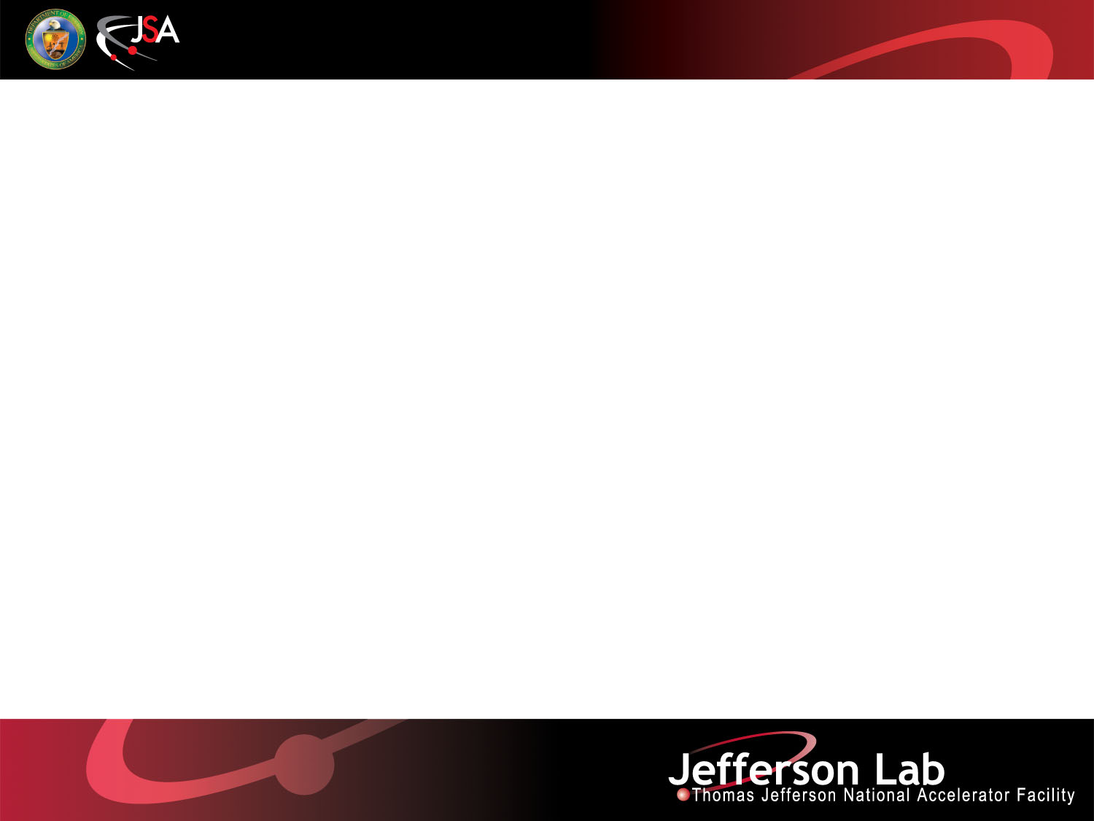
QDP++ and Chroma
  Balint Joo
  Jefferson Lab
  HackLatt '08, Edinburgh

Slide 2

Contents
High Level View of QDP++ and Chroma
  What they are, what they do etc
  Software Maps
  Getting, Building, Testing(?)
  Using (?)
QDP++ Details
  Data Parallel Primitives
  Subsets, Checkerboarding
  I/O with XML, QIO

Slide 3
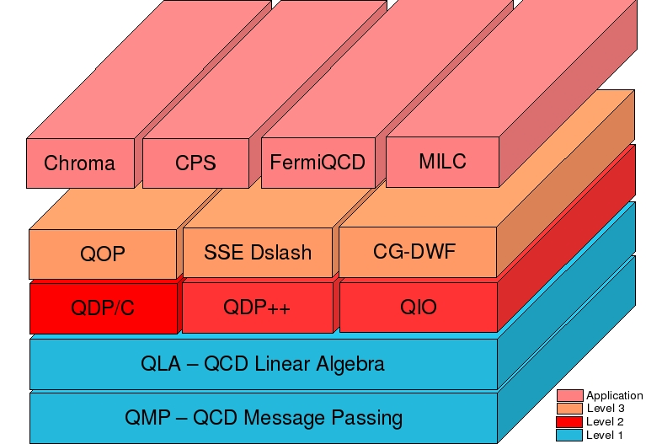
QDP++ and Chroma What Are They
Chroma is a lattice QCD framework written in C++
Provides a library and some applications to do LQCD
Relies on QDP++ to provide a data parallel platform
Relies on 3rd party libraries for numerically intensive work
QDP++ is “platform” for data parallel QCD computations
It provides, expressions, shifts, memory management and I/O
Relies on QIO library for binary I/O, QMP library for parallel communications

Slide 4
Use of Chroma in the US
USQCD Spectrum Project
  Anisotropic Wilson/Clover Gauge Generation with (R)HMC algorithm
  Wilson Clover Spectroscopy, photoproduction etc
USQCD HASTE Project (now RBC-LHPC-UKQCD megacollaboration ?)
  Domain Wall Fermion Forward/Sequential Propagator calculations
  Hadron Structure (GPDA-s)
USQCD NPLQCD Project
  Domain Wall Fermion Propagator Calculations
Algorithmic Studies
  New inversion algorithms, preconditionings, dilution etc.

Slide 5
Current List of Target Machines
SSE2 Based Machines
  Intel/Opteron workstations
  Intel/Opteron clusters
  Cray XT series supercomputers
  QMP typically over MPI (MVIA-Mesh will deprecate)
  Fast Dslash and some SSE optimized ops in QDP++
  Fast DWF CG propagator solver from MIT
BlueGene/L Machines
  QMP typically over MPI (native QMP does exist)
  Fast Bagel based Dslash from Peter Boyle
  Fast QDP++ operations and Clover term coded using BAGEL Generator from Peter.
QCDOC – Similar setup to BlueGene/L

Slide 6
Future/Development ports
BlueGene/P
  Start with BlueGene/L setup
  Will do our best to integrate new components when/if we have access to them.
Large Multi-Core Machines of the future
  Ranger at TACC (port in progress)
  whatever comes along?

Slide 7
Software Map – SSE Based Systems
Bundled
Main Package
3rd Party
Level 3: AsqTAD
SSE Wilson Dslash
Chroma
QDP/C
QOP
CG-DWF
Integrated by
Craig McNeile
& colleauges
GMP
XpathReader
QIO
QDP++
libxml2
QMP
depending on your
system these may
already be installed
MPI
System Level

Slide 8
Software Map – BG/L & QCDOC
BAGEL & Dslash thanks to Peter Boyle
Bundled
Main Package
3rd Party
Level 3
AsqTAD
BAGEL
Wilson
Dslash
CG-DWF
Chroma
QDP/C
BAGEL
Clover
Currently
specialized build only – Needs Special GCC
QOP
Integrated by
Craig McNeile
& colleauges
GMP
BAGEL QDP
XpathReader
QIO
QDP++
libxml2
QMP
These have to be
cross compiled
System Level
MPI (on BG/L)
BAGEL Generator

Slide 9


Getting the bits and Pieces
QMP, QDP++ and Chroma (and bundled packages) and BAGEL QDP, BAGEL Clover
  from anonymous CVS:
    Root :pserver:anonymous@cvs.jlab.org:/group/lattice/cvsroot
    Modules: bagel_qdp, bagel_clover, qmp, qdp++, chroma
  from USQCD Web Page:
    http://usqcd.jlab.org/usqcd-software
BAGEL and Wilson Dslash from Peter's web page
    http://www.ph.ed.ac.uk/~paboyle/bagel/Bagel.html
GMP from: http://www.swox.com/gmp
LibXML2 from: http://www.xmlsoft.org

Slide 10
Building
Packages have a “configure ; make ; make install” style
  but configure has many options that need to be set
Simplest builds
  use mpicc, mpicxx
  build qmp, qdp++, chroma in sequence (GMP, libxml are already installed)
Most complicated builds (BlueGene/L / QCDOC)
  build libxml2, GMP, bagel, bagel_qdp, etc...
This is a real pain to manage
Jlab CVS module: jlab-standard-chroma-build attempts to automate the build workflow (download, configure, etc)
  most build failures tend to be automake related :(
  QCDOC poses some “special” problems...

Slide 11
Compiler Versions etc
We made the move to gcc-4.x series of compilers on SSE Based Platforms
QMP and QDP++ should now also compile with Intel/Pathscale/PGI compilers – SSE may not be available with PGI – this needs investigation
We've switched to automake-1.10 (automake versions tend to move along with our cluster upgrades)

Slide 12

Some Configure Options for QDP++
SZIN Leftovers:
scalar – workstation builds
parscalar - “parallel machine with scalar processing elements”- MPI/QMP
QDP++
  --prefix=<install location>
  --enable-parallel-arch=(scalar|parscalar)
  --enable-precision=(single|double)
  --with-libxml2=<location of libxml2 installation>
  --with-qmp=<location of QMP installation>
SSE Options
  --enable-sse2
BAGEL Related Options
  --with-bagel-qdp=<location of Bagel QDP installation>
QCDOC Specific Option
  --enable-qcdoc (QCDOC Specific memory allocator)
CXXFLAGS=”-O2 -finline-limit=50000” CFLAGS=”-O2”

Slide 13
Some Configure Options for Chroma
Chroma
  --prefix=<install location>
  --with-qdp=<location of QDP++ installation>
  --with-gmp=<location of GMP library>
SSE Options
  --enable-sse-wilson-dslash (SSE Only)
  --enable-cg-dwf=sse (SSE Domain Wall Solver)
  --enable-cg-dwf-lowmem (Low memory DWF Solver)
  --with-qmp=<location of QMP – DWF Solver needs this>
BAGEL related options
  --with-bagel-wilson-dslash=<location of BAGEL dslash>
  --enable-bagel-wilson-dslash-sloppy <Sloppy Dslash>
  --with-bagel-clover=<Location of BAGEL Clover>
CXXFLAGS=”” CFLAGS=”” (disables default -g flag)
NEW
NEW

Slide 14
Hints to Help You Build
A (slightly out of date) set of installation notes on the USQCD Web Site
The jlab-standard-chroma-build package in the Chroma CVS server
  cvs checkout jlab-standard-chroma-build
  cd jlab-standard-chroma-build
  Need to configure this with ./configure
  Useful Options are
    --enable-install-root=<root of install tree>
    --enable-qdp-version=<version of QDP++ to use>
    --enable-chroma-version=<version of Chroma to use>
    --enable-parallel-make=<no of threads for make>

Slide 15
More on Jlab Standard Chroma Build
The standard build is organised in directories as:
  package/machine/build-type
  eg: Single precision, parscalar build of QDP++ for Jlab 7n machine: qdp++/ib-7n/parscalar-ib-7n
  eg: Scalar build of Chroma: chroma/scalar/scalar
  These triplets map directly onto directory names
    cd qdp++/ib-7n/parscalar-ib-7n
    There is a build/ subdirectory here.
      cd ./build/
      There is “configure.sh” script here.
        In the configure.sh script are useful flags for this target
You can use this to get a handle on what flags you want where

Slide 16
More on Jlab Standard Chroma Build
Can actually build the code with this too
  look at eg: xt3_build.sh – complete the configure line then run on your favourite Cray XT machine
  look at eg: bgl_build.sh – complete the configure line then run on your favourite BG/L
Logs of builds kept in ./logs/package
Successful builds installed in
  <install-root>/package/version/build-type
  eg: /home/bjoo/install/qdp++/qdp1-25-1/parscalar-ib-7n
./build.sh package/machine/build-type will attempt to download package source for you
Package source is downloaded to package/package subdirectory of jlab-standard-chroma-build
  In case you need the source to run automake etc.

Slide 17
Testing
Chroma contains many regression tests (over 100) mostly in
  chroma/tests/chroma (main chroma measurement tests)
  chroma/tests/t_leapfrog (MD tests)
  chroma/tests/hmc (HMC tests)
Test comprised of:
  executable (chroma, hmc, t_leapfrog etc)
  input param file (XML)
  expected output file (XML)
  output comparison metric file (XML)
    used to check code output against expected output
Need xmldiff utility to check output against expected output
Need some infrastructure to run through all tests

Slide 18
How to run the tests
Have xmldiff installed and on your PATH before configuring chroma
After chroma is configured it will produce a script called RUN – you may need to edit this. In the case of a scalar machine it may be as simple as
  #!/bin/bash
  $*
For an MPI machine with 4 CPUs you may want it to look like
  #!/bin/bash
  mpirun -np 4 $*
Then in an interactive session you should run 'make xcheck'
There are complicated ways to run this through batch queues as well...

Slide 19
Linking against an installed Chroma
Suppose chroma is installed in /foo/chroma
Use script chroma-config in /foo/chroma/bin
  CXX=`chroma-config --cxx`
  CXXFLAGS=`chroma-config --cxxflags`
  LDFLAGS=`chroma-config --ldflags`
  LIBS=`chroma-config --libs`
Compile your program (prog.cc) with:
  $(CXX) $(CXXFLAGS) prog.cc $(LDFLAGS) $(LIBS)
  NB: Ordering of flags may be important.

Slide 20
Running Chroma Applications
Measurement Application: chroma
Gauge Generation Applications: hmc and purgaug
Installed in same place as chroma-config
  eg: /foo/chroma/bin
Typical usage flags (-i, -o, -geom):
  ./chroma -i in.xml -o out.xml -geom Px Py Pz Pt
  in.xml – Input Parameter XML File
  out.xml – Output XML Log File
  Px Py Pz Pt the (possibly virtual) Processor Geometry (eg -geom “4 4 8 8” for QCDOC Rack)

Slide 21
Chroma XML Input File Structure
<?xml version=”1.0” encoding=”UTF-8”?>
<chroma>
<annotation>Your annotation here</annotation>
<Param>
<InlineMeasurements>
<elem>
<Name>MAKE_SOURCE</Name>
<Frequency>1</Frequency>
<Param/>
<NamedObject>
<gauge_id>default_gauge_field</gauge_id>
<source_id>sh_source_0</source_id>
</NamedObject>
</elem>
<elem>
<Name>PROPAGATOR</Name>
<Frequency>1</Frequency>
<Param/>
<NamedObject>
<gauge_id>default_gauge_field<gauge_id>
<source_id>sh_source_0</source_id>
<prop_id>sh_prop_0</prop_id>
</NamedObject>
<xml_file>./prop_out.xml<xml_file>
</elem>
</InlineMeasurements>
<nrow>4 4 4 8</nrow>
</Param>
<RNG/>
<Cfg>
<cfg_type>SCIDAC</cfg_type>
<cfg_file>foo.lime</cfg_file>
</Cfg>
</chroma>
Array of Measurements (Tasks)
Task (array element)
Task Name
Task specific
parameters
Named Objects
(communicate between tasks
-- like “in memory” files)
Global Lattice Size
Input Configuration to use as
default_gauge_field
Task output
XML file

Slide 22
Where to find XML examples
Measurement Tasks for:
Numerous Measurement Task Examples in
  chroma/tests/chroma/hadron/
  sources, smearings, propagators, spectroscopy, 3pt functions, eigenvalues
  Reading and Writing Named Objects
Also MD and HMC input files in
  chroma/tests/t_leapfrog
  chroma/tests/hmc
Input file names usually contain the string “ini”

Slide 23
QDP++ Details
QDP++ Is the Foundation of Chroma
It provides
  way to write the maths of lattice QCD without looping over indices (expressions)
  Custom memory allocation possibilities
  I/O facilities (XML and Binary)
You can do Lattice QCD just in QDP++ without Chroma
  See: Lectures from the 2007 INT Lattice Summer School
  but you'd need to write a whole lot of infrastructure that comes for free with Chroma

Slide 24
QDP++ Templated Types
In QDP++ tries to capture the index structure of our lattice fields:
To do this we use C++ templated types:
typedef OScalar < PScalar < PScalar< RScalar <REAL> > > > Real;
typedef OLattice< PScalar < PColorMatrix< RComplex<REAL>, Nc> > > LatticeColorMatrix;
typedef OLattice< PSpinMatrix< PColorMatrix< RComplex<REAL>, Nc>, Ns> > LatticePropagator;
QDP++ and Portable Expression Template Engine:
  Provide expressions and recursion through type structure

Slide 25
QDP++ and Expressions
Use “convenient” mathematical expressions:
LatticeFermion x,y,z;
Real a = Real(1);
gaussian(x);
gaussian(y);
z = a*x + y;
int mu, nu;
multi1d<LatticeColorMatrix> u(Nd);
Double tmp = sum( real( trace( u[mu]
*shift(u[nu],FORWARD,mu)
* adj( shift(u[mu],FORWARD,nu) )
*adj(u[nu])
)
)
);
Wowee! No indices or for loops!
multi1d<T> =
1 dimensional array
of T
Lattice Wide Shifts
FORWARD =
from x+mu
Functions
but array indices are explicit

Slide 26
Subsets and Layouts
Subset: Object that identifies a subset of sites
Can be predefined: eg rb is “red-black” colouring
Can be contiguous or not (s.hasOrderedRep() == true or not)
Layout is an ordering of sites in memory (compile time choice)
Same subset may be contiguous in one layout and not in another
R.I.P.
OrderedSet
OrderedSubset
Notional Lattice
Lexicographic
Layout
CB2 Layout
Storage Order:
Subset rb[0]
Subset rb[0]
rb[0].hasOrderedRep():
false
true

Slide 27
Using Subsets
  In expressions, subset index is on the target
    bar[rb[1]] = foo; // (Copy foo's rb[1] subset to bar's)
  Users can define new sets
  Layout chosen at compile time with configure switch
    Default is CB2 (2 colour checkerboard) layout
  Layout needs to be initialized on entry to QDP++
multi1d<int> nrow(4); nrow[0]=nrow[1]=nrow[2]=4; nrow[3]=8;
Layout::setLattSize(nrow);
Layout::create();

Slide 28
QDP++ and XML
No “static data binding” in QDP++
Treat documents as “amorphous” (contain anything)
Interrogate documents using XPath.
Root of Path expression is “context node”
root node
<?xml version=”1.0” encoding=”UTF-8”?>
<foo>
<bar>
<fred>6</fred>
<jim>7 8 9</jim>
</bar>
</foo>
From root:
from /bar:
/foo/bar/fred
./fred

Slide 29
Reading XML
Array markup of
non-simple types
XMLReader r(“filename”);
Double y;
multi1d<Int> int_array;
multi1d<Complex> cmp_array;
try {
read(r, “/foo/cmp_array”, cmp_array);
XMLReader new_r(r, “/foo/bar”);
read(new_r, “./int_array”, int_array);
read(new_r, “./double”, y);
}
catch( const std::string& e) {
QDPIO::cerr << “Caught exception: “
<< e <<endl;
QDP_abort(1);
}
<?xml version=”1.0”
encoding=”UTF-8”?>
<foo>
<cmp_array>
<elem>
<re>1</re>
<im>-2.0</im>
</elem>
<elem>
<re>2</re>
<im>3</im>
</elem>
</cmp_array>
<bar>
<int_array>2 3 4 5</int_array>
<double>1.0e-7</double>
</bar>
</foo>
Absolute Path Read
New Context
Relative Paths
Array markup
for simple types
QDP++ error
“stream”

Slide 30
Writing XML
// Write to file
XMLFileWriter foo(“./out.xml”);
push(out, “rootTag”);
int x=5;
Real y=Real(2.0e-7);
write(foo, “xTag”, x);
write(foo, “yTag”, y);
pop(out);
<?xml version=”1.0”?>
<rootTag>
<xTag>5</xTag>
<yTag>2.0e-7</yTag>
</rootTag>
// Write to Buffer
XMLBufferWriter foo_buf;
push(foo_buf, “rootTag”);
int x = 5;
Real y = Real(2.0e-7);
write(foo_buf, “xTag”, x);
write(foo_buf, “yTag”, y);
pop(foo_buf);
QDPIO::cout << “Buffer contains” << foo_buf.str()
<< endl;
get buffer content

Slide 31
QIO and LIME Files
Private File XML Data
HEADER
QIO works with record oriented LIME files
LIME files made up of messages
messages are composed of
  File XML records
  Record XML records
  Record Binary data
SciDAC mandates checksum records
ILDG mandates certain records
User File XML Data
Private Record XML Data
User Record XML Data
Message 1
Record 1
Record Binary Data
Checksum Record
Private Record XML Data
User Record XML Data
Message 1
Record 2
Record Binary Data
Checksum Record
Private Record XML Data
User Record XML Data
Message 2
Record 1
Record Binary Data
Checksum Record

Slide 32
Three modes of writing in QIO
QDPIO_PARTFILE
QDPIO_SINGLEFILE
Writing/Reading
patterns for
QDPIO_SERIAL
I/O process
non I/O process
QDPIO_MULTIFILE
file

Slide 33
QDP++ interface to QIO
Write with QDPFileWriter
Must supply user file and user record XML as XMLBufferWriter-s
Read with QDPFileReader
User File XML and User Record XML returned in XML Readers
Checksum/ILDG details checked internally to QIO
File XML
LatticeFermion my_lattice_fermion;
XMLBufferWriter file_metadata;
push(file_metadata, "file_metadata");
write(file_metadata, "annotation", "File Info");
pop(file_metadata);
QDPFileWriter out(file_metadata,
file_name,
QDPIO_SINGLEFILE,
QDPIO_SERIAL);
XMLBufferWriter record_metadata;
push(record_metadata, "record_metadata");
write(record_metadata, "annotation", "Rec Info");
pop(record_metadata);
out.write( record_metadata, my_lattice_fermion);
out.close();
XMLReader file_in_xml;
XMLReader record_in_xml;
QDPFileReader in(file_in_xml,
file_name,
QDPIO_SERIAL);
LatticeFermion my_lattice_fermion;
in.read(record_in_xml, my_lattice_fermion);
in.close();
Record XML
QIO Write
Mode Flags

Slide 34
ILDG Support (?)
The underlying QIO support layer can handle ILDG format.
Specialization of write() function and type traits:
  multi1d<LatticeColorMatrix> always written in ILDG format.
  ILDG dataLFN is optional argument to the QDPFileWriter constructor.
nersc2ildg program provided in examples/ directory
lime_contents and lime_extract_record programs from QIO automatically built and installed

Slide 35
Custom Memory Allocation
Occasionally need to allocate/free memory explicitly – e.g. to provide memory to external library.
Memory may need custom attributes (eg fast/communicable etc)
Memory may need to be suitably aligned.
May want to monitor memory usage
Allocate memory
from desired pool
if possible, with
alignment suitable
to pool
pointer=QDP::Allocator::theQDPAllocator::Instance().allocate( size,
QDP::Allocator::FAST);
QDP::Allocator::theQDPAllocator::Instance()::free(pointer);
Namespace
Get reference to allocator
MemoryPoolHint (attribute)

Slide 36
Move To Fast Memory (If you have it)
QCDOC/SP inspired construct (copy to CRAM?)
moves/copies data to/from fast memory (eg EDRAM)
NOP on machines where there is no fast memory
Accelerate x!
Do not copy contents.
Contents of x lost
LatticeFermion x;
moveToFastMemoryHint(x);
// Do some fast computation here
revertFromFastMemoryHint(x,true);
Bring x back to slow
memory. Copy contents

Slide 37
Efficiency Considerations
PETE eliminates Lattice sized temporaries
But still there are temporaries at the site level
  This really hurts performance
Workaround: Cliché Expressions Optimized
  eg: a*x + y, a*x + P y, norm2(), innerProduct() etc.
  Optimizations in C, SSE and bagel_qdp library
Non optimized expression still slow:
  eg: a*x+y+z etc.

Slide 38
Summary
QDP++ and Chroma are quite mature now
In this presentation I have discussed
  basic usage (getting, building, testing, using)
  a reasonably thorough description of QDP++
Stay tuned for:
  aspects of the chroma class structure
  tutorial exercises
  a presentation on writing XML input files

