Slide 1




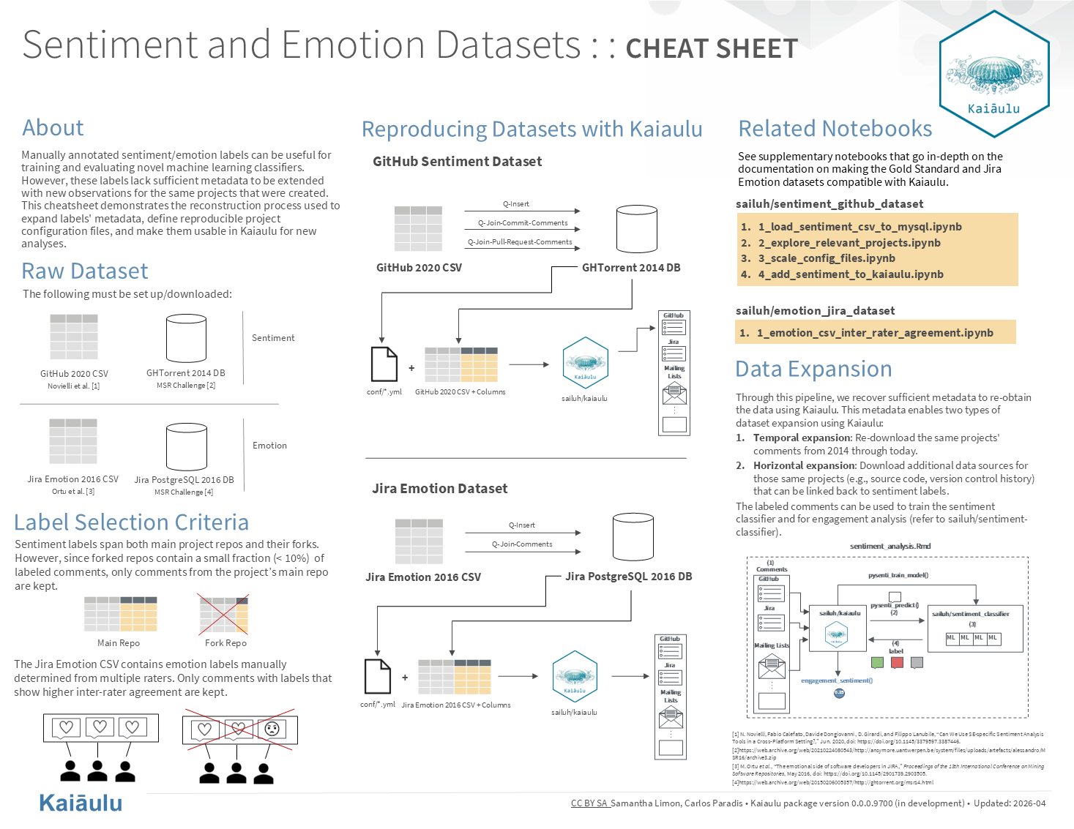
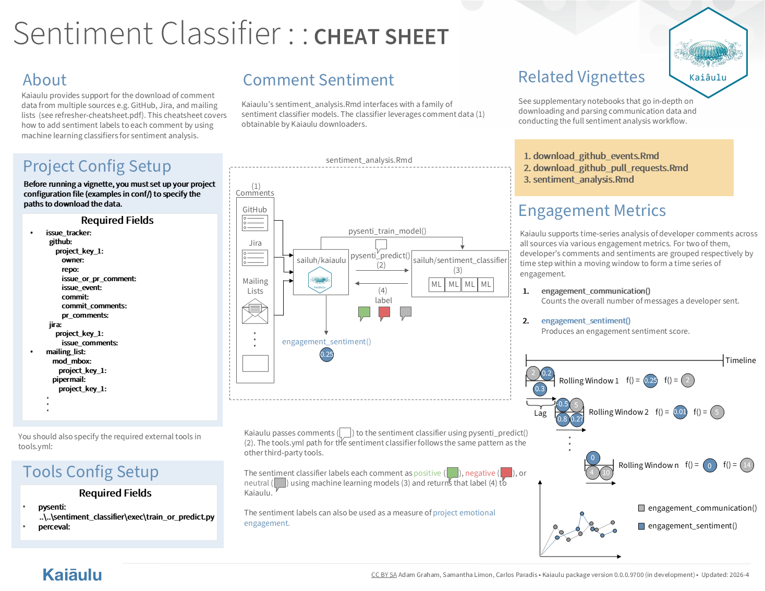
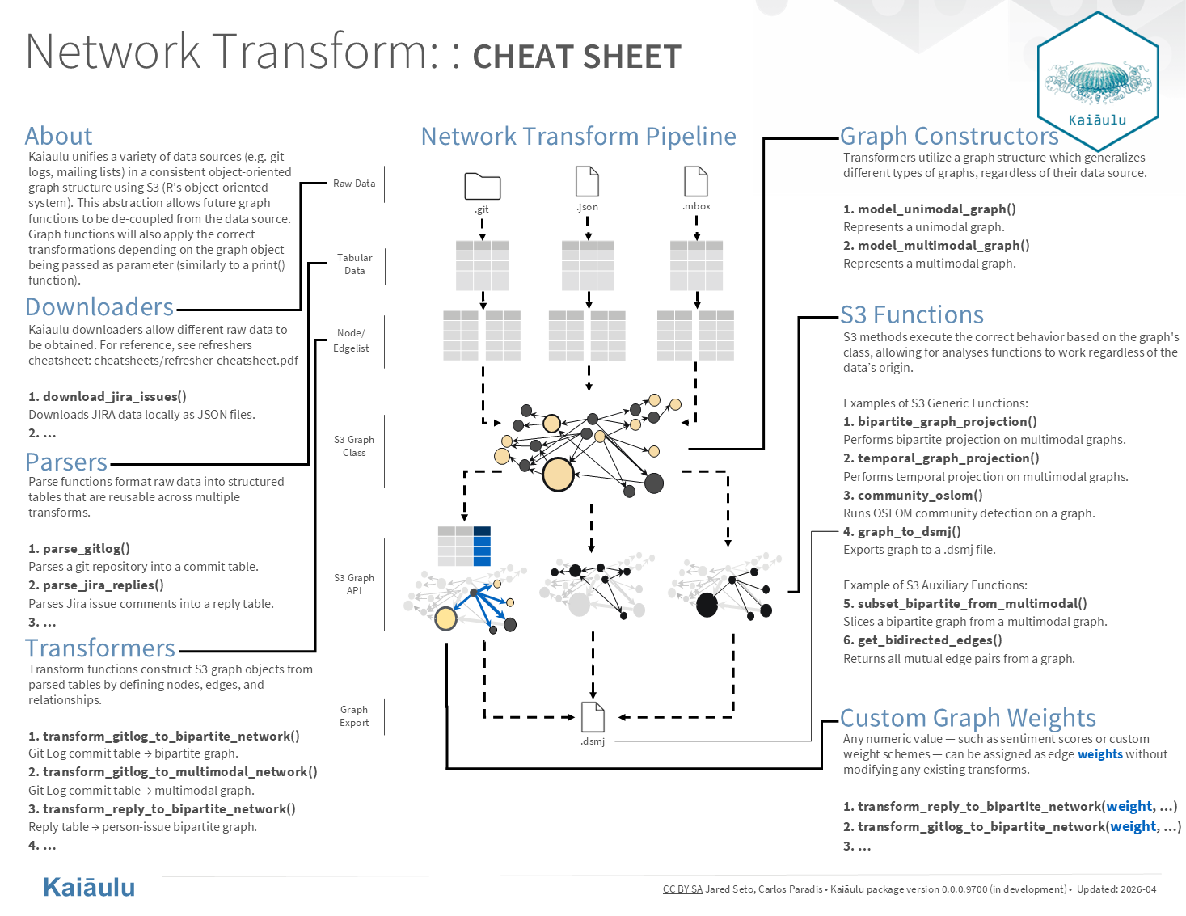
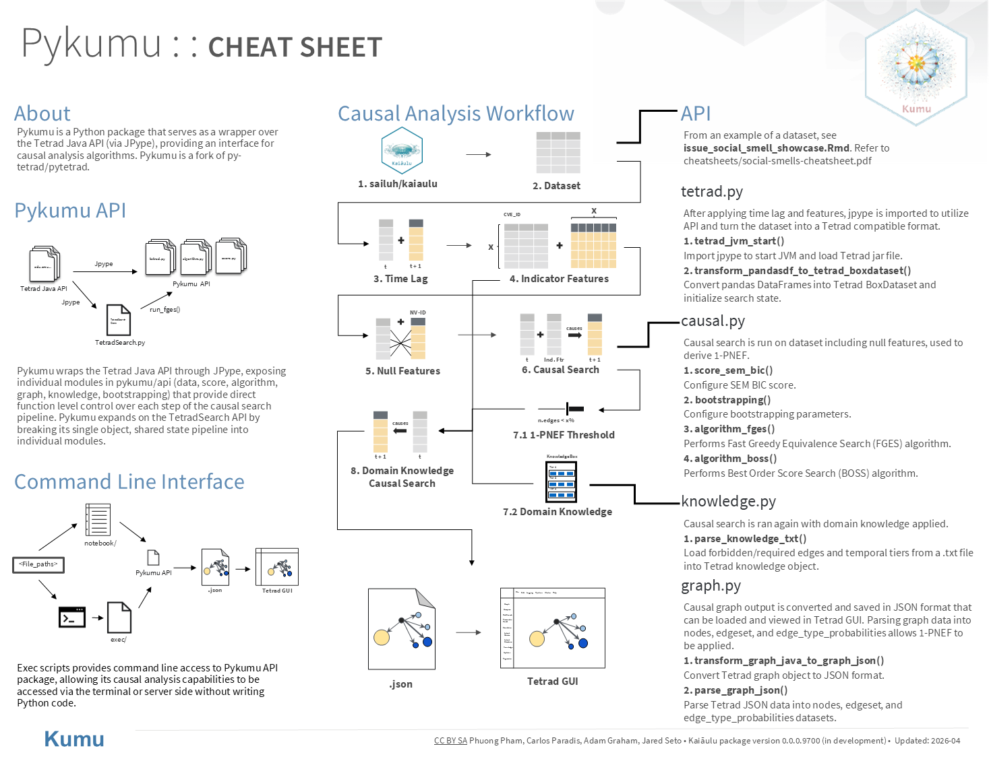
Negative Sentiment Causal Effect on Code Contribution in Open-Source Communities
Adam Graham, Samantha Limon, Phuong Pham, Jared Seto
Sponsors: Carlos Paradis and Rick Kazman, Software Analytics Insight Lab
ICS 496 Capstone Project - Spring 2026
github.com/sailuh
What is SAILUH?
Objectives
Our overall objective was to build an end-to-end pipeline that integrates 4 components to gain insight on the causal effect of negative sentiment on code contribution in open-source communities. The goals were to (1) extend a sentiment classifier to label comments according to their sentiment, (2) take those labels and provide an aggregated engagement sentiment score for a developer, (3) use the aggregated sentiment as weights for a graph representation of a developer's engagement network, and (4) integrate these sentiment variables into a causal analysis notebook to understand the cause and effect of a developer's negative sentiment on overall code contribution for an open-source project.
Methodology
Software Analytics Insight Lab at the University of Hawaii at Mānoa.
GitHub organization for a UH Mānoa research lab that builds tools to analyze software projects and developer communities.
Project Management
Agile software development
Documented GitHub Issues/PRs/Project Board
Roles
Project Manager: Adam
Liaison: Samantha
Quality Manager: Phuong
Architect: Jared
Challenges
Establishing an understanding of the project scope and documentation requirements.
All team members have limited prior experience with the R programming language.
Maintaining a consistent system architecture when implementing features within the Kaiaulu repository to align with predefined workflows and design patterns.
Tasks Accomplished
Sentiment Classifier: Built an end-to-end pipeline that produces sentiment-labeled communication comments compatible with Kaiaulu.
New Metrics: Implemented new metrics that measure engagement, productivity, sentiment, and communication among developers in a project.
Network Refactoring: Introduced a standardized S3 graph model with typed constructors and dispatch methods for extensible downstream analysis.
Causal Analysis: Implemented Pykumu API package, a Python interface to Tetrad's causal analysis library.
Learnings and Conclusion
We learned how to contribute to open-source software by expanding the SAILUH ecosystem and discovered how to effectively extend SAILUH’s capabilities through mutually agreed upon specifications from our sponsors. We were able to extend these capabilities with an improved sentiment classifier, new developer engagement metrics, an improved graph model, and causal analysis, ensuring we write maintainable code for future contributors. The project improved our technical skills by working on a large-scale software project, utilizing industry standard developer tools like RStudio, GitHub, and Git. The future consideration for this project is to completely bridge our 4 components as a unified end-to-end pipeline.
Technologies
Developer Tools: RStudio, Jupyter Notebook, Visual Studio Code, GitHub, Git
Languages: R, Python
Third-Party Tools: Perceval, Depends, Understand, Jira, SCC, OSLOM, DV8, Sentiment Classifiers, PyTetrad

