Slide 1
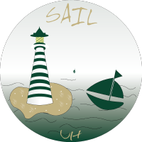
SAILUH
github.com/sailuh
Adam Graham, Samantha Limon, Jared Seto, Phuong Pham
Sponsored by: Carlos Paradis and Rick Kazman
Notes:
Jared
For our capstone project, we worked with SAILUH, a research lab within the Shidler College of Business.

Slide 2
What is SAILUH?
Software Analytics Insight Lab
A GitHub organization for a UH Mānoa research lab that builds tools to analyze software projects and developer communities.
Problem Statement
A subset of the SAILUH ecosystem does not yet provide interoperability among its tools to identify how developers’ sentiment affects project health.
Sentiment Classifier
Engagement Trends
Network Refactoring
Causal Analysis
Notes:
Jared
Before explaining our project, it’s helpful to understand what SAILUH is.
SAILUH is the Software Analytics Insight Lab at UH Mānoa, a GitHub organization that develops tools for software analytics, allowing researchers to study developer activity and collaboration within software projects.
However, a subset of the ecosystem lacked interoperability between several of these analysis tools.
Our work focused on improving how tools in the SAILUH ecosystem work together to analyze developer behavior and understand the health of software projects.
To address this problem, we divided the project into four main components:
sentiment classification, engagement trends, network refactoring, and causal analysis.
Each member of our team focused on one of these components, and together they formed the pipeline we built.

Slide 3
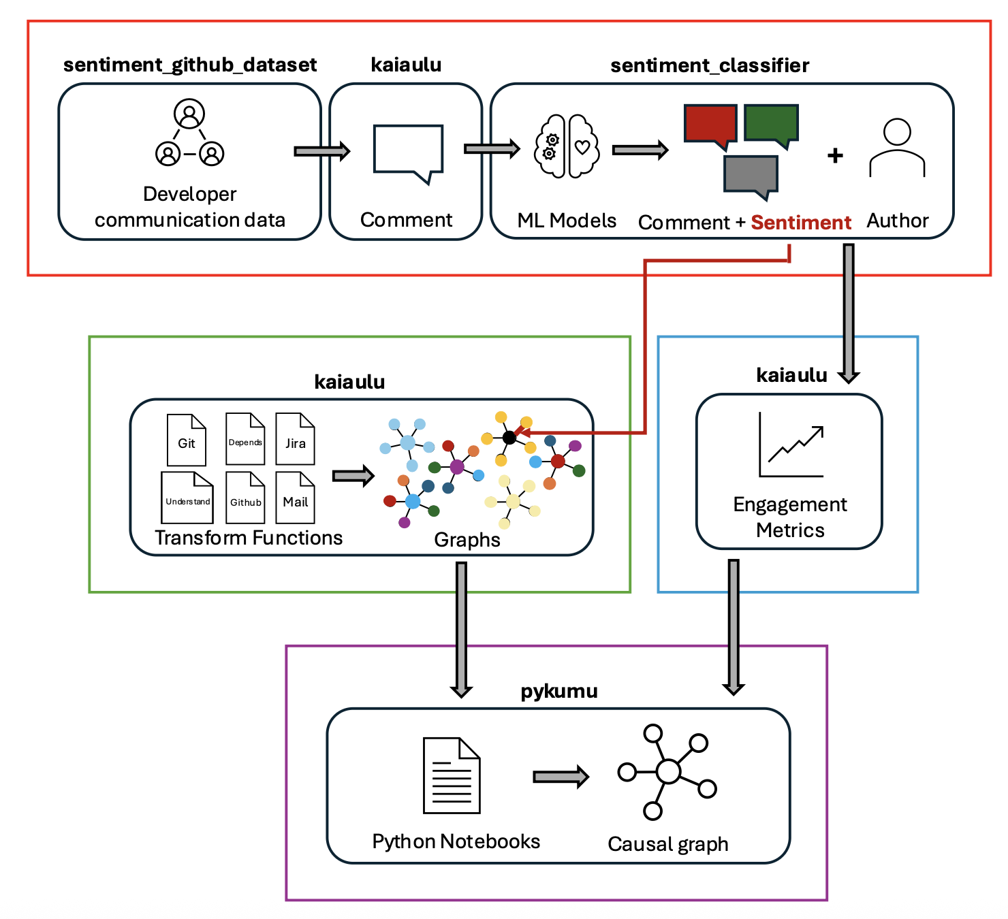
Technical Solution Overview
Notes:
Samantha
As mentioned, our project is broken down into 4 components to assess how developer communication affects project health and our solution does so by:
Offering the capability to measure developer sentiment
Seeing whether it effects project health and
Having a way to analyze the causality of this relationship
First, we need a way to get this developer sentiment data.
We take raw developer comments and run them through machine learning models to produce sentiment data - attaching positive, negative, or neutral labels to each comment.
That sentiment data feeds into an engagement function to measure engagement metrics. This could be things like people posting less commits or less comments as an indicator of poor project health.
Meanwhile, transform functions standardize how different data sources are represented as networks to keep our pipeline consistent.
Finally, all of this flows into Pykumu, which lets us analyze the causal relationship between developer sentiment and project health and produces a Causal Graph as the output.
Together, these pieces give us a complete, end-to-end pipeline for assessing how developer sentiment affects project health.

Slide 4
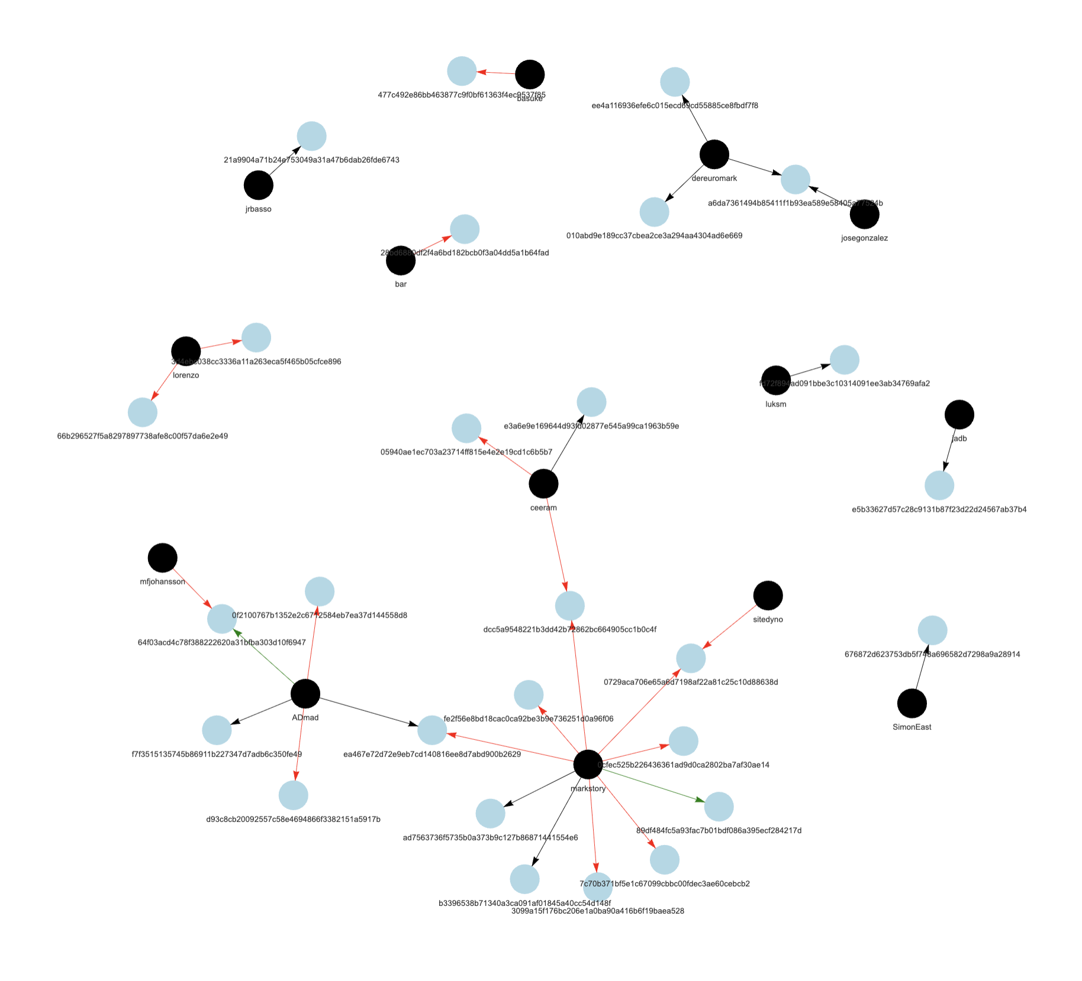
Major Accomplishments
Sentiment Classifier: Built an end-to-end pipeline that produces sentiment-labeled communication comments compatible with Kaiaulu.
New Metrics: Implemented new metrics that measure engagement, sentiment, and productivity among developers in a project.
Network Refactoring: Introduced a standardized S3 graph model with typed constructors and dispatch methods for extensible downstream analysis.
Causal Analysis: Implemented Pykumu API package, a Python interface to Tetrad's causal analysis library.
Notes:
Samantha
Some of our major accomplishments include building an end-to-end pipeline that produces sentiment-labeled communication comments compatible with Kaiaulu, implementing new metrics that measure engagement, productivity, sentiment, and communication among developers in a project, introducing a standardized S3 graph model with typed constructors and dispatch methods for extensible downstream analysis, and implementing Pykumu API package, a Python interface to Tetrad's causal analysis library.

Slide 5
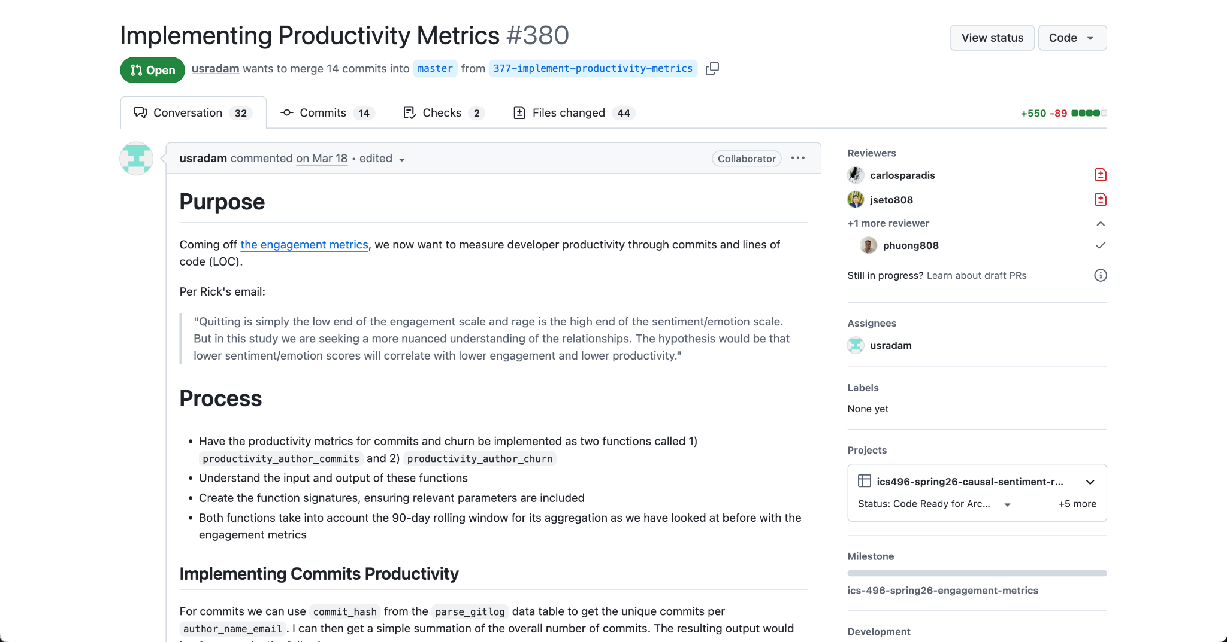
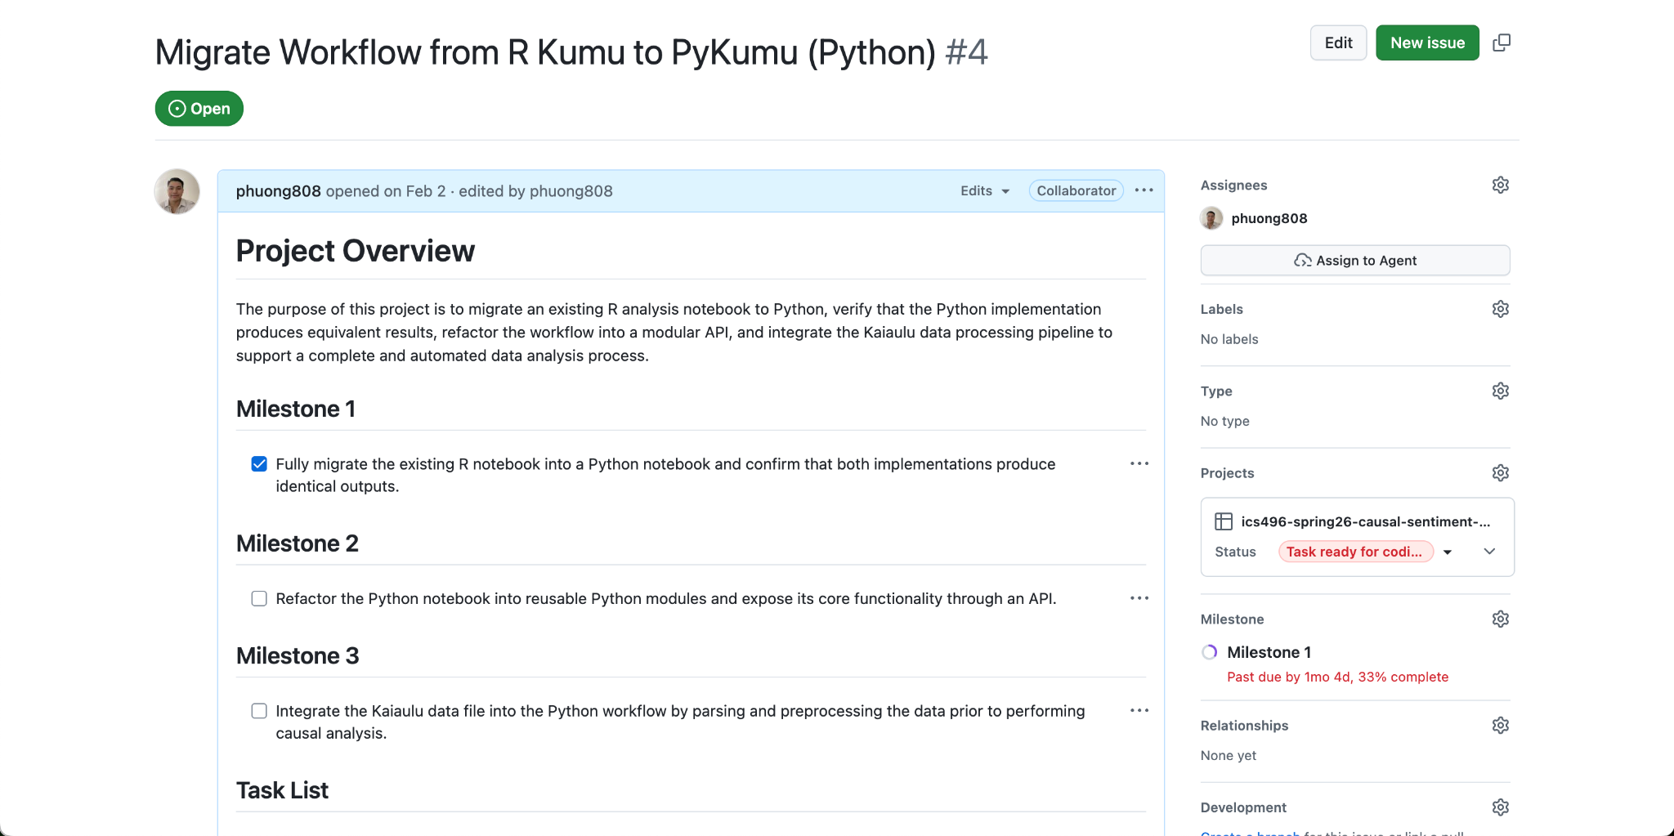
Quality Assurance Metrics
Submitted pull requests with new features and fixes
Incorporated sponsor feedback through PR and Issue discussions before a merge
Maintain a “Project Overview” issue tab
Project Scope
Requirements
Milestones
Weekly notes
Next steps
Notes:
Phuong presenting
For our quality assurance metric, to ensured quality, we submit pull requests for new features and include our sponsor’s feedback to refine our code before merging. We also have a project overview tab with our weekly notes and next steps, so we could track progress and what needs to be completed each week.

Slide 6
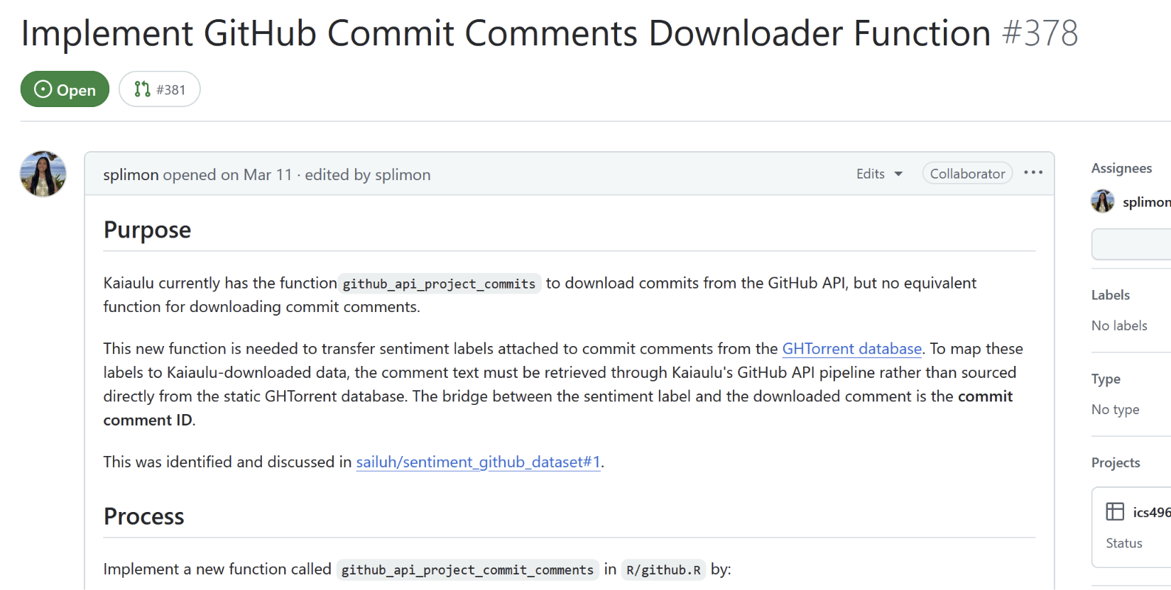
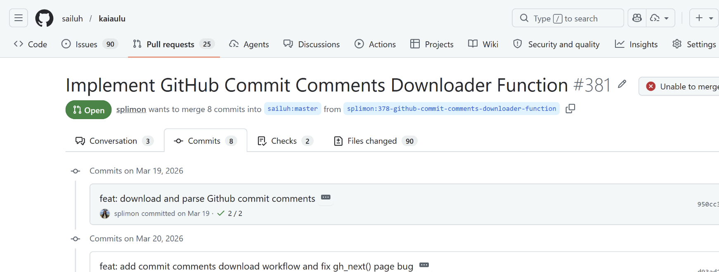
Project Management and Delivery
Notes:
Adam
We had a few methods of communication and project management. With just the 4 of us, we had internal group meetings in-person on Mondays and communication in Discord.
Our main methods of communication with the sponsor are 1) through Microsoft Teams meetings on Fridays, 2) GitHub issues where we detail a project task’s purpose, process, and TODOS, and 3) email.
Our source of delivery was through GitHub by submitting a pull request and having each other perform code reviews.

Slide 7
Reflections
We learned how to contribute to open-source software while aligning with SAILUH’s architecture
We discovered how to effectively extend SAILUH’s capabilities through mutually agreed upon specifications from our sponsors
Wrote maintainable code for future contributors
The project improved our technical skills by working on a large-scale software project, utilizing industry standard developer tools like RStudio, GitHub, and Git.
Notes:
Adam

Slide 8
Next Steps
SAILUH is ever-evolving…
Sentiment Classifier
Metrics
Clean up the sentiment classifier codebase to ensure the full pipeline is compatible with the data format produced by dataset preparation.
Expand the connection of the data pipelines to the metrics for the R notebooks.
Create new R notebooks that document the additional functionality enabled by transform standardization.
Network Refactoring
Apply the pykumu pipeline to an engagement metrics dataset to produce a causal graph.
Causal Analysis
Notes:
Jared
Next steps for the development of this project include:
Cleaning up the sentiment classifier codebase to ensure the full pipeline is compatible with the data format produced by the dataset preparation.
Expanding the connection of the data pipelines to the metrics for the R notebooks.
Creating new R notebooks that document the additional functionality enabled by transform standardization.
Appling the pykumu pipeline to an engagement metrics dataset to produce a causal graph.

Slide 9

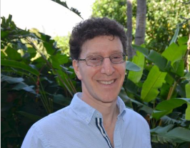
Acknowledgements
Carlos Paradis
Data Scientist at KBR, Inc.
Ph.D. in Computer Science from UH Manoa
Rick Kazman
Professor of Information Technology Management at Shidler College of Business
Notes:
Phuong
We would like to acknowledge our sponsor Carlos and Rick for guiding us through this project.

