Slide 1
About
Sentiment Data
Iteration 1
Project Config
Engagement Metrics
Notes:
Maybe there could be another header for integration and related vignettes. Could diagram how the data you obtain passes down to me which I can then use for functions. My functions in turn output data tables.

Slide 2
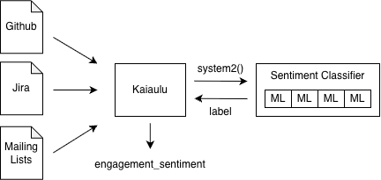
About
Comment Sentiment
Related Vignettes
Kaiaulu provides support for analyzing developer communication in open source projects. This cheatsheet covers how to configure, download, and label comments from multiple sources (GitHub, Jira, and mailing lists) with sentiment using a machine learning classifier.
Comments are text written by developers from GitHub (commit, issue, or PR comments), Jira (issue comments), or mailing lists (emails). Kaiaulu downloads and parses this data from each source so it can be passed to the sentiment classifier.
See notebooks that go in-depth on downloading and parsing communication data, and conducting the full sentiment analysis workflow.
Iteration 2
1. download_github_events.Rmd
2. download_github_pull_requests.Rmd
3. sentiment_analysis.Rmd
Project Config Setup
Engagement Metrics
Before running a vignette, you must set up a project configuration file (examples in conf/) to specify the paths to download the data.
After labeling, Kaiaulu aggregates each developer's comment sentiment across all sources over a rolling 90-day window to produce an engagement score.
Required Fields
sentiment_classifier
issue_tracker:
github:
project_key_1:
owner:
repo:
issue_or_pr_comment:
issue_event:
commit:
commit_comments:
pr_comments:
Message with UTC timestamp YYYY-MM-DDThh:mm:ssZ
Author name and email
firstname lastname <email@domain.com>
Message polarity
positive, negative, neutral
Kaiaulu (R) passes comment text to the sentiment classifier (Python) using the system2() call. The classifier predicts whether each comment is positive, negative, or neutral, and returns that label to Kaiaulu.
engagement_sentiment
tools.yml required fields
pysenti:
perceval:
The function sets aggregate_func = mean by default when aggregating the polarity of a developer’s messages within a 90-day rolling window.
function(datetimetz, user_name_email, polarity, quit_lag = 90, aggregate_func)
Notes:
Maybe there could be another header for integration and related vignettes. Could diagram how the data you obtain passes down to me which I can then use for functions. My functions in turn output data tables.
Add sentiment analysis notebook: https://github.com/sailuh/kaiaulu/pull/347/changes#diff-410622b0b81c7706813f954374bf25cc0f75a5e73064edcaae6e17d1e8366cbc
The line of code with system2: https://github.com/sailuh/kaiaulu/pull/347/changes#diff-93170c206bbe5c492a0430b7c4dea9c5079a83c6717…

Slide 3



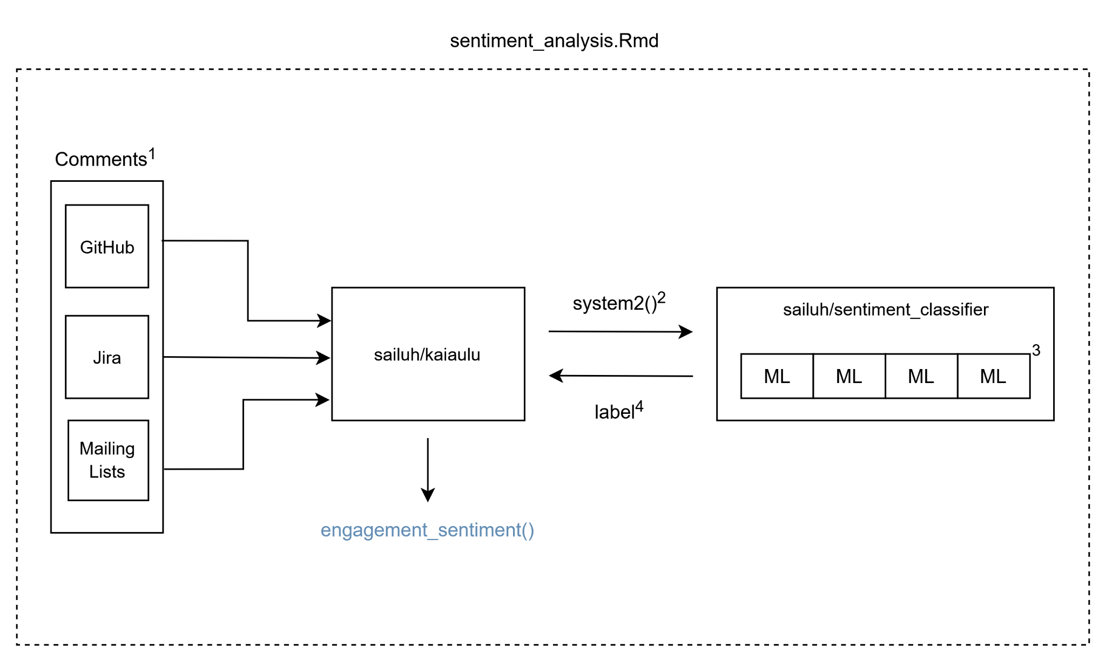
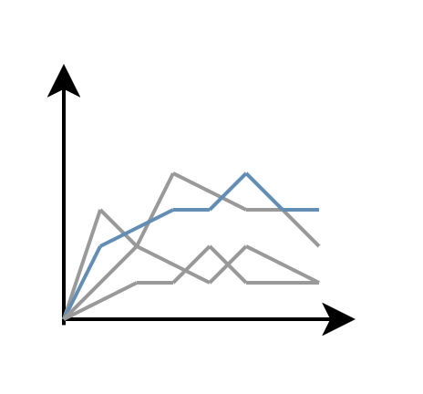
Sentiment Classifier : : CHEAT SHEET
About
Kaiaulu provides support for analyzing developer communication in open source projects. This cheatsheet covers how to configure, download, and label comments from multiple sources (GitHub, Jira, and mailing lists) with sentiment using a machine learning classifier.
Comment Sentiment
Related Vignettes
Comments¹ are text written by developers from GitHub (commits, issues, or PR comments), Jira (issue comments), or mailing lists (emails). Kaiaulu downloads and parses this data from each source so it can be passed to the sentiment classifier.
See supplementary notebooks that go in-depth on downloading and parsing communication data and conducting the full sentiment analysis workflow.
Iteration 3
1. download_github_events.Rmd
2. download_github_pull_requests.Rmd
3. sentiment_analysis.Rmd
Project Config Setup
Before running a vignette, you must set up your project configuration file (examples in conf/) to specify the paths to download the data.
Engagement Metric
After labeling, Kaiaulu aggregates the sentiment of each developer's comments across all sources over a rolling window to produce an engagement sentiment score.
Required Fields
issue_tracker:
github:
project_key_1:
owner:
repo:
issue_or_pr_comment:
issue_event:
commit:
commit_comments:
pr_comments:
sailuh/sentiment_github_dataset
Message
UTC timestamp
Author name and email
Message polarity
Kaiaulu (R) passes the text comments to the sentiment classifier (Python) using the system2()² call. The classifier predicts whether each comment is positive, negative, or neutral using machine learning models³ and returns that label⁴ to Kaiaulu.
kaiaulu/metric.R
You should also specify the required external tools in tools.yml:
engagement_sentiment()
Tools Config Setup
pysenti:
perceval:
Required Fields
Kaiāulu
CC BY SA Samantha Limon, Adam Graham, Carlos Paradis • Kaiaulu package version 0.0.0.9700 (in development) • Updated: 2025-12
Notes:
Maybe there could be another header for integration and related vignettes. Could diagram how the data you obtain passes down to me which I can then use for functions. My functions in turn output data tables.
Add sentiment analysis notebook: https://github.com/sailuh/kaiaulu/pull/347/changes#diff-410622b0b81c7706813f954374bf25cc0f75a5e73064edcaae6e17d1e8366cbc
The line of code with system2: https://github.com/sailuh/kaiaulu/pull/347/changes#diff-93170c206bbe5c492a0430b7c4dea9c5079a83c6717…

Slide 4
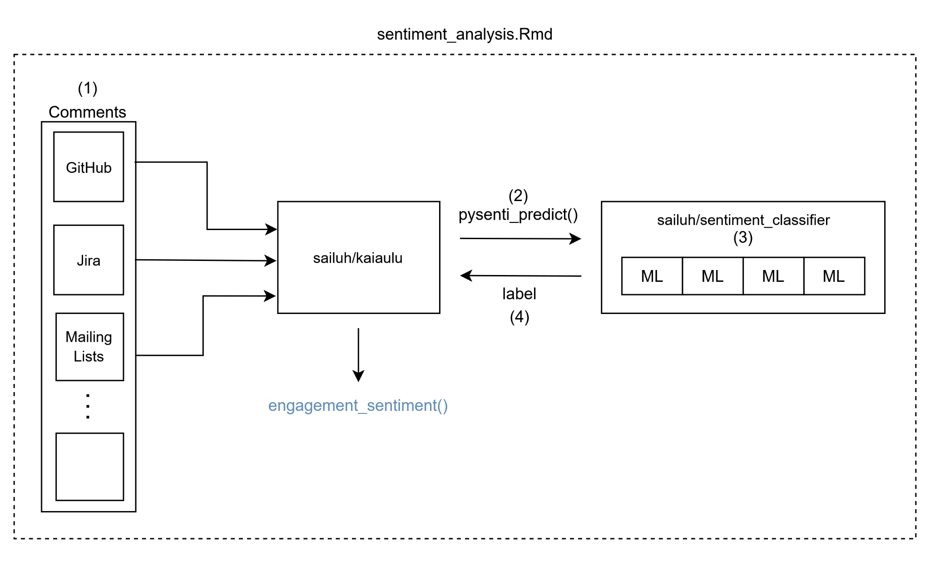
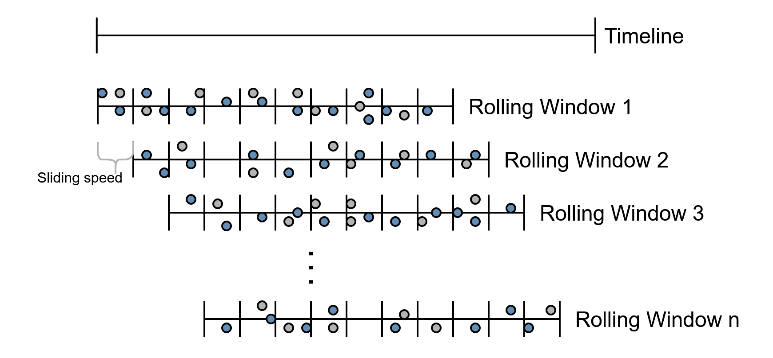
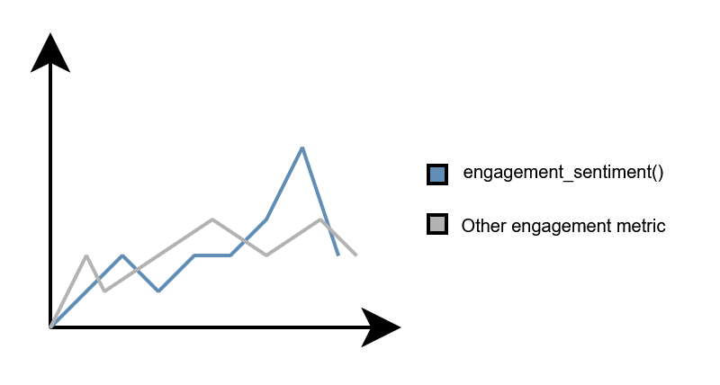
Sentiment Classifier : : CHEAT SHEET
About
Comment Sentiment
Related Vignettes
Iteration 4
Kaiaulu provides support for the download of comment data from multiple sources e.g. GitHub, Jira, and mailing lists (see the refresher cheatsheet). This cheatsheet covers how to take these comments and apply a sentiment to them using a machine learning classifier for sentiment analysis.
Kaiaulu has a sentiment notebook titled sentiment_analysis.Rmd that allows you to interface with the sentiment classifier. The download of comments (1) is required so that Kaiaulu can pass the comment data to the sentiment classifier.
See supplementary notebooks that go in-depth on downloading and parsing communication data and conducting the full sentiment analysis workflow.
1. download_github_events.Rmd
2. download_github_pull_requests.Rmd
3. sentiment_analysis.Rmd
Project Config Setup
Before running a vignette, you must set up your project configuration file (examples in conf/) to specify the paths to download the data.
Engagement Metric
Once the comments are labeled, Kaiaulu supports the aggregation of developer sentiment. Kaiaulu has a function called engagement_sentiment() (see metric.R) that takes into account a developer’s comments across all sources over a rolling window to produce an engagement sentiment score.
Required Fields
issue_tracker:
github:
project_key_1:
owner:
repo:
issue_or_pr_comment:
issue_event:
commit:
commit_comments:
pr_comments:
Kaiaulu (R) passes the text comments to the sentiment classifier (Python) using the pysenti_predict() (2) call. The tools.yml path for the sentiment classifier follows that of the other third-party tools. In the case of the sentiment classifier, the path would look like the following:
pysenti: ..\..\sentiment_classifier\exec\train_or_predict.py
The sentiment classifier predicts whether each comment is positive, negative, or neutral using machine learning models (3) and returns that label (4) to Kaiaulu.
You should also specify the required external tools in tools.yml:
Tools Config Setup
pysenti:
perceval:
Required Fields
Kaiāulu
CC BY SA Adam Graham, Samantha Limon, Carlos Paradis • Kaiaulu package version 0.0.0.9700 (in development) • Updated: 2025-12
Notes:
Reordered names in bottom credits so I come first and then Samantha second.
Changed the numbering from superscripts to just regular numbers inside parenthesis for the diagram and text.
The “About” section was reworded: it acknowledges that Kaiaulu allows for the download of comment data (with the refresher cheatsheet mentioned in parenthesis) and that this cheatsheet showcases the use of these comments for sentiment analysis.
In the middle diagram in the comments box, I added a vertical ellipsis with another box below to represent that comments can come from other sources as well.
Changed the function call in the middle diagram from system2() to pysenti_predict() for Kaiaulu. pysenti_predict() is the actual function that it uses to predict the text sentiment. I also updated corresponding function in the below paragraph. [The sentiment analysis notebook for reference](https://github.com/sailuh/kaiaulu/pull/347/changes#diff-410622b0b81c7706813f954374bf25cc0f75a5e73064edcaae6e17d1e8366cbc)
In the bottom paragraph on the middle column, I made clear the specification of the script path in tools.yml for the sentiment classifier. I noted that it follows that of the paths for the other third-party tools that Kaiaulu uses.
Made it clear that Kaiaulu has a sentiment notebook titled sentiment_analysis.Rmd the user can interface with and mentioned the requirement of the downloaded comment data so that it can be passed to and utilized by the sentiment classifer.
Fixed engagement metric section by adding diagrams that represent the rolling window and associated time series.

Slide 5
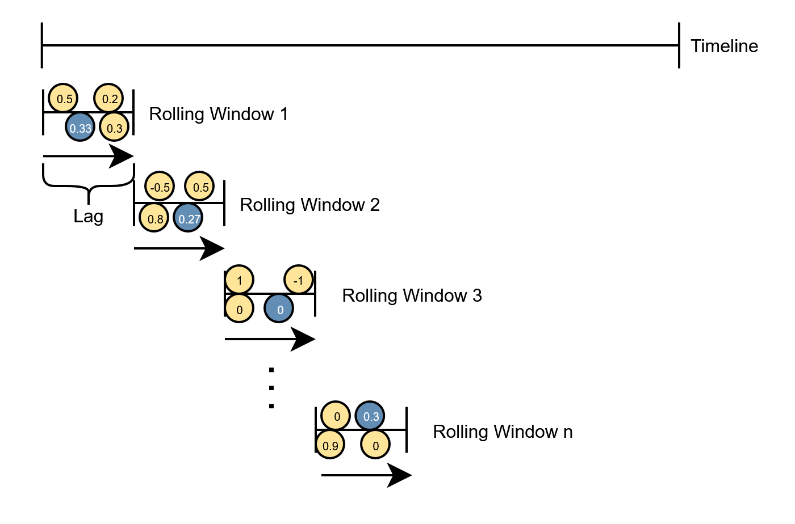
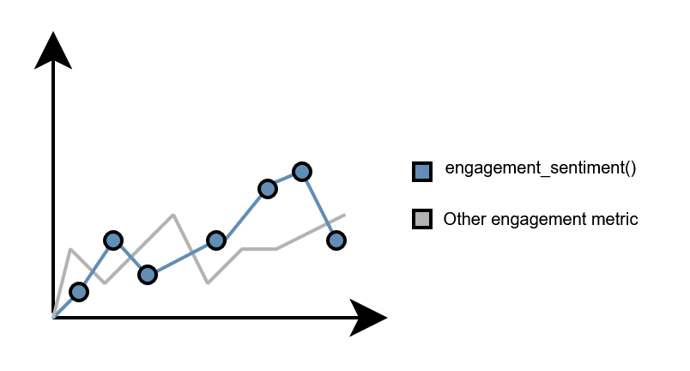
Sentiment Classifier : : CHEAT SHEET
About
Comment Sentiment
Related Vignettes
Iteration 5
Kaiaulu provides support for the download of comment data from multiple sources e.g. GitHub, Jira, and mailing lists (see the refresher cheatsheet). This cheatsheet covers how to take these comments and apply a sentiment to them using a machine learning classifier for sentiment analysis.
Kaiaulu has a sentiment notebook titled sentiment_analysis.Rmd that allows you to interface with the sentiment classifier. The download of comments (1) is required so that Kaiaulu can pass the comment data to the sentiment classifier.
See supplementary notebooks that go in-depth on downloading and parsing communication data and conducting the full sentiment analysis workflow.
1. download_github_events.Rmd
2. download_github_pull_requests.Rmd
3. sentiment_analysis.Rmd
Project Config Setup
Before running a vignette, you must set up your project configuration file (examples in conf/) to specify the paths to download the data.
Engagement Metric
Once the comments are labeled, Kaiaulu supports the aggregation of developer sentiment. Kaiaulu has a function called engagement_sentiment() (see metric.R) that takes into account a developer’s comments across all sources over a rolling window to produce an engagement sentiment score.
Required Fields
issue_tracker:
github:
project_key_1:
owner:
repo:
issue_or_pr_comment:
issue_event:
commit:
commit_comments:
pr_comments:
Kaiaulu (R) passes the text comments to the sentiment classifier (Python) using the pysenti_predict() call (2). The tools.yml path for the sentiment classifier follows that of the other third-party tools. In the case of the sentiment classifier, the path would look like the following:
pysenti: ..\..\sentiment_classifier\exec\train_or_predict.py
The sentiment classifier predicts whether each comment is positive, negative, or neutral using machine learning models (3) and returns that label (4) to Kaiaulu.
You should also specify the required external tools in tools.yml:
Tools Config Setup
pysenti:
perceval:
Required Fields
Kaiāulu
CC BY SA Adam Graham, Samantha Limon, Carlos Paradis • Kaiaulu package version 0.0.0.9700 (in development) • Updated: 2025-12

Slide 6




Sentiment Classifier : : CHEAT SHEET
About
Comment Sentiment
Related Vignettes
Iteration 6
Kaiaulu provides support for the download of comment data from multiple sources e.g. GitHub, Jira, and mailing lists (see the refresher cheatsheet). This cheatsheet covers how to take these comments and apply a sentiment to them using a machine learning classifier for sentiment analysis.
Kaiaulu has a sentiment notebook titled sentiment_analysis.Rmd that allows you to interface with the sentiment classifier. The download of comments (1) is required so that Kaiaulu can pass the comment data to the sentiment classifier.
See supplementary notebooks that go in-depth on downloading and parsing communication data and conducting the full sentiment analysis workflow.
1. download_github_events.Rmd
2. download_github_pull_requests.Rmd
3. sentiment_analysis.Rmd
sentiment_analysis.Rmd
(1)
Project Config Setup
Comments
Sentiment Metric
GitHub
Before running a vignette, you must set up your project configuration file (examples in conf/) to specify the paths to download the data.
pysenti_train_model()
Once the comments are labeled, Kaiaulu supports the aggregation of developer sentiment. Kaiaulu has a function called engagement_sentiment() (see metric.R) that takes into account a developer’s comments across all sources over a rolling window to produce an engagement sentiment score.
Jira
pysenti_predict()
sailuh/sentiment_classifier
Required Fields
sailuh/kaiaulu
(2)
(3)
issue_tracker:
github:
project_key_1:
owner:
repo:
issue_or_pr_comment:
issue_event:
commit:
commit_comments:
pr_comments:
Mailing Lists
(4)
ML
ML
ML
ML
label
Timeline
0.3
0.2
Rolling Window 1
f() =
f() =
0.3
engagement_sentiment()
0.3
0.3
0.3
-0.5
Lag
0.9
Rolling Window 2
f() =
f() =
0.9
0.8
0.27
0.27
Kaiaulu (R) passes the text comments to the sentiment classifier (Python) using the pysenti_predict() call (2). The tools.yml path for the sentiment classifier follows that of the other third-party tools. In the case of the sentiment classifier, the path would look like the following:
pysenti: ..\..\sentiment_classifier\exec\train_or_predict.py
The sentiment classifier predicts whether each comment is positive ( ), negative ( ), or neutral ( ) using machine learning models (3) and returns that label (4) to Kaiaulu.
0
Rolling Window n
f() =
f() =
0
You should also specify the required external tools in tools.yml:
0
0
Tools Config Setup
Required Fields
engagement_sentiment()
pysenti:
perceval:
Other engagement metric
Kaiāulu
CC BY SA Adam Graham, Samantha Limon, Carlos Paradis • Kaiaulu package version 0.0.0.9700 (in development) • Updated: 2025-12
Notes:
Be creative on right-hand side diagram. See how the “Engagement Metric” portion would look as small list of the functions rather than a text block explanation.
Make another slide version for iteration 6 (after all the other edits) that substitutes the “Engagement Metric” section text for the functions with some associated text (see the GitHub comments cheatsheet). If I can fit at least two functions in there, one would be a bolded blue for engagement_sentiment() and the other would be a bolded grey for the other engagement metric. But no need for the black connecting lines as seen in the GitHub comments cheatsheet.

Slide 7
Sentiment Classifier : : CHEAT SHEET
About
Comment Sentiment
Related Vignettes
Iteration 6
(Alternate version)
Kaiaulu provides support for the download of comment data from multiple sources e.g. GitHub, Jira, and mailing lists (see the refresher cheatsheet). This cheatsheet covers how to take these comments and apply a sentiment to them using a machine learning classifier for sentiment analysis.
Kaiaulu has a sentiment notebook titled sentiment_analysis.Rmd that allows you to interface with the sentiment classifier. The download of comments (1) is required so that Kaiaulu can pass the comment data to the sentiment classifier.
See supplementary notebooks that go in-depth on downloading and parsing communication data and conducting the full sentiment analysis workflow.
1. download_github_events.Rmd
2. download_github_pull_requests.Rmd
3. sentiment_analysis.Rmd
sentiment_analysis.Rmd
(1)
Project Config Setup
Comments
Engagement Metrics
GitHub
Kaiaulu has two engagement metrics (see metric.R) that takes into account a developer’s comments across all sources over a rolling window.
Before running a vignette, you must set up your project configuration file (examples in conf/) to specify the paths to download the data.
pysenti_train_model()
Jira
pysenti_predict()
sailuh/sentiment_classifier
engagement_communication() Counts the overall number of messages they have sent.
engagement_sentiment() Produces an engagement sentiment score.
Required Fields
sailuh/kaiaulu
(2)
(3)
issue_tracker:
github:
project_key_1:
owner:
repo:
issue_or_pr_comment:
issue_event:
commit:
commit_comments:
pr_comments:
Mailing Lists
(4)
ML
ML
ML
ML
label
engagement_sentiment()
0.25
Timeline
2
0.2
Rolling Window 1
f() =
f() =
2
0.3
0.25
-0.5
Kaiaulu (R) passes the text comments to the sentiment classifier (Python) using the pysenti_predict() call (2). The tools.yml path for the sentiment classifier follows that of the other third-party tools. In the case of the sentiment classifier, the path would look like the following:
pysenti: ..\..\sentiment_classifier\exec\train_or_predict.py
The sentiment classifier predicts whether each comment is positive ( ), negative ( ), or neutral ( ) using machine learning models (3) and returns that label (4) to Kaiaulu.
Lag
5
Rolling Window 2
f() =
f() =
0.8
0.01
5
You should also specify the required external tools in tools.yml:
0.27
Tools Config Setup
0
Rolling Window n
f() =
f() =
14
4
10
0
Required Fields
pysenti:
perceval:
engagement_communication()
engagement_sentiment()
Kaiāulu
CC BY SA Adam Graham, Samantha Limon, Carlos Paradis • Kaiaulu package version 0.0.0.9700 (in development) • Updated: 2025-12
Notes:
Alternate iteration 6 that substitutes the “Engagement Metric” section text for the functions with some associated text (see the GitHub comments cheatsheet).

Slide 8
Sentiment Classifier : : CHEAT SHEET
About
Comment Sentiment
Related Vignettes
Iteration 7
Kaiaulu provides support for the download of comment data from multiple sources e.g. GitHub, Jira, and mailing lists (see sailuh/kaiaulu_cheatsheet/cheatsheets/refresher-cheatsheet.pdf). This cheatsheet covers how to take these comments and apply a sentiment to them using a machine learning classifier for sentiment analysis.
See supplementary notebooks that go in-depth on downloading and parsing communication data and conducting the full sentiment analysis workflow.
Kaiaulu’s sentiment_analysis.Rmd interfaces with a family of sentiment classifier models. The classifier leverages comment data (1) obtainable by Kaiaulu downloaders.
Project Config Setup
sentiment_analysis.Rmd
1. download_github_events.Rmd
2. download_github_pull_requests.Rmd
3. sentiment_analysis.Rmd
Before running a vignette, you must set up your project configuration file (examples in conf/) to specify the paths to download the data.
(1)
Comments
Engagement Metrics
Required Fields
GitHub
issue_tracker:
github:
project_key_1:
owner:
repo:
issue_or_pr_comment:
issue_event:
commit:
commit_comments:
pr_comments: jira:
project_key_1:
issue_comments:
mailing_list: mod_mbox: project_key_1: pipermail: project_key_1:
pysenti_train_model()
Kaiaulu supports time-series analysis of developer comments across all sources via engagement_sentiment(). Developer’s comments are grouped by time step within a moving window to form a time series of engagement. Other engagement metric functions can also be combined.
Jira
pysenti_predict()
sailuh/sentiment_classifier
sailuh/kaiaulu
(2)
(3)
Mailing Lists
(4)
ML
ML
ML
ML
label
Timeline
0.3
0.2
Rolling Window 1
f() =
f() =
0.3
engagement_sentiment()
0.3
0.3
0.3
-0.5
Lag
0.9
Rolling Window 2
f() =
f() =
0.9
0.8
0.27
0.27
0
Rolling Window n
f() =
f() =
0
You should also specify the required external tools in tools.yml:
Kaiaulu passes comments ( ) to the sentiment classifier using pysenti_predict() (2). The tools.yml path for the sentiment classifier follows the same pattern as the other third-party tools.
The sentiment classifier labels each comment as positive ( ), negative ( ), or neutral ( ) using machine learning models (3) and returns that label (4) to Kaiaulu.
The sentiment labels can also be used as a measure of project emotional engagement.
0
0
Tools Config Setup
Required Fields
engagement_sentiment()
pysenti:
..\..\sentiment_classifier\exec\train_or_predict.py
perceval:
Other engagement metric
Kaiāulu
CC BY SA Adam Graham, Samantha Limon, Carlos Paradis • Kaiaulu package version 0.0.0.9700 (in development) • Updated: 2026-4

Slide 9
Sentiment Classifier : : CHEAT SHEET
About
Comment Sentiment
Related Vignettes
Iteration 7 (Alternate version)
Kaiaulu provides support for the download of comment data from multiple sources e.g. GitHub, Jira, and mailing lists (see sailuh/kaiaulu_cheatsheet/cheatsheets/refresher-cheatsheet.pdf). This cheatsheet covers how to take these comments and apply a sentiment to them using a machine learning classifier for sentiment analysis.
See supplementary notebooks that go in-depth on downloading and parsing communication data and conducting the full sentiment analysis workflow.
Kaiaulu’s sentiment_analysis.Rmd interfaces with a family of sentiment classifier models. The classifier leverages comment data (1) obtainable by Kaiaulu downloaders.
Project Config Setup
sentiment_analysis.Rmd
1. download_github_events.Rmd
2. download_github_pull_requests.Rmd
3. sentiment_analysis.Rmd
Before running a vignette, you must set up your project configuration file (examples in conf/) to specify the paths to download the data.
(1)
Comments
Engagement Metrics
Required Fields
GitHub
issue_tracker:
github:
project_key_1:
owner:
repo:
issue_or_pr_comment:
issue_event:
commit:
commit_comments:
pr_comments: jira:
project_key_1:
issue_comments:
mailing_list: mod_mbox: project_key_1: pipermail: project_key_1:
pysenti_train_model()
Kaiaulu supports time-series analysis of developer comments across all sources via two engagement metrics. Developer’s comments are grouped by time step within a moving window to form a time series of engagement.
Jira
pysenti_predict()
sailuh/sentiment_classifier
sailuh/kaiaulu
(2)
(3)
Mailing Lists
(4)
ML
ML
ML
ML
engagement_communication() Counts the overall number of messages a developer sent.
engagement_sentiment() Produces an engagement sentiment score.
label
engagement_sentiment()
0.25
Timeline
2
0.2
Rolling Window 1
f() =
f() =
2
0.3
0.25
-0.5
Lag
5
Rolling Window 2
f() =
f() =
0.8
0.01
5
Kaiaulu passes comments ( ) to the sentiment classifier using pysenti_predict() (2). The tools.yml path for the sentiment classifier follows the same pattern as the other third-party tools.
The sentiment classifier labels each comment as positive ( ), negative ( ), or neutral ( ) using machine learning models (3) and returns that label (4) to Kaiaulu.
The sentiment labels can also be used as a measure of project emotional engagement.
0.27
You should also specify the required external tools in tools.yml:
Tools Config Setup
0
Rolling Window n
f() =
f() =
14
4
10
0
Required Fields
pysenti:
..\..\sentiment_classifier\exec\train_or_predict.py
perceval:
engagement_communication()
engagement_sentiment()
Kaiāulu
CC BY SA Adam Graham, Samantha Limon, Carlos Paradis • Kaiaulu package version 0.0.0.9700 (in development) • Updated: 2026-4
Notes:
Be creative on right-hand side diagram. See how the “Engagement Metric” portion would look as small list of the functions rather than a text block explanation.
Make another slide version for iteration 6 (after all the other edits) that substitutes the “Engagement Metric” section text for the functions with some associated text (see the GitHub comments cheatsheet). If I can fit at least two functions in there, one would be a bolded blue for engagement_sentiment() and the other would be a bolded grey for the other engagement metric. But no need for the black connecting lines as seen in the GitHub comments cheatsheet.

Slide 10
Sentiment Classifier : : CHEAT SHEET
About
Comment Sentiment
Related Vignettes
Iteration 7 (Alternate version)
Kaiaulu provides support for the download of comment data from multiple sources e.g. GitHub, Jira, and mailing lists (see refresher-cheatsheet.pdf). This cheatsheet covers how to add sentiment labels to each comment, by using machine learning classifiers for sentiment analysis.
See supplementary notebooks that go in-depth on downloading and parsing communication data and conducting the full sentiment analysis workflow.
Kaiaulu’s sentiment_analysis.Rmd interfaces with a family of sentiment classifier models. The classifier leverages comment data (1) obtainable by Kaiaulu downloaders.
Project Config Setup
sentiment_analysis.Rmd
1. download_github_events.Rmd
2. download_github_pull_requests.Rmd
3. sentiment_analysis.Rmd
Before running a vignette, you must set up your project configuration file (examples in conf/) to specify the paths to download the data.
(1)
Comments
Engagement Metrics
Required Fields
GitHub
issue_tracker:
github:
project_key_1:
owner:
repo:
issue_or_pr_comment:
issue_event:
commit:
commit_comments:
pr_comments: jira:
project_key_1:
issue_comments:
mailing_list: mod_mbox: project_key_1: pipermail: project_key_1:
pysenti_train_model()
Kaiaulu supports time-series analysis of developer comments across all sources via various engagement metrics. For two of them, developer’s comments and sentiments are grouped respectively by time step within a moving window to form a time series of engagement.
Jira
sailuh/kaiaulu
pysenti_predict()
sailuh/sentiment_classifier
(2)
(3)
Mailing Lists
(4)
ML
ML
ML
ML
engagement_communication() Counts the overall number of messages a developer sent.
engagement_sentiment() Produces an engagement sentiment score.
label
engagement_sentiment()
0.25
Timeline
2
0.2
Rolling Window 1
f() =
f() =
2
0.3
0.25
-0.5
Lag
5
Rolling Window 2
f() =
f() =
0.8
0.01
5
Kaiaulu passes comments ( ) to the sentiment classifier using pysenti_predict() (2). The tools.yml path for the sentiment classifier follows the same pattern as the other third-party tools.
The sentiment classifier labels each comment as positive ( ), negative ( ), or neutral ( ) using machine learning models (3) and returns that label (4) to Kaiaulu.
The sentiment labels can also be used as a measure of project emotional engagement.
0.27
You should also specify the required external tools in tools.yml:
Tools Config Setup
0
Rolling Window n
f() =
f() =
14
4
10
0
Required Fields
pysenti:
..\..\sentiment_classifier\exec\train_or_predict.py
perceval:
engagement_communication()
engagement_sentiment()
Kaiāulu
CC BY SA Adam Graham, Samantha Limon, Carlos Paradis • Kaiaulu package version 0.0.0.9700 (in development) • Updated: 2026-4

Slide 11
Sentiment Classifier : : CHEAT SHEET
About
Comment Sentiment
Related Vignettes
Kaiaulu provides support for the download of comment data from multiple sources e.g. GitHub, Jira, and mailing lists (see refresher-cheatsheet.pdf). This cheatsheet covers how to add sentiment labels to each comment by using machine learning classifiers for sentiment analysis.
Kaiaulu’s sentiment_analysis.Rmd interfaces with a family of sentiment classifier models. The classifier leverages comment data (1) obtainable by Kaiaulu downloaders.
See supplementary notebooks that go in-depth on downloading and parsing communication data and conducting the full sentiment analysis workflow.
Project Config Setup
sentiment_analysis.Rmd
1. download_github_events.Rmd
2. download_github_pull_requests.Rmd
3. sentiment_analysis.Rmd
Before running a vignette, you must set up your project configuration file (examples in conf/) to specify the paths to download the data.
(1)
Comments
Engagement Metrics
Required Fields
GitHub
issue_tracker:
github:
project_key_1:
owner:
repo:
issue_or_pr_comment:
issue_event:
commit:
commit_comments:
pr_comments: jira:
project_key_1:
issue_comments:
mailing_list: mod_mbox: project_key_1: pipermail: project_key_1:
pysenti_train_model()
Kaiaulu supports time-series analysis of developer comments across all sources via various engagement metrics. For two of them, developer’s comments and sentiments are grouped respectively by time step within a moving window to form a time series of engagement.
Jira
sailuh/kaiaulu
pysenti_predict()
sailuh/sentiment_classifier
(2)
(3)
Mailing Lists
(4)
ML
ML
ML
ML
engagement_communication() Counts the overall number of messages a developer sent.
engagement_sentiment() Produces an engagement sentiment score.
label
engagement_sentiment()
0.25
Timeline
2
0.2
Rolling Window 1
f() =
f() =
2
0.3
0.25
-0.5
Lag
5
Rolling Window 2
f() =
f() =
0.8
0.01
5
Kaiaulu passes comments ( ) to the sentiment classifier using pysenti_predict() (2). The tools.yml path for the sentiment classifier follows the same pattern as the other third-party tools.
The sentiment classifier labels each comment as positive ( ), negative ( ), or neutral ( ) using machine learning models (3) and returns that label (4) to Kaiaulu.
The sentiment labels can also be used as a measure of project emotional engagement.
0.27
You should also specify the required external tools in tools.yml:
Tools Config Setup
0
Rolling Window n
f() =
f() =
14
4
10
0
Required Fields
pysenti:
..\..\sentiment_classifier\exec\train_or_predict.py
perceval:
engagement_communication()
engagement_sentiment()
Kaiāulu
CC BY SA Adam Graham, Samantha Limon, Carlos Paradis • Kaiaulu package version 0.0.0.9700 (in development) • Updated: 2026-4

