Slide 1
Task Tracker
React + FastAPI + PowerApps
Microsoft Entra ID · Microsoft Dataverse · Azure Cloud
Deployed architecture · live in your Azure subscription
Generated 2026-05-19

Slide 2
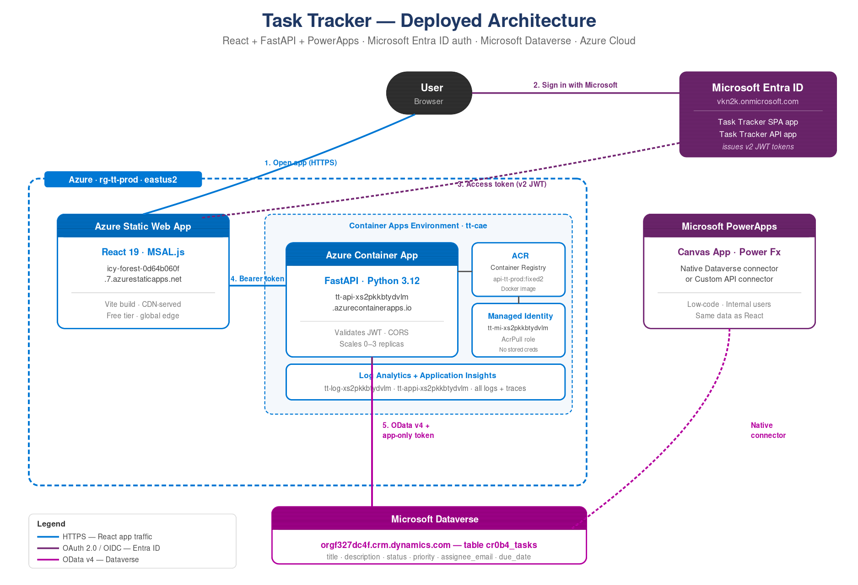
Architecture at a glance
How React, FastAPI, PowerApps and Dataverse work together — all auth via Microsoft Entra ID.

Slide 3
Authentication flow
One Microsoft sign-in, two app registrations, three layers — all linked by JWT.
1
User clicks Sign in
Browser redirects to login.microsoftonline.com, hosted by Entra ID.
2
Entra ID issues a v2 token
Audience = api://<API_CLIENT_ID>, scope = access_as_user, signed by tenant vkn2k.
3
React calls FastAPI with Bearer
Token validated by fastapi-azure-auth: signature, issuer (v2.0), audience.
4
FastAPI exchanges for app-only token
MSAL ConfidentialClient → scope https://orgf327dc4f.crm.dynamics.com/.default.
5
FastAPI calls Dataverse OData v4
App-only token grants System Customizer role → reads/writes cr0b4_tasks rows.

Slide 4
What's live in your Azure subscription
Resource group rg-tt-prod · eastus2 · ~$2–5/month idle
SWA
ACA
ACR
MI
Static Web App
Container App
Container Registry
Managed Identity
React 19 + MSAL.js
icy-forest-0d64b060f
.7.azurestaticapps.net
FastAPI in Python 3.12
tt-api-xs2pkkbtydvlm
.azurecontainerapps.io
ttacrxs2pkkbtydvlm
.azurecr.io
Image: api-tt-prod:fixed2
tt-mi-xs2pkkbtydvlm
AcrPull role
No stored creds
DV
AAD
LOG
AI
Microsoft Dataverse
Entra ID Apps
Log Analytics
Application Insights
orgf327dc4f.crm.dynamics.com
Table: cr0b4_tasks
6 columns + picklists
Task Tracker API
Task Tracker SPA
Admin consent granted
tt-log-xs2pkkbtydvlm
Container + ingress logs
30-day retention
tt-appi-xs2pkkbtydvlm
Distributed tracing
Live metrics
All 8 resources provisioned via Bicep (infra/main.bicep) and deployed via 'azd up'.

Slide 5
It's live
End-to-end verified — React to FastAPI to Dataverse — on a real Azure deployment.
App
https://icy-forest-0d64b060f.7.azurestaticapps.net/
API
https://tt-api-xs2pkkbtydvlm.wonderfulstone-03965d5b.eastus2.azurecontainerapps.io/
Dataverse
https://orgf327dc4f.crm.dynamics.com/
Tear down with azd down --purge · Cost: ~$2-5/month idle

