Slide 1
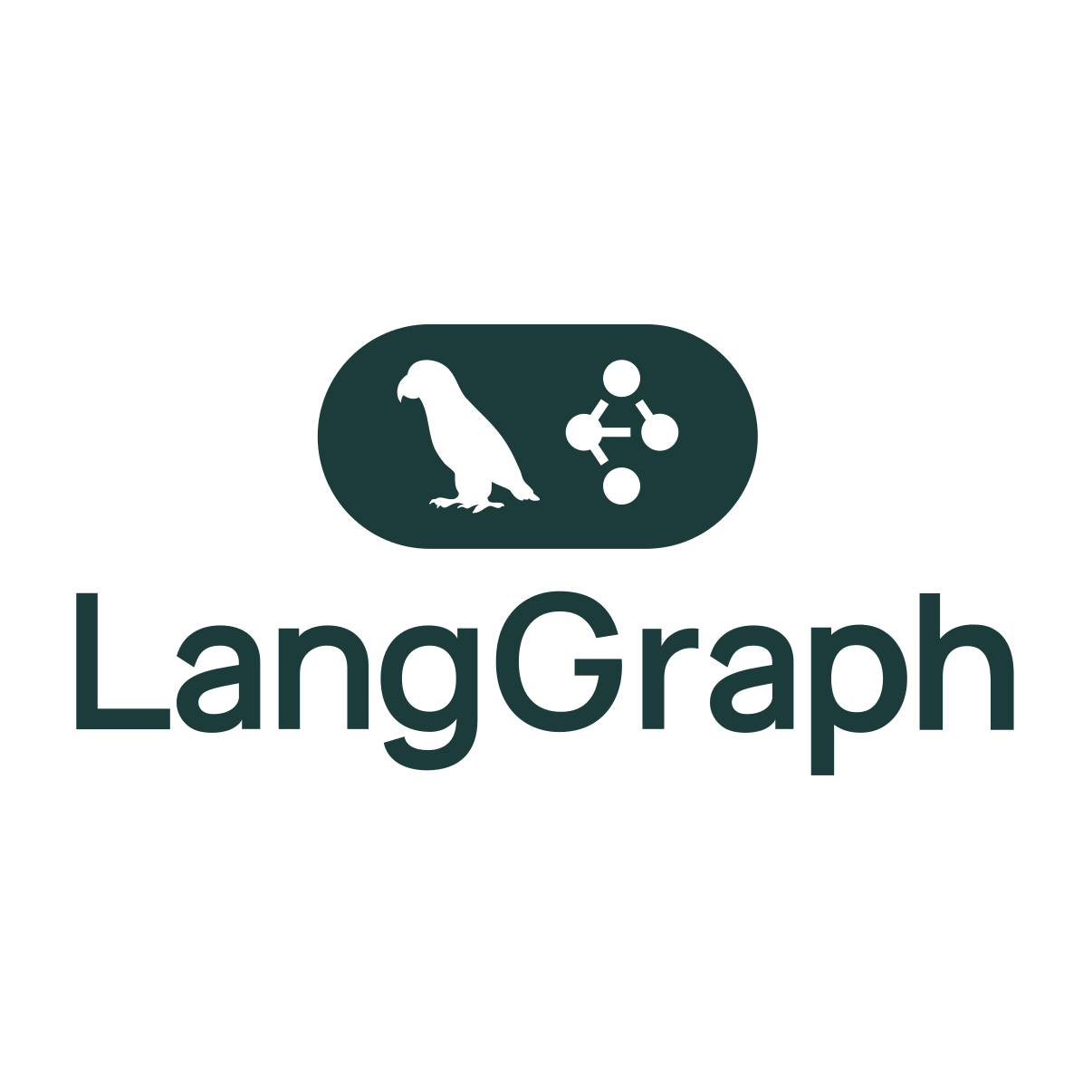

Slide 2
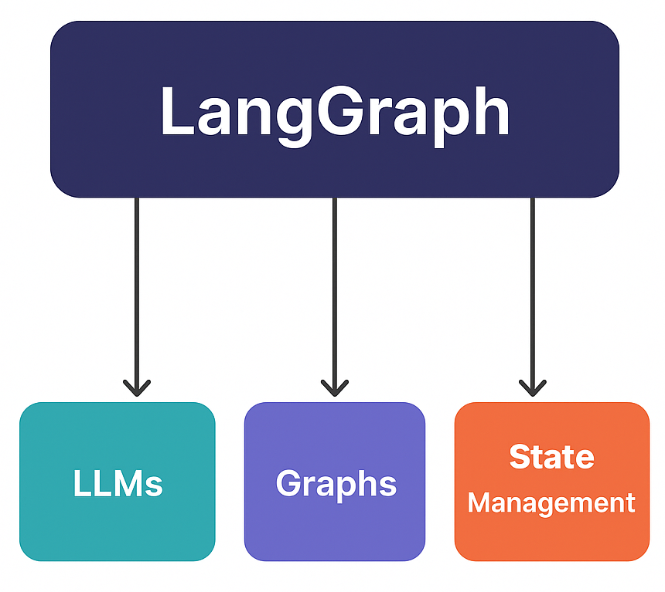
What is LangGraph?
Notes:
LangGraph is an open-source framework for building stateful and multi-agent applications using Large Language Models (LLMs).
Built on top of LangChain, focused on workflows as graphs.
Think of LangGraph as LLMs + Graphs + State Management.

Slide 3
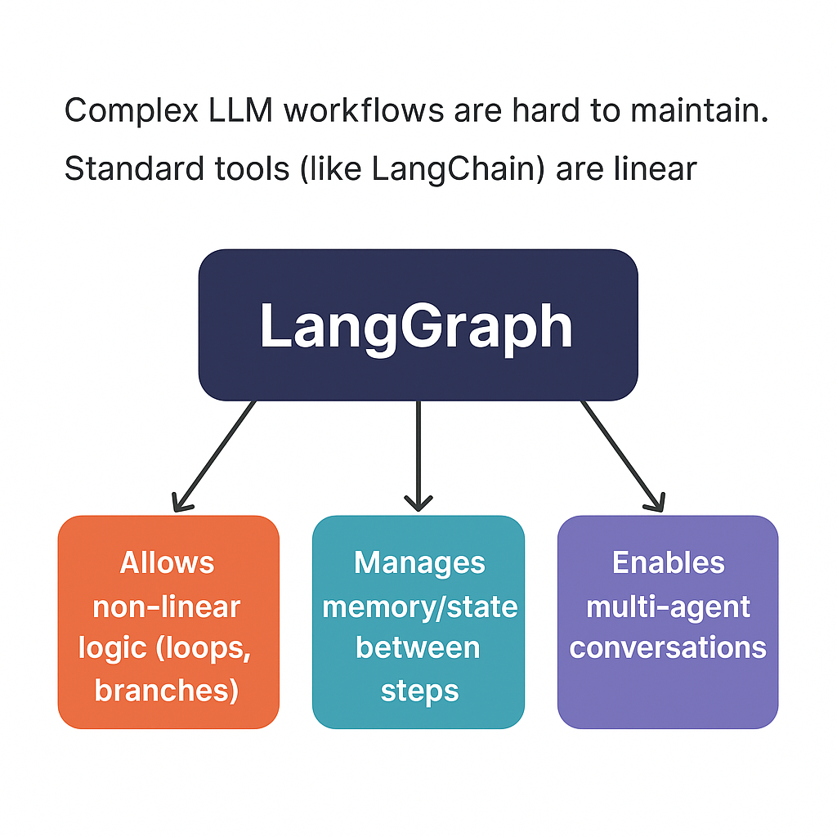
Why Use LangGraph?
Notes:
Complex LLM workflows are hard to maintain.
Standard tools (like LangChain) are linear.
LangGraph:
Allows non-linear logic (loops, branches).
Manages memory/state between steps.
Enables multi-agent conversations.

Slide 4
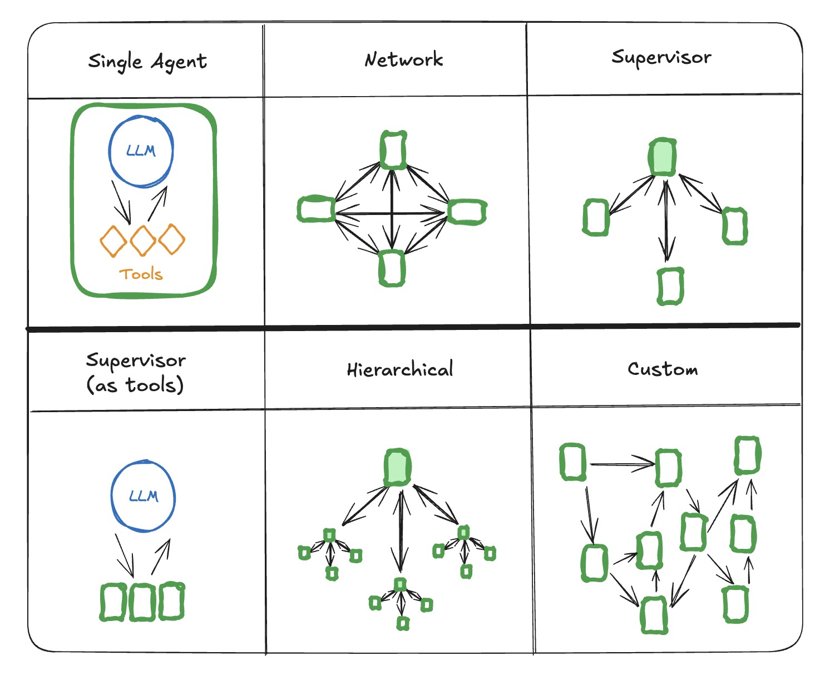
Graph Structure
Notes:
LangGraph represents a program as a graph:
Nodes = Functions or chains (e.g., LLM calls, tools).
Edges = Transitions (i.e., what comes next based on output).
It supports:
Conditionals (if/else logic).
Loops (retry until satisfied).
Parallel execution (coming soon).

Slide 5
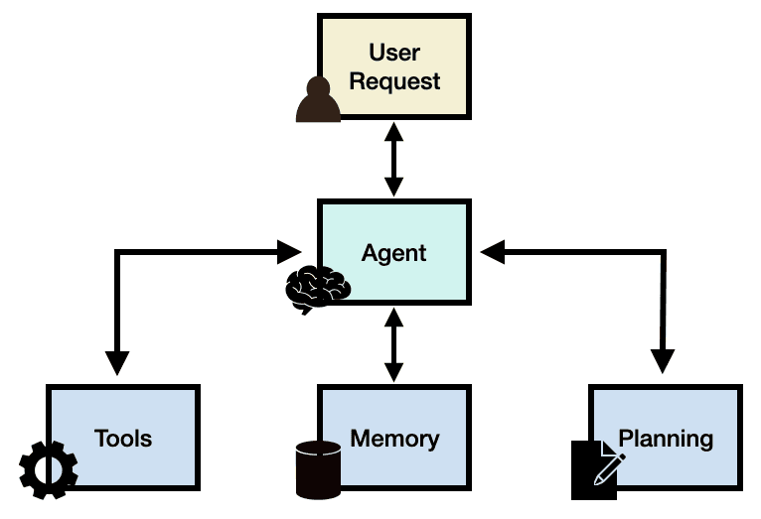
Agents
Notes:
You can create multi-agent systems:
Each agent = a LangChain agent or a tool + memory
Agents can communicate with each other via messages
Good for modeling real-world team dynamics

Slide 6
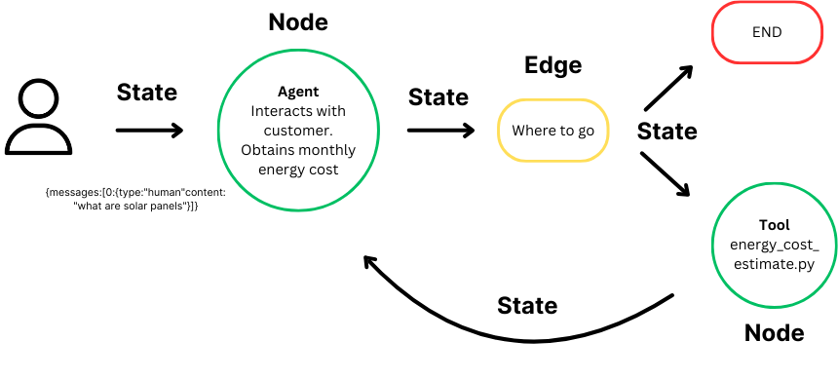
Stateful Execution
Think of state as your agent’s brain where it remembers what happened at every step.
Notes:
LangGraph apps have memory and state.
State can include:
Chat history
Variables (user inputs, decisions, flags)
Agent thoughts
State is updated after each node.

Slide 7
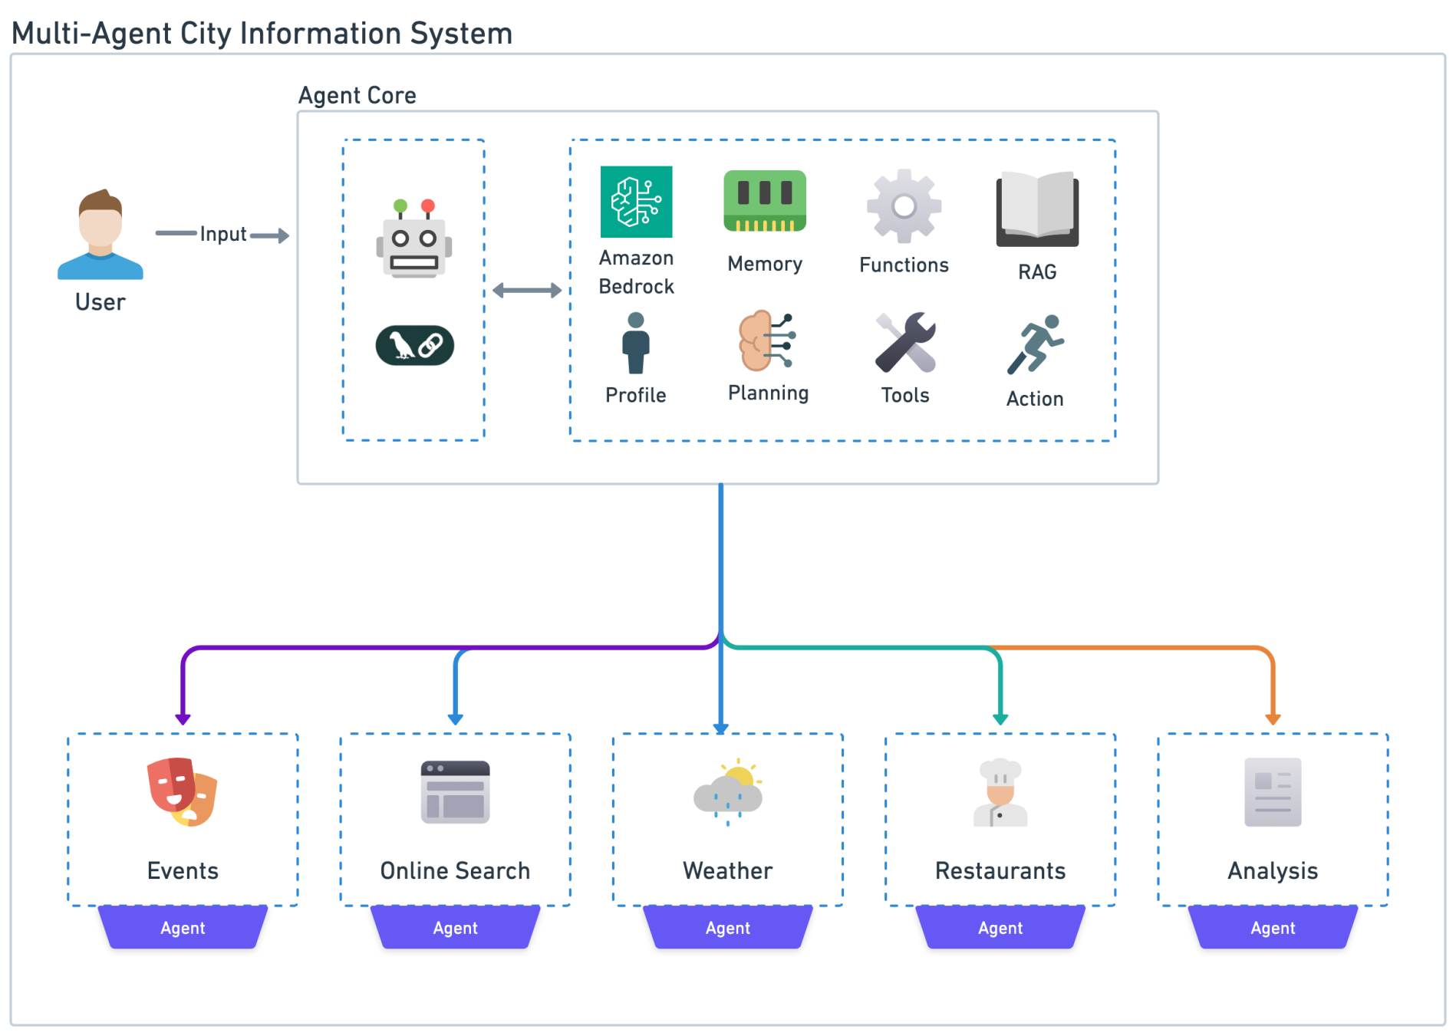
Real-World Use Cases

Slide 8
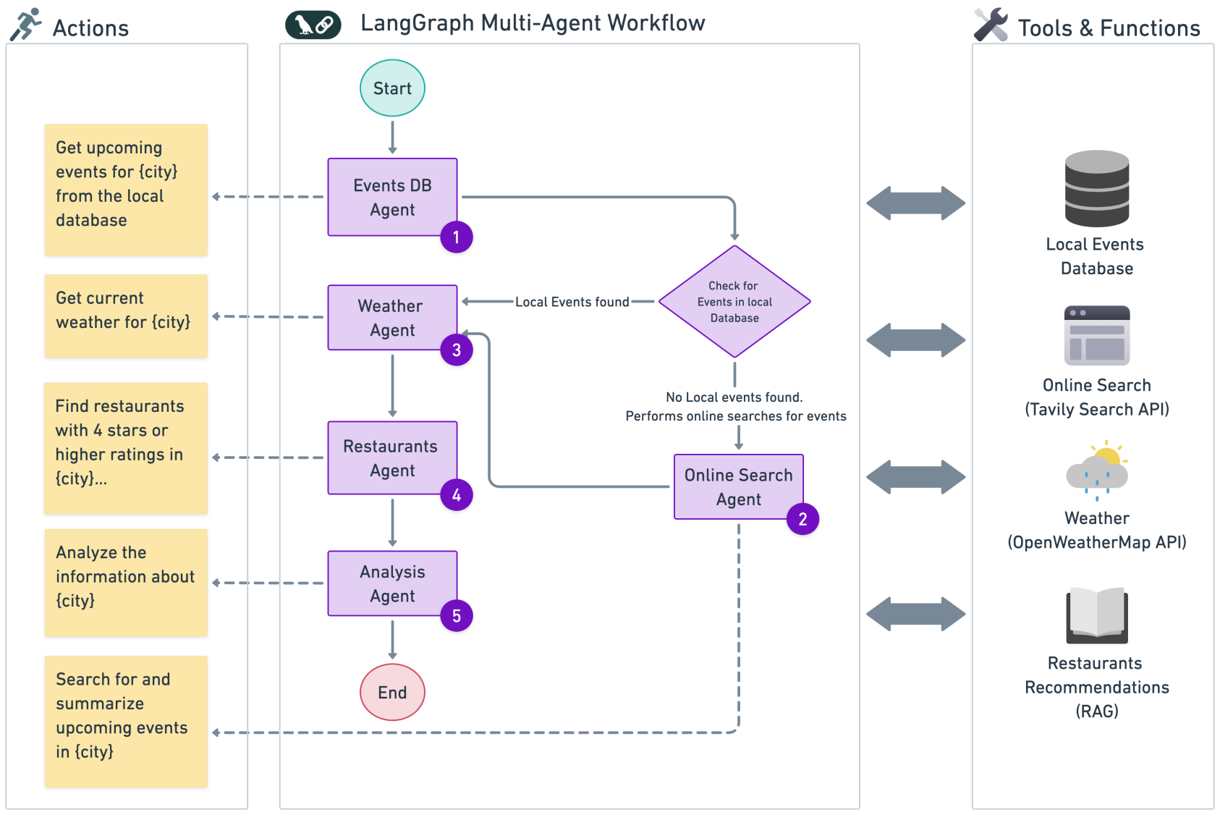
Real-World Use Cases
Notes:
https://aws.amazon.com/blogs/machine-learning/build-a-multi-agent-system-with-langgraph-and-mistral-on-aws/

Slide 9
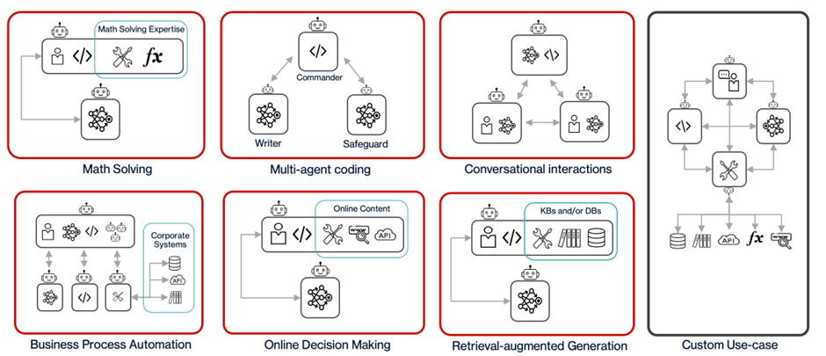
Real-World Use Cases
Notes:
https://community.hitachivantara.com/blogs/miguel-gaspar/2023/10/27/multi-agent-the-genai-secret-weapon-for-enterprise

Slide 10
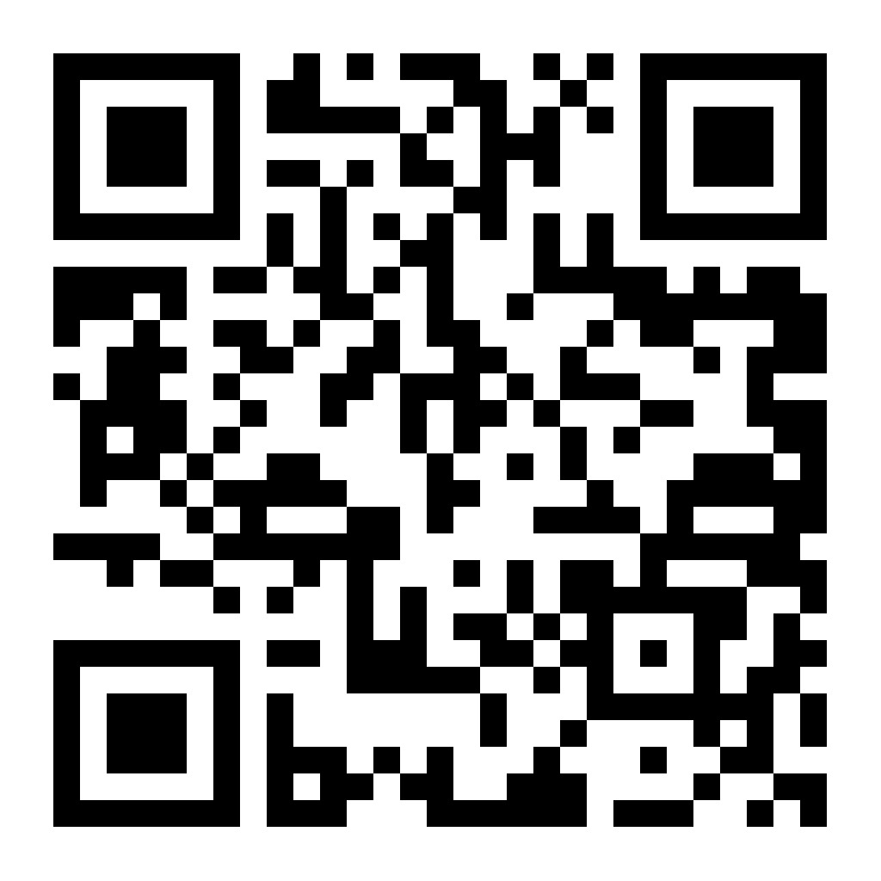
Multi-Agent GitHub Project Recommender
https://colab.research.google.com/drive/1BxqvGpyKoKZ4KBmr7nSoF8JirBLakw45?usp=sharing
Notes:
## LangGraph Terms
---
### **State**
✅ *Think of state as your agent’s brain — where it remembers what happened at every step.*
It stores inputs, outputs, decisions, and memory during the workflow.
---
### **Node**
✅ *Think of a node as a task performer — it does one job, like calling an LLM, using a tool, or doing a calculation.*
It takes the state as input, does something, and returns the updated state.
---
### **Edge**
✅ *Think of edges as arrows showing the path between steps — they tell LangGraph what comes next.*
You can have simple arrows or logic-based ones like “if this, then go there.”
---
### **Graph**
✅ *Think of the graph as the roadmap of your app — it connects all nodes and shows the flow of logic.*
It can go forward, loop, or branch like a mind map.
---
### **Agent**
✅ *Think of an agent as a smart team member — it can think (LLM), use tools, and has its own memory.*
LangGraph lets multiple agents work together on a shared task.
---
### **Conditional Edge**
✅ *Think of it like an if-else decision — based on the state, it chooses where to go next.*
Example: If LLM is unsure → ask another agent, else → finish.
---
### **Loop**
✅ *Think of a loop as “try again until it works” — it repeats a node until a condition is met.*
Good for re-asking questions or retrying when LLM gets it wrong.
---
### **Tool**
✅ *Think of a tool as something the agent can use — like Google Search, a calculator, or an API.*
It’s an external function the agent can call to fetch or process info.
---
### **Entry Point**
✅ *Think of it as the starting gate — the first node that runs when you start the graph.*
---
### **Finish Point**
✅ *Think of it as the final stop — the last node that completes the workflow and returns the final result.*
---
### **LangChain**
✅ *Think of LangChain as the toolbox — LangGraph uses LangChain’s tools, LLMs, memory, and chains inside its nodes.*

