Slide 1
Transfer Learning
From Pretrained Models to Real-World Applications

Slide 2
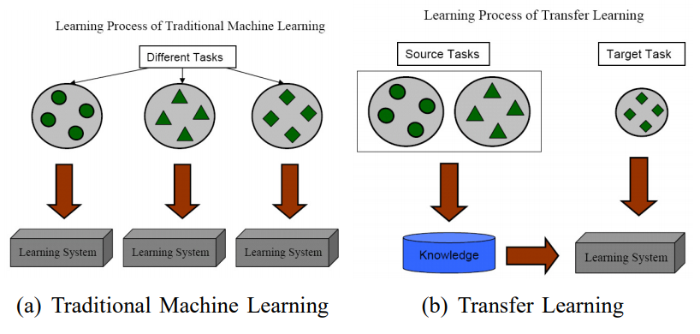
Introduction to Transfer Learning
Transfer Learning is a machine learning technique where a model trained on one task is reused as the starting point for another task.
Analogy: Like using your knowledge of riding a bicycle to learn riding a motorcycle faster.

Slide 3
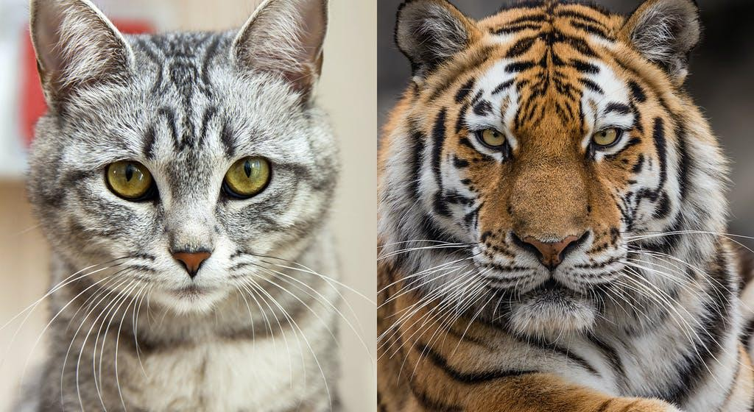
Transfer learning
Transfer learning (TL) is a research problem in ML that focuses on storing knowledge gained while solving one problem and applying it to a different but related problem. For example, knowledge gained while learning to recognize Cats could apply when trying to recognize Tigers.

Slide 4
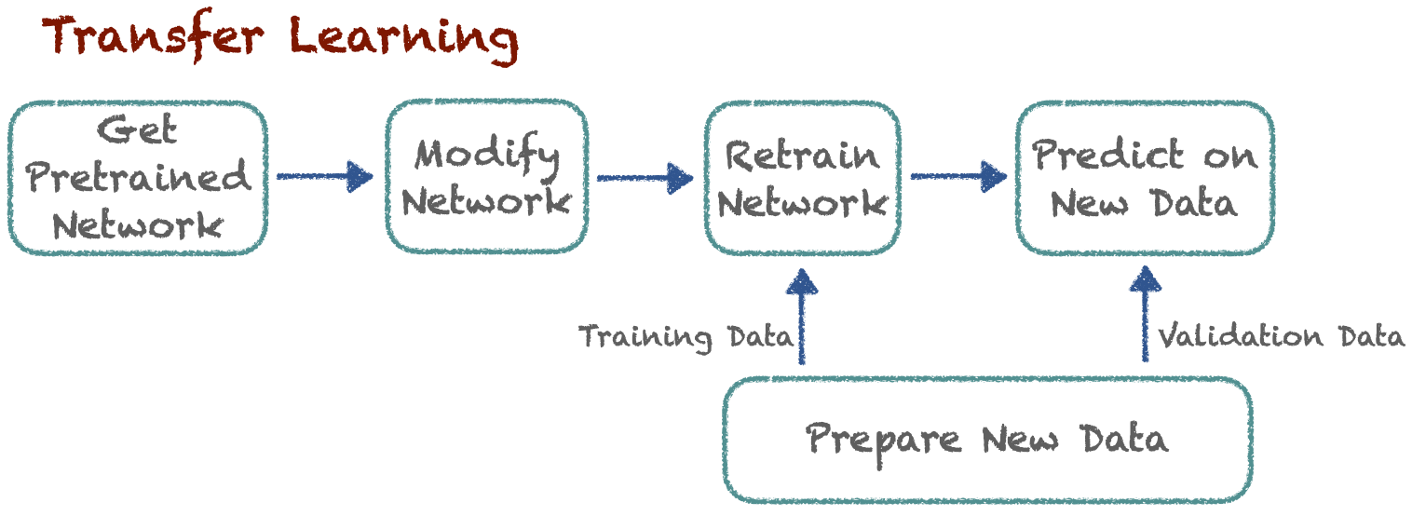
How Transfer Learning Works
1. Choose a pretrained model (e.g., ResNet, MobileNet)
2. Replace the final layers to match your task
3. Freeze initial layers (feature extraction) or fine-tune all layers
4. Train with your dataset

Slide 5
Reusing Pretrained Layers
It is generally not a good idea to train a very large DNN from scratch: instead, you should always try to find an existing neural network that accomplishes a similar task to the one you are trying to tackle then reuse the lower layers of this network.
This technique is called transfer learning.
It will not only speed up training considerably but also require significantly
less training data
The output layer of the original model should usually be replaced because it is most likely not useful at all for the new task, and it may not even have the right number of outputs for the new task.

Slide 6
CNN Variations
Over the years, variants of the CNN architecture have been developed, leading to amazing advances in the field. A good measure of this progress is the error rate in competitions such as the ILSVRC ImageNet challenge.
LeNet-5 (1998)
AlexNet (2012)
VGG-16 (2014)
Inception-v1
Inception-v3
ResNet-50
Xception (2016)
Inception-v4 (2016)
Inception-ResNets
10. ResNeXt-50 (2017)

Slide 7
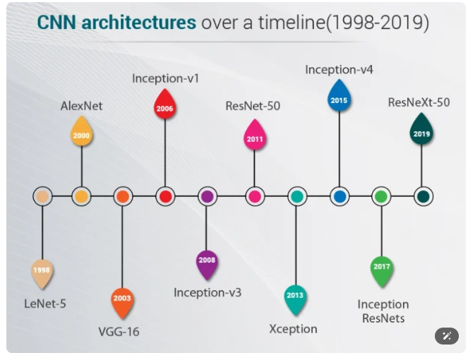
Popular Pretrained Models

Slide 8
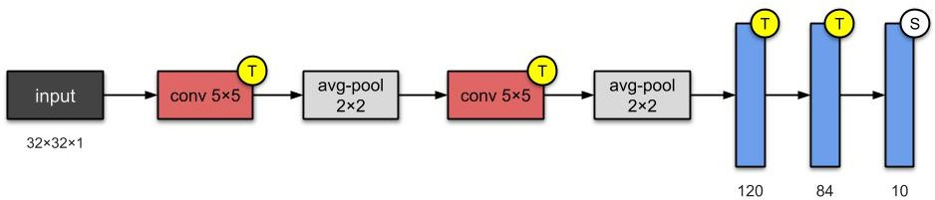
CNN Variations - LeNet-5
It was created by Yann LeCun in 1998 and has been widely used for
handwritten digit recognition (MNIST).
This architecture has become the standard “ template” : stacking convolutions and pooling layers and ending the network with one or more fully-connected layers.

Slide 9
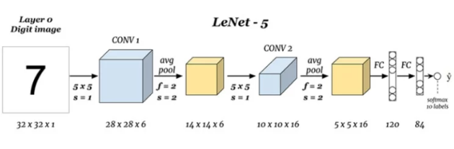
LeNet

Slide 10
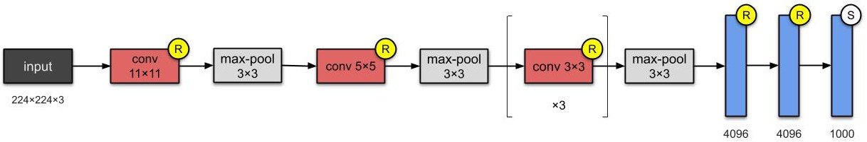
CNN Variations - AlexNet
The AlexNet CNN architecture won the 2012 ImageNet ILSVRC challenge.
To reduce overfitting, the authors used two regularization techniques. First, they applied dropout with a 50% dropout rate during training to the outputs of layers F1 and F2. Second, they performed data augmentation.

Slide 11
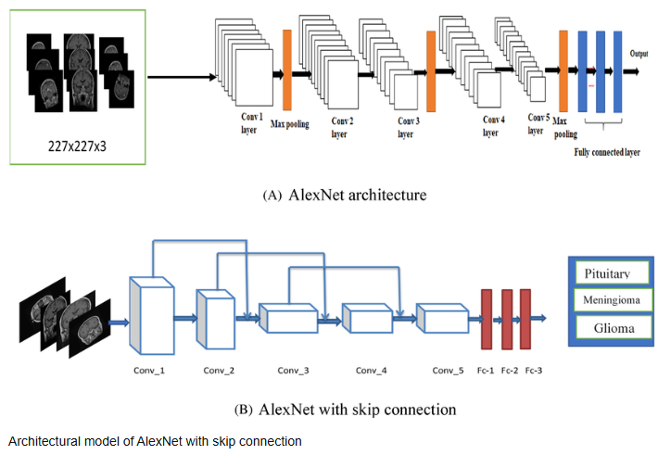
AlexNet

Slide 12
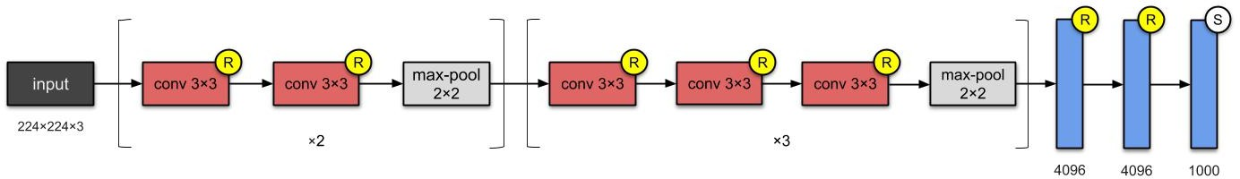
CNN Variations - VGG
The runner-up in the ILSVRC 2014 challenge was VGG, developed by Karen Simonyan and Andrew Zisserman from the Visual Geometry Group (VGG) research lab at Oxford University.
VGG-16 architecture and VGG-19 architecture

Slide 13
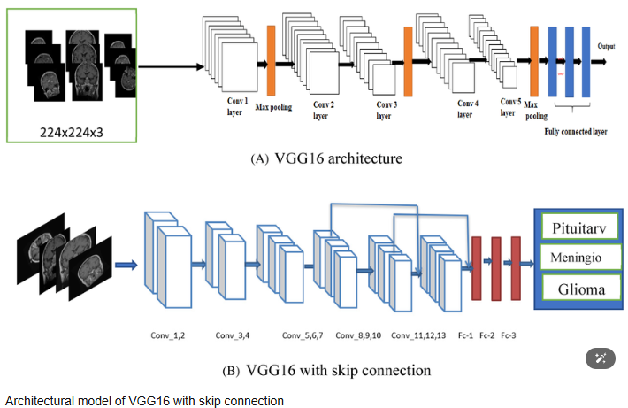
VGGNet

Slide 14
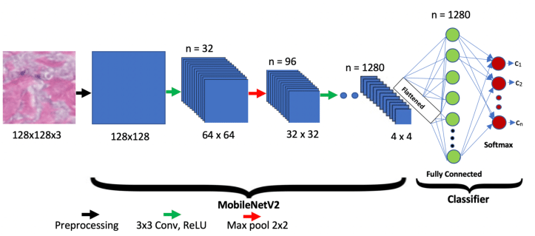
MobileNet

Slide 15
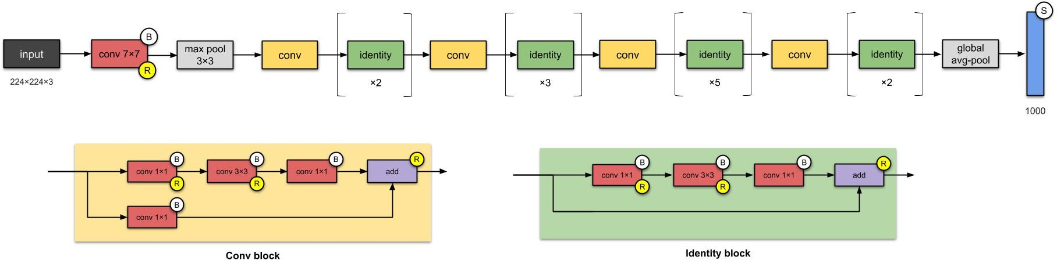
CNN Variations - ResNet-50
The basic building block for ResNets are the conv and identity blocks.
It uses skip connections (also called shortcut connections).
If you add many skip connections, the network can start making progress even if several layers have not started learning yet.

Slide 16
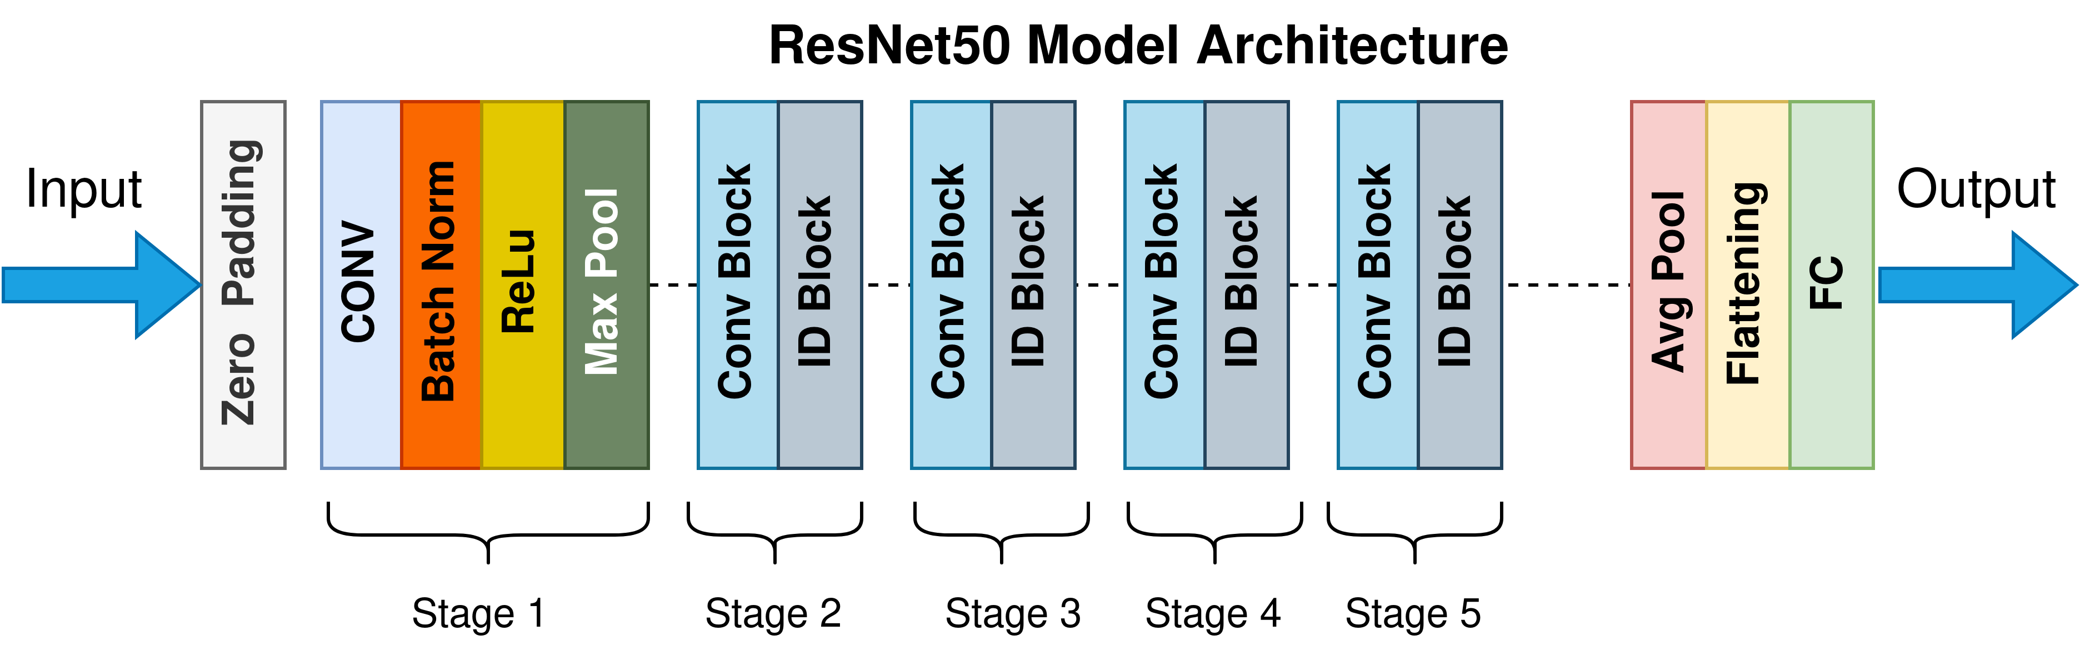
ResNet

Slide 17
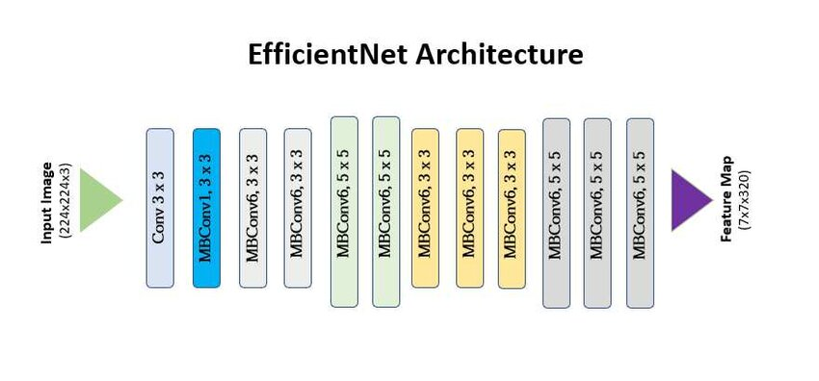
EfficientNet

Slide 18
Using Pretrained Models from Keras
In general, you won’t have to implement standard models like GoogLeNet or ResNet manually, since pretrained networks are r e a d i l y a v a i l a b l e w i t h a s i n g l e l i n e o f c o d e i n t h e keras.applications package.
For example, you can load the ResNet-50 model, pretrained on
ImageNet, with the following line of code:
model = keras.applications.resnet50. ResNet50
(weights= "imagenet")

Slide 19
Using Pretrained Models from Keras
Available models :
Models for image classification with weights trained on ImageNet:
Xception
VGG16
VGG19
ResNet, ResNetV2
InceptionV3
InceptionResNetV2
MobileNet
MobileNetV2
DenseNet
NASNet
https://keras.io/applications/

Slide 20
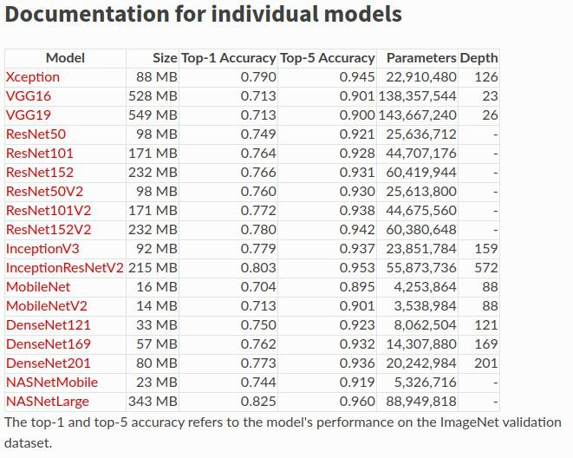
Using Pretrained Models from Keras

Slide 21
Using Pretrained Models from Keras
model = keras.applications.resnet50.ResNet50(weights="imagenet")
# you first need to ensure that the images have the right size # ResNet-50(224 × 224)
images_resized = tf.image.resize(images, [224, 224])
# Each model provides a preprocess_input() function
inputs = keras.applications.resnet50.preprocess_input(images_resized * 255)
# Now we can use the pretrained model to make predictions Y_proba = model.predict(inputs)

Slide 22
Using Pretrained Models from Keras
import tensorflow as tf
from tensorflow import keras
model = keras.applications.vgg16.VGG16(weights=None)
# The model’s summary() method displays all the model’s layers print(model.summary())
include_top: whether to include the top layers of the network or not (False, True).
weights: one of None (random initialization) or 'imagenet' (pre-training on ImageNet).

Slide 23
Pretrained Models for Transfer Learning
If you want to build an image classifier but you do not have enough training data, then it is often a good idea to reuse the lower layers of a pretrained model.
For example Xception model, we exclude the top of the network by setting include_top=False: this excludes the global average pooling layer and the dense output layer. We then add our own layers. Finally, we create the Keras Model:

Slide 24
Current Trends & Applications
Computer Vision: Object detection, medical imaging
NLP: Sentiment analysis, translation (BERT, GPT)
Multimodal: Combining text, images, audio
Industry: Self-driving cars, fraud detection

Slide 25
Real-world Case Studies
1. Medical Imaging: Detecting pneumonia from X-rays using pretrained CNNs
2. NLP: Sentiment analysis on customer reviews using BERT
3. Agriculture: Identifying crop diseases from leaf images

Slide 26
Types of Transfer Learning
Feature Extraction: Use pretrained layers as fixed feature extractor
Fine-tuning: Unfreeze some or all layers for training
Domain Adaptation: Apply knowledge to a different but related domain

Slide 27
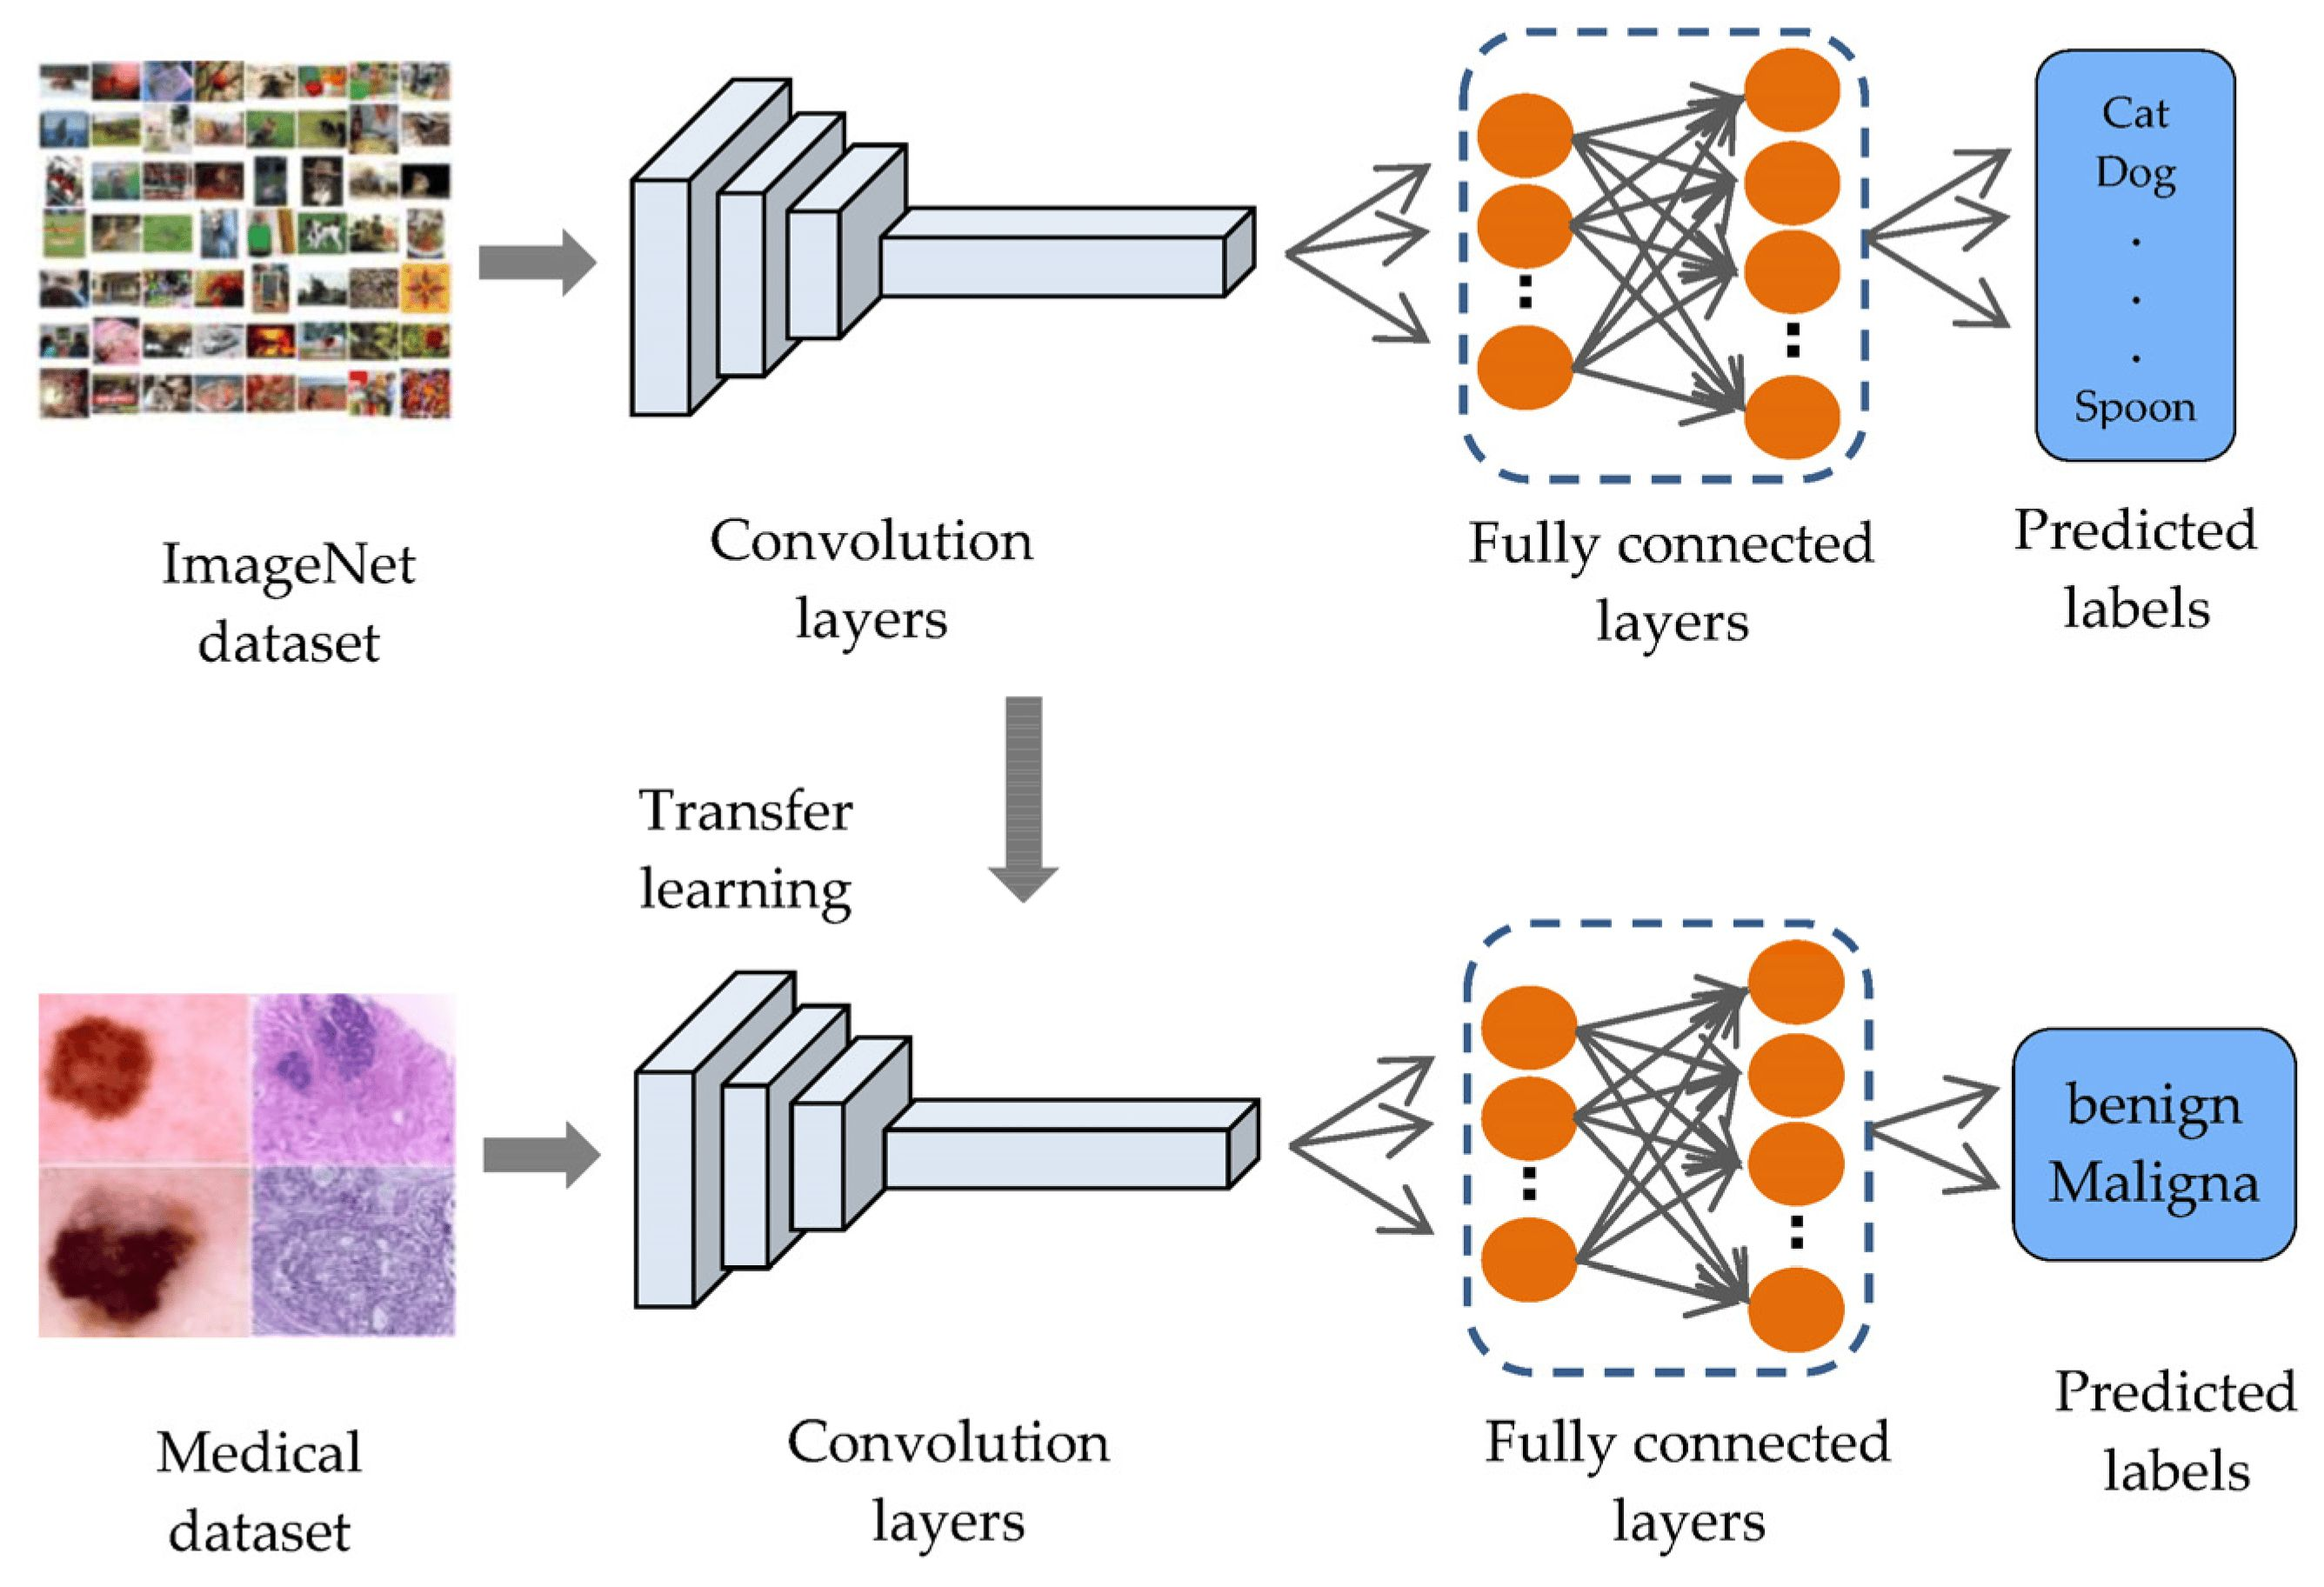
Hands-on Workflow
Notes:
1. Import pretrained model
2. Modify output layer
3. Freeze/unfreeze layers
4. Compile and train
5. Evaluate performance

Slide 28
Advantages & Limitations
Advantages:
Faster training
Requires less data
Better performance on small datasets
Limitations:
May not adapt well to very different domains
Large models require high computational resources

Slide 29
Best Practices
Start with feature extraction, then fine-tune
Use data augmentation
Monitor for overfitting
Choose model size based on hardware

