Slide 1
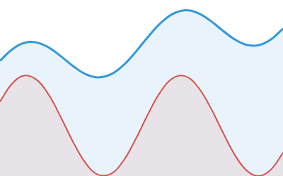
Time Series Analysis
A comprehensive exploration of techniques, models, and applications for analyzing temporal data patterns and making accurate forecasts

Slide 2
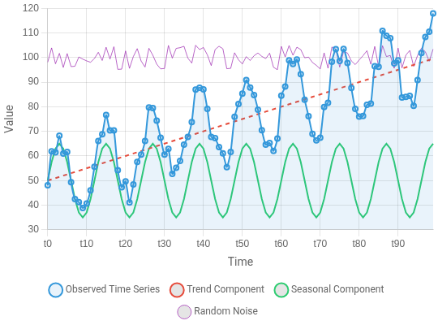
What is Time Series Analysis?
Definition & Importance
Time series analysis is the study of data points collected over time at regular intervals, with the goal of identifying patterns, trends, and making predictions about future values.
Key Characteristics
Temporal Ordering: Data points have a chronological sequence that matters
Autocorrelation: Observations are not independent; they relate to previous values
Multiple Components: Often contains trend, seasonality, cyclical patterns, and random noise
Specialized Methods: Requires dedicated statistical and machine learning techniques
A time series decomposed into its components: trend, seasonality, and random variations
Domain-Specific: Analysis approaches vary based on the field (finance, economics, healthcare, etc.)
Made with Genspark
Time Series Analysis: Complete Guide from Statistics to Deep Learning

Slide 3
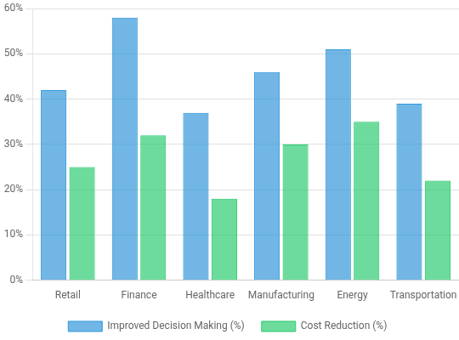
Why Analyze Time Series Data?
Key Goals and Business Value
Forecasting: Predict future values to support proactive decision- making and resource planning
Pattern Recognition: Identify hidden patterns, seasonality, and anomalies in historical data
Causal Analysis: Understand what factors influence changes over time
Risk Management: Quantify uncertainty and prepare for potential volatility
Performance Monitoring: Track KPIs over time and detect deviations from expected behavior
Organizations that effectively analyze time series data gain 35% better forecast accuracy and reduce operational costs by up to 25% through improved resource allocation and risk management.
Business value of time series analysis across industries

Slide 4
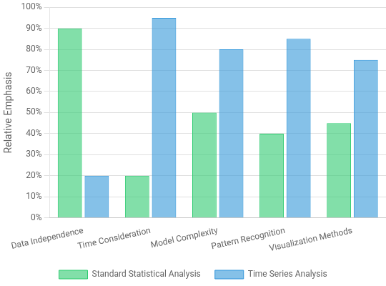
How Time Series Analysis Differs from Other Analyses
Unique Characteristics
Temporal Ordering: The sequence of observations matters fundamentally, unlike cross-sectional data where ordering is arbitrary
Dependence Structure: Observations are not independent; current values depend on past values
Autocorrelation: Values are correlated with their own previous values at various lags
Non-stationarity: Statistical properties (mean, variance) often change over time
Specialized Methods: Requires specific techniques like ARIMA, decomposition, and spectral analysis
These unique properties of time series data necessitate specialized analytical approaches that account for temporal dependencies and patterns.
Key differences between time series analysis and standard statistical analysis

Slide 5
Section 1: Time Series Fundamentals
1
Understanding the basics
An introduction to core concepts, components, and properties of time series data that form the foundation for all analysis techniques.

Slide 6
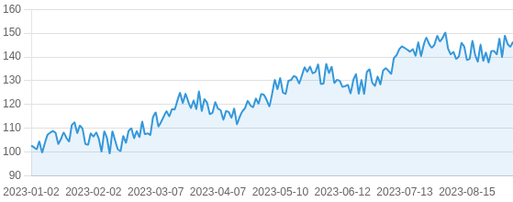

What is a Time Series? (Detailed)
Definition & Concepts
A time series is a sequence of data points collected or recorded at specific time intervals. Unlike regular data, the temporal ordering is crucial as it captures how values change over time.
Understanding the temporal dependencies between observations is what makes time series analysis unique compared to other statistical methods.
Values are ordered chronologically
Intervals are typically uniform (hourly, daily, monthly) Observations are dependent on previous values
Used for forecasting future values based on historical patterns
Time series of daily closing prices showing trend and volatility patterns
Made with Genspark
Time Series Analysis: Complete Guide from Statistics to Deep Learning

Slide 7
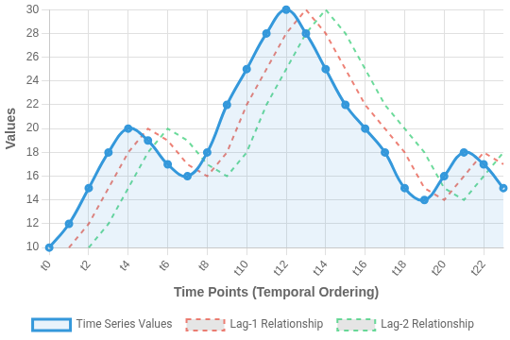
Core Properties of Time Series
Key Characteristics
Temporal Ordering: Data points are sequentially ordered by timestamps, creating a natural progression that cannot be randomly shuffled like other data types
Temporal Dependence: Future values typically depend on past observations, creating autocorrelation patterns that are crucial for forecasting
Lag Relationships: The influence of past values (lags) on current values, where observations at t-1, t-2, etc., impact the value at time t
Granularity: The time interval between observations (hourly, daily, monthly) that affects data patterns and modeling approaches
Understanding these core properties is essential for choosing appropriate preprocessing techniques, selecting the right models, and accurately interpreting results in time series analysis.
Illustration of temporal ordering and lag relationships in a time series
Made with Genspark
Time Series Analysis: Complete Guide from Statistics to Deep Learning

Slide 8
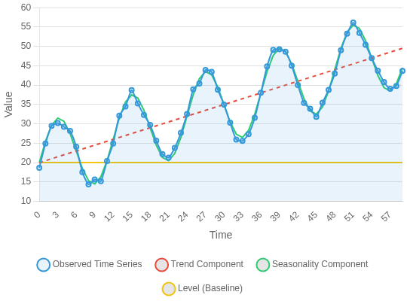
Components of Time Series: Level, Trend, Seasonality
Key Components of Time Series Data
Level
The baseline value or the average value around which the time series fluctuates. Represents the underlying value of the series when other components are removed.
Trend
Long-term upward or downward movement in the data. Shows the general direction in which the time series is moving over an extended period.
Seasonality
Regular and predictable patterns that repeat over fixed periods (daily, weekly, monthly, quarterly). Caused by seasonal factors like weather, holidays, or business cycles.
Understanding these components is crucial for effective time series modeling and forecasting. Models can be designed to capture each component specifically.
Decomposition of a time series into its basic components

Slide 9
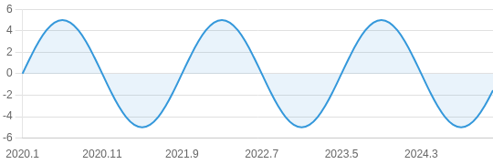
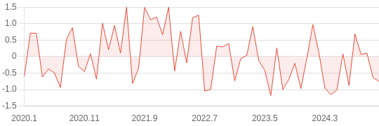
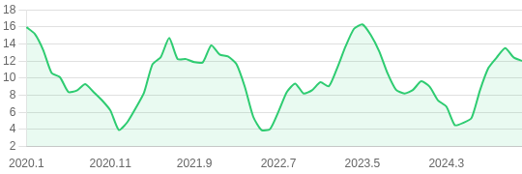
Cyclical Patterns and Noise
Understanding Time Series Components
Cyclical Patterns: Fluctuations that occur without fixed frequencies, unlike seasonal patterns
Key Characteristics: Non-fixed periodicity, often spans multiple years (business cycles, economic fluctuations)
Example: Economic expansions and contractions, financial market cycles
Cyclical pattern in economic data (business cycle)
Noise Component: Random, irregular fluctuations in time series data
Importance of Noise: Represents unexplained variation that can't be attributed to trend, seasonality, or cycles
Random noise component in time series
WHY it matters: Distinguishing between cyclical patterns and noise is crucial for accurate forecasting. Cycles represent real patterns that can be modeled, while noise must be filtered out.
Real-world time series: Combined cyclical pattern with noise
Made with Genspark
Time Series Analysis: Complete Guide from Statistics to Deep Learning

Slide 10
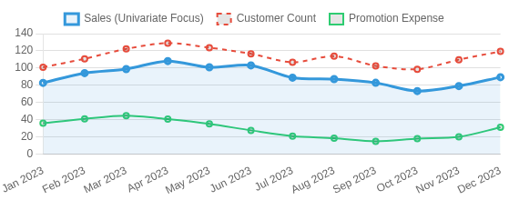
Types of Time Series Data
Univariate vs Multivariate
Time series data can be categorized based on the number of variables measured at each time point. Understanding these types is critical for selecting appropriate analysis methods.
The complexity and richness of insights increases with the number of variables tracked over time.
Univariate models focus on patterns within a single sequence
Multivariate analysis reveals relationships and dependencies Choice depends on research question and available data
Multivariate requires more complex modeling techniques (VAR, VECM)
Univariate | Multivariate
Single variable tracked over time | Multiple variables tracked simultaneously
Examples: Daily temperature, stock price | Examples: Weather data (temp, humidity, pressure), financial indicators
Simpler analysis techniques | Captures relationships between variables
Comparison of univariate (sales only) vs multivariate retail data (sales, customers, promotions)
Made with Genspark
Time Series Analysis: Complete Guide from Statistics to Deep Learning

Slide 11
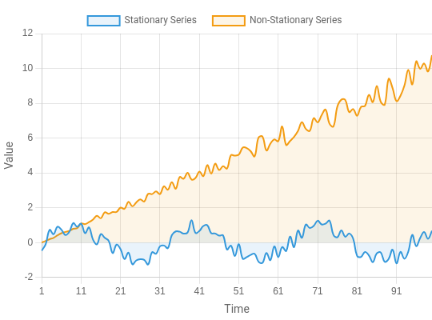
Stationarity in Time Series
What is Stationarity?
When your time series isn't stationary, transformations like differencing, logarithmic transformation, or Box-Cox can help achieve stationarity.
A time series is stationary when its statistical properties do not change over time. Specifically, this means:
Constant mean (no trend)
Constant variance (homoscedasticity)
Constant autocorrelation structure (pattern of dependence doesn't change)
Why is Stationarity Important?
Most statistical forecasting methods assume stationarity Makes forecasting more reliable as patterns remain consistent Simplifies mathematical models and improves interpretability Easier to detect genuine patterns vs random fluctuations
Comparison of stationary vs. non-stationary time series. The stationary series (blue) maintains consistent statistical properties over time, while the non-stationary series (orange) shows changing mean and variance.

Slide 12
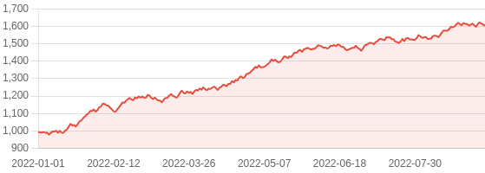

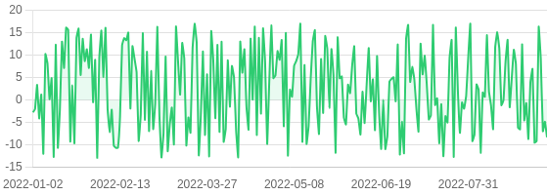
Examples of Stationary vs. Non-Stationary Series
Real-World Examples
Example 1: Stock Prices (Non-Stationary)
Understanding Stationarity
A stationary time series has statistical properties that do not change over time - specifically constant mean, variance, and autocorrelation structure.
Most statistical time series models (like ARIMA) require stationarity to make valid predictions!
Stationary series: White noise, differenced stock returns, residuals after removing trend/seasonality
Non-stationary series: Stock prices, GDP, temperature readings with seasonal patterns
We can transform non-stationary series to stationary using differencing, detrending, or seasonal adjustment
Statistical tests like ADF, KPSS, and Phillips-Perron help determine stationarity
Google stock price - exhibits clear upward trend (non-stationary)
After Differencing
Example 2: Stock Returns (Stationary)
Daily returns (differenced) - fluctuate around constant mean (stationary)

Slide 13
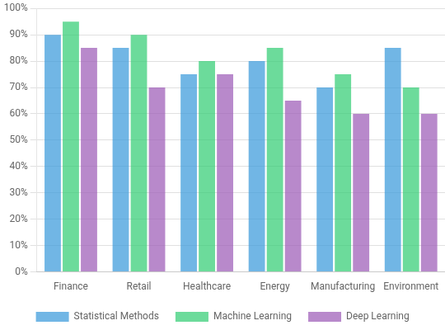
Applications & Use Cases
Time Series Analysis Across Industries
Finance: Stock price prediction, portfolio optimization, risk management, algorithmic trading, and market volatility analysis
Retail & E-commerce: Demand forecasting, inventory management, sales prediction, seasonal pattern identification, and pricing optimization
Healthcare: Patient monitoring, disease progression tracking, epidemic outbreak prediction, and hospital resource planning
Energy & Utilities: Load forecasting, renewable energy production prediction, consumption pattern analysis, and smart grid optimization
Manufacturing: Predictive maintenance, production planning, supply chain optimization, and quality control
Environment & Climate: Weather forecasting, climate change analysis, natural disaster prediction, and ecological monitoring
Time series analysis provides valuable insights across industries by transforming temporal data into actionable business intelligence, helping organizations make data-driven decisions.
Relative adoption of time series analysis techniques by industry

Slide 14
Section 2: Data Preprocessing & Exploration
2
Preparing and understanding your
data
Essential techniques for cleaning, transforming, and exploring time series data to ensure accurate analysis and modeling results.

Slide 15
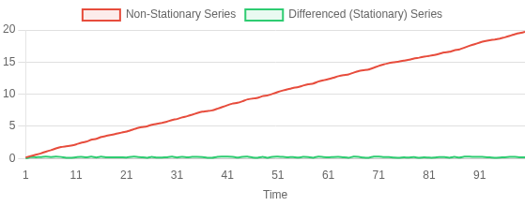
Checking Stationarity: How & Why
Statistical Tests for Stationarity
Stationarity is critical for time series modeling because many techniques assume statistical properties remain constant over time. Rather than relying on visual inspection alone, we use formal statistical tests to confirm stationarity.
For robust analysis, apply multiple tests as they have different strengths. The ADF and PP tests are sensitive to trend stationarity, while KPSS is better at detecting level stationarity.
ADF Test Results:
ADF Statistic: 0.7529
p-value: 0.9918 → Non-stationary
KPSS Test Results:
KPSS Statistic: 0.9682
p-value: 0.0100 → Non-stationary
Why test for stationarity? Non-stationary data can lead to spurious regressions and unreliable forecasts in traditional time series models.
Null Hypothesis
Test
Interpretation
Series has a unit root (non- stationary)
ADF
p-value < 0.05: Reject null hypothesis (stationary)
(Augmented Dickey- Fuller)
KPSS
Series is stationary
p-value < 0.05: Reject null hypothesis (non-stationary)
(Kwiatkowski-Phillips- Schmidt-Shin)
Series has a unit root (non- stationary)
PP
p-value < 0.05: Reject null hypothesis (stationary)
Comparison of original non-stationary series vs. differenced stationary series
(Phillips-Perron)
Made with Genspark
Time Series Analysis: Complete Guide from Statistics to Deep Learning

Slide 16
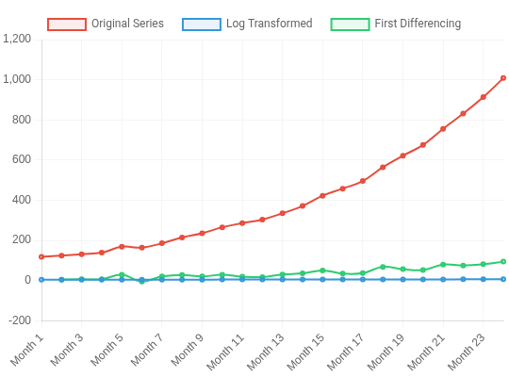
Transformations for Time Series
Why Transform Time Series Data?
Stabilize variance - Make data more consistent across time Achieve stationarity - Essential for many forecasting models Normalize distribution - Make data more symmetrical Remove trend & seasonality - Isolate the underlying patterns
Transformation | When to Use | Why It Works
Log Transform | Data with exponential growth or multiplicative patterns | Reduces exponential trends to linear; stabilizes variance when SD proportional to mean
Box-Cox | When simple log transform isn't optimal | Family of power transformations that finds optimal parameter (λ) to normalize data
Differencing | Series with trend or seasonality | Removes trend (1st diff) and seasonality (seasonal diff) by calculating changes between observations
Visualization of different transformations applied to a non-stationary time series
The choice of transformation depends on your data's properties. Always check if the transformation achieved stationarity before modeling.
Made with Genspark
Time Series Analysis: Complete Guide from Statistics to Deep Learning

Slide 17
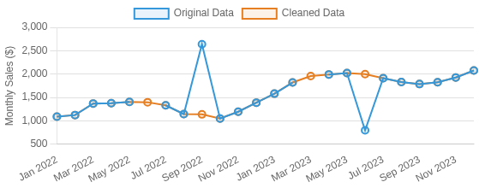
Handling Missing Values & Outliers
Outlier Detection & Treatment
IQR Method - Identify points beyond 1.5×IQR from quartiles Z-Score - Flag values beyond ±3 standard deviations
Moving Window - Compare values to local averages/medians Treatment - Replace with median, truncate, or use robust models
Why It Matters
Time series data often contains missing values and outliers that can significantly distort analysis and forecasting models. Properly handling these anomalies is crucial for accurate modeling.
Ignoring missing values or outliers can lead to biased parameter estimates, unreliable forecasts, and misleading insights about the underlying patterns.
Missing Value Techniques
Forward/Backward Fill - Propagate last known value forward or first known value backward
Interpolation - Linear, spline, or time-weighted methods to estimate missing points
Statistical Imputation - Replace with mean, median, or model-based estimates
Before (blue) and after (orange) handling missing values and outliers
Impact on Model Performance
Properly handling these issues typically results in: More stable parameter estimates
Reduced forecast error (MAPE, RMSE)
Better capture of true underlying patterns
Made with Genspark
Time Series Analysis: Complete Guide from Statistics to Deep Learning

Slide 18
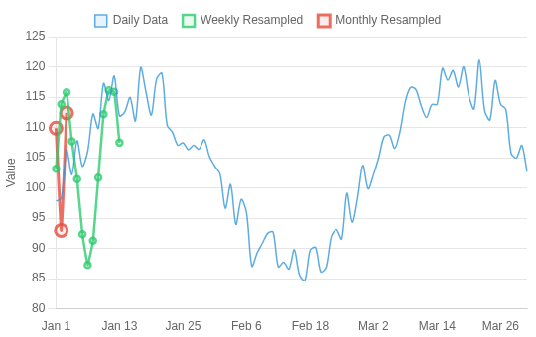
Resampling and Frequency Adjustment
Why Resample Time Series Data?
Change analysis granularity - Aggregate daily data to weekly/monthly for high-level trends
Reduce noise - Lower frequencies often smooth out short-term fluctuations
Match different data sources - Align data collected at different frequencies
Computational efficiency - Reduce dataset size for faster processing
How to Resample?
Upsampling - Increase frequency (e.g., monthly → daily); requires interpolation
Downsampling - Decrease frequency (e.g., daily → monthly); requires aggregation
In Python: df.resample('M').mean() - Resample to monthly frequency using mean aggregation
Visual comparison of original daily data vs. weekly and monthly resampling
Made with Genspark
Time Series Analysis: Complete Guide from Statistics to Deep Learning

Slide 19
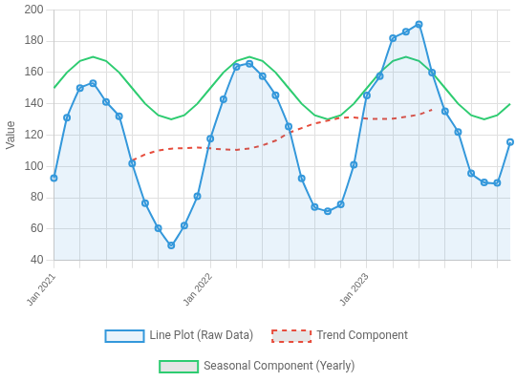
Visualizing Time Series
Common Visualization Methods
Line plots: Most basic visualization showing evolution over time; reveals overall trends, patterns, and outliers
Seasonal plots: Overlays same seasons from different cycles; highlights seasonal patterns and variations between cycles
Lag plots: Shows relationship between an observation and its lagged value; useful for identifying autocorrelation and non-linear patterns
ACF/PACF plots: Displays correlations between the series and its lags; reveals dependencies and helps with model selection
Heatmaps: Color-coded grid visualization; effective for multiple time series or displaying cyclical patterns by hour/day/month
Decomposition plots: Breaks down series into trend, seasonal, and residual components; helps understand underlying patterns
Choosing the right visualization depends on what aspect of the time series you want to analyze. Combining multiple plot types provides more comprehensive insights.
Different visualization methods applied to the same time series data
Made with Genspark
Time Series Analysis: Complete Guide from Statistics to Deep Learning

Slide 20
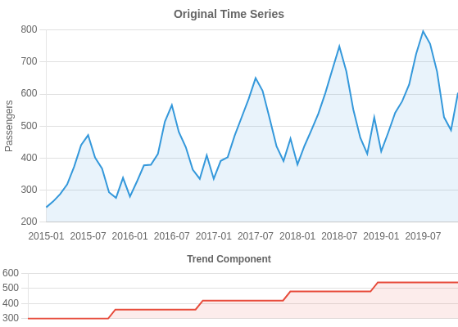
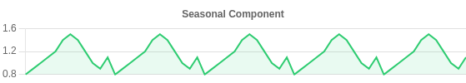
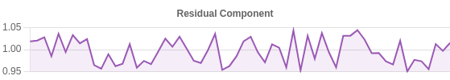
Seasonal Decomposition (STL, Classical)
What is Seasonal Decomposition?
Seasonal decomposition is a technique that breaks down a time series into its constituent components: trend, seasonality, and residuals. This helps in better understanding the underlying patterns and improving forecasting accuracy.
Decomposition reveals hidden patterns that might not be visible in the original series, making it easier to model each component separately.
Two Main Approaches:
Classical Decomposition: Simple approach that assumes constant seasonal component; can be additive or multiplicative
STL (Seasonal-Trend decomposition using LOESS): More robust method that handles changing seasonality and outliers
Additive Model: Y = Trend + Seasonality + Residual (for constant seasonal amplitude)
Multiplicative Model: Y = Trend × Seasonality × Residual (for increasing seasonal amplitude)
STL Decomposition Example
When to Use:
As an exploratory step to understand patterns
To remove seasonality before applying non-seasonal models
To forecast individual components separately
Decomposition showing trend (increasing), yearly seasonality, and irregular residuals
Made with Genspark
Time Series Analysis: Complete Guide from Statistics to Deep Learning

Slide 21

Section 3: Statistical Techniques
3
Essential analytical tools
Examining core statistical methods that help identify patterns, relationships, and structures within time series data to support robust forecasting and analysis.

Slide 22
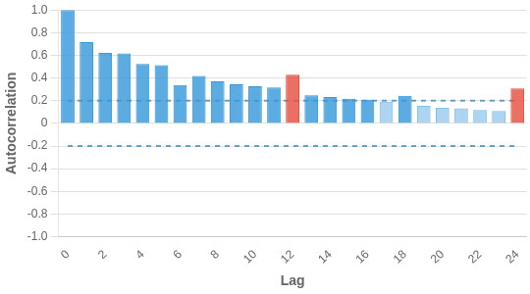
Autocorrelation Function (ACF)
What is Autocorrelation?
Definition: Autocorrelation measures the correlation between a time series and its lagged values (correlation with itself)
Mathematical expression: Correlation between Y_{t} and Y_{t-k} for different lag values k
Scale: Ranges from -1 (perfect negative correlation) to +1 (perfect positive correlation)
Interpretation: Shows how current values relate to past values at different time intervals
Practical Use Cases
Model identification: Helps determine appropriate ARIMA/SARIMA model parameters
Key insight: ACF at lag k tells us how much the series is correlated with itself shifted k time periods
Seasonality detection: Regular spikes at fixed intervals indicate seasonality
Example ACF Plot with Interpretations
Significant autocorrelation- Values above/below blue dashed lines
Stationarity assessment: Slow decay in ACF suggests non- stationarity
Seasonal pattern- Regular spikes at fixed intervals (e.g., 12 for monthly)
Exponential decay- Suggests AR process
Forecasting validation: Residual ACF should show no significant pattern
Sharp cutoff- Suggests MA process
Made with Genspark
Time Series Analysis: Complete Guide from Statistics to Deep Learning

Slide 23
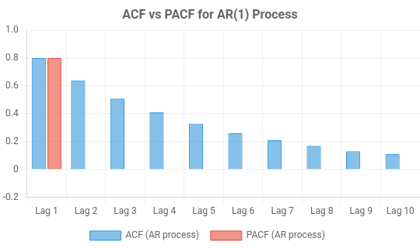

Partial Autocorrelation Function (PACF)
What is PACF?
Definition: Measures the direct correlation between observations at different lags after removing the influence of intermediate observations
Purpose: Isolates the "pure" relationship between observations at specific lags
Interpretation: Shows significant spikes at lags that have direct influence on the current value
Model Identification: Used to determine the order (p) of an autoregressive (AR) model
PACF vs ACF
ACF PACF
Key Insight: When analyzing both ACF and PACF together, you can determine the appropriate ARIMA(p,d,q) model parameters.
Shows total correlation (direct + indirect)
Comparison of ACF and PACF patterns for different time series models
Common PACF Patterns:
Shows only direct correlation
AR(p) process: PACF cuts off after lag p
Helpful for identifying MA(q) models
Helpful for identifying AR(p) models
MA(q) process: PACF shows damped oscillation
ARMA(p,q): Both ACF and PACF tail off
Gradually trails off for AR processes
Cuts off sharply after lag p for AR(p) processes
Made with Genspark
Time Series Analysis: Complete Guide from Statistics to Deep Learning

Slide 24
Using ACF/PACF for Model Selection
Examine ACF & PACF plots
Interpreting Autocorrelation Plots
ACF plot: Shows correlation between a series and its lags; helps identify MA(q) order
PACF plot: Shows direct correlation between a series and lags
ACF: Cuts off PACF: Tails off
ACF: Tails off PACF: Cuts off
after removing intermediate effects; helps identify AR(p) order
Differencing: Apply until ACF/PACF show stationarity (quick decay) to determine d
Suggests MA(q)
q = lag where ACF cuts off
Suggests AR(p)
p = lag where PACF cuts off
ARIMA(p,d,q): Model parameters can be derived directly from pattern recognition in ACF/PACF plots
Look for the cutoff point where values fall within significance bands (dashed lines). This helps determine the appropriate order for model parameters.
Both ACF & PACF tail off gradually
Both ACF & PACF show no pattern
Key Guidelines
AR process: PACF cuts off after lag p, ACF decays gradually
MA process: ACF cuts off after lag q, PACF decays gradually ARMA process: Both ACF and PACF decay gradually
Suggests ARMA(p,q) Try different combinations
White noise
No modeling needed
Decision flowchart for ARIMA model selection based on ACF/PACF patterns

Slide 25
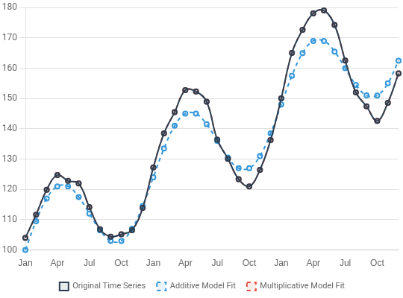
Decomposition: Additive vs Multiplicative
Feature | Additive | Multiplicative
Interpretation | Absolute changes | Percentage changes
Two Approaches to Time Series Decomposition
Additive Decomposition: Y = Trend + Seasonality + Residual Multiplicative Decomposition: Y = Trend × Seasonality × Residual
When to Use Each Model
Additive: When seasonal variations are relatively constant over time, regardless of the level of the series
Multiplicative: When seasonal variations increase with the level of the series (amplitude of seasonality grows with trend)
Model selection is critical: Using an additive model for multiplicative data (or vice versa) leads to poor decomposition and affects forecasting accuracy.
Same as original series
Seasonality/residuals are ratios
Units
Negative values
Can handle
Cannot handle
Comparison of additive vs multiplicative decomposition on retail sales data

Slide 26
Unit Root Tests: ADF, KPSS, Phillips-Perron
Testing for Stationarity
Unit root tests are statistical methods used to determine whether a time series is stationary or not. They're crucial because most time series models require stationarity.
Unit root tests should be the first step in your time series modeling workflow to ensure you're working with stationary data.
Example Results for Stock Price Series:
Original Price Series:
ADF p-value: 0.632 (Non-stationary) KPSS p-value: 0.01 (Non-stationary) PP p-value: 0.581 (Non-stationary)
After First Differencing:
ADF p-value: 0.0001 (Stationary) KPSS p-value: 0.1 (Stationary) PP p-value: 0.0001 (Stationary)
The results show consensus: original series is non-stationary, but becomes stationary after first differencing.
Null Hypothesis
Test
When to Use
ADF
(Augmented Dickey- Fuller)
Series has a unit root (non- stationary)
Most common test; use as your first check
KPSS
(Kwiatkowski-Phillips- Schmidt-Shin)
Series is stationary
Complements ADF; use both to confirm results
Small p-value in ADF/PP test (<0.05): Reject null hypothesis →
Stationary
Large p-value in KPSS test (>0.05): Fail to reject null hypothesis →
Stationary
Tests sometimes disagree; use your judgment and try differencing Consider trend-stationarity vs. difference-stationarity
Series has a unit root (non- stationary)
When data has heteroskedasticity or serial correlation
Phillips-Perron (PP)

Slide 27
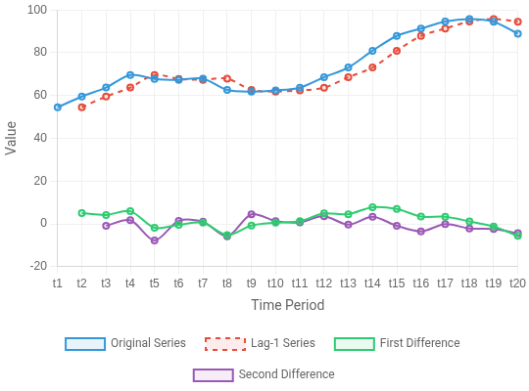
Lag, Differencing, and Memory
Key Concepts for Time Series Analysis
Lag: Shifted version of a time series; Lag-1 refers to observations shifted by one time period (Yt-1). Critical for autocorrelation and model building.
Differencing: Subtracting lagged values from current values to stabilize mean and remove trends. First-order: Yt - Yt-1, Second- order: (Yt - Yt-1) - (Yt-1 - Yt-2).
Memory: How past values influence current observations. Short memory (decay quickly) vs. Long memory (persist for many periods).
Partial Redundancy: After accounting for intermediate lags, how much unique information exists between current and earlier observations.
Understanding these concepts is crucial for model selection: AR models depend on lags, differencing creates stationary series, and memory characteristics determine appropriate forecasting techniques.
Visualization of original series, lagged series, and differenced series
Made with Genspark
Time Series Analysis: Complete Guide from Statistics to Deep Learning

Slide 28
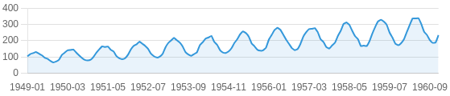
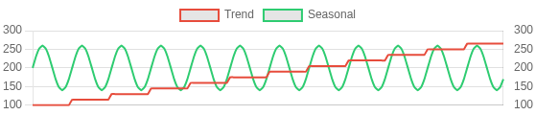
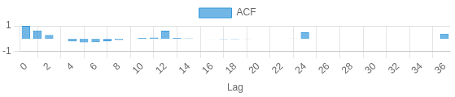
Practical Example: Decomposition and ACF/PACF Analysis
Airline Passengers Dataset (1949-1960)
The classic airline passengers dataset shows monthly totals of international airline passengers over 12 years, exhibiting both trend and seasonality.
This dataset is ideal for demonstrating decomposition and autocorrelation analysis as it contains clear patterns that are easily identifiable.
Clear upward trend showing increasing passenger numbers over time Strong seasonal pattern with peaks in summer months
Multiplicative seasonality (seasonal variations increase with the trend) ACF shows strong seasonality with peaks at lags 12, 24, 36
PACF cuts off after lag 1 and shows significant spike at lag 12
These patterns suggest a seasonal ARIMA model with parameters related to 12-month seasonality would be appropriate.
Implementation & Results
Original Time Series: Monthly Airline Passengers (1949-1960)
Decomposition: Trend, Seasonal, and Residual Components
ACF (left) and PACF (right) plots showing seasonal patterns at lag 12
Made with Genspark
Time Series Analysis: Complete Guide from Statistics to Deep Learning

Slide 29
Section 4: Classical Models
4
ARIMA, SARIMA, and Exponential Smoothing
Exploring traditional statistical approaches that form the backbone of time series forecasting, their mathematical foundations, implementation, and practical applications.

Slide 30
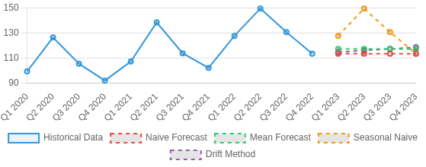
Naive and Simple Forecasting Methods
Simple Methods as Benchmarks
Simple forecasting methods provide baselines against which more complex models are compared. A sophisticated model should at minimum outperform these basic methods to justify its complexity.
Always compare advanced models against naive benchmarks to ensure additional complexity is justified by improved performance.
Method
Description
Uses the average of all historical observations as the forecast for all future values
Mean
Uses the last observed value as the forecast for all future periods
Naive
Comparison of four simple forecasting methods applied to quarterly retail sales data
Seasonal
Uses the value from the same season (e.g., same month last year) as the forecast
Naive
Extends the line between the first and last observations to forecast future values
These methods are especially useful for short-term forecasting and when data exhibits simple patterns or limited historical data is available.
Drift
Made with Genspark
Time Series Analysis: Complete Guide from Statistics to Deep Learning

Slide 31
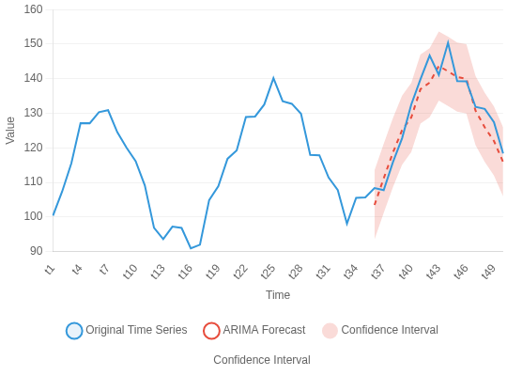
Introduction to ARIMA
What, How, and Why of ARIMA Models
AR(p)
AutoRegressive
I(d)
Integrated
MA(q)
Moving Average
What: ARIMA (AutoRegressive Integrated Moving Average) is a classical statistical model that combines three techniques for time series forecasting
Uses past values
Differencing
How: ARIMA(p,d,q) model parameters:
p - AR order: Number of lag observations
Past errors
d - Integration order: Differencing needed for stationarity
q - MA order: Size of the moving average window
Why: ARIMA models excel at capturing complex temporal dynamics in time series data with trend patterns
When to use: Best for stationary (or can be made stationary) series with linear relationships between current and past values
ARIMA combines the strengths of autoregression (AR), differencing (I), and moving average (MA) to create a powerful and flexible framework for time series forecasting.
ARIMA model's ability to capture trends in time series data
ARIMA(p,d,q): (1-φ₁B-...-φₚBᵖ)(1-B)ᵈYₜ = (1+θ₁B+...+θₚBᵍ)εₜ

Slide 32
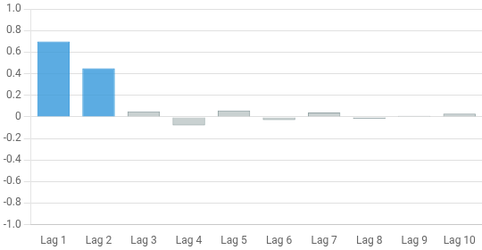
Autoregressive Model (AR)
The Building Block of ARIMA
Definition: Autoregressive models predict future values based on a linear combination of past observations (lags)
AR(p) Model: Uses p previous time steps as predictors Mathematical Formulation:
Y_{t} = c + φ₁Y_{t-1} + φ₂Y_{t-2} + ... + φ_{p}Y_{t-p} + ε_{t}
Parameters: φ₁, φ₂, ..., φ_{p} are coefficients that indicate the strength and direction of the relationship
Identification: PACF shows significant spikes at lags 1 to p, then cuts off
PACF plot for an AR(2) process showing significant spikes at lags 1 and 2
Stationarity Requirement: Data must be stationary (constant mean, variance)
When to use AR models: When current values have direct dependencies on past values and PACF shows clear cutoff pattern. Excellent for capturing momentum effects in time series.
φ₂
φ₁
Y_t-2
Y_t-1
Y_t
AR(2) process: Current value depends on previous two observations

Slide 33
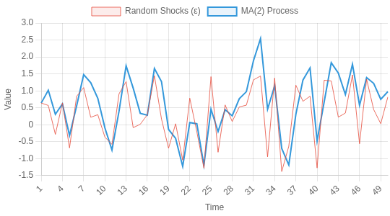
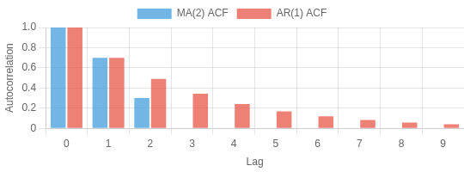
Moving Average Model (MA)
What is a Moving Average Model?
A Moving Average (MA) model predicts the current value based on past forecast errors (not past values)
MA(q) model of order q uses q previous error terms: y_{t} = μ + ε_{t} + θ₁ε_{t-1} + θ₂ε_{t-2} + ... + θ_{q}ε_{t-q}
Unlike AR, MA models use unobservable errors rather than observable past values
MA models are essentially weighted averages of random shocks
Comparison with AR Models
Visualization of Moving Average Effect on Time Series
MA(2): y_{t} = μ + ε_{t} + θ₁ε_{t-1} + θ₂ε_{t-2}
AR uses past values; MA uses past errors
MA models have finite memory, AR models have infinite memory
In ARIMA, both components (AR and MA) work together to capture different aspects of time dependence
Use Cases: MA models excel at capturing short-term random fluctuations and are particularly useful for financial time series (stock returns), quality control processes, and capturing sudden but temporary changes in time series data.
ACF Pattern: MA vs AR

Slide 34
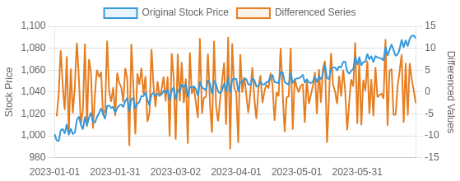
Integrated (Differencing) in ARIMA
What is Differencing?
Differencing is the "I" (Integrated) component in ARIMA. It transforms a non-stationary time series into a stationary one by computing the difference between consecutive observations.
The "d" parameter in ARIMA(p,d,q) represents how many times differencing is applied to achieve stationarity.
First differencing: y'_{t} = y_{t} - y_{t-1} (removes trends)
Second differencing: y''_{t} = y'_{t} - y'_{t-1} = y_{t} - 2y_{t-1} + y_{t-2} (for quadratic trends) Seasonal differencing: y'_{t} = y_{t} - y_{t-s} (removes seasonality of period s) Differencing reduces the data length by 1 for each application
Stationarity after differencing means the resulting series has constant mean, variance, and autocorrelation structure over time, which is a requirement for ARIMA modeling.
Original Google stock prices (blue) vs. First-differenced series (orange)
The differenced series shows stationarity with consistent variability around zero, regardless of time. This demonstrates how differencing makes the data appropriate for ARIMA modeling.

Slide 35
Model Order Selection (p,d,q) for ARIMA
Determining ARIMA Parameters
p (AR order): Number of autoregressive terms - Check PACF for significant lags
Check for Stationarity (ADF/KPSS Tests)
d (differencing): Order of differencing needed to achieve stationarity - Use ADF/KPSS tests
If not stationary: Apply differencing (d=1,2...)
q (MA order): Number of moving average terms - Check ACF for significant lags
Information criteria: Compare AIC (Akaike) and BIC (Bayesian) values - lower is better
Residual analysis: Check residuals for white noise (no pattern) to validate model adequacy
Examine ACF & PACF plots of stationary series
Rule of thumb: Start with small values (p ≤ 2, d ≤ 2, q ≤ 2) and use Grid Search or Auto ARIMA to find optimal parameters if manual selection is difficult.
ACF cuts off
→ Estimate q
PACF cuts off
→ Estimate p
Pattern in ACF | Pattern in PACF | Suggested Model
Cuts off after lag q | Tails off | MA(q)
Tails off | Cuts off after lag p | AR(p)
Tails off | Tails off | ARMA(p,q)
Fit several models with different (p,d,q) values
Select best model using AIC/BIC & residual analysis

Slide 36
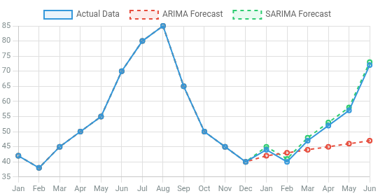
Seasonal ARIMA (SARIMA)
Extending ARIMA to Handle Seasonality
SARIMA Definition: Extends ARIMA to incorporate seasonal patterns in time series data
Notation: SARIMA(p,d,q)(P,D,Q,s) where lowercase letters represent non-seasonal components and uppercase letters represent seasonal components
Seasonal Orders:
P = Seasonal autoregressive order
D = Seasonal differencing order
Q = Seasonal moving average order
ARIMA vs. SARIMA forecast on seasonal data
s = Seasonal period (e.g., 12 for monthly data with yearly seasonality)
When to Use: When data exhibits clear seasonal patterns at fixed intervals (daily, weekly, monthly, quarterly)
SARIMA is particularly effective for forecasting seasonal data like retail sales, tourism, and utility consumption where ARIMA alone would miss seasonal patterns.
Feature | ARIMA | SARIMA
Handles trends
Handles seasonality
Parameter count | 3 (p,d,q) | 7 (p,d,q,P,D,Q,s)
Model complexity | Lower | Higher

Slide 37
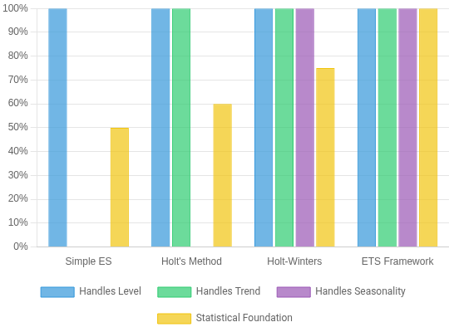
Exponential Smoothing & ETS
Family of Powerful Forecasting Methods
Simple Exponential Smoothing (SES)
For time series with no clear trend or seasonality Formula: ŷ_{t+1} = αy_{t} + (1-α)ŷ_{t}
Holt's Method (Double Exponential Smoothing)
Extends SES to capture trend
Uses level and trend smoothing equations
Holt-Winters (Triple Exponential Smoothing)
Captures level, trend, and seasonality
Can handle additive or multiplicative seasonality
ETS Framework (Error, Trend, Seasonal)
Unified statistical framework for all exponential smoothing methods Notation: ETS(Error, Trend, Seasonal) e.g., ETS(A,A,M)
WHY: Exponential smoothing methods are popular due to their simplicity, computational efficiency, and ability to handle a wide range of time series patterns with minimal configuration.
Evolution of exponential smoothing methods and their capabilities for handling different time series components

Slide 38
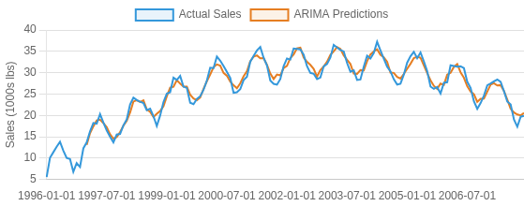


Practical Example: ARIMA on Catfish Sales
Step-by-Step Implementation
Using catfish sales data (thousands of pounds sold monthly from 1996 to 2008), we'll implement an ARIMA model to capture the trend and patterns in the data.
Data Exploration
Load the data and examine trends, seasonality, and stationarity properties
Checking Stationarity
Apply ADF test and differencing if needed to achieve stationarity
Determine ARIMA Parameters
Use ACF/PACF plots to identify p, d, q values (order=12,1,1)
Model Fitting
Fit the ARIMA model using statsmodels and generate predictions
Evaluation & Interpretation
Compare predictions with actual values and assess model fit
ARIMA Implementation
Comparison of actual catfish sales (blue) versus ARIMA(12,1,1) predictions (orange)
The model captures the overall trend but misses some peak values, suggesting that adding seasonality (SARIMA) might improve performance.

Slide 39
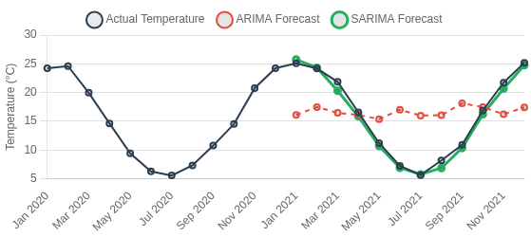
Practical Example: SARIMA with Seasonality
SARIMA vs ARIMA
While ARIMA models can handle trends effectively, they struggle with seasonal patterns. SARIMA (Seasonal ARIMA) extends ARIMA by incorporating seasonal components, making it ideal for data with recurring patterns.
SARIMA captures both the non-seasonal components (p,d,q) and seasonal components (P,D,Q,m) where m represents the seasonal period.
Significantly improves forecast accuracy for seasonal data Reduces residual seasonality in the model
Better captures monthly, quarterly, or yearly patterns More accurate prediction intervals
Comparison of ARIMA vs SARIMA forecasts for monthly temperature data. SARIMA clearly captures seasonal patterns that ARIMA misses.
ARIMA
SARIMA
8.92
RMSE
3.41
RMSE

Slide 40
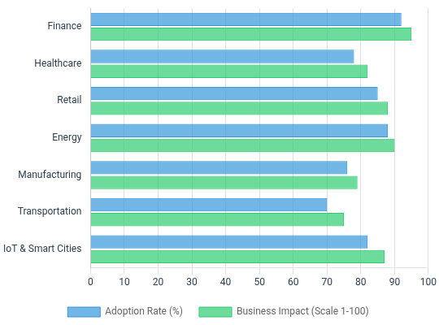
Applications & Impact Across Industries
Time Series Analysis: Cross-Industry Impact
Finance: Revolutionized risk management, algorithmic trading, and market forecasting with improved accuracy
Healthcare: Enhanced patient monitoring, epidemic prediction, and resource allocation in hospitals
Retail: Transformed inventory management, staffing optimization, and supply chain efficiency
Energy: Improved grid stability, demand forecasting, and renewable energy integration
Manufacturing: Enabled predictive maintenance, optimized production scheduling, and reduced downtime
Transportation: Enhanced traffic prediction, fleet management, and logistics optimization
IoT & Smart Cities: Facilitating real-time monitoring, anomaly detection, and infrastructure management
Relative impact and adoption of time series analysis across industries (2023)
Time series analysis has become a critical capability across all industries, with an estimated global market value exceeding $4 billion by 2025. Organizations leveraging advanced time series techniques report 15-25% improvements in forecasting accuracy.
Made with Genspark
Time Series Analysis: Complete Guide from Statistics to Deep Learning

