Slide 1

Introduction to Neural Networks
Biological Neuron
McCulloch-Pitts
Linear Separability
Perceptron
Delta Rule
Notes:
## Notebook Explanation for ML Practitioners
This notebook provides a practical introduction to fundamental neural network concepts, progressing from simple McCulloch-Pitts neurons to a basic Perceptron and the Delta Rule with a sigmoid activation.
### 1. McCulloch-Pitts Neuron
The initial sections demonstrate the McCulloch-Pitts (MCP) neuron model, the foundational element of artificial neural networks.
- **`mcp_neuron` function**: This function simulates an MCP neuron. It takes inputs, corresponding weights, and a threshold. The core idea is to compute a weighted sum of inputs and compare it against a fixed threshold to produce a binary output (0 or 1).
- **AND, OR, NOT gates**: The notebook shows how to configure the weights and threshold of an MCP neuron to replicate the behavior of basic logic gates (AND, OR, and NOT). This highlights the ability of simple neural models to perform basic logical operations.
### 2. Linear Separability Visualization
This section visualizes the concept of linear separability, which is crucial for understanding the limitations of simple models like the Perceptron.
- **`plot_logic_gate` function**: This function visualizes the input combinations for a given logic gate (AND or XOR) and colors them based on their output (0 or 1).
- **AND vs. XOR plots**: The plots clearly show that the AND gate's inputs can be separated by a single straight line (linearly separable), while the XOR gate's inputs cannot. This visual demonstration explains why a single-layer Perceptron cannot solve the XOR problem.
### 3. Perceptron Learning Rule (AND gate)
This section introduces the Perceptron learning algorithm and demonstrates its application to solve the linearly separable AND gate problem.
- **Perceptron implementation**: The code initializes weights and a bias and iteratively updates them based on the error between the predicted and actual output. The learning rule adjusts weights and bias to minimize this error.
- **Training loop**: The training loop iterates through the dataset, adjusting the weights and bias using the Perceptron update rule. Observe how the weights and bias converge over epochs to values that correctly classify the AND gate inputs.
### 4. Delta Rule using Gradient Descent
This section introduces the Delta Rule, a more general learning rule that uses gradient descent and a differentiable activation function (sigmoid) to train a single-layer network. This allows for learning on non-linearly separable data in principle, although a single layer is still limited.
- **Sigmoid function**: The `sigmoid` function is used as the activation function, squashing the output between 0 and 1.
- **Sigmoid derivative**: The `sigmoid_derivative` is needed for the gradient descent update rule.
- **Delta Rule implementation**: The code initializes weights and iteratively updates them based on the error and the derivative of the activation function. This is a basic form of backpropagation applied to a single layer.
- **XOR problem with Delta Rule**: The notebook attempts to solve the XOR problem using the Delta Rule with a single layer. Notice that the predictions after training are all around 0.5. This demonstrates that a single-layer network, even with a differentiable activation and gradient descent, cannot solve the non-linearly separable XOR problem. This limitation necessitates the use of multi-layer networks (which are not covered in this specific notebook).
This notebook serves as a good starting point to understand the building blocks of neural networks and the evolution of learning algorithms from simple rule-based approaches to gradient-based optimization.

Slide 2
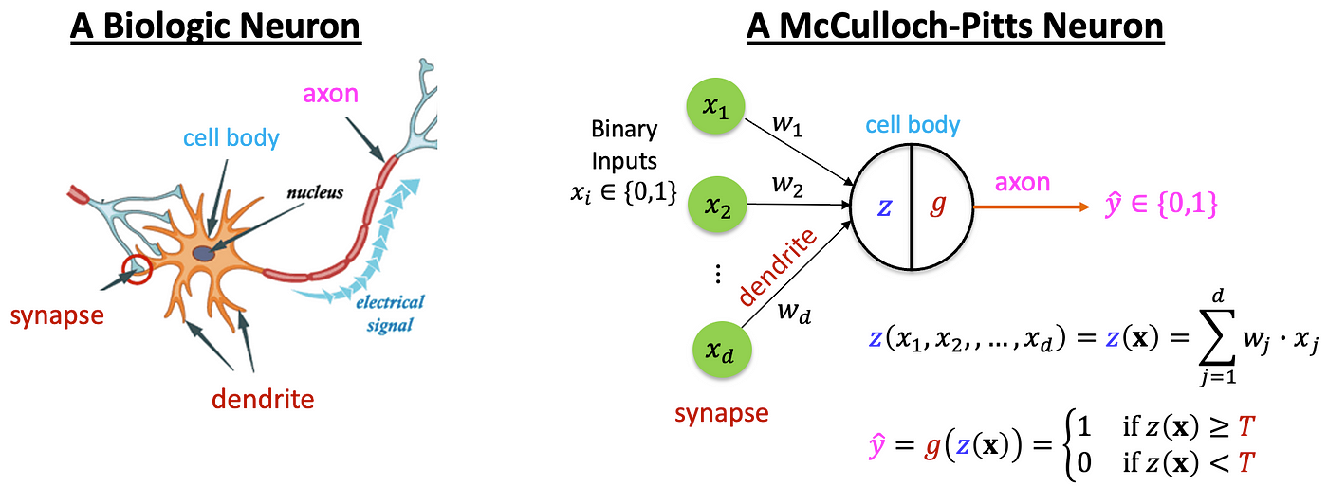
Biological Neuron vs Artificial Neuron
Notes:
Biological: Dendrites, Axon, Synapse
Artificial: Inputs, Weights, Activation
Inspiration behind ANN
Mapping biological to artificial components

Slide 3
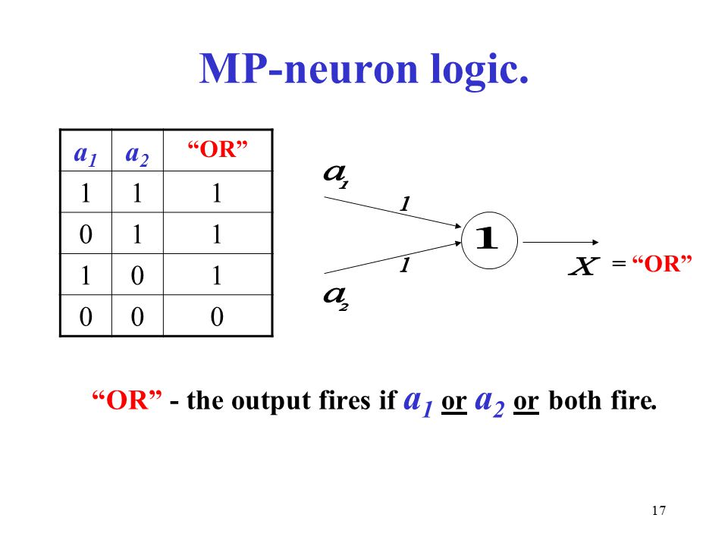
McCulloch-Pitts Neuron Model
Notes:
- Simple binary threshold model
- Logical functions: AND, OR, NOT
- Fixed weights, binary output
- Used for linearly separable problems

Slide 4
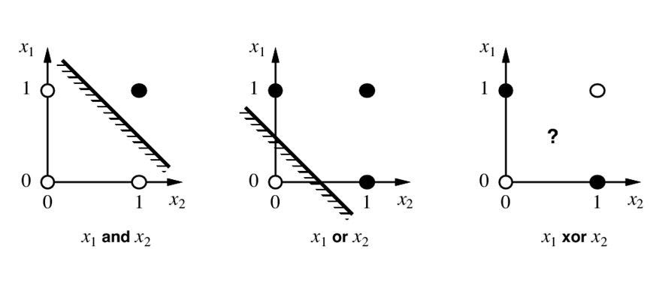
Linear Separability
Notes:
- A dataset is linearly separable if a straight line can divide classes
- AND, OR = linearly separable
- XOR = not linearly separable
- Visualize using scatter plots

Slide 5
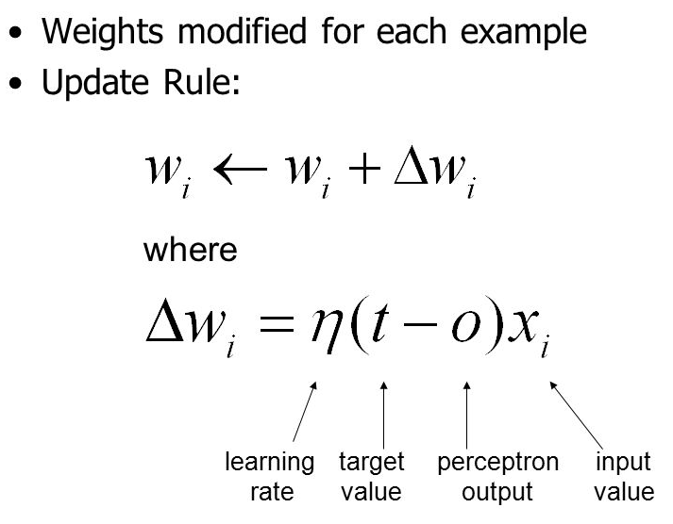
Perceptron Learning Rule
Notes:
- Introduced by Rosenblatt
- Inputs, weights, bias, activation
- Weight update rule: w = w + α * (target - output) * input
- Suitable for linearly separable problems

Slide 6
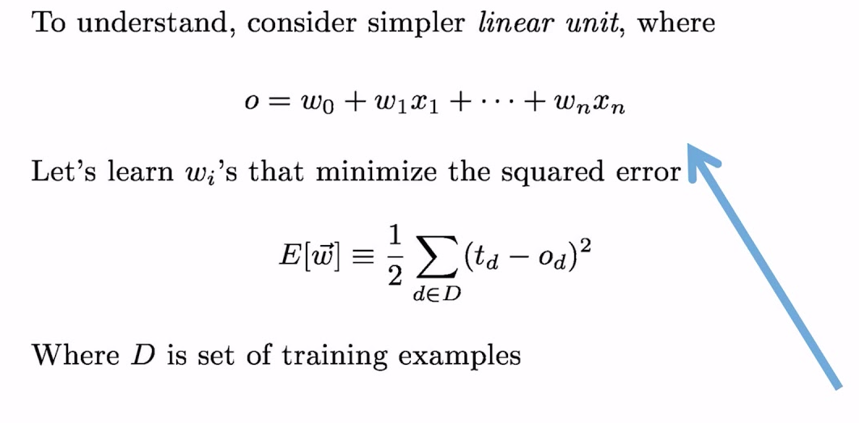
Delta Rule (Gradient Descent Intro)
Notes:
- Improves over perceptron by minimizing error
- Uses continuous activation (e.g., sigmoid)
- Loss = (target - output)^2
- Gradient Descent to update weights

Slide 7
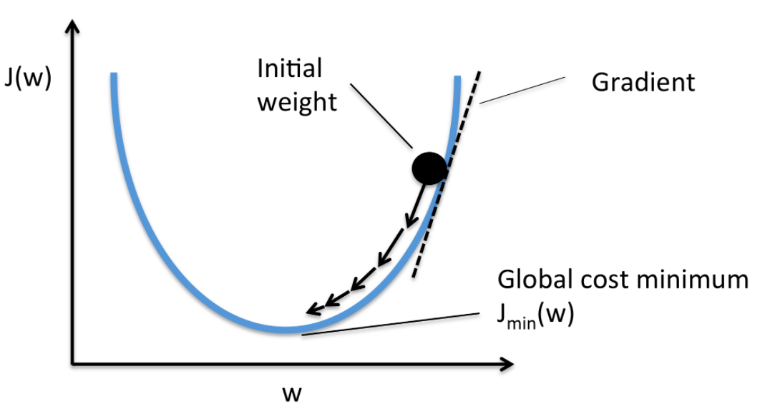
Delta Rule (Gradient Descent Intro)
Notes:
- Improves over perceptron by minimizing error
- Uses continuous activation (e.g., sigmoid)
- Loss = (target - output)^2
- Gradient Descent to update weights

