Slide 1

Introduction to Neural Networks
Biological Neuron
McCulloch-Pitts
Linear Separability
Perceptron
Delta Rule
Notes:
## Notebook Explanation for ML Practitioners
This notebook provides a practical introduction to fundamental neural network concepts, progressing from simple McCulloch-Pitts neurons to a basic Perceptron and the Delta Rule with a sigmoid activation.
### 1. McCulloch-Pitts Neuron
The initial sections demonstrate the McCulloch-Pitts (MCP) neuron model, the foundational element of artificial neural networks.
- **`mcp_neuron` function**: This function simulates an MCP neuron. It takes inputs, corresponding weights, and a threshold. The core idea is to compute a weighted sum of inputs and compare it against a fixed threshold to produce a binary output (0 or 1).
- **AND, OR, NOT gates**: The notebook shows how to configure the weights and threshold of an MCP neuron to replicate the behavior of basic logic gates (AND, OR, and NOT). This highlights the ability of simple neural models to perform basic logical operations.
### 2. Linear Separability Visualization
This section visualizes the concept of linear separability, which is crucial for understanding the limitations of simple models like the Perceptron.
- **`plot_logic_gate` function**: This function visualizes the input combinations for a given logic gate (AND or XOR) and colors them based on their output (0 or 1).
- **AND vs. XOR plots**: The plots clearly show that the AND gate's inputs can be separated by a single straight line (linearly separable), while the XOR gate's inputs cannot. This visual demonstration explains why a single-layer Perceptron cannot solve the XOR problem.
### 3. Perceptron Learning Rule (AND gate)
This section introduces the Perceptron learning algorithm and demonstrates its application to solve the linearly separable AND gate problem.
- **Perceptron implementation**: The code initializes weights and a bias and iteratively updates them based on the error between the predicted and actual output. The learning rule adjusts weights and bias to minimize this error.
- **Training loop**: The training loop iterates through the dataset, adjusting the weights and bias using the Perceptron update rule. Observe how the weights and bias converge over epochs to values that correctly classify the AND gate inputs.
### 4. Delta Rule using Gradient Descent
This section introduces the Delta Rule, a more general learning rule that uses gradient descent and a differentiable activation function (sigmoid) to train a single-layer network. This allows for learning on non-linearly separable data in principle, although a single layer is still limited.
- **Sigmoid function**: The `sigmoid` function is used as the activation function, squashing the output between 0 and 1.
- **Sigmoid derivative**: The `sigmoid_derivative` is needed for the gradient descent update rule.
- **Delta Rule implementation**: The code initializes weights and iteratively updates them based on the error and the derivative of the activation function. This is a basic form of backpropagation applied to a single layer.
- **XOR problem with Delta Rule**: The notebook attempts to solve the XOR problem using the Delta Rule with a single layer. Notice that the predictions after training are all around 0.5. This demonstrates that a single-layer network, even with a differentiable activation and gradient descent, cannot solve the non-linearly separable XOR problem. This limitation necessitates the use of multi-layer networks (which are not covered in this specific notebook).
This notebook serves as a good starting point to understand the building blocks of neural networks and the evolution of learning algorithms from simple rule-based approaches to gradient-based optimization.

Slide 2
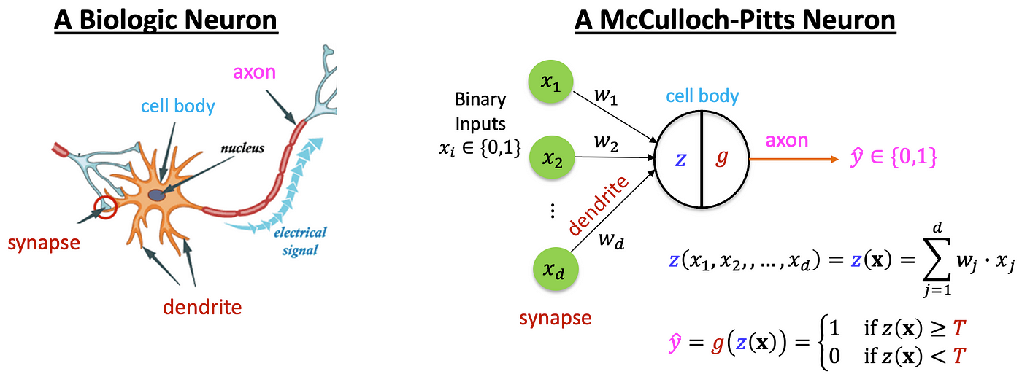
Biological Neuron vs Artificial Neuron
Notes:
Biological: Dendrites, Axon, Synapse
Artificial: Inputs, Weights, Activation
Inspiration behind ANN
Mapping biological to artificial components

Slide 3
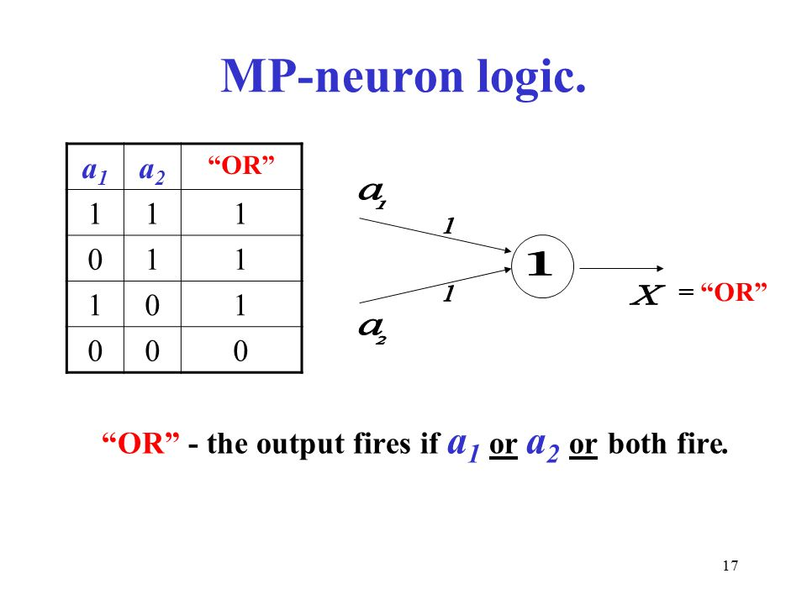
McCulloch-Pitts Neuron Model
Notes:
- Simple binary threshold model
- Logical functions: AND, OR, NOT
- Fixed weights, binary output
- Used for linearly separable problems

Slide 4
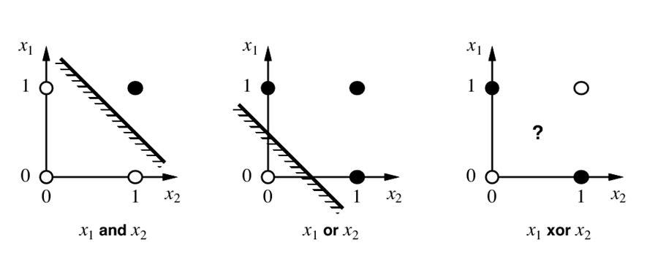
Linear Separability
Notes:
- A dataset is linearly separable if a straight line can divide classes
- AND, OR = linearly separable
- XOR = not linearly separable
- Visualize using scatter plots

Slide 5
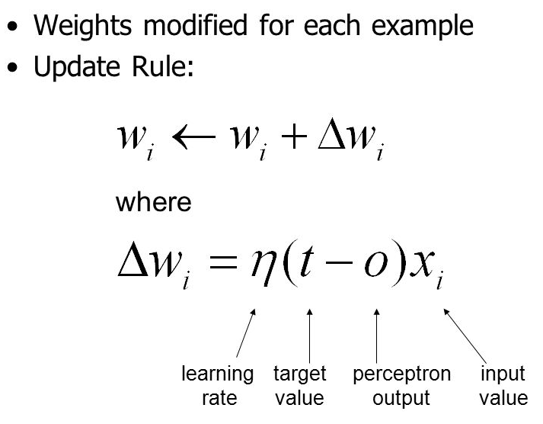
Perceptron Learning Rule
Notes:
- Introduced by Rosenblatt
- Inputs, weights, bias, activation
- Weight update rule: w = w + α * (target - output) * input
- Suitable for linearly separable problems

Slide 6
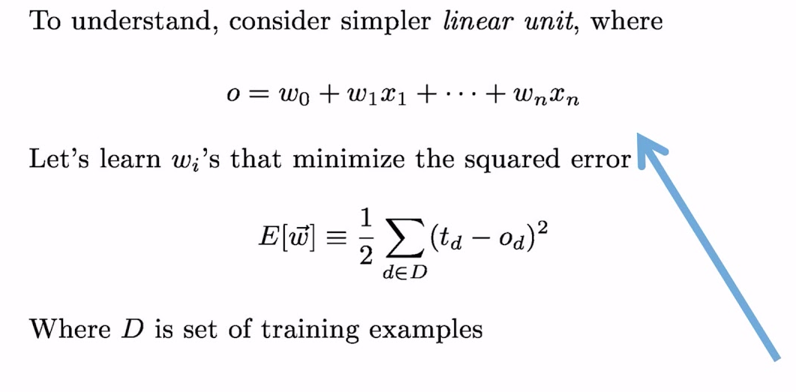
Delta Rule (Gradient Descent Intro)
Notes:
- Improves over perceptron by minimizing error
- Uses continuous activation (e.g., sigmoid)
- Loss = (target - output)^2
- Gradient Descent to update weights

Slide 7
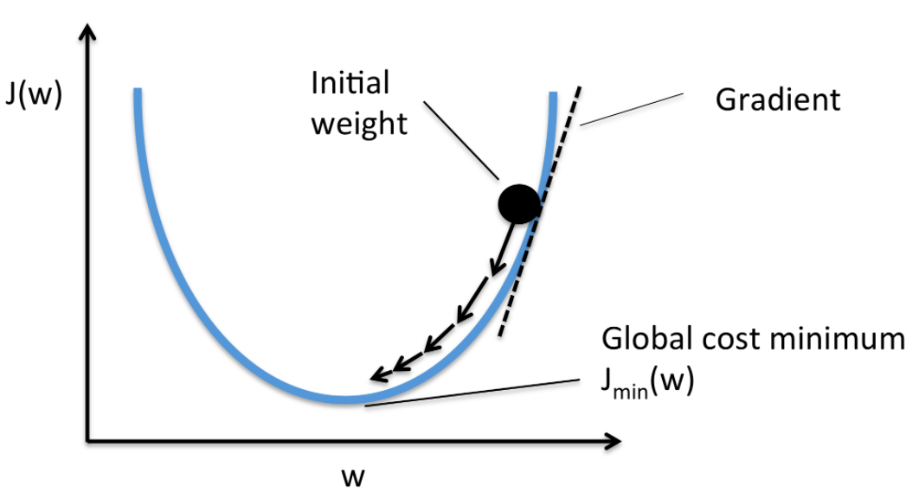
Delta Rule (Gradient Descent Intro)
Notes:
- Improves over perceptron by minimizing error
- Uses continuous activation (e.g., sigmoid)
- Loss = (target - output)^2
- Gradient Descent to update weights

Slide 8

Introduction to Deep Learning
ML vs DL
DL Algorithms
Hyperparameters
Loss Functions
Data Augmentation
Activation Functions
Notes:
This notebook provides a hands-on introduction to key concepts in machine learning and deep learning, building upon foundational knowledge. We'll explore basic classification with traditional ML, delve into hyperparameters in neural networks, visualize loss functions, understand data augmentation techniques, and look at the role of activation functions.
**1. ML vs DL - Basic Classifier Example**
This section demonstrates a simple machine learning classification task using a Logistic Regression model on the Iris dataset.
- We start by importing necessary libraries: `load_iris` for the dataset, `LogisticRegression` for the model, `train_test_split` to divide data, and `accuracy_score` to evaluate performance.
- The Iris dataset is loaded and split into training and testing sets.
- A `LogisticRegression` model is initialized and trained on the training data.
- Finally, the model's accuracy is evaluated on the test set and printed. This serves as a basic example of a traditional machine learning approach to classification.
**2. Hyperparameters - Learning Rate in a Neural Network**
This section introduces the concept of hyperparameters, specifically the learning rate, within the context of a simple neural network for image classification using the MNIST dataset.
- We import `tensorflow` and its modules for building sequential models and dense layers.
- The MNIST dataset (handwritten digits) is loaded and preprocessed by reshaping and normalizing the pixel values.
- A simple sequential model is defined with a dense hidden layer and a dense output layer with softmax activation for multi-class classification.
- The model is compiled with the Adam optimizer, which uses a learning rate. Here, we explicitly set the `learning_rate` to 0.01 to demonstrate how this hyperparameter is configured.
- The model is then trained on the training data, with validation on the test data, for a specified number of epochs. The training process shows the impact of the chosen learning rate on convergence and performance.
**3. Loss Function Visualization**
This section visually compares two common loss functions: Mean Squared Error (MSE) and Mean Absolute Error (MAE). Understanding loss functions is crucial as they quantify the error between predicted and actual values, guiding the model's learning process.
- We import `numpy` for numerical operations and `matplotlib.pyplot` for plotting.
- We generate a range of values to represent errors and calculate the corresponding MSE and MAE values.
- The two loss functions are plotted against the error values, illustrating their different behaviors. MSE penalizes larger errors more heavily due to the squaring operation, while MAE provides a linear penalty.
**4. Data Augmentation (Image)**
This section demonstrates data augmentation techniques for image data, a common method to increase the size and diversity of a training dataset, which helps improve model generalization and reduce overfitting.
- We import `ImageDataGenerator` from Keras for applying image transformations and `matplotlib.pyplot` and `numpy` for visualization.
- An `ImageDataGenerator` object is configured with various augmentation parameters like rotation, zoom, and horizontal flipping.
- The CIFAR-10 dataset (color images) is loaded, and a sample image is selected.
- An iterator is created using `datagen.flow()` to apply the configured augmentations to the sample image.
- A loop iterates through the augmented images generated by the iterator and displays 5 different augmented versions of the original image, showcasing the effects of the applied transformations.
**5. Activation Functions**
This section visualizes common activation functions used in neural networks. Activation functions introduce non-linearity into the network, enabling it to learn complex patterns.
- We import `numpy` and `matplotlib.pyplot`.
- We generate a range of input values.
- We calculate the output of several popular activation functions (Sigmoid, Tanh, ReLU, and a simulated Softmax) for these input values.
- These activation functions are then plotted, illustrating their characteristic shapes and output ranges. This helps understand how different activation functions transform the input signals within a neural network.

Slide 9
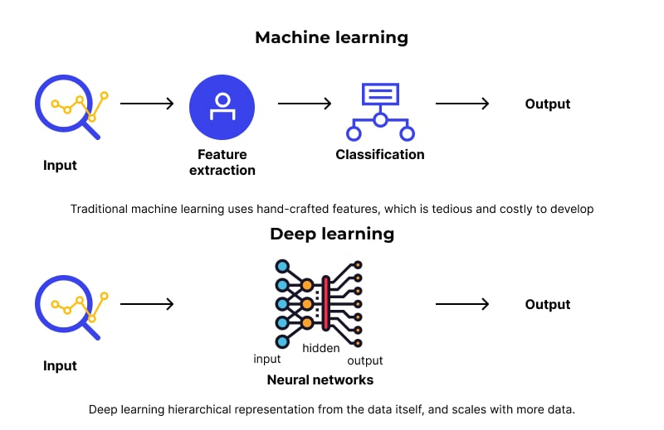
Machine Learning vs Deep Learning
Notes:
- ML uses manual feature engineering, DL uses automatic feature extraction
- DL requires large data and high compute
- DL uses neural networks with multiple hidden layers
- DL performs better in unstructured data like images/audio

Slide 10
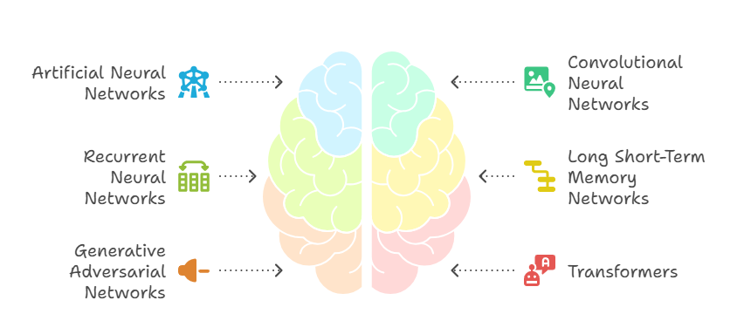
Types of Deep Learning Algorithms
Notes:
- ANN: General-purpose neural network
- CNN: Specialized in image processing
- RNN: Used for sequence data like text/speech
- GAN, Autoencoders: Used in generation and encoding

Slide 11
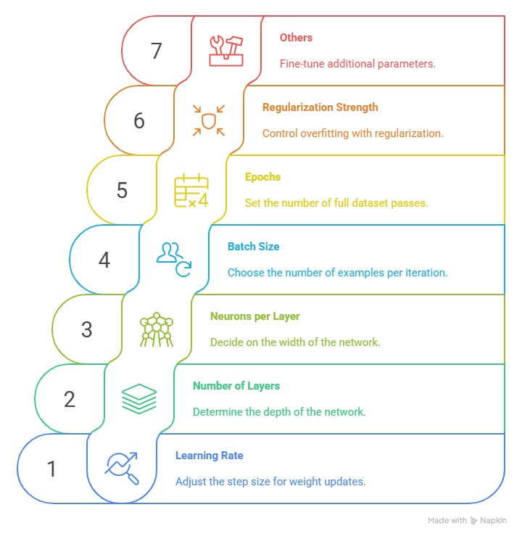
Hyperparameters in Deep Learning
Notes:
- Learning Rate: Step size in optimization
- Batch Size: Number of samples per training step
- Epochs: Full pass over dataset
- Others: Optimizer type, dropout rate, hidden layers

Slide 12
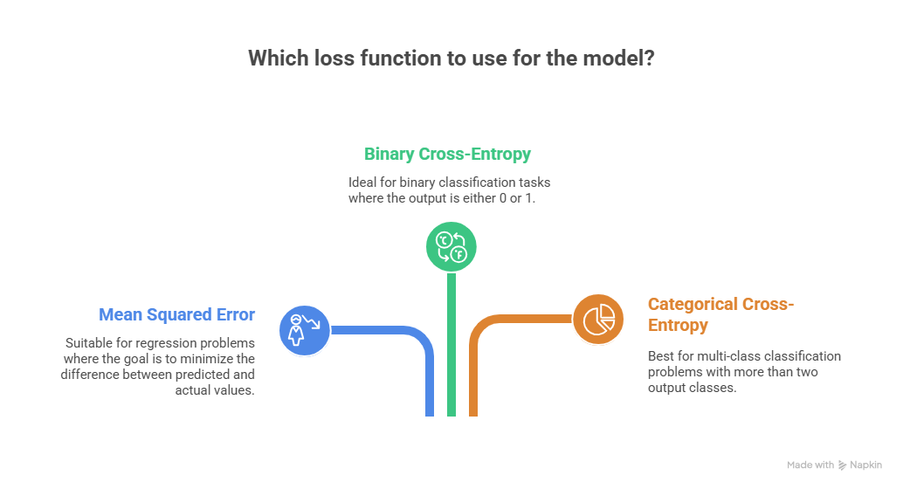
Loss Functions
Notes:
- Mean Squared Error (MSE): For regression tasks
- Binary Cross-Entropy: For binary classification
- Categorical Cross-Entropy: For multi-class classification
- Important for gradient descent updates

Slide 13

Data Augmentation
Notes:
- Improve generalization by altering training data
- Common techniques: Flip, rotate, scale, crop
- Used in image and text data augmentation
- Helps prevent overfitting

Slide 14
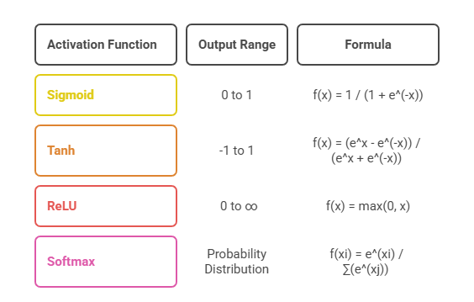
Activation Functions
Notes:
- Sigmoid: Smooth curve, range (0,1)
- Tanh: Range (-1,1), zero-centered
- ReLU: Fast, good for deep networks
- Softmax: Converts outputs to probabilities

