Slide 1

Unsupervised Learning Algorithms
Agenda
Introduction to PCA
Understanding PCA Mechanism
Limitations of PCA
Applications

Slide 2
What is PCA?
Definition: Principal Components (PCs) are new uncorrelated variables that maximize variance in the data. Key Properties: ✅ PCs are linear combinations of original features. ✅ The first principal component (PC1) captures the highest variance. ✅ Each subsequent PC captures the next highest variance while being orthogonal (perpendicular) to the previous ones.
📝 Example:
In a dataset with height and weight, PCA can transform it into one principal component that captures overall body size.

Slide 3
Steps in PCA Algorithm
Standardization
Convert all features to mean = 0 and standard deviation = 1 (to remove scale differences).
Compute Covariance Matrix
Find relationships between variables using a covariance matrix.
Compute Eigenvalues & Eigenvectors
Sort and Select Principal Components
Eigenvalues determine the importance of each principal component.
Eigenvectors define the direction of the new principal components.
Rank eigenvalues in descending order.
Choose the top k components based on variance explained.
Transform Data into New Space
Project original data onto the selected principal components.

Slide 4
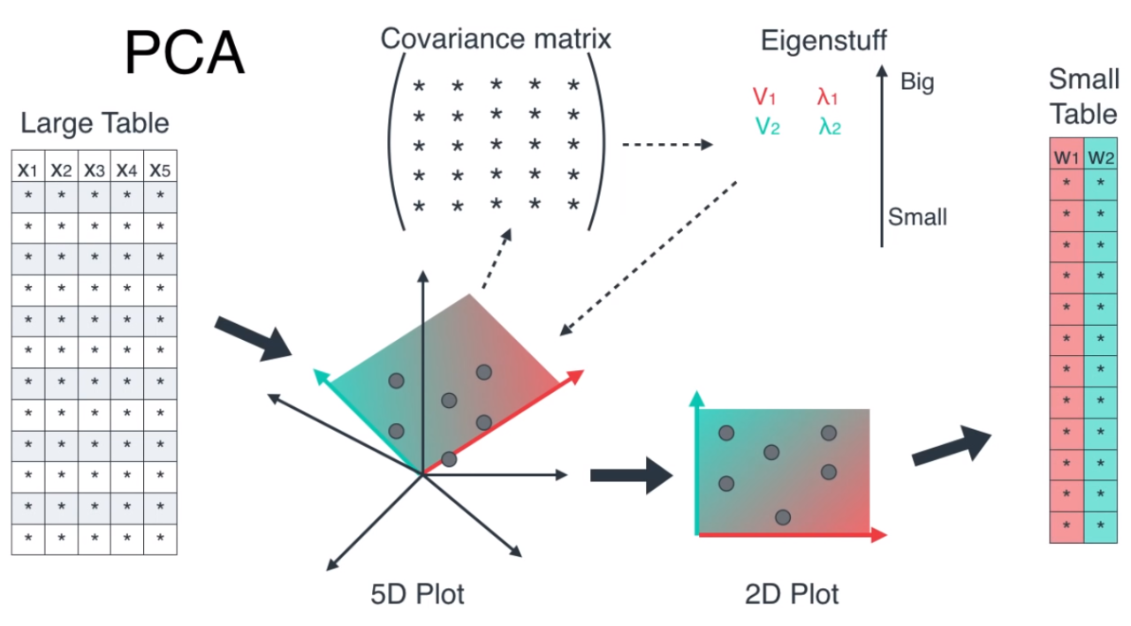
Steps in PCA Algorithm

Slide 5
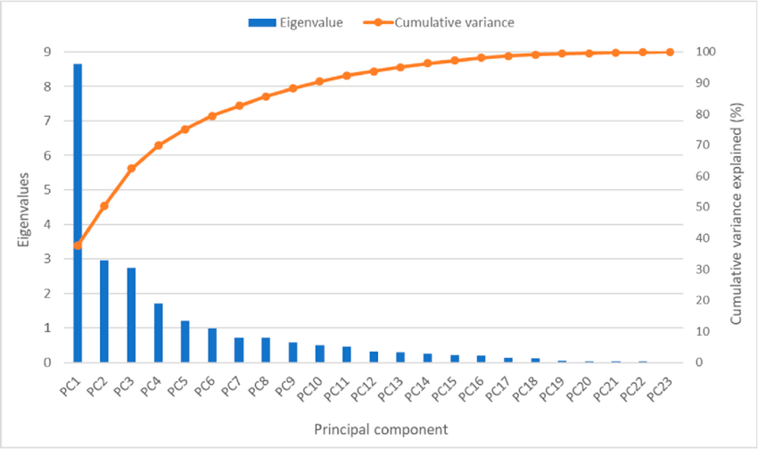
Eigenvalues and Eigenvectors in PCA
📌 Eigenvalues: Measure the variance explained by each principal component. 📌 Eigenvectors: Define the direction of the principal components.
✅ Higher eigenvalues → More important principal components. ✅ Total variance = Sum of all eigenvalues.
📝 Example:
If PC1 explains 70% of the variance and PC2 explains 20%, we retain PC1 and PC2 and ignore the rest.

Slide 6
Why Do We Need PCA?
Challenges with High-Dimensional Data: ❌ Computational cost increases as dimensions grow. ❌ Difficult to visualize high-dimensional data. ❌ Overfitting due to redundant or irrelevant features.
✅ How PCA Helps: ✔ Reduces storage and computation cost. ✔ Makes visualization easier (e.g., 2D and 3D plots). ✔ Improves model performance by eliminating noise.

Slide 7
Limitations of PCA
❌ Loss of Interpretability
Principal components don’t have direct meaning like original features.
❌ Assumes Linear Relationships
PCA works best when variables have linear dependencies.
❌ Sensitive to Scaling
PCA requires feature scaling (Standardization or Normalization).
❌ May Not Work Well for All Data Types
For categorical or discrete data, other techniques like t-SNE or UMAP may work better.

Slide 8
Real-World Applications of PCA
Image Compression
PCA helps reduce image size while preserving important features.
Finance & Stock Market Analysis
Identifies key trends from multiple stock prices.
Medical Diagnosis
Reduces complexity in genomic data for disease classification.
Speech Recognition & NLP
Reduces feature space for sentiment analysis or voice recognition models.
Example: Face recognition systems (Eigenfaces).
Example: Predicting stock movements based on principal components.
Example: Cancer detection using PCA on gene expression data.

Slide 9
Thank You

