Slide 1
Natural Language Processing

Slide 2
What is NLP ?
  ”Natural language processing (NLP) is a field of computer science, artificial intelligence (also called machine learning), and linguistics concerned with the interactions between computers and human (natural) languages. Specifically, the process of a computer extracting meaningful information from natural language input and/or producing natural language output ”
  - Wikipedia

Slide 3
Why NLP ?

Slide 4
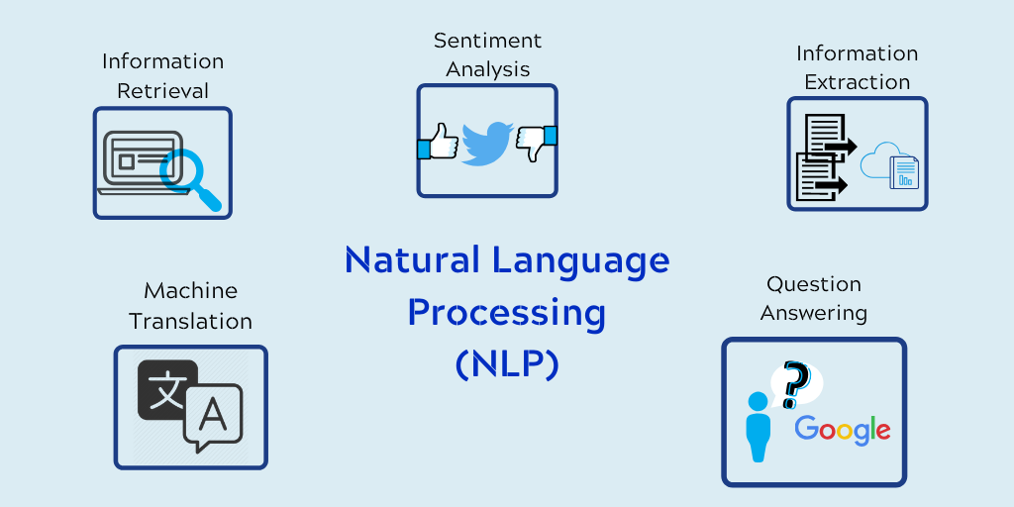

Slide 5
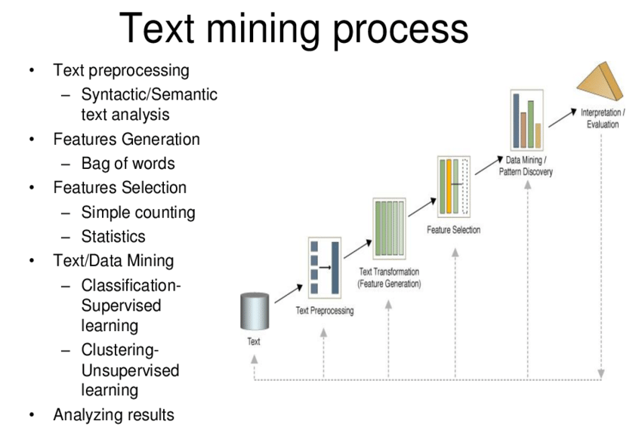

Slide 6
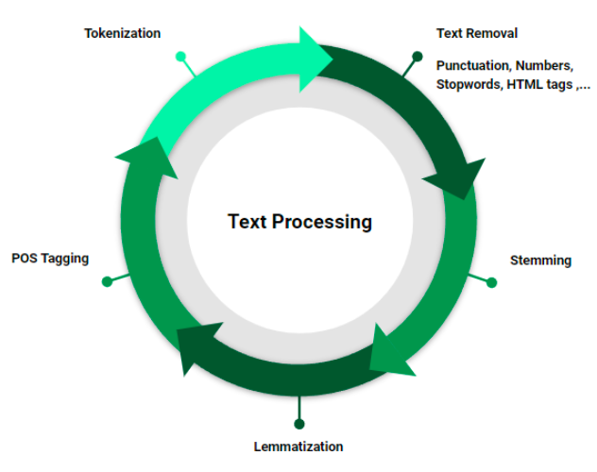

Slide 7
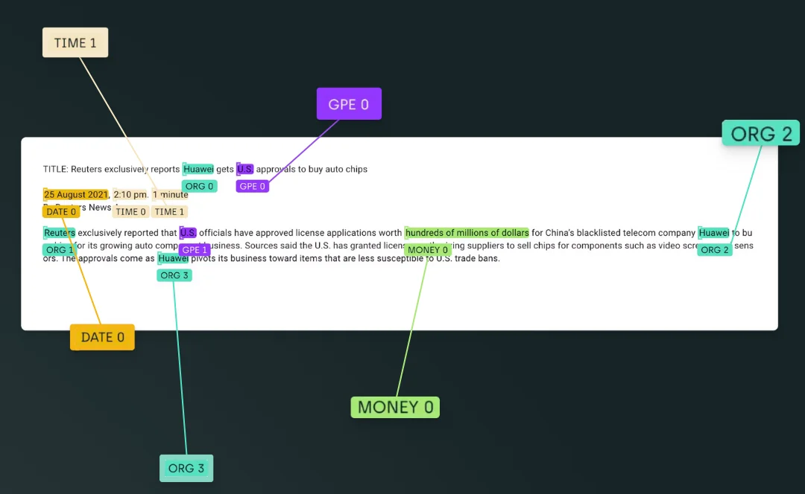
Information extraction

Slide 8
Information extraction
  Extraction of meaning from email :-
  We have decided to meet tomorrow at 10:00am in the lab.
To do : meeting
Time : 10:00 am, 22/3/2012
Venue : Lab

Slide 9
Machine Translation
  என் பெயர் உஷா. => My name is Usha.
  Knowledge is power. - அறிவு சக்தி. (Arivu Sakthi)

Slide 10
Tasks in NLP
Text Cleaning – Lowercase, stop word removal, bag of words
Tokenization
Segmentation
Stemming and Lemmatization
Part of Speech (POS) tagging
Disambiguation
Contextual Analysis

Slide 11
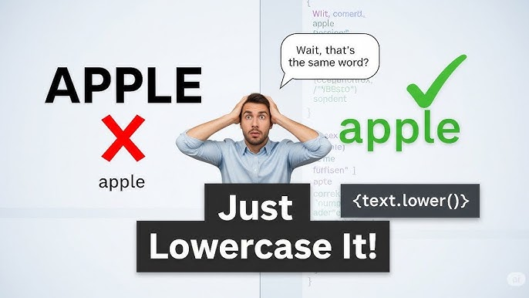
Lowercasing

Slide 12
Lowercasing
Text: "Usha Loves NLP and Natural Language Processing."
After Lowercasing: "usha loves nlp and natural language processing."
Why Lowercasing?
Reduces dimensionality (treats “Apple” and “apple” as the same word).
Prevents duplication of features.
Useful for Bag-of-Words, TF-IDF, and most classical NLP tasks.
When NOT to lowercase?
Named Entity Recognition (NER): Case may matter (e.g., “Apple” (ORG) vs. “apple” (fruit)).
Case-sensitive tasks: Sentiment in capital letters (“I am ANGRY!!!”).

Slide 13
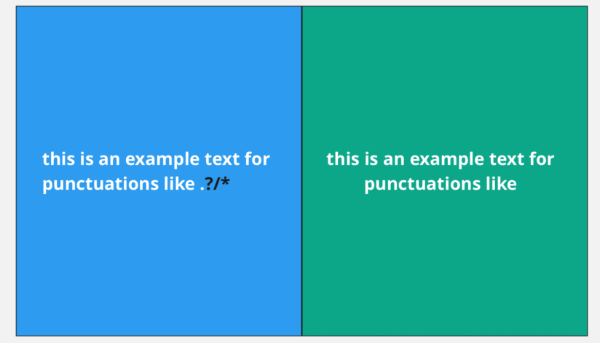
Punctuation Removal

Slide 14
Punctuation Removal
Text: "Hello, Usha! How's NLP going?"
After Punctuation Removal: "Hello Usha Hows NLP going"
Why Remove Punctuation?
Reduces noise in text data.
Simplifies feature extraction (Bag-of-Words, TF-IDF).
Prevents counting “word” and “word!” as different tokens.
When to Keep Punctuation?
Sentiment Analysis: Exclamation marks (!) may convey emotion.
Dialogue/Speech Analysis: Punctuation like “?” may indicate questions.

Slide 15
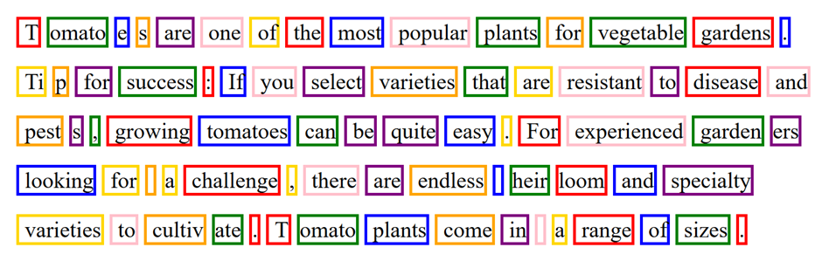
Tokenization
Tokenization = Splitting text into smaller units like sentences or words.
Why important? → Helps in search, translation, sentiment analysis, and speech-to-text.

Slide 16
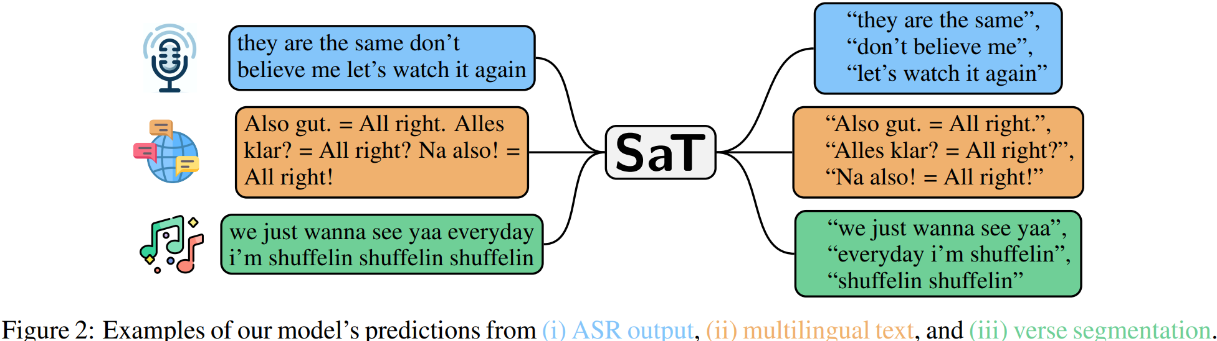
Segmentation
Segmentation = Splitting words into meaningful subunits (morphemes, syllables, subwords).
Why important? → Helps in search, translation, sentiment analysis, and speech-to-text.

Slide 17
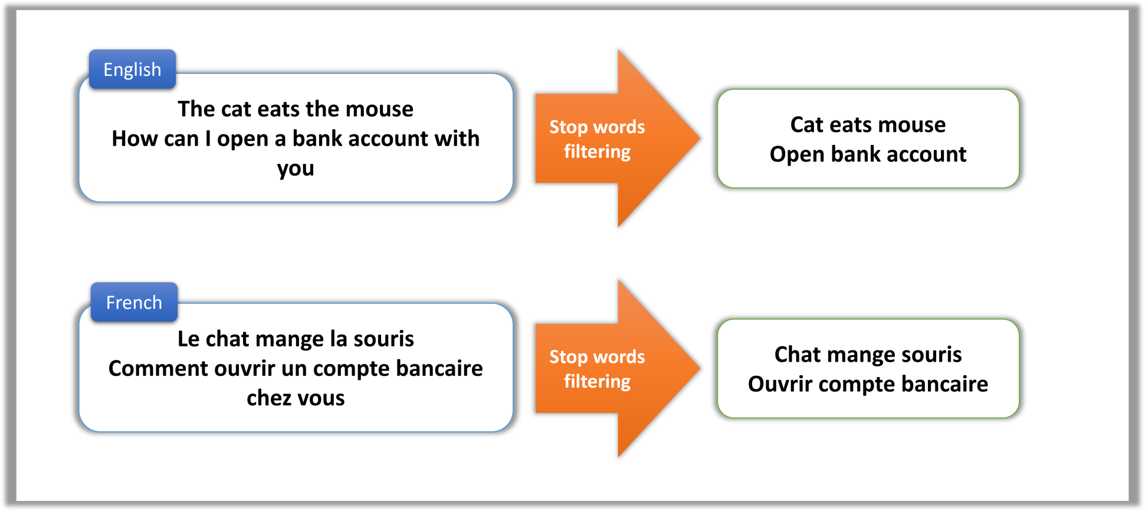
Stopwords
What are Stopwords?
Common words that carry little or no semantic meaning.
Examples: is, am, are, the, in, of, to, and.
Removing them reduces noise in text.

Slide 18
Stopwords
Text: "Usha is learning Natural Language Processing in Python."
After Stopword Removal: "Usha learning Natural Language Processing Python"
Why Remove Stopwords?
Reduces dataset dimensionality (fewer unique words).
Improves efficiency of text mining tasks.
Focuses analysis on important words.
When NOT to Remove Stopwords?
In sentiment analysis (“not good” → removing “not” changes meaning).
In translation (stopwords may be meaningful in another language).

Slide 19
Stemming and Lemmatization
Aspect | Stemming | Lemmatization
Definition | Rule-based removal of suffix/prefix | Uses vocab + grammar for root word
Accuracy | Less accurate (may produce non-words) | More accurate (valid dictionary words)
Example | running → runn | running → run
Use case | Fast & simple NLP tasks | Machine learning, translation, search engines

Slide 20
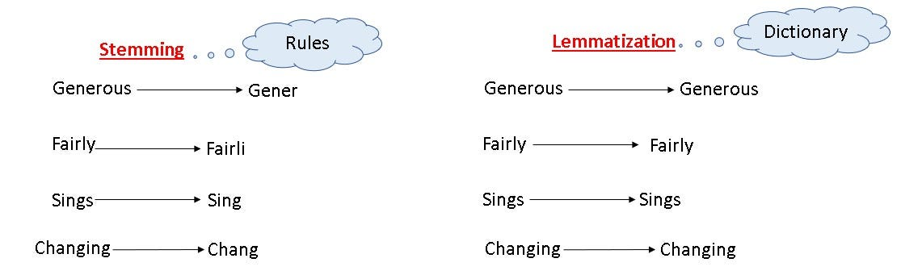
Stemming and Lemmatization

Slide 21
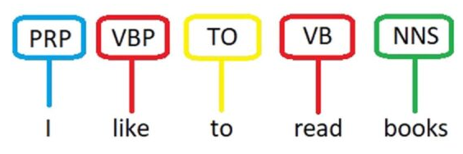
POS tagging

Slide 22
POS tagging
Tag | Meaning | Example
NN | Noun (Singular) | book
NNP | Proper Noun | Usha
VB | Verb (Base form) | eat
VBG | Verb (Gerund) | eating
JJ | Adjective | beautiful
RB | Adverb | quickly
PRP | Pronoun | she

Slide 23
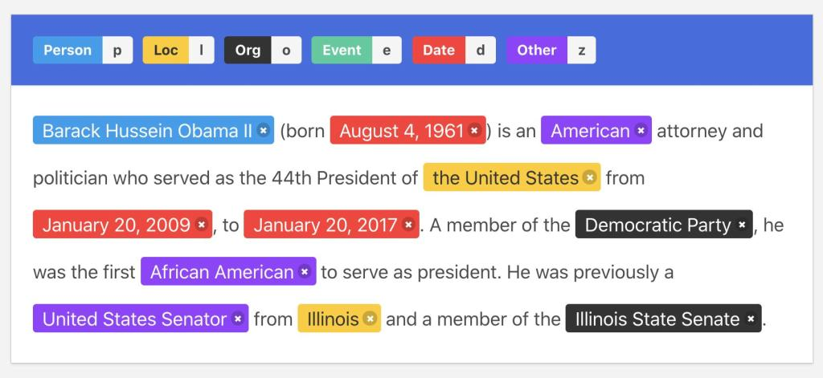
NER
The NER process identifies and classifies key information (entities) in text into predefined categories such as names, organizations, locations, dates, and more. The following are the general steps of the NER process:
Notes:
https://demo.prodi.gy/?=null&view_id=ner_manual

Slide 24
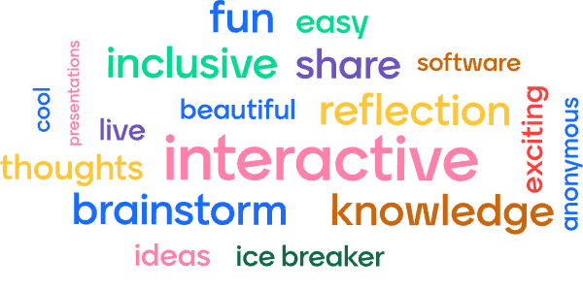
Word Cloud
A word cloud, or tag cloud, is a visual representation of text data where words are displayed in different sizes, with more frequent and important words appearing larger and more prominent. It serves as an exploratory tool in natural language processing, providing a quick, high-level overview of the key themes or most repeated terms within a document or dataset by showing their relative frequency.
Notes:
https://www.wordclouds.com/

Slide 25
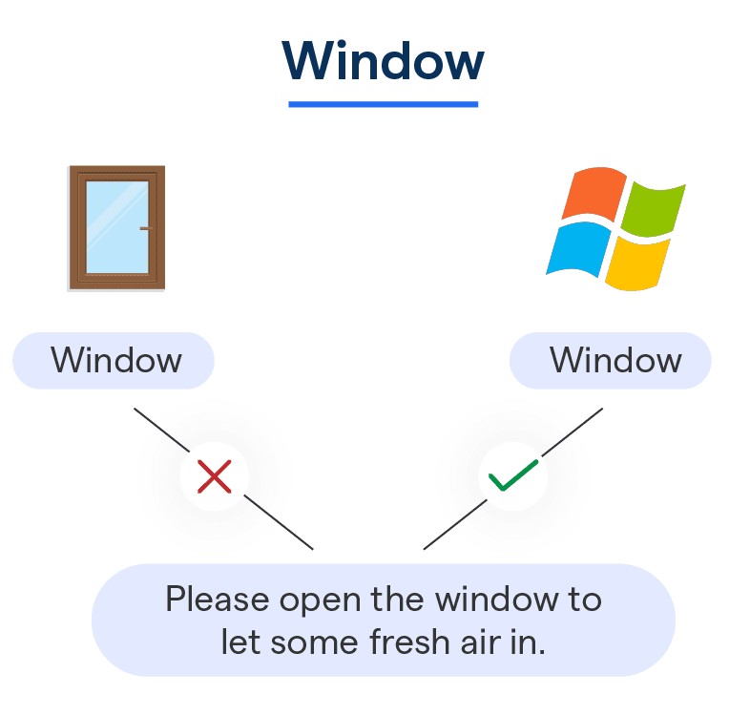
Word Sense Disambiguation

Slide 26
Word Sense Disambiguation
Concept | Example
Polysemy | A word having multiple meanings (e.g., "bank")
Need for WSD | Correct interpretation in Search, Translation, Chatbots, Q&A
Approaches | 1. Dictionary-based (Lesk) 2. Supervised ML 3. Deep Learning
Applications | Machine Translation, Sentiment Analysis, Question Answering

Slide 27
Contextual Analysis
Usha went to the bank to deposit money. → Bank = Financial institution
Usha sat near the bank of the river. → Bank = River side
context helps decide the correct sense.

Slide 28
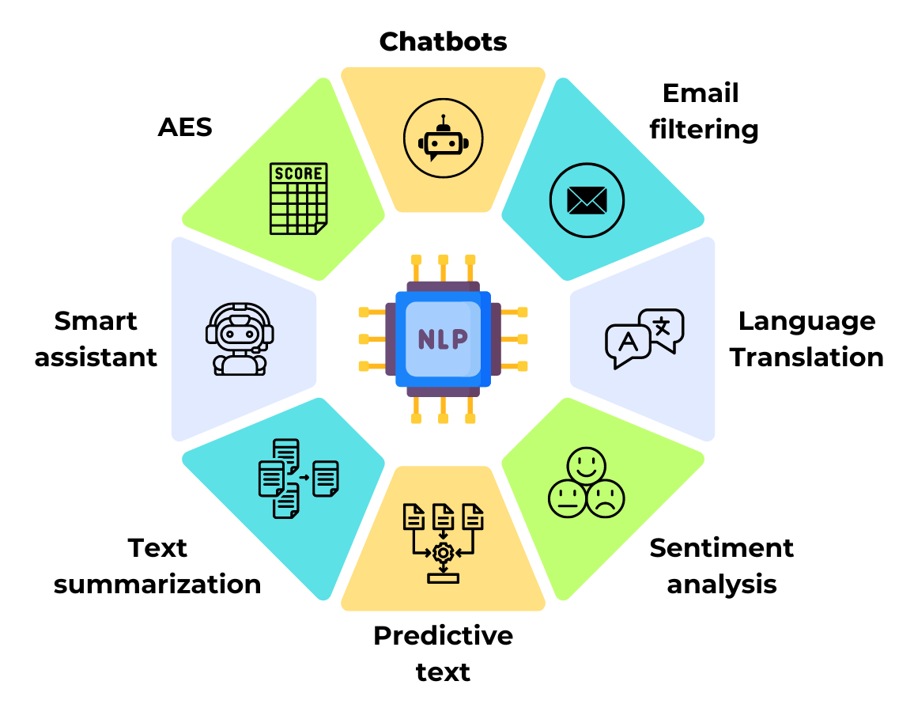
NLP Applications
Notes:
https://corenlp.run/

Slide 29
Thank You!

