Slide 1
Secplan
Ebenezer Bonney Ussher & Claudio Ripper

Slide 2
Problems of Security Workers
Work time and place can change on short term
No possibility to report injuries and unexpected events
without direct communication
Different working location
→ new commute for every assignment

Slide 3
Solution
Users can see their weekly schedules in app
Working location always visible
→ navigation through open street maps
Quick reporting functions
→ report injuries with few taps

Slide 4
Login
Input UserID
→ hashed and sent to Server
Server sends ID to Database
→if it exists, returns personal data of user
as JSON data
User can see his schedule and has access to reporting and location service

Slide 5
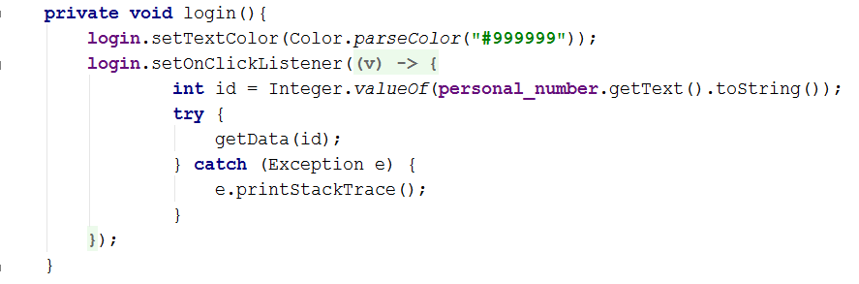
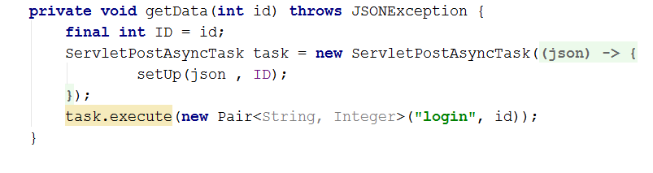
Login

Slide 6
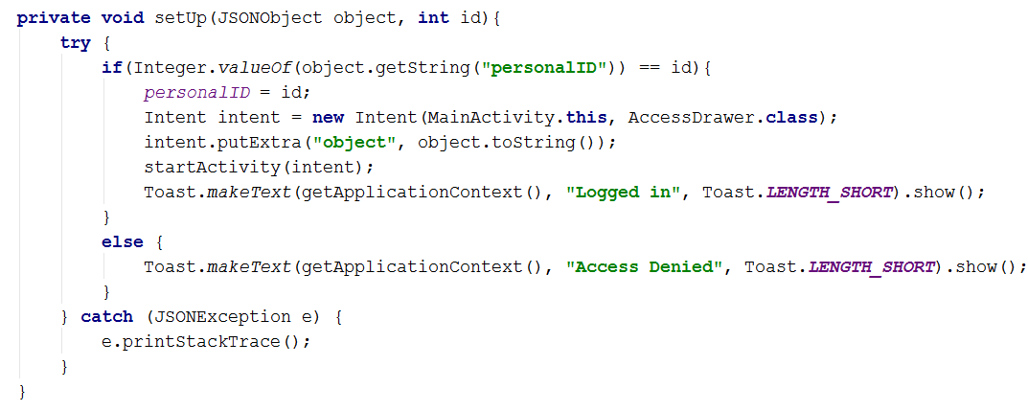
Login

Slide 7
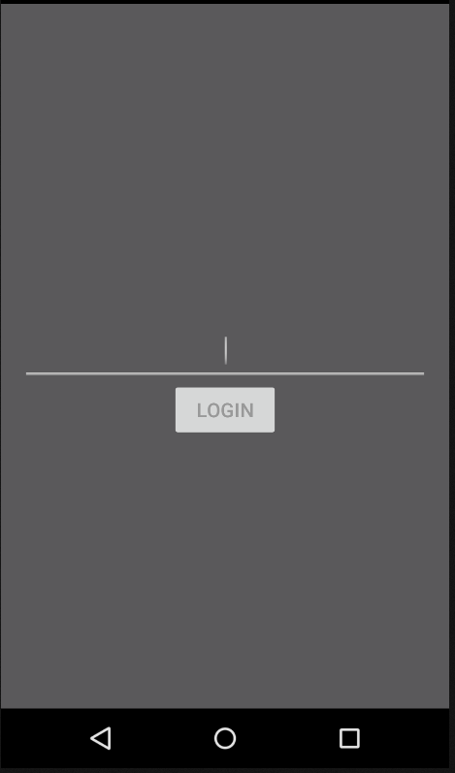
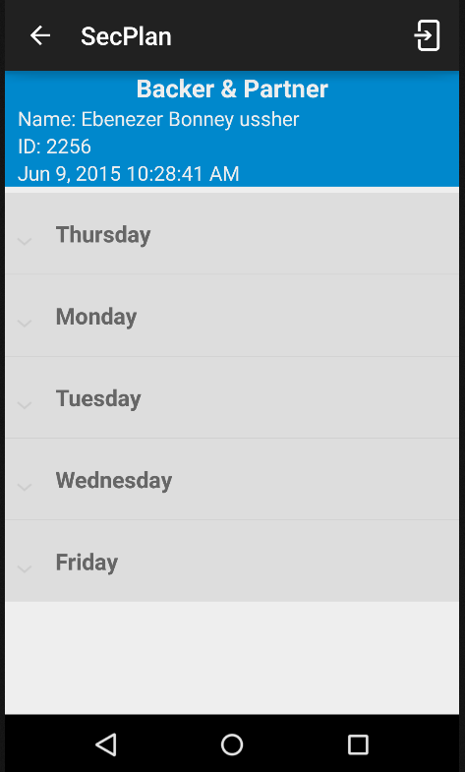
Login

Slide 8
Navigation
Adress is sent to GeoCoder
→ Gets latitude and longitude of the location
Point is shown on Open Street Maps
App shows the path between all the assigned Checkpoints

Slide 9
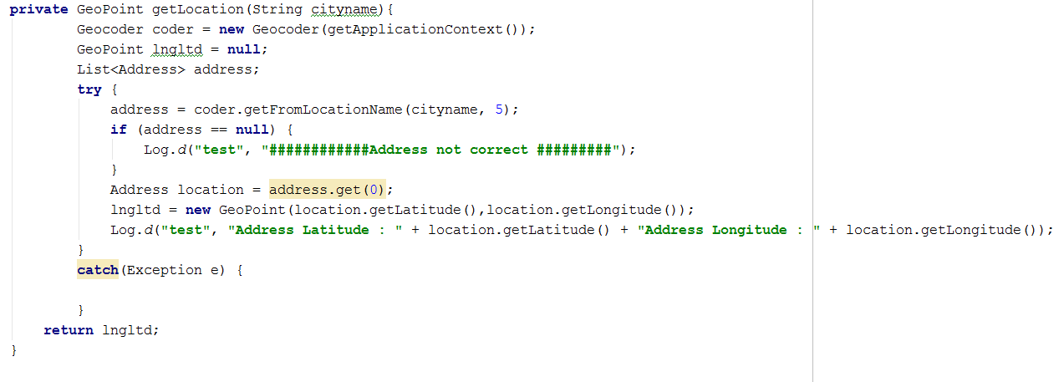
Navigation

Slide 10
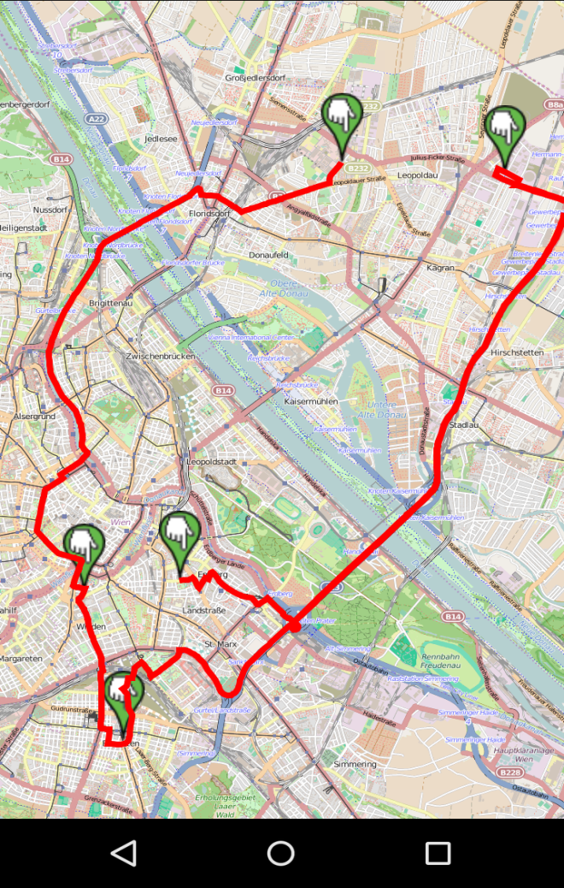
Navigation

Slide 11
Reporting
User can report injuries
→ sent to database, visible to employer
besides UserID
Possibility to write custom reports
Fast way to request help in case of unexpected events

Slide 12
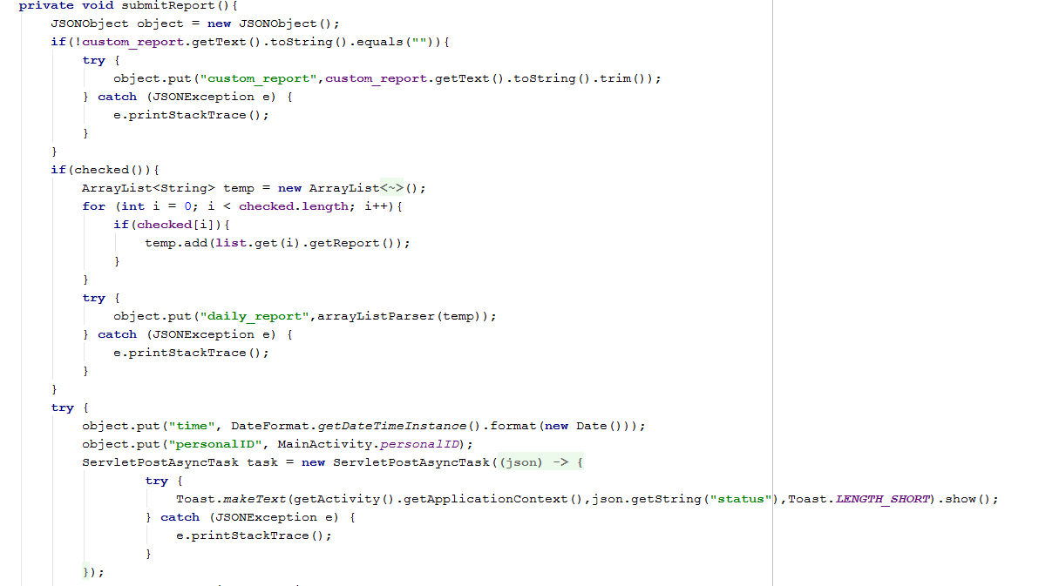
Reporting

Slide 13
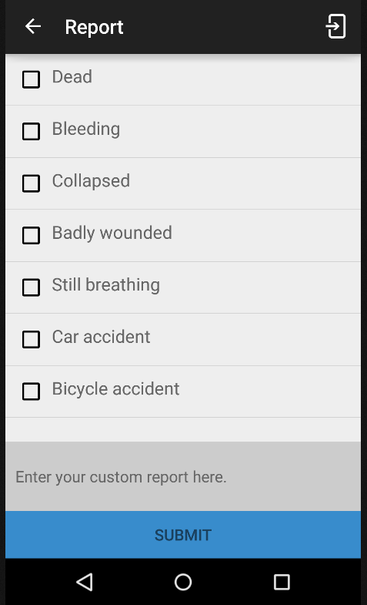
Reports

Slide 14
Lessons learned
First „real“ Android App
→ better knowledge of IDE and System
TomCat and MongoDB in connection
with Android
Map implementation wasn‘t easy
→ different markers and line colors not implemented

Slide 15
Live Demo

