Slide 1
[ COURSE / WEEK ] CAPSTONE ASSESSMENT
SHOPKART Automation Framework
Software Testing Automation Capstone — UI, API, Database, CI/CD & Reporting
[Language]
[Build Tool]
[BDD Tool]
[UI Tool]
[API Tool]
[Database]
[CI Tool]
[Reporting Tool]
Automation Testing Trainer Review | 10-Minute Technical Demo
Bhumika511/week6

Slide 2
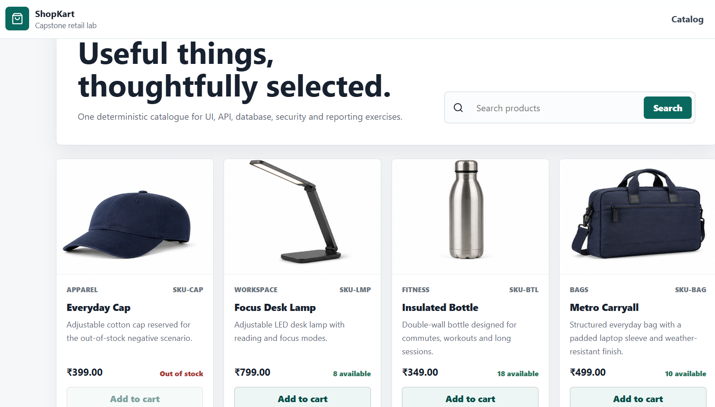




Project Objective
What this capstone project sets out to prove
[Objective 1]
e.g. automate critical business flows
[Objective 2]
e.g. validate UI + API + Database
Application Under Test Screenshot
Insert screenshot here
[Objective 3]
e.g. generate automated CI reports
github.com/your-username/your-repo
2

Slide 3

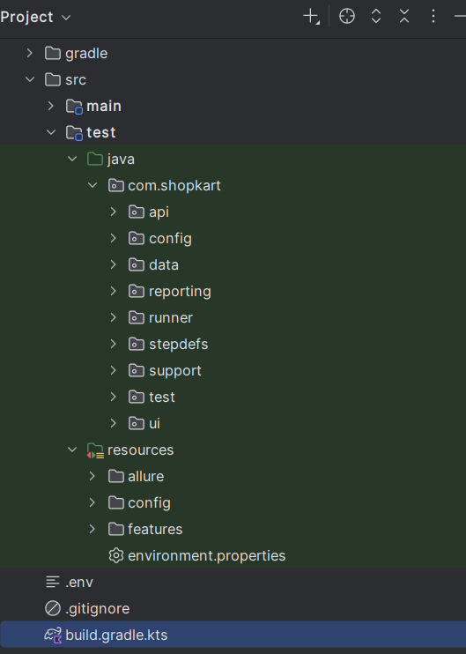



Framework Overview
A simple, layered architecture
Feature Files
↓
Step Definitions
↓
UI | API | Database
↓
Test Reports
Project Structure Screenshot
Insert screenshot here
↓
CI Pipeline
↓
Published Report
3

Slide 4
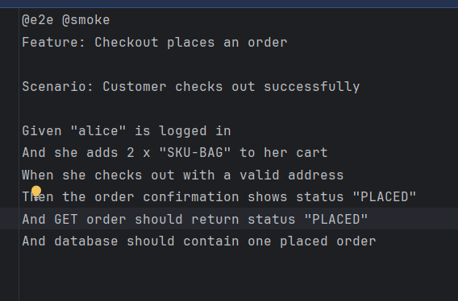

Test Coverage
Rename each scenario and tick the layers it validates
Scenario
UI
API
DB
Scenario 1
Scenario 2
Scenario 3
Scenario 4
Feature Files Screenshot
Insert screenshot here
Scenario 5
Scenario 6
4

Slide 5

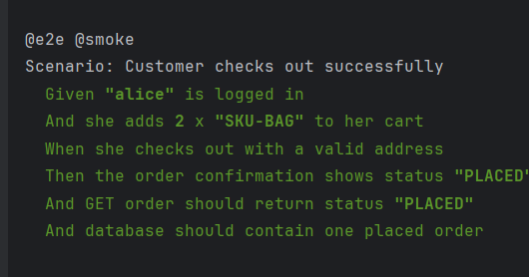
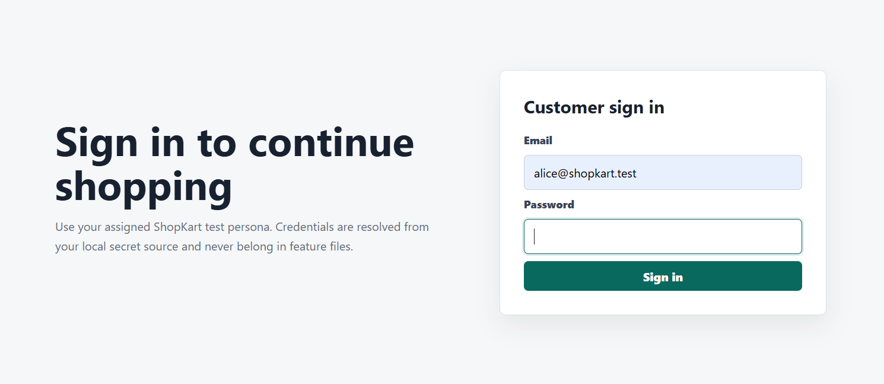
Local Execution
Running the suite on a developer machine
Execute tests using your build tool
Modular execution using tags / groups
Test Excution Screenshot
Insert screenshot here
Running Application Screenshot
Insert screenshot here
5

Slide 6
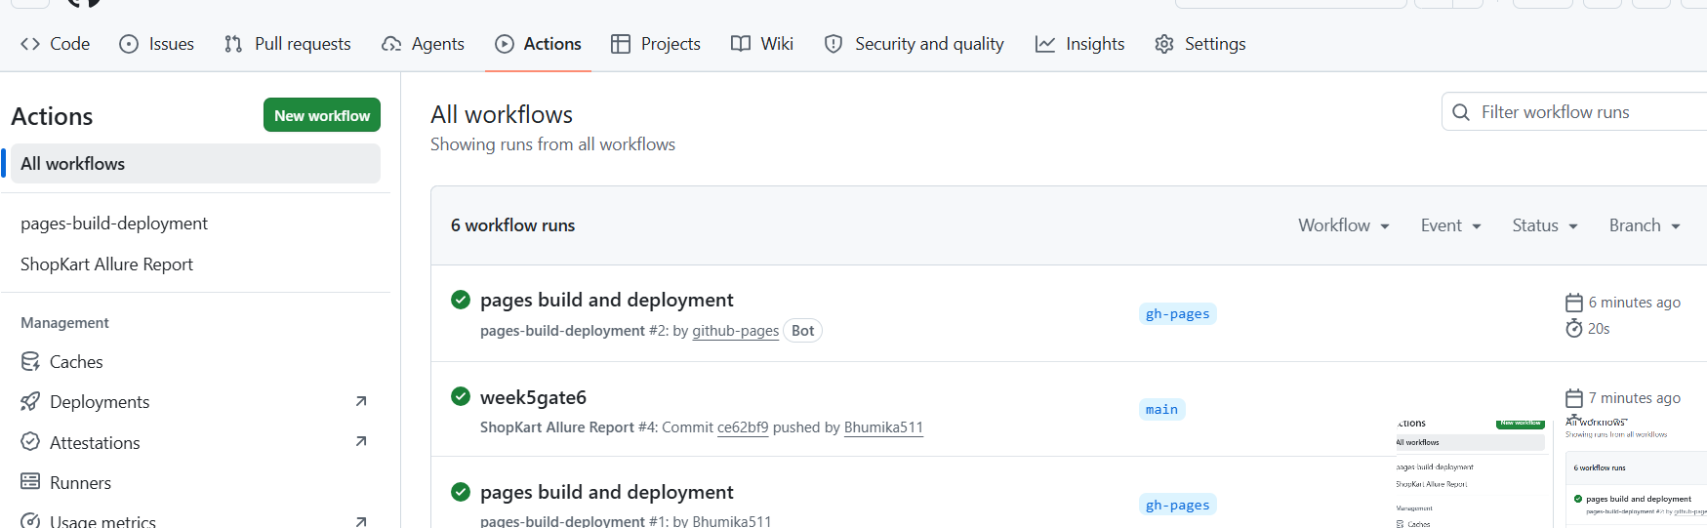
CI/CD Pipeline
Every push triggers a fully automated cycle
Code Push
↓
CI Trigger
↓
Run Tests
CI Pipeline Screenshot
↓
Generate Report
Insert screenshot here
↓
Publish Report
6

Slide 7


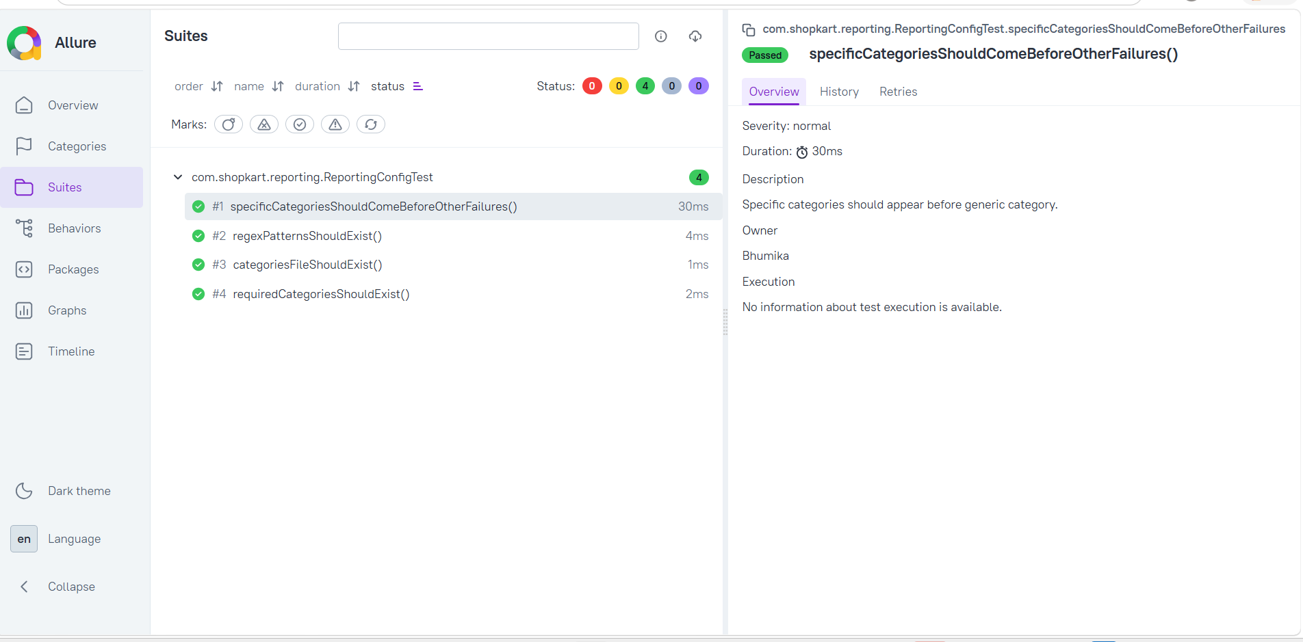
Reporting
One dashboard, four views
Automatic reporting
Failure categorization
Historical trends
Environment details
Overview Screenshot
Categories Screenshot
Insert screenshot here
Insert screenshot here
History / Trend Screenshot
Environment Screenshot
Insert screenshot here
Insert screenshot here
7

Slide 8
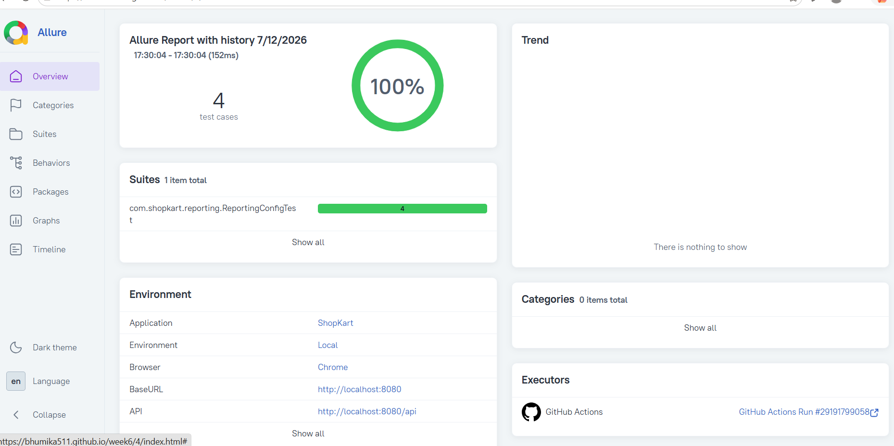
Conclusion
Update the list below to match your project's achievements
UI Automation
API Automation
Database Validation
Security Validation
Final Report Screenshot
Insert screenshot here
CI/CD Integration
Automated Reporting
[Insert a one-line closing statement about what your framework demonstrates.]
8

