Slide 1
CAPSTONE DEMO NARRATIVE
ShopKart Automation Framework
From a hardened test framework to a ten-minute story any room can act on
Cipiraj · SDET 7-Week Automation Engineering Programme
Week 6 · Gate 6 Pre-Capstone Review
ShopKart Automation Framework | Capstone Demo | Cipiraj
1

Slide 2
OPEN STRONG
Every layer, proven — UI to database
7 / 7
100%
3
automated tests
passing
Allure pass rate
this run
layers proven
UI · API · DB
“Six days ago this suite was three manual clicks and a hope. Today it runs itself, proves itself, and I'll show you it live.”
ShopKart Automation Framework | Capstone Demo | Cipiraj
2

Slide 3
SET THE SCENE
The starting point: a build worth trusting, not yet proven
No automated proof
Checkout, cart and search relied on manual spot-checks with no repeatable evidence
THE SHAPE
“We inherited a checkout service with no automated safety net. Every release meant someone clicking through the happy path by hand and hoping nothing broke underneath.
That's the gap this build closes.”
No layered coverage
Nothing tied the UI, the API and the database back to one fact
No visibility
A green build meant “ran locally”, not “verified, reported, and repeatable in CI”
ShopKart Automation Framework | Capstone Demo | Cipiraj
3

Slide 4
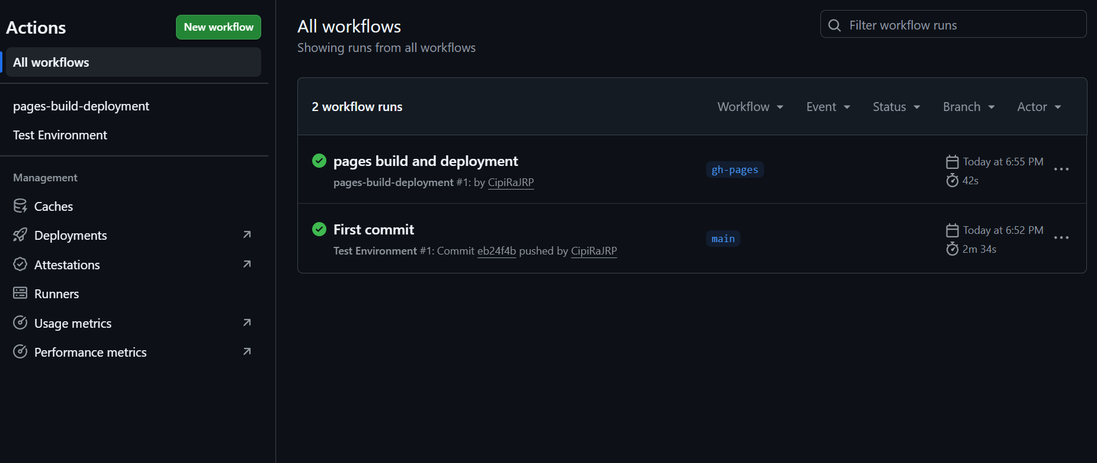
SHOW THE WORK · STRUCTURE
A framework built in clean, reviewable layers
1
Configuration
EVIDENCE · CI — BUILD & REPORT PUBLISH
External, environment-driven — nothing hardcoded
2
API & UI, separated
Independent client and page layers, never entangled
3
Dynamic XPath (Xp)
One parameterized locator class — the project standard
4
Data builders
Per-test data, isolated — never a shared fixture
GitHub Actions validates the build and publishes the Allure report on every push — both green. The API/UI suite itself still runs locally (see Risk).
5
Thin step definitions
Glue only, zero logic — readable Cucumber steps
ShopKart Automation Framework | Capstone Demo | Cipiraj
4

Slide 5
SHOW THE WORK · SCOPE
Seven scenarios, spanning every layer
Scenario
Scenario
Layer
Layer
Run in
Run in
Status
Status
End-to-End full journey
UI → API → DB
Local
PASSED
Product search (Cucumber)
API
Local
PASSED
Happy-path checkout
API
Local
PASSED
Cart total validation
API
Local
PASSED
Order access
API
Local
PASSED
Cancel order
API
Local
PASSED
Out-of-stock handling
API
Local
PASSED
UI happy path
UI (Selenide)
Local
PASSED
UI product search
UI (Selenide)
Local
PASSED
Scope note — all seven scenarios run locally today (happy-path only); CI currently handles build validation and report publishing, not execution (see Risk).
ShopKart Automation Framework | Capstone Demo | Cipiraj
5

Slide 6
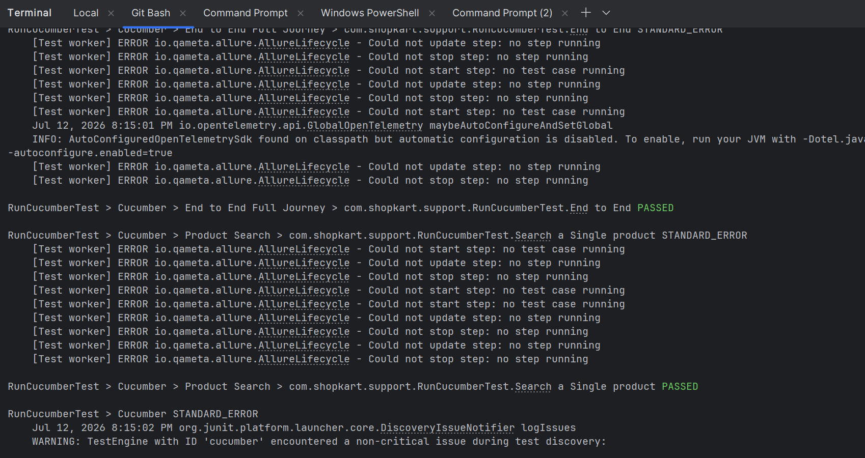
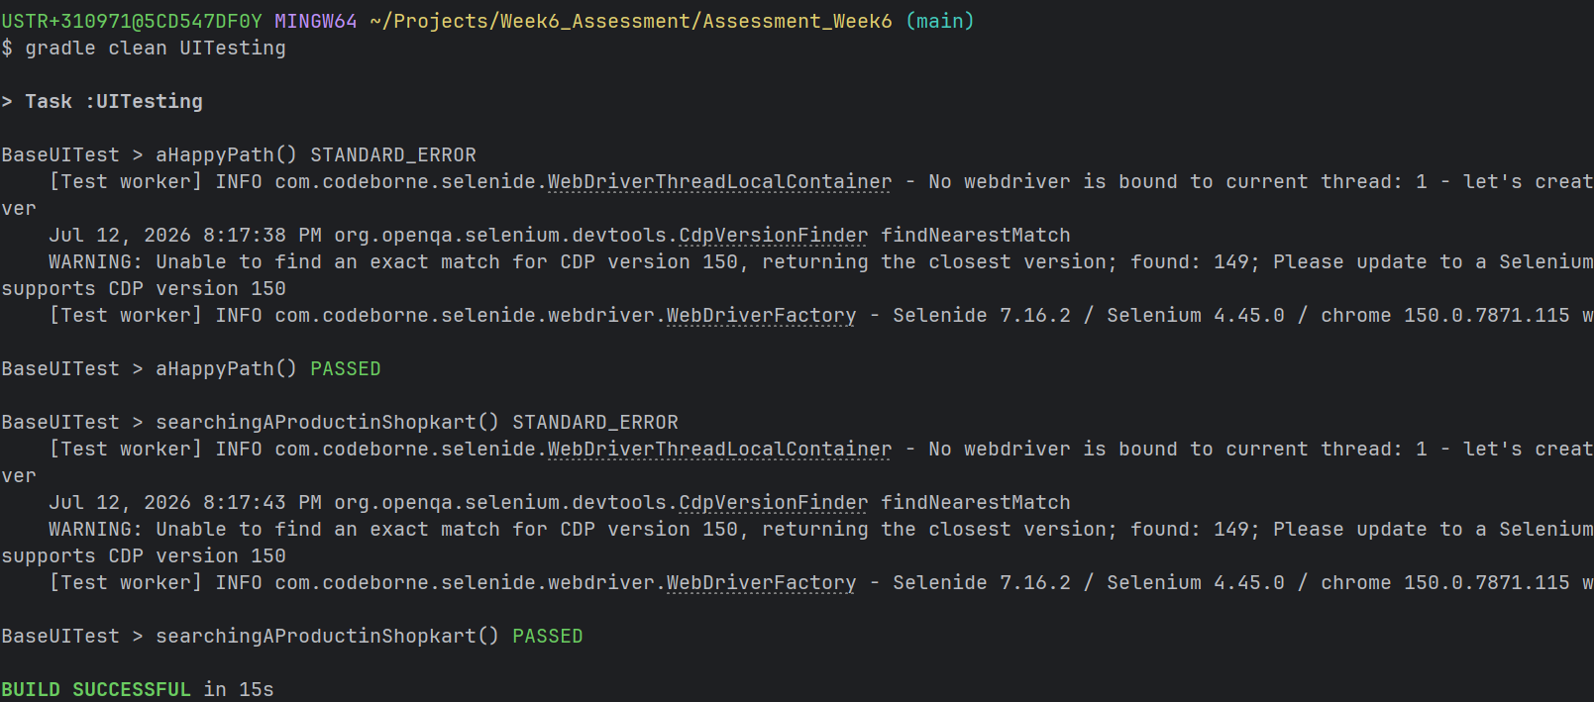
SHOW THE WORK · LIVE
The 4-minute live run — two moments, narrated
Run locally — CI doesn't execute the suite yet, it builds and publishes the report
MOMENT 1 · CUCUMBER END-TO-END (LOCAL)
MOMENT 2 · UI SUITE (SELENIDE, LOCAL)
“BUILD SUCCESSFUL in 15s” — aHappyPath and searchingAProductinShopkart both PASSED, driven end to end in Chrome.
“End to End Full Journey” and “Product Search” both PASSED — one user story, proven UI-to-DB.
ShopKart Automation Framework | Capstone Demo | Cipiraj
6

Slide 7
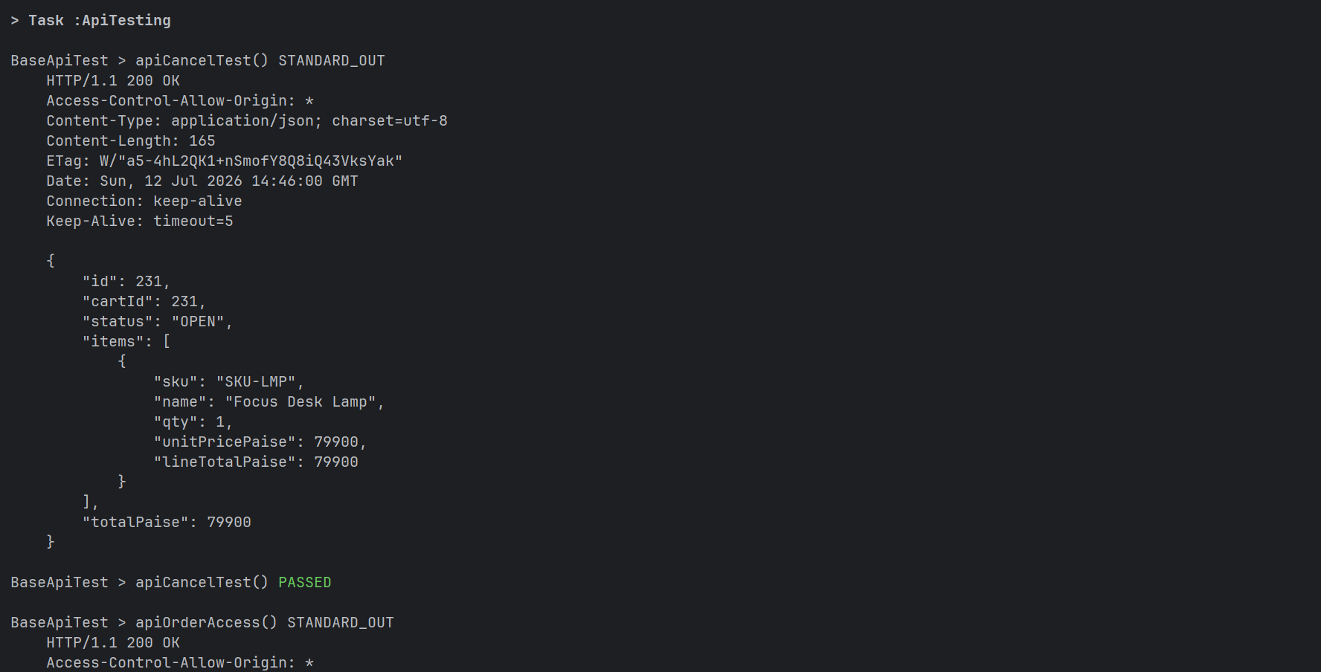
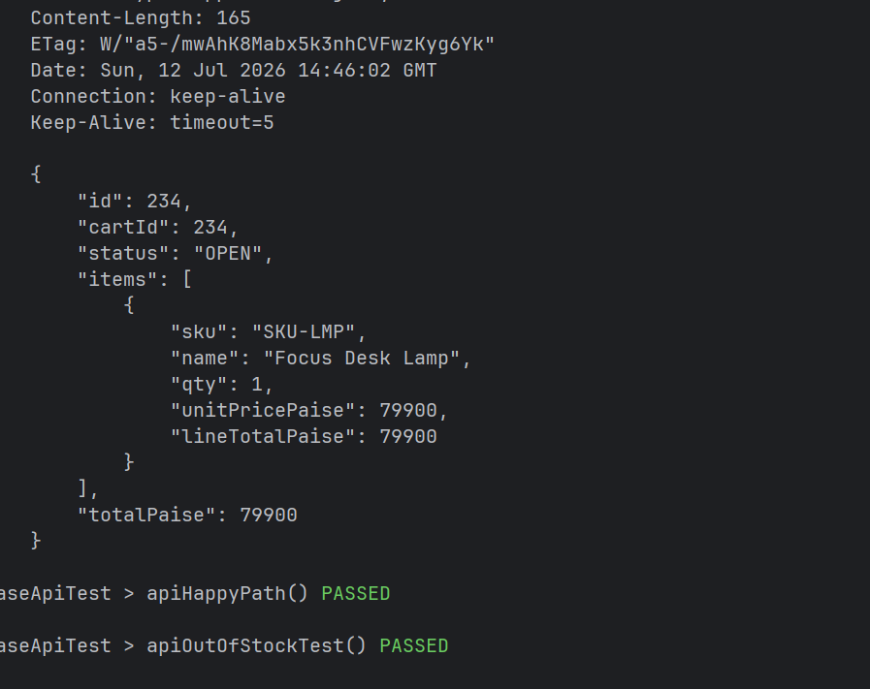
SHOW THE WORK · LIVE
The API layer — six checks, six 200s
Run locally via Gradle — not yet executed inside the CI pipeline
apiCancelTest → 200 OK, cart CANCELLED cleanly
apiOrderAccess → cartTotalValidation → apiProductSearch → apiHappyPath: all PASSED
ShopKart Automation Framework | Capstone Demo | Cipiraj
7

Slide 8
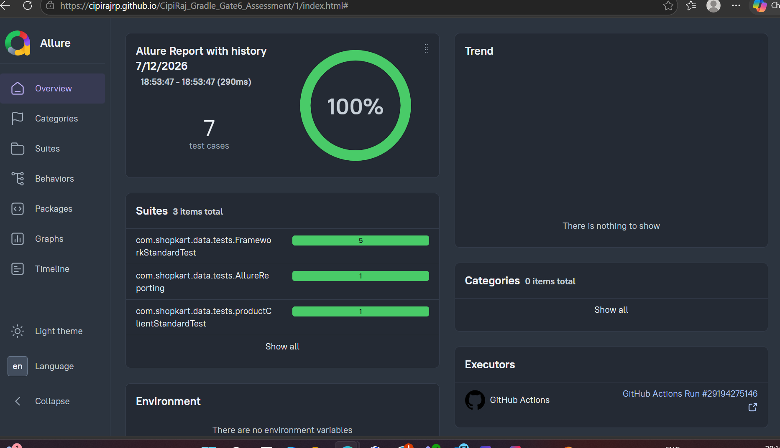
PROVE IT
One dashboard, hosted, updated on every run
100%
pass rate, local run
7
test cases across 3 suites
#29194275146
CI run that published this report
Allure report — generated from the local suite run, published to GitHub Pages by CI
“That 100% comes from the local suite you just saw — CI's job today is publishing this report, not yet running the suite itself.”
GitHub-link
ShopKart Automation Framework | Capstone Demo | Cipiraj
8

Slide 9
TALK RISK HONESTLY
Raise the gap before anyone asks
Everything green above is real — and two gaps sit under it. Both named first, not found later.
NAME
QUANTIFY
CONTEXT
MITIGATE
Coverage today is happy-path only
7 / 7 scenarios are happy-path; no negative, security or defect-injection cases yet
The gate calls for a security-negative (403) case and defect/flaky handling — not yet built
Next sprint adds the negative-path and security scenarios before the capstone gate
CI runs build & report only — not the suite
0 of 7 scenarios execute in CI today; all run locally via Gradle
CI validates the build and publishes the Allure report; it doesn't yet trigger the API/UI tests
Wire the local suite into the CI job (headless browser + service container) before the gate
ShopKart Automation Framework | Capstone Demo | Cipiraj
9

Slide 10
LAND THE CLOSE
The so-what, and the ask
“We built a three-layer ShopKart framework — UI, API and database, tied to one fact each time — and it's 100% green across all seven scenarios, run locally with the report published automatically via CI.
Next to add the negative and security-path scenarios and wire the suite into CI itself, and this is capstone-ready.
That's the story. What would you like to dig into?”
ONE MESSAGE
Structurally sound, fully green, happy-path proven locally — CI execution and negative-path are the next , not a mystery.
ShopKart Automation Framework | Capstone Demo | Cipiraj
10

