Slide 1
UST GLOBAL SDET PROGRAMME · WEEK 6 · GATE 6 PRE-CAPSTONE REVIEW
ShopKart Automation Framework
Software Testing Automation Capstone — UI, API, Database, CI/CD & Reporting
Java 21
Gradle
Cucumber 7
Selenide
REST Assured
PostgreSQL
GitHub Actions
Allure 2.x
Automation Testing Trainer Review | 10-Minute Technical Demo
github.com/Hemanth6559/week6gate6.git

Slide 2



Project Objective
What this pre-capstone gate sets out to prove
Automate the checkout flow
Login → search → add to cart → checkout → PLACED
Validate every layer
UI, API and Database each verify the same order
Report and protect secrets
Allure history, categories & redacted attachments
github.com/Hemanth6559/week6gate6.git
2

Slide 3




Framework Overview
A simple, layered architecture
Feature Files
↓
Step Definitions
↓
UI | API | Database
↓
Test Reports
↓
CI Pipeline
↓
Published Report
github.com/Hemanth6559/week6gate6.git
3

Slide 4

Test Coverage
The six scenarios and the layers each one proves
Scenario
UI
API
DB
Product search
Cart totals
Checkout E2E
Order access
Cancel rules
Out of stock
github.com/Hemanth6559/week6gate6.git
4

Slide 5

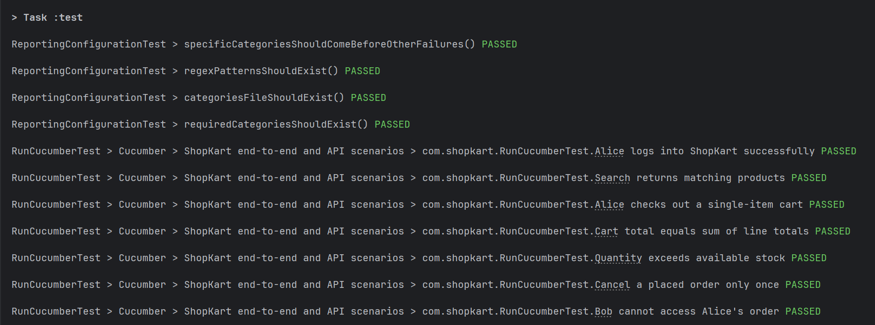

Local Execution
Running the suite on a developer machine
./gradlew test spins up Testcontainers Postgres
Cucumber tags: @smoke @api @db @negative @security
Test Execution Screenshot
Insert screenshot here
Running Application Screenshot
Insert screenshot here
github.com/Hemanth6559/week6gate6.git
5

Slide 6
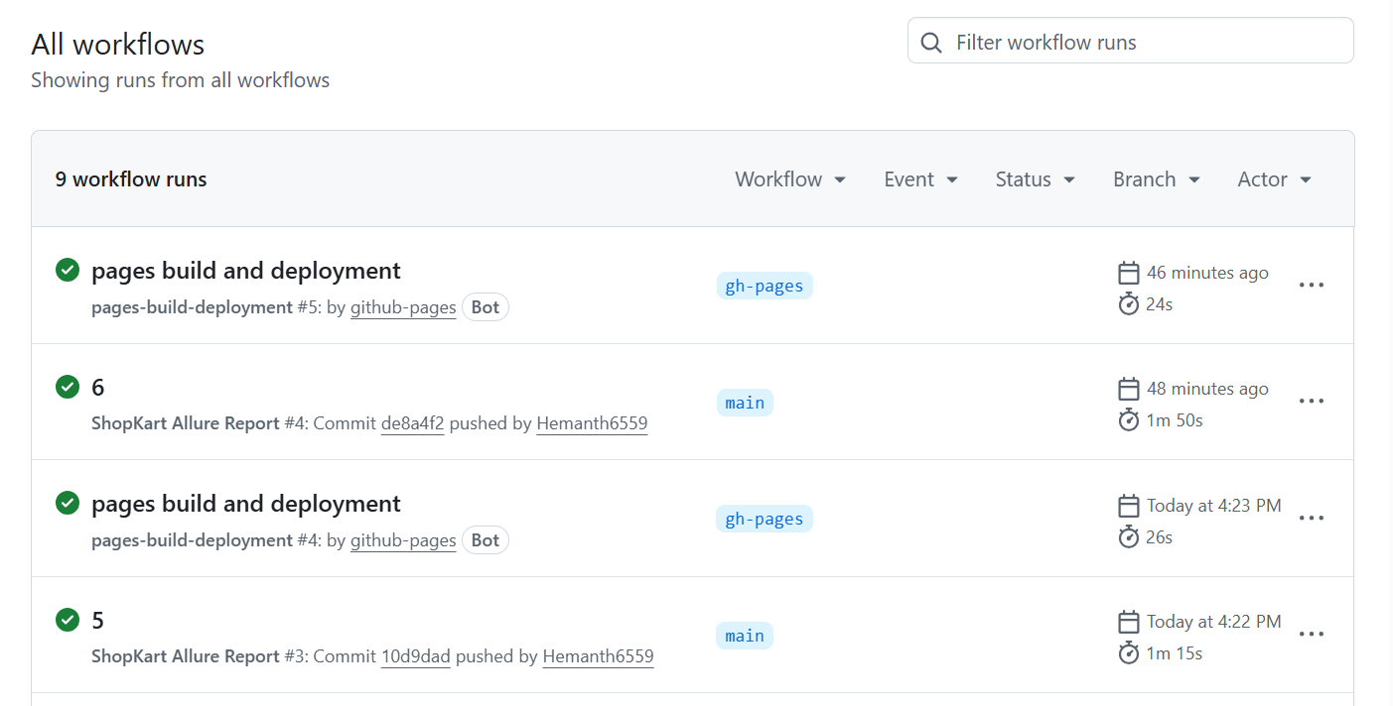
CI/CD Pipeline
Every push triggers a fully automated cycle
Code Push
↓
CI Trigger
↓
Run Tests
CI Pipeline Screenshot
↓
Generate Report
Insert screenshot here
↓
Publish Report
github.com/Hemanth6559/week6gate6.git
6

Slide 7


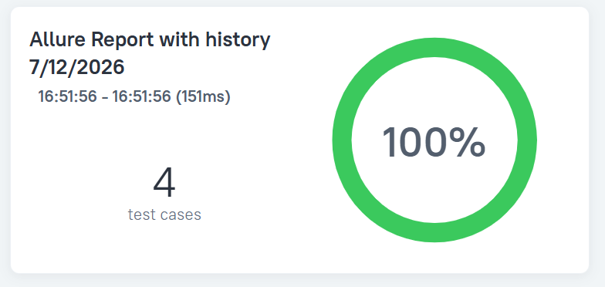
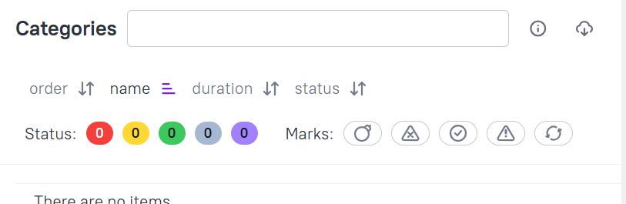
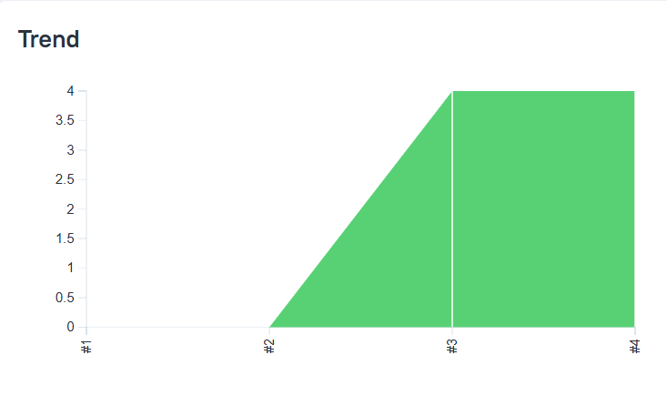
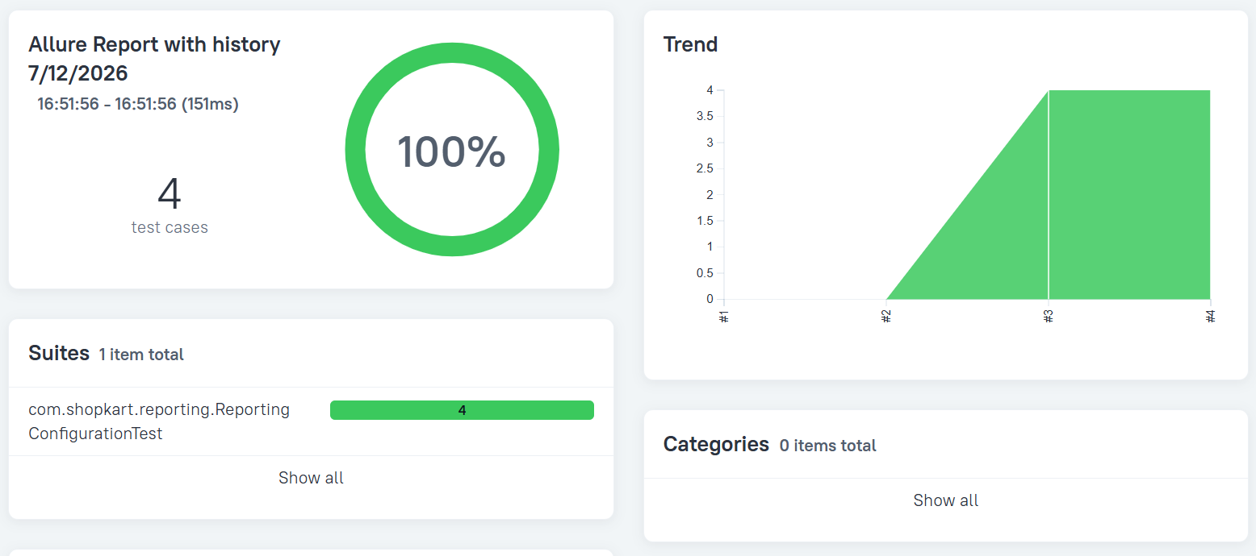
Reporting
One dashboard, four views
Automatic reporting
Failure categorization
Historical trends
Environment details
Overview Screenshot
Categories Screenshot
Insert screenshot here
Insert screenshot here
History / Trend Screenshot
Environment Screenshot
Insert screenshot here
Insert screenshot here
github.com/Hemanth6559/week6gate6.git
7

Slide 8
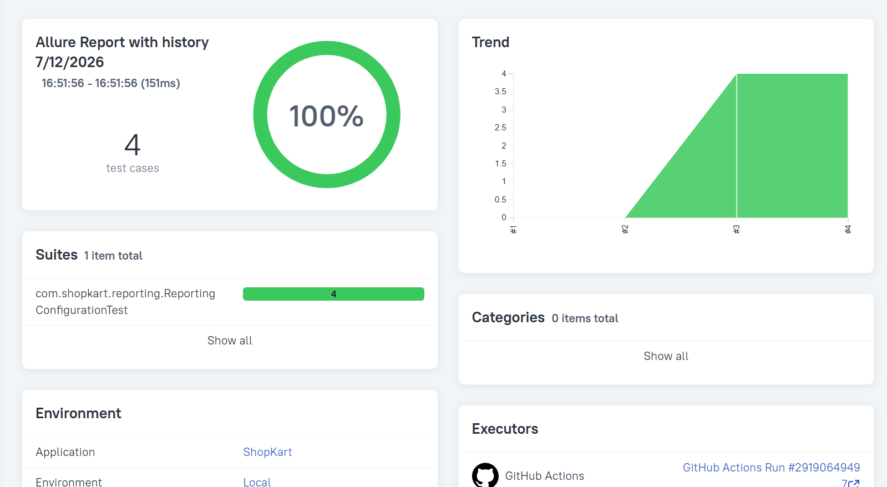
Conclusion
What Gate 6 evidence is in place
UI Automation
API Automation
Database Validation
Security Validation
Final Report Screenshot
Insert screenshot here
CI/CD Integration
Automated Reporting
A gate-ready framework where one order is proven true across UI, API, and Database — with every secret redacted.
github.com/Hemanth6559/week6gate6.git
8

