Slide 1
SHOPKART AUTOMATION
10-Minute Demo
Project: Shopkart-Automation
Focus: real test architecture, clean CI, E2E proof, Allure reporting, security
Rehearsal: live demo from cold container
UI · API · DB · CI · ALLURE · SECURITY

Slide 2
Project overview
One repo, four layers, proven end to end
Shopkart automation covers UI, API, DB, and support layers in one repo.
Stack: Java, Gradle, JUnit 5, Cucumber, Selenide, RestAssured, Testcontainers, Allure.
CI proof lives in ci.yml.
pages
UI
UI page objects
API
api
API clients
This is a real end-to-end automation project — not just one layer.
builders
DB
Data builders
⚙
db
DB support
SHOPKART AUTOMATION
2

Slide 3
Framework architecture
Locators centralized in com.shopkart.ui.locators.Xp
UI
API
B
S
UI layer
API layer
Builders
Shared support
LoginPage, CatalogPage, ProductPage
CartPage, CheckoutPage, OrderPage
Shared XPath locators in Xp
AuthClient, CartClient
OrderClient, ProductClient
HTTP encapsulated via RestAssured
OrderBuilder
CartBuilder
CustomerBuilder — reusable, readable flows
BaseApiTest, BaseE2ETest, Hooks
World object stores Cucumber state
SHOPKART AUTOMATION
3

Slide 4
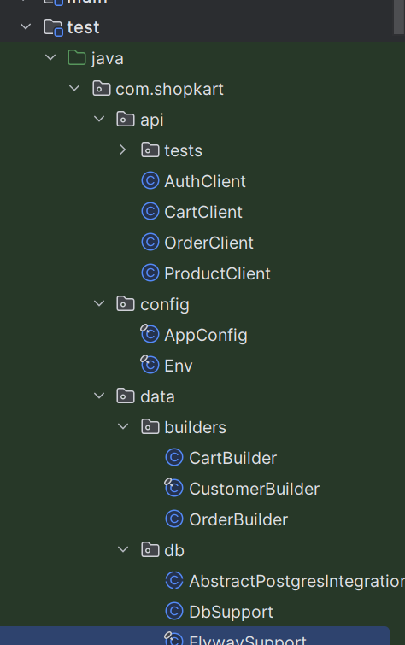
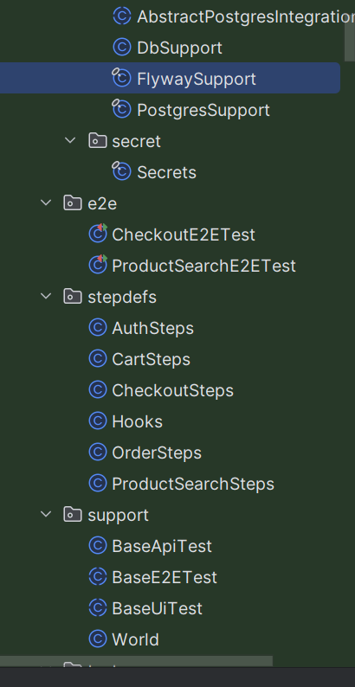
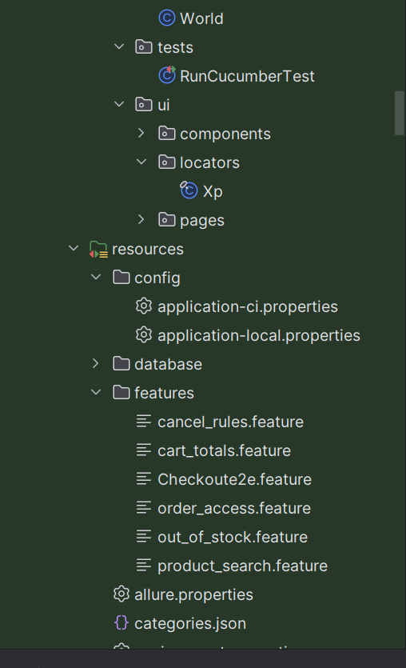

Slide 5
Run the suite
A cold run on a clean container — not a stale local setup
LOCAL
./gradlew clean test cucumber --no-configuration-cache
DB
Real isolation
Postgres Testcontainers starts postgres:16-alpine automatically
CI (ci.yml)
gradle clean test cucumber --no-configuration-cache
No local database dependency
Build uses Gradle properties for baseUrl, headless, browser, and Allure output.
PostgresSupport starts the container if it isn't already running
Same base URL config shared by API and UI tests.
SHOPKART AUTOMATION
4

Slide 6
E2E proof: UI → API → DB
Core scenario: CheckoutE2ETest — one fact proven where it lives
UI
API
✓
UI PATH
API / DB ASSERT
RESULT
Login as alice
Search “Metro Carryall”
Add quantity 2
Checkout with address
UI order status: PLACED
DB row exists for alice
DB status PLACED, total 99800
Address + customer id verified
UI experience proven
API / backend contract proven
Persistent DB state proven
→
→
SHOPKART AUTOMATION
5

Slide 7
Allure reporting & quality insight
Trend widgets only work when history is preserved
CI history pipeline
Useful report views
1
allure.properties enables Allure config
Pass-rate trend
Retry / flaky widget
Category buckets
Executive overview
2
CI generates the report via simple-elf/allure-report-action@master
3
Checkout gh-pages branch
Failure categories map to:
Product defect
Test defect
Flaky
4
Store results in allure-history
Categories keep triage fast: know what's product, what's test, what's noise.
SHOPKART AUTOMATION
6

Slide 8
Redaction & secure attachments
Flat logs are useful, but only after redacting secrets
Never attach raw network logs with secrets to Allure.
!
REDACT BEFORE ATTACHING
Why it matters
Authorization headers
Attach only filtered logs to Allure.
Critical for security and reviewer trust.
Reports stay shareable across teams without exposing credentials.
Bearer tokens
Passwords
SHOPKART AUTOMATION
7

Slide 9
Negative scenario: security boundary
Security tests matter as much as checkout success
OrderSecurityTest proves another customer gets 403
1
→
2
→
3
→
4
Login alice
Create order
Login bob
Request alice’s order
403
Assertions: HTTP 403 · error code ORDER_FORBIDDEN Message:
“The order belongs to another customer”
This validates the authorization boundary, not just the happy path.
SHOPKART AUTOMATION
8

Slide 10
Readiness & risk assessment
SOLID
BIGGEST RISK
Clean layer separation
Reusable builders
Cucumber + JUnit integration
Testcontainers DB isolation
Allure with history and categories
Environment / test-data stability and timing when running across UI + API + DB.
MITIGATION
Isolated Postgres container
Central config in AppConfig
Focused negative checks in security tests
ONE-SENTENCE READINESS
Core checkout and authorization flows are proven repeatably with isolated automation and clear Allure insight.
SHOPKART AUTOMATION
9

Slide 11
Git hub link: Chandana-Burra/Evaluation_Gate6

