Slide 1
WEEK-6 Pre-CAPSTONE ASSESSMENT
ShopKart Automation Framework
Software Testing Automation Capstone — UI, API, Database, CI/CD & Reporting
Java
Gradle
Cucumber
Selenide
REST Assured
MySQL
GitHub Actions
Allure
ShopKart Automation Framework | Week-6 Pre-Capstone Assessment
Saitejakodi/Saiteja_Shopkart_Assessment at Saiteja_Week06_Gate6_Assessment

Slide 2

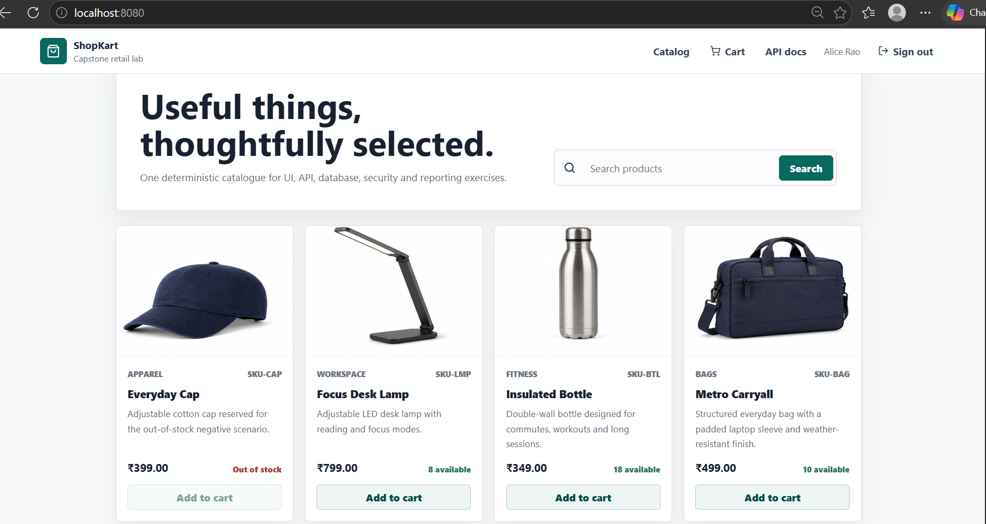



Project Objective
What this capstone project sets out to prove
GitHub Repository :
Saitejakodi/Saiteja_Shopkart_Assessment at Saiteja_Week06_Gate6_Assessment
Automate critical business flows
Validate UI + API + Database
Application Under Test Screenshot
Insert screenshot here
Generate automated CI reports
ShopKart Automation Framework
2

Slide 3

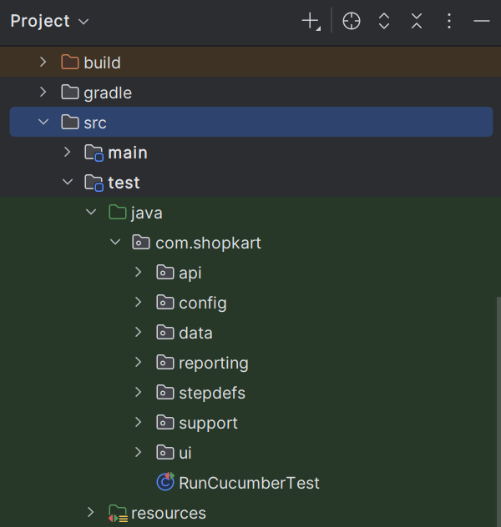



Framework Overview
A simple, layered architecture
Feature Files
↓
Step Definitions
↓
UI | API | Database
↓
Allure Reports
Project Structure Screenshot
Insert screenshot here
↓
GitHub Actions
↓
GitHub Pages
ShopKart Automation Framework
3

Slide 4
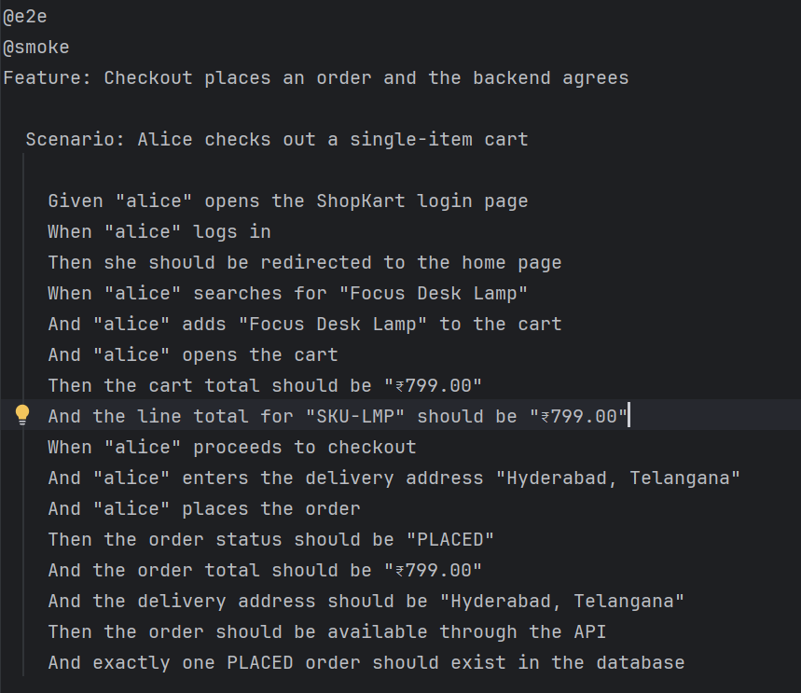

Test Coverage
Six scenarios, validated across three layers
Scenario
UI
API
DB
Product Search
Cart Totals
Checkout E2E
Order Access
Feature Files Screenshot
Insert screenshot here
Cancel Rules
Out of Stock
ShopKart Automation Framework
4

Slide 5

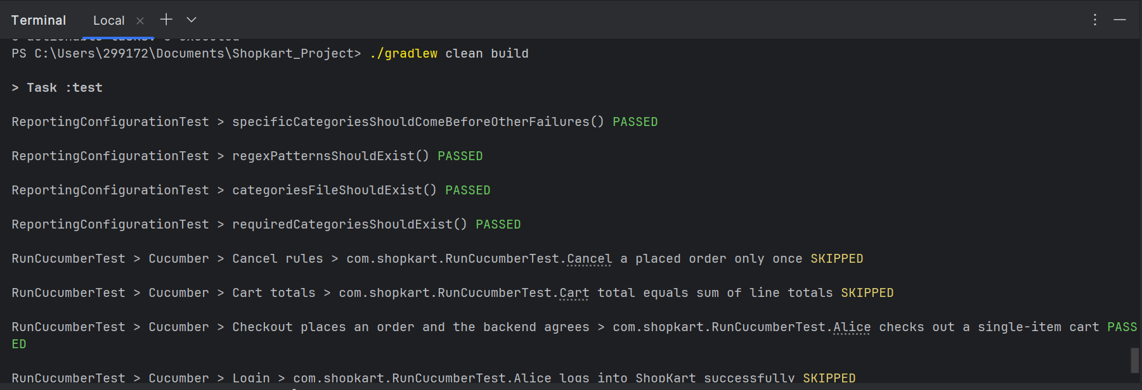
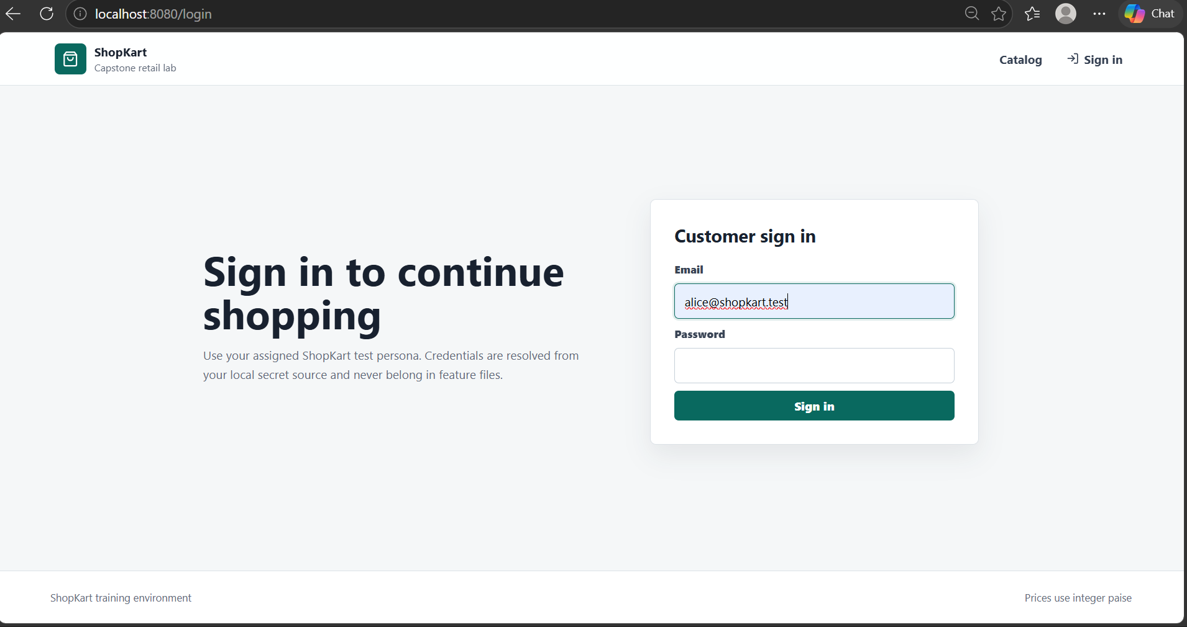
Local Execution
Running the suite on a developer machine
Execute tests using Gradle Tasks
Modular execution using tags
ShopKart Automation Framework
5

Slide 6
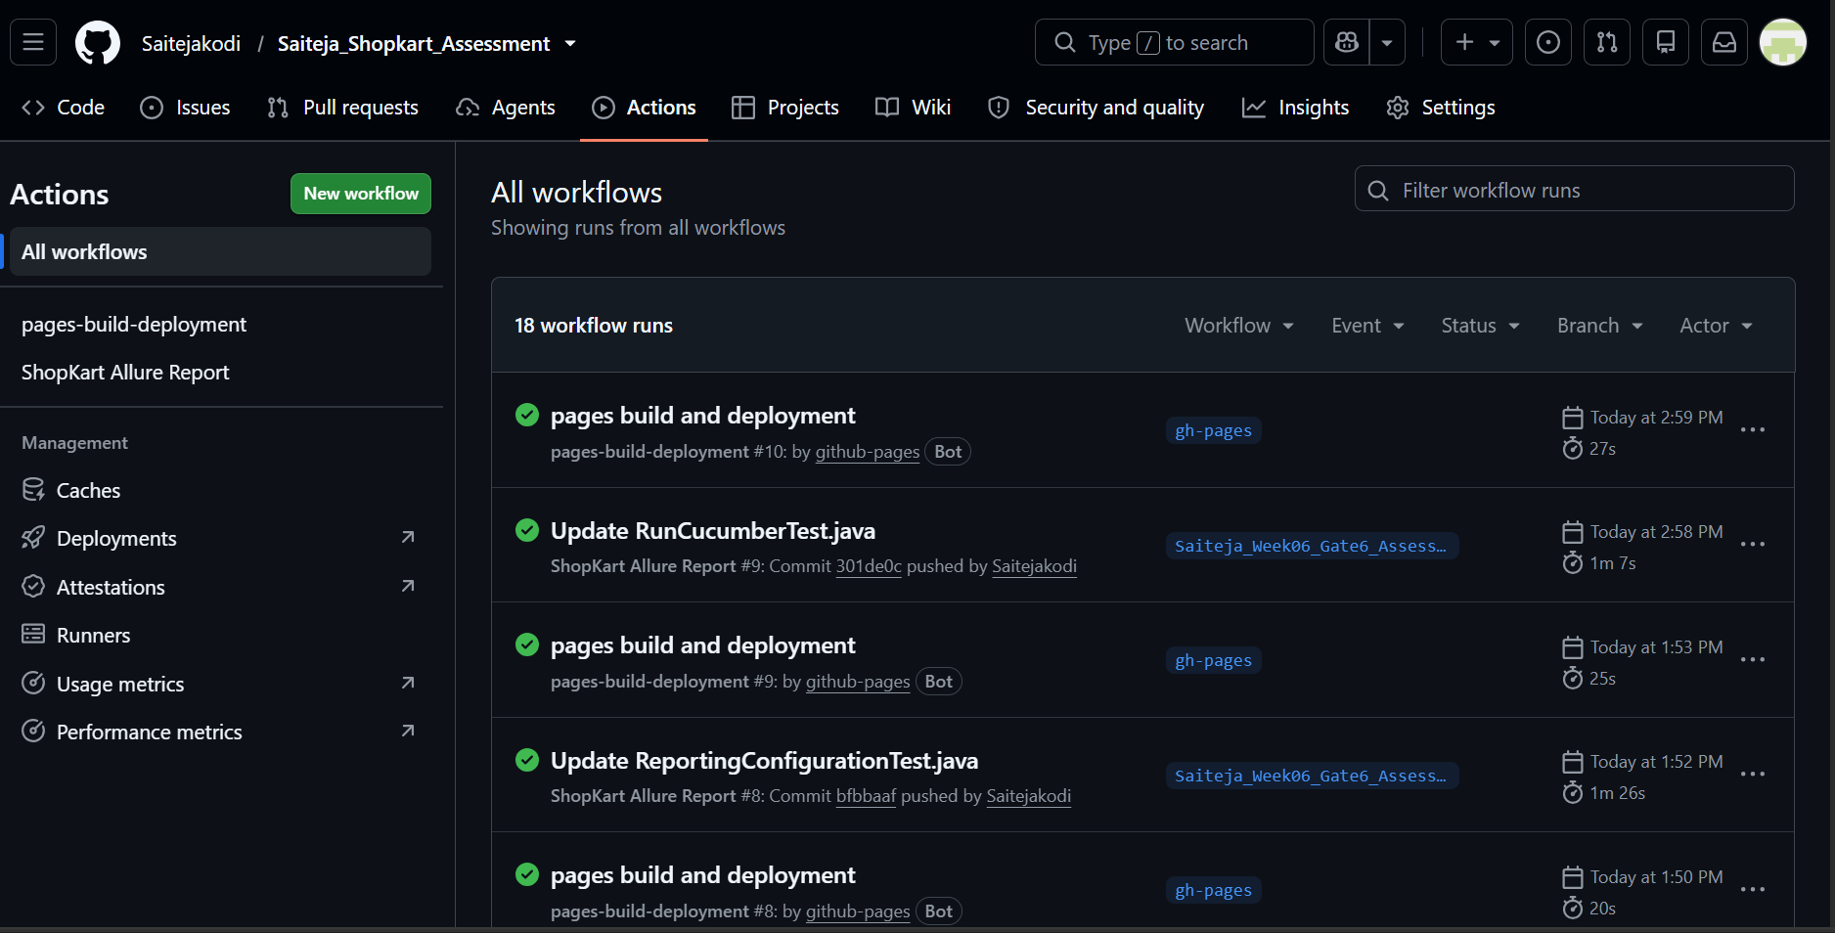
CI/CD Pipeline
Every push triggers a fully automated cycle
Git Push
↓
GitHub Actions
↓
Run Tests
GitHub Actions Screenshot
↓
Generate Allure
Insert screenshot here
↓
Publish GitHub Pages
ShopKart Automation Framework
6

Slide 7


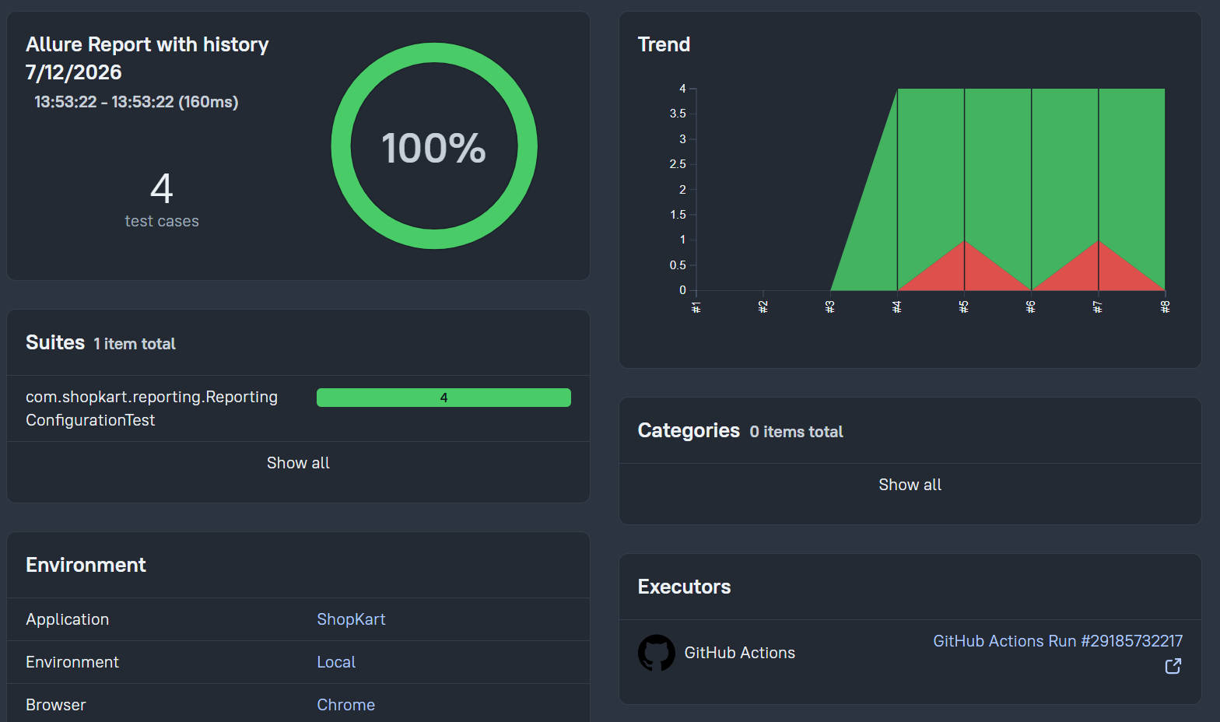
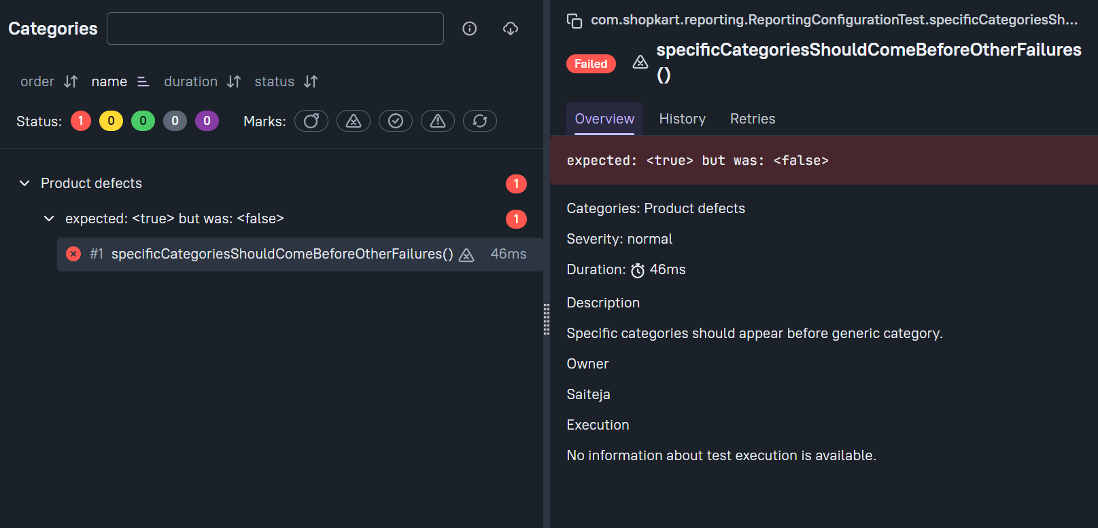
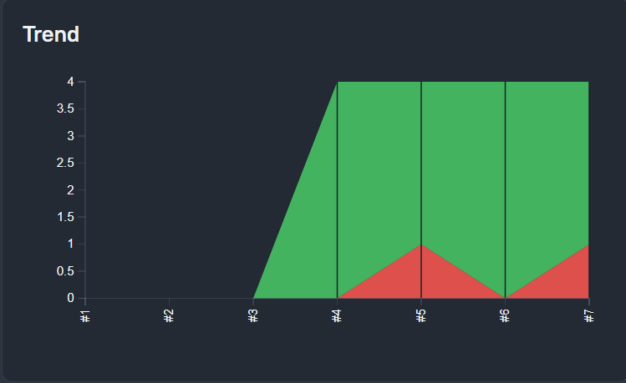
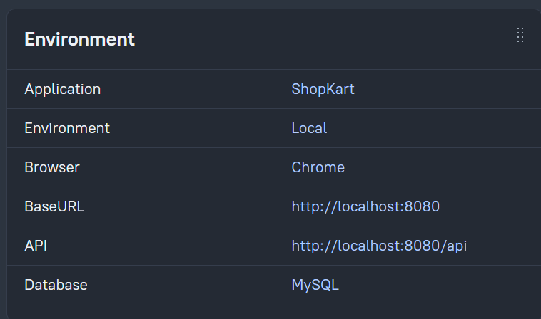
Reporting
One dashboard, four views
Automatic reporting
Failure categorization
Historical trends
Environment details
Overview Screenshot
Categories Screenshot
Insert screenshot here
Insert screenshot here
History / Trend Screenshot
Environment Screenshot
Insert screenshot here
Insert screenshot here
ShopKart Automation Framework
7

Slide 8
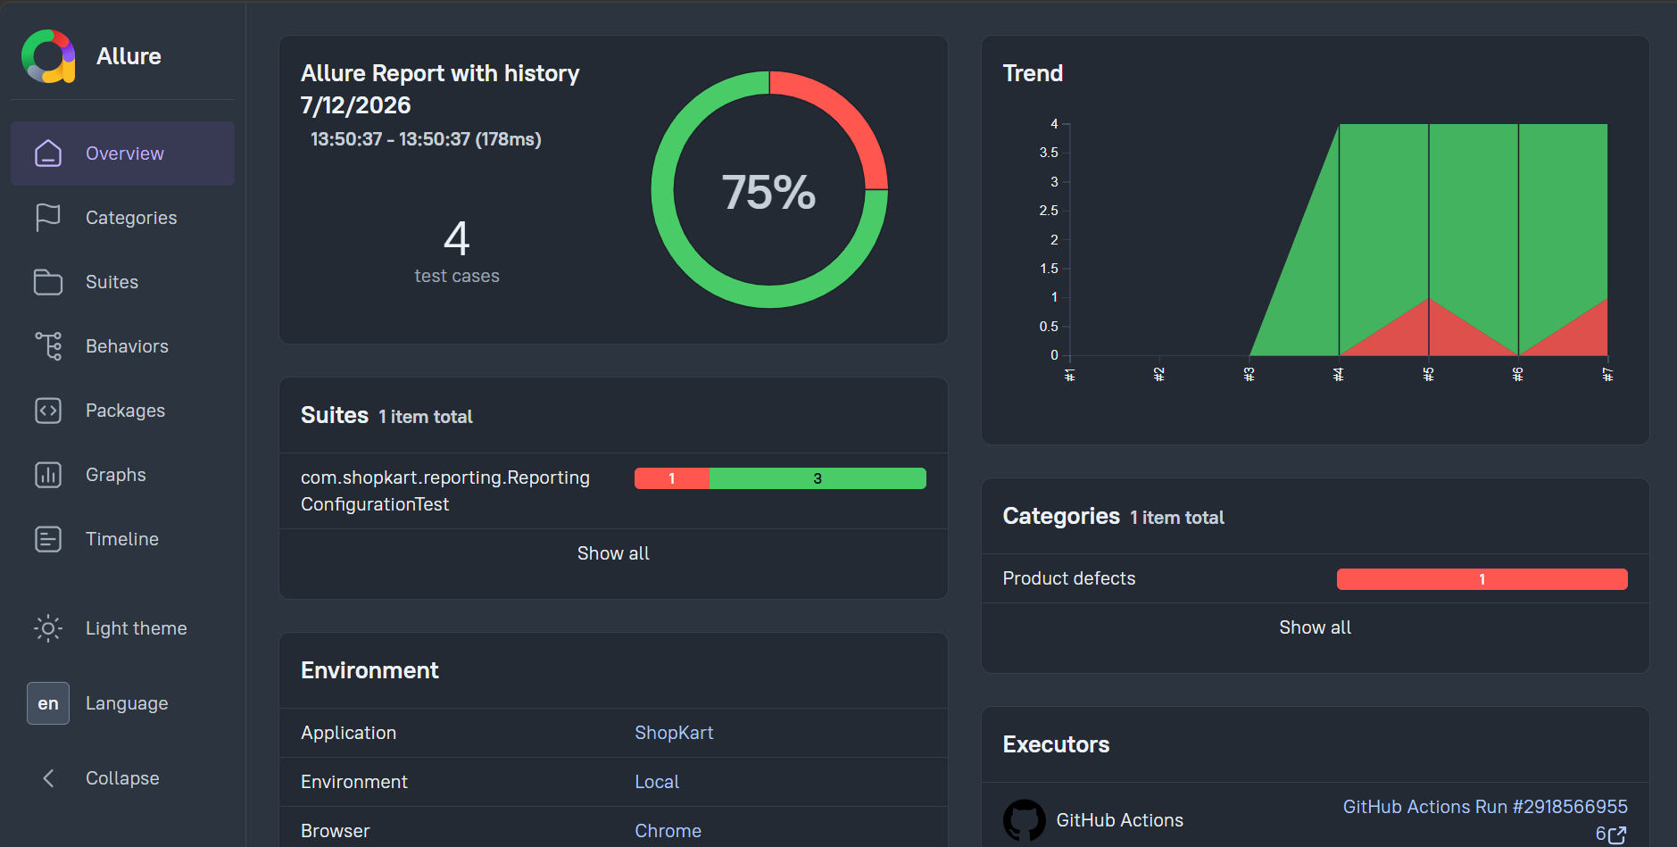
Conclusion
What this capstone demonstrates
UI Automation
API Automation
Database Validation
Security Validation
Final GitHub Pages Report Screenshot
Insert screenshot here
CI/CD
Allure Reporting
Successfully built an end-to-end automation framework validating application behaviour across UI, API and Database.
ShopKart Automation Framework
8

