Slide 1
SDET 7-WEEK AUTOMATION ENGINEERING PROGRAMME · WEEK 6 PRE-CAPSTONE
ShopKart Automation Framework
Software Testing Automation Capstone — UI, API, Database, CI/CD & Reporting
Java 22
Gradle
Cucumber 7
Selenide
REST Assured
MySQL
GitHub Actions
Allure
What I built — a walkthrough of my submitted assessment against the Gate 6 build brief
Repository: github.com/Premchand-302/Premchand-Week6-Assessment Submitted by: Premchand Chellisseril Pramod
github.com/Premchand-302/Premchand-Week6-Assessment
1

Slide 2
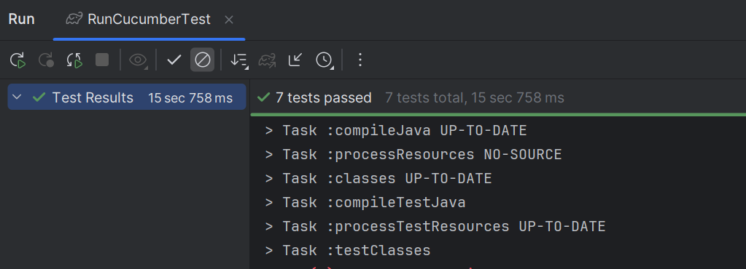




Executive Summary
What this submission delivers, in one paragraph
A Cucumber + REST Assured + Selenide framework automating ShopKart's checkout domain across UI, API, and database layers, wired into a GitHub Actions pipeline that publishes an Allure report with history to GitHub Pages on every push to main.
Layered framework
config / api / ui / data / support / stepdefs — the same separation the gate scores first
Real 3-layer E2E
checkout_e2e.feature verified through the UI, the orders API, and a direct SQL check in one run
Repo Overview / Cucumber Run Screenshot
Insert screenshot here
Off-repo secrets, live CI/CD
Env → Secrets → AppConfig off a git-ignored .env; GitHub Actions deploys Allure history to gh-pages
github.com/Premchand-302/Premchand-Week6-Assessment
2

Slide 3

Stack — As Implemented
Technology choices actually wired up in the repo
Concern | What's actually wired up
Language / runtime | Java 22 (Gradle toolchain)
BDD / runner | Cucumber 7.14 · JUnit Platform Suite
API testing | REST Assured 5.5
UI testing | Selenide 7.9 (dynamic XPath via $x-style locators)
Database | MySQL, via plain JDBC (mysql-connector-j)
Config / secrets | dotenv-java — env var → system property → .env
Build | Gradle Kotlin DSL (build.gradle.kts)
Reporting | Allure 2.35 (Cucumber7, REST Assured, Selenide, JUnit5 adapters)
Notes vs. the Reference Brief
Java 22 + MySQL, where the reference brief specifies Java 21 + PostgreSQL
Secrets resolved via dotenv rather than a custom off-repo Secrets file only — same effect, different library
DB access is direct JDBC — no Testcontainers, so isolation relies on discipline, not a throwaway instance per class
github.com/Premchand-302/Premchand-Week6-Assessment
3

Slide 4
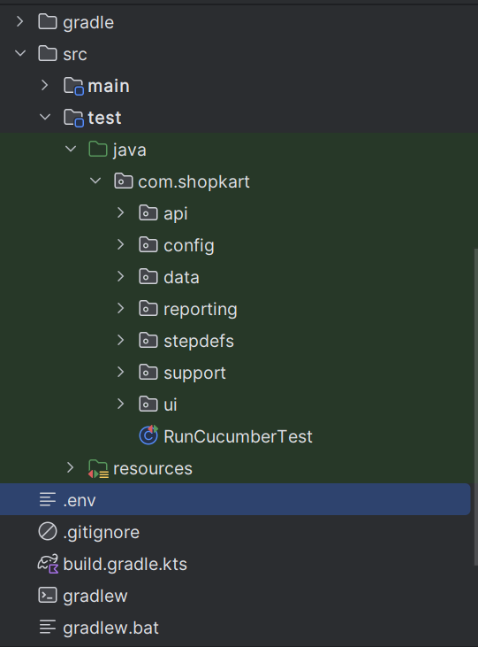





Framework Overview
A layered architecture, as built
Feature Files
7 files, secret-free
↓
Step Definitions
thin glue — no logic
↓
UI | API | Database
Selenide · REST Assured · JDBC
↓
Project Structure Screenshot
Test Reports
Allure, with history
Insert screenshot here
↓
CI Pipeline
GitHub Actions
↓
Published Report
gh-pages
github.com/Premchand-302/Premchand-Week6-Assessment
4

Slide 5
Locator Strategy
Dynamic XPath — what's in the repo
Class | Elements Covered | Representative XPath
LoginLocators | EMAIL, PASSWORD, SIGN_IN, ERROR_MESSAGE | //input[@id='email']
HomeLocators | SEARCH_BOX, PRODUCT_BY_NAME(%s) | //div[...][.//h2/button[normalize-space()='%s']]
CartLocators | CART_LINE(%s), LINE_TOTAL, CART_TOTAL, CHECKOUT | //tr[...][td[normalize-space()='%s']]
CheckoutLocators | address field, place-order button | (same pattern — id / attribute anchored)
OrderLocators | order status, order total | //*[@data-field=...] style attribute anchors
// HomeLocators.PRODUCT_BY_NAME — one template, reused for every product card
public static final String PRODUCT_BY_NAME =
"//div[contains(@class,'product-card')][.//h2/button[normalize-space()='%s']]";
github.com/Premchand-302/Premchand-Week6-Assessment
5

Slide 6
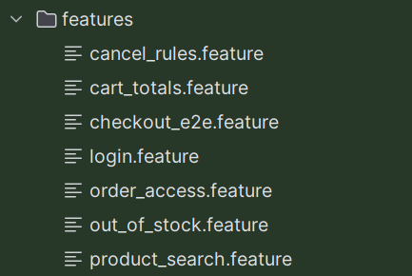
Test Coverage
7 feature files, all passing tags
Scenario | UI | API | DB
login.feature | ✓ | — | —
product_search.feature | ✓ | ✓ | —
checkout_e2e.feature | ✓ | ✓ | ✓
cart_totals.feature | — | ✓ | ✓
order_access.feature | — | ✓ | —
cancel_rules.feature | — | ✓ | ✓
out_of_stock.feature | — | ✓ | —
Feature Files Screenshot
Insert screenshot here
login.feature is an extra beyond the required six — an isolated smoke check the other scenarios build on. Negative scenarios (order_access, cancel_rules, out_of_stock) each assert a specific 403/409 status.
github.com/Premchand-302/Premchand-Week6-Assessment
6

Slide 7



The Flagship E2E, As Written
checkout_e2e.feature — proven three ways in one run
Verified in CheckoutSteps.java
@e2e @smoke
Feature: Checkout places an order and the backend agrees
Scenario: Alice checks out a single-item cart
Given "alice" opens the ShopKart login page
When "alice" logs in
Then she should be redirected to the home page
When "alice" searches for "Focus Desk Lamp"
And "alice" adds "Focus Desk Lamp" to the cart
And "alice" opens the cart
Then the cart total should be "₹799.00"
And the line total for "SKU-LMP" should be "₹799.00"
When "alice" proceeds to checkout
And "alice" enters the delivery address "Hyderabad, Telangana"
And "alice" places the order
Then the order status should be "PLACED"
And the order total should be "₹799.00"
Then the order should be available through the API
And exactly one PLACED order should exist in the database
UI
OrderPage reads status / total straight off the confirmation page
API
orderClient.getOrder(...) asserts id + status == PLACED
DB
OrderRepository confirms the row exists, is PLACED, and is the only PLACED row for that customer
github.com/Premchand-302/Premchand-Week6-Assessment
7

Slide 8

The Security Negative, As Written
order_access.feature — object-level authorization
Why It Matters
@api @negative @security
Feature: Order access
Scenario: Bob cannot access Alice's order
Given Alice has placed an order
When Bob requests that order through the API
Then the response status should be 403
Alice's order is seeded through the real API (createCart → addItem → placeOrder), not a fixture
Bob authenticates as himself, with his own token — the test proves authorization, not just a missing header
The assertion is a single, explicit status-code check: 403
Implementation Note
OrderAccessSteps currently exercises Bob's 403 through the cancel-order endpoint rather than a plain GET on the order. It proves the same object-level authorization boundary, but a literal GET /orders/{id} check would match the reference scenario more exactly.
github.com/Premchand-302/Premchand-Week6-Assessment
8

Slide 9
How Credentials Actually Flow
Secrets & config — off-repo, end to end
Env.java
→
Secrets.java
→
AppConfig.java
→
AuthClient /
DatabaseConfig
Env.get(key) resolves: system env var → system property → .env file (dotenv-java) — throws if still missing.
Repo Hygiene Check
// AppConfig.java — everything sourced off-repo
public static final String BASE_URL =
Secrets.get("SHOPKART_BASE_URL");
public static final String API_BASE_URL =
Secrets.get("SHOPKART_API_BASE_URL");
// AuthClient.java
public LoginResponse loginAsAlice() {
return login(TestUsers.ALICE_EMAIL,
Secrets.get("SHOPKART_ALICE_PASSWORD"));
}
.env is git-ignored
No password literals in feature files
Login / customer emails only — not secrets
Tokens never logged in step defs
github.com/Premchand-302/Premchand-Week6-Assessment
9

Slide 10

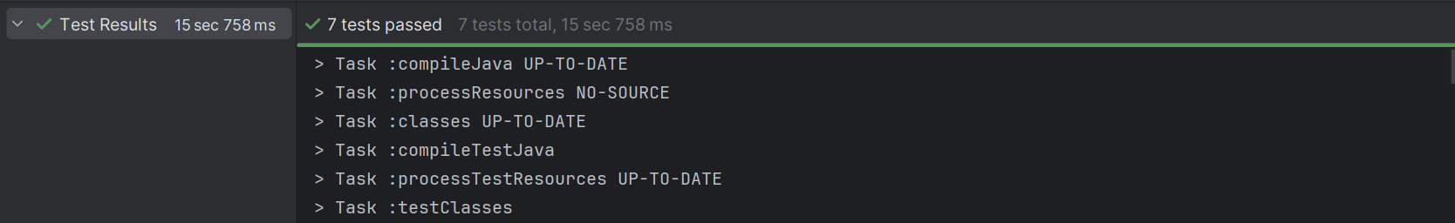
Local Execution
Tag-scoped Gradle tasks — running the suite on a developer machine
Execute tests using Gradle
Modular execution using tags / groups
build.gradle.kts registers one task per tag, so any slice of the suite runs on its own:
./gradlew test
./gradlew api
./gradlew ui
./gradlew db
./gradlew negative
./gradlew security
./gradlew e2e
./gradlew reporting
Test Execution Screenshot
Running Application Screenshot
Insert screenshot here
Insert screenshot here
github.com/Premchand-302/Premchand-Week6-Assessment
10

Slide 11

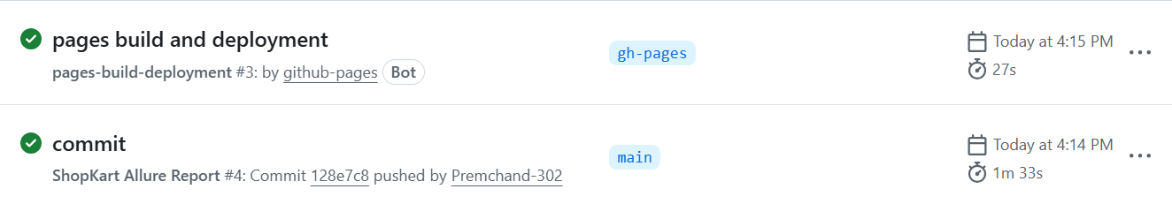
CI/CD Pipeline
Every push triggers a fully automated cycle
→
→
→
→
Code Push
CI Trigger
Run Tests
Generate Report
Publish Report
Push to main
actions/checkout, temurin JDK 22
gradle reporting
results → build/allure-results
deploy to gh-pages
CI Pipeline Screenshot
Insert screenshot here
Result: an always-current, history-tracked Allure report on gh-pages — no manual report generation required.
github.com/Premchand-302/Premchand-Week6-Assessment
11

Slide 12
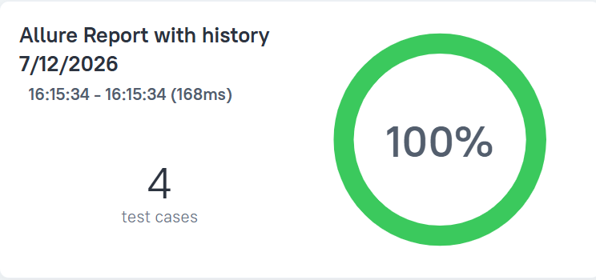


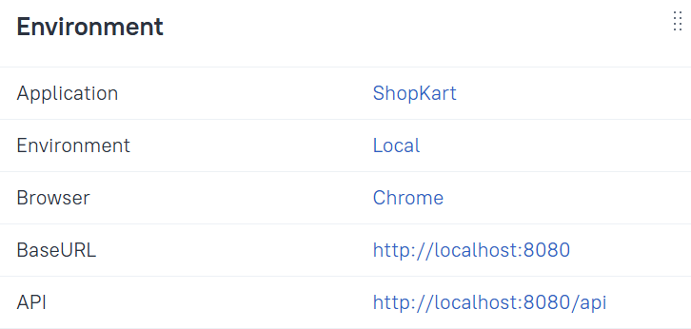
Reporting
One Allure dashboard, four views
Automatic reporting
Failure categorization
No Tests Failed
Overview Screenshot
Insert screenshot here
Historical trends
Environment details
History / Trend Screenshot
Environment Screenshot
Insert screenshot here
Insert screenshot here
github.com/Premchand-302/Premchand-Week6-Assessment
12

Slide 13
Self-Assessment
What's solid, what I'd tighten next
Solid
To Tighten
Real three-layer proof on the flagship E2E — UI, API, and a direct SQL check all in one run
No Testcontainers — DB tests share a real MySQL instance, so isolation depends on cleanup discipline
Config and secrets never hardcoded — one Env / Secrets / AppConfig chain, .env git-ignored
order_access.feature proves 403 via the cancel endpoint, not a literal GET /orders/{id}
Every locator is relative, attribute- or text-anchored, and parameterized where reused
Committed allure-results show a 'broken / no tests discovered' run — worth cleaning before the next push
CI already deploys a history-tracked Allure report automatically — most cohorts do this by hand
Stack drifts slightly from the reference brief (Java 22 vs 21, MySQL vs Postgres) — worth calling out explicitly
github.com/Premchand-302/Premchand-Week6-Assessment
13

Slide 14
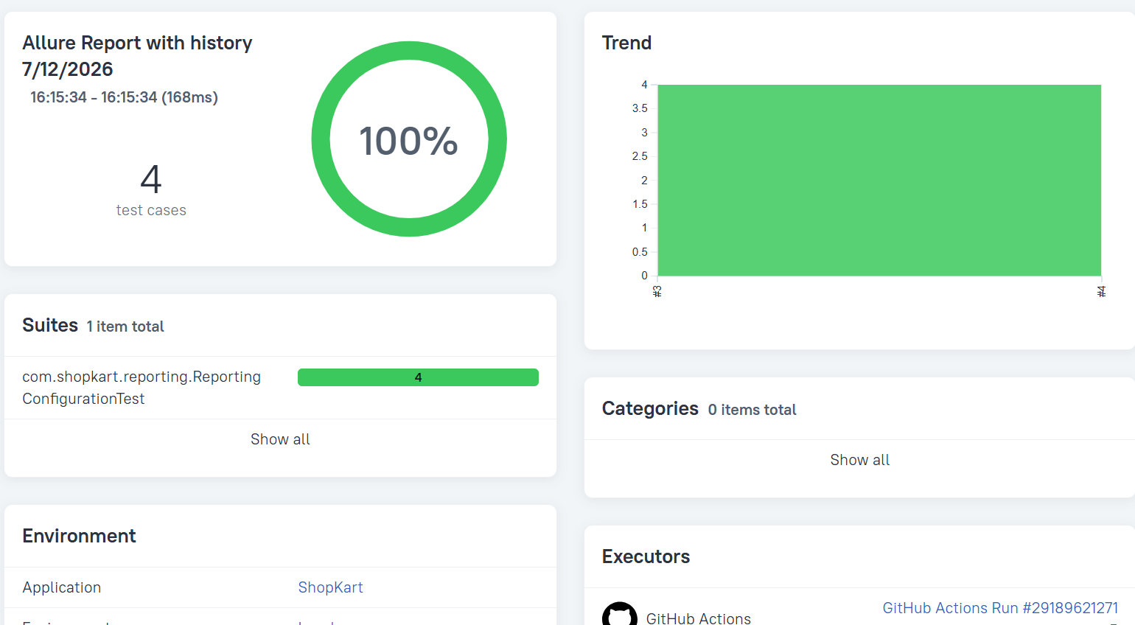
Conclusion
What this framework demonstrates
UI Automation
API Automation
Database Validation
Security Validation
Final Report Screenshot
CI/CD Integration
Insert screenshot here
Automated Reporting
A working, CI-integrated automation framework covering UI, API, database and security for ShopKart's checkout flow.
github.com/Premchand-302/Premchand-Week6-Assessment
14

