Slide 1
GATE 6 · BENCHMARK 4
Pre-Capstone Automation Review
ShopKart SDET Framework — Structure, Dynamic XPath & Secret-Safe Test Data
Java 21 · Cucumber 7 / JUnit 5 · REST Assured · Selenide · Testcontainers · PostgreSQL · Gradle · Allure
Jai Singh
Week 6 · Day 6 · Project-Team Reference

Slide 2
What I'll Walk Through
10-minute demonstration structure
01
02
03
System Under Test
Framework Structure
Dynamic XPath Locators
ShopKart — API + Web UI + PostgreSQL
Layered architecture reviewed first
One templated locator class
04
05
06
Six Scenarios
Secret Data Handling
Allure Reporting & Live Demo
UI, API, DB & security layers
Never in repo, logs, or on screen
History, categories, redaction
ShopKart SDET Automation · Week 6 Pre-Capstone
2

Slide 3
The System Under Test — “ShopKart”
A minimal e-commerce checkout service — REST API + Web UI, backed by PostgreSQL
UI
{ }
DB
Web UI
REST API
Database
http://localhost:8080
http://localhost:8080/api
postgres://localhost:5432/shopkart
Rendered pages, driven via dynamic XPath ($x())
JSON responses, Bearer-token auth on cart/order routes
Tests never touch this directly — Testcontainers gives each class its own
Data model
customers · products · carts · cart_items · orders — money stored in paise (₹499.00 = 49900)
Seeded logins & products
Persona | Login | Key SKUs (price → stock)
alice | alice@shopkart.test | SKU-BAG → ₹499 · 10 | SKU-PEN → ₹99 · 100
bob | bob@shopkart.test | SKU-MUG → ₹249 · 3 | SKU-CAP → ₹399 · 0 (out of stock)
carol | carol@shopkart.test | SKU-TEE → ₹599 · 25 | SKU-KEY → ₹149 · 50
ShopKart SDET Automation · Week 6 Pre-Capstone
3

Slide 4
Locked Stack — Week 6
Same automation stack carries into the Week-7 capstone
Language / runtime
Java 21 (LTS)
BDD / runner
Cucumber 7 · JUnit Platform
API testing
REST Assured
UI testing
Selenide (dynamic XPath via $x())
Data / isolation
Testcontainers 2 · PostgreSQL · Flyway
Build
Gradle (primary) · Maven (variant)
Reporting
Allure — history, categories, exec view
ShopKart SDET Automation · Week 6 Pre-Capstone
4

Slide 5
Framework Structure — Scored First
Clean layering, as implemented in com.shopkart — matches the reviewer's first checkpoint
api
config
data
ui
support · runner · stepdefs
• AuthClient
• AppConfig
• builders/ CartBuilder
• components/ Header
• BaseApiTest · BaseUiTest
• BaseApi
• Env
• builders/ CustomerBuilder
• components/ ProductCard
• DriverFactory · Hooks · WorldContext
• CartClient
• builders/ OrderBuilder
• locators/ Xp
• runner/ TestRunner
• OrderAssertions
• db/ DatabaseHelper
• pages/ CartPage · CheckoutPage
• stepdefs/ 9 step classes (thin glue)
• OrderClient
• db/ FlywaySupport
• pages/ HomePage · LoginPage · OrderPage
• ProductClient
• db/ MySqlSupport
• secret/ Secrets
ShopKart SDET Automation · Week 6 Pre-Capstone
5

Slide 6
Dynamic XPath — The Locator Standard
Relative, attribute/text-anchored, parameterized — one class, no absolute or index paths
public final class Xp {
public static final String PRODUCT =
"//div[contains(@class,'product')][.//*[normalize-space()='%s']]";
public static final String ADD_TO_CART = PRODUCT + "//button[normalize-space()='Add to cart']";
public static SelenideElement product(String name) { return $x(String.format(PRODUCT, name)); }
public static SelenideElement addToCart(String name) { return $x(String.format(ADD_TO_CART, name)); }
}
✓
Relative & anchored
Built on stable attributes or visible text — never brittle absolute paths
✓
Templated
One expression (%s) reused across every product/cart row
✗
Failure mode to avoid
Absolute or index-based paths (//div[3]/span[2]) — the project's explicit anti-pattern
ShopKart SDET Automation · Week 6 Pre-Capstone
6

Slide 7
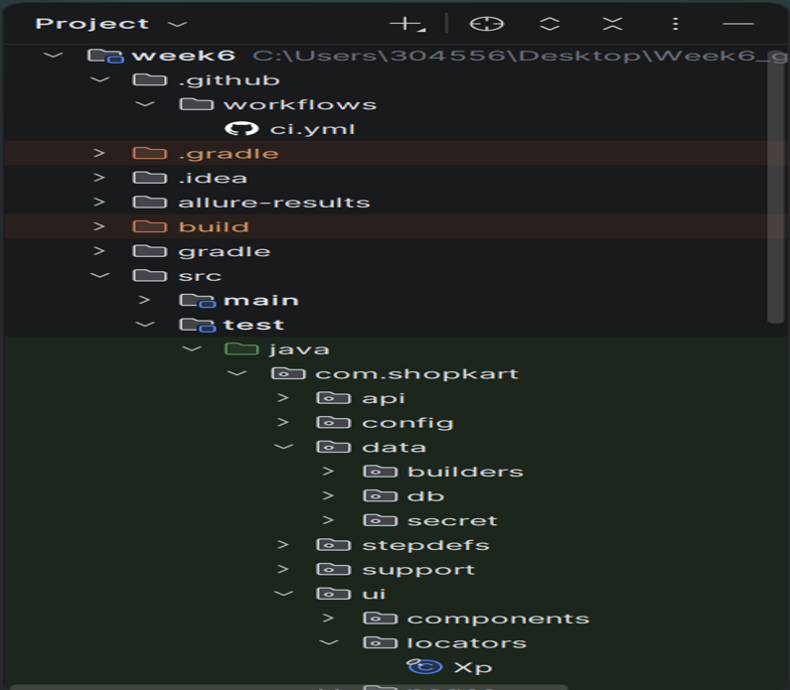
Folder Structure
\
✓
✓
✗
ShopKart SDET Automation · Week 6 Pre-Capstone
6

Slide 8
Six Scenarios Across Every Layer
UI, API, database and a security negative — what the gate checks
# | Feature | Proves | UI | API | DB | Neg. | Priority
1 | Product search | Search returns matching products | ✓ | ✓ | — | — | P1
2 | Cart totals | Total = Σ(qty × price), paise | — | ✓ | ✓ | — | P1
3 | Checkout E2E | Login→search→add→cart→checkout→PLACED | ✓ | ✓ | ✓ | — | P0
4 | Order access | Owner 200; another customer 403 | — | ✓ | — | 403 | P0
5 | Cancel rules | PLACED→CANCELLED; again→409 | — | ✓ | ✓ | 409 | P1
6 | Out of stock | Add qty > stock → 409 | — | ✓ | — | 409 | P2
Do not push everything through the UI — automate on the layer that proves the fact.
ShopKart SDET Automation · Week 6 Pre-Capstone
7

Slide 9
The Flagship E2E — One Fact, Three Layers
checkout_e2e.feature — secret-free; password resolved inside the step
UI
The order confirmation shows PLACED
@e2e @smoke
Feature: Checkout places an order and the backend agrees
Scenario: A logged-in customer checks out a two-item cart
Given "alice" is logged in
And she adds 2 x "SKU-BAG" (49900 paise each) to her cart
When she checks out with a valid address
Then the order confirmation shows status "PLACED"
And GET /api/orders/{id} returns PLACED and totalPaise 99800
And the orders table has exactly one PLACED row for alice
API
GET /api/orders/{id} confirms the same order & total
DB
Exactly one PLACED row exists for alice
Note: the feature names “alice” — never her password.
ShopKart SDET Automation · Week 6 Pre-Capstone
8

Slide 10
The Security Negative — Do Not Skip
Object-level authorization: orders are visible only to their owner
@api @negative @security
Feature: Orders are visible only to their owner
Scenario: Another customer cannot read someone else's order
Given "alice" has a PLACED order
When "bob" requests GET /api/orders/{that id}
Then the response status is 403
!
403, never 200, never the body
A valid token on another customer's object must be rejected — this is the object-level authorization case the gate specifically checks.
Auth model recap
Condition | Result
No / invalid token | 401 Unauthorized
Valid token, wrong owner | 403 Forbidden
Valid token, correct owner | 200 OK
ShopKart SDET Automation · Week 6 Pre-Capstone
9

Slide 11
Test-Data Strategy
Seed the baseline, build per test, isolate every run
1
2
3
4
Seed public data
Build per-test data
Isolate
Stay idempotent
Flyway
Builders
Testcontainers
Clean container
V1__schema.sql + V2__seed.sql create tables & insert products / customers. Runs on every container start — identical baseline everywhere.
CustomerBuilder · CartBuilder · OrderBuilder — never shared fixtures. A test states only what it cares about.
Each test class gets its own throwaway Postgres — kills the “3 orders / now 5” flake.
Re-running from a clean container always gives the same result.
SKU-CAP has stock 0 — reserved for the out-of-stock negative (Scenario 6)
ShopKart SDET Automation · Week 6 Pre-Capstone
10

Slide 12
Secret Data — Never in the Repo, Logs, or Demo
Passwords, tokens, payment/UPI details, PII — sourced off-repo and resolved only where consumed
Never in Git — secrets.local.properties is git-ignored; commits scanned with gitleaks
public final class Secrets {
// env var -> CI secret store -> secrets.local.properties
public static String get(String key) { ... }
// callers MUST NOT log the return value
}
auth.login("alice@shopkart.test",
Secrets.get("alice.password"));
Mask everywhere — logs, console, Allure attachments & screenshots show ****
Dedicated, rotated test accounts — never a real user's credentials
Feature files stay secret-free — reference the persona; the step resolves it at runtime
ShopKart SDET Automation · Week 6 Pre-Capstone
11

Slide 13
Reporting — Allure, With Redaction
Trend, categories, executive overview — never a leaked secret
1
Categories
2
History
categories.json buckets failures: Product defect (assertion), Test defect (broken locator / 500), Flaky (passed on retry).
Restore the previous report's history/ in CI so trend and retry widgets populate across runs.
3
Executive view
4
Redacted attachments
One glance: pass-rate trend, flaky rate, risk by area.
A filter replaces Authorization headers, tokens & passwords with **** before any attachment is written.
Golden rule: never attach a raw network log carrying a bearer token.
ShopKart SDET Automation · Week 6 Pre-Capstone
12

Slide 14
The 10-Minute Demo — Rehearsed Sequence
Against a clean container — the gate scores what is shown and explained live
1
0–2 min
Framework tour
Layers, Xp locators, builders, base classes
2
2–4 min
Run the suite
./gradlew test — Testcontainers spins Postgres, all green
3
4–6 min
The E2E
Scenario 3, UI→API→DB — one order proven three ways
4
6–8 min
Allure report
Trend, categories, a triaged flaky, executive overview
5
8–9 min
The negative
Scenario 4 — another customer gets 403
6
9–10 min
Readiness
One honest sentence: what's solid, biggest capstone risk
ShopKart SDET Automation · Week 6 Pre-Capstone
13

Slide 15
Gate Evidence Checklist
What I'm bringing to Gate 6
✓
Green suite run from a cold start (Testcontainers, no local DB)
✓
Framework structure matching the standard, Xp locator class, thin steps
✓
Allure report with history (≥3 runs), categories, environment — no secrets in attachments
✓
Filled test matrix across all six scenarios
✓
Data-isolation proof — run twice, identical results, no leftover rows
✓
Secret handling proof — nothing in repo/features, Secrets resolver in use, clean gitleaks scan
✓
The security negative (403) passing
✓
A rehearsed demo, recording verified secret-free
ShopKart SDET Automation · Week 6 Pre-Capstone
14

Slide 16
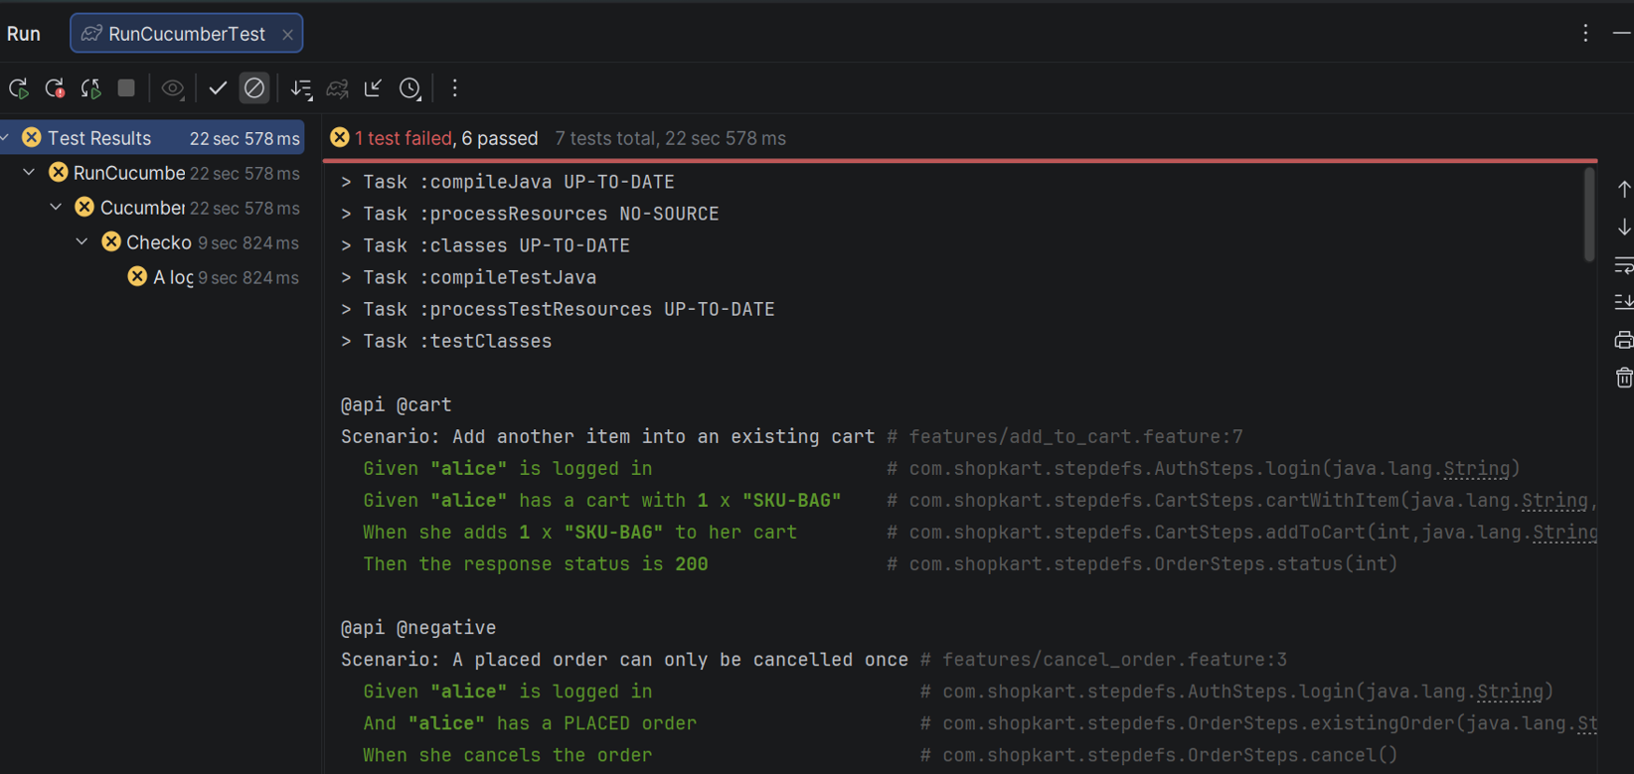
14

Slide 17
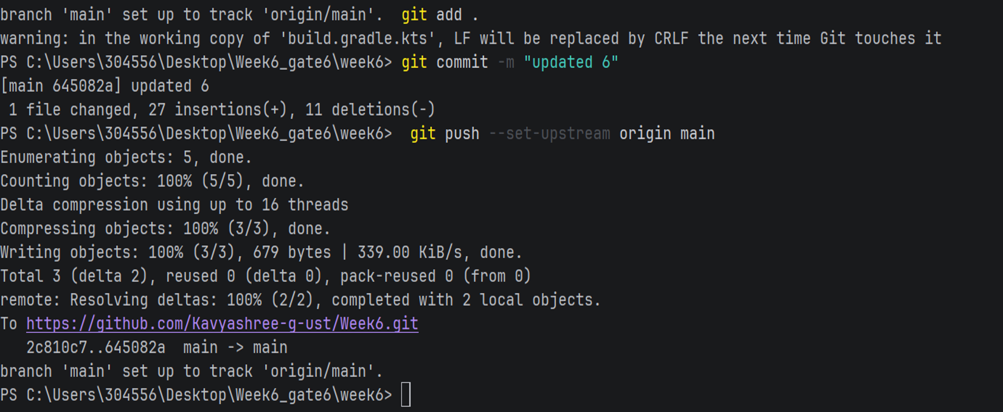
14

Slide 18
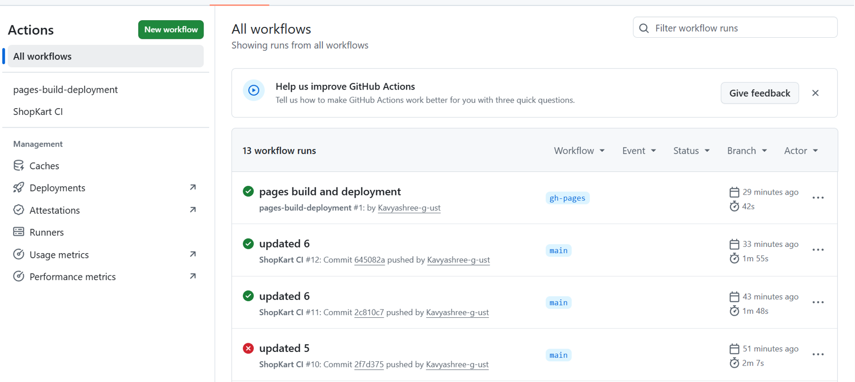
14

Slide 19
What's Solid — and the Biggest Capstone Risk
Structure, locators, and secret handling are gate-ready. Watching Allure history continuity and DB-isolation timing heading into Week 7.
Thank you — questions welcome

