Slide 1
WEEK 6 · GATE 6 · SDET TRAINING
Shopkart Test
Automation Framework
API + BDD + DB verification, wired into Allure & Extent reporting,
shipped through a GitHub Actions CI/CD pipeline.
REST Assured
Cucumber BDD
MySQL Verify
Allure Report
GitHub Actions

Slide 2
TODAY'S WALKTHROUGH
What We'll Cover
1
Project Architecture
Layered package structure: API clients, builders, config, models, reporting, step defs, support, UI page objects.
2
Test Coverage
REST Assured API tests, Cucumber BDD features, and a full checkout E2E flow with direct DB verification.
3
Reporting Stack
Allure (categories, history, trend) running side-by-side with an ExtentReports Spark HTML report.
4
CI/CD Pipeline
GitHub Actions: MySQL service container, Gradle test run, Allure report build, publish to GitHub Pages.
5
Live Demo
Trigger a run, watch it go green, open the published Allure report with real history.
02

Slide 3
GITHUB LINK FOR CI/CD
updated tests · https://github.com/304483/shopkartassessnmentsaturday
GITHUB LINK FOR ACTIONS PAGES
updated tests · https://github.com/304483/shopkartassessnmentsaturday/actions/runs/29195568364/job/86657799651
ALLURE REPORT
https://304483.github.io/shopkartassessnmentsaturday/2/index.html

Slide 4
COVERAGE
Four Ways We Prove It Works
API Tests
BDD Features
REST ASSURED
CUCUMBER
TotalCartApiTest, ProductApiTest, OutOfStockApiTest, OrderAccessApiTest, CancelOrderApiTest — status codes, payload assertions, ownership rules.
checkout.feature and search.feature, glued to CheckoutSteps / SearchProductsSteps under com.ust.shopkart, run via RunCucumberTest.
End-to-End Flow
Database Verification
CHECKOUTE2ETEST
DBSUPPORT
Login → search → cart → place order → fetch order, each phase traced as an Allure @Step with attached evidence.
Every API-level assertion is cross-checked directly against MySQL — cart quantities, unit prices, order status and totals.
04

Slide 5
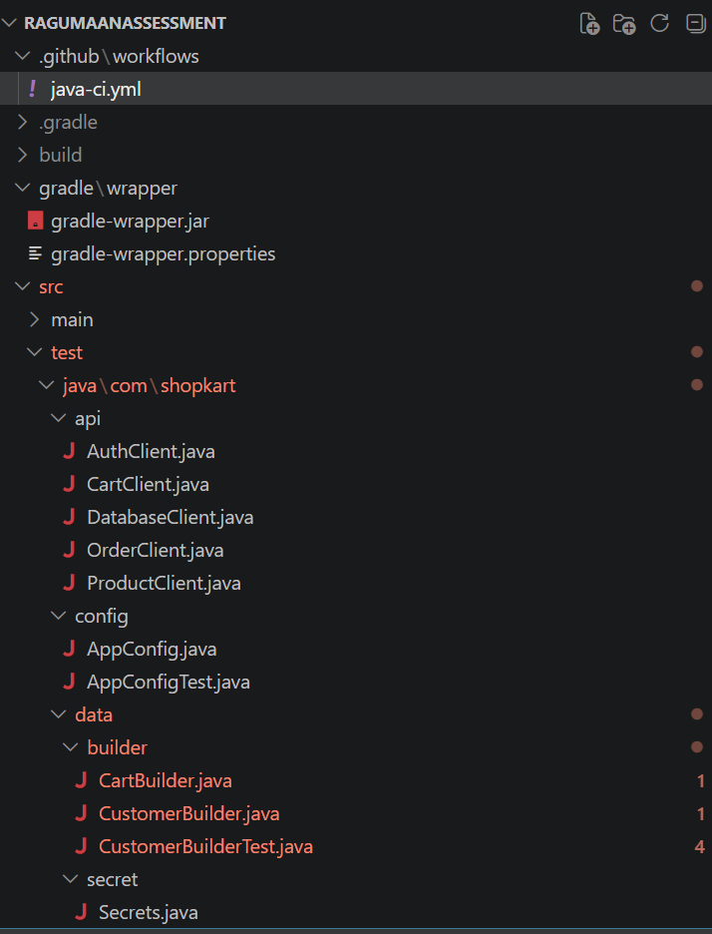
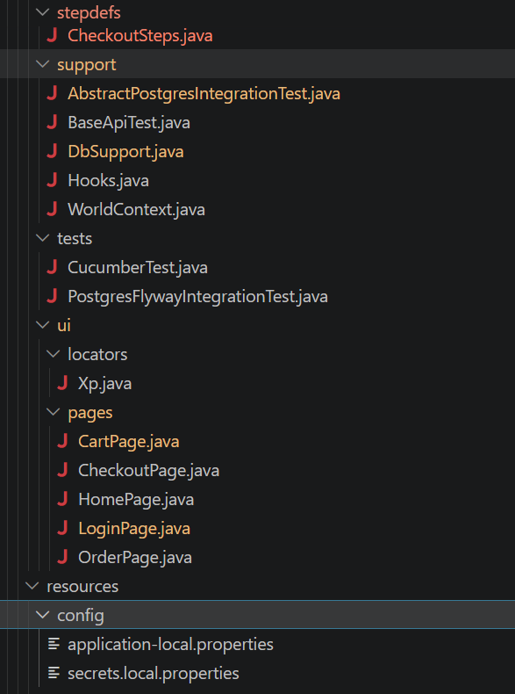
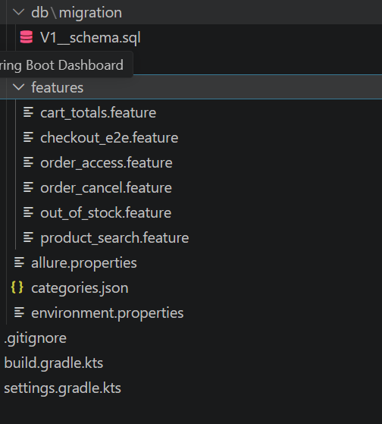
Folder Structure(Framwork)

Slide 6
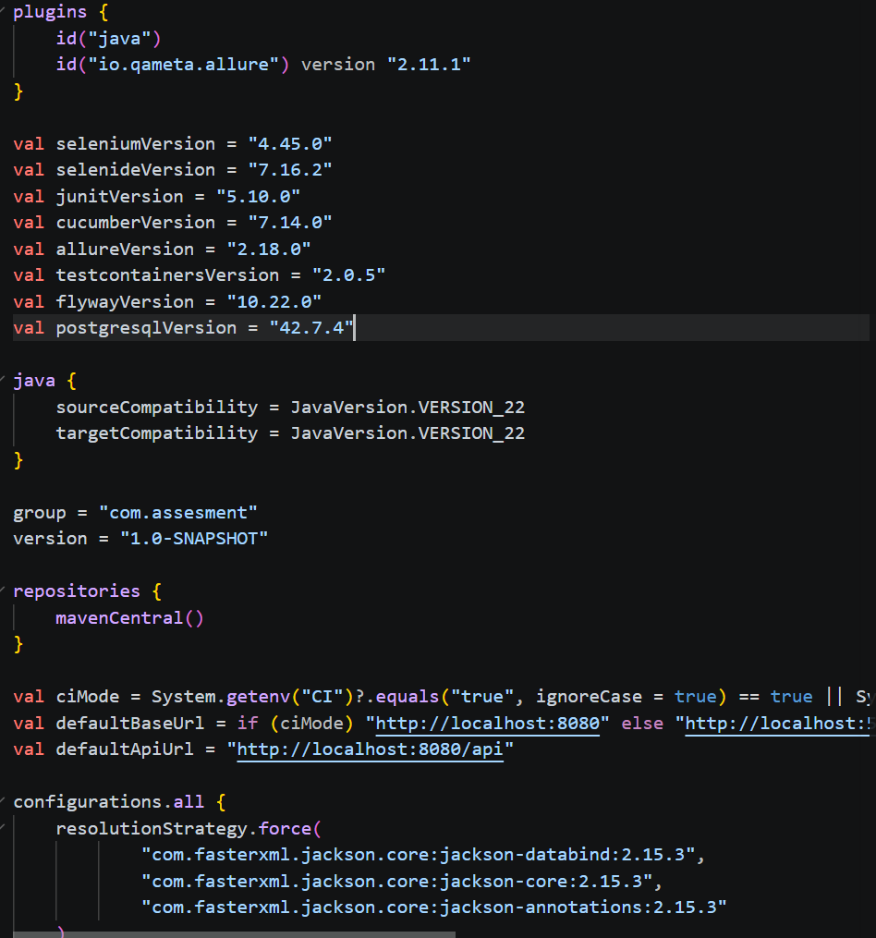
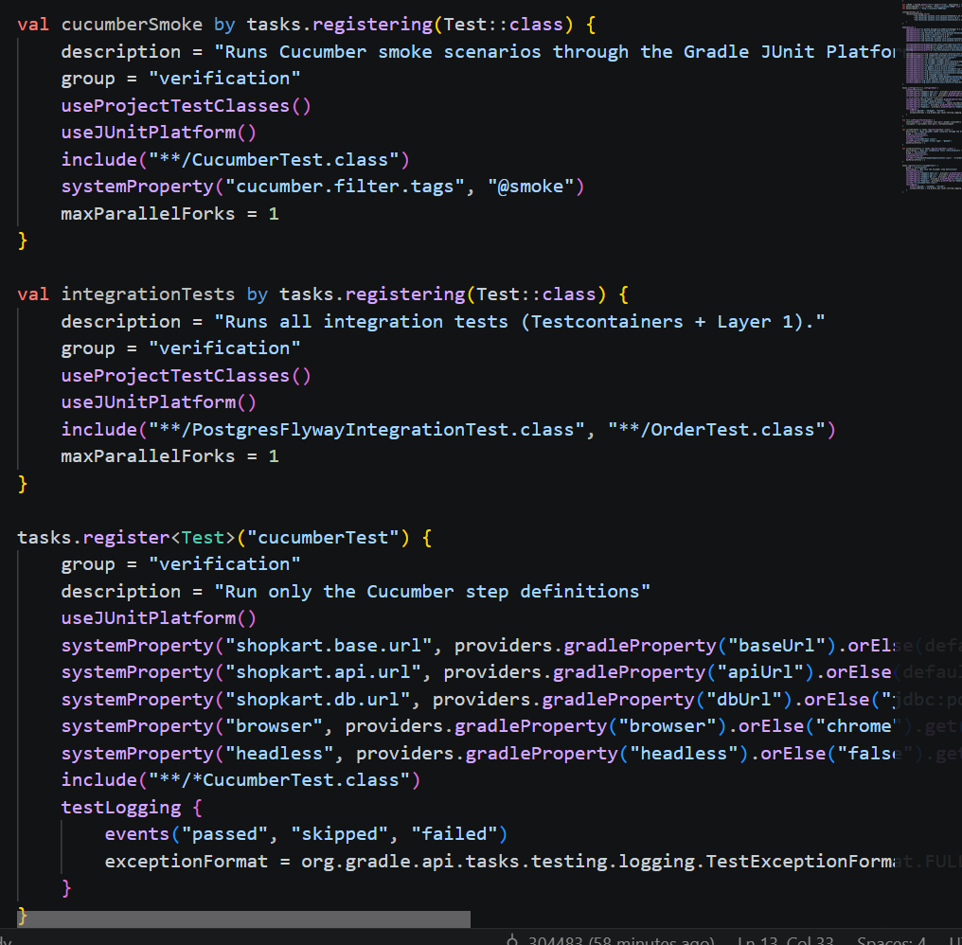
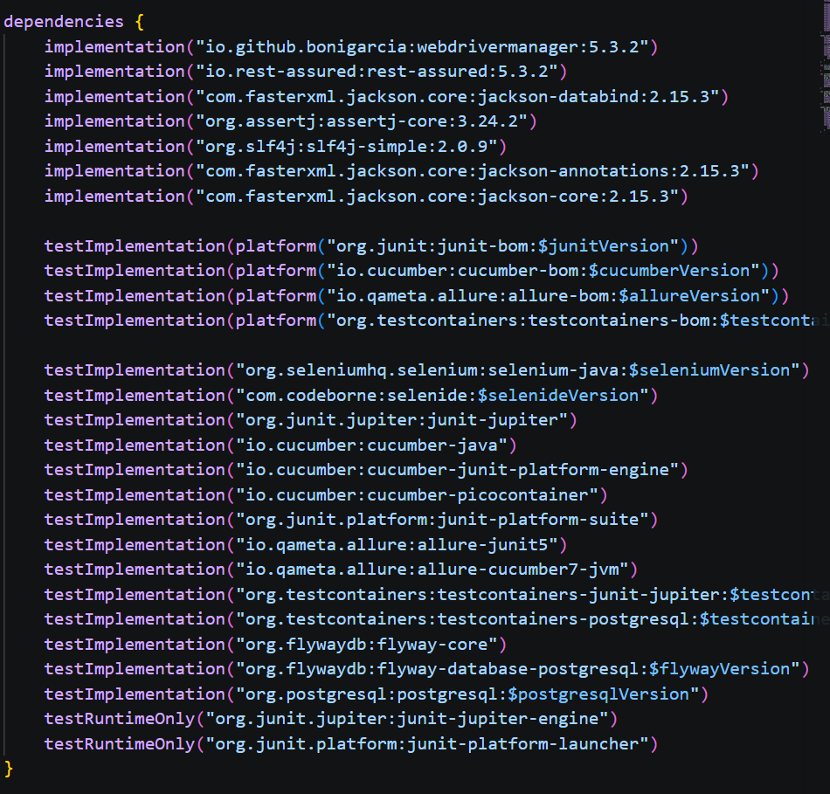
build.gradle.kts

Slide 7
CHECKOUTE2ETEST.JAVA
One Test, Seven Traced Steps
Login
→
Search
Product
→
Create
Cart
→
Add
Item
→
Place
Order
→
Fetch
Order
→
Verify
in DB
@Step 1
@Step 2
@Step 3
@Step 4
@Step 5
@Step 6
@Step 7
Every phase is annotated, evidenced, and categorized
@Epic / @Feature / @Story / @Severity / @Description — rich Allure grouping, not raw method names
@Step("...") on each private helper — renders as an expandable timeline inside the Allure report
@Attachment("{name}") — real API responses and DB rows attached as text evidence per step
05

Slide 8
TWO REPORTS, ONE SUITE
Allure + Extent, Side by Side
ALLURE REPORT
EXTENT SPARK REPORT
allure-junit5 + allure-cucumber7-jvm — covers both plain JUnit5 tests and Cucumber scenarios
categories.json — auto-buckets failures into Flaky, Test defects (broken), Product defects (failed)
History & Trend — preserved run-over-run via the gh-pages branch
Suites, Behaviors, Packages, Timeline, Graphs — severity, duration, retries all visualized
ExtentTestListener — one JUnit5 extension, applied once on AbstractShopkartTest, inherited by every test class
Pass / Fail / Flaky / Skip all classified via TestWatcher callbacks, with a FLAKY_PATTERN regex matching Allure's own categories.json
Single-file HTML — SparkReport.html, viewable with zero server setup
Log events, timeline, and system info (OS, Java version) baked into every run
06

Slide 9
GITHUB ACTIONS
From Push To Published Report
Checkout +
Setup JDK 22
→
Start MySQL
Service
→
./gradlew test
(maxParallelForks=1)
→
Verify Allure
Results Exist
→
Build Report
+ History
→
Publish to
GitHub Pages
Isolation matters
History that persists
A gotcha we hit
maxParallelForks = 1 is set globally. With a shared MySQL instance, parallel forks caused real race-condition test failures — fixed once, applies to every future task.
gh-pages is checked out before the report builds, and simple-elf/allure-report-action merges old + new results so the Trend graph spans runs, not just one.
simple-elf's report action leaves a root-owned .git folder inside allure-history; peaceiris/actions-gh-pages can't clean it without sudo rm -rf — now handled explicitly.
08

Slide 10
RIGHT NOW
Live Demo Checklist
1
Push a small change to shahbaz-week06-gate6 and open the Actions tab
2
Watch the MySQL service container spin up, then ./gradlew test run
3
Show the Verify Allure Results step passing (results actually generated)
4
Open the published GitHub Pages Allure report — point out Trend and Categories
5
Open the local ExtentReports Spark HTML report side by side
6
Drill into one failing CategoryDemonstrationTest to show Flaky vs Broken vs Failed classification
09

Slide 11
Questions?
Shopkart Test Automation Framework — Week 6, Gate 6
REST Assured · Cucumber · MySQL Verification · Allure · Extent Spark · GitHub Actions

