Slide 1

XLA Compiler
Just-In-Time Compilation in TensorFlow

Slide 2
TensorFlow
What is TensorFlow?
Input0
f32[1024]
Input1
f32[1024]
An open source software library for numerical computation using data flow graphs.
Op
Add
f32[1024]
What is data flow graphs?
Tensor
Nodes: mathematical operations
Edges: multidimensional data arrays
...

Slide 3
TensorFlow
Flexible
Expressive
Extensible

Slide 4
Flexibility
Allows researchers to richly express themselves
Operation may be data dependent in unobvious ways

Slide 5
Flexibility
Input0
f32[???]
Input1
f32[???]
Op
Add
f32[???]
Tensor
...

Slide 6
Expressive
TensorFlow has a large Operation vocabulary, why?
To keep TensorFlow expressive, more operations are needed in practice.
Composition of existing operations is not efficient.
Result in more ops, leading more kernel launches, memory allocations.

Slide 7
Extensible

Slide 8
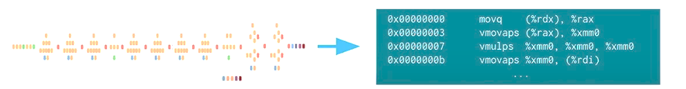
How do TensorFlow keep the strengths, but add more speed?

Slide 9
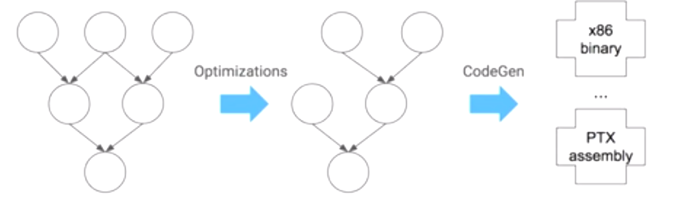
XLA in one Picture
Optimizing compiler and runtime, targeting CPU,GPU, etc.
TensorFlow Graph
XLA Graph
Binary Code

Slide 10
Man’s Working on it!

Slide 11
Flexibility
Input0
f32[???]
Input1
f32[???]
Op
Add
f32[???]
Tensor
...

Slide 12


