Slide 1
IterFuse: Linear Layer Fusion via Iterative Few-Sample Inference Alignment
Hongxu Chen

Slide 2
Introduction
Imagin that:
We aim to generate text in a new style, customize concepts for Text-to-Image diffusion, or perform downstream NLP tasks. How can we achieve these goals?
Transfer Learning
Fine-tuning a pre-training model on task-specific datasets.
If we have training data that is abundant and of high quality.
We can easily get a task-specific model with good performance through training.
PTM
Data D₁
Fine-tune
Agent₁

Slide 3
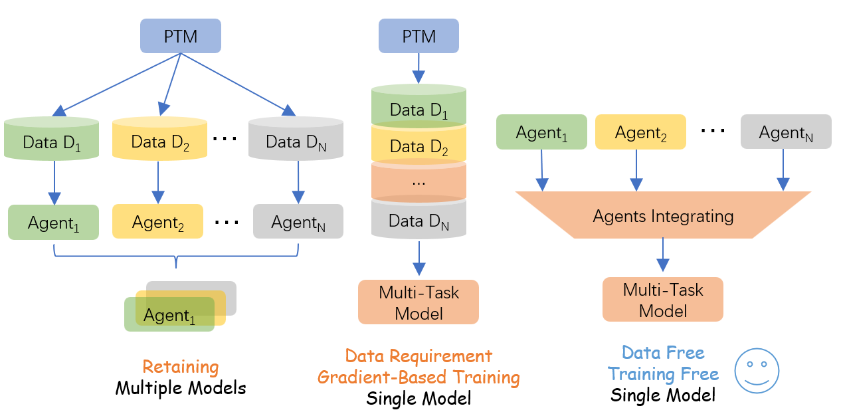
Introduction
If there are multiple tasks, each task corresponding
a task-specific model. (For convenience, we refer to a task as not only a task but also a concept, a style…)
Using these models to do multiple tasks have
extremely high cost. Because we must to retain all of these models to ensure every type of task can be handled.
Additionally, If we want to generate a photo with
multiple concepts across different concept-specific Text-to-Image diffusions. Retaining all the model is useless.

Slide 4
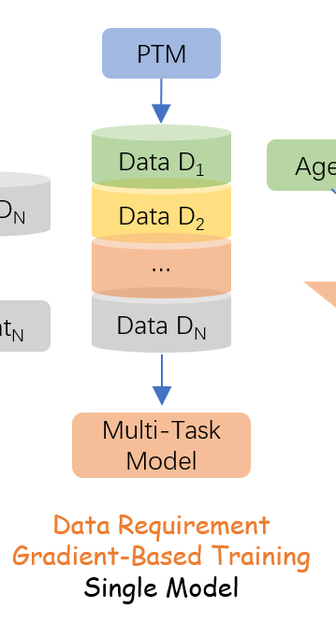
Introduction
A natural Idea: Retrain a single model with multi-
task datasets. So we can retain only one model for multi-task.
Data privacy:
The access to task-specific datasets may be limited. Training a model on limited labeled data can lead to overfitting.
Training cost:
Even if we have enough data to do the training, we need consider the cost.

Slide 5
Introduction
So how about thinking one way to utilize the
existing task-specific models and integrate them into a single model?
Data-less & Training-Free & Single Model
There’s actually one direction focusing one such
thing, it is called model merging.

Slide 6
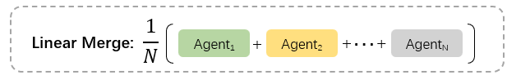
Introduction
The simplest model merging method is Linear Merging.
performance
Task₁
Task₂
…
Task_{N}
It is simple and elegant but, not efficient…

Slide 7
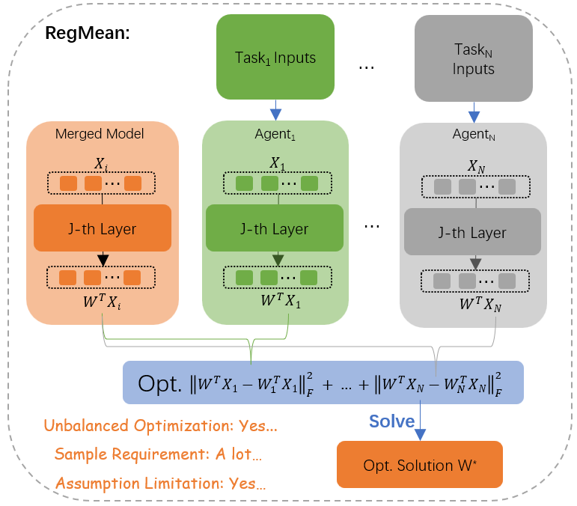
Introduction
Most studies formulate model merging as an optimization problem and apply closed-form solution to get the parameters of the merged model.

Slide 8
Introduction
RegMean, Mix-of-Show, and Custom Diffusion, these studies all formulate a similar optimization based on the idea of aligning the intermediate features.
So following I’ll introduce these works respectively and analyze their shortcomings. Then naturally lead to our proposed method.

Slide 9
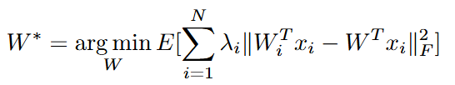
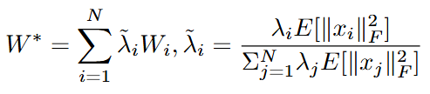
Linear Merging
Consider following optimization:
where W_{i} represents the i-th agent's linear layer. Under the assumption that the distribution of each x_{i} is isotropic, the above expression has a closed-form solution:

Slide 10
Linear Merging
The isotropic assumption is too simple, suggesting that it may lead to degraded performance.
So we try to formulate the model merging optimization in a more accurate way. Instead of applying above assumption and mathematical expectations. We try to use the features of inference sample directly.

Slide 11
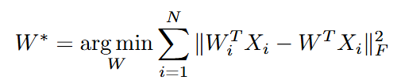

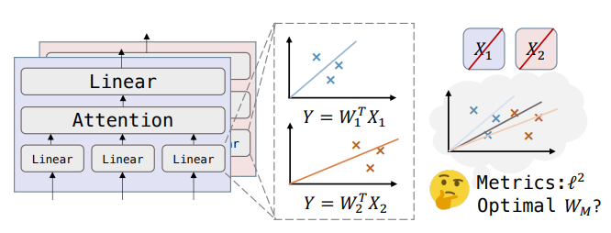
RegMean (Mix-of-Show also
utilizes this Opt.)
LBFGS optimizer
Closed-Form Solution

Slide 12
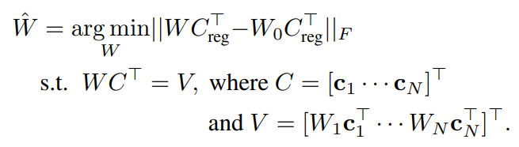
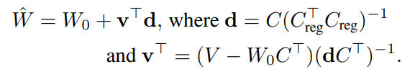
Custom Diffusion Optimization
Prevent the updated parameters too far from the pre-training parameter
Issue: This regularization needs ∼ 1000 randomly sampled captions.
Closed-Form Solution
Use constraint to align mid-features
Issue: Only utilize a single prompt per concept within the constraint, making it difficult to capture more information in each agent.
The solution is derived from the use of Lagrange multipliers.

Slide 13
The shortcomings of previous works in summary:
1) Unbalanced Optimization:
Significant differences in the magnitudes of intermediate features between agents across different tasks or concepts can result in biased optimization.
2) Sample Requirement:
Thousands of inference samples are always required, leading to increased computational costs. And in some cases, it is unrealistic.
3) Insufficient Utilization:
The optimization doesn't fully leverage the knowledge of each agent.
4) Assumption Limitation:
Approximations used in assumption are imprecise.

Slide 14
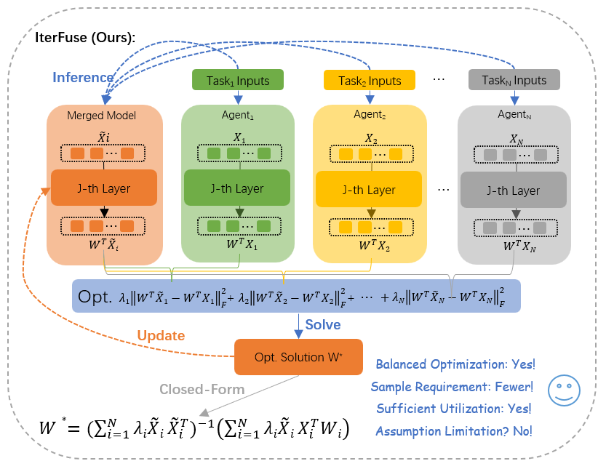
IterFuse (Ours)
Iterative Inference-Solving
Balanced Optimization
Fewer Sample Requirement(<60)
Sufficient Utilization
Assumption Limitation? No!

Slide 15



IterFuse (Ours)
Optimization (Ours):
Closed-Form Solution:
Iterative Inference-Solving
This process is somewhat complex to explain verbally, so let's move on…
2) Balance the Norm of Each Term
The magnitude differences between mid-features can be substantial, causing an imbalance in the optimization objective. To balance each term in Opt. we set:

Slide 16

IterFuse (Ours)
Optimization (Ours):
Closed-Form Solution:
3) Regularization Prevents Singular Cases
Our method relies on a limited number of inference samples (typically 50-60), which has been experimentally demonstrated to be sufficient for capturing the knowledge from each agent. However, there is a heightened risk of encountering singular cases in the closed-form solution. So we set:

Slide 17
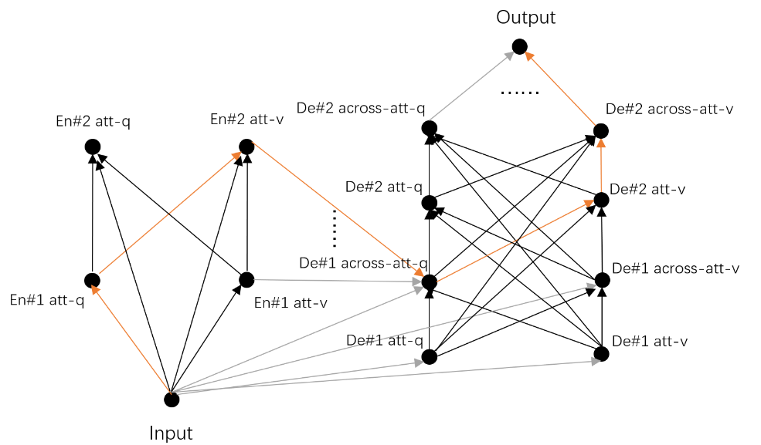
IterFuse (Ours)
Optimization (Ours):
Closed-Form Solution:
4) Property of IterFuse：
We derive an upper bound on the number of iterations required for the convergence of our proposed algorithm, which is influenced by the network’s depth and architecture

Slide 18
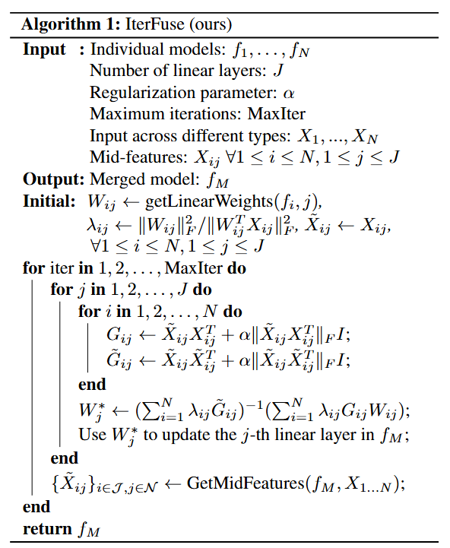

Slide 19
Results on Multi-Task integrating(NLP)
BART-base | IterFuse(ours) | RegMean | Linear
mnli | 3.390 | 3.056 | 2.798
cola | 3.434 | 3.229 | 3.255
qqp | 4.179 | 4.064 | 3.762
qnli | 4.379 | 4.310 | 3.559
mrpc | 3.919 | 3.909 | 3.676
sst2 | 4.561 | 4.259 | 4.081
SUM | 23.863 | 22.827 | 21.132
T5-base | IterFuse(ours) | RegMean | Linear
mnli | 4.842 | 4.740 | 4.388
cola | 3.997 | 3.911 | 4.065
qqp | 5.116 | 5.104 | 4.960
qnli | 5.504 | 5.493 | 5.339
mrpc | 4.907 | 4.853 | 4.686
sst2 | 5.674 | 5.669 | 5.593
rte | 4.827 | 4.809 | 4.718
SUM | 34.867 | 34.579 | 33.750

Slide 20
Results on In Domain Tasks integrating(NLP)
 | IterFuse (ours) | RegMean | Linear | IterFuse (ours) | RegMean | Linear | IterFuse (ours) | RegMean | Linear | IterFuse (ours) | RegMean | Linear
EMOTION_t5_large_restart | Task1 |  |  | Task2 |  |  | Task3 |  |  | Task4
emoint/emotion-cause | 0.810 | 0.808 | 0.784 | 0.938 | 0.922 | 0.912 | - | - | - | - | - | -
emoint/tec | 0.807 | 0.758 | 0.731 | 0.551 | 0.544 | 0.474 | - | - | - | - | - | -
emoint/isear | 0.811 | 0.786 | 0.733 | 0.665 | 0.650 | 0.603 | - | - | - | - | - | -
emotion-cause/tec | 0.945 | 0.926 | 0.881 | 0.603 | 0.630 | 0.592 | - | - | - | - | - | -
emotion-cause/isear | 0.953 | 0.938 | 0.900 | 0.709 | 0.719 | 0.679 | - | - | - | - | - | -
tec/isear | 0.574 | 0.592 | 0.526 | 0.710 | 0.661 | 0.631 | - | - | - | - | - | -
emoint/emotion-cause/tec | 0.782 | 0.753 | 0.727 | 0.942 | 0.923 | 0.877 | 0.540 | 0.510 | 0.460 | - | - | -
emoint/emotion-cause/isear | 0.795 | 0.774 | 0.720 | 0.935 | 0.926 | 0.887 | 0.670 | 0.641 | 0.593 | - | - | -
emoint/tec/isear | 0.786 | 0.721 | 0.683 | 0.500 | 0.499 | 0.455 | 0.646 | 0.607 | 0.593 | - | - | -
emotion-cause/tec/isear | 0.950 | 0.910 | 0.857 | 0.552 | 0.555 | 0.486 | 0.683 | 0.649 | 0.614 | - | - | -
emoint/emotion-cause/tec/isear | 0.776 | 0.714 | 0.688 | 0.935 | 0.901 | 0.873 | 0.508 | 0.481 | 0.445 | 0.657 | 0.607 | 0.590

Slide 21
Results on Multi-Task integrating(NLP)
 | Methods | B-1 | B-2 | B-3 | B-4 | RougeL | Cider | POS_Senti | NEG_Senti
POSITIVE | FFML | 0.560561 | 0.358618 | 0.231671 | 0.15062 | 0.419885 | 0.794337 | 0.830609 | 0.781312
 | RegMean | 0.57581 | 0.37024 | 0.239286 | 0.15569 | 0.421384 | 0.800756 | 0.624071 | 0.691849
 | Linear | 0.560696 | 0.357194 | 0.23019 | 0.150638 | 0.416946 | 0.770605 | 0.521545 | 0.55666
 | Origin | 0.570264 | 0.369382 | 0.241157 | 0.158822 | 0.425951 | 0.807878 | 0.84844 | --
NEGATIVE | FFML | 0.540423 | 0.347531 | 0.229749 | 0.153062 | 0.40598 | 0.79442 | 0.830609 | 0.781312
 | RegMean | 0.53981 | 0.3441 | 0.223023 | 0.144067 | 0.407238 | 0.77859 | 0.624071 | 0.691849
 | Linear | 0.508658 | 0.31939 | 0.205573 | 0.133191 | 0.400807 | 0.733289 | 0.521545 | 0.55666
 | Origin | 0.550148 | 0.35387 | 0.233725 | 0.156618 | 0.41449 | 0.810864 | -- | 0.866799

