Slide 1
Chapter 10: Virtual Memory

Slide 2
Chapter 10: Virtual Memory
Background
Demand Paging
Copy-on-Write
Page Replacement
Allocation of Frames
Thrashing
Memory-Mapped Files
Allocating Kernel Memory
Other Considerations
Operating-System Examples

Slide 3
Objectives
To describe the benefits of a virtual memory system
To explain the concepts of demand paging, page-replacement algorithms, and allocation of page frames
To discuss the principle of the working-set model
To examine the relationship between shared memory and memory-mapped files
To explore how kernel memory is managed

Slide 4
Background
Code needs to be in memory to execute, but entire program rarely used
  Error code, unusual routines, large data structures
Entire program code not needed at same time
Consider ability to execute partially-loaded program
  Program no longer constrained by limits of physical memory
  Each program takes less memory while running; hence more programs run at the same time
    Increased CPU utilization and throughput with no increase in response time or turnaround time
  Less I/O needed to load or swap programs into memory; hence, each user program runs faster

Slide 5
Virtual Memory
Virtual memory – separation of user logical memory from physical memory
Only part of the program needs to be in memory for execution
Logical address space can therefore be much larger than physical address space
Allows address spaces to be shared by several processes
Allows for more efficient process creation
More programs running concurrently
Less I/O needed to load or swap processes
Virtual memory can be implemented via:
  Demand paging
  Demand segmentation

Slide 6

Virtual Memory That is Larger Than Physical Memory

Slide 7

Virtual-address Space
Usually design logical address space for stack to start at Max logical address and grow “down” while heap grows “up”
  Maximizes address space use
  Unused address space between the two is hole
    No physical memory needed until heap or stack grows to a given new page
Enables sparse address spaces with holes left for growth, dynamically linked libraries, etc
System libraries shared via mapping into virtual address space
Shared memory by mapping pages read-write into virtual address space
Pages can be shared during fork(), speeding process creation

Slide 8

Shared Library Using Virtual Memory

Slide 9

Demand Paging
Could bring entire process into memory at load time
Or bring a page into memory only when it is needed
  Less I/O needed, no unnecessary I/O
  Less memory needed
  Faster response
  More users
Similar to paging system with swapping (diagram on right)
Page is needed ⇒ reference to it
  invalid reference ⇒ abort
  not-in-memory ⇒ bring to memory
Lazy swapper – never swaps a page into memory unless page will be needed
  Swapper that deals with pages is a pager

Slide 10
Basic Concepts
When a process is to be swapped in, the pager guesses which pages will be used before the process is swapped out again
Instead of swapping in a whole process, the pager brings in only those “guessed” pages into memory
Need new MMU functionality to implement demand paging. Need to distinguish between the pages that are in memory and the pages that are on the disk. Use a variation of the valid-invalid scheme used for protection (see next slide)
If pages needed are already memory resident
  No difference from non demand-paging
If page needed and not memory resident, need to detect and load the page into memory from storage
  Without changing program behavior
  Without programmer needing to change code

Slide 11

Valid-Invalid Bit
With each page table entry a valid–invalid bit is associated
(v ⇒ in-memory, i ⇒ not-in-memory)
Initially valid–invalid bit is set to i on all entries
Example of a page table snapshot:
During MMU address translation, if valid–invalid bit in page table entry is i ⇒ page fault

Slide 12

Page Table When Some Pages are Not in Main Memory

Slide 13
Page Fault
If there is a reference to a page, first reference to that page will trap to operating system:
page fault
Actions when a page fault occurs
Operating system looks at another table to decide:
  Invalid reference ⇒ abort
  Just not in memory. Go to step (2).
Find free frame
Swap page into frame via scheduled disk operation
Reset tables to indicate page now in memory
Set validation bit = v
Restart the instruction that caused the page fault

Slide 14

Steps in Handling a Page Fault

Slide 15
Aspects of Demand Paging
  Pure demand paging – start process with no pages in memory
  OS sets instruction-pointer to the first instruction of the process, non-memory-resident -> page fault
  And for every other process pages on first access
Actually, a given instruction could access multiple pages → multiple page faults
  Consider fetch and decode of instruction which adds 2 numbers from memory and stores result back to memory
  The two numbers may reside in two different pages
Hardware support needed for demand paging
  Page table with valid / invalid bit
  Secondary memory (swap device with swap space)
  Instruction restart

Slide 16

Instruction Restart
Consider an instruction that could access several different locations
  Block move
  Page fault during the move
  Restart the whole operation?
What if source and destination overlap?
  Several solution. Simplest one is to figure out all the pages that are needed to execute the instruction to completion and ensure that these pages are in memory before the instruction starts executing.

Slide 17
Stages in Demand Paging
Stages in Demand Paging (worse case)
Trap to the operating system
Save the user registers and process state
Determine that the interrupt was a page fault
Check that the page reference was legal and determine the location of the page on the disk
Issue a read I/O from the disk to a free frame:
  Wait in a queue for this device until the read request is serviced
  Wait for the device seek and/or latency time
  Begin the transfer of the page to a free frame
While waiting, allocate the CPU to some other user

Slide 18
Stages in Demand Paging (Cont.)
Stages in Demand Paging (Cont.)
Receive an interrupt from the disk I/O subsystem (I/O completed).
Save the registers and process state for the other user
Determine that the interrupt was from the disk
Correct the page table and other tables to show page is now in memory
Wait for the CPU to be allocated to this process again
Restore the user registers, process state, and new page table, and then resume the interrupted instruction

Slide 19
Performance of Demand Paging
Three major activities
  Service the interrupt – careful coding means just several hundred instructions needed
  Read in the page – lots of time
  Restart the process – again just a small amount of time
Page Fault Rate 0 ≤ p ≤ 1
  if p = 0 no page faults
  if p = 1, every reference is a fault
Effective Access Time (EAT)
EAT = (1 – p) x memory access
+ p (page fault overhead
+ swap page out
+ swap page in )

Slide 20
EAT Example
Memory access time = 200 nanoseconds
Average page-fault service time = 8 milliseconds
EAT = (1 – p) x 200 + p (8 milliseconds)
= (1 – p x 200 + p x 8,000,000
= 200 + p x 7,999,800
If one access out of 1,000 causes a page fault, then
EAT = 8.2 microseconds.
This is a slowdown by a factor of 40!!
If want performance degradation < 10 percent
  220 > 200 + 7,999,800 x p
  20 > 7,999,800 x p
  p < .0000025
  < one page fault in every 400,000 memory accesses

Slide 21
Demand Paging Optimizations
Swap space I/O faster than file system I/O even if on the same device
  Swap allocated in larger chunks, less management needed than file system
Copy entire process image to swap space at process load time
  Then page in and out of swap space
  Used in older BSD Unix
Demand page in from program binary on disk, but discard rather than paging out when freeing frame
  Used in Solaris and current BSD
  Still need to write to swap space
    Pages not associated with a file (like stack and heap) – anonymous memory
    Pages modified in memory but not yet written back to the file system

Slide 22
Demand Paging in Mobile Systems
Typically don’t support swapping
Instead, demand page from file system and reclaim read-only pages (such as code)

Slide 23
Copy-on-Write
Copy-on-Write (COW) allows both parent and child processes to initially share the same pages in memory
  If either process modifies a shared page, only then is the page copied
COW allows more efficient process creation as only modified pages are copied
In general, free pages are allocated from a pool of zero-fill-on-demand pages (pages whose content has been zeroed out before allocation)
  Pool should always have free frames for fast demand page execution
    Don’t want to have to free a frame as well as other processing on page fault
vfork() variation on fork() system call has parent suspend and child using copy-on-write address space of parent
  Designed to have child call exec()
  Very efficient

Slide 24


Before and after Process 1 Modifies Page C
Before
After

Slide 25
Page Replacement
Page replacement occurs when:
  A page fault occurs and we need to bring the desired page into memory
  There are NO free frames.
Page replacement – find some page in memory, but not really in use, page it out
  Algorithm – decide which frame to free
  Performance – want an algorithm which will result in minimum number of page faults
Same page may be brought into memory several times

Slide 26

Need For Page Replacement
All frames are used. No free fames. User 2 needs B

Slide 27
Page Replacement (Cont.)
Use modify (dirty) bit to reduce overhead of page transfers – only modified pages are written to back to disk
Page replacement completes separation between logical memory and physical memory – large virtual memory can be provided on a smaller physical memory

Slide 28
Basic Page Replacement
Find the location of the desired page on disk
Find a free frame:
- If there is a free frame, use it
- If there is no free frame, use a page replacement algorithm:
- Select a victim frame
- Write victim frame to disk if dirty
Bring the desired page into the (newly) free frame; update the page and frame tables
Continue the process by restarting the instruction that caused the trap

Slide 29

Page Replacement

Slide 30
Page and Frame Replacement Algorithms
Frame-allocation algorithm determines
  How many frames to give each process
  Which frames to replace
Page-replacement algorithm
  Want lowest page-fault rate on both first access and re-access
Evaluate algorithm by running it on a particular string of memory references (reference string) and computing the number of page faults on that string
  String is just page numbers, not full addresses
  Repeated access to the same page does not cause a page fault
  Results depend on number of frames available
In all our examples, the reference string of referenced page numbers is
7,0,1,2,0,3,0,4,2,3,0,3,0,3,2,1,2,0,1,7,0,1

Slide 31

Graph of Page Faults Versus The Number of Frames

Slide 32

First-In-First-Out (FIFO) Algorithm
Reference string: 7,0,1,2,0,3,0,4,2,3,0,3,0,3,2,1,2,0,1,7,0,1
3 frames (3 pages can be in memory at a time per process)
How to track ages of pages?
  Just use a FIFO queue
15 page faults

Slide 33
Number of Frames vs Page Faults
One would expect that the more frames are allocated to a process the fewer page faults
Consider the reference string:
1,2,3,4,1,2,5,1,2,3,4,5
How many page faults if we have 3 frames?
How many page faults if we have 4 frames?

Slide 34
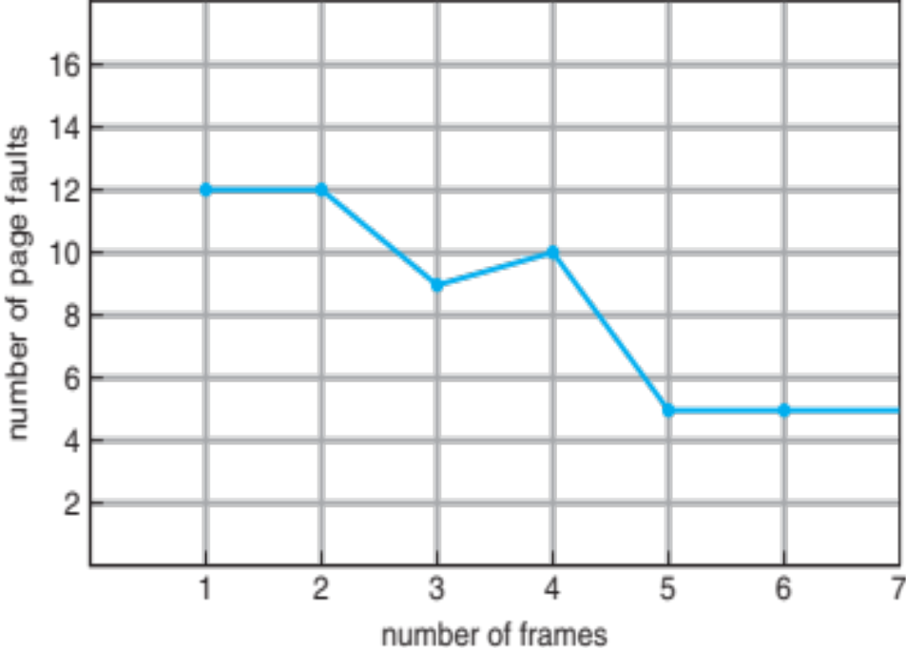
Belady’s Anomaly
If we use FIFO for page replacement we can encounter the anomaly that more frames may lead to more page faults
FIFO Illustrating Belady’s Anomaly

Slide 35

Optimal Algorithm
Replace page that will not be used for longest period of time
  With 3 frame, 9 is optimal for the example reference.
How do you know which page will not be used for longest period of time
  Can’t read the future
Used mainly for measuring how well a given algorithm performs

Slide 36

Least Recently Used (LRU) Algorithm
Use past knowledge rather than future
Replace page that has not been used for the longest period of time.
Associate time of last use with each page
12 faults – better than FIFO but worse than OPT
Generally good algorithm and frequently used
But how do we implement?

Slide 37
LRU Algorithm (Cont.)
Counter (time-of-use) implementation
  Every page-table entry has a counter associated with it; every time a page is referenced through this entry, the content of the clock is copied into the counter
  We replace the page with the smallest time value.
    Search through table needed
Stack implementation
  Keep a stack of page numbers in a double link form:
  Page referenced:
    move it to the top
    requires 6 pointers to be changed
  No search for replacement
LRU needs special hardware and is still slow
LRU and OPT are cases of stack algorithms that don’t suffer from Belady’s Anomaly

Slide 38
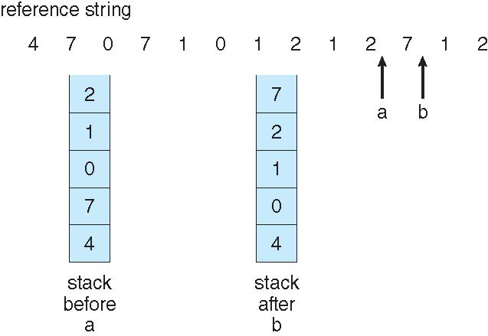
Stack Algorithm Example
Use of a stack to record the most recent page references

Slide 39
LRU Approximation Algorithms
To get efficient implementation we use an approximation of LRU
Reference bit
  With each page associate a hardware-provided bit; initially = 0
  When a page is referenced the associated bit is set to 1
  Replace any page with reference bit = 0 (if one exists)
    We do not know the order, however
Second-chance algorithm
  FIFO scheme, plus hardware-provided reference bit
  If page to be replaced has
    Reference bit = 0 → replace it
    Reference bit = 1 then:
      set reference bit 0, leave page in memory
      replace next page, subject to same rules

Slide 40

Second-Chance (clock) Page-Replacement Algorithm

Slide 41
Enhanced Second-Chance Algorithm
Improve algorithm by using reference bit and modify bit (if available) in concert
Take ordered pair (reference, modify)
  (0, 0) neither recently used not modified – best page to replace
  (0, 1) not recently used but modified – not quite as good, must write out before replacement
  (1, 0) recently used but clean – probably will be used again soon
  (1, 1) recently used and modified – probably will be used again soon and need to write out before replacement
When page replacement called for, use the clock scheme but use the four classes replace page in lowest non-empty class
  Might need to search circular queue several times

Slide 42
Counting Algorithms
Keep a counter of the number of references that have been made to each page
Lease Frequently Used (LFU) Algorithm: replaces page with smallest count
Most Frequently Used (MFU) Algorithm: based on the argument that the page with the smallest count was probably just brought in and has yet to be used
Both LFU and MFU are expensive to use and are not commonly used.

Slide 43
Page-Buffering Algorithms
Other procedures are often used in addition to a specific page-replacement algorithm. Several schemes:
Keep a pool of free frames
  When a page fault occurs, a victim page is chosen as before.
  The desired page that needs to brought into memory is read into one of the free frame from the pool before the victim page is written out. Start the process immediately.
  When the victim page is finally written out, the frame is added to pool of free framed
Maintain a list of modified pages
  Whenever a backing store is idle, a modified page is selected and written to the disk and its modified bit is reset.
Possibly, keep a pool of free frame and remember which page was in each frame
  If page is referenced again before the frame is reused, no need to load contents again from disk
  Generally useful to reduce penalty if wrong victim frame selected

Slide 44
Applications and Page Replacement
All of these algorithms have OS guessing about future page access
Some applications have better knowledge – i.e., databases
Memory intensive applications can cause double buffering
  OS keeps copy of page in memory as I/O buffer
  Application keeps page in memory for its own work
Operating system can given direct access to the disk, getting out of the way of the applications
  Raw disk mode
Bypasses buffering, locking, etc

Slide 45
Allocation of Frames
Each process needs minimum number of frames
Example: IBM 370 – 6 pages to handle SS MOVE instruction:
  instruction is 6 bytes, might span 2 pages
  2 pages to handle from
  2 pages to handle to
Maximum of course is total frames in the system
Two major allocation schemes
  fixed allocation
  priority allocation
Many variations

Slide 46
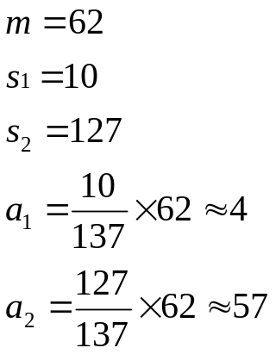

Frame Allocation
Equal allocation – split m frames among n processes equally -- m/n For example, if there are 100 frames (after allocating frames for the OS) and 5 processes, give each process 20 frames
  Keep some as free frame buffer pool
Proportional allocation – Allocate according to the size of process
  Dynamic as degree of multiprogramming, process sizes change
  Does a “large” process need more frames? Locality?

Slide 47
Global vs. Local Allocation
Global replacement – process selects a replacement frame from the set of all frames; one process can take a frame from another
  Process execution time can vary greatly
  A process cannot control its own page-fault rate
  Greater throughput so more common
Local replacement – each process selects from only its own set of allocated frames
  More consistent per-process performance
  If a process does not have sufficient number of frames allocated to it, the process will suffer many page faults (thrashing).
  Possibly underutilized memory

Slide 48
Thrashing
If a process does not have “enough” pages, the page-fault rate is very high
  Page fault to get page
  Replace existing frame
  But quickly need replaced frame back
  This leads to:
    Low CPU utilization
    Operating system thinking that it needs to increase the degree of multiprogramming
    Another process added to the system
Thrashing ≡ a process is busy swapping pages in and out

Slide 49

Thrashing (Cont.)

Slide 50
Demand Paging and Thrashing
Why does demand paging work?
Locality model
  Process migrates from one locality to another
  Localities may overlap
Why does thrashing occur?
Σ size of locality > total memory size
  Can limit the effects of thrashing by using:
    Local page replacement
    Priority page replacement – replace a page from a process with the lowest priority.

Slide 51

Locality In A Memory-Reference Pattern

Slide 52

Working-Set Model
Define Δ to be a working-set window. Δ is a fixed number of page references For example: 10,000 instructions
WSS_{i} (working set of Process P_{i}) is defined to be the total number of pages referenced in the most recent Δ (varies in time)
Example with Δ = 10

Slide 53
Working-Set Model (Cont.)
WSS_{i} -- tries to approximate the size of the locality of process P_{i}
  if Δ too small will not encompass entire locality
  if Δ too large will encompass several localities
  if Δ = ∞ ⇒ will encompass entire program
D = Σ WSS_{i} ≡ approximate the total demand frames
  Approximation of ALL localities
m = total number of frames.
if D > m ⇒ Thrashing
Policy: if D > m, then suspend or swap out one of the processes

Slide 54
Keeping Track of the Working Set
Keeping the exact information about each working set is impractical since the working set window is a moving window.
Approximate with interval timer + a reference bit
Example: Δ = 10,000
  Timer interrupts after every 5000 time units
  Keep in memory 2 bits for each page.
  View the reference bit and 2-in memory bits as a register (3-bits), with the reference bit being the most significant bit
  Whenever a timer interrupts shift to the right by one place the 3-bits and set the values of all reference bits to 0.
  If a page fault occurs, we can examine the 3-bits to determine whether a page was used within the last 10,000 to 15,000 references (at least one bit is on). If so the page is in working set
Why is this not completely accurate?
Improvement = 10 bits and interrupt every 1000 time units

Slide 55

Page-Fault Frequency
More direct approach than WSS
Establish “acceptable” page-fault frequency (PFF) rate and use local replacement policy
  If actual rate too low, process loses frame
  If actual rate too high, process gains frame

Slide 56

Working Sets and Page Fault Rates
Direct relationship between working set of a process and its page-fault rate
Working set changes over time
Peaks and valleys over time

Slide 57
Other Considerations
Prepaging
Page size
TLB reach
Inverted page tables
Program structure
I/O interlock and page locking

Slide 58
Other Considerations -- Prepaging
Prepaging used to reduce the large number of page faults that occurs at process startup
Prepage all or some of the pages a process will need, before they are referenced
But if prepaged pages are unused, I/O and memory was wasted
Assume that:
  s pages are prepaged and
  A fraction α of these s pages is actually used (α between 0 and 1)
  Question -- is the cost of s * α saved pages faults greater or less than the cost of prepaging s * (1- α) unnecessary pages?
    If α near zero ⇒ prepaging loses
    If α near one ⇒ prepaging wins

Slide 59
Other Issues – Page Size
Sometimes OS designers have a choice
  Especially if running on custom-built CPU
Page size selection must take into consideration:
  Fragmentation
  Page table size
  Resolution
  I/O overhead
  Number of page faults
  Locality
  TLB size and effectiveness
Always power of 2, usually in the range 2¹² (4,096 bytes) to 2²² (4,194,304 bytes)
On average, growing over time

Slide 60
Other Issues – TLB Reach
TLB Reach - The amount of memory accessible from the TLB
TLB Reach = (TLB Size) X (Page Size)
Ideally, the working set of each process is stored in the TLB
  Otherwise there is a high degree of page faults
Increase the Page Size
  This may lead to an increase in fragmentation as not all applications require a large page size
Provide Multiple Page Sizes
  This allows applications that require larger page sizes the opportunity to use them without an increase in fragmentation

Slide 61
Other Issues – Program Structure
Program structure
  int[128,128] data;
  Each row is stored in one page
  Program 1
for (j = 0; j <128; j++)
for (i = 0; i < 128; i++)
data[i,j] = 0;
  128 x 128 = 16,384 page faults
  Program 2
  for (i = 0; i < 128; i++)
  for (j = 0; j < 128; j++)
  data[i,j] = 0;
  128 page faults

Slide 62

Other Issues – I/O interlock
I/O Interlock – Pages must sometimes be locked into memory
Consider I/O - Pages that are used for copying a file from a device must be locked from being selected for eviction by a page replacement algorithm
Pinning of pages to lock into memory

Slide 63
Operating System Examples
Windows
Solaris

Slide 64
Windows
Uses demand paging with clustering. Clustering brings in pages surrounding the faulting page
Processes are assigned working set minimum and working set maximum
Working set minimum is the minimum number of pages the process is guaranteed to have in memory
A process may be assigned as many pages up to its working set maximum
When the amount of free memory in the system falls below a threshold, automatic working set trimming is performed to restore the amount of free memory
Working set trimming removes pages from processes that have pages in excess of their working set minimum

Slide 65
Solaris
Maintains a list of free pages to assign faulting processes
Lotsfree – threshold parameter (amount of free memory) to begin paging
Desfree – threshold parameter to increasing paging
Minfree – threshold parameter to being swapping
Paging is performed by pageout process
Pageout scans pages using modified clock algorithm
Scanrate is the rate at which pages are scanned. This ranges from slowscan to fastscan
Pageout is called more frequently depending upon the amount of free memory available
Priority paging gives priority to process code pages

Slide 66

Solaris 2 Page Scanner

Slide 67
End of Chapter 10

