Slide 1
Chapter 13: File-System Interface

Slide 2
Chapter 13: File-System Interface
File Concept
Access Methods
Disk and Directory Structure
Protection

Slide 3
Objectives
To explain the function of file systems
To describe the interfaces to file systems
To discuss file-system design tradeoffs, including access methods, file sharing, file locking, and directory structures
To explore file-system protection

Slide 4
File Concept
Contiguous logical address space
Types:
  Data
    numeric
    character
    binary
  Program
Contents (many types) is defined by file’s creator
  text file,
  source file,
  executable file

Slide 5
File Attributes
Name – only information kept in human-readable form
Identifier – unique tag (number) identifies file within file system
Type – needed for systems that support different types
Location – pointer to file location on the device (disk)
Size – current file size
Protection – controls who can do reading, writing, executing
Time, date, and user identification – information kept for creation time, last modification time, and last use time.
  Useful for data for protection, security, and usage monitoring
Many variations, including extended file attributes such as file checksum
Information kept in the directory structure (on disk), which consists of “inode” entries for each of the files in the system.

Slide 6
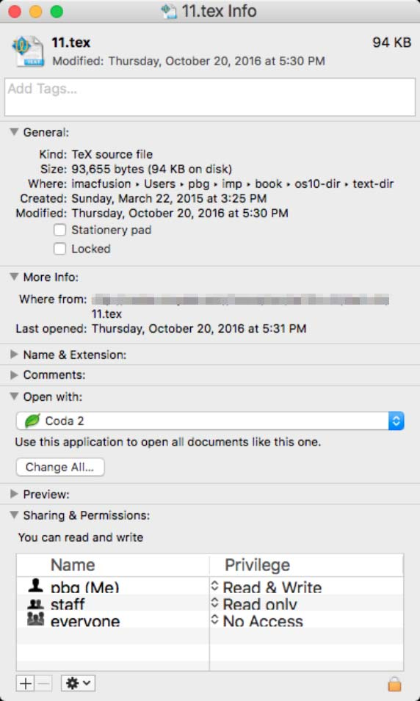
File info Window on Mac OS X

Slide 7
File Operations
Create
Write – at write pointer location
Read – at read pointer location
Reposition within file - seek
Delete
Truncate
Open(F_{i}) – search the directory structure on disk for inode entry F_{i}, and move the content of the entry to memory
Close (F_{i}) – move the content of inode entry F_{i} in memory to directory structure on disk.

Slide 8
Open Files
Several pieces of data are needed to manage open files:
Open-file table: Keeps information (inode data) about all the open files
File pointer : A pointer to last read/write location, per process that has the file open
File-open count: A counter of the number of times a file is open – to allow removal of data from open-file table when last processes closes it
Disk location of the file: Many file operations require the system to modify data within the file. The information needed to locate the file on disk is kept in memory so that the system does not have to read it from disk for each operation.
Access rights: Per-process access mode information

Slide 9
Open File Locking
Provided by some operating systems and file systems
  Similar to reader-writer locks
  Shared lock similar to reader lock – several processes can acquire concurrently
  Exclusive lock similar to writer lock
Mediates access to a file according to the lock state.
Access policy:
  Mandatory – access is denied depending on locks held and requested
  Advisory – processes can find status of locks and decide what to do

Slide 10

File Types – Name, Extension

Slide 11
File Structure
None - sequence of words, bytes
Simple record structure
  Lines
  Fixed length
  Variable length
Complex Structures
  Formatted document
  Relocatable load file
Who decides?
  Operating system
  Program

Slide 12
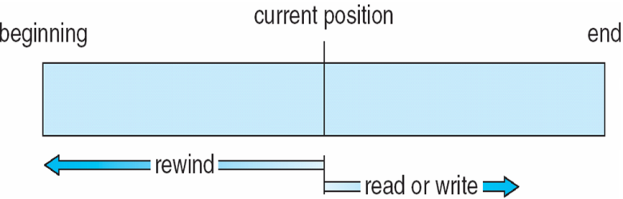
Access Methods
Sequential Access
General structure
Operations:
  read_next () – reads the next portion of the file and automatically advances a file pointer.
  write_next () – append to the end of the file and advances to the end of the newly written material (the new end of file).
  reset – back to the beginning of the file.

Slide 13
Access Methods
Direct Access
File is made up of fixed-length logical records that allow programs to read and write records rapidly in no particular order.
File is viewed as a numbered sequence of blocks or records. For example, can read block 14, then read block 53, and then write block 7.
Operations:
  read(n) – reads relative block number n.
  write(n) – writes relative block number n.
Relative block numbers allow OS to decide where file should be placed
  See allocation problem in Ch 14

Slide 14

Simulation of Sequential Access on Direct-access File
cp is a pointer to the next block to be read/written

Slide 15
Other Access Methods
Can be built on top of the base methods
Generally -- involve creation of an index for the file
Keep index in memory for fast determination of location of data to be operated on (consider UPC code plus record of data about that item)
If too large, keep index (in memory) of the main index (on disk)
IBM indexed sequential-access method (ISAM)
  Small master index, points to disk blocks of secondary index
  File kept sorted on a defined key
  All done by the OS
VMS operating system provides index and relative files as another example (see next slide)

Slide 16

Example of Index and Relative Files

Slide 17
Directory Structure
A collection of nodes containing information about all files
Directory
Files
F 1
F 2
F 3
F 4
F n
Both the directory structure and the files reside on disk

Slide 18
Operations Performed on Directory
Search for a file
Create a file
Delete a file
List a directory
Rename a file
Traverse the file system

Slide 19
Directory Organization
The directory is organized logically to obtain
Efficiency – locating a file quickly
Naming – convenient to users
  Two users can have same name for different files
  The same file can have several different names
Grouping – logical grouping of files by properties (e.g., all Java programs, all games, …)

Slide 20

Single-Level Directory
A single directory for all users
Naming problem
Grouping problem

Slide 21

Two-Level Directory
Separate directory for each user
Path name
Can have the same file name for different user
Efficient searching
No grouping capability

Slide 22

Tree-Structured Directories

Slide 23
Tree-Structured Directories (Cont.)
Efficient searching
Grouping Capability
Current directory (working directory)
  cd /spell/mail/prog
  type list

Slide 24

Tree-Structured Directories (Cont)
Absolute or relative path name
Creating a new file is done in current directory
Delete a file
rm <file-name>
Creating a new subdirectory is done in current directory
mkdir <dir-name>
Example: Suppose the current directory is -- “/mail“
  mkdir count
Deleting “mail” ⇒ deleting the entire subtree rooted by “mail”

Slide 25

Acyclic-Graph Directories
Have shared subdirectories and files

Slide 26
Acyclic-Graph Directories (Cont.)
Files/subdirectories have two different names (aliasing)
  Only one actual file exists, so any changes made by one person are immediately visible to the other.
How do we implement shared files and subdirectories?
  Can duplicate the inode information about the shared file/subdirectory in each of the subdirectories that “point’ to the shared structure.
    If some information changes about the file it had to be updated in several places.
  Have a new directory entry type:
    Link – another name (pointer) to an existing file or subdirectory.

Slide 27
Acyclic-Graph Directories -- Links
A link may be implemented as an absolute or a relative path name.
When a reference to a file is made, the directory is searched. If the directory entry is marked as a link, then the name of the real file is included in the link information.
We resolve the link by using that path name to locate the real file.
Links are easily identified by their format in the directory entry (or by having a special type on systems that support types) and are effectively indirect pointers.
The operating system ignores these links when traversing directory trees to preserve the acyclic structure of the system.

Slide 28
Acyclic-Graph Directories -- Deletion
If dict /count is deleted ⇒ dangling pointer
Solutions:
  Backpointers -- so we can delete all pointers.
    Variable size records a problem
  Backpointers using a daisy-chain organization
  Entry-hold-count solution

Slide 29

General Graph Directory

Slide 30
General Graph Directory (Cont.)
How do we guarantee no cycles?
  Allow only links to file not subdirectories
  Garbage collection
  Every time a new link is added use a cycle detection algorithm to determine whether it is OK

Slide 31
Protection
File owner/creator should be able to control:
  What can be done
  By whom
Types of access
  Read
  Write
  Execute
  Append
  Delete
  List

Slide 32
Access Control in Unix
Mode of access: read, write, execute
Three classes of users on Unix / Linux:
  owner
  group
  public
  With each file and subdirectory we keep 9 protection bits, 3 for owner, 3 for group, 3 for public.
RWX
a) owner access 7 ⇒ 1 1 1
RWX
b) group access 6 ⇒ 1 1 0
RWX
c) public access 1 ⇒ 0 0 1

Slide 33

Access Control (Cont.)
To create a group, ask the system manager to create a new group (unique name), say G, and to add some users to the group (say, Judi, Mark)
For a particular file (or subdirectory), say game, define an appropriate access.
Attach a group, say G, to a file , say game – using the command “chgrp”
Set protection for file “game” -- using the command “chmod”
chgrp G game

Slide 34

A Sample UNIX Directory Listing
Example:
Explanation:
  “into.ps” is a file owned by “pbg” with group ”staff”
  “lib” is a subdirectory owned by “pbg” with group “faculty”

Slide 35

Windows 7 Access-Control List Management

Slide 36
End of Chapter 13

