Slide 1
Chapter 14: File-System Implementation

Slide 2
Chapter 14: File-System Implementation
Directory Implementation
Allocation Methods
Free-Space Management
Efficiency and Performance
Recovery

Slide 3
Objectives
To describe the details of implementing local file systems and directory structures
To describe the implementation of remote file systems
To discuss block allocation and free-block algorithms and trade-offs

Slide 4
Disk Space Allocation Methods
A disk is a direct-access device and thus gives us flexibility in the implementation of files.
The main issue is how to allocate space to these files so that disk space is utilized effectively and files can be accessed quickly.
Three major methods of allocating disk space are in wide
  Contiguous
  Linked
  Indexed

Slide 5
Contiguous Allocation
Each file occupies a set of contiguous blocks
Best performance in most cases
Simple – only starting location (block #) and length (number of blocks) are required
Problems include:
  Finding space for file,
  Knowing the max file size,
  External fragmentation,
    Need for compaction
      Off-line (downtime) or
      On-line

Slide 6

Contiguous Allocation (Cont.)
Mapping from logical to physical (assume block size if 512)
Block to be accessed = “starting address” + Q
Displacement into block = R
Q
LA/512
R

Slide 7
Extent-Based Systems
Many newer file systems (i.e., Veritas File System) use a modified contiguous allocation scheme
Extent-based file systems allocate disk blocks in chunks called extents.
An extent is a contiguous block of disks
  Extents are allocated for file allocation
  A file consists of one or more extents

Slide 8
Linked Allocation
Each file is a linked list of blocks
No external fragmentation
Each block contains pointer to next block
Free space management system called when new block needed
Locating a block can take many I/Os and disk seeks
Reliability can be a problem (what if one of the pointers get corrupted?)
Improve efficiency by clustering blocks into groups but increases internal fragmentation

Slide 9
Linked Allocation (Cont.)
Each file is a linked list of disk blocks: blocks may be scattered anywhere on the disk
block =
pointer
Mapping:
  Block to be accessed is the Qth block in the linked chain of blocks representing the file
  Displacement into block = R + 1
Q
LA/511
R

Slide 10
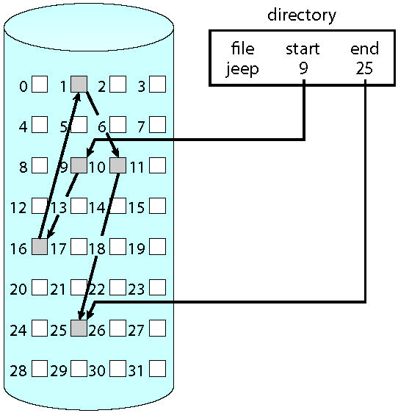
Linked Allocation (Cont.)

Slide 11
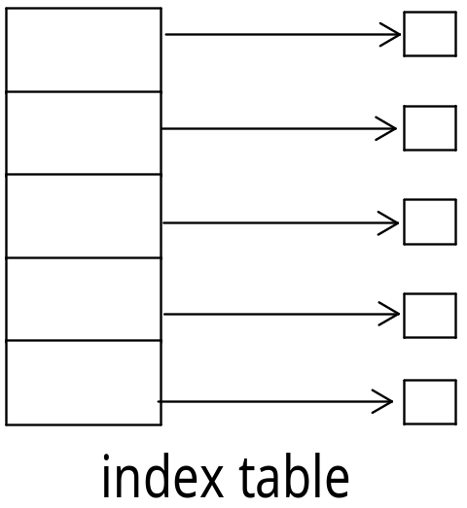
Indexed Allocation
Indexed allocation
  Each file has its own index block(s) of pointers to its data blocks
Logical view

Slide 12

Example of Indexed Allocation

Slide 13
Indexed Allocation (Cont.)
Need an index table
Random access
Dynamic access without external fragmentation, but have overhead of index block
Mapping from logical to physical in a file of maximum size of 256K bytes and block size of 512 bytes. We need only 1 block for index table
  Q = displacement into index table
  R = displacement into block
Q
LA/512
R

Slide 14
Indexed Allocation – Large Files
Mapping from logical to physical in a file of unbounded length (block size of 512 words)
Can be accomplished with 3 different methods:
  Linked scheme.
  Multilevel index
  Combined scheme.

Slide 15
Indexed Allocation – Linked Scheme
Link the blocks of an index table
Q₁
LA / (512 x 511)
R₁
  Q₁ = block of index table
  R₁ is used as follows:
Q₂
R₁ / 512
R₂
  Q₂ = displacement into block of index table
  R₂ displacement into block of file:

Slide 16
Indexed Allocation – Multilevel Index
Two-level index (4K blocks could store 1,024 four-byte pointers in outer index → 1,048,567 data blocks and file size of up to 4GB)
Q₁
LA / (512 x 512)
R₁
  Q₁ = displacement into outer-index
  R₁ is used as follows:
Q₂
R₁ / 512
R₂
  Q₂ = displacement into block of index table
  R₂ displacement into block of file:

Slide 17
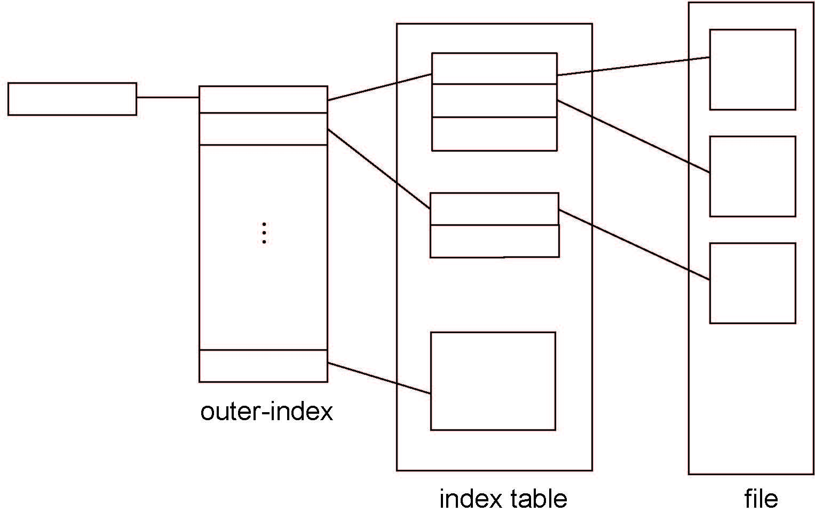
Indexed Allocation – Multilevel (Cont.)

Slide 18
Combined Scheme: UNIX UFS
4K bytes per block, 32-bit addresses
Keep the first 15 pointers of the index block in the file’s inode
The first 12 of these point to direct blocks; i.e., they contain addresses of the first 12 data blocks of the file. No need for a separate index block small files (of no more than 12 blocks). Up to 48 KB of data can be accessed directly.
The next three pointers point to indirect blocks.
  The first points to a single indirect block, which is an index block containing not data but the addresses of blocks that do contain data.
  The second points to a double indirect block, which contains the address of a block that contains the addresses of blocks that contain pointers to the actual data blocks.
  The last pointer contains the address of a triple indirect block.

Slide 19

Combined Scheme: UNIX UFS Example

Slide 20
Performance
Best method depends on file access type
  Contiguous great for sequential and random
Linked good for sequential, not random
Declare access type at creation -> select either contiguous or linked
Indexed more complex
  Single block access could require 2 index block reads then data block read

Slide 21
Performance (Cont.)
Adding instructions to the execution path to save one disk I/O is reasonable
  Intel Core i7 Extreme Edition 990x (2011) at 3.46Ghz = 159,000 MIPS
    http://en.wikipedia.org/wiki/Instructions_per_second
  Typical disk drive at 250 I/Os per second
    159,000 MIPS / 250 = 630 million instructions during one disk I/O
  Fast SSD drives provide 60,000 IOPS
    159,000 MIPS / 60,000 = 2.65 millions instructions during one disk I/O

Slide 22
Free-Space Management
File system maintains free-space list to track available blocks/clusters
  (Using term “block” for simplicity)
Four different methods:
  Bit map
  Free list
  Grouping
  Counting

Slide 23
Free-Space Management – bit map
Bit vector (or bit map) (n blocks)
0
1
2
n-1
…
1 ⇒ block[i] free
0 ⇒ block[i] occupied
bit[i] =

Block number calculation
(number of bits per word) *
(number of 0-value words) +
offset of first 1 bit
CPUs have instructions to return offset within word of first “1” bit

Slide 24
Free-Space Management – bit map
Bit vector (or bit map) (n blocks)
0
1
2
n-1
…
1 ⇒ block[i] free
0 ⇒ block[i] occupied
bit[i] = {
Block number calculation
(number of bits per word) *
(number of 0-value words) +
offset of first 1 bit
CPUs have instructions to return offset within word of first “1” bit

Slide 25
Bit Map (Cont.)
Bit map requires extra space
  Example:
block size = 4KB = 2¹² bytes
disk size = 2⁴⁰ bytes (1 terabyte)
n = 2⁴⁰/2¹² = 2²⁸ bits (or 32MB)
if clusters of 4 blocks -> 8MB of memory
But -- easy to get contiguous files

Slide 26

Free List
Linked list (free list)
  Cannot get contiguous space easily
  No waste of space
  No need to traverse the entire list (if # free blocks recorded)

Slide 27
Grouping and Counting
Grouping
  Modify linked list to store address of next n-1 free blocks in first free block, plus a pointer to next block that contains free-block-pointers (like this one)
Counting
  Because space is frequently contiguously used and freed, with contiguous-allocation allocation, extents, or clustering
    Keep address of first free block and count of following free blocks
    Free space list then has entries containing addresses and counts

Slide 28
Recovery
Consistency checking – compares data in directory structure with data blocks on disk, and tries to fix inconsistencies
  Can be slow and sometimes fails
Use system programs to back up data from disk to another storage device (magnetic tape, other magnetic disk, optical)
Recover lost file or disk by restoring data from backup

Slide 29
End of Chapter 14

