Slide 1
Chapter 15: Advanced File System

Slide 2
Chapter 15: Advanced File System
File-system Structure
Disk Structure
File-System Mounting
Partitions and Mounting
Virtual File Systems
Remote File Systems
Consistency Semantics
NSF
Internal File Structure
File Sharing

Slide 3
Objectives
To describe the details of implementing local file systems and directory structures
To describe the implementation of remote file systems
To discuss block allocation and free-block algorithms and trade-offs

Slide 4
File-System Structure
File structure
  Logical storage unit
  Collection of related information
File system resides on secondary storage (disks)
  Provided user interface to storage, mapping logical to physical
  Provides efficient and convenient access to disk by allowing data to be stored, located retrieved easily
Disk provides in-place rewrite and random access
  I/O transfers performed in blocks of sectors (usually 512 bytes)
File control block – storage structure consisting of information about a file
Device driver controls the physical device
File system organized into layers

Slide 5

Layered File System

Slide 6
File System Layers
Device drivers manage I/O devices at the I/O control layer
  Given commands like “read drive1, cylinder 72, track 2, sector 10, into memory location 1060” outputs low-level hardware specific commands to hardware controller
Basic file system given command like “retrieve block 123” translates to device driver
  Also manages memory buffers and caches (allocation, freeing, replacement)
    Buffers hold data in transit
    Caches hold frequently used data
File organization module understands files, logical address, and physical blocks
  Translates logical block # to physical block #
  Manages free space, disk allocation

Slide 7
File System Layers (Cont.)
Logical file system manages metadata information
  Translates file name into file number, file handle, location by maintaining file control blocks (inodes in UNIX)
  Directory management
  Protection
Layering useful for reducing complexity and redundancy, but adds overhead and can decrease performance. Translates file name into file number, file handle, location by maintaining file control blocks (inodes in UNIX)
  Logical layers can be implemented by any coding method according to OS designer

Slide 8
File System Layers (Cont.)
Many file systems, sometimes many within an operating system
  Each with its own format (CD-ROM is ISO 9660; Unix has UFS, FFS; Windows has FAT, FAT32, NTFS as well as floppy, CD, DVD Blu-ray, Linux has more than 40 types, with extended file system ext2 and ext3 leading; plus distributed file systems, etc.)
  New ones still arriving – ZFS, GoogleFS, Oracle ASM, FUSE

Slide 9
Disk Structure
Disk can be subdivided into partitions
Disk or partition can be used raw – without a file system, or formatted with a file system
An entity containing a file system is known as a volume
Each volume containing file system also tracks that file system’s info in device directory or volume table of contents
A device directory (or simply directory) records information; e.g., name, location, size, etc, about all the files that are kept on the volume.

Slide 10

A Typical File-system Organization

Slide 11
File System Mounting
A file system must be mounted before it can be accessed by the various processes executing in the system
Mount procedure. The operating system is given the name of the device and the mount point -- a location within the file structure where the file system is to be attached.
Typically, a mount point is an empty directory.
  For instance, on a UNIX system, a file system containing a user's home directories might be mounted as:
    /home
  To access the directory structure within that file system, we precede the directory names with /home, as in
    /home/jane.

Slide 12
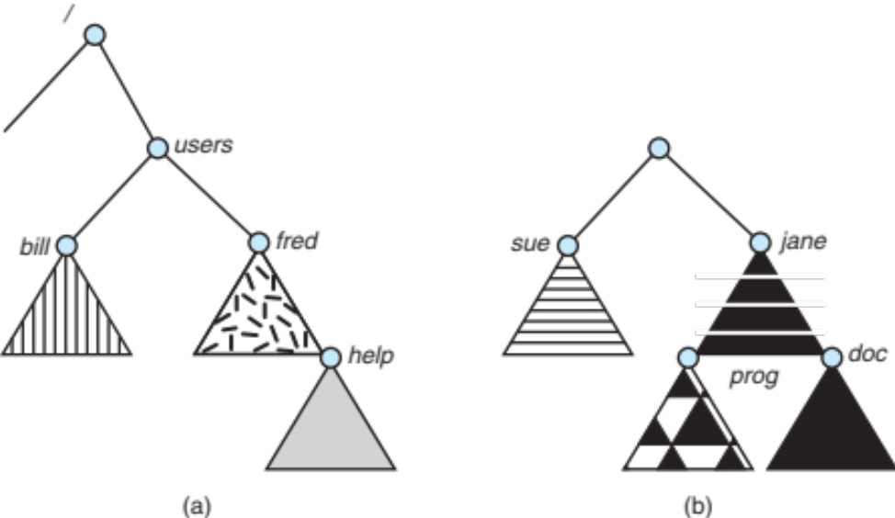
File System Mounting Example
Consider the file system depicted below
The triangles represent subtrees of directories.
Figure (a) shows an existing file system. Figure (b) shows an unmounted volume residing on /device/dsk.
At this point, only the files on the existing file system can be accessed.

Slide 13

File System Mounting Example
The figure blow shows the effect of mounting the volume residing on /device/dsk over /users.
If the volume is unmounted, the file system is restored to the situation depicted in previous slide.

Slide 14
File-System Implementation
We have system calls at the API level, but how do we implement their functions?
  On-disk and in-memory structures
Boot control block contains info needed by system to boot OS from that volume
  Needed if volume contains OS, usually first block of volume
Volume control block (superblock, master file table) contains volume details
  Total number of blocks, number of free blocks, block size, free block pointers or array
Directory structure organizes the files
  Names and inode numbers, master file table

Slide 15

File-System Implementation (Cont.)
File Control Block (FCB) contains many details about a particular file.
  inode number, permissions, size, dates
  NFTS (Window 7 file system) stores into in master file table using relational DB structures

Slide 16
Partitions and Mounting
Partition can be a volume containing a file system (“cooked”) or raw – just a sequence of blocks with no file system
Boot block can point to boot volume or boot loader set of blocks that contain enough code to know how to load the kernel from the file system
  Or a boot management program for multi-os booting
Root partition contains the OS, other partitions can hold other Oses, other file systems, or be raw
  Mounted at boot time
  Other partitions can mount automatically or manually
At mount time, file system consistency checked
  Is all metadata correct?
    If not, fix it, try again
    If yes, add to mount table, allow access

Slide 17
Virtual File Systems
Virtual File Systems (VFS) on Unix provide an object-oriented way of implementing file systems
VFS allows the same system call interface (the API) to be used for different types of file systems
  Separates file-system generic operations from implementation details
  Implementation can be one of many file systems types, or network file system
    Implements vnodes which hold inodes or network file details
  Then dispatches operation to appropriate file system implementation routines

Slide 18

Virtual File Systems (Cont.)
The API is to the VFS interface, rather than any specific type of file system

Slide 19
Virtual File System Implementation
For example, Linux has four object types:
  inode, file, superblock, dentry
VFS defines set of operations on the objects that must be implemented
  Every object has a pointer to a function table
    Function table has addresses of routines to implement that function on that object
    For example:
    • int open(. . .)—Open a file
    • int close(. . .)—Close an already-open file
    • ssize t read(. . .)—Read from a file
    • ssize t write(. . .)—Write to a file
    • int mmap(. . .)—Memory-map a file

Slide 20
File Sharing
Sharing of files on multi-user systems is desirable
Sharing may be done through a protection scheme
On distributed systems, files may be shared across a network
Network File System (NFS) is a common distributed file-sharing method
If multi-user system
  User IDs identify users, allowing permissions and protections to be per-user
  Group IDs allow users to be in groups, permitting group access rights
  Owner of a file / directory
  Group of a file / directory

Slide 21
File Sharing – Remote File Systems
Uses networking to allow file system access between systems
  Manually via programs like FTP
  Automatically, seamlessly using distributed file systems
  Semi automatically via the world wide web
Client-server model allows clients to mount remote file systems from servers
  Server can serve multiple clients
  Client and user-on-client identification is insecure or complicated
  NFS is standard UNIX client-server file sharing protocol
  CIFS is standard Windows protocol
  Standard operating system file calls are translated into remote calls
Distributed Information Systems (distributed naming services) such as LDAP, DNS, NIS, Active Directory implement unified access to information needed for remote computing

Slide 22
File Sharing – Failure Modes
All file systems have failure modes
  For example corruption of directory structures or other non-user data, called metadata
Remote file systems add new failure modes, due to network failure, server failure
Recovery from failure can involve state information about status of each remote request
Stateless protocols such as NFS v3 include all information in each request, allowing easy recovery but less security

Slide 23
File Sharing – Consistency Semantics
Specify how multiple users are to access a shared file simultaneously
  Similar to Ch 5 process synchronization algorithms
    Tend to be less complex due to disk I/O and network latency (for remote file systems
  Andrew File System (AFS) implemented complex remote file sharing semantics
  Unix file system (UFS) implements:
    Writes to an open file visible immediately to other users of the same open file
    Sharing file pointer to allow multiple users to read and write concurrently
  AFS has session semantics
    Writes only visible to sessions starting after the file is closed

Slide 24
Network File System (NFS)
An implementation and a specification of a software system for accessing remote files across LANs (or WANs)
The implementation is part of the Solaris and SunOS operating systems running on Sun workstations using an unreliable datagram protocol (UDP/IP protocol) and Ethernet
Interconnected workstations viewed as a set of independent machines with independent file systems, which allows sharing among these file systems in a transparent manner

Slide 25
NFS -- Interconnected workstations
A remote directory is mounted over a local file system directory
  The mounted directory looks like an integral sub-tree of the local file system, replacing the sub-tree descending from the local directory
Specification of the remote directory for the mount operation is nontransparent; the host name of the remote directory has to be provided
  Files in the remote directory can then be accessed in a transparent manner
Subject to access-rights accreditation, potentially any file system (or directory within a file system), can be mounted remotely on top of any local directory

Slide 26
NFS (Cont.)
NFS is designed to operate in a heterogeneous environment of different machines, operating systems, and network architectures; the NFS specifications independent of these media
This independence is achieved through the use of RPC primitives built on top of an External Data Representation (XDR) protocol used between two implementation-independent interfaces
The NFS specification distinguishes between the services provided by a mount mechanism and the actual remote-file-access services

Slide 27
NFS Mount
For a remote directory to be accessible in a transparent manner from a particular machine (say M1), a client of M1 must first carry out a mount operation.
The semantics of the operation involve mounting a remote directory over a directory of a local file system.
Once the mount operation is completed, the mounted directory looks like an integral sub-tree of the local file system, replacing the sub-tree descending from the local directory.
The local directory becomes the name of the root of the newly mounted directory.
Specification of the remote directory as an argument for the mount operation is not done transparently; the location (or host name) of the remote directory has to be provided.
However, from then on, users on machine M1 can access files in the remote directory in a totally transparent manner.

Slide 28

NFS Mount Example
Consider the file system depicted in the figure below, where the triangles represent subtrees of directories that are of interest.
The figure shows three independent file systems of machines named U, S1, and S2.
At this point, on each machine, only the local files can be accessed.

Slide 29
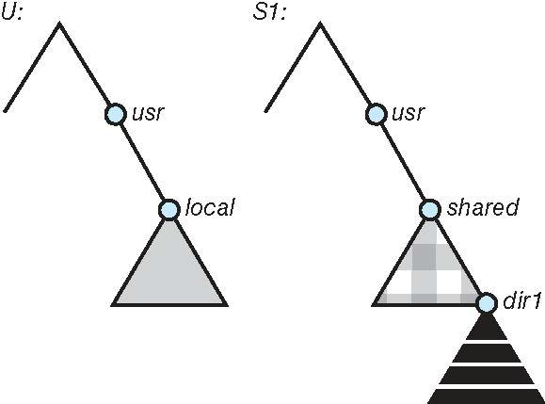
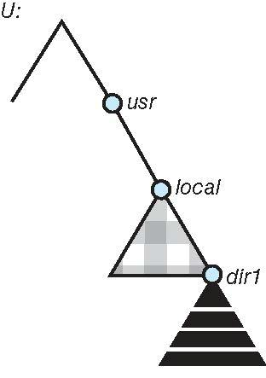
NFS Mount Example
Figure (b) below shows the effects of mounting S1:/usr/shared over U:/usr/local. This figure (b) depicts the view users U have of their file system
After the mount is complete, the users can access any file within the dir1 directory using the prefix /usr/local/dir1.
The original directory /usr/local on that machine is no longer visible.
(a) (b)

Slide 30
NFS Mount Protocol
Establishes initial logical connection between server and client
Mount operation includes name of remote directory to be mounted and name of server machine storing it
  Mount request is mapped to corresponding RPC and forwarded to mount server running on server machine
  Export list – specifies local file systems that server exports for mounting, along with names of machines that are permitted to mount them
Following a mount request that conforms to its export list, the server returns a file handle—a key for further accesses
File handle – a file-system identifier, and an inode number to identify the mounted directory within the exported file system
The mount operation changes only the user’s view and does not affect the server side

Slide 31
NFS Protocol
Provides a set of remote procedure calls for remote file operations. The procedures support the following operations:
  searching for a file within a directory
  reading a set of directory entries
  manipulating links and directories
  accessing file attributes
  reading and writing files
NFS servers are stateless; each request has to provide a full set of arguments (NFS V4 is just coming available – very different, stateful)
Modified data must be committed to the server’s disk before results are returned to the client (lose advantages of caching)
The NFS protocol does not provide concurrency-control mechanisms

Slide 32
Three Major Layers of NFS Architecture
UNIX file-system interface (based on the open, read, write, and close calls, and file descriptors)
Virtual File System (VFS) layer – distinguishes local files from remote ones, and local files are further distinguished according to their file-system types
  The VFS activates file-system-specific operations to handle local requests according to their file-system types
  Calls the NFS protocol procedures for remote requests
NFS service layer – bottom layer of the architecture
  Implements the NFS protocol

Slide 33
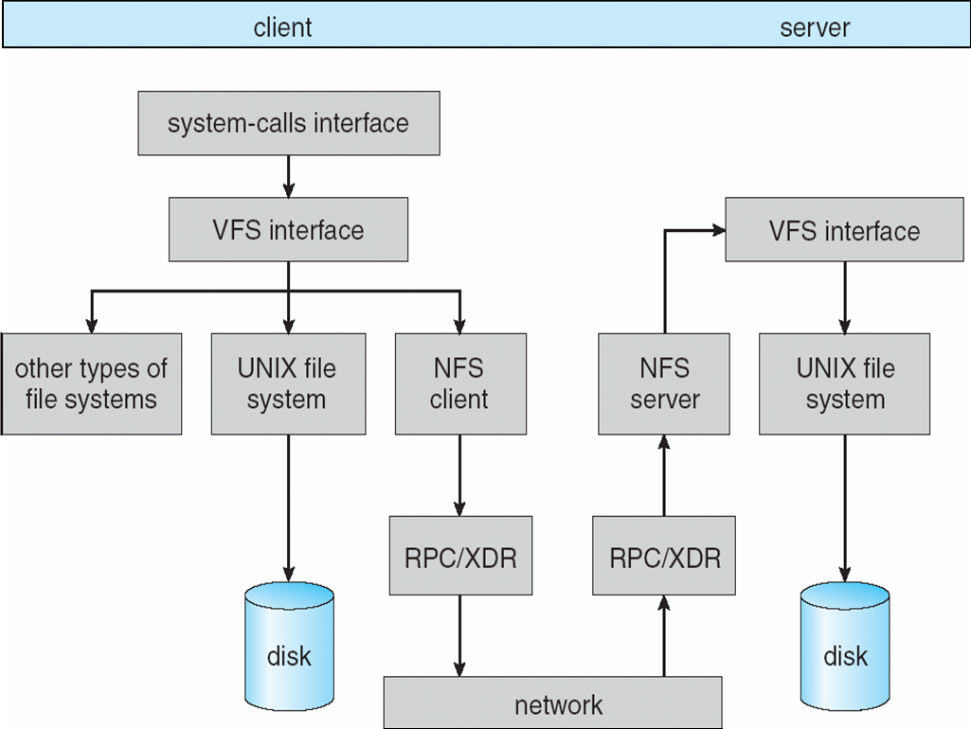
Schematic View of NFS Architecture

Slide 34
NFS Path-Name Translation
Performed by breaking the path into component names and performing a separate NFS lookup call for every pair of component name and directory vnode
To make lookup faster, a directory name lookup cache on the client’s side holds the vnodes for remote directory names

Slide 35
NFS Remote Operations
Nearly one-to-one correspondence between regular UNIX system calls and the NFS protocol RPCs (except opening and closing files)
NFS adheres to the remote-service paradigm, but employs buffering and caching techniques for the sake of performance
File-blocks cache – when a file is opened, the kernel checks with the remote server whether to fetch or revalidate the cached attributes
  Cached file blocks are used only if the corresponding cached attributes are up to date
File-attribute cache – the attribute cache is updated whenever new attributes arrive from the server
Clients do not free delayed-write blocks until the server confirms that the data have been written to disk

Slide 36
End of Chapter 15

