Slide 1
Chapter 17: Security

Slide 2
Chapter 17: Security
The Security Problem
Program Threats
System and Network Threats
Cryptography as a Security Tool
User Authentication
Implementing Security Defenses
Firewalling to Protect Systems and Networks
Computer-Security Classifications
An Example: Windows 7

Slide 3
Objectives
To discuss security threats and attacks
To explain the fundamentals of encryption, authentication, and hashing
To examine the uses of cryptography in computing
To describe the various countermeasures to security attacks

Slide 4
The Security Problem
System secure if resources used and accessed as intended under all circumstances
  Unachievable
Intruders (crackers) attempt to breach security
Threat is potential security violation
Attack is attempt to breach security
Attack can be accidental or malicious
Easier to protect against accidental than malicious misuse

Slide 5
Security Violation Categories
Breach of confidentiality
  Unauthorized reading of data
Breach of integrity
  Unauthorized modification of data
Breach of availability
  Unauthorized destruction of data
Theft of service
  Unauthorized use of resources
Denial of service (DOS)
  Prevention of legitimate use

Slide 6
Security Violation Methods
Masquerading (breach authentication)
  Pretending to be an authorized user to escalate privileges
Replay attack
  As is or with message modification
Man-in-the-middle attack
  Intruder sits in data flow, masquerading as sender to receiver and vice versa
Session hijacking
  Intercept an already-established session to bypass authentication

Slide 7

Standard Security Attacks

Slide 8
Security Measure Levels
Impossible to have absolute security, but make cost to perpetrator sufficiently high to deter most intruders
Security must occur at four levels to be effective:
  Physical
    Data centers, servers, connected terminals
  Human
    Avoid social engineering, phishing, dumpster diving
  Operating System
    Protection mechanisms, debugging
  Network
    Intercepted communications, interruption, DOS
Security is as weak as the weakest link in the chain
But can too much security be a problem?

Slide 9
Program Threats
Many variations, many names
Trojan Horse
  Code segment that misuses its environment
  Exploits mechanisms for allowing programs written by users to be executed by other users
  Spyware, pop-up browser windows, covert channels
  Up to 80% of spam delivered by spyware-infected systems
Trap Door
  Specific user identifier or password that circumvents normal security procedures
  Could be included in a compiler
  How to detect them?

Slide 10
Program Threats (Cont.)
Logic Bomb
  Program that initiates a security incident under certain circumstances
Stack and Buffer Overflow
  Exploits a bug in a program (overflow either the stack or memory buffers)
  Failure to check bounds on inputs, arguments
  Write past arguments on the stack into the return address on stack
  When routine returns from call, returns to hacked address
    Pointed to code loaded onto stack that executes malicious code
  Unauthorized user or privilege escalation

Slide 11
C Program with Buffer-overflow Condition
#include <stdio.h>
#define BUFFER SIZE 256
int main(int argc, char *argv[])
{
char buffer[BUFFER SIZE];
if (argc < 2)
return -1;
else {
strcpy(buffer,argv[1]);
return 0;
}
}

Slide 12

Layout of Typical Stack Frame

Slide 13
Modified Shell Code
#include <stdio.h>
int main(int argc, char *argv[])
{
execvp(‘‘\bin\sh’’,‘‘\bin \sh’’, NULL);
return 0;
}

Slide 14

Hypothetical Stack Frame
Before attack
After attack

Slide 15
Great Programming Required?
For the first step of determining the bug, and second step of writing exploit code, yes
Script kiddies can run pre-written exploit code to attack a given system
Attack code can get a shell with the processes’ owner’s permissions
  Or open a network port, delete files, download a program, etc
Depending on bug, attack can be executed across a network using allowed connections, bypassing firewalls
Buffer overflow can be disabled by disabling stack execution or adding bit to page table to indicate “non-executable” state
  Available in SPARC and x86
  But still have security exploits

Slide 16
Program Threats (Cont.)
Viruses
  Code fragment embedded in legitimate program
  Self-replicating, designed to infect other computers
  Very specific to CPU architecture, operating system, applications
  Usually borne via email or as a macro
  Visual Basic Macro to reformat hard drive
    Sub AutoOpen()
    Dim oFS
    Set oFS = CreateObject(’’Scripting.FileSystemObject’’)
    vs = Shell(’’c:command.com /k format c:’’,vbHide)
    End Sub

Slide 17
Program Threats (Cont.)
Virus dropper inserts virus onto the system
Many categories of viruses, literally many thousands of viruses
  File / parasitic
  Boot / memory
  Macro
  Source code
  Polymorphic to avoid having a virus signature
  Encrypted
  Stealth
  Tunneling
  Multipartite
  Armored

Slide 18

A Boot-sector Computer Virus

Slide 19
The Threat Continues
Attacks still common, still occurring
Attacks moved over time from science experiments to tools of organized crime
  Targeting specific companies
  Creating botnets to use as tool for spam and DDOS delivery
  Keystroke logger to grab passwords, credit card numbers
Why is Windows the target for most attacks?
  Most common
  Everyone is an administrator
    Licensing required?
  Monoculture considered harmful

Slide 20
System and Network Threats
Some systems “open” rather than secure by default
  Reduce attack surface
  But harder to use, more knowledge needed to administer
Network threats harder to detect, prevent
  Protection systems weaker
  More difficult to have a shared secret on which to base access
  No physical limits once system attached to internet
    Or on network with system attached to internet
  Even determining location of connecting system difficult
    IP address is only knowledge

Slide 21
System and Network Threats (Cont.)
Worms – use spawn mechanism; standalone program
Internet worm
  Exploited UNIX networking features (remote access) and bugs in finger and sendmail programs
  Exploited trust-relationship mechanism used by rsh to access friendly systems without use of password
  Grappling hook program uploaded main worm program
    99 lines of C code
  Hooked system then uploaded main code, tried to attack connected systems
  Also tried to break into other users accounts on local system via password guessing
  If target system already infected, abort, except for every 7th time

Slide 22

The Morris Internet Worm

Slide 23
System and Network Threats (Cont.)
Port scanning
  Automated attempt to connect to a range of ports on one or a range of IP addresses
  Detection of answering service protocol
  Detection of OS and version running on system
  nmap scans all ports in a given IP range for a response
  nessus has a database of protocols and bugs (and exploits) to apply against a system
  Frequently launched from zombie systems
    To decrease trace-ability

Slide 24
System and Network Threats (Cont.)
Denial of Service
  Overload the targeted computer preventing it from doing any useful work
  Distributed denial-of-service (DDOS) come from multiple sites at once
  Consider the start of the IP-connection handshake (SYN)
    How many started-connections can the OS handle?
  Consider traffic to a web site
    How can you tell the difference between being a target and being really popular?
  Accidental – CS students writing bad fork() code
  Purposeful – extortion, punishment

Slide 25
Sobig.F Worm
More modern example
Disguised as a photo uploaded to adult newsgroup via account created with stolen credit card
Targeted Windows systems
Had own SMTP engine to mail itself as attachment to everyone in infect system’s address book
Disguised with innocuous subject lines, looking like it came from someone known
Attachment was executable program that created WINPPR23.EXE in default Windows system directory
Plus the Windows Registry
[HKCU\SOFTWARE\Microsoft\Windows\CurrentVersion\Run]
"TrayX" = %windir%\winppr32.exe /sinc
[HKLM\SOFTWARE\Microsoft\Windows\CurrentVersion\Run]
"TrayX" = %windir%\winppr32.exe /sinc

Slide 26
Cryptography as a Security Tool
Broadest security tool available
  Internal to a given computer, source and destination of messages can be known and protected
    OS creates, manages, protects process IDs, communication ports
  Source and destination of messages on network cannot be trusted without cryptography
    Local network – IP address?
      Consider unauthorized host added
    WAN / Internet – how to establish authenticity
      Not via IP address

Slide 27
Cryptography
Means to constrain potential senders (sources) and / or receivers (destinations) of messages
  Based on secrets (keys)
  Enables
    Confirmation of source
    Receipt only by certain destination
    Trust relationship between sender and receiver

Slide 28
Encryption
Constrains the set of possible receivers of a message
Encryption algorithm consists of
  Set K of keys
  Set M of Messages
  Set C of ciphertexts (encrypted messages)
  A function E : K → (M→C). That is, for each k ∈ K, E_{k} is a function for generating ciphertexts from messages
    Both E and E_{k} for any k should be efficiently computable functions
  A function D : K → (C → M). That is, for each k ∈ K, D_{k} is a function for generating messages from ciphertexts
    Both D and D_{k} for any k should be efficiently computable functions

Slide 29
Encryption (Cont.)
An encryption algorithm must provide this essential property: Given a ciphertext c ∈ C, a computer can compute m such that E_{k}(m) = c only if it possesses k
  Thus, a computer holding k can decrypt ciphertexts to the plaintexts used to produce them, but a computer not holding k cannot decrypt ciphertexts
  Since ciphertexts are generally exposed (for example, sent on the network), it is important that it be infeasible to derive k from the ciphertexts

Slide 30
Symmetric Encryption
Same key used to encrypt and decrypt
  Therefore k must be kept secret
DES was most commonly used symmetric block-encryption algorithm (created by US Govt)
  Encrypts a block of data at a time
  Keys too short so now considered insecure
Triple-DES considered more secure
  Algorithm used 3 times using 2 or 3 keys
  For example
2001 NIST adopted new block cipher - Advanced Encryption Standard (AES)
  Keys of 128, 192, or 256 bits, works on 128 bit blocks
RC4 is most common symmetric stream cipher, but known to have vulnerabilities
  Encrypts/decrypts a stream of bytes (i.e., wireless transmission)
  Key is a input to pseudo-random-bit generator
    Generates an infinite keystream

Slide 31

Secure Communication over Insecure Medium

Slide 32
Asymmetric Encryption
Public-key encryption based on each user having two keys:
  public key – published key used to encrypt data
  private key – key known only to individual user used to decrypt data
Must be an encryption scheme that can be made public without making it easy to figure out the decryption scheme
  Most common is RSA block cipher
  Efficient algorithm for testing whether or not a number is prime
  No efficient algorithm is know for finding the prime factors of a number

Slide 33
Asymmetric Encryption (Cont.)
Formally, it is computationally infeasible to derive k_{d,N} from k_{e,N}, and so k_{e} need not be kept secret and can be widely disseminated
  k_{e} is the public key
  k_{d} is the private key
  N is the product of two large, randomly chosen prime numbers p and q (for example, p and q are 512 bits each)
  Encryption algorithm is E_{ke,N}(m) = m^{ke} mod N, where k_{e} satisfies k_{e}k_{d} mod (p−1)(q −1) = 1
  The decryption algorithm is then D_{kd,N}(c) = c^{kd} mod N

Slide 34
Asymmetric Encryption Example
For example. make p = 7and q = 13
We then calculate N = 7∗13 = 91 and (p−1)(q−1) = 72
We next select k_{e} relatively prime to 72 and< 72, yielding 5
Finally, we calculate k_{d} such that k_{e}k_{d} mod 72 = 1, yielding 29
We how have our keys
  Public key, k_{e,N} = 5, 91
  Private key, k_{d,N} = 29, 91
Encrypting the message 69 with the public key results in the cyphertext 62
Cyphertext can be decoded with the private key
  Public key can be distributed in cleartext to anyone who wants to communicate with holder of public key

Slide 35

Encryption using RSA Asymmetric Cryptography

Slide 36
Cryptography (Cont.)
Note symmetric cryptography based on transformations, asymmetric based on mathematical functions
  Asymmetric much more compute intensive
  Typically not used for bulk data encryption

Slide 37
Authentication
Constraining set of potential senders of a message
  Complementary to encryption
  Also can prove message unmodified
Algorithm components
  A set K of keys
  A set M of messages
  A set A of authenticators
  A function S : K → (M→ A)
    That is, for each k ∈ K, S_{k} is a function for generating authenticators from messages
    Both S and S_{k} for any k should be efficiently computable functions
  A function V : K → (M × A→ {true, false}). That is, for each k ∈ K, V_{k} is a function for verifying authenticators on messages
    Both V and V_{k} for any k should be efficiently computable functions

Slide 38
Authentication (Cont.)
For a message m, a computer can generate an authenticator a ∈ A such that V_{k}(m, a) = true only if it possesses k
Thus, computer holding k can generate authenticators on messages so that any other computer possessing k can verify them
Computer not holding k cannot generate authenticators on messages that can be verified using V_{k}
Since authenticators are generally exposed (for example, they are sent on the network with the messages themselves), it must not be feasible to derive k from the authenticators
Practically, if V_{k}(m,a) = true then we know m has not been modified and that send of message has k
  If we share k with only one entity, know where the message originated

Slide 39
Authentication – Hash Functions
Basis of authentication
Creates small, fixed-size block of data message digest (hash value) from m
Hash Function H must be collision resistant on m
  Must be infeasible to find an m’ ≠ m such that H(m) = H(m’)
If H(m) = H(m’), then m = m’
  The message has not been modified
Common message-digest functions include MD5, which produces a 128-bit hash, and SHA-1, which outputs a 160-bit hash
Not useful as authenticators
  For example H(m) can be sent with a message
    But if H is known someone could modify m to m’ and recompute H(m’) and modification not detected
    So must authenticate H(m)

Slide 40
Authentication - MAC
Symmetric encryption used in message-authentication code (MAC) authentication algorithm
Cryptographic checksum generated from message using secret key
  Can securely authenticate short values
If used to authenticate H(m) for an H that is collision resistant, then obtain a way to securely authenticate long message by hashing them first
Note that k is needed to compute both S_{k} and V_{k}, so anyone able to compute one can compute the other

Slide 41
Authentication – Digital Signature
Based on asymmetric keys and digital signature algorithm
Authenticators produced are digital signatures
Very useful – anyone can verify authenticity of a message
In a digital-signature algorithm, computationally infeasible to derive k_{s} from k_{v}
  V is a one-way function
  Thus, k_{v} is the public key and k_{s} is the private key
Consider the RSA digital-signature algorithm
  Similar to the RSA encryption algorithm, but the key use is reversed
  Digital signature of message S_{ks} (m) = H(m)^{ks} mod N
  The key k_{s} again is a pair (d, N), where N is the product of two large, randomly chosen prime numbers p and q
  Verification algorithm is V_{kv}(m, a) (a^{kv} mod N = H(m))
    Where k_{v} satisfies k_{v}k_{s} mod (p − 1)(q − 1) = 1

Slide 42
Authentication (Cont.)
Why authentication if a subset of encryption?
  Fewer computations (except for RSA digital signatures)
  Authenticator usually shorter than message
  Sometimes want authentication but not confidentiality
    Signed patches et al
  Can be basis for non-repudiation

Slide 43
Key Distribution
Delivery of symmetric key is huge challenge
  Sometimes done out-of-band
Asymmetric keys can proliferate – stored on key ring
  Even asymmetric key distribution needs care – man-in-the-middle attack

Slide 44
Digital Certificates
Proof of who or what owns a public key
Public key digitally signed a trusted party
Trusted party receives proof of identification from entity and certifies that public key belongs to entity
Certificate authority are trusted party – their public keys included with web browser distributions
  They vouch for other authorities via digitally signing their keys, and so on

Slide 45

Man-in-the-middle Attack on Asymmetric Cryptography

Slide 46


Implementation of Cryptography
Can be done at various layers of ISO Reference Model
  SSL at the Transport layer
  Network layer is typically IPSec
    IKE for key exchange
    Basis of Virtual Private Networks (VPNs)
Why not just at lowest level?
  Sometimes need more knowledge than available at low levels
    i.e. User authentication
    i.e. e-mail delivery
Source: http://en.wikipedia.org/wiki/OSI_model

Slide 47
Encryption Example - SSL
Insertion of cryptography at one layer of the ISO network model (the transport layer)
SSL – Secure Socket Layer (also called TLS)
Cryptographic protocol that limits two computers to only exchange messages with each other
  Very complicated, with many variations
Used between web servers and browsers for secure communication (credit card numbers)
The server is verified with a certificate assuring client is talking to correct server
Asymmetric cryptography used to establish a secure session key (symmetric encryption) for bulk of communication during session
Communication between each computer then uses symmetric key cryptography
More details in textbook

Slide 48
User Authentication
Crucial to identify user correctly, as protection systems depend on user ID
User identity most often established through passwords, can be considered a special case of either keys or capabilities
Passwords must be kept secret
  Frequent change of passwords
  History to avoid repeats
  Use of “non-guessable” passwords
  Log all invalid access attempts (but not the passwords themselves)
  Unauthorized transfer
Passwords may also either be encrypted or allowed to be used only once
  Does encrypting passwords solve the exposure problem?
    Might solve sniffing
    Consider shoulder surfing
    Consider Trojan horse keystroke logger
    How are passwords stored at authenticating site?

Slide 49
Passwords
Encrypt to avoid having to keep secret
  But keep secret anyway (i.e. Unix uses superuser-only readably file /etc/shadow)
  Use algorithm easy to compute but difficult to invert
  Only encrypted password stored, never decrypted
  Add “salt” to avoid the same password being encrypted to the same value
One-time passwords
  Use a function based on a seed to compute a password, both user and computer
  Hardware device / calculator / key fob to generate the password
    Changes very frequently
Biometrics
  Some physical attribute (fingerprint, hand scan)
Multi-factor authentication
  Need two or more factors for authentication
    i.e. USB “dongle”, biometric measure, and password

Slide 50
Implementing Security Defenses
Defense in depth is most common security theory – multiple layers of security
Security policy describes what is being secured
Vulnerability assessment compares real state of system / network compared to security policy
Intrusion detection endeavors to detect attempted or successful intrusions
  Signature-based detection spots known bad patterns
  Anomaly detection spots differences from normal behavior
    Can detect zero-day attacks
  False-positives and false-negatives a problem
Virus protection
  Searching all programs or programs at execution for known virus patterns
  Or run in sandbox so can’t damage system
Auditing, accounting, and logging of all or specific system or network activities
Practice safe computing – avoid sources of infection, download from only “good” sites, etc

Slide 51
Firewalling to Protect Systems and Networks
A network firewall is placed between trusted and untrusted hosts
  The firewall limits network access between these two security domains
Can be tunneled or spoofed
  Tunneling allows disallowed protocol to travel within allowed protocol (i.e., telnet inside of HTTP)
  Firewall rules typically based on host name or IP address which can be spoofed
Personal firewall is software layer on given host
  Can monitor / limit traffic to and from the host
Application proxy firewall understands application protocol and can control them (i.e., SMTP)
System-call firewall monitors all important system calls and apply rules to them (i.e., this program can execute that system call)

Slide 52

Network Security Through Domain Separation Via Firewall

Slide 53
Computer Security Classifications
U.S. Department of Defense outlines four divisions of computer security: A, B, C, and D
D – Minimal security
C – Provides discretionary protection through auditing
  Divided into C1 and C2
    C1 identifies cooperating users with the same level of protection
    C2 allows user-level access control
B – All the properties of C, however each object may have unique sensitivity labels
  Divided into B1, B2, and B3
A – Uses formal design and verification techniques to ensure security

Slide 54
Example: Windows 7
Security is based on user accounts
  Each user has unique security ID
  Login to ID creates security access token
    Includes security ID for user, for user’s groups, and special privileges
    Every process gets copy of token
    System checks token to determine if access allowed or denied
Uses a subject model to ensure access security
  A subject tracks and manages permissions for each program that a user runs
Each object in Windows has a security attribute defined by a security descriptor
  For example, a file has a security descriptor that indicates the access permissions for all users

Slide 55
Example: Windows 7 (Cont.)
Win added mandatory integrity controls – assigns integrity label to each securable object and subject
  Subject must have access requested in discretionary access-control list to gain access to object
Security attributes described by security descriptor
  Owner ID, group security ID, discretionary access-control list, system access-control list

Slide 56
End of Chapter 17

Slide 57
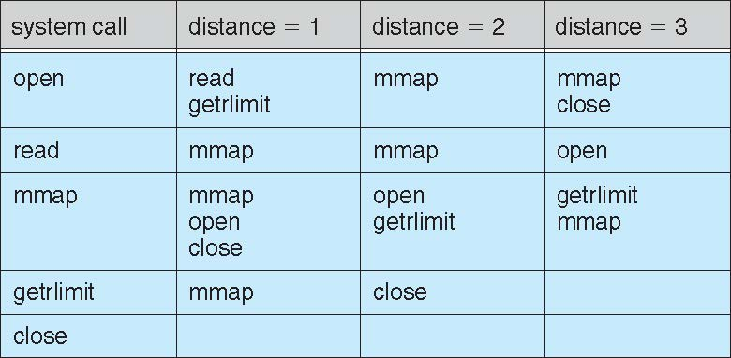
Figure 15 unidentified

Slide 58
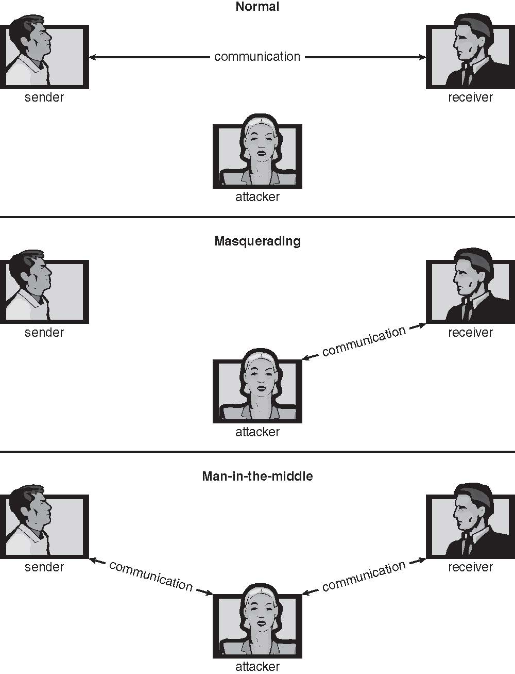
Figure 17.01

Slide 59
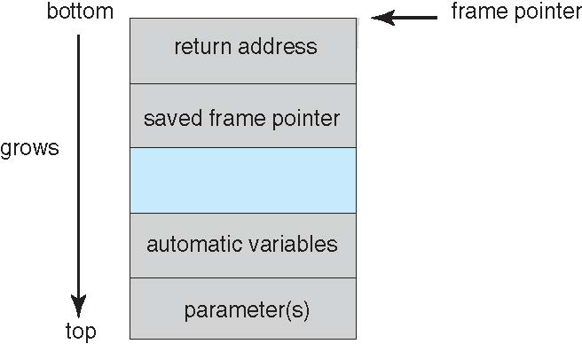
Figure 17.03

Slide 60
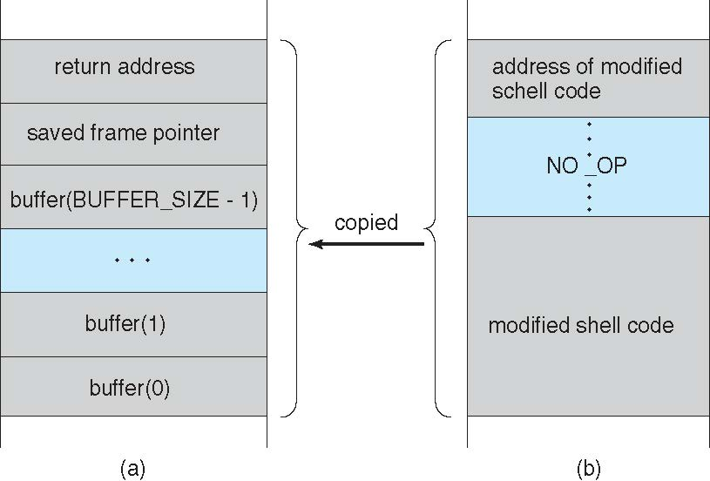
Figure 17.04

Slide 61

Figure 17.05

Slide 62
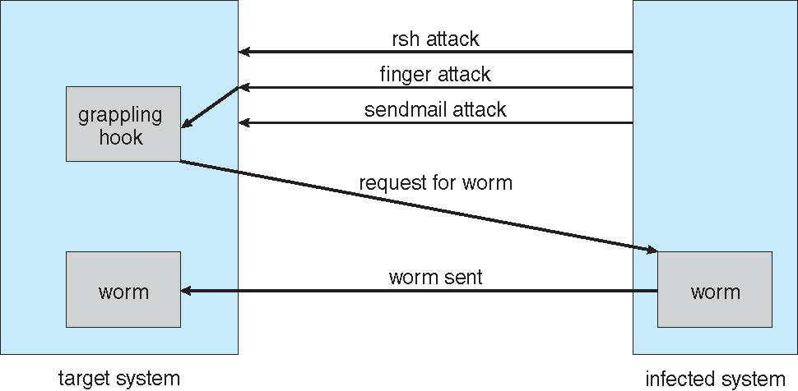
Figure 17.06

Slide 63
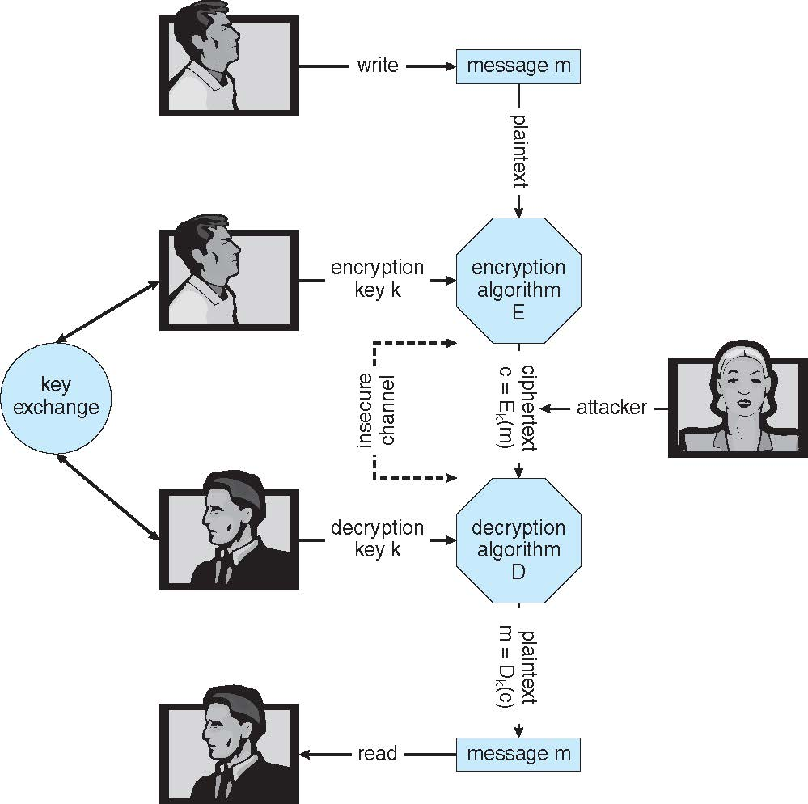
Figure 17.07

Slide 64
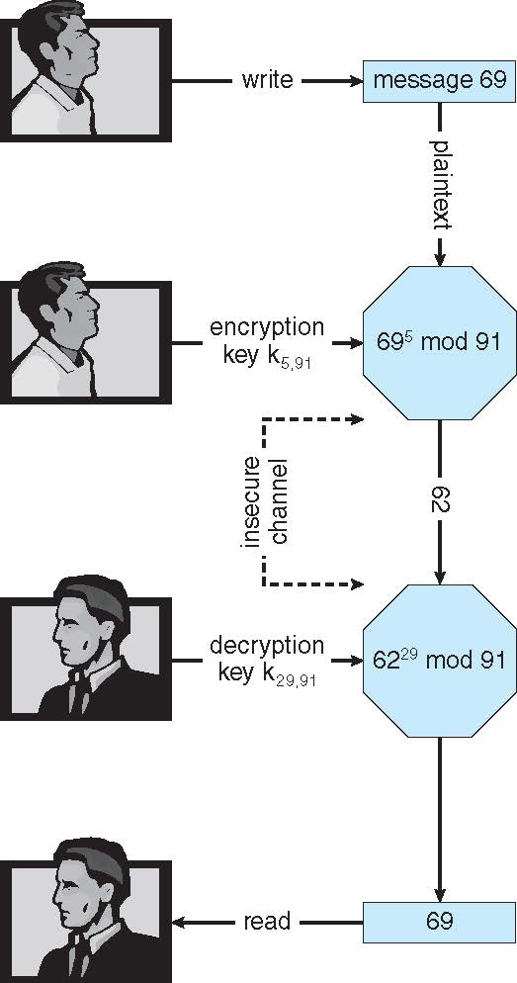
Figure 17.08

Slide 65

Figure 17.09

Slide 66
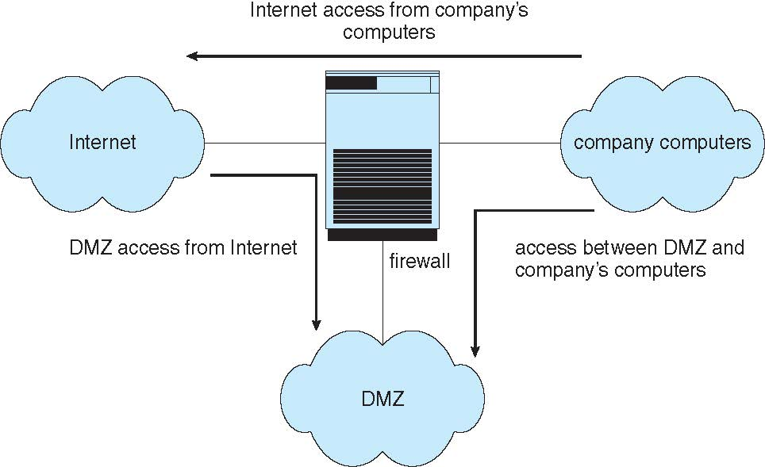
Figure 17.10

