Slide 1
A Gaussian Process Emulator Based Approach for Bayesian Calibration of a Functional Input
Zhaohui Li
Georgia Institute of Technology
Joint work with Matthias Hwai Yong Tan
Acknowledgement: This work has been supported by two grants from the Research Grants Council of the Hong Kong Special Administrative Region, China (General Research Fund Project Nos.: CityU 11201117 and CityU 11205118).

Slide 2
Outline
Introduction and motivation example
Methodology for Bayesian calibration of functional input
Numerical studies
Summary

Slide 3
Introduction
In this talk, we will introduce a new method for calibration of functional input with a time-consuming simulator.
Problem in consideration: Estimating the functional input of a partial differential equation (PDE) model form the observation of physical experiment.

Slide 4
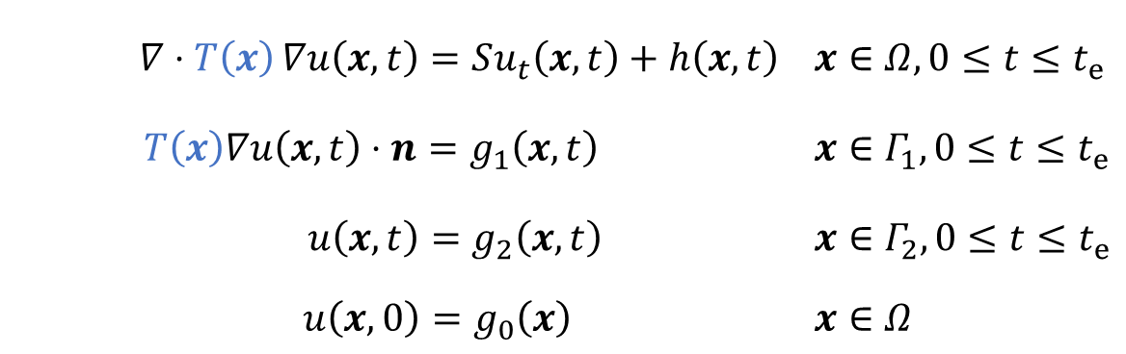
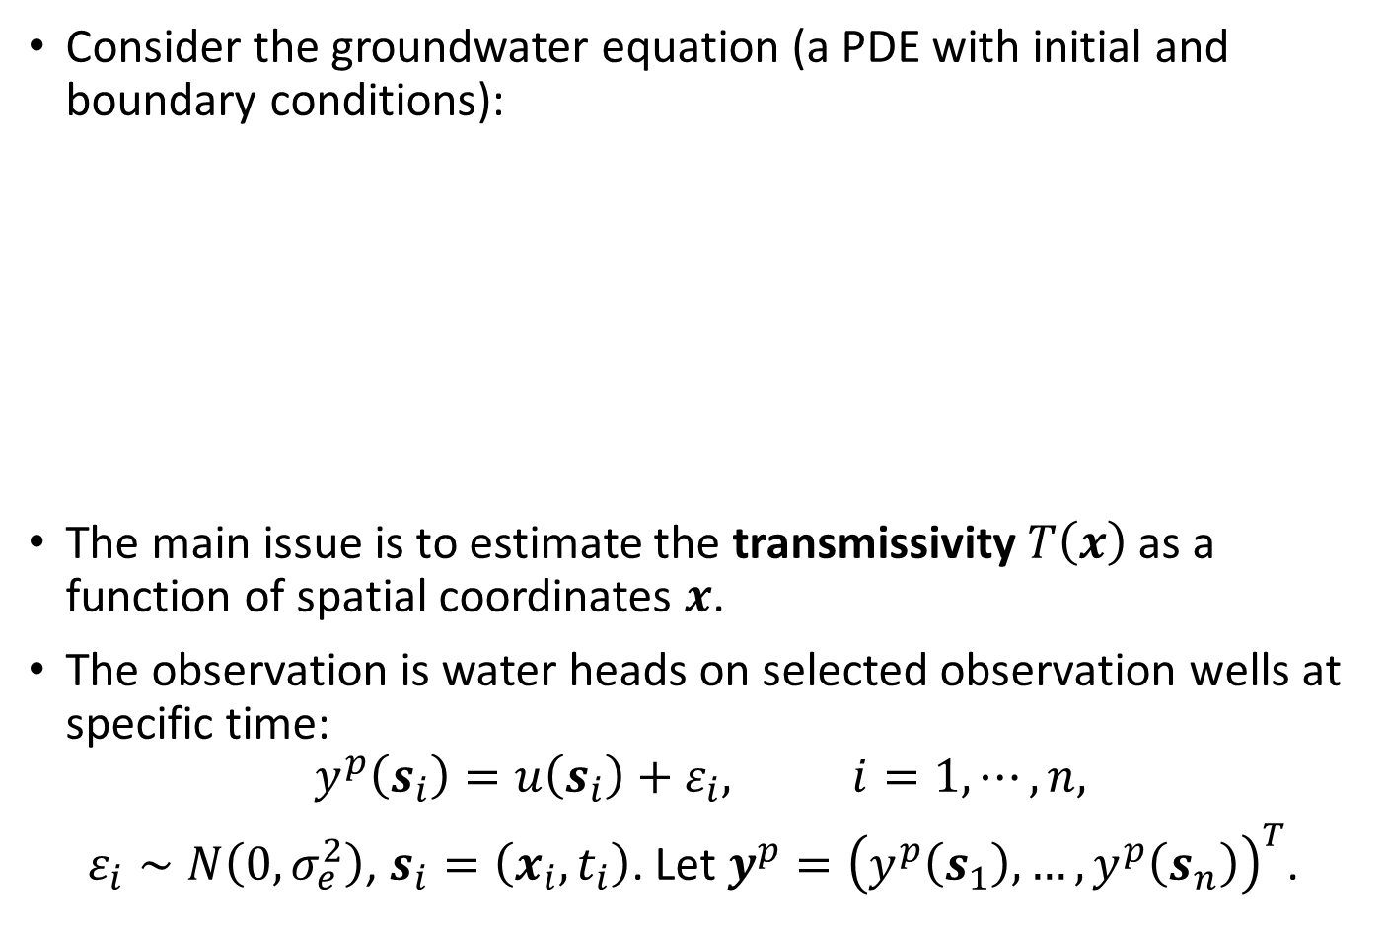
Motivation Example
Consider the groundwater equation (a PDE with initial and boundary conditions):
The main issue is to estimate the transmissivity $T\left(x\right)$ as a function of spatial coordinates $x$.
The observation is water heads on selected observation wells at specific time:
$$y^{p}\left(s_{i}\right)=u\left(s_{i}\right)+ε_{i}, i=1,⋯,n,$$
$ε_{i}∼N\left(0, σ_{e}^{2}\right)$, $s_{i}=\left(x_{i},t_{i}\right)$. Let$y^{p}={\left(y^{p}\left(s_{1}\right),…,y^{p}\left(s_{n}\right)\right)}^{T}$.
$$∇⋅T\left(x\right){∇u\left(x,t\right)}=Su_{t}\left(x,t\right)+h\left(x,t\right)$$ | $x∈Ω,0≤t≤t_{e}$
$$T\left(x\right)∇u\left(x,t\right)⋅n=g_{1}\left(x,t\right)$$ | $x∈Γ_{1}, 0≤t≤t_{e}$
$$u\left(x,t\right)=g_{2}\left(x,t\right)$$ | $x∈Γ_{2}, 0≤t≤t_{e}$
$$u\left(x,0\right)=g_{0}\left(x\right)$$ | $x∈Ω$

Slide 5
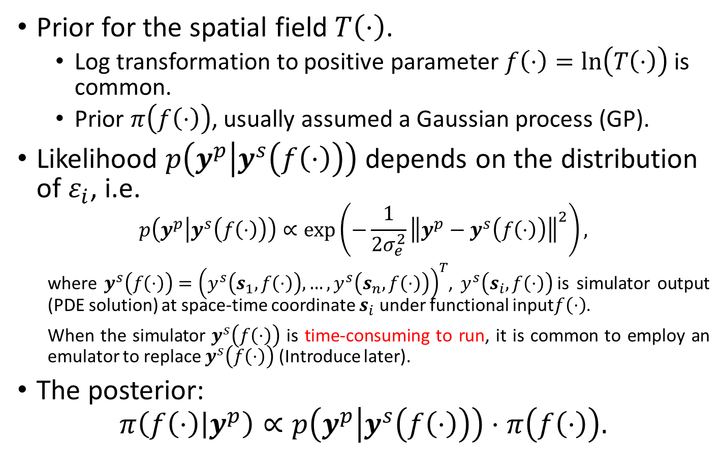
Bayesian Calibration Framework
Prior for the spatial field $T\left(⋅\right)$.
Log transformation to positive parameter $f\left(⋅\right)=ln\left(T\left(⋅\right)\right)$ is common.
Prior $π\left(f\left(⋅\right)\right)$, usually assumed a Gaussian process (GP).
Likelihood $p\left(y^{p} | y^{s}\left(f\left(⋅\right)\right)\right)$ depends on the distribution of $ε_{i}$, i.e.
$$p\left(y^{p} | y^{s}\left(f\left(⋅\right)\right)\right)∝\exp\left(−\frac{1}{2σ_{e}^{2}}{\left\|y^{p}−y^{s}\left(f\left(⋅\right)\right)\right\|}^{2}\right),$$
where $y^{s}\left(f\left(⋅\right)\right)={\left(y^{s}\left(s_{1},f\left(⋅\right)\right), …,y^{s}\left(s_{n},f\left(⋅\right)\right)\right)}^{T}$, $y^{s}\left(s_{i},f\left(⋅\right)\right)$is simulator output (PDE solution) at space-time coordinate $s_{i}$ under functional input$f\left(⋅\right)$.
When the simulator $y^{s}\left(f\left(⋅\right)\right)$ is time-consuming to run, it is common to employ an emulator to replace $y^{s}\left(f\left(⋅\right)\right)$ (Introduce later).
The posterior:
$$π\left(f\left(⋅\right) | y^{p}\right)∝p\left(y^{p} | y^{s}\left(f\left(⋅\right)\right)\right)⋅π\left(f\left(⋅\right)\right).$$

Slide 6
Main Contributions
For functional input:
We employ a GP prior with a Gaussian correlation function and a uniform prior for its correlation parameter to model the standardized functional input. We propose the use of a truncated KL expansion of the prior process for dimension reduction.
For time-consuming simulator:
When employing GP emulator to approximate time-consuming simulator, we propose a sequential design criterion that select follow-up design points from high posterior regions with large prediction variance. The criterion can be efficiently computed when the input and output are high dimensional.

Slide 7
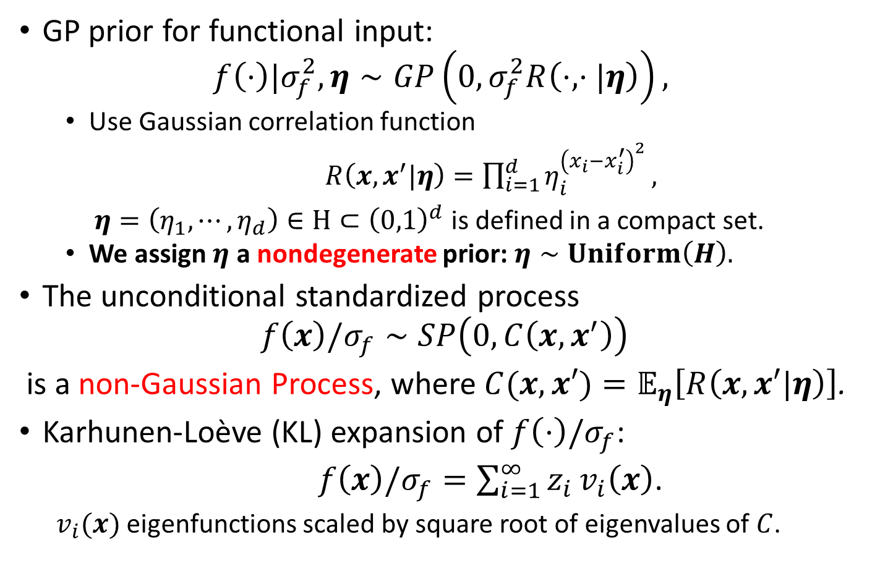
Prior for Functional Input
GP prior for functional input:
$$f\left(⋅\right)|σ_{f}^{2},η∼GP\left(0,σ_{f}^{2}R\left(⋅, ⋅|η\right)\right),$$
Use Gaussian correlation function
$R\left(x,x^{′}|η\right)=\prod_{i=1}^{d}{η_{i}^{{\left(x_{i}−x_{i}^{′}\right)}^{2}}},$
$η=\left(η_{1},⋯,η_{d}\right)∈Η⊂{\left(0,1\right)}^{d}$ is defined in a compact set.
We assign $η$ a nondegenerate prior: $η∼Uniform\left(Η\right).$
The unconditional standardized process
$$f\left(x\right)/σ_{f}∼SP\left(0, C\left(x,x^{′}\right)\right)$$
is a non-Gaussian Process, where $C(x,x′)=𝔼_{η}\left[R\left(x,x′|η\right)\right]$.
Karhunen-Loève (KL) expansion of $f\left(⋅\right)/σ_{f}$:
$f\left(x\right)/σ_{f}=\sum_{i=1}^{∞}{z_{i}}v_{i}\left(x\right)$.
$v_{i}(x)$ eigenfunctions scaled by square root of eigenvalues of $C$.

Slide 8
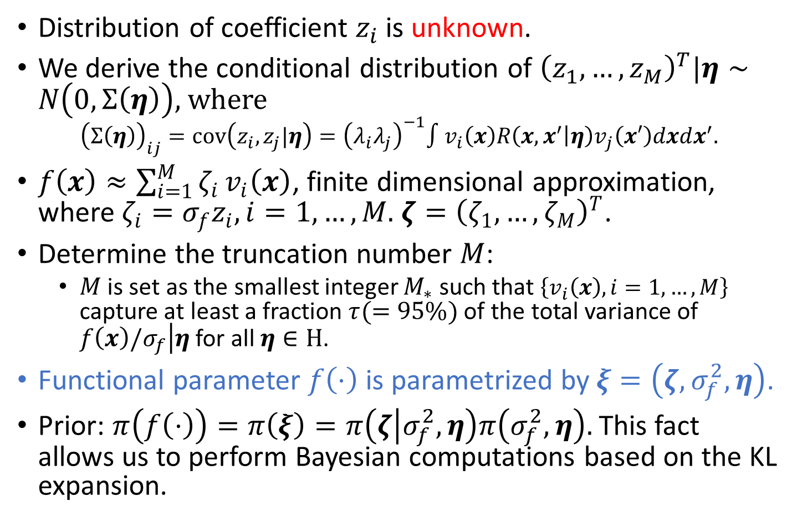
Karhunen-Loève (KL) Expansion
Distribution of coefficient $z_{i}$is unknown.
We derive the conditional distribution of ${\left(z_{1},…,z_{M}\right)}^{T}|η∼N\left(0, Σ\left(η\right)\right)$, where
$${\left(Σ\left(η\right)\right)}_{ij}=cov\left(z_{i},z_{j}|η\right)={\left(λ_{i}λ_{j}\right)}^{−1}∫v_{i}\left(x\right)R\left(x,x^{′} | η\right)v_{j}\left(x′\right)dxdx^{′}.$$
$f\left(x\right)≈\sum_{i=1}^{M}{ζ_{i}}v_{i}\left(x\right)$, finite dimensional approximation, where $ζ_{i}=σ_{f}z_{i}, i=1,…,M.$ $ζ={\left(ζ_{1},…,ζ_{M}\right)}^{T}$.
Determine the truncation number $M$:
$M$ is set as the smallest integer $M_{∗}$ such that $\left\{v_{i}\left(x\right), i=1,…,M\right\}$ capture at least a fraction $τ(=95\%)$ of the total variance of $\left.f\left(x\right)/σ_{f}\right|η$ for all $η∈Η$.
Functional parameter $f\left(⋅\right)$ is parametrized by $ξ=\left(ζ,σ_{f}^{2}, η\right)$.
Prior: $π\left(f\left(⋅\right)\right)=π\left(ξ\right)=π\left(ζ | σ_{f}^{2},η\right)π\left(σ_{f}^{2},η\right).$This fact allows us to perform Bayesian computations based on the KL expansion.

Slide 9
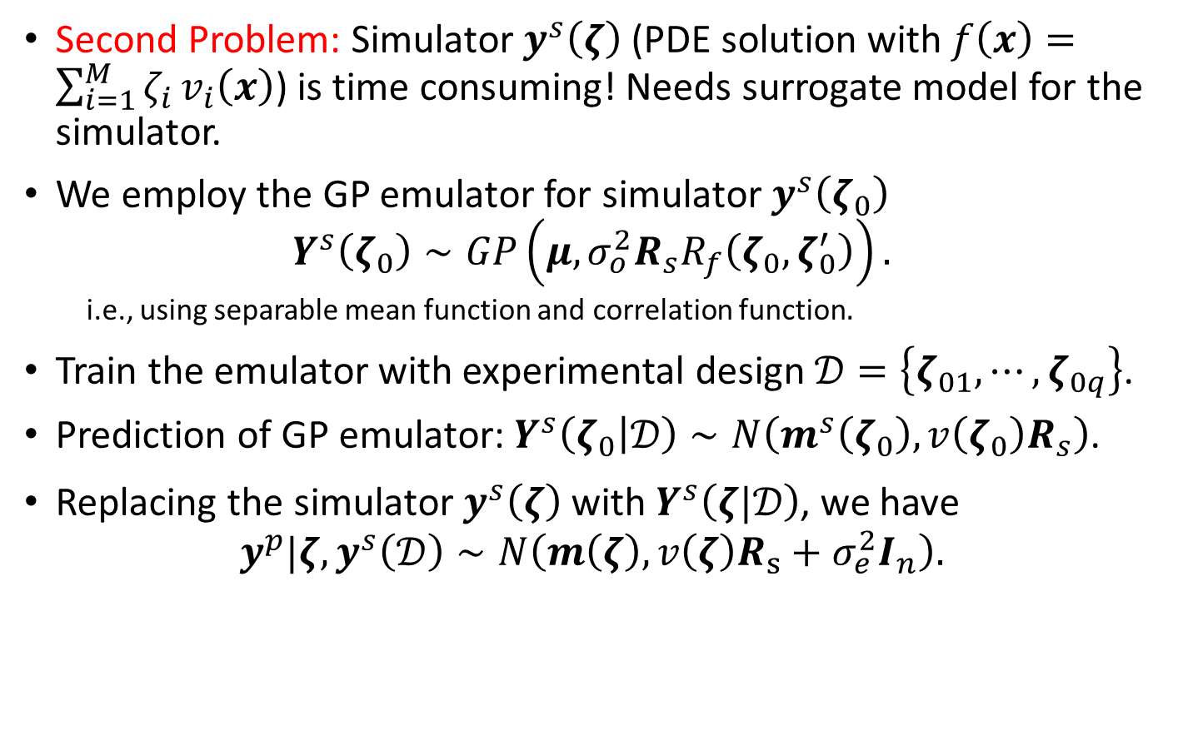
The Emulator-based Posterior
Second Problem: Simulator $y^{s}\left(ζ\right)$ (PDE solution with $f\left(x\right)=\sum_{i=1}^{M}{ζ_{i}}v_{i}\left(x\right)$) is time consuming! Needs surrogate model for the simulator.
We employ the GP emulator for simulator $y^{s}\left(ζ_{0}\right)$
$$Y^{s}\left(ζ_{0}\right)∼GP\left(μ,σ_{o}^{2}R_{s}R_{f}\left(ζ_{0},ζ_{0}^{′}\right)\right).$$
i.e., using separable mean function and correlation function$.$
Train the emulator with experimental design $𝒟=\left\{ζ_{01},⋯,ζ_{0q}\right\}$.
Prediction of GP emulator: $Y^{s}\left(\left.ζ_{0}\right|𝒟\right)∼N\left(m^{s}\left(ζ_{0}\right),v\left(ζ_{0}\right)R_{s}\right)$.
Replacing the simulator $y^{s}\left(ζ\right)$ with $Y^{s}\left(ζ|𝒟\right)$, we have
$$y^{p}|ζ,y^{s}\left(𝒟\right)∼N\left(m\left(ζ\right),v\left(ζ\right)R_{s}+σ_{e}^{2}I_{n}\right).$$

Slide 10
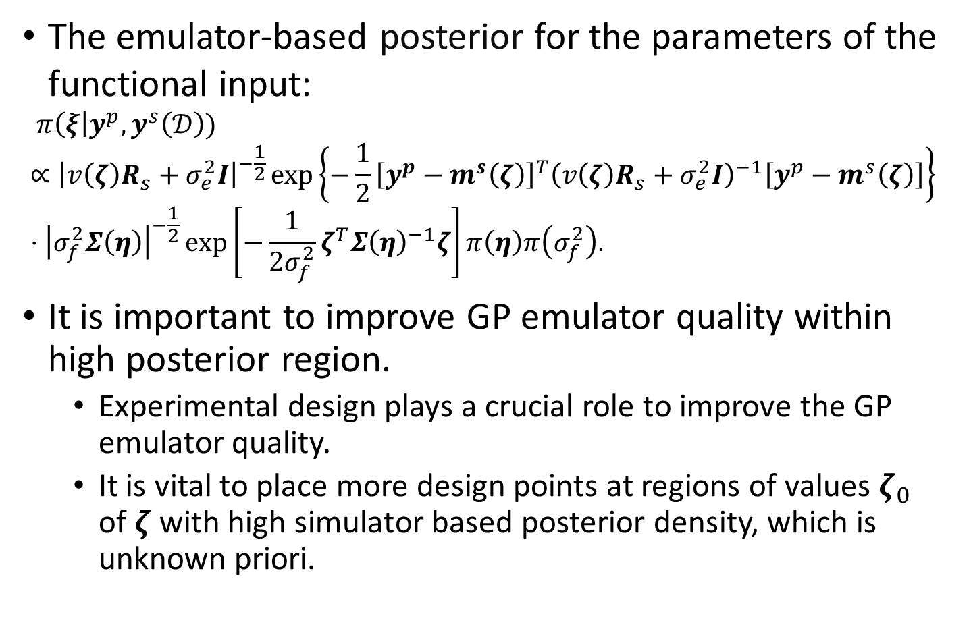
The Emulator-based Posterior
The emulator-based posterior for the parameters of the functional input:
$$π\left(ξ\right|y^{p},y^{s}\left(𝒟\right))∝{\left|v\left(ζ\right)R_{s}+σ_{e}^{2}I\right|}^{−\frac{1}{2}}\exp\left\{−\frac{1}{2}{\left[y^{p}−m^{s}\left(ζ\right)\right]}^{T}{\left(v\left(ζ\right)R_{s}+σ_{e}^{2}I\right)}^{−1}\left[y^{p}−m^{s}\left(ζ\right)\right]\right\}⋅{\left|σ_{f}^{2}Σ\left(η\right)\right|}^{−\frac{1}{2}}\exp\left[−\frac{1}{2σ_{f}^{2}}ζ^{T}{Σ\left(η\right)}^{−1}ζ\right]π\left(η\right)π\left(σ_{f}^{2}\right).$$
It is important to improve GP emulator quality within high posterior region.
Experimental design plays a crucial role to improve the GP emulator quality.
It is vital to place more design points at regions of values $ζ_{0}$ of $ζ$ with high simulator based posterior density, which is unknown priori.

Slide 11
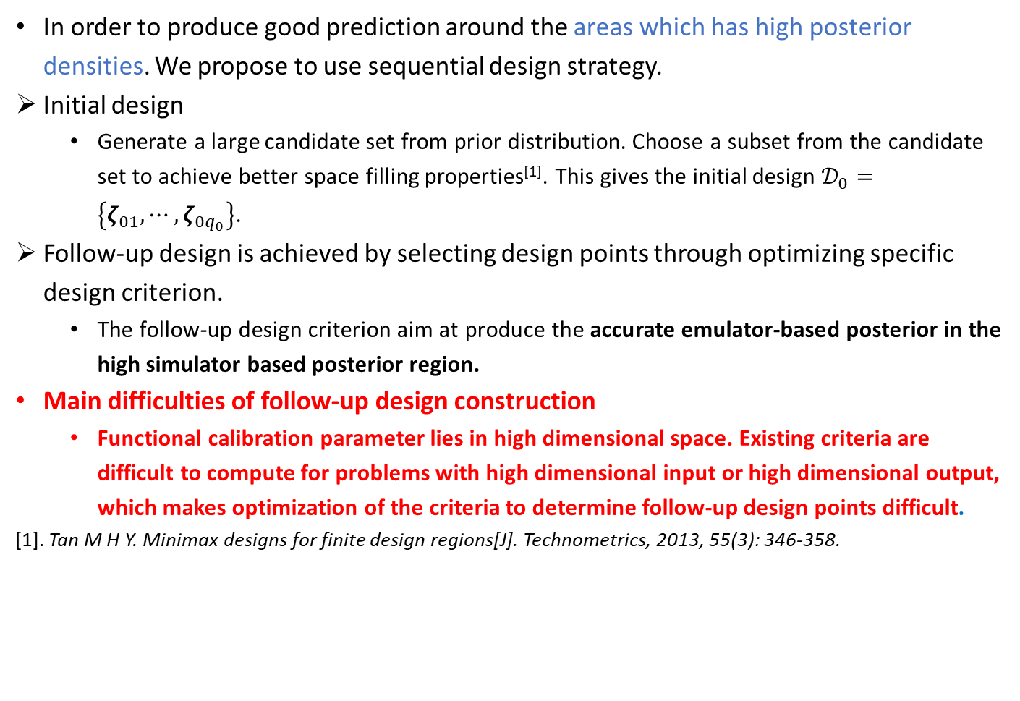
Sequential Experimental Design
In order to produce good prediction around the areas which has high posterior densities. We propose to use sequential design strategy.
Initial design
Generate a large candidate set from prior distribution. Choose a subset from the candidate set to achieve better space filling properties^{[1]}. This gives the initial design $𝒟_{0}=\left\{ζ_{01},⋯,ζ_{0q_{0}}\right\}$.
Follow-up design is achieved by selecting design points through optimizing specific design criterion.
The follow-up design criterion aim at produce the accurate emulator-based posterior in the high simulator based posterior region.
Main difficulties of follow-up design construction
Functional calibration parameter lies in high dimensional space. Existing criteria are difficult to compute for problems with high dimensional input or high dimensional output, which makes optimization of the criteria to determine follow-up design points difficult.
[1]. Tan M H Y. Minimax designs for finite design regions[J]. Technometrics, 2013, 55(3): 346-358.

Slide 12
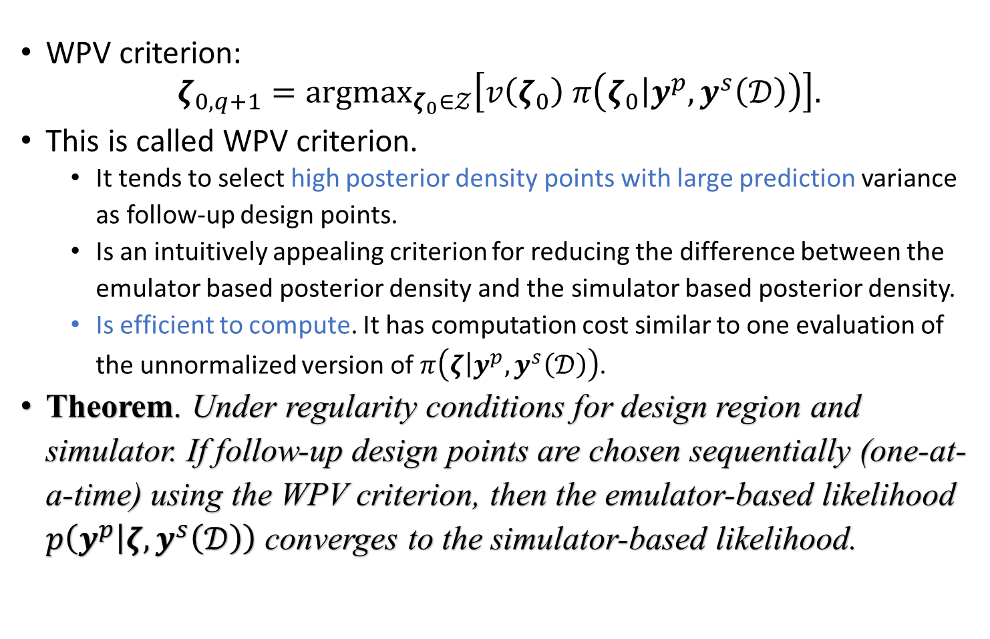
Weighted Prediction Variance (WPV)
WPV criterion:
$$ζ_{0,q+1}={argmax}_{ζ_{0}∈𝒵}\left[v\left(ζ_{0}\right) π\left(\left.ζ_{0}\right|y^{p}, y^{s}\left(𝒟\right)\right)\right].$$
This is called WPV criterion.
It tends to select high posterior density points with large prediction variance as follow-up design points.
Is an intuitively appealing criterion for reducing the difference between the emulator based posterior density and the simulator based posterior density.
Is efficient to compute. It has computation cost similar to one evaluation of the unnormalized version of $π\left(\left.ζ\right|y^{p}, y^{s}\left(𝒟\right)\right)$.
Theorem. Under regularity conditions for design region and simulator. If follow-up design points are chosen sequentially (one-at-a-time) using the WPV criterion, then the emulator-based likelihood $p\left(y^{p} | ζ,y^{s}\left(𝒟\right)\right)$ converges to the simulator-based likelihood.

Slide 13
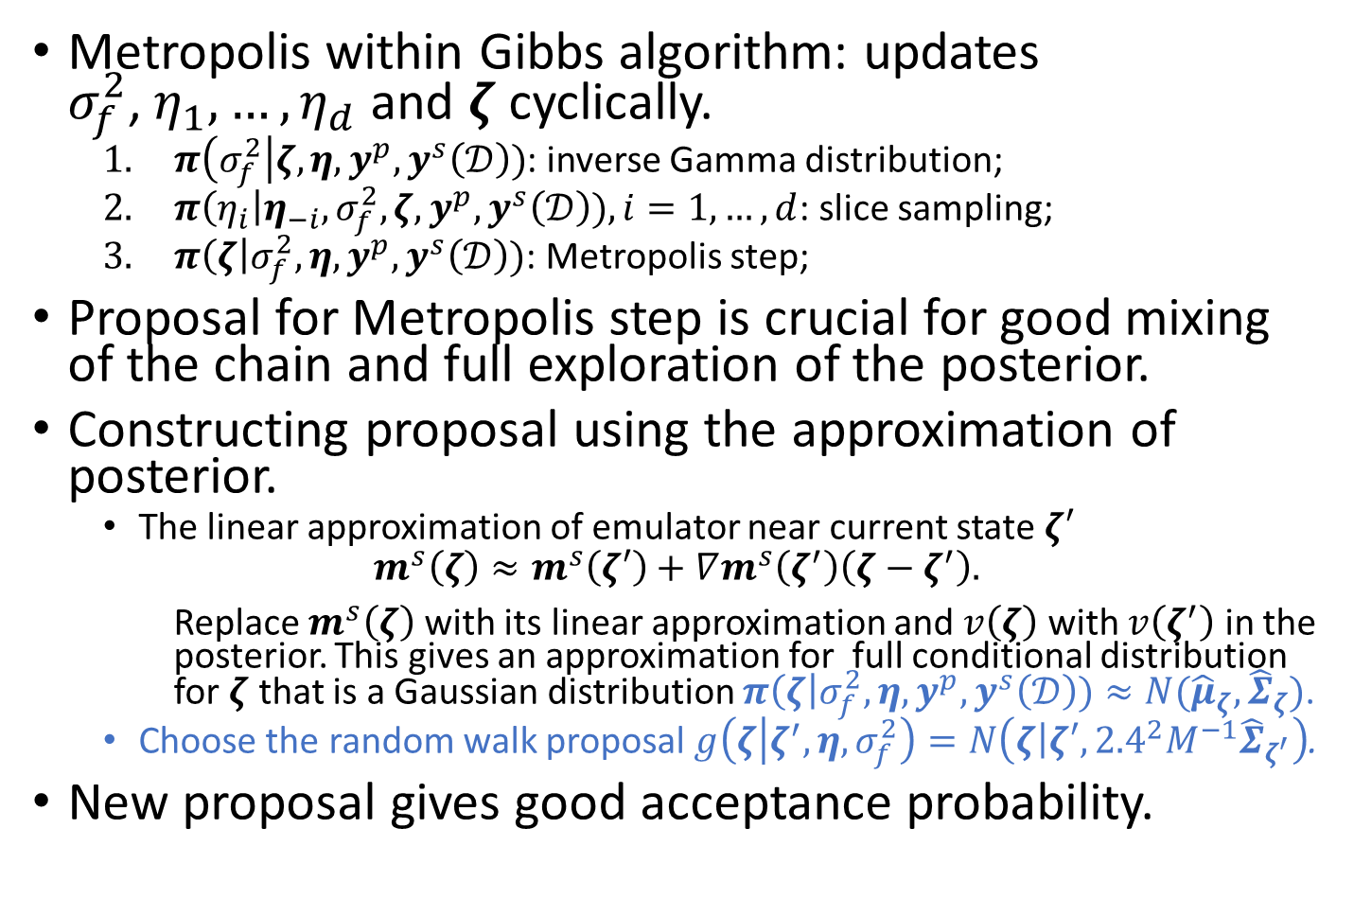
MCMC Algorithm
Metropolis within Gibbs algorithm: updates ${σ_{f}^{2}\text{,} η}_{1},…,η_{d}$and $ζ$ cyclically.
$π\left(σ_{f}^{2}\right|ζ, η, y^{p},y^{s}\left(𝒟\right))$: inverse Gamma distribution;
$π\left(η_{i}\right|η_{−i}, σ_{f}^{2},ζ, y^{p},y^{s}\left(𝒟\right)), i=1,…,d$: slice sampling;
$π\left(ζ\right|σ_{f}^{2}, η, y^{p},y^{s}\left(𝒟\right))$: Metropolis step;
Proposal for Metropolis step is crucial for good mixing of the chain and full exploration of the posterior.
Constructing proposal using the approximation of posterior.
The linear approximation of emulator near current state $ζ′$
$$m^{s}\left(ζ\right)≈m^{s}\left(ζ′\right)+∇m^{s}\left(ζ^{′}\right)\left(ζ−ζ^{′}\right).$$
Replace $m^{s}\left(ζ\right)$ with its linear approximation and $v\left(ζ\right)$ with $v\left(ζ^{′}\right)$ in the posterior. This gives an approximation for full conditional distribution for $ζ$ that is a Gaussian distribution $π\left(ζ\right|σ_{f}^{2}, η, y^{p},y^{s}\left(𝒟\right))≈N({\hat{μ}}_{ζ}, {\hat{Σ}}_{ζ})$.
Choose the random walk proposal $g\left(ζ | ζ^{′},η,σ_{f}^{2}\right)=N\left(\left.ζ\right|ζ′,{2.4}^{2}M^{−1}{\hat{Σ}}_{ζ^{′}}\right)$.
New proposal gives good acceptance probability.

Slide 14
Calibration of Functional Parameter
Step 1. | Determine the prior model for functional input and apply dimension reduction for functional calibration parameter.
Step 2. | Construct Initial experiment design and fit GP emulator.
Step 3. | Select Follow-up experiment design points using WPV criterion. Update the GP emulator.
Step 4. | Posterior inference using MCMC algorithm.

Slide 15
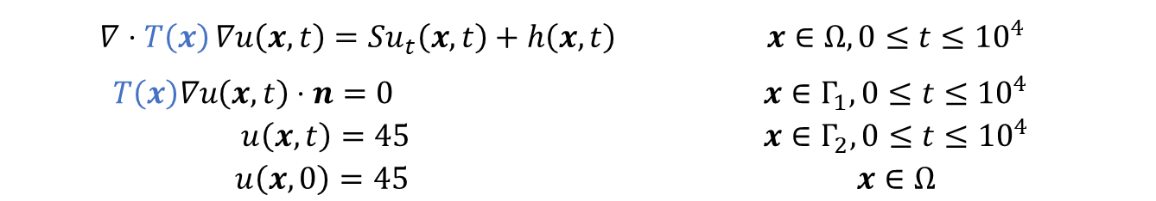
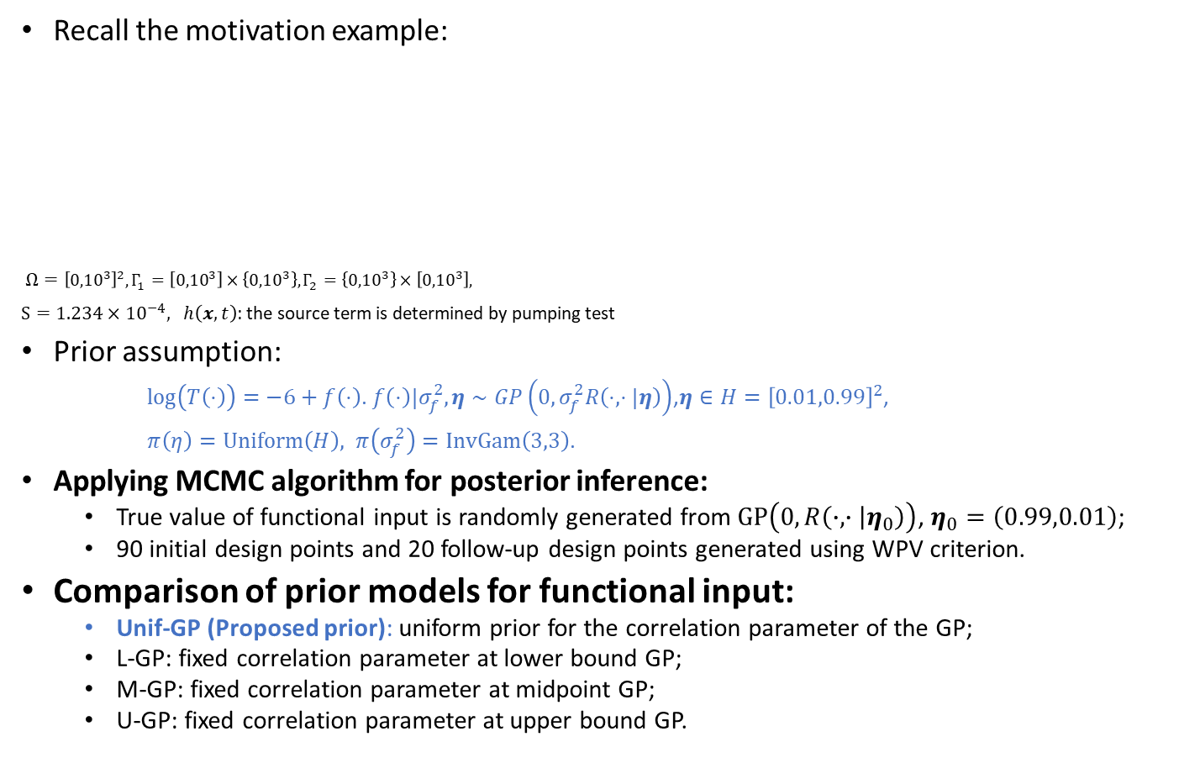
Numerical Study
Recall the motivation example:
$Ω={\left[{0,10}^{3}\right]}^{2}, Γ_{1}=\left[{0,10}^{3}\right]×\left\{{0,10}^{3}\right\}, Γ_{2}=\left\{{0,10}^{3}\right\}×\left[{0,10}^{3}\right],$
$S=1.234×{10}^{−4}, h\left(x,t\right)$: the source term is determined by pumping test
Prior assumption:
$\log\left(T\left(⋅\right)\right)=−6+f\left(⋅\right)$. $f\left(⋅\right)|σ_{f}^{2},η∼GP\left(0,σ_{f}^{2}R\left(⋅, ⋅|η\right)\right)$,$η∈H={\left[0.01,0.99\right]}^{2}$,
$π\left(η\right)=Uniform\left(H\right), π\left(σ_{f}^{2}\right)=InvGam\left(3,3\right)$.
Applying MCMC algorithm for posterior inference:
True value of functional input is randomly generated from $GP\left(0,R\left(∙,∙ | η_{0}\right)\right)$, $η_{0}=\left(0.99,0.01\right)$;
90 initial design points and 20 follow-up design points generated using WPV criterion.
Comparison of prior models for functional input:
Unif-GP (Proposed prior): uniform prior for the correlation parameter of the GP;
L-GP: fixed correlation parameter at lower bound GP;
M-GP: fixed correlation parameter at midpoint GP;
U-GP: fixed correlation parameter at upper bound GP.
$$∇⋅T\left(x\right){∇u\left(x,t\right)}=Su_{t}\left(x,t\right)+h\left(x,t\right)$$ | $$x∈Ω,0≤t≤{10}^{4}$$
$$T\left(x\right)∇u\left(x,t\right)⋅n=0$$ | $$x∈Γ_{1}, 0≤t≤{10}^{4}$$
$$u\left(x,t\right)=45$$ | $$x∈Γ_{2}, 0≤t≤{10}^{4}$$
$$u\left(x,0\right)=45$$ | $$x∈Ω$$

Slide 16
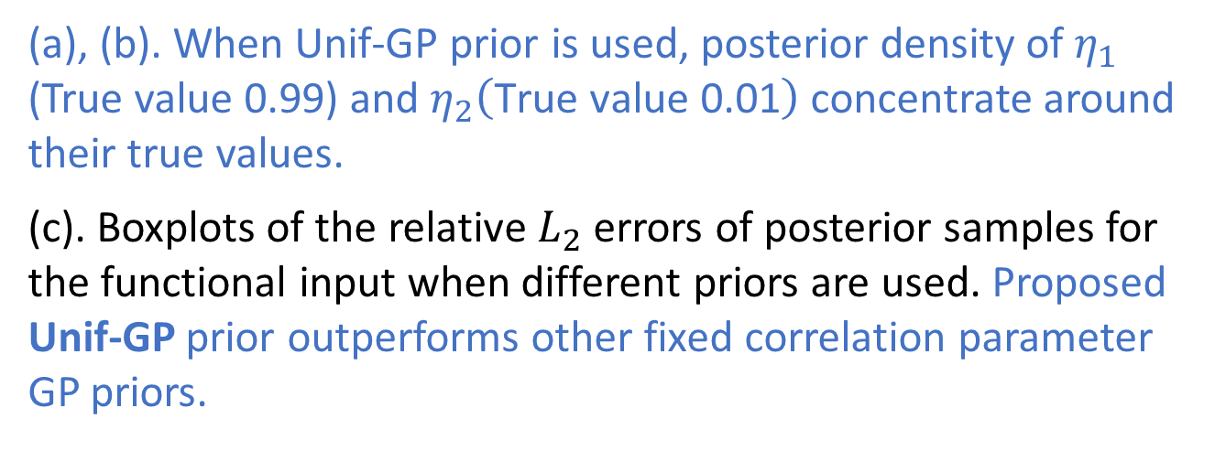
Numerical Study
(a), (b). When Unif-GP prior is used, posterior density of $η_{1}$ (True value 0.99) and $η_{2}\left(\text{True} \text{value}\text{ 0.01}\right)$ concentrate around their true values.
(c). Boxplots of the relative $L_{2}$ errors of posterior samples for the functional input when different priors are used. Proposed Unif-GP prior outperforms other fixed correlation parameter GP priors.

Slide 17
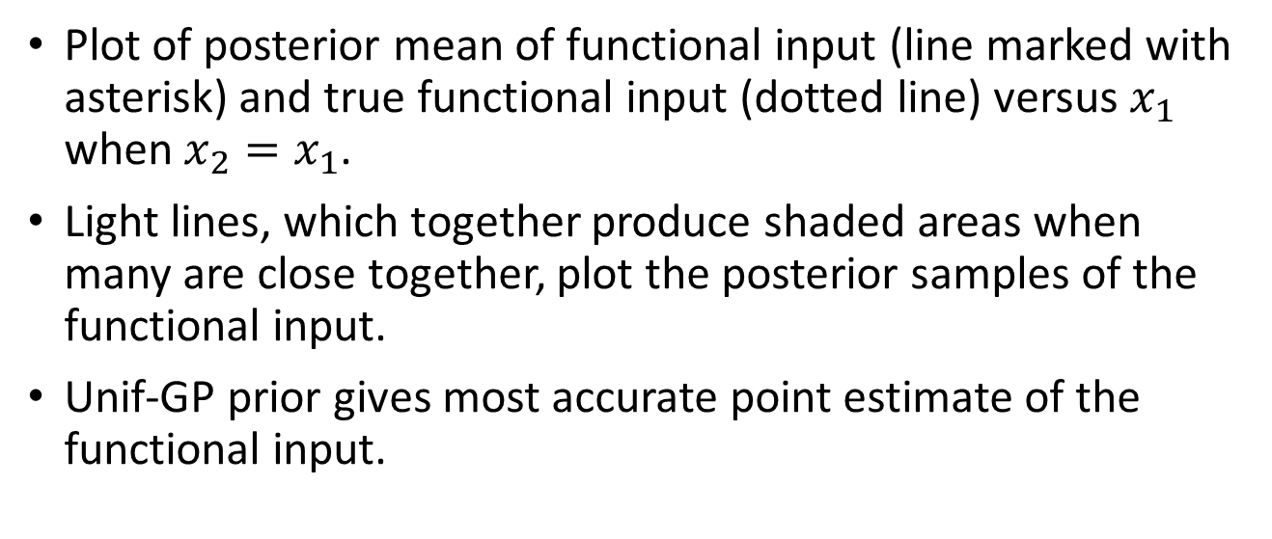
Numerical Study
Plot of posterior mean of functional input (line marked with asterisk) and true functional input (dotted line) versus $x_{1}$ when $x_{2}=x_{1}$.
Light lines, which together produce shaded areas when many are close together, plot the posterior samples of the functional input.
Unif-GP prior gives most accurate point estimate of the functional input.

Slide 18
Conclusion
We generate a new method for Bayesian calibration of a functional input to a time-consuming simulator based on a PDE model.
Main contributions:
Employing a GP prior with a Gaussian correlation function and a uniform prior for its correlation parameter to model the standardized functional input. We propose the use of a truncated KL expansion of the prior process for dimension reduction.
Proposing WPV sequential design criterion that select follow-up design points from high posterior regions with large prediction. It can be efficiently computed when the input and output are high dimensional. We prove the convergence of the emulator-based posterior when design is selected using WPV criterion.

Slide 19
Thank You!

