Slide 1

cs242
Kathleen Fisher
Reading: “Beautiful Concurrency”,
“The Transactional Memory / Garbage Collection Analogy”
Thanks to Simon Peyton Jones for these slides.

Slide 2

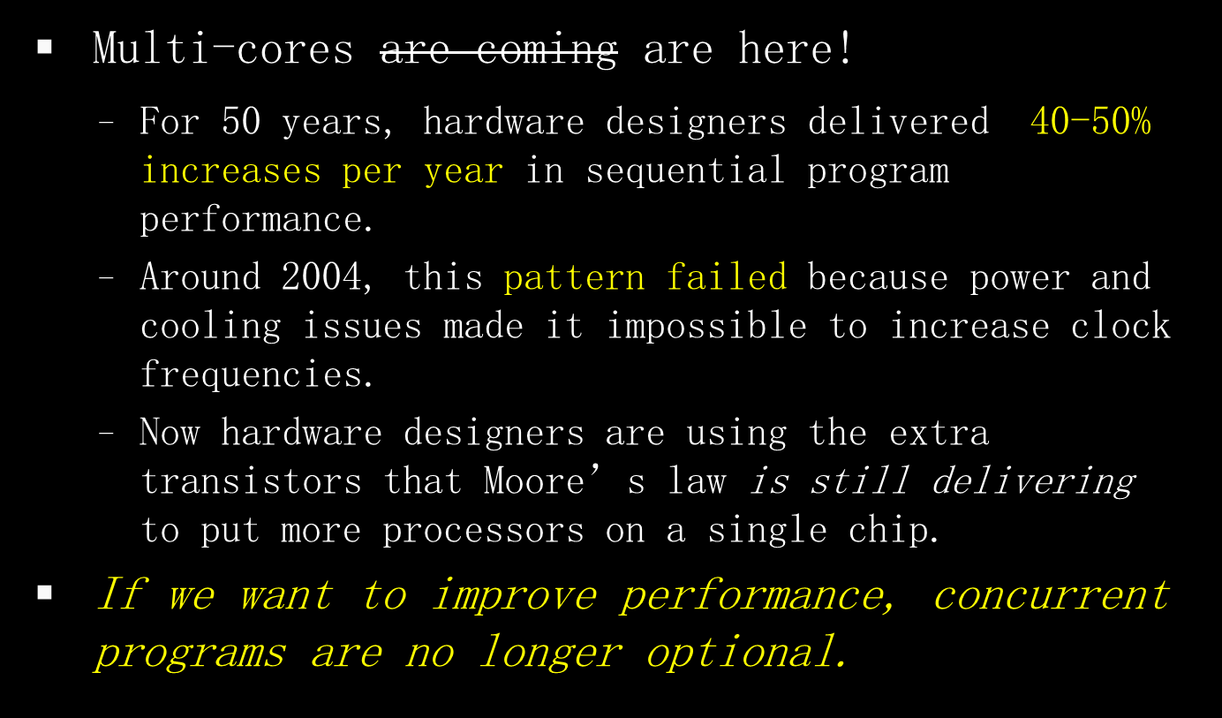
Notes:
NB: Not just our work: many have contributed both in Microsoft and outside.

Slide 3

Concurrent programming is essential to improve performance on a multi-core.
Yet the state of the art in concurrent programming is 30 years old: locks and condition variables. (In Java: synchronized, wait, and notify.)
Locks and condition variables are fundamentally flawed: it’s like building a sky-scraper out of bananas.
This lecture describes significant recent progress: bricks and mortar instead of bananas
Notes:
NB: Not just our work: many have contributed both in Microsoft and outside.

Slide 4

Libraries build layered concurrency abstractions
Library
Library
Library
Library
Library
Library
Library
Concurrency primitives
Hardware

Slide 5

Locks and condition variables
(a) are hard to use and
(b) do not compose
Library
Library
Library
Library
Library
Library
Library
Locks and condition variables
Hardware

Slide 6

Atomic blocks are much easier to use, and do compose
Library
Library
Library
Library
Library
Library
Library
Atomic blocks
3 primitives: atomic, retry, orElse
Hardware

Slide 7

A 10-second review:
Races: forgotten locks lead to inconsistent views
Deadlock: locks acquired in “wrong” order
Lost wakeups: forgotten notify to condition variables
Diabolical error recovery: need to restore invariants and release locks in exception handlers
These are serious problems. But even worse...

Slide 8
Consider a (correct) Java bank Account class:
Now suppose we want to add the ability to transfer funds from one account to another.
class Account{
float balance;
synchronized void deposit(float amt) {
balance += amt;
}
synchronized void withdraw(float amt) {
if (balance < amt)
throw new OutOfMoneyError();
balance -= amt;
}
}

Slide 9
Simply calling withdraw and deposit to implement transfer causes a race condition:
class Account{
float balance;
synchronized void deposit(float amt) {
balance += amt;
}
synchronized void withdraw(float amt) {
if(balance < amt)
throw new OutOfMoneyError();
balance -= amt;
}
void transfer_wrong1(Acct other, float amt) {
other.withdraw(amt);
// race condition: wrong sum of balances
this.deposit(amt);}
}

Slide 10
Synchronizing transfer can cause deadlock:
class Account{
float balance;
synchronized void deposit(float amt) {
balance += amt;
}
synchronized void withdraw(float amt) {
if(balance < amt)
throw new OutOfMoneyError();
balance -= amt;
}
synchronized
void transfer_wrong2(Acct other, float amt) {
// can deadlock with parallel reverse-transfer
this.deposit(amt);
other.withdraw(amt);
}
}

Slide 11
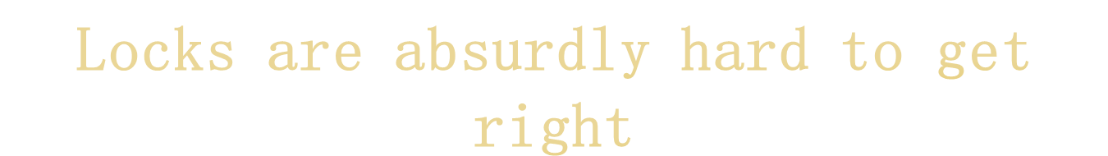
Scalable double-ended queue: one lock per cell
No interference if ends “far enough” apart
But watch out when the queue is 0, 1, or 2 elements long!

Slide 12
Coding style | Difficulty of queue implementation
Sequential code | Undergraduate

Slide 13
Coding style | Difficulty of concurrent queue
Sequential code | Undergraduate
Locks and condition variables | Publishable result at international conference
Coding style | Difficulty of queue implementation
Sequential code | Undergraduate
Locks and condition variables | Publishable result at international conference¹
¹ Simple, fast, and practical non-blocking and blocking concurrent queue algorithms.

Slide 14
Coding style | Difficulty of queue implementation
Sequential code | Undergraduate
Locks and condition variables | Publishable result at international conference¹
Atomic blocks | Undergraduate
¹ Simple, fast, and practical non-blocking and blocking concurrent queue algorithms.

Slide 15
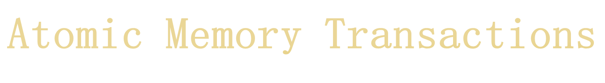
Like database transactions
atomic {...sequential code...}
To a first approximation, just write the sequential code, and wrap atomic around it
All-or-nothing semantics: Atomic commit
Atomic block executes in Isolation
Cannot deadlock (there are no locks!)
Atomicity makes error recovery easy
(e.g. throw exception inside sequential code)
ACID

Slide 16

Optimistic
concurrency
atomic {... <code> ...}
One possibility:
Execute <code> without taking any locks.
Log each read and write in <code> to a thread-local transaction log.
Writes go to the log only, not to memory.
At the end, the transaction validates the log.
  If valid, atomically commits changes to memory.
  If not valid, re-runs from the beginning, discarding changes.
read y;
read z;
write 10 x;
write 42 z;
…

Slide 17
Realizing STM
in
Haskell

Slide 18

Logging memory effects is expensive.
Haskell already partitions the world into
  immutable values (zillions and zillions)
  mutable locations (some or none)
  Only need to log the latter!
Type system controls where I/O effects happen.
Monad infrastructure ideal for constructing transactions & implicitly passing transaction log.
Already paid the bill. Simply reading or writing a mutable location is expensive (involving a procedure call) so transaction overhead is not as large as in an imperative language.

Slide 19

Consider a simple Haskell program:
Effects are explicit in the type system.
Main program is a computation with effects.
main = do { putStr (reverse “yes”);
putStr “no” }
(reverse “yes”) :: String -- No effects
  (putStr “no” ) :: IO () -- Effects okay
main :: IO ()

Slide 20
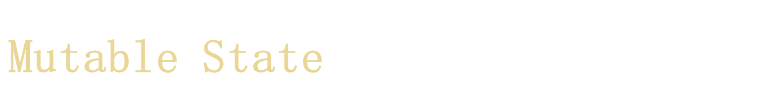
newRef :: a -> IO (IORef a)
readRef :: IORef a -> IO a
writeRef :: IORef a -> a -> IO ()
Recall that Haskell uses newIORef, readIORef, and writeIORef functions within the IO Monad to manage mutable state.
main = do { r <- newIORef 0;
incR r;
s <- readIORef r;
print s }
incR :: IORef Int -> IO ()
incR r = do { v <- readIORef r; writeIORef r (v+1) }
Reads and writes are 100% explicit.
The type system disallows (r + 6), because r :: IORef Int

Slide 21

The fork function spawns a thread.
It takes an action as its argument.
fork :: IO a -> IO ThreadId
main = do { r <- newIORef 0;
fork (incR r);
incR r;
... }
incR :: IORef Int -> IO ()
incR r = do { v <- readIORef f; writeIORef r (v+1) }
A race

Slide 22

Idea: add a function atomic that executes its argument computation atomically.
atomic :: IO a -> IO a -- almost
main = do { r <- newRef 0;
fork (atomic (incR r));
atomic (incR r);
... }
Worry: What prevents using incR outside atomic, which would allow data races between code inside atomic and outside?

Slide 23

Introduce a type for imperative transaction variables (TVar) and a new Monad (STM) to track transactions.
Ensure TVars can only be modified in transactions.
atomic :: STM a -> IO a
newTVar :: a -> STM (TVar a)
readTVar :: TVar a -> STM a
writeTVar :: TVar a -> a -> STM ()
incT :: TVar Int -> STM ()
incT r = do { v <- readTVar r; writeTVar r (v+1) }
main = do { r <- atomic (newTVar 0);
fork (atomic (incT r))
atomic (incT r);
... }

Slide 24

atomic :: STM a -> IO a
newTVar :: a -> STM (TVar a)
readTVar :: TVar a -> STM a
writeTVar :: TVar a -> a -> STM()
Notice that:
Can’t fiddle with TVars outside atomic block [good]
Can’t do IO or manipulate regular imperative variables inside atomic block [sad, but also good]
atomic is a function, not a syntactic construct (called atomically in the actual implementation.)
...and, best of all...
atomic (if x<y then launchMissiles)

Slide 25

incT :: TVar Int -> STM ()
incT r = do { v <- readTVar r; writeTVar r (v+1) }
incT2 :: TVar Int -> STM ()
incT2 r = do { incT r; incT r }
foo :: IO ()
foo = ...atomic (incT2 r)...
Composition is THE way to build big programs that work
The type guarantees that an STM computation is always executed atomically (e.g. incT2).
Simply glue STMs together arbitrarily; then wrap with atomic to produce an IO action.

Slide 26

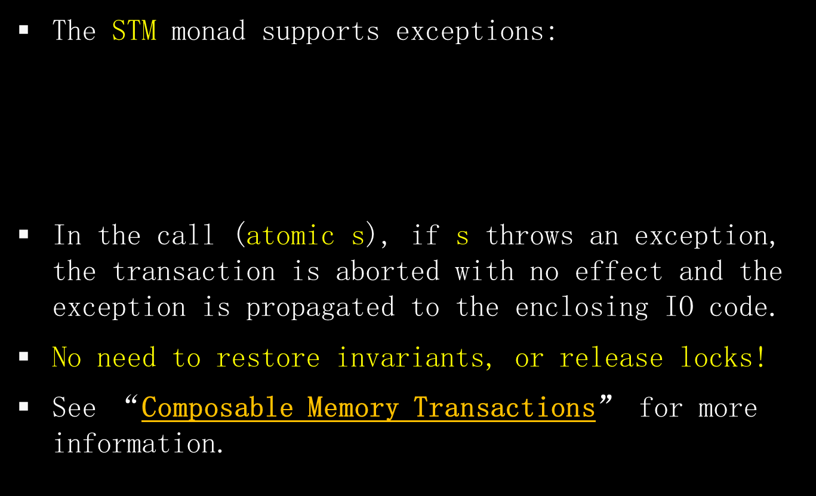
throw :: Exception -> STM a
catch :: STM a -> (Exception -> STM a) -> STM a

Slide 27
Three new ideas
retry
orElse
always

Slide 28

withdraw :: TVar Int -> Int -> STM ()
withdraw acc n =
do { bal <- readTVar acc;
if bal < n then retry;
writeTVar acc (bal-n) }
retry :: STM ()
retry means “abort the current transaction and re-execute it from the beginning”.
Implementation avoids the busy wait by using reads in the transaction log (i.e. acc) to wait simultaneously on all read variables.

Slide 29

withdraw :: TVar Int -> Int -> STM ()
withdraw acc n =
do { bal <- readTVar acc;
if bal < n then retry;
writeTVar acc (bal-n) }
No condition variables!
Retrying thread is woken up automatically when acc is written, so there is no danger of forgotten notifies.
No danger of forgetting to test conditions again when woken up because the transaction runs from the beginning. For example:
atomic (do { withdraw a1 3;
withdraw a2 7 })

Slide 30

retry can appear anywhere inside an atomic block, including nested deep within a call. For example,
waits for a1>3 AND a2>7, without any change to withdraw function.
Contrast:
which breaks the abstraction inside “...stuff...”
atomic (do { withdraw a1 3;
withdraw a2 7 })
atomic (a1 > 3 && a2 > 7) { ...stuff... }

Slide 31

Suppose we want to transfer 3 dollars from either account a1 or a2 into account b.
atomic (do {
withdraw a1 3 `orelse`
withdraw a2 3;
deposit b 3 })
Try this
...and if it retries, try this
...and and then do this
orElse :: STM a -> STM a -> STM a

Slide 32

transfer :: TVar Int -> TVar Int -> TVar Int -> STM ()
transfer a1 a2 b = do
{ withdraw a1 3
`orElse`
withdraw a2 3;
deposit b 3 }
atomic
(transfer a1 a2 b
`orElse`
transfer a3 a4 b)
The function transfer calls orElse, but calls to transfer can still be composed with orElse.

Slide 33

A transaction is a value of type STM a.
Transactions are first-class values.
Build a big transaction by composing little transactions: in sequence, using orElse and retry, inside procedures....
Finally seal up the transaction with
atomic :: STM a -> IO a

Slide 34

STM supports nice equations for reasoning:
  orElse is associative (but not commutative)
  retry `orElse` s = s
  s `orElse` retry = s
(These equations make STM an instance of the Haskell typeclass MonadPlus, a Monad with some extra operations and properties.)

Slide 35

The route to sanity is to establish invariants that are assumed on entry, and guaranteed on exit, by every atomic block.
We want to check these guarantees. But we don’t want to test every invariant after every atomic block.
Hmm.... Only test when something read by the invariant has changed.... rather like retry.

Slide 36

always :: STM Bool -> STM ()
newAccount :: STM (TVar Int)
newAccount = do { v <- newTVar 0; always (do { cts <- readTVar v;
return (cts >= 0) });
return v }
Any transaction that modifies the account will check the invariant (no forgotten checks). If the check fails, the transaction restarts.
An arbitrary boolean valued STM computation

Slide 37

always :: STM Bool -> STM ()
The function always adds a new invariant to a global pool of invariants.
Conceptually, every invariant is checked as every transaction commits.
But the implementation checks only invariants that read TVars that have been written by the transaction
...and garbage collects invariants that are checking dead Tvars.

Slide 38

Everything so far is intuitive and arm-wavey.
But what happens if it’s raining, and you are inside an orElse and you throw an exception that contains a value that mentions...?
We need a precise specification!

Slide 39
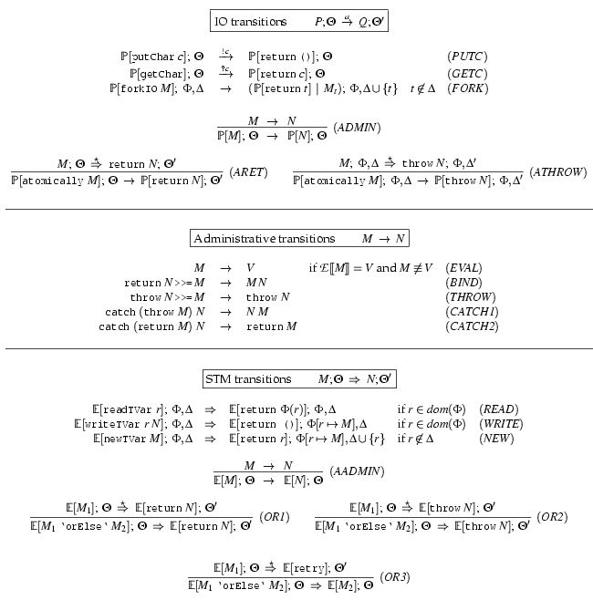

One exists
No way to wait for complex conditions
See “Composable Memory Transactions” for details.

Slide 40

A complete, multiprocessor implementation of STM exists as of GHC 6.
Experience to date: even for the most mutation-intensive program, the Haskell STM implementation is as fast as the previous MVar implementation.
  The MVar version paid heavy costs for (usually unused) exception handlers.
Need more experience using STM in practice, though!
You can play with it. The reading assignment contains a complete STM program.

Slide 41
There are similar proposals for adding STM to Java and other mainstream languages.
class Account {
float balance;
void deposit(float amt) {
atomic { balance += amt; }
}
void withdraw(float amt) {
atomic {
if(balance < amt) throw new OutOfMoneyError();
balance -= amt; }
}
void transfer(Acct other, float amt) {
atomic { // Can compose withdraw and deposit.
other.withdraw(amt);
this.deposit(amt); }
}
}

Slide 42

Unlike Haskell, type systems in mainstream languages don’t control where effects occur.
What happens if code outside a transaction conflicts with code inside a transaction?
  Weak Atomicity: Non-transactional code can see inconsistent memory states. Programmer should avoid such situations by placing all accesses to shared state in transaction.
  Strong Atomicity: Non-transactional code is guaranteed to see a consistent view of shared state. This guarantee may cause a performance hit.
For more information: “Enforcing Isolation and Ordering in STM”

Slide 43

At first, atomic blocks look insanely expensive.
A naive implementation (c.f. databases):
  Every load and store instruction logs information into a thread-local log.
  A store instruction writes the log only.
  A load instruction consults the log first.
  Validate the log at the end of the block.
    If succeeds, atomically commit to shared memory.
    If fails, restart the transaction.

Slide 44
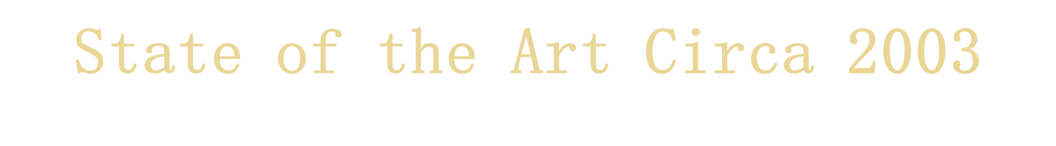
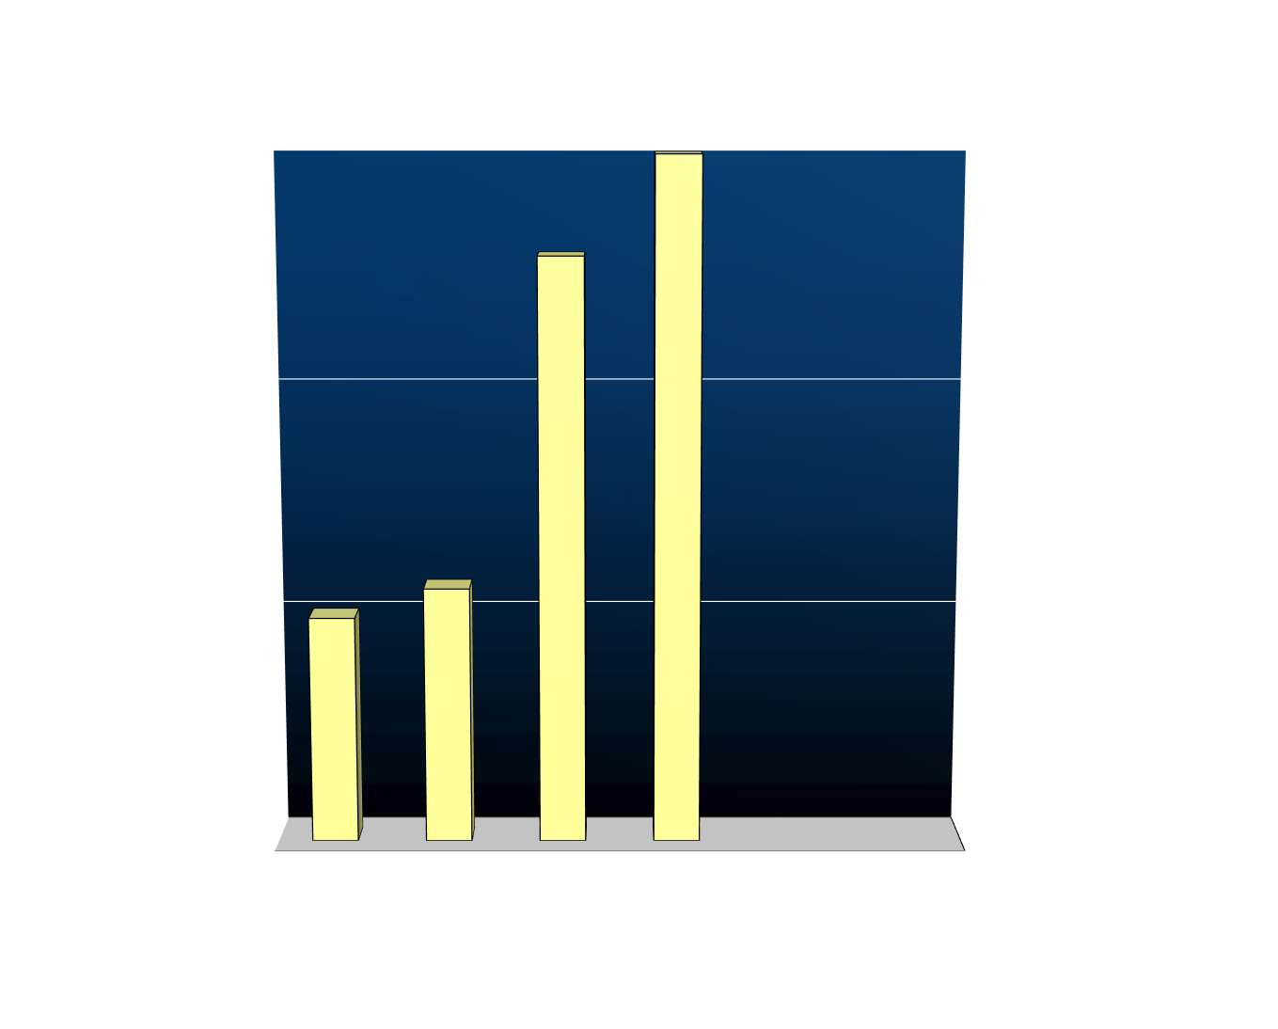
Fine-grained locking (2.57x)
Traditional STM (5.69x)
Coarse-grained locking (1.13x)
Normalised execution time
Sequential baseline (1.00x)
Workload: operations on a red-black tree, 1 thread, 6:1:1 lookup:insert:delete mix with keys 0..65535
See “Optimizing Memory Transactions” for more information.
Notes:
Scalable lock-per-node design
Visible arrows
Predede with “How much does it cost”
Cost of entry/exit
Cost oflogging etc
Compare -- unsafe / coarse-grained / fine-grained

Slide 45

Direct-update STM
  Allows transactions to make updates in place in the heap
  Avoids reads needing to search the log to see earlier writes that the transaction has made
  Makes successful commit operations faster at the cost of extra work on contention or when a transaction aborts
Compiler integration
  Decompose transactional memory operations into primitives
  Expose these primitives to compiler optimization (e.g. to hoist concurrency control operations out of a loop)
Runtime system integration
  Integrates transactions with the garbage collector to scale to atomic blocks containing 100M memory accesses

Slide 46
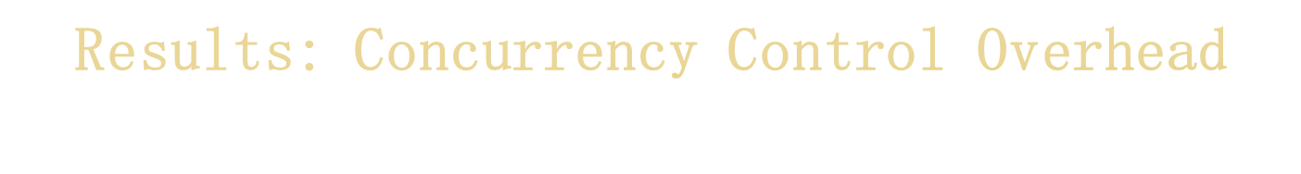
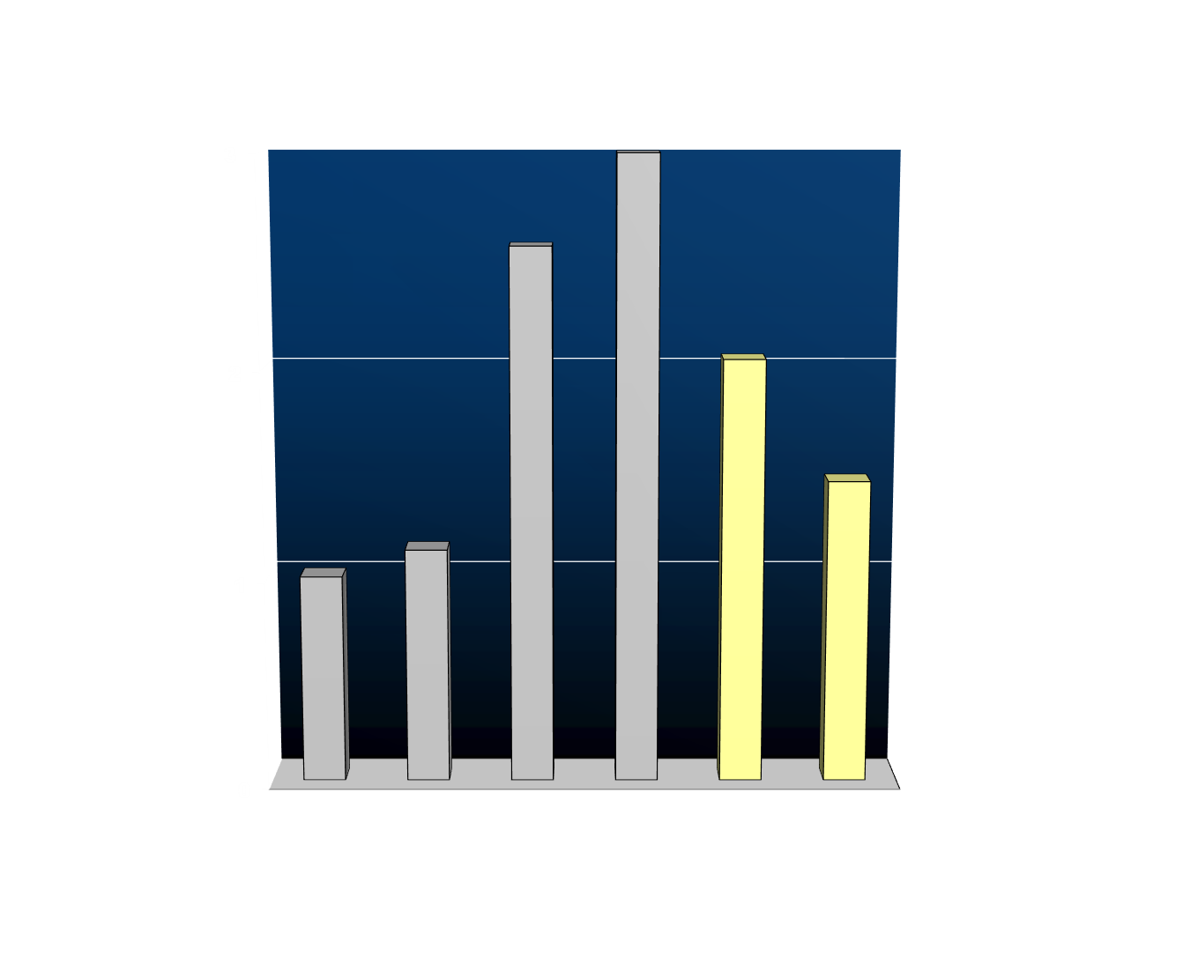
Fine-grained locking (2.57x)
Traditional STM (5.69x)
Coarse-grained locking (1.13x)
Direct-update STM (2.04x)
Normalised execution time
Direct-update STM + compiler integration (1.46x)
Sequential baseline (1.00x)
Workload: operations on a red-black tree, 1 thread, 6:1:1 lookup:insert:delete mix with keys 0..65535
Scalable to multicore
Notes:
Scalable lock-per-node design
Visible arrows
Predede with “How much does it cost”
Cost of entry/exit
Cost oflogging etc
Compare -- unsafe / coarse-grained / fine-grained

Slide 47


Coarse-grained locking
Fine-grained locking
Traditional STM
Microseconds per operation
Direct-update STM + compiler integration
#threads
Notes:
Scalable lock-per-node design
Visible arrows
Predede with “How much does it cost”
Cost of entry/exit
Cost oflogging etc
Compare -- unsafe / coarse-grained / fine-grained

Slide 48

Naïve STM implementation is hopelessly inefficient.
There is a lot of research going on in the compiler and architecture communities to optimize STM.
This work typically assumes transactions are smallish and have low contention. If these assumptions are wrong, performance can degrade drastically.
We need more experience with “real” workloads and various optimizations before we will be able to say for sure that we can implement STM sufficiently efficiently to be useful.

Slide 49

The essence of shared-memory concurrency is deciding where critical sections should begin and end. This is a hard problem.
  Too small: application-specific data races (Eg, may see deposit but not withdraw if transfer is not atomic).
  Too large: delay progress because deny other threads access to needed resources.

Slide 50

Consider the following program:
Successful completion requires A3 to run after A1 but before A2.
So adding a critical section (by uncommenting A0) changes the behavior of the program (from terminating to non-terminating).
Initially, x = y = 0
Thread 1
// atomic { //A0
atomic { x = 1; } //A1
atomic { if (y==0) abort; } //A2
//}
Thread 2
atomic { //A3
if (x==0) abort;
y = 1;
}

Slide 51

Worry: Could the system “thrash” by continually colliding and re-executing?
No: A transaction can be forced to re-execute only if another succeeds in committing. That gives a strong progress guarantee.
But: A particular thread could starve:
Thread 1
Thread 2
Thread 3

Slide 52

In languages like ML or Java, the fact that the language is in the IO monad is baked in to the language. There is no need to mark anything in the type system because IO is everywhere.
In Haskell, the programmer can choose when to live in the IO monad and when to live in the realm of pure functional programming.
Interesting perspective: It is not Haskell that lacks imperative features, but rather the other languages that lack the ability to have a statically distinguishable pure subset.
This separation facilitates concurrent programming.

Slide 53

Arbitrary effects
Useful
No effects
Useless
Dangerous
Safe

Slide 54

Plan A
(everyone else)
Arbitrary effects
Nirvana
Useful
Plan B
(Haskell)
No effects
Useless
Dangerous
Safe

Slide 55

Arbitrary effects
Default = Any effect
Plan = Add restrictions
Examples
Regions
Ownership types
Vault, Spec#, Cyclone

Slide 56

Default = No effects
Plan = Selectively permit effects
Types play a major role
Two main approaches:
Domain specific languages (SQL, Xquery, Google map/reduce)
Wide-spectrum functional languages + controlled effects (e.g. Haskell)
Value oriented programming

Slide 57

Plan A
(everyone else)
Arbitrary effects
Nirvana
Useful
Envy
Plan B
(Haskell)
No effects
Useless
Dangerous
Safe

Slide 58
Plan A
(everyone else)
Arbitrary effects
Nirvana
Useful
Ideas; e.g. Software Transactional Memory (retry, orElse)
Plan B
(Haskell)
No effects
Useless
Dangerous
Safe

Slide 59
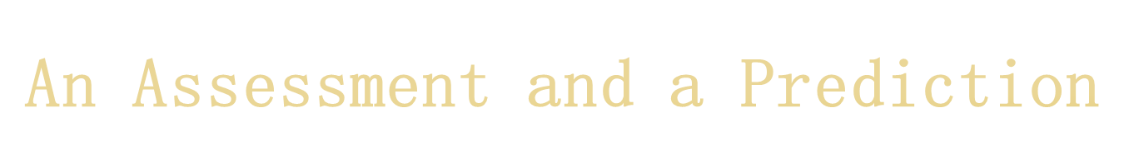
One of Haskell’s most significant contributions is to take purity seriously, and relentlessly pursue Plan B.
Imperative languages will embody growing (and checkable) pure subsets.
-- Simon Peyton Jones

Slide 60

Atomic blocks (atomic, retry, orElse) dramatically raise the level of abstraction for concurrent programming.
It is like using a high-level language instead of assembly code. Whole classes of low-level errors are eliminated.
Not a silver bullet:
  you can still write buggy programs;
  concurrent programs are still harder than sequential ones
  aimed only at shared memory concurrency, not message passing
There is a performance hit, but it seems acceptable (and things can only get better as the research community focuses on the question.)

