Slide 1
Financio – Finance Management System

Slide 2
Our Team
Team Leader | Team Member | Team Member | Team Member
Rahul Sanghvi | Shambhavi Milgir | Alok Singh | Viraj Chogle
10683787 | 10683343 | 10683924 | 10683352

Slide 3
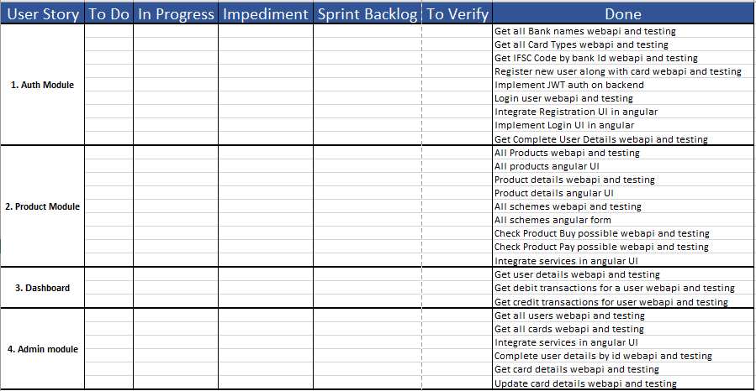
Scrum Board ( Sprint 1)

Slide 4
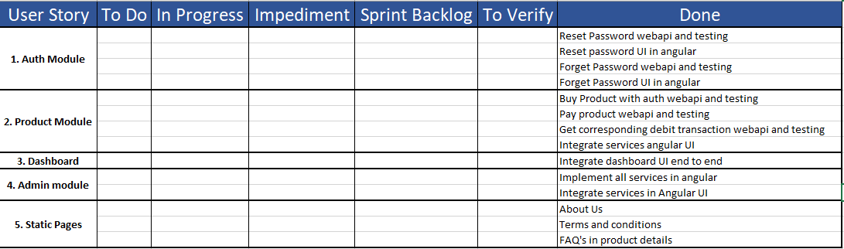
Scrum Board (Sprint 2)

Slide 5
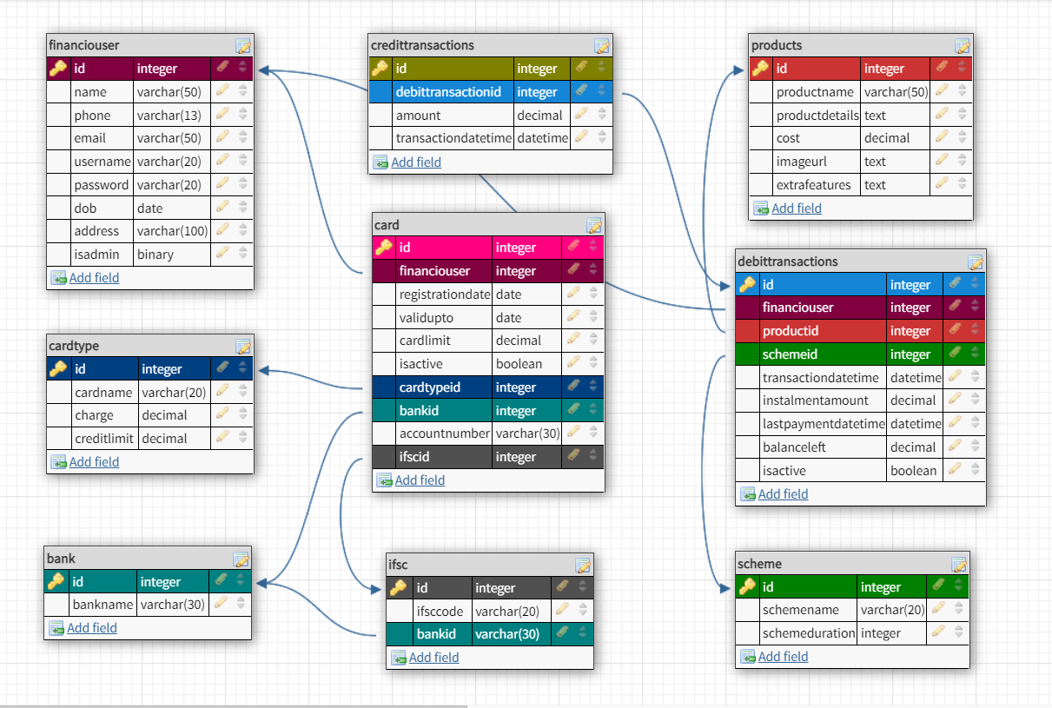
Database Schema

Slide 6
Technologies Used
Microsoft SQL Server - > Database Management System
Dotnet Core Web API with C# -> For bussiness logic and OOPs concepts
EntityFrameworkCore -> Object Relational Mapping Service
Angular -> Front End Framework & Client Side Logic
Git -> Version Control System
HTML -> Skeleton for the web pages
CSS -> Styling Web Pages
TypeScript -> For frontend logic

Slide 7
Application Architecture
Models | Repositories | Modules | Controllers
Bank Card CardType CreditTransaction DebitTransaction FinancioUser Ifsc Product Scheme | 1. FiancioApp 2. FinancioAPI 3. FinancioExtras | Authentication Product Dashboard Admin | AuthController BanksController CardsController CardTypesController CreditTranscationsController DebitTransactionsController FinancioUserController IfscController ProductsController SchemesController

Slide 8
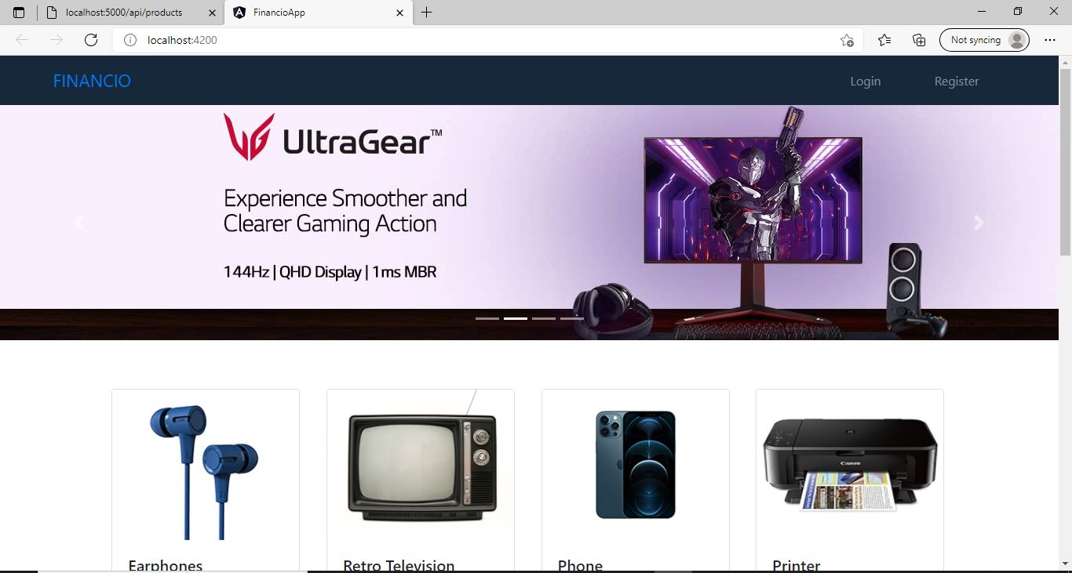
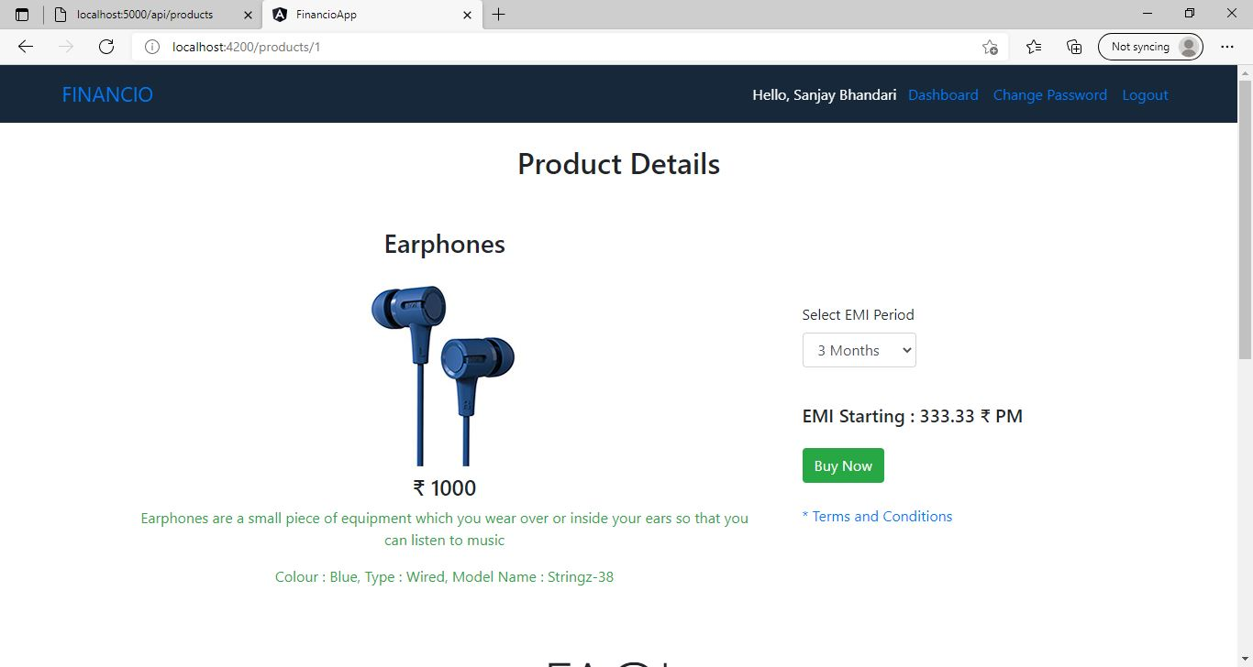

Slide 9
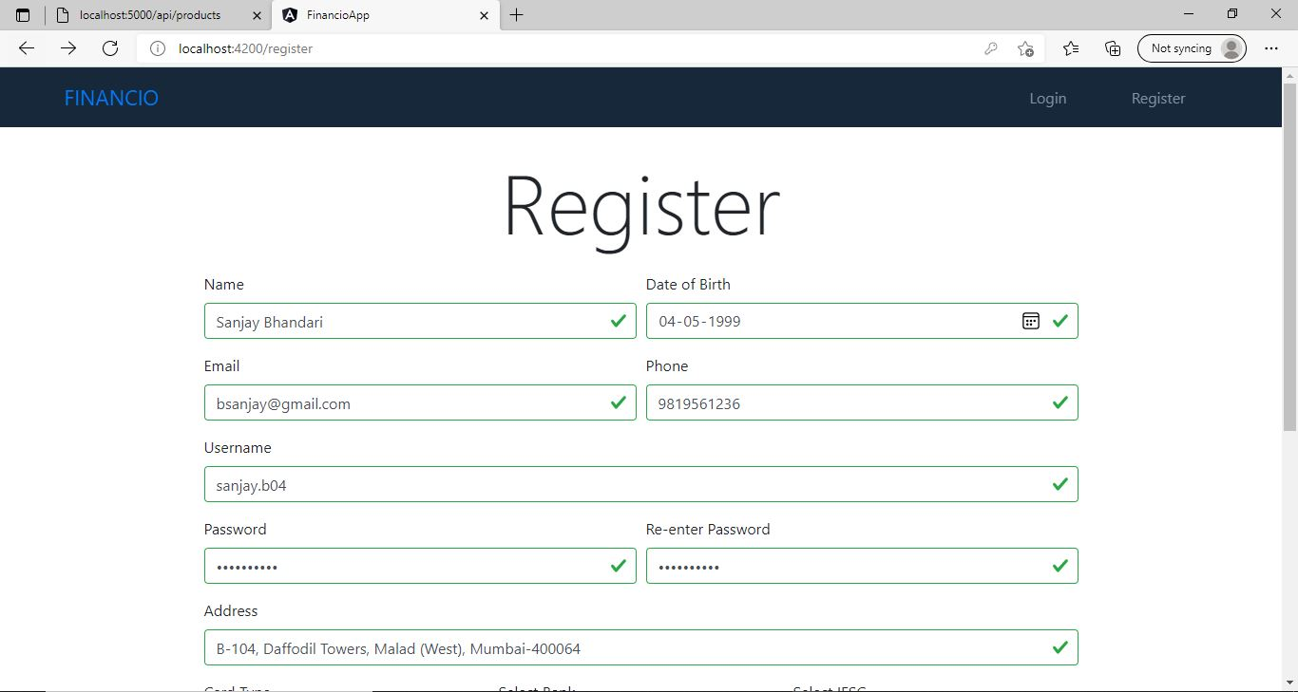
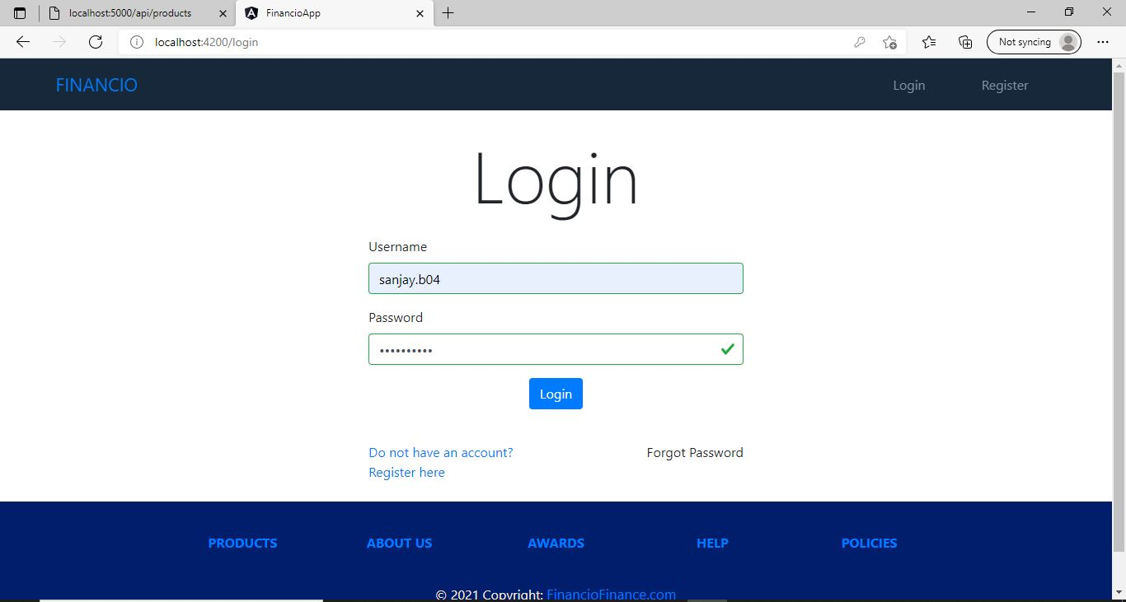
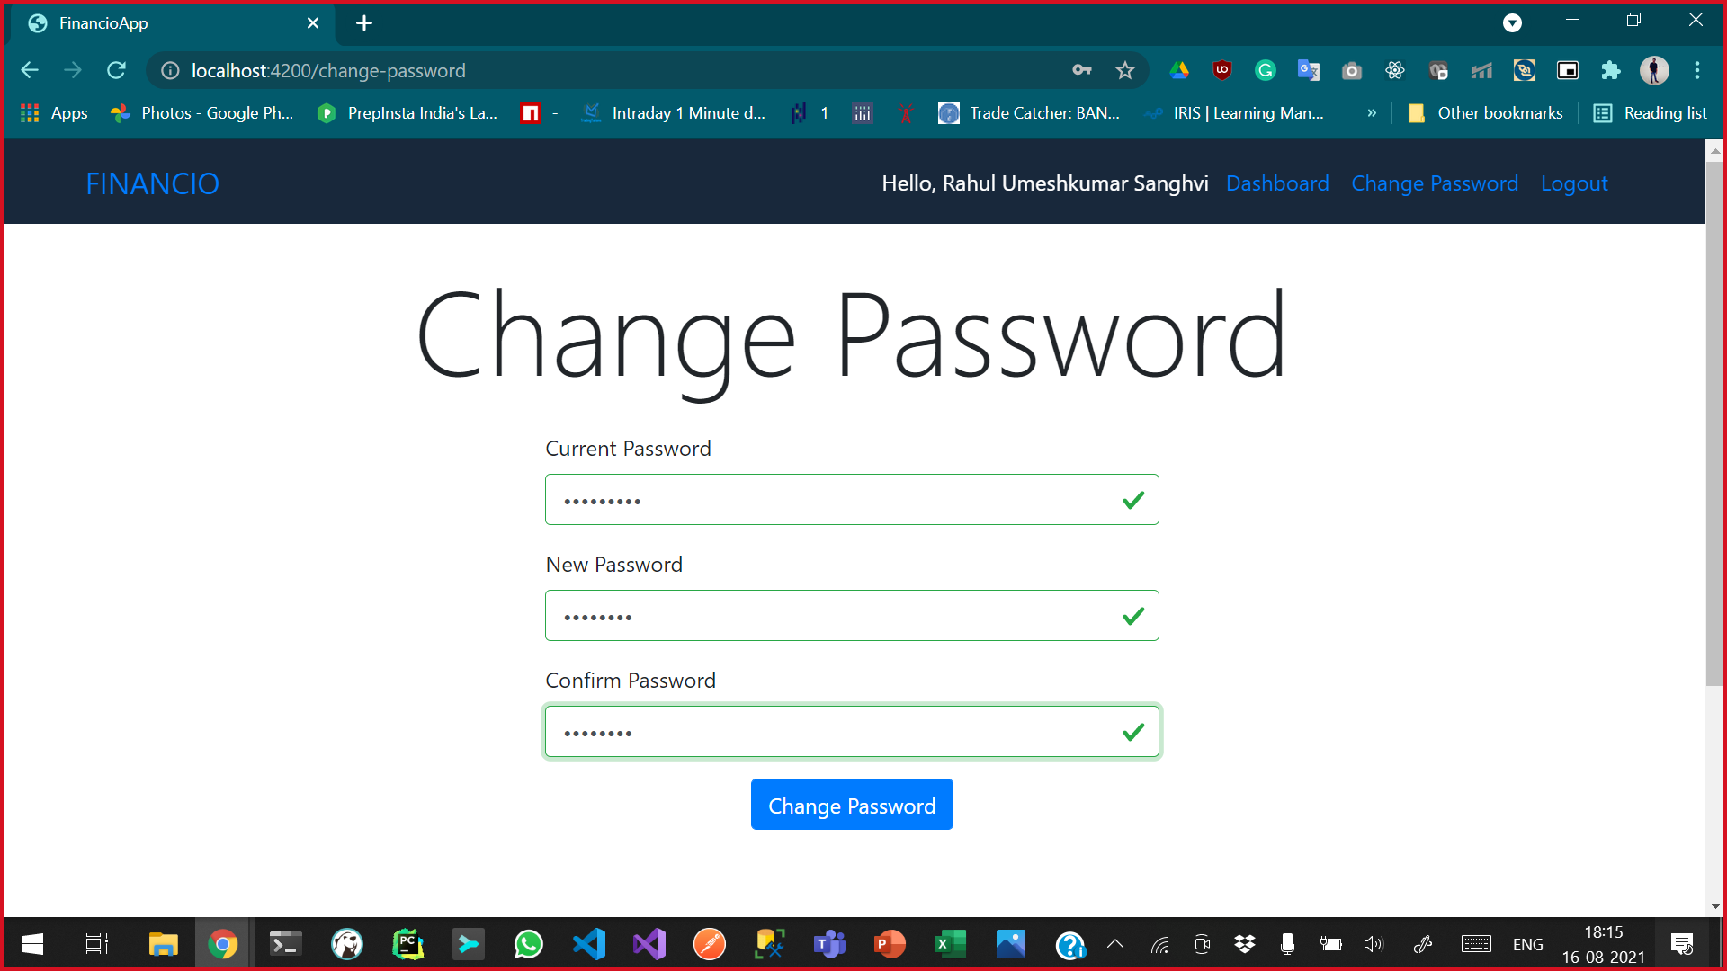
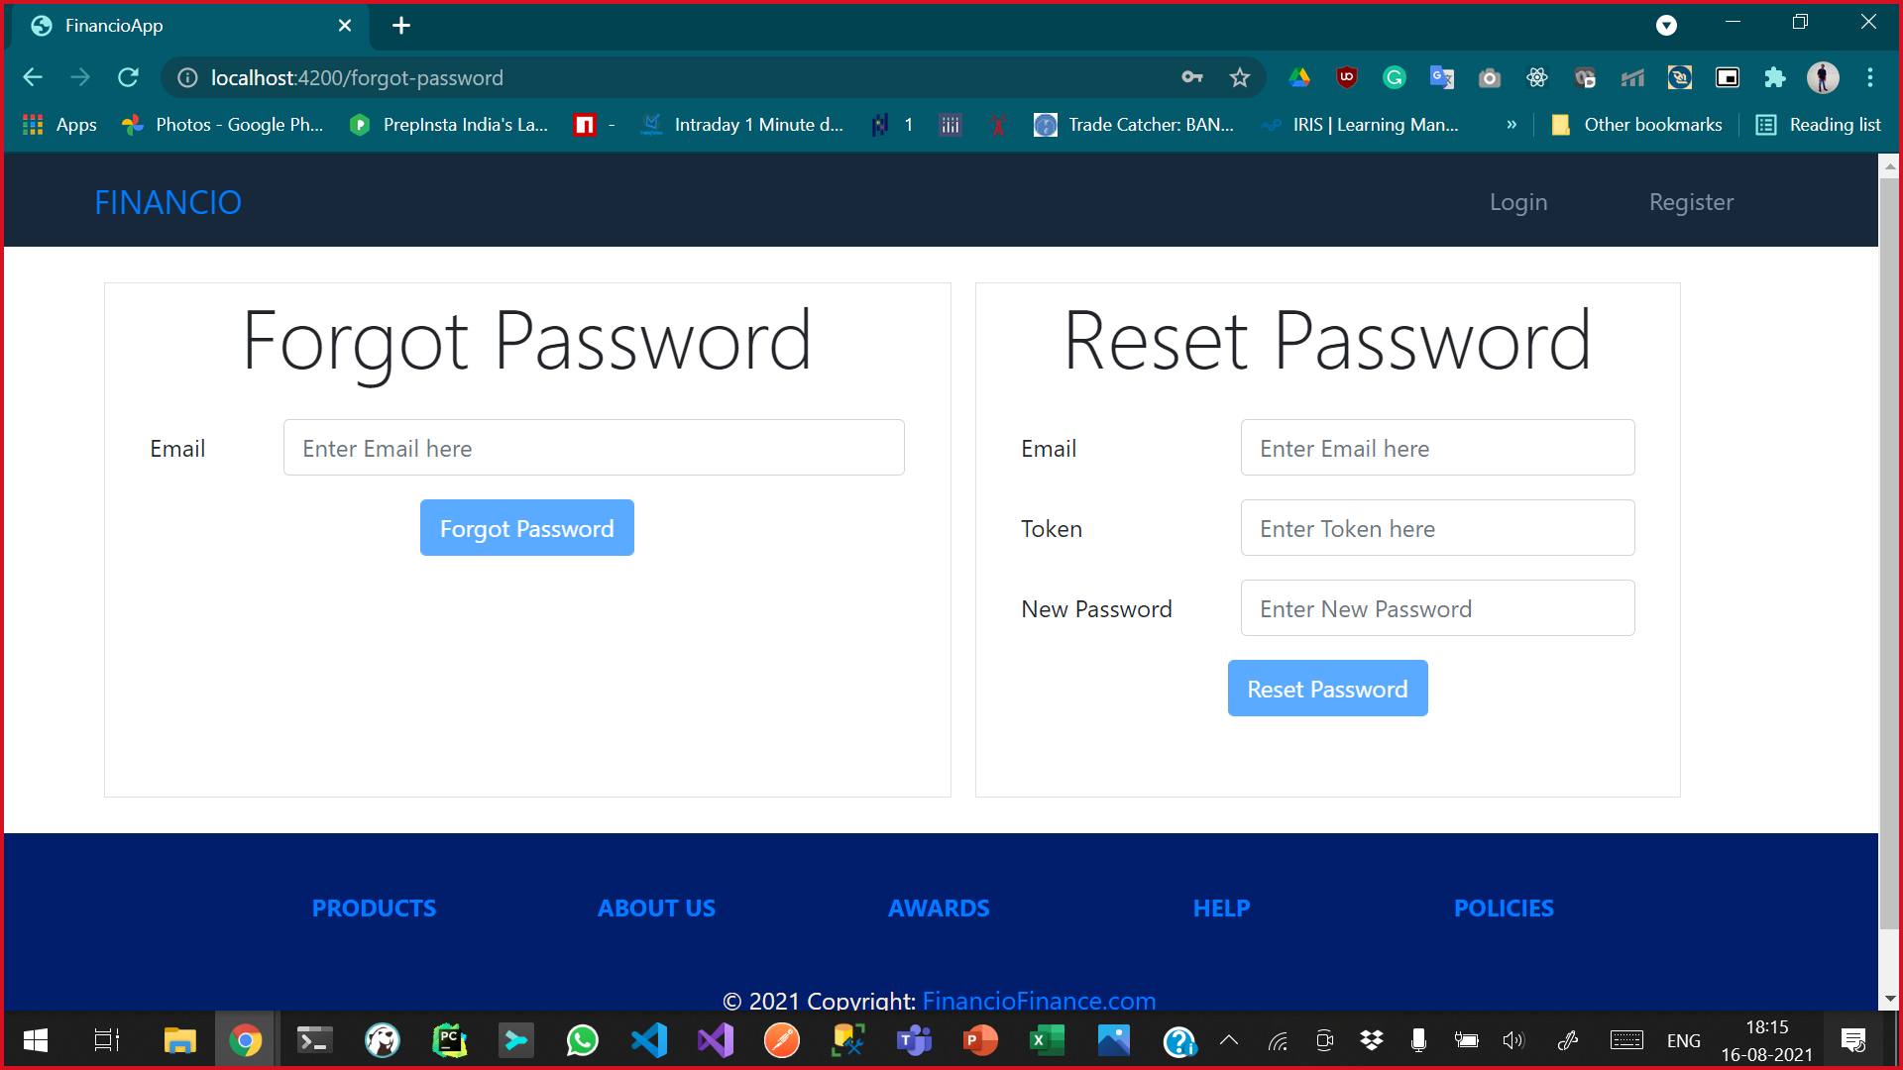

Slide 10
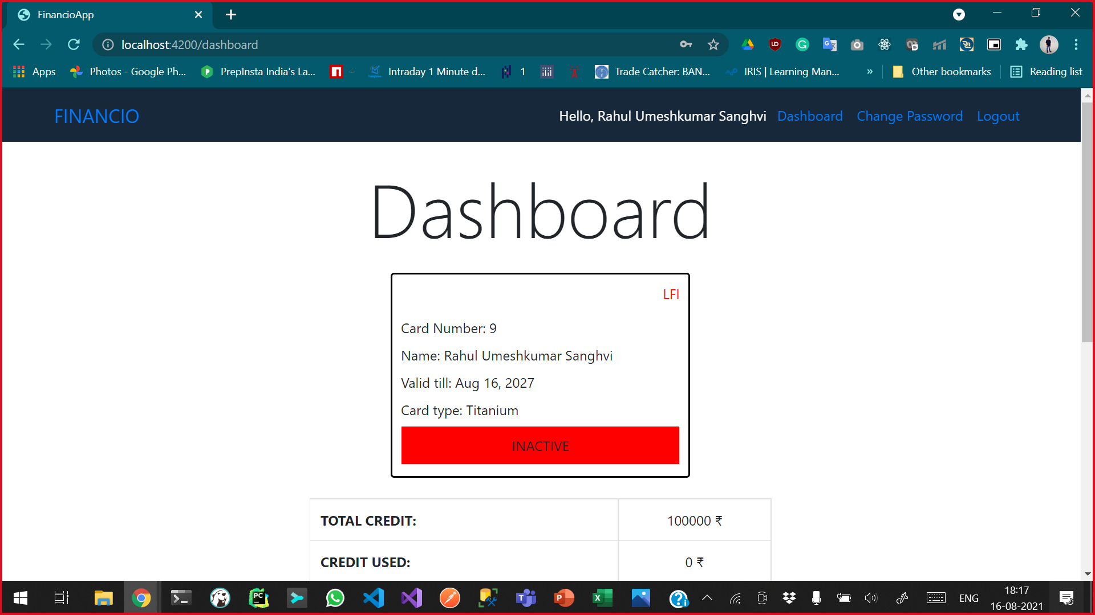
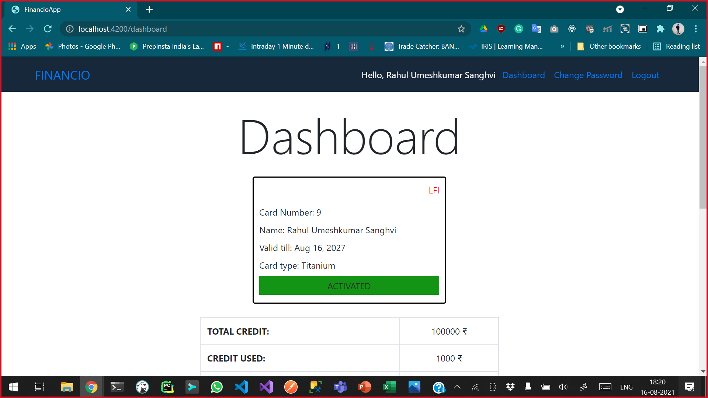
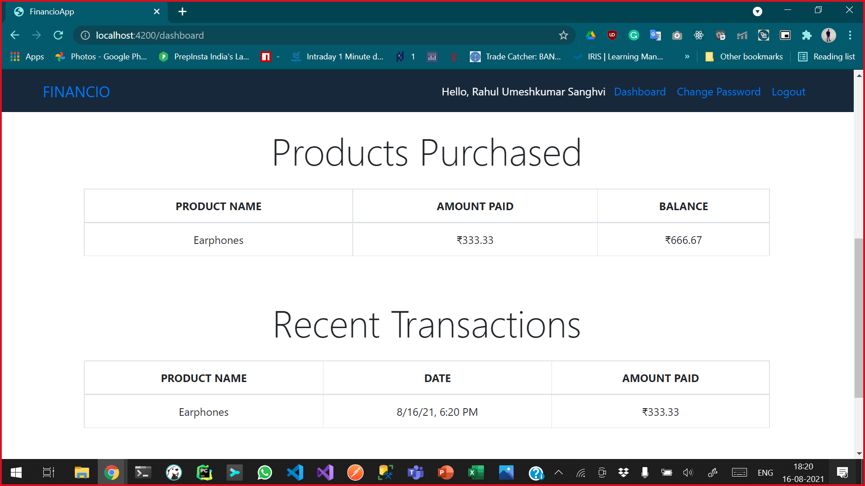

Slide 11
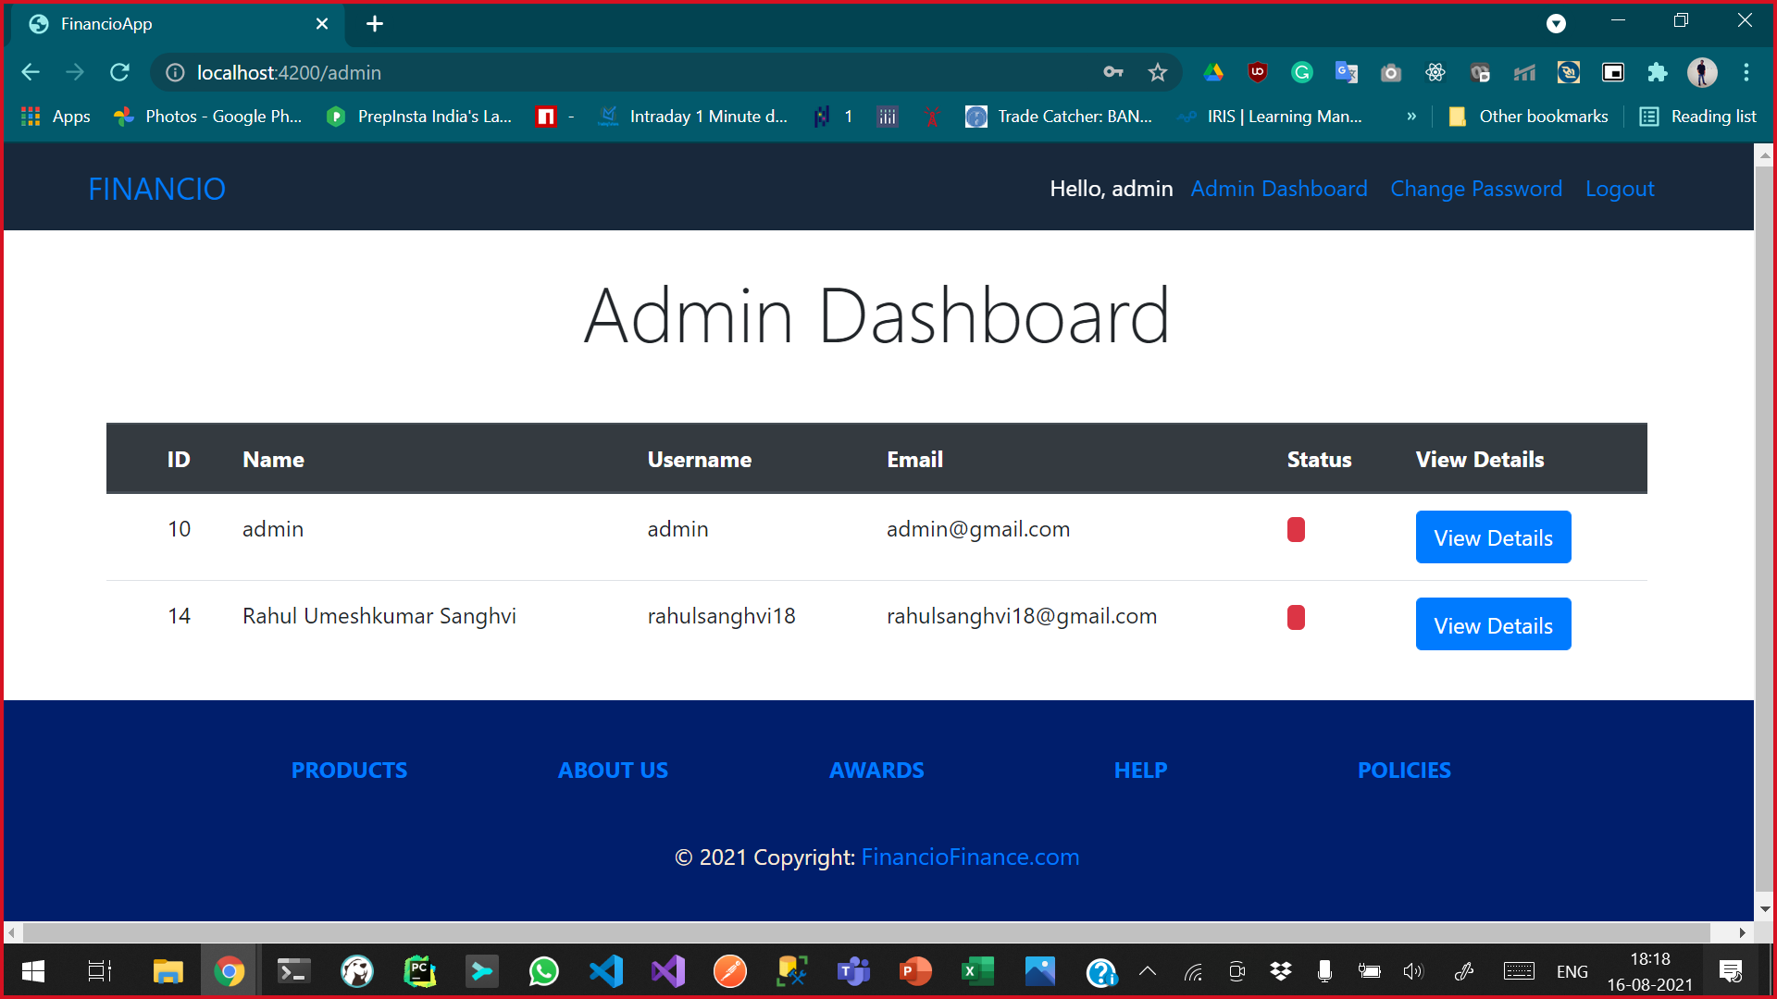
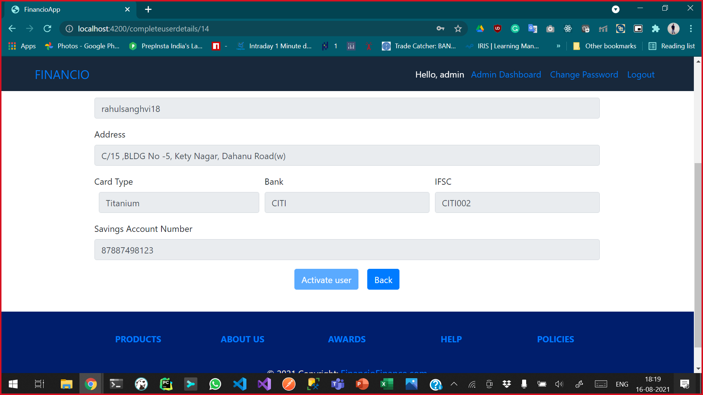
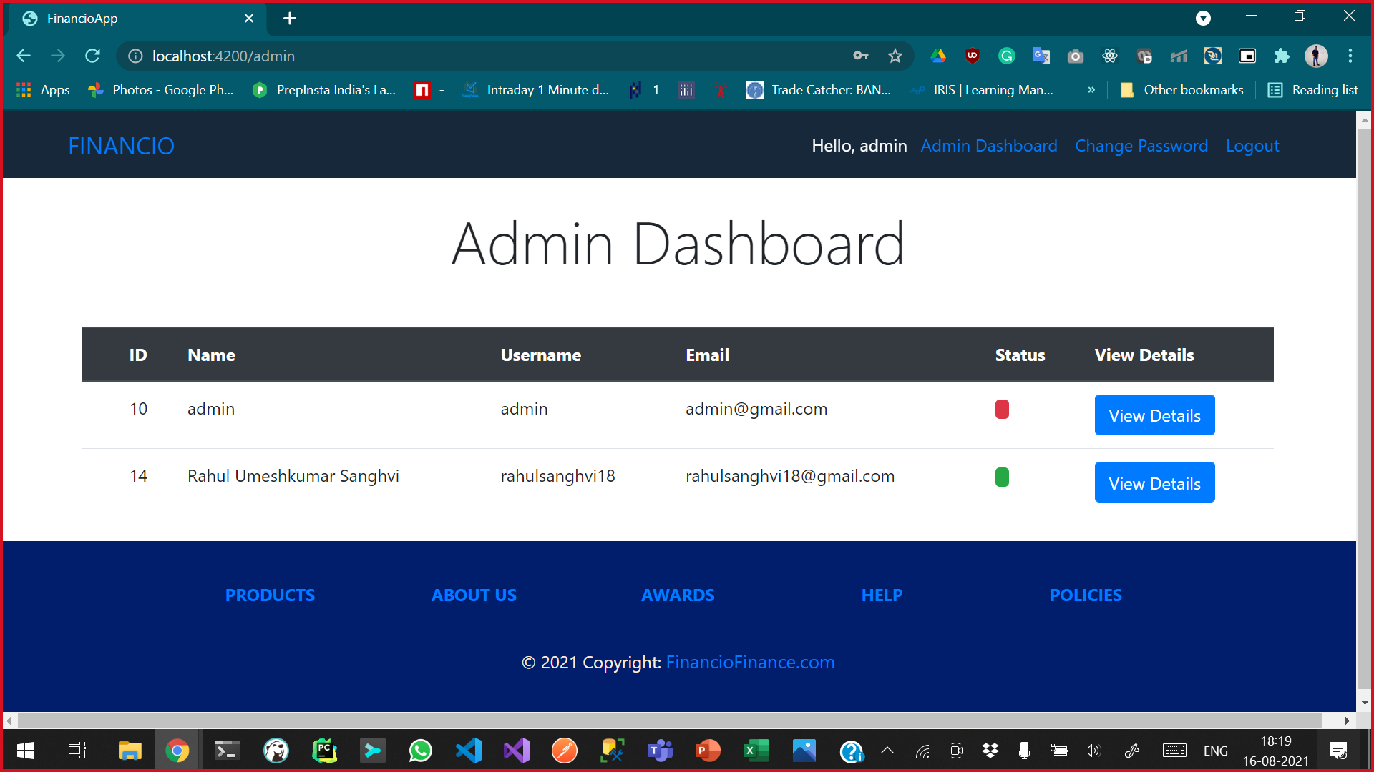

Slide 12
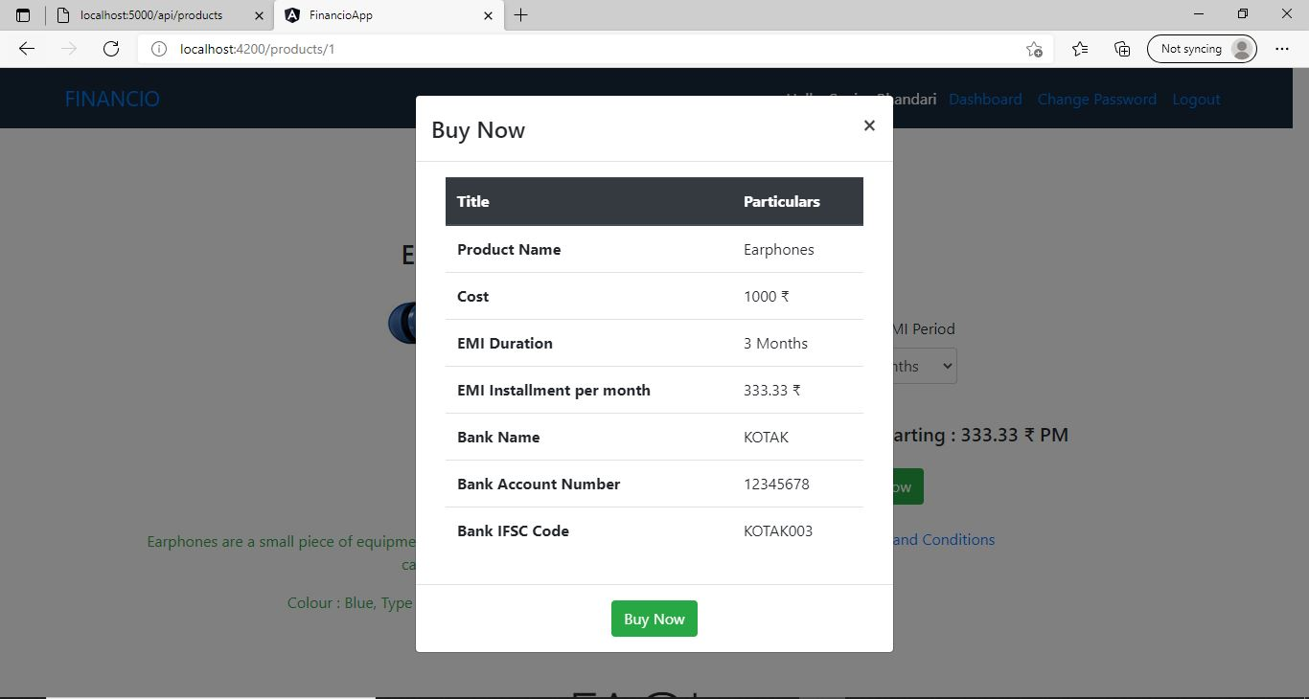
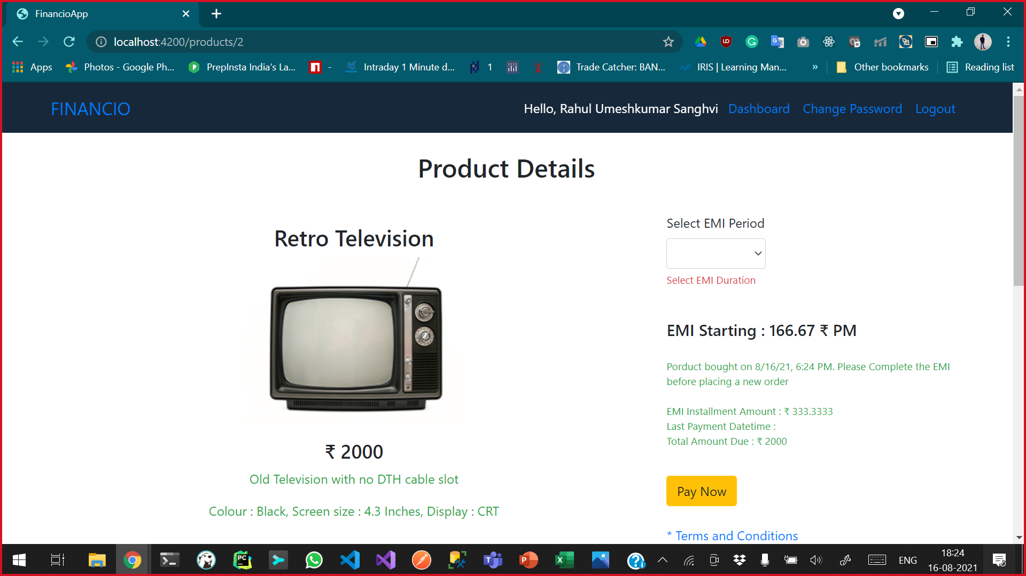
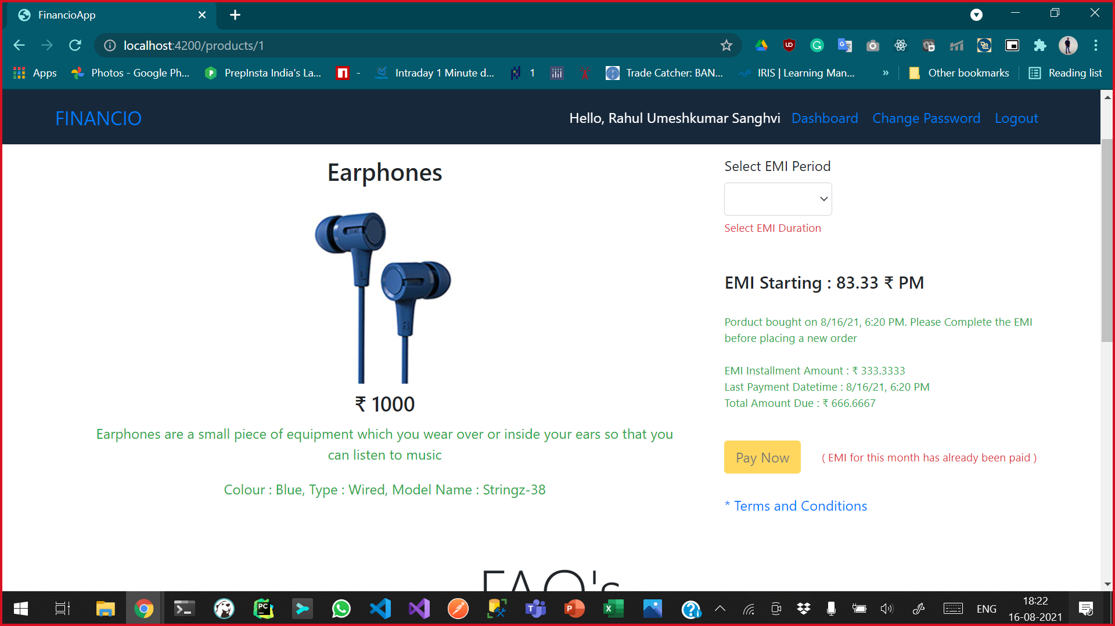
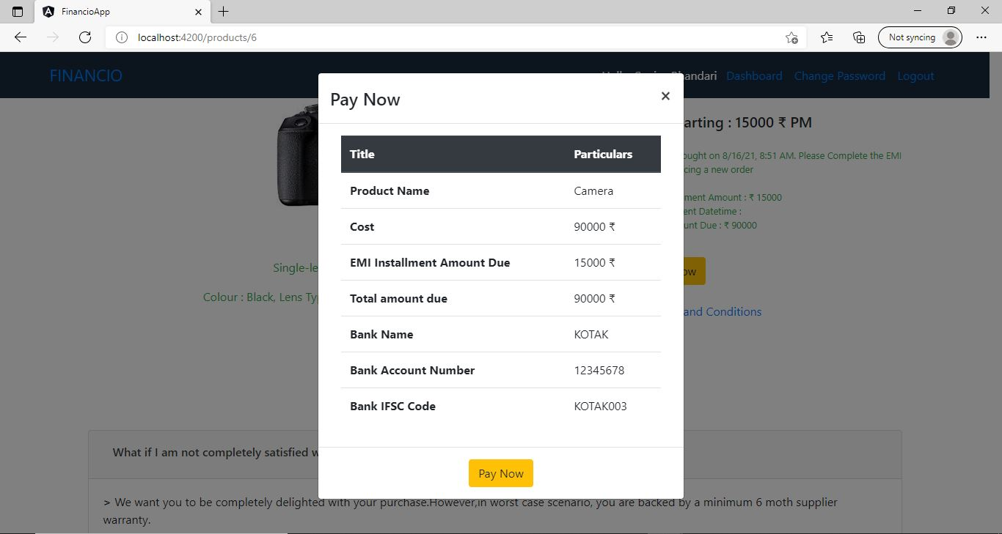

Slide 13
