Slide 1
Information system of the household shops
Done by
Ivan Karayanov PITE 3.01

Slide 2
INTRO TO TOPIC
System
Automatization
Effectivity
‘Fail bills’
Security
Notes:
Bookkeeping, human resourse, system relation wirks money, headache, waste of time , gargage ,service , concentration on main ,

Slide 3
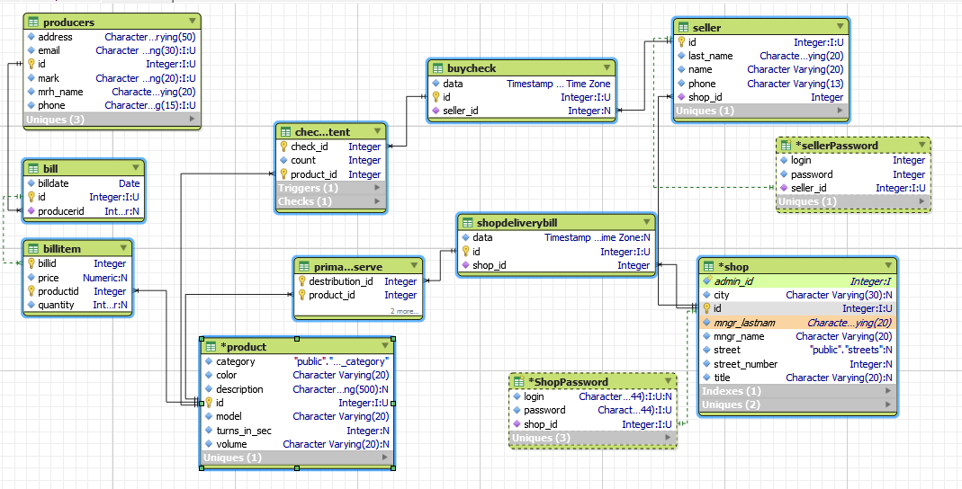
ER diagram

Slide 4
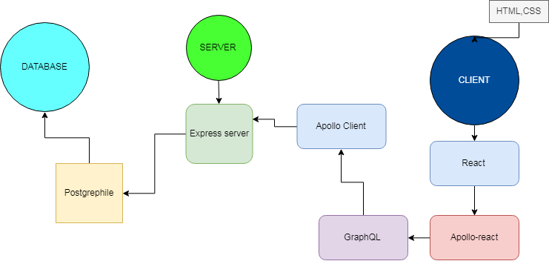
Tools
Notes:
Tools I used are repre. Database

Slide 5
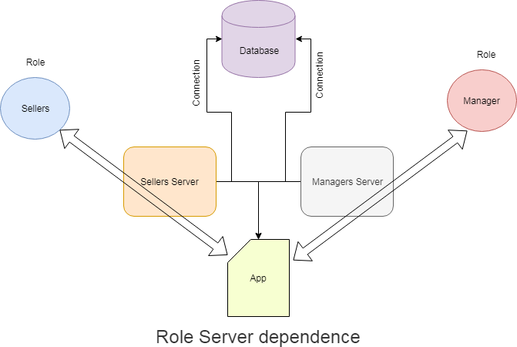
Roles

Slide 6
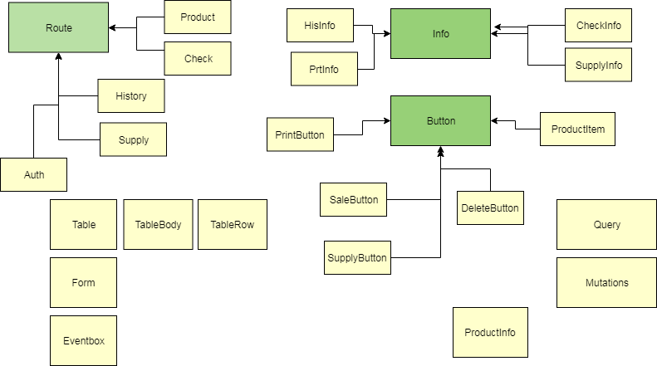
Component diagram
Notes:
Application architecture will see realy soon

Slide 7
Conclusion
Security
Integrity
Roles
Commercial

Slide 8
Thank you for watching
QA

