Slide 1


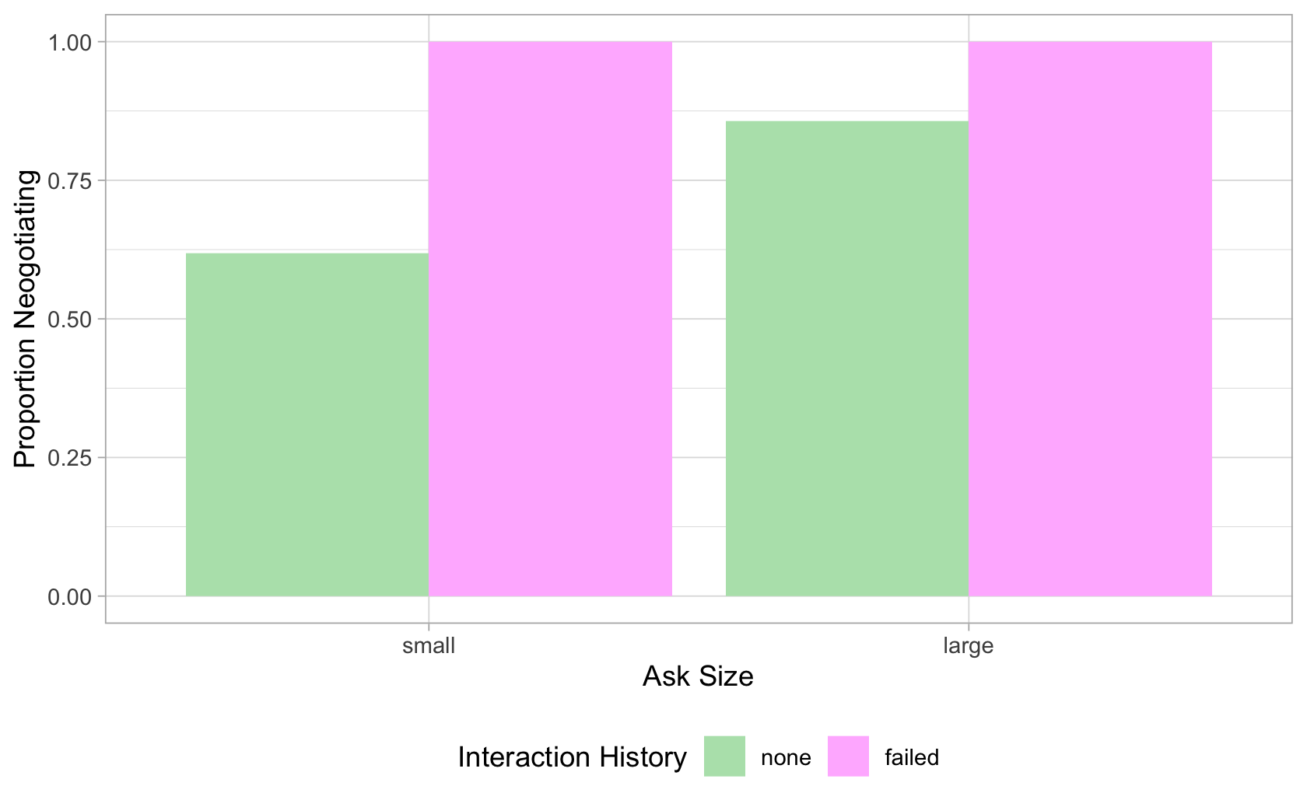
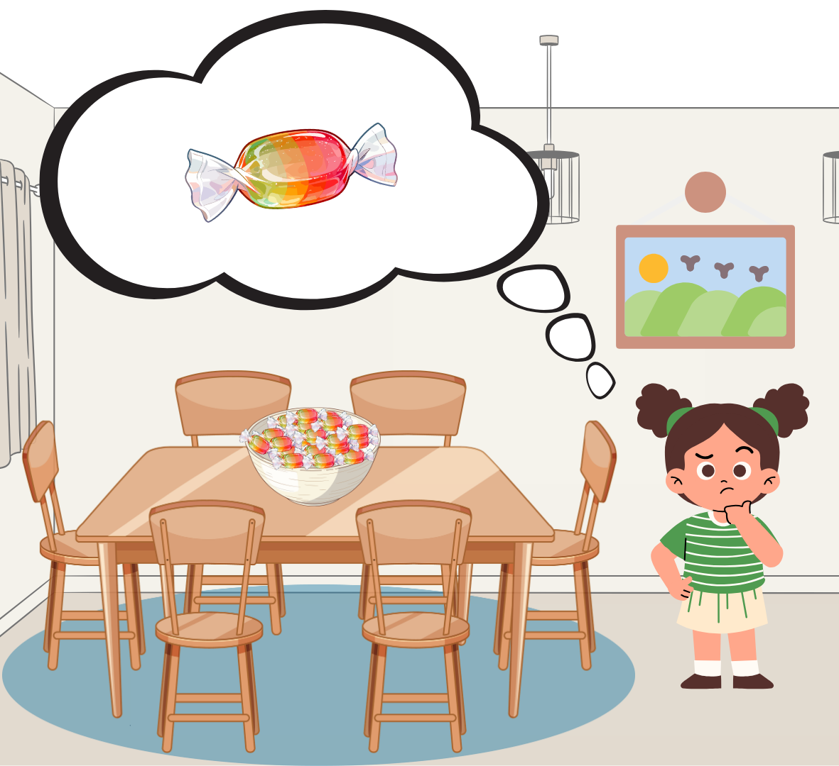
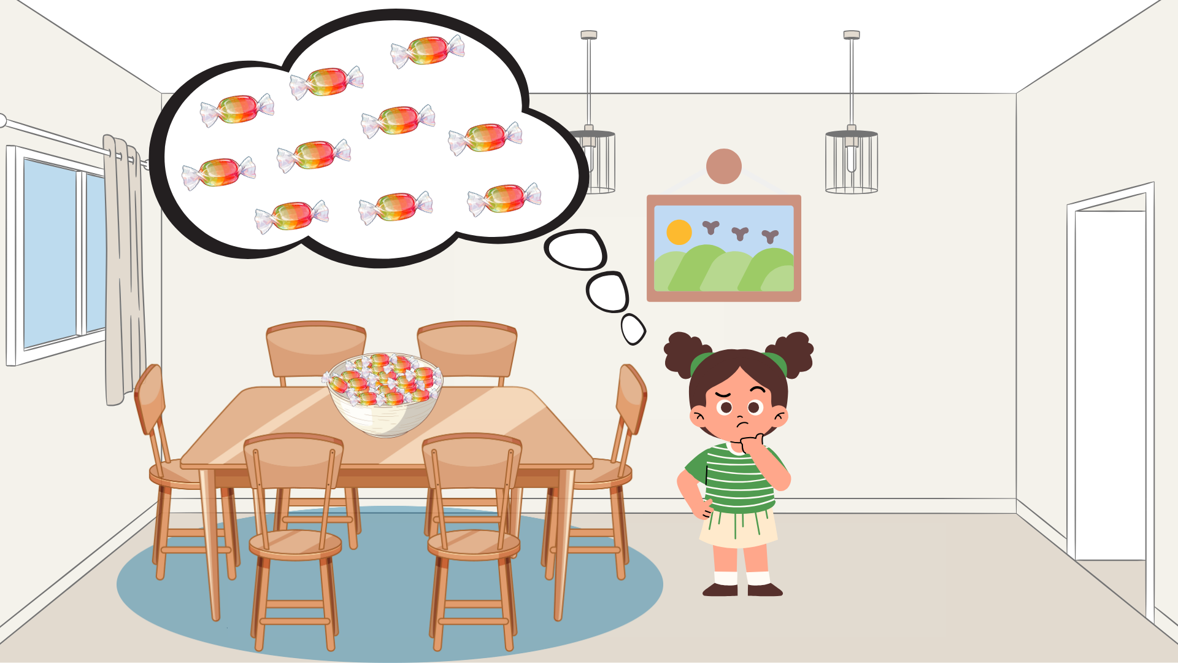
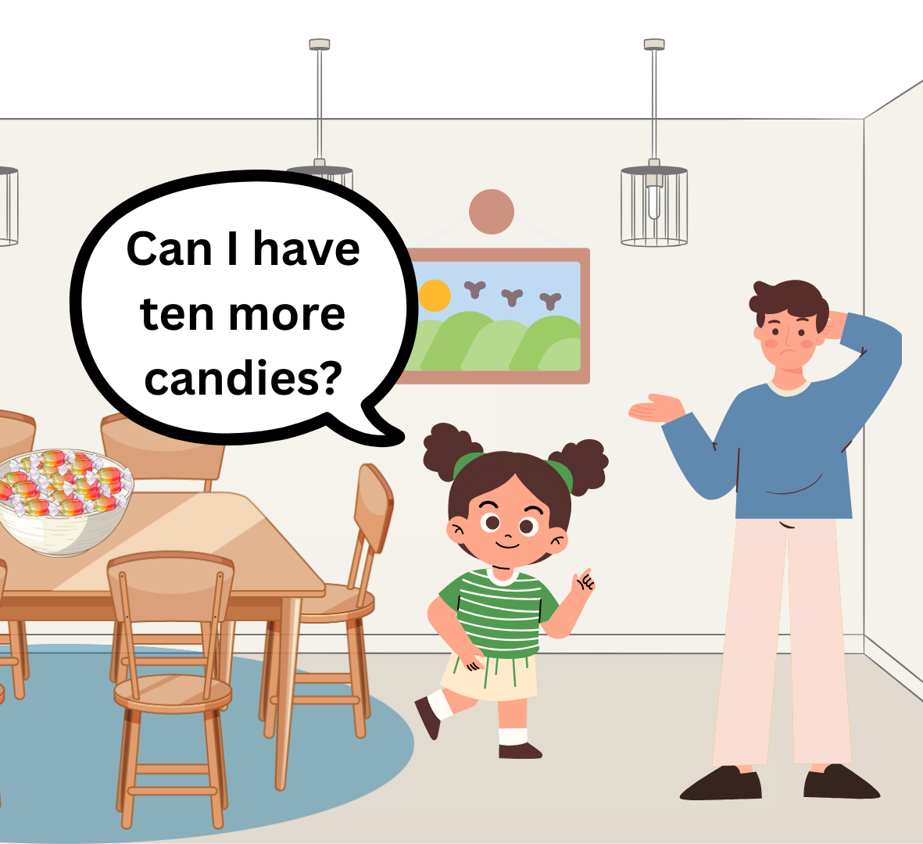
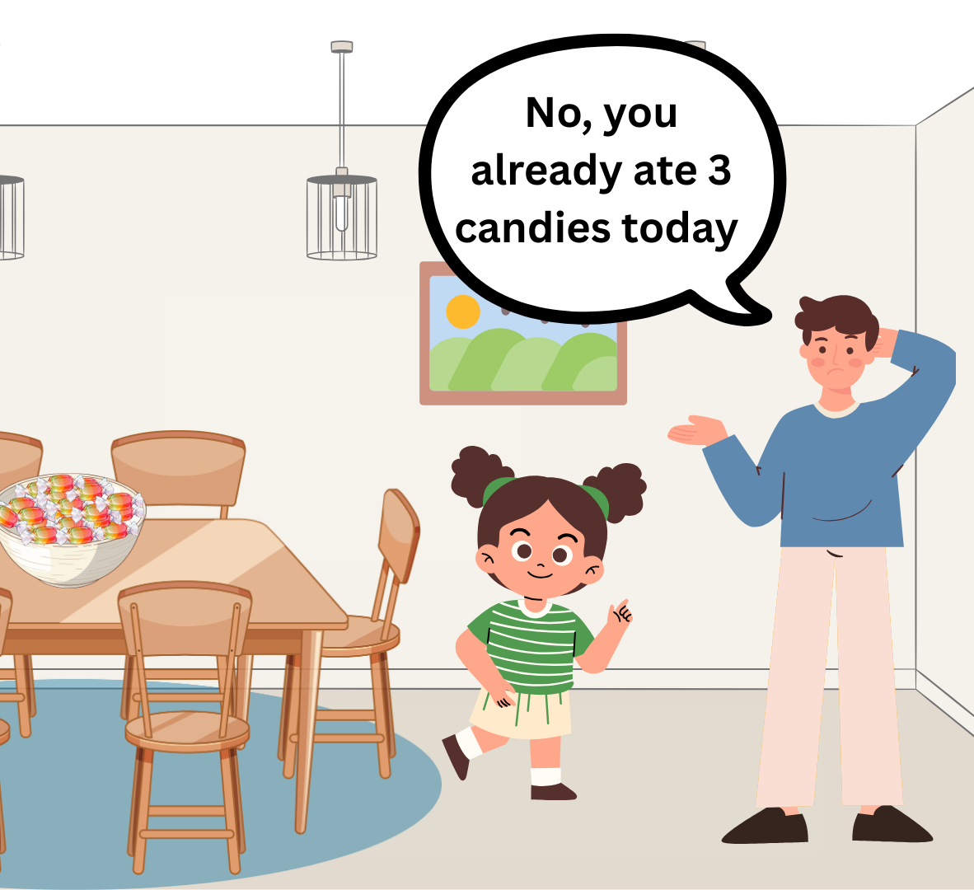
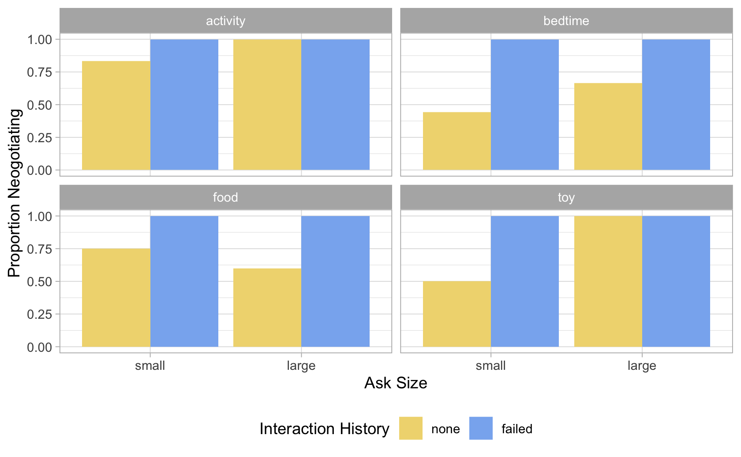
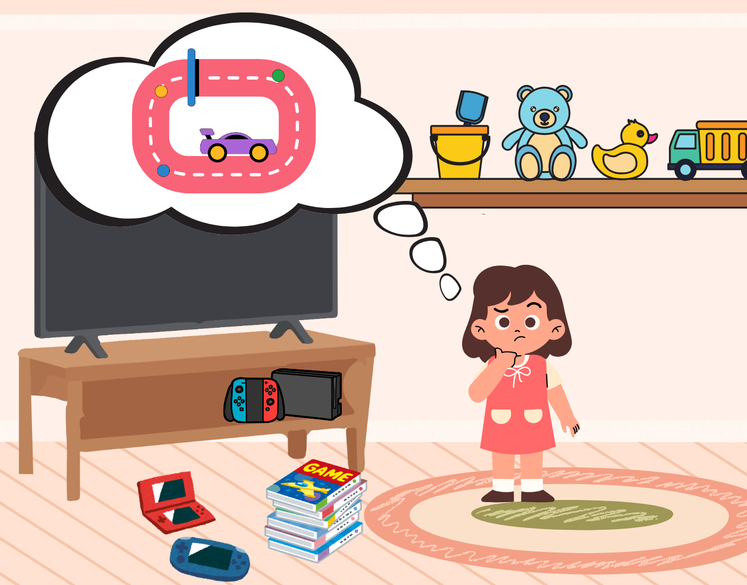
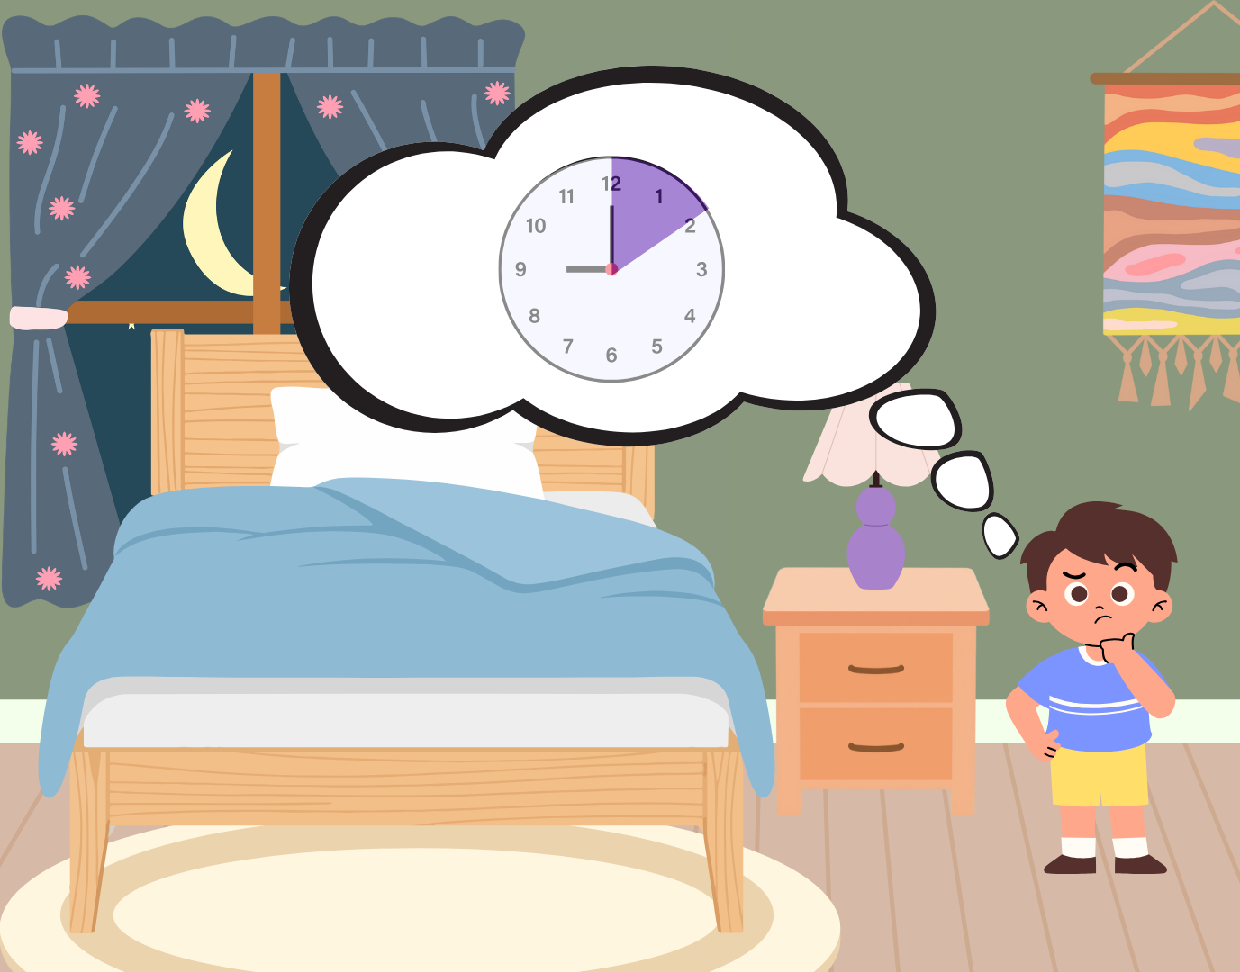
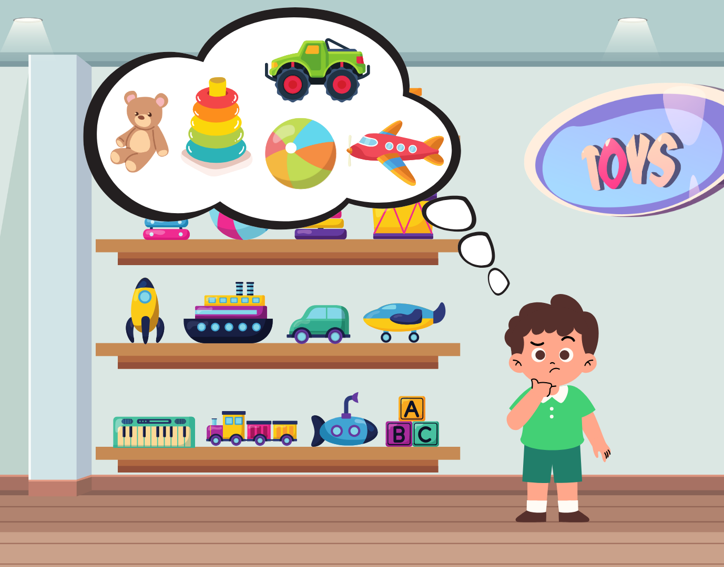
Children’s Understanding of When to Negotiate
Urvi Suwal & Martin Zettersten
University of California, San Diego
Motivation
Negotiations are pervasive in communication and interpersonal life. They are a critical part of human interaction that allows people to align competing goals to achieve a desired outcome, and an important aspect of conflict resolution and problem-solving. Prior work shows different ways in which children engage in behaviors that resemble negotiation such as:
bargaining (Grueneisen and Tomasello, 2022)
boundary probing (Bridgers et al., 2024)
producing counterarguments (Köymen et al., 2019)
When does negotiation become necessary? Do children strategically choose to negotiate depending on prior failed interactions and the magnitude of the request?
Conditions
We manipulate these scenarios across two orthogonal dimensions:
Magnitude of the request: how far does the request exceed what is typically allowed (small ask vs. big ask)
Small ask: Big ask:
Interaction history: whether or not a request has been previously made to a parent (no prior attempt vs. failed prior attempt)
Failed interaction history:
2x2, within-participants design; condition and scenario pairing is counterbalanced
Children choose to negotiate after a failed request
*Note: pilot results
N = 21; M(age) = 5.67 years
Negotiation preference after failed interactions is consistent across scenarios
Preliminary takeaways:
Overall preference for negotiating over direct request
Negotiating preference also tracks with ask size (but variability across scenarios)
100% consistency in negotiating request post failed interaction!
Methods
There are four everyday scenarios in which different agents make requests. In each scenario, there is a pre-existing constraint that makes the request something that the children are not normally granted or are typically refused.
Food | Activity
Bedtime | Toy
Procedure
Warm up trial
Four scenario blocks:
Agent wants something that they must request their parent for
Participants must decide what they think the agent should say in order to get what they want from their parent
Forced choice paradigm: a direct request (agent simply asks for the outcome) or a negotiating request (agent offers an appeal to strengthen their request
Future Directions
What are other factors children are sensitive to? For e.g. social relationship, costliness of the request
Parent survey to explore the emergence, extent, and circumstances that prompt negotiating behavior
Do children have an intuition/understanding of which negotiating strategy works better?
References
Bridgers, S., et al. (2025). Child Development
Grueneisen, S., & Tomasello, M. (2022). Child Development
Köymen, B., et al. (2020). Child Development

